Slide 1




Regional Satellite Application Course for MENA Region / SAC-21
Feb,2026
Principles of Weather Satellite
Zamzam AL.Rawahi
Zamzam.Rawahi@caa.gov.om

Slide 2



Do not edit
How to change the design
From Online-Phase...
The Slido app must be installed on every computer you’re presenting from

Slide 3
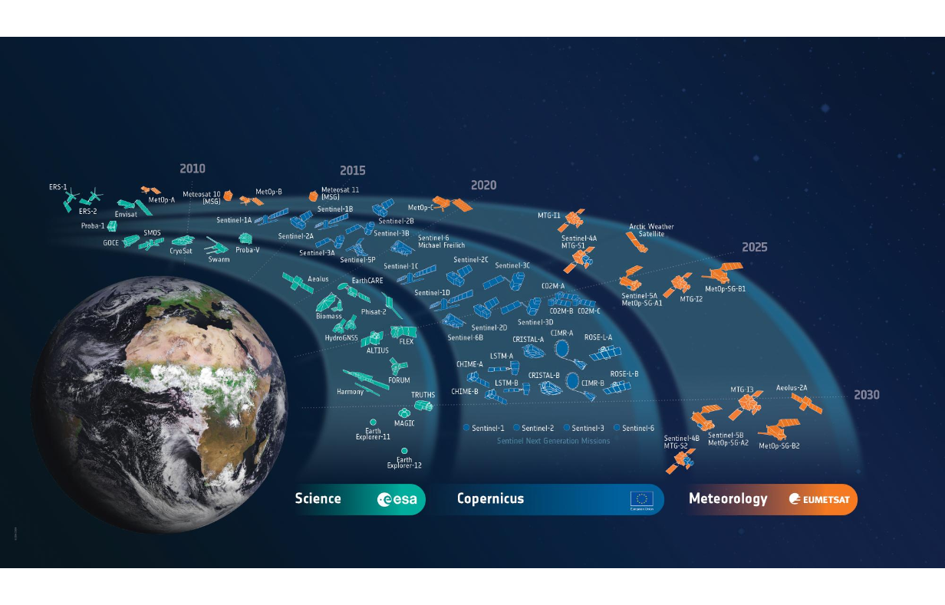
Earth Observation Weather Satellite

Slide 4
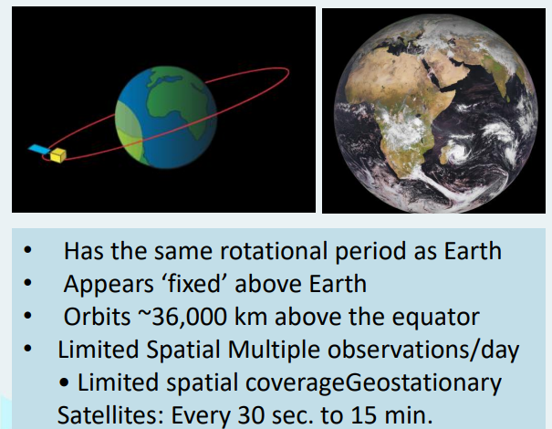
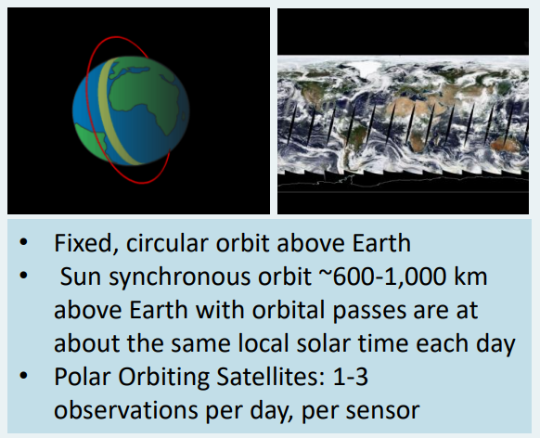
Common Orbit Types
Geostationary Orbit
Polar Orbit / Low orbiting

Slide 5
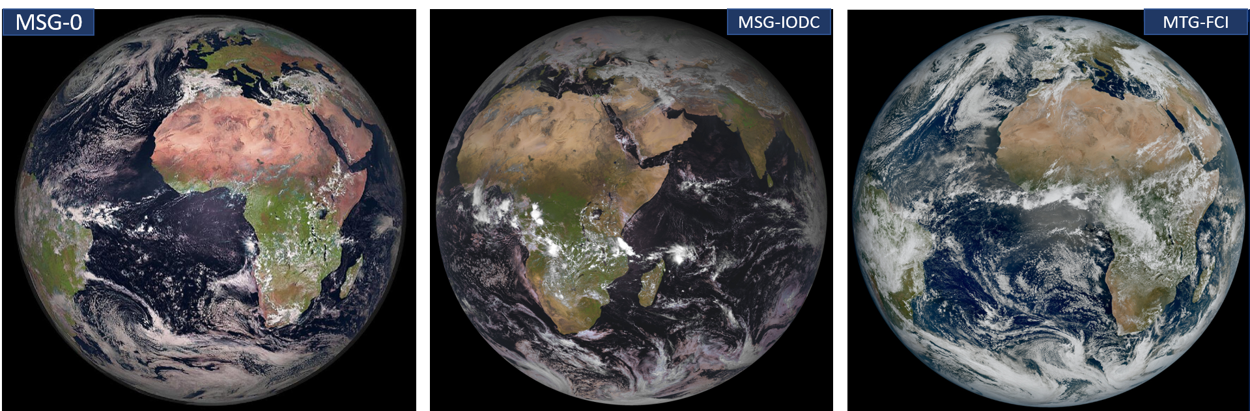
Common Orbit Types
EUMETSAT currently operates:
MSG (0° longitude): Best Coverage over Africa/Europe, degraded view over India and Brazil.
MSG-IODC (~41.5°E): Best over the Indian Ocean and the Middle East, weaker over western Africa.
MTG (0° longitude, 1 km at nadir): Excellent resolution over Africa/Europe,

Slide 6
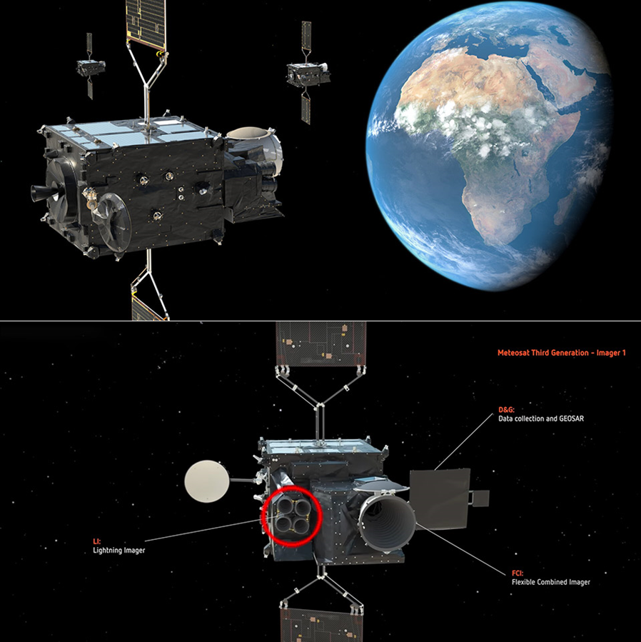
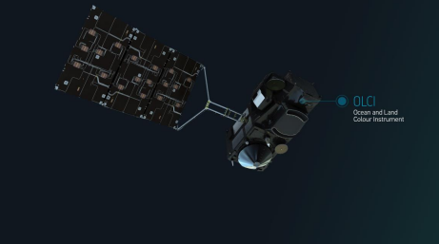
Energy Source (Type of Sensor)
Satellites carry sensors or instruments. The names of sensors are usually acronyms that can
include the name of the satellite
Meteosat-8
41.5⁰ East

Slide 7
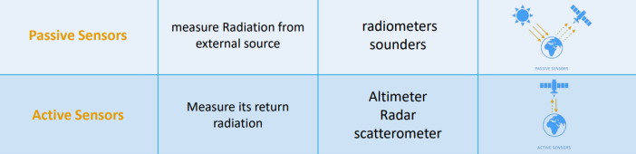
Energy Source (Type of Sensor)
Meteosat-8
41.5⁰ East

Slide 8
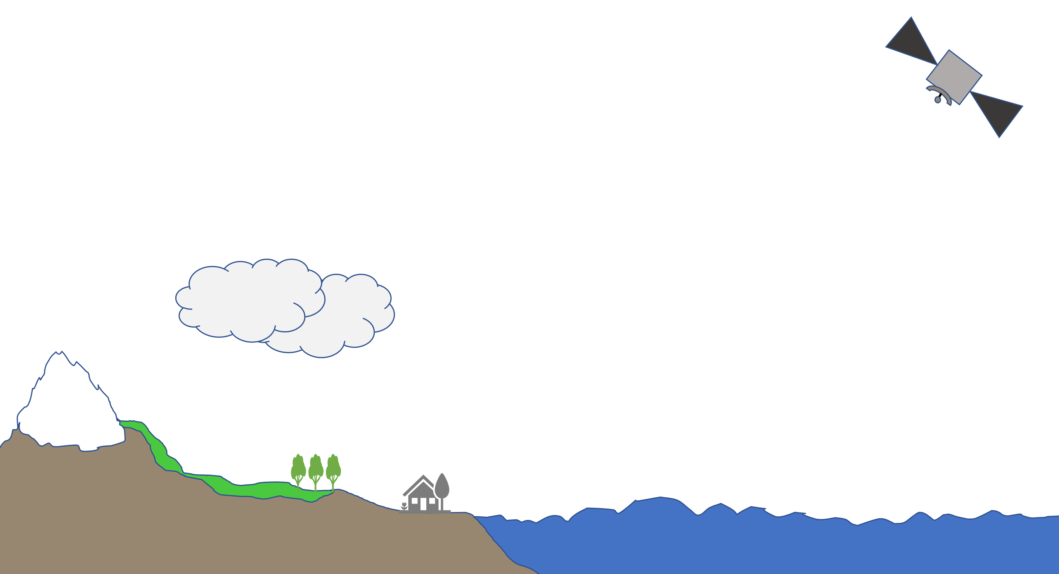
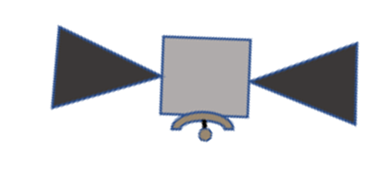
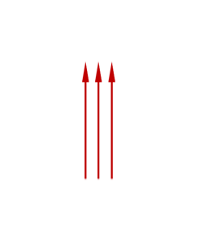
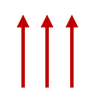
Passive Instruments:
Receives and measures naturally emitted or scattered radiation from the earth and its atmosphere

Slide 9
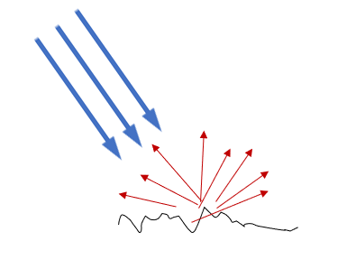

Active Instruments:
Like a radar where instrument transmits its own radiation and then collects the reflected or scattered back signals from the earth and its atmosphere

Slide 10

Expect Spectral ?
Resolution
Spatial
Temporal
Spectral
Radiometric

Slide 11
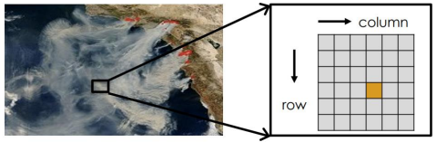

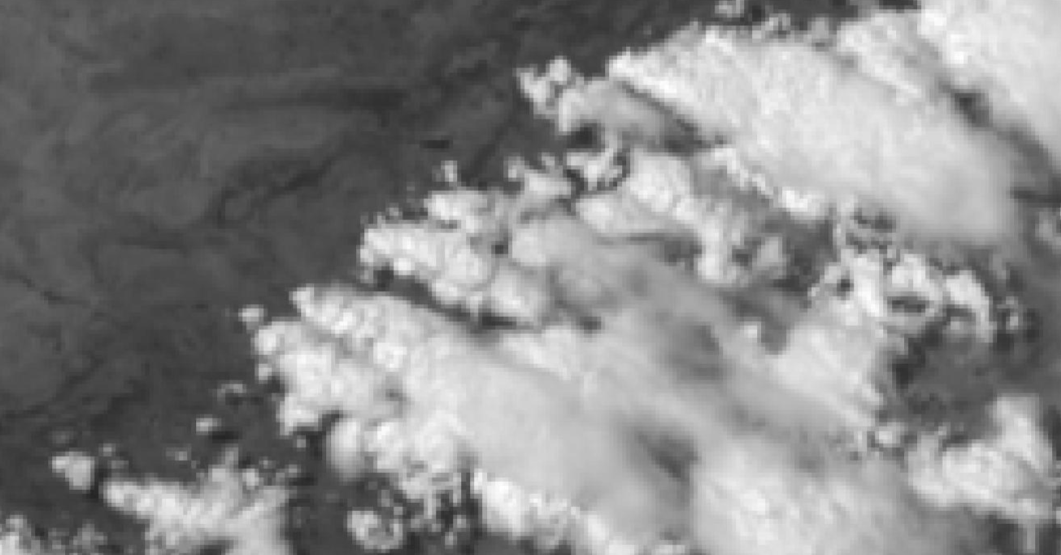
Satellite Characteristics/Spatial Resolution
• Pixel – the Smallest Unit of an Image
• Spatial resolution is defined by the size of a pixe1
MSG-0
MTG

Slide 12
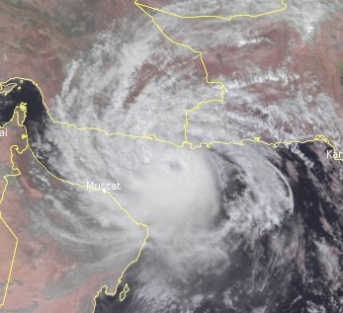
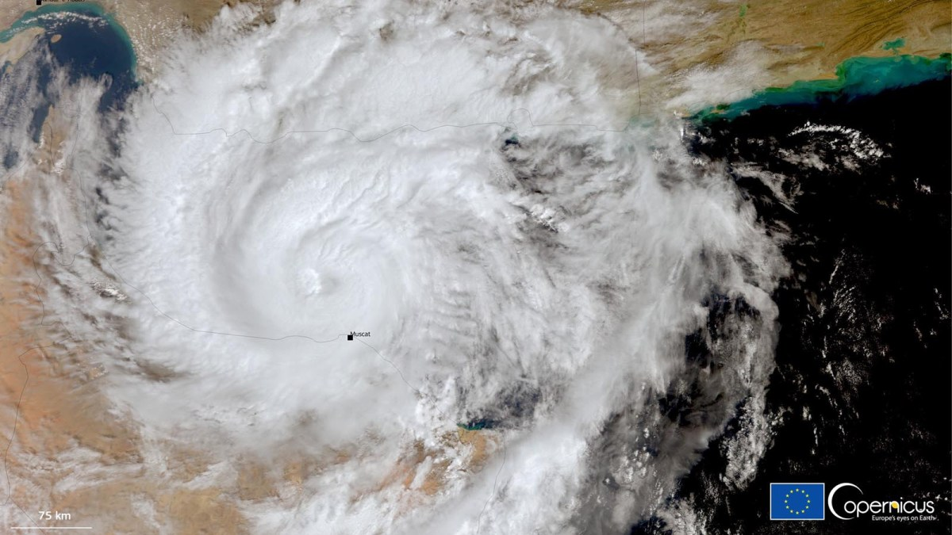
Low Orbiting Vs. Geostationary Satellites
Geostationary Satellite
Polar Orbiting Satellite
Notice the more detailed image from Polar (low orbiting satellite )

Slide 13
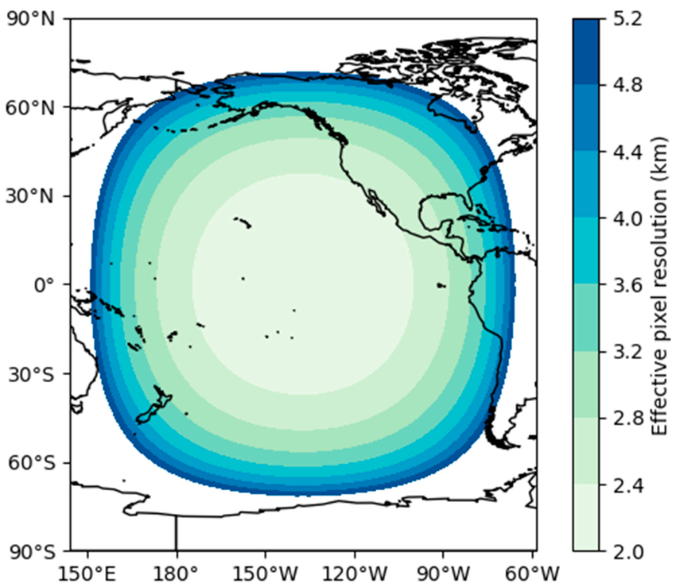
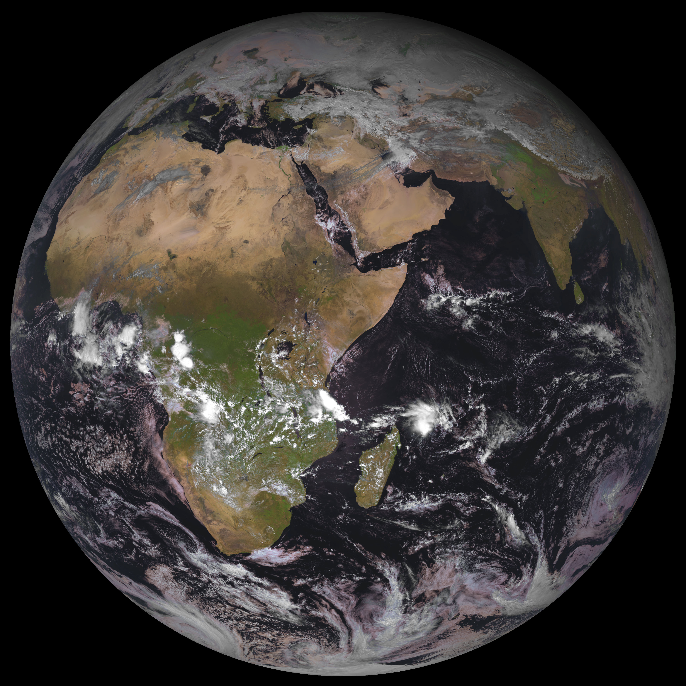
Spatial Resolution

Slide 14
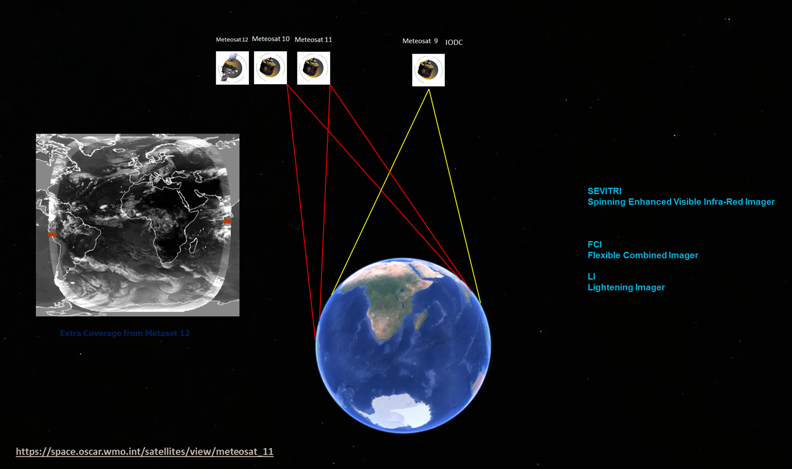
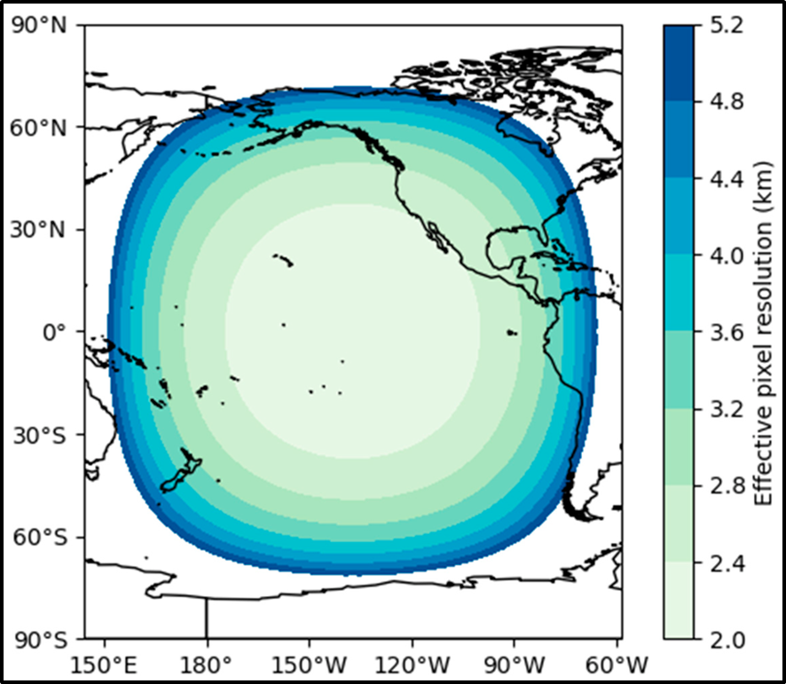
MSG (SEVIRI) VS MTG (FCI)
Meteosat-8
41.5⁰ East

Slide 15
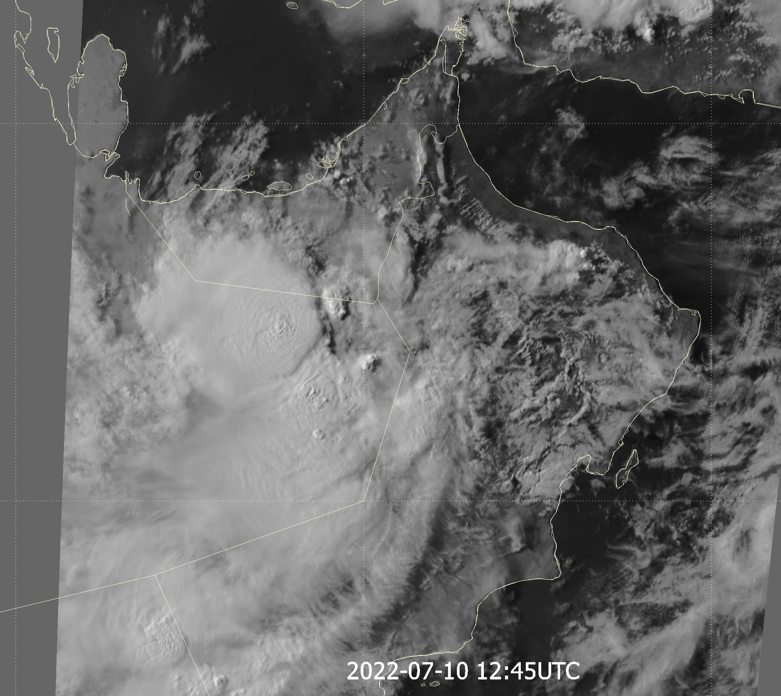
Radiometric Resolution
The ability of a sensor to detect small differences in radiance (number of gray levels per pixel).
0
255

Slide 16
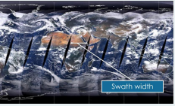

Temporal Resolution
• The time it takes for a satellite to complete one orbit cycle—also called “revisit time”
• It mostly depends on swath width of the satellite – the larger the swath – the higher the temporal resolution
< 10 min
2 times per day

Slide 17
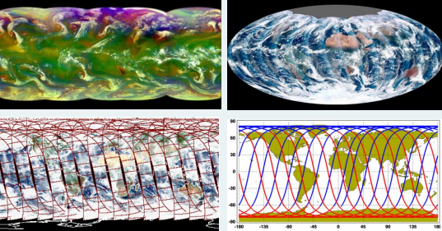
Temporal Resolution
• The time it takes for a satellite to complete one orbit cycle—also called “revisit time”
• It mostly depends on swath width of the satellite – the larger the swath – the higher the temporal resolution
VIIRS / 3040km
Geostationary
MODIS (2330)
CALIPSO

Slide 18
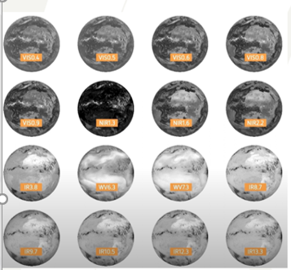

Spectral Resolution
Resolution depends upon satellite orbit configuration and sensor design. Different sensors have different resolutions.
Signifies the number and width of spectral bands of the sensor. The higher the spectral resolution, the
narrower the wavelength range for a given channel or band.
More and finer spectral channels enable remote sensing of different parts of the Earth’s surface.
Typically, multispectral imagery refers to 3 to 10 bands, while hyperspectral imagery consists of hundreds or thousands of (narrower) bands (i.e., higher spectral resolution).
Panchromatic is a single broad band that collects a wide range of wavelengths

Slide 19


Geostationary Satellite
large coverage area (about a third of Earth's surface)
High image frequency (every 15 minutes or less )
-> monitoring of rapidly-changing weather and phenomena .
Polar regions are not well observed.
Relatively Low spatial resolution.
Meteosat-8
41.5⁰ East

Slide 20
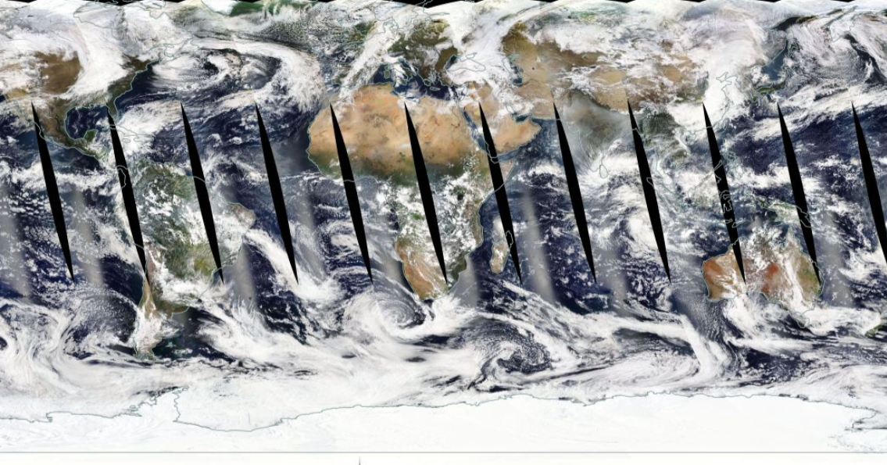
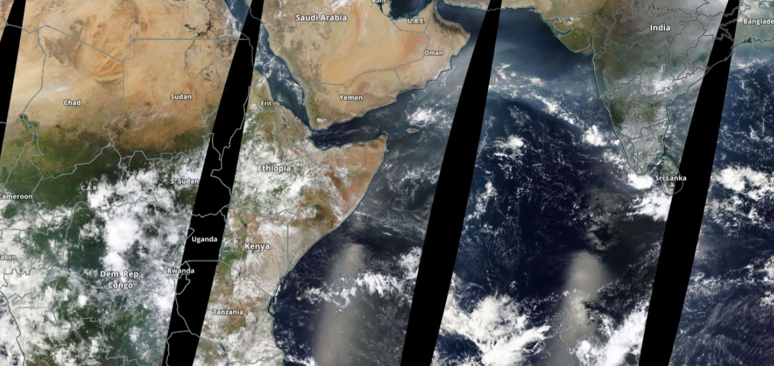
Geostationary Satellite
Global coverage.
Good spatial resolution because of low orbit.
low image frequency (2 images a day per satellite )
Meteosat-8
41.5⁰ East
Swath
Highest Spatial Resolution at the middle of the Swath

Slide 21
MSG (SEVIRI) VS MTG (FCI)
1. Higher Spatial Resolution:
0.6 um and 2.3 um in 1.0 km resolution ( and 0.5 km in Hi-Re mode)
3.8 um and 10.5 um in 2.0 km resolution ( and 1 km in Hi-Re mode)
2. Higher Temporal Resolution
10min and 5min for Rapid Scan
3. Higher Spectral Resolution
Meteosat-8
41.5⁰ East
16 channels more
4. Higher Radiometric Resolution
MSG SEVIRI has 10-bit resolution (~1024 levels),
while MTG FCI has 12-bit resolution (~4096 levels).

Slide 22
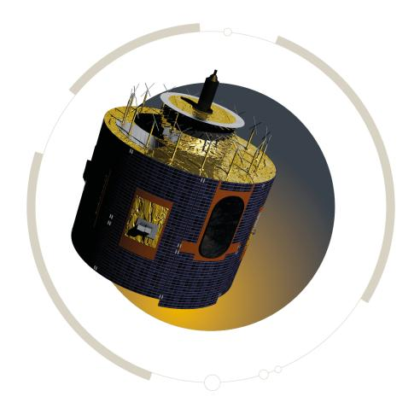
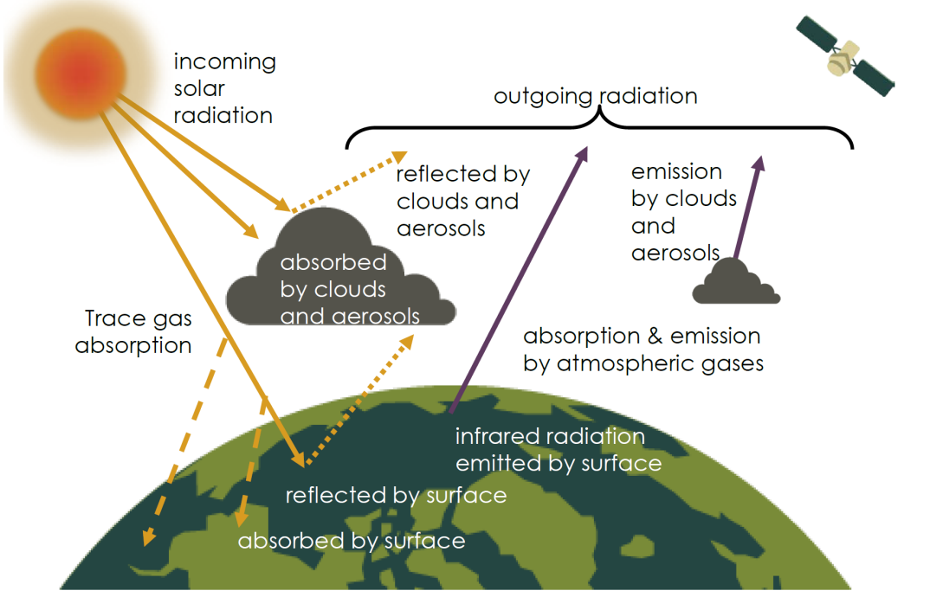
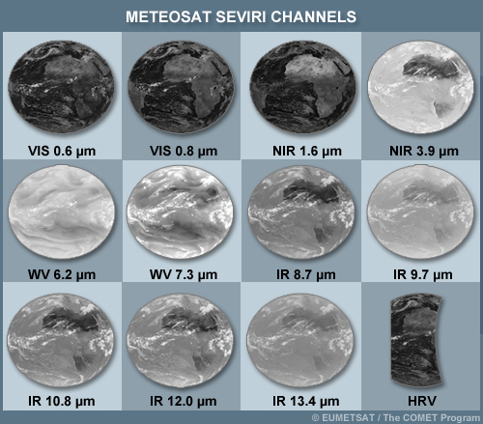
Electromagnetic radiation: Sun , Earth’s Atmosphere and Surface
Average Global Temperature
15 C
Credit: https://tinyurl.com/HEISatelliteWorkshop

Slide 23
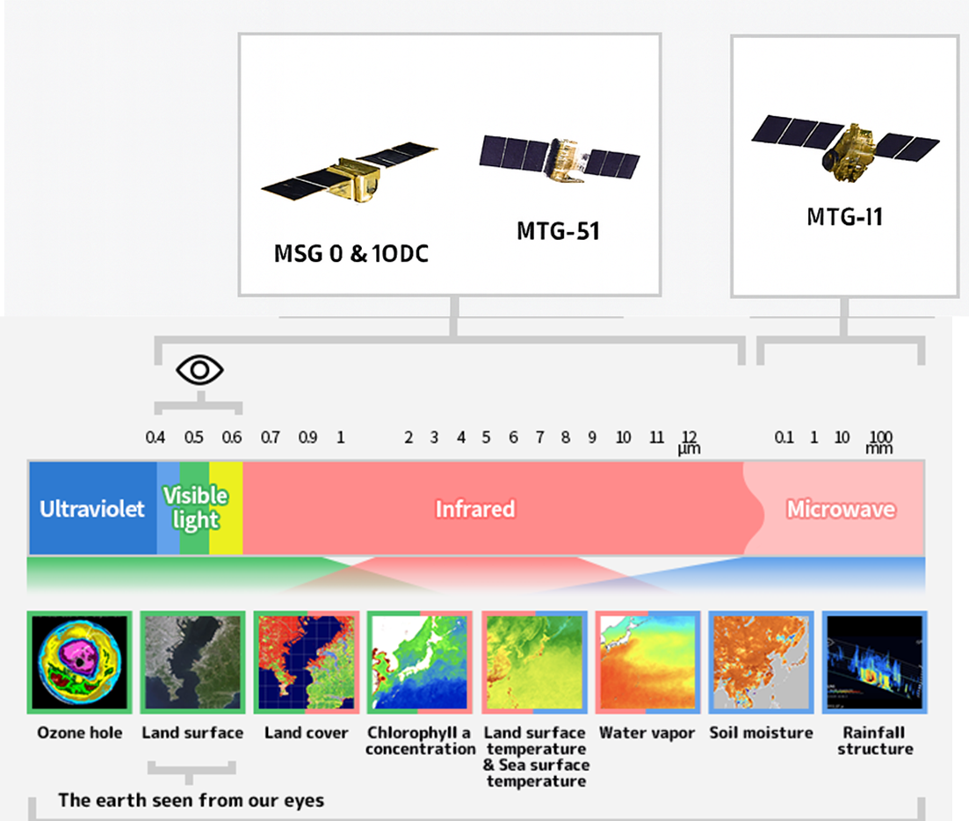
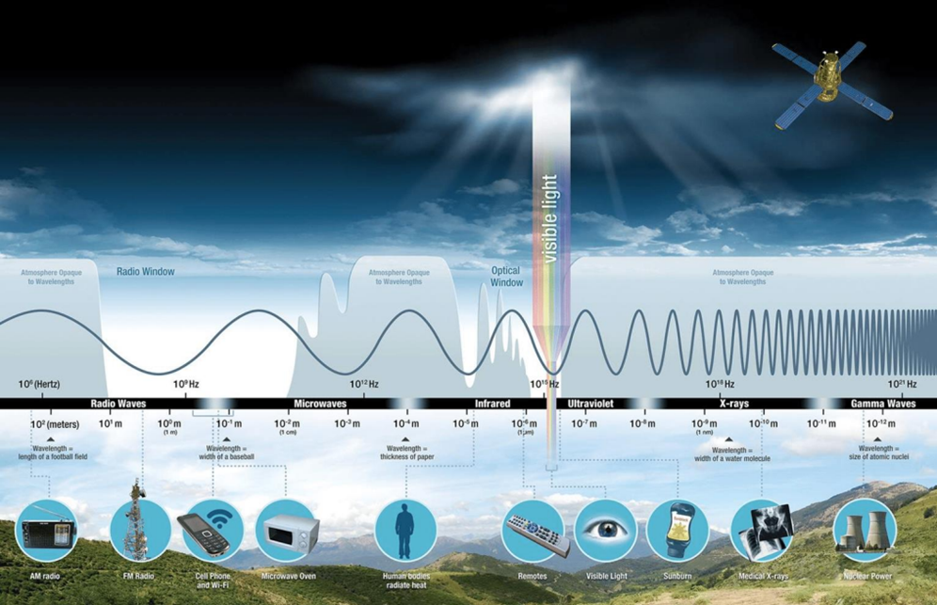
From photons to products
MTG-S1
MTG-I1

Slide 24
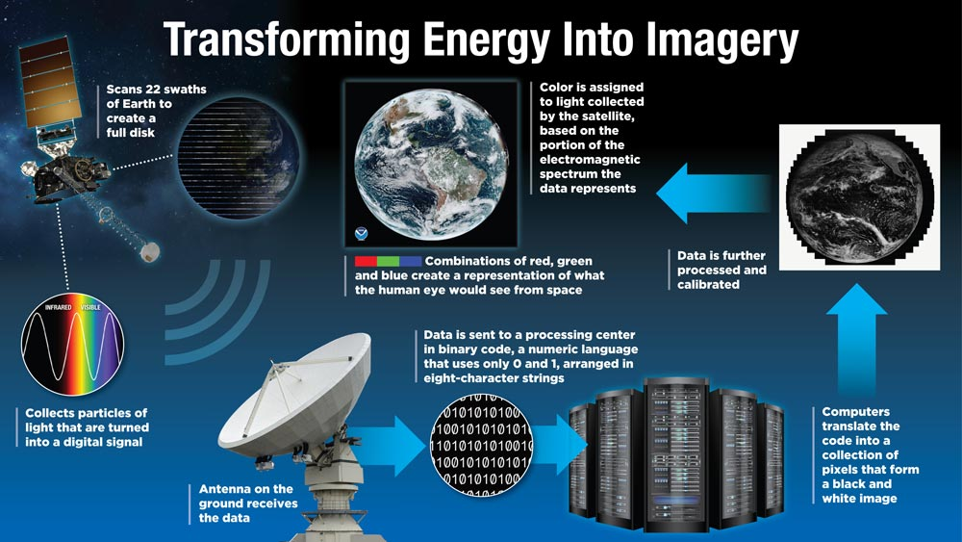
Satellite Data Processing

Slide 25
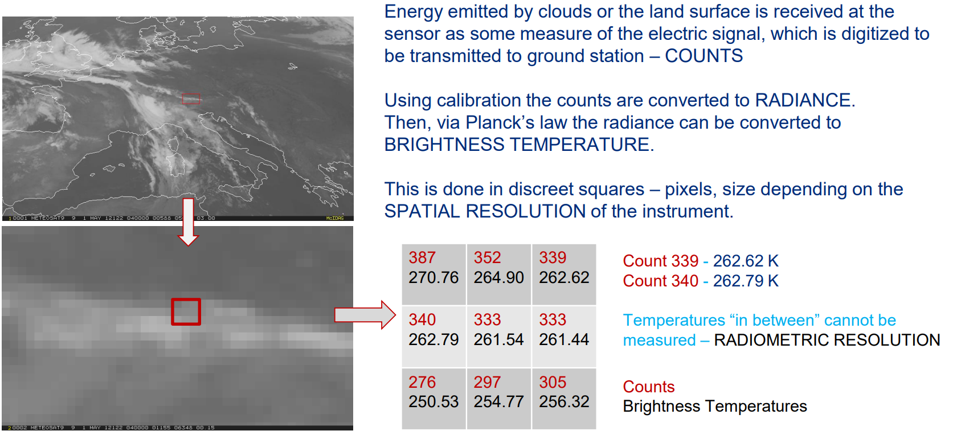
What is really measured?

Slide 26
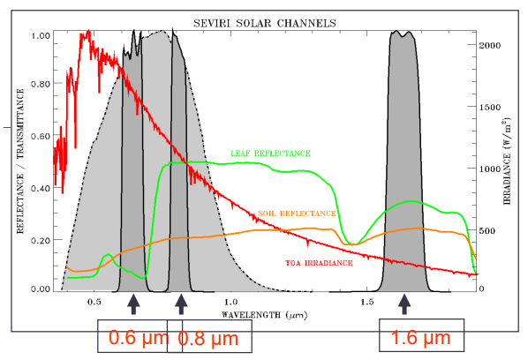
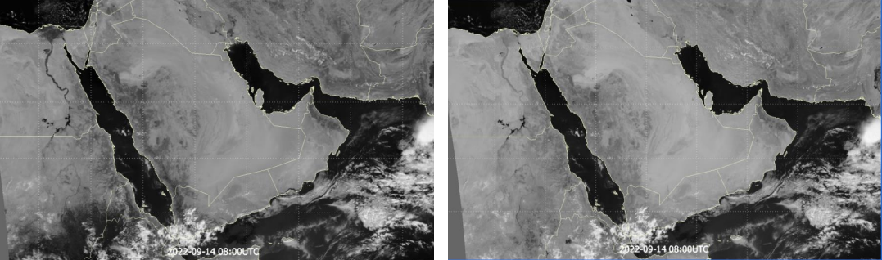
Single Channels
Reflected solar radiation
Available during daytime only.
Cloud monitoring
In 0.8 μm vegetation reflects much more used for land an vegetation products

Slide 27
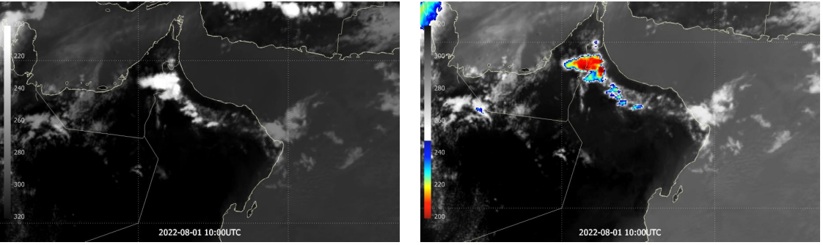
Single Channel (Enhanced IR10.8)

Slide 28
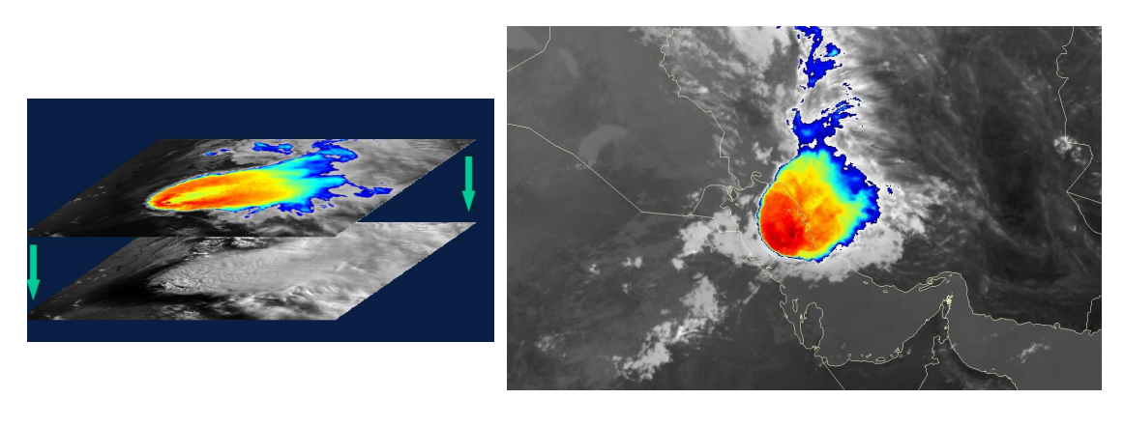
Sandwich Products

Slide 29
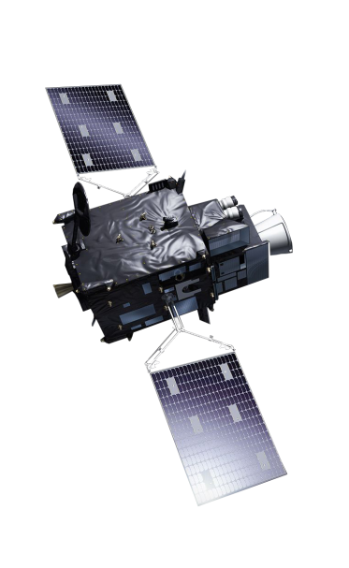
Except spectral?
Resolution :
Spatial
Temporal
Spectral
Radiometric

Slide 30
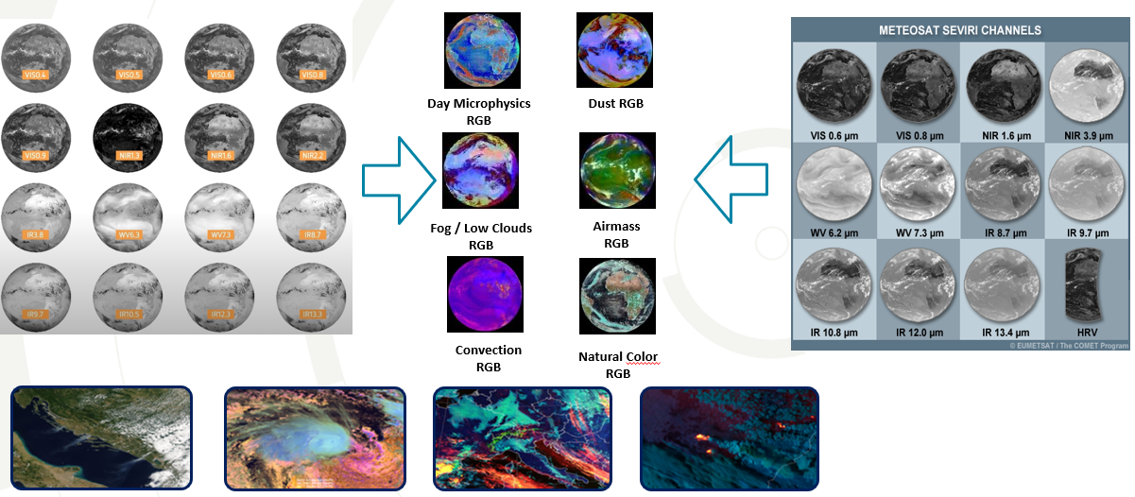
Spectral Resolution :
Signifies the number and width of spectral bands of the sensor. The higher the spectral resolution, the narrower the wavelength range for a given channel or band.

Slide 31
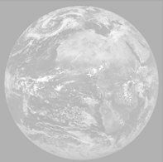
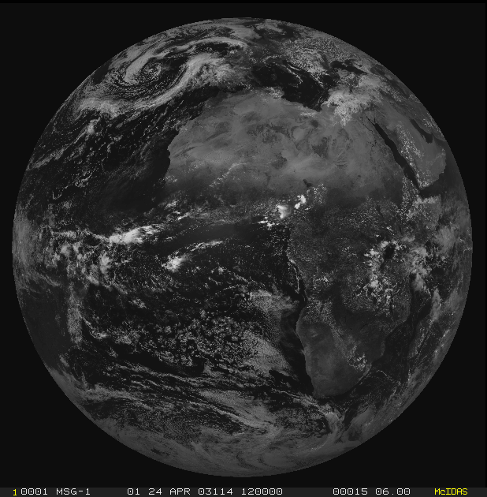
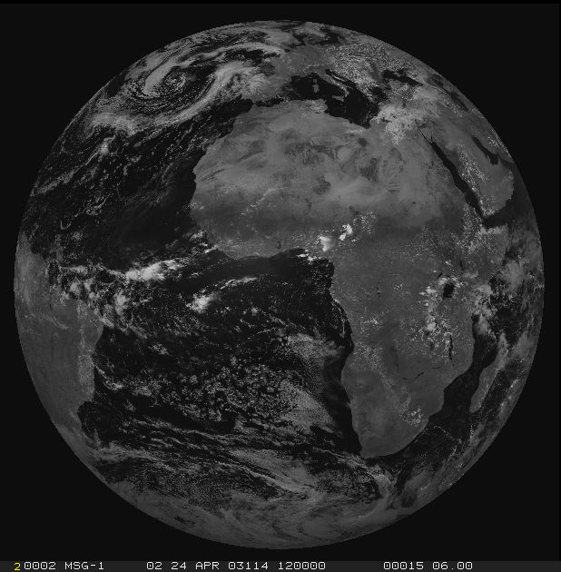
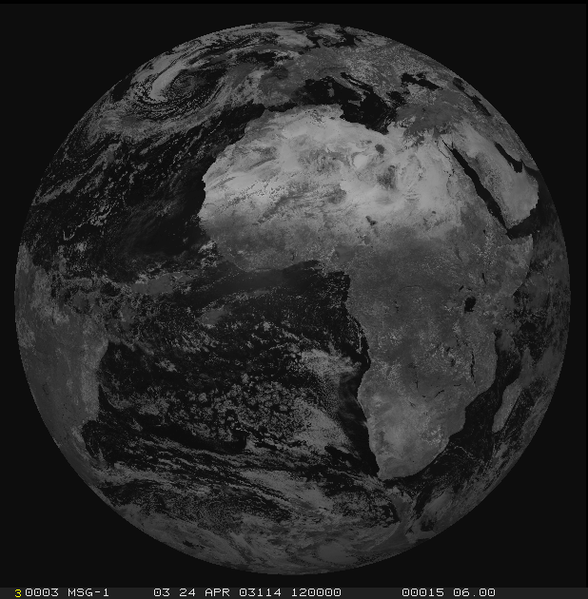
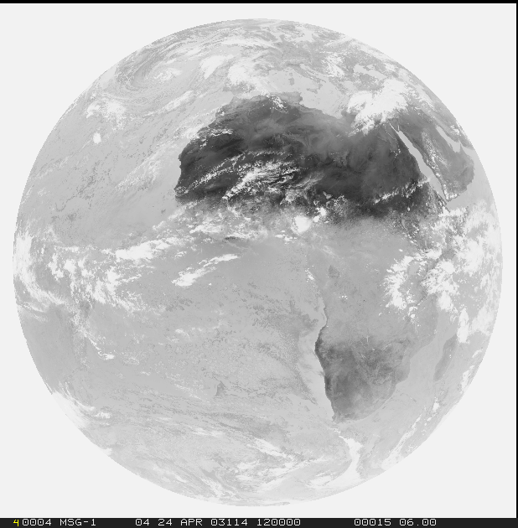
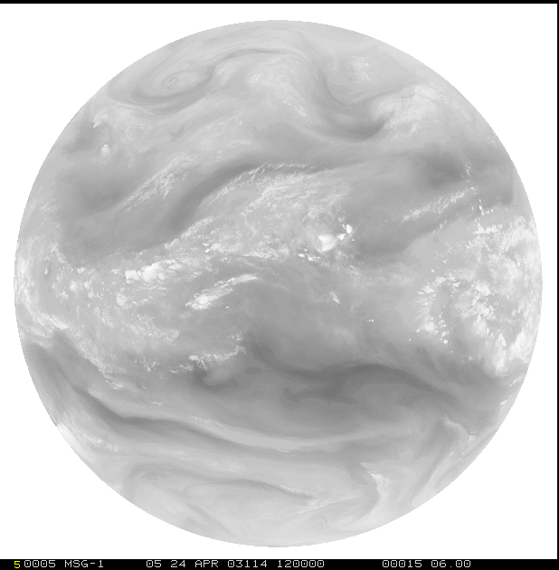
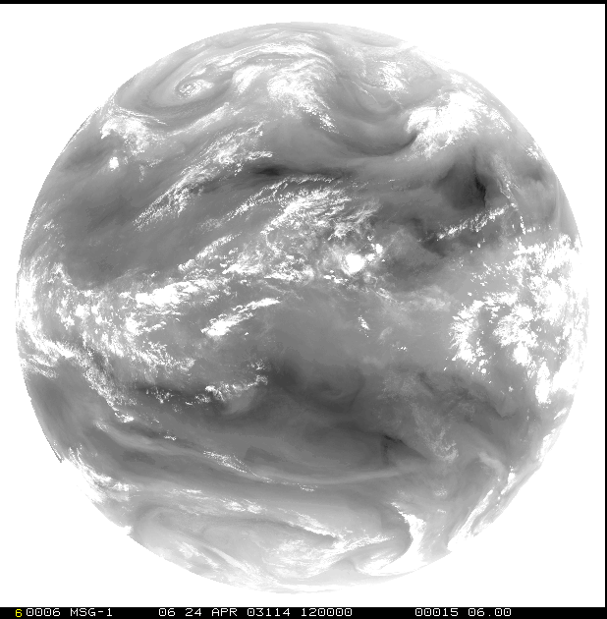
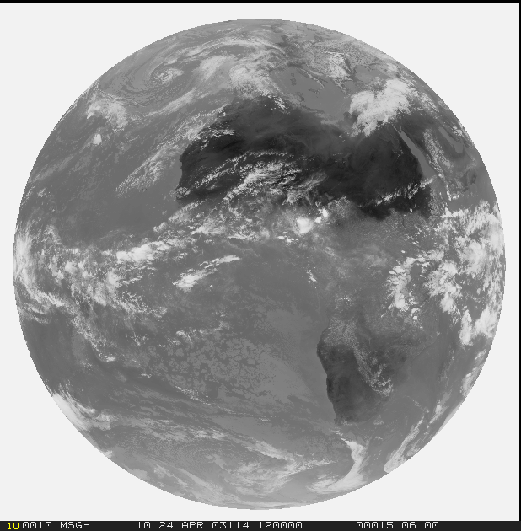
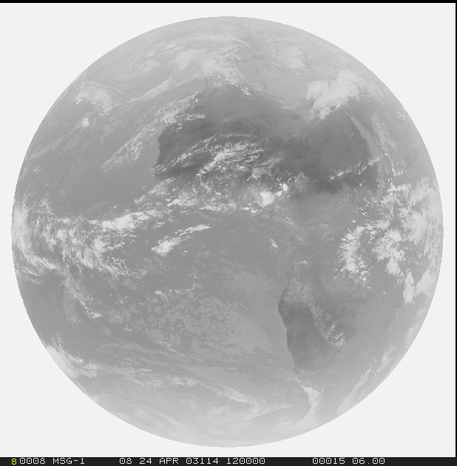
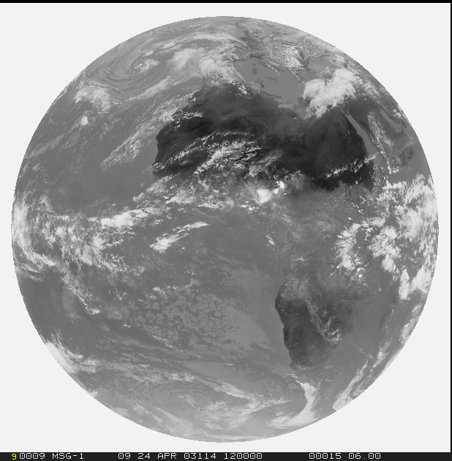
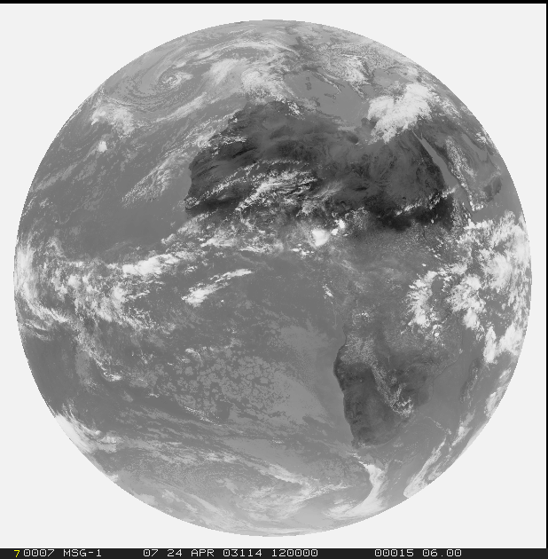

Spectral Resolution
1=VIS0.4
2=VIS0.5
3=VIS0.6
4=VIS0.8
5=NIR0.9
6=NIR1.3
Solar
3.0 (1.0/0.5) km
Thermal
3.0 (2.0/1.0) km
7=NIR1.6
8=NIR2.25
9=IR3.8
10=WV6.2
11=WV7.3
12=IR8.7
13=IR9.7
14=IR10.5
15=IR12.3
16=IR13.3

Slide 32

Spatial Resolution
Spatial Resolution Comparison
MSG-0
MTG

Slide 33





Spatial Resolution (FCI vs SEVIRI
What’s new? – High Resolution Mode:
0.6 um and 2.3 um in 1.0 km resolution ( and 0.5 km in Hi-Re mode)
3.8 um and 10.5 um in 2.0 km resolution ( and 1 km in Hi-Re mode)
2km
3km
0.5km
1km

Slide 34



Spatial Resolution

Slide 35



Parallax Shift :

Slide 36



Slide 37


Parallax Shift :

Slide 38





Slide 39




Limb View :
Meteosat 10
Meteosat 9
Meteosat 10
Meteosat 9

Slide 40
Radiometric resolution :
The ability of a sensor to detect small differences in radiance (number of gray levels per pixel).
MSG SEVIRI has 10-bit resolution (~1024 levels),
while MTG FCI has 12-bit resolution (~4096 levels).
0
255

Slide 41

Temporal resolution :

Slide 42
Satellite Data Processing

Slide 43
Satellite Data Processing

Slide 44




What is really measured??
EMW can be :
Emitted
Scattered
Reflected
Transmitted
Absorbed
.
.
Every Object has a temperature > 0 K and should should emit EM.

Slide 45


10.8 um sensor
-70 C
Less radiation Intensity \
smaller number of photons
Cold Surface
45 C
Hot Surface
Higher radiation Intensity \
larger number of photons

Slide 46

Cosmic background radiation
Electromagnetic radiation: From Sun , Earth’s Atmosphere and other earth Systems and from Everywhere in the Space
Average Global Temperature
15 C
Credit: https://tinyurl.com/HEISatelliteWorkshop

Slide 47
What is really measured??
02

Slide 48

Data Exploration ?
How to use data??
Single Channels
Channel difference/ratio
Sandwich products
RGB products
L2(+) / Geophysical products

Slide 49
Single Channels
Reflected solar radiation
In 0.8 μm vegetation reflects much more used for land an vegetation products

Slide 50
Single Channels (Enhanced IR10.8)

Slide 51
Sandwich Products

Slide 52



-70 C
0.6 um \ Reflectance
Cloud top Feature Identification
45 C
-70 C
-90 C
Color enhancement of single channels
45 C
45 C

Slide 53
RGB Composite !

Slide 54

Single Channel
?
?
?
?
?
?
?
?
Convective Cloud
?

Slide 55

Single Channel

Slide 56

How is RGB image (or RGB composite) made ?
Every spectral channel could be assigned to one of the RGB primary components
Red
Green
Blue
Allows analysis of 3 (or more) spectral characteristics in one image!

Slide 57




Channel’s Intensity
 | R | G | B
 | 255 | 255 | 255
 | 255 | 255 | 0
 | 255 | 0 | 255
 | 0 | 255 | 255
 | 0 | 0 | 0
 | 143 | 143 | 143
 | 255 | 0 | 0
 | 0 | 255 | 0
 | 0 | 0 | 255
Natural Color RGB

Slide 58






Slide 59






Slide 60

Water cloud
Ice Cloud
Dust

Slide 61
Thanks

