Slide 1
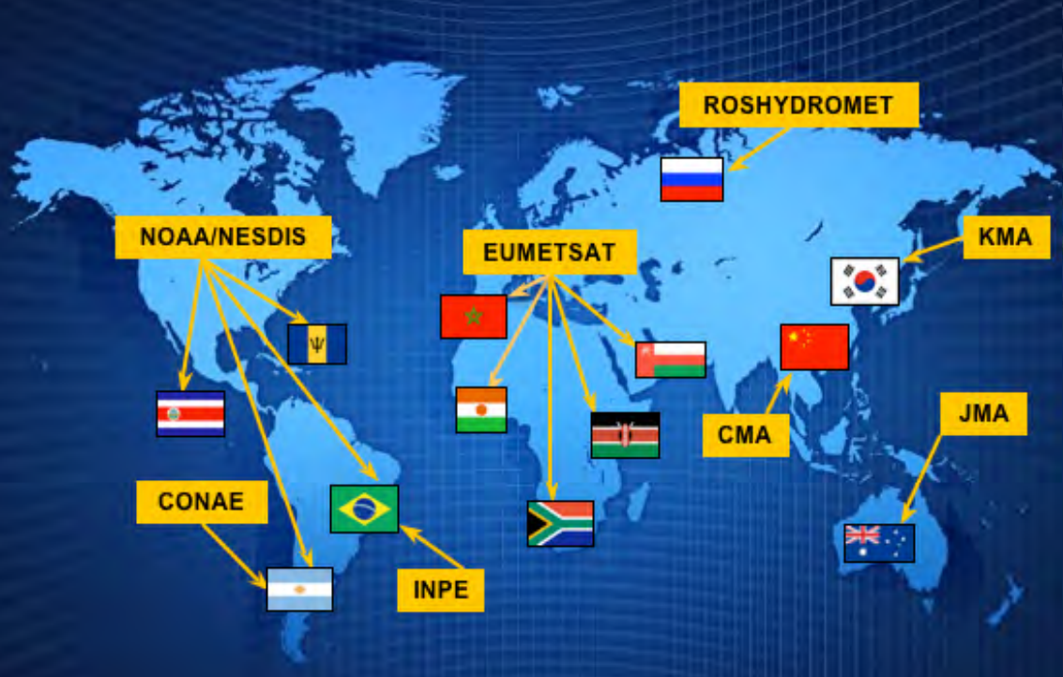
مركز الامتياز لتطبيقات الأقمار الاصطناعية - مسقط
Center of Excellence for Satellite Applications CoE-Muscat
In General :
The WMO’s Centers of Excellence (CoEs) are specialized training centers established in all WMO Regions to meet user needs for increased skills and knowledge in using satellite data within their regions.
CoEs are working closely with one or more of the satellite operators.
Virtual Laboratory (V-Lab)
A global network of specialized training centers collaborating with satellite operators.
Established by: the WMO and the CGMS, the Coordination Group for Meteorological Satellites (CGMS),
Serving as a platform to develop and facilitate training programs, ensuring the achievement of the goals set by the Centers of Excellence (CoEs), Strengthens collaboration between the Centers and their supporting satellite operators.
V-Lab Meeting – Muscat Jan 2025

Slide 2
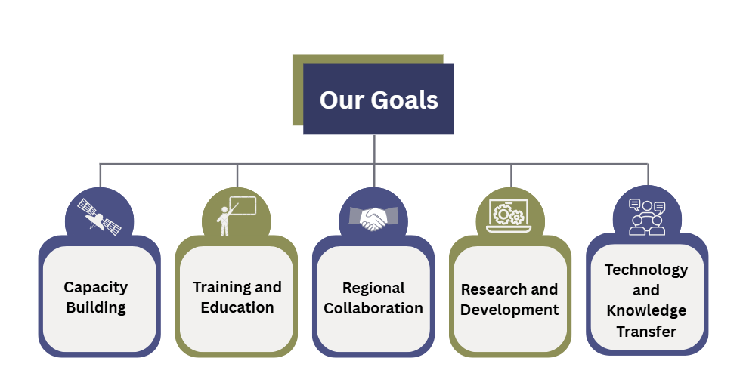

Slide 3
