Slide 1

Satellite Application Course for MENA Region / SAC-20
15 Sep 2025
Cloud Classifications: Benefits of FCI
Zamzam AL.Rawahi
Zamzam.Rawahi@caa.gov.om

Slide 2
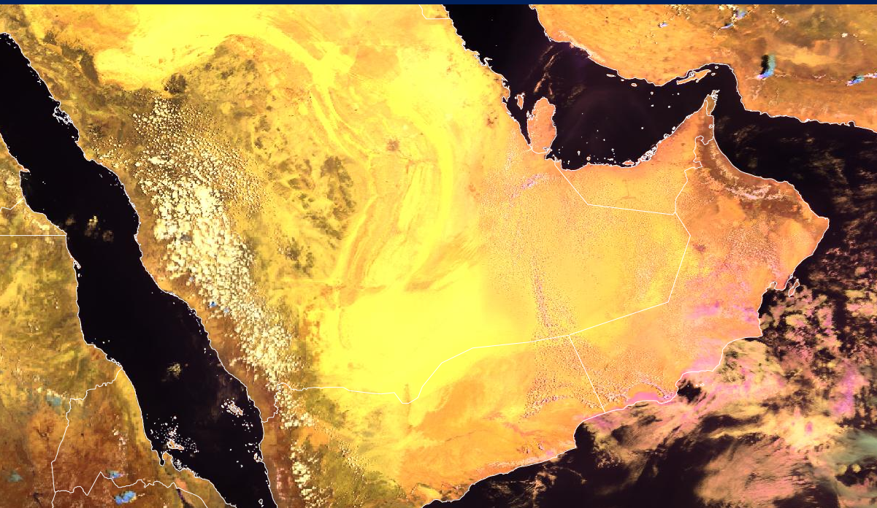

Starting with Cloud Phase RGB – Yesterday’s Closing Point
EUMETView: Case link

Slide 3
Starting with Cloud Phase RGB – Yesterday’s Closing Point

Slide 4
Starting with Cloud Phase RGB – Yesterday’s Closing Point

Slide 5
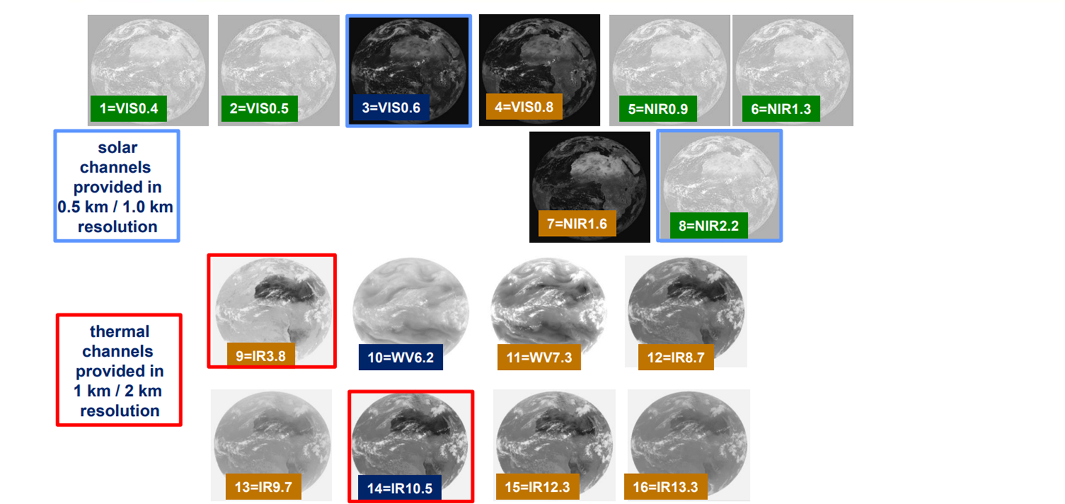
The new RGBs with FCI
The FCI sensor has new channels, mainly in the short wave spectrum (0.44um, 0.51um, 0.9um,1.38 and 2.25um)

Slide 6
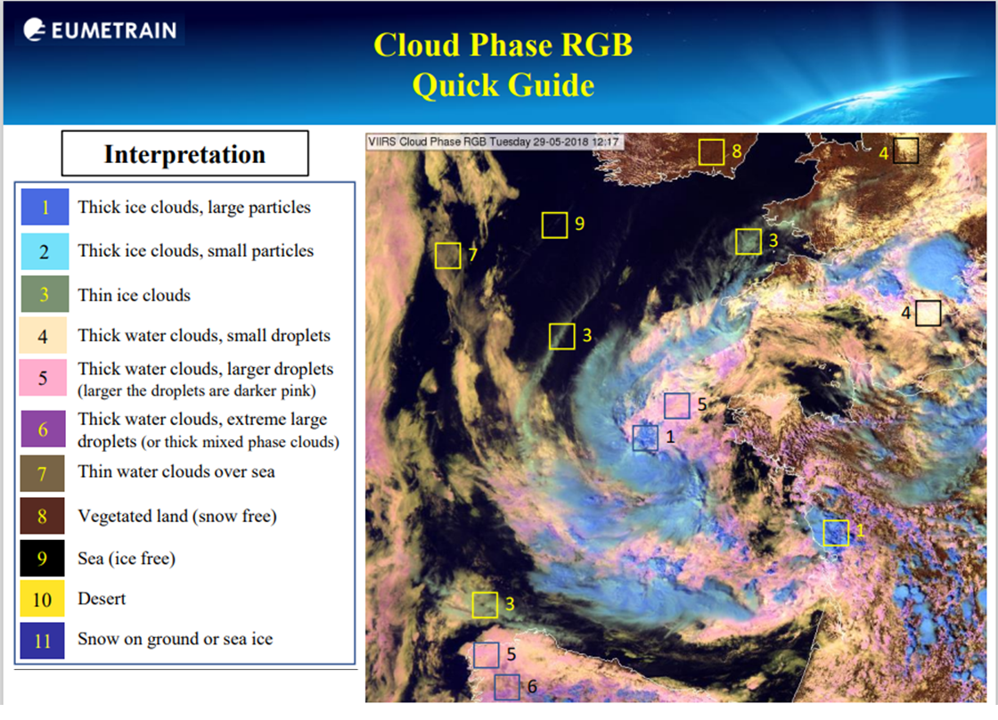
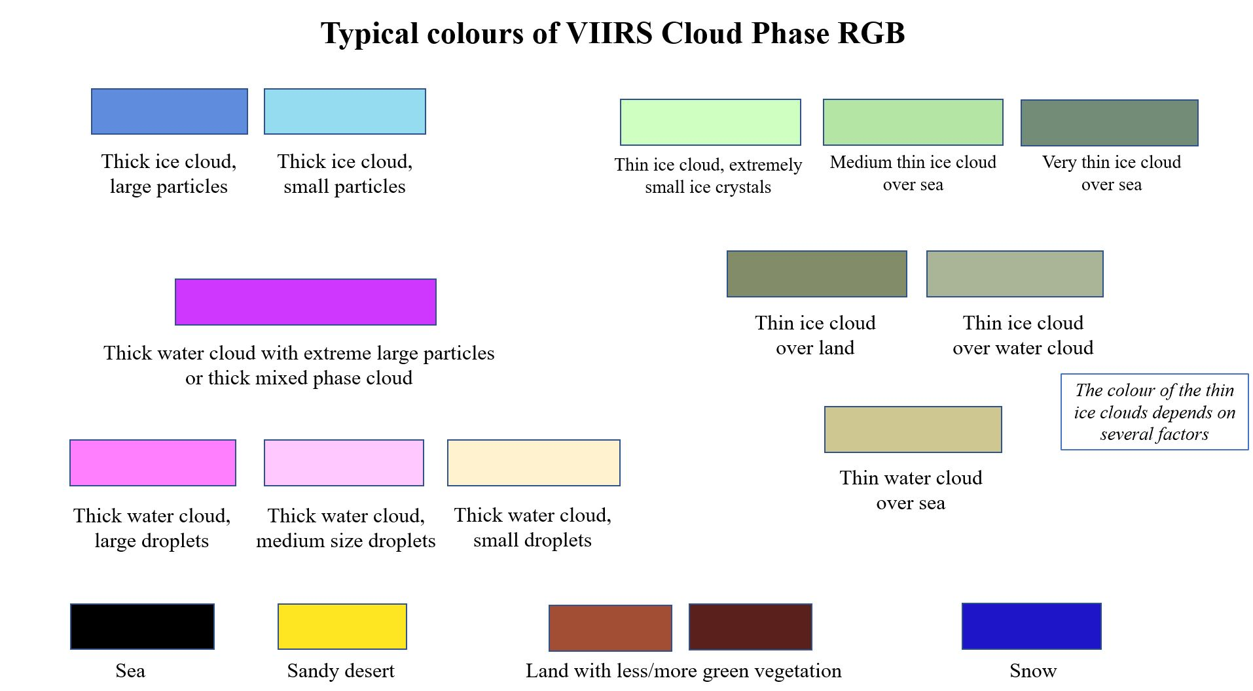
The new RGBs with FCI

Slide 7
The new RGBs with FCI

Slide 8
Interpretation Cloud Types

Slide 9
Interpretation Cloud Types

Slide 10
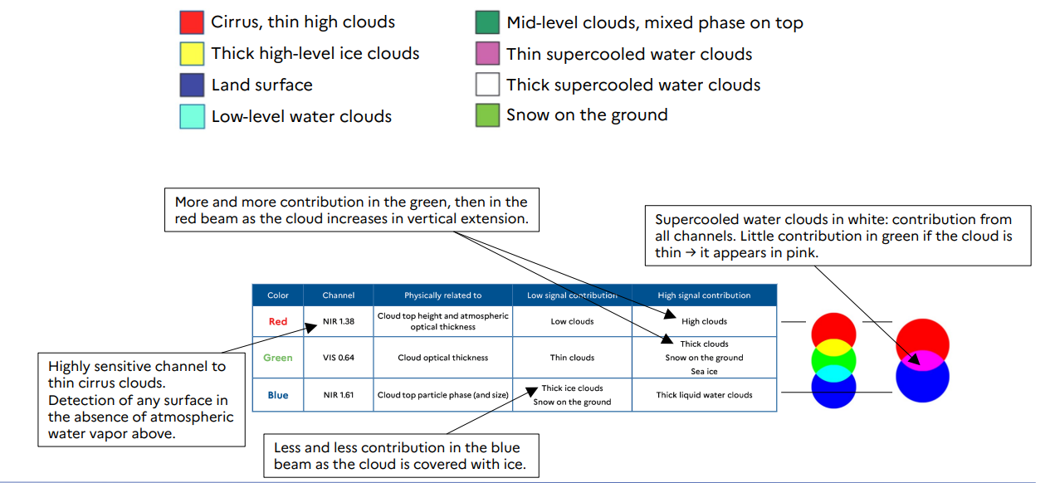
Interpretation Cloud Types

Slide 11
Interpretation Cloud Types

Slide 12
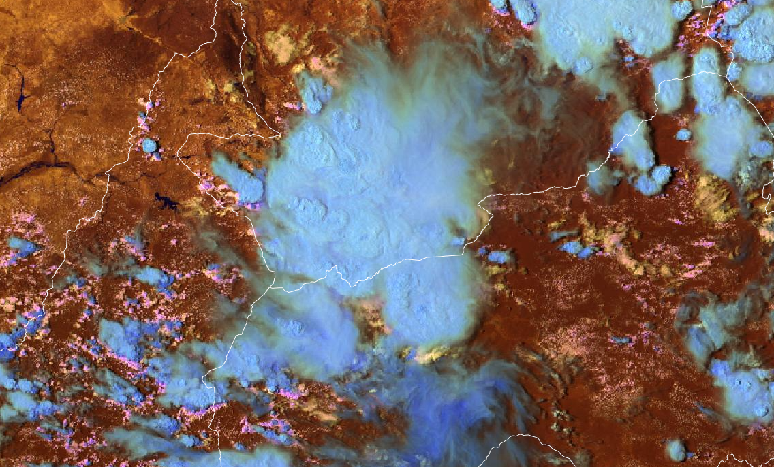
Cloud Type RGB:

