Slide 1


Satellite Application Course for MENA Region / SAC-20
15 Sep 2025
Principles of Satellite channels and RGB
Zamzam AL.Rawahi
Zamzam.Rawahi@caa.gov.om

Slide 2
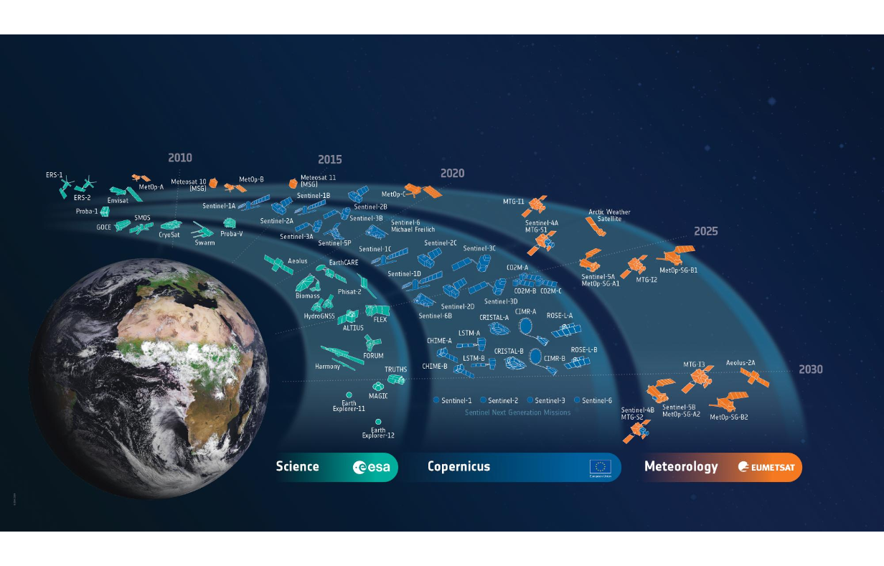

Slide 3
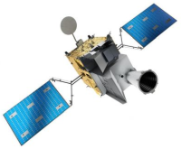
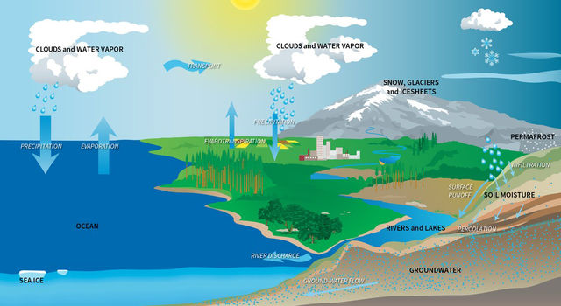
From photons to products

Slide 4
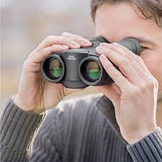
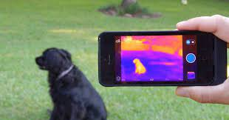
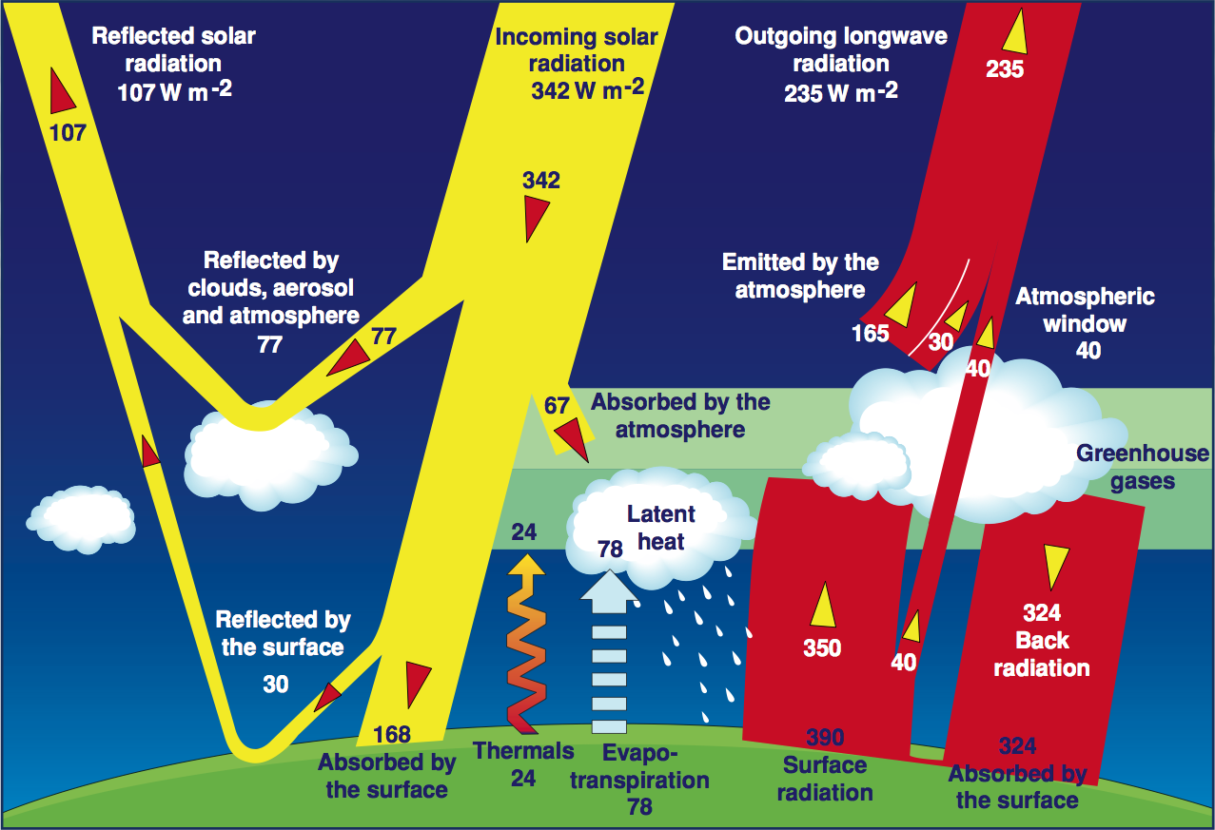
From photons to products

Slide 5
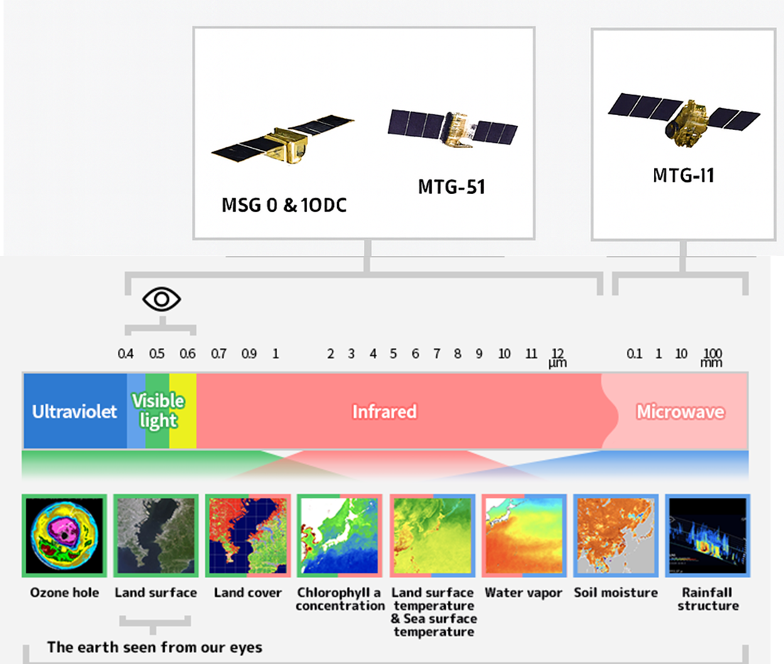
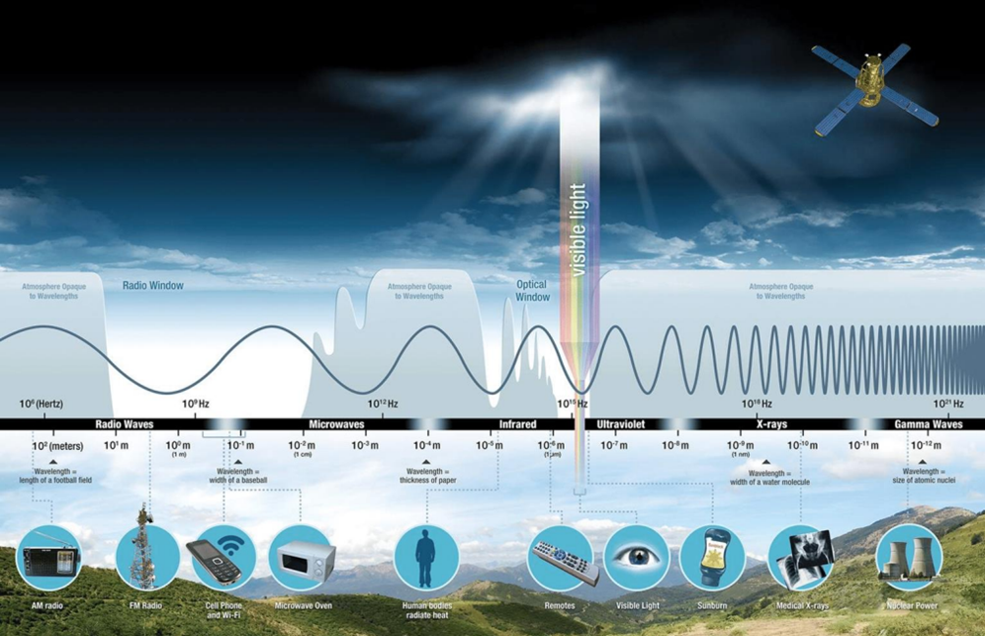
From photons to products
MTG-S1
MTG-I1

Slide 6
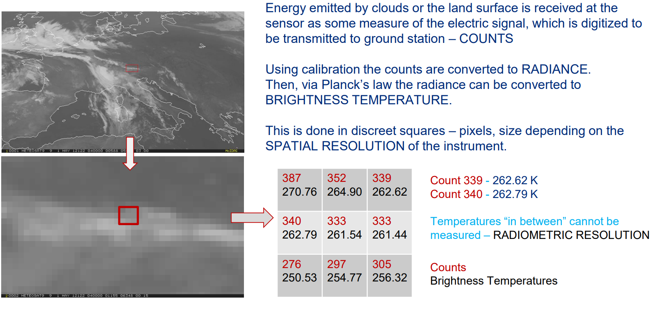
What is really measured?

Slide 7
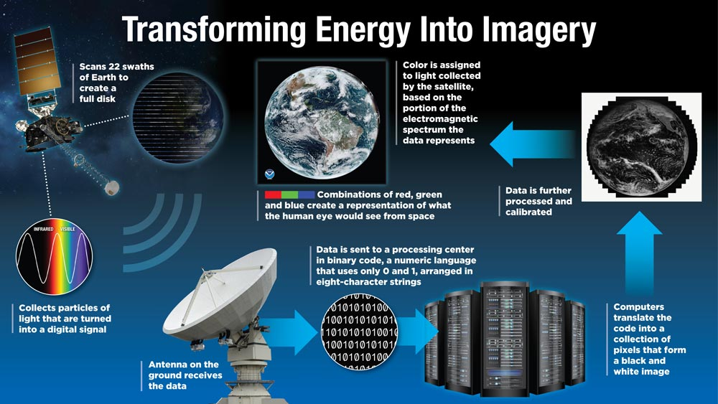
Satellite Data Processing

Slide 8
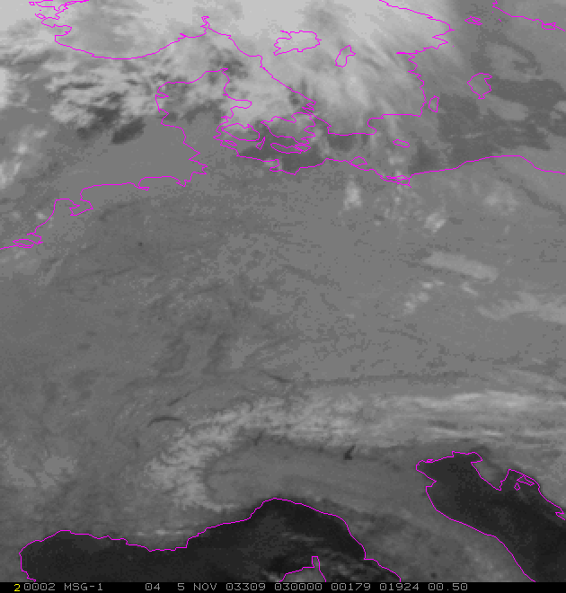
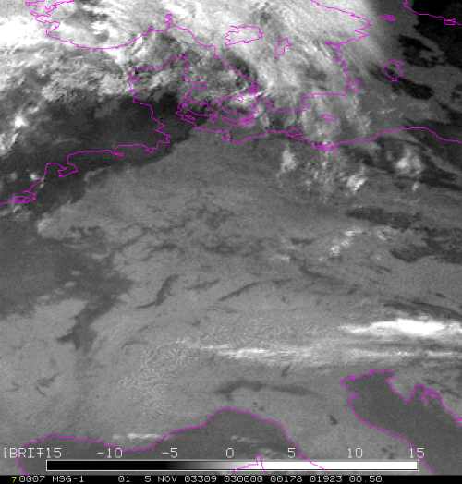
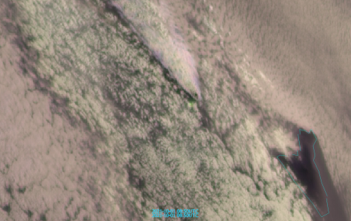
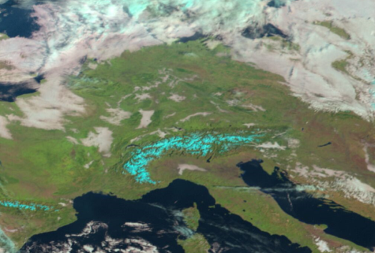
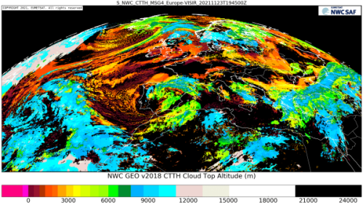
Data exploration
How to use data?
Single channel
Channel difference/ratio
Sandwich products
RGB products
...
-
L2(+) / Geophysical products

Slide 9
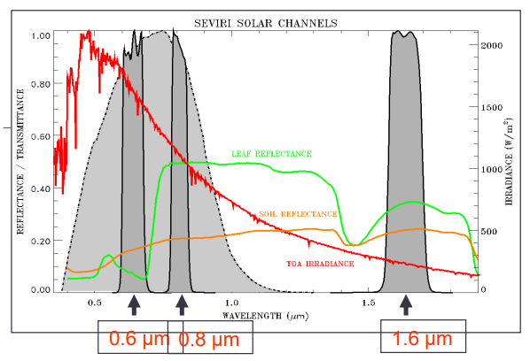
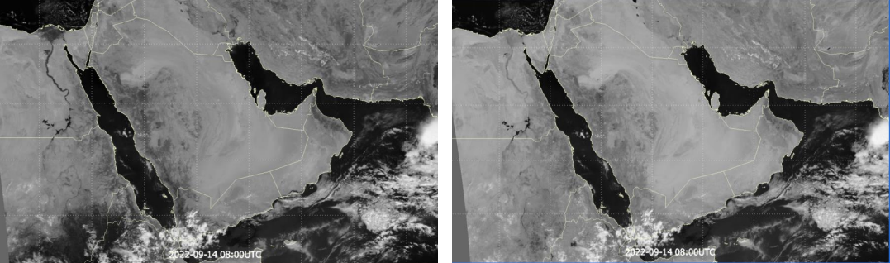
Single Channels
Reflected solar radiation
Available during daytime only.
Cloud monitoring
In 0.8 μm vegetation reflects much more used for land an vegetation products

Slide 10
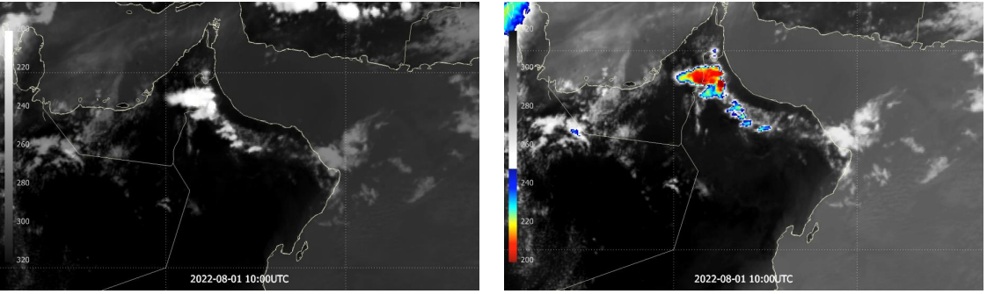
Single Channel (Enhanced IR10.8)

Slide 11
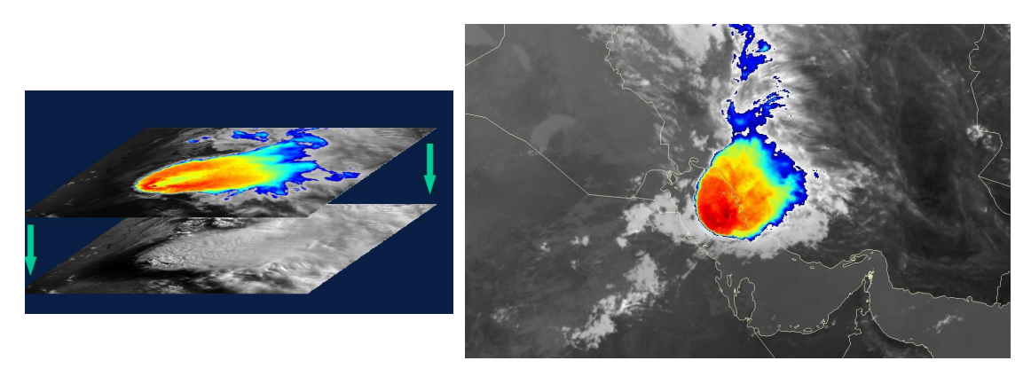
Sandwich Products

Slide 12
But we have many more channels!

Slide 13
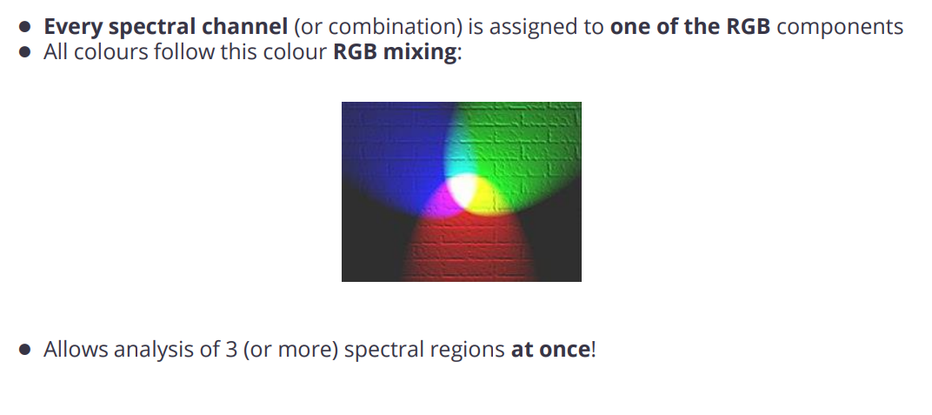
RGB Composite

Slide 14
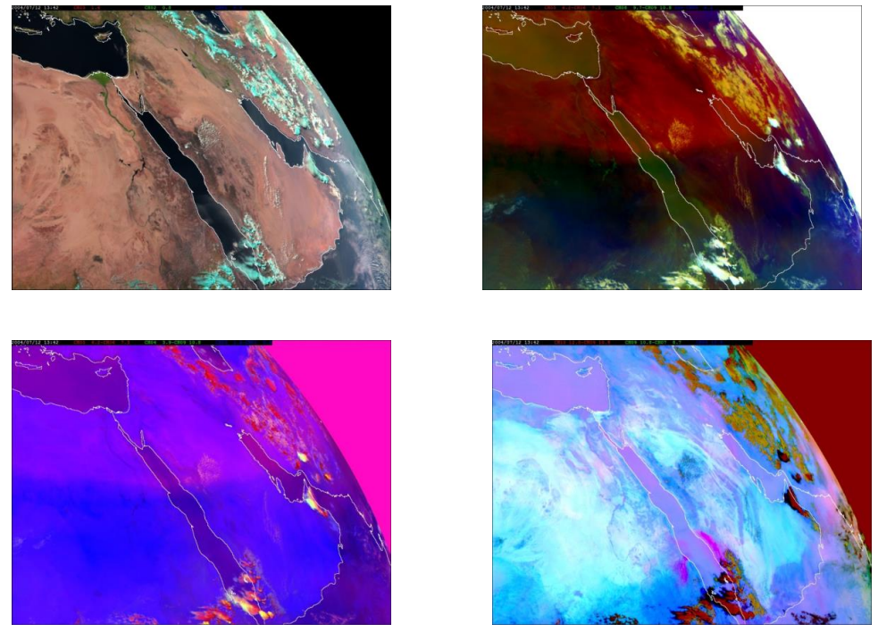
RGB Composite

Slide 15
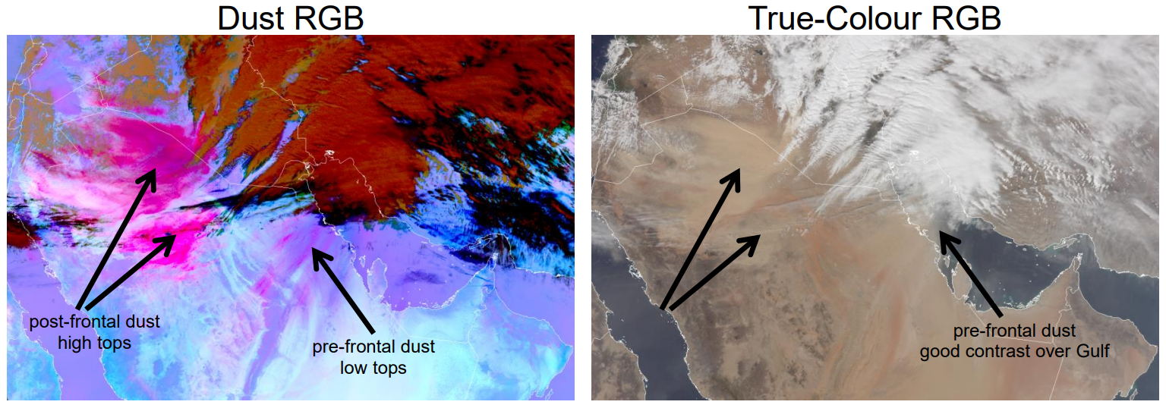
RGB Composite

Slide 16
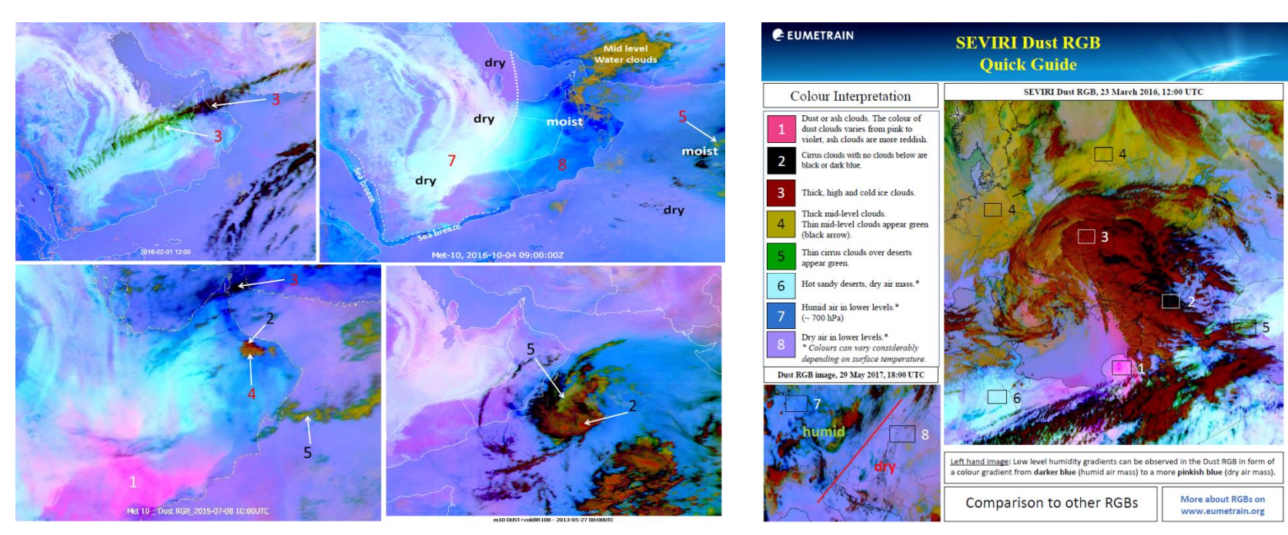
RGB Composite

Slide 17
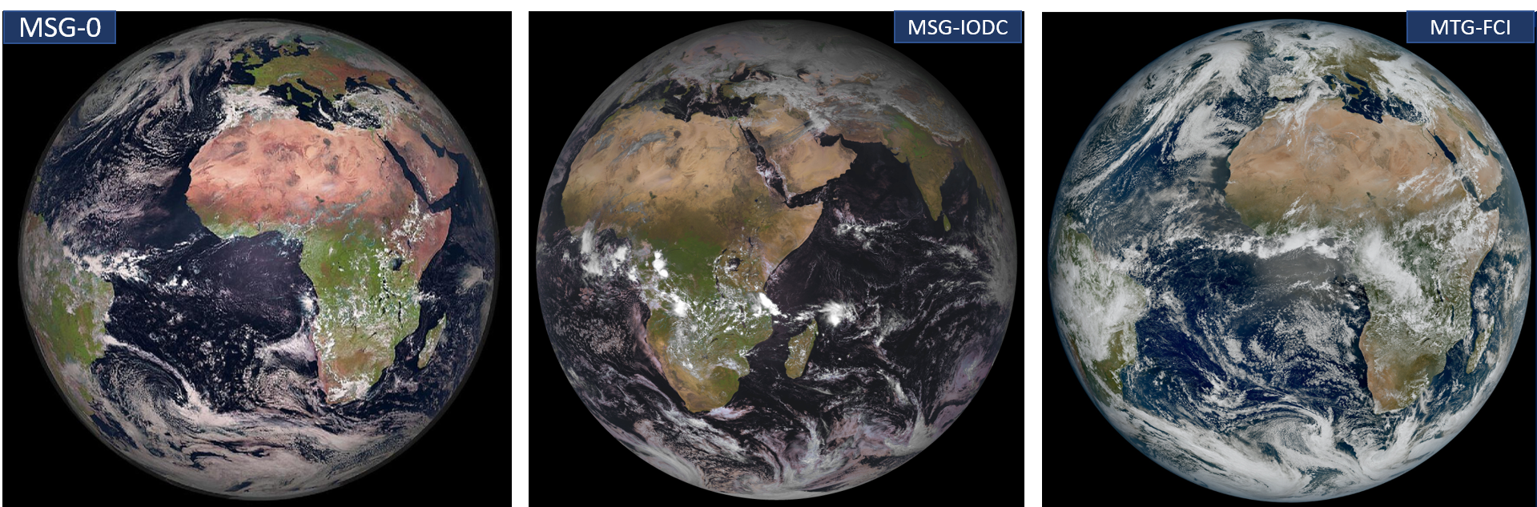
EUMETSAT Operational Satellite
EUMETSAT currently operates:
MSG (0° longitude): Best Coverage over Africa/Europe, degraded view over India and Brazil.
MSG-IODC (~41.5°E): Best over the Indian Ocean and the Middle East, weaker over western Africa.
MTG (0° longitude, 1 km at nadir): Excellent resolution over Africa/Europe,

Slide 18
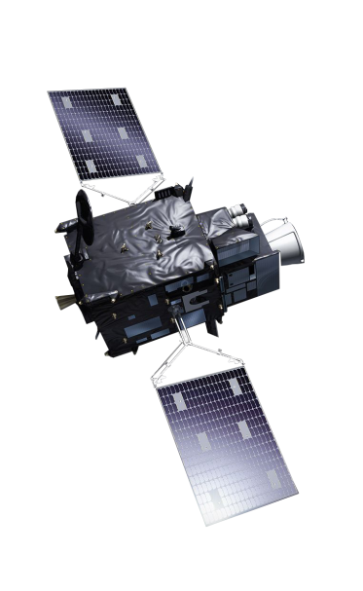
Except spectral?
RESOLUTION:
Spatial
Temporal
Spectral
Radiometric

Slide 19
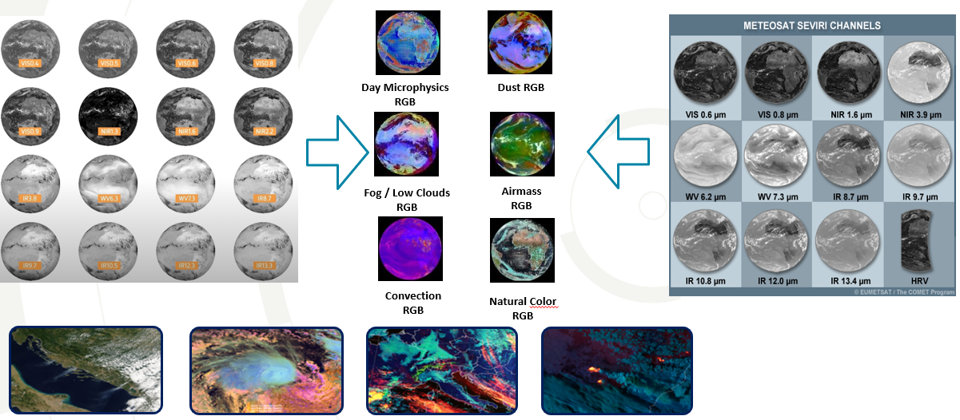
Spectral Resolution :
Signifies the number and width of spectral bands of the sensor. The higher the spectral resolution, the narrower the wavelength range for a given channel or band.

Slide 20
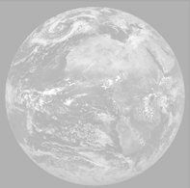
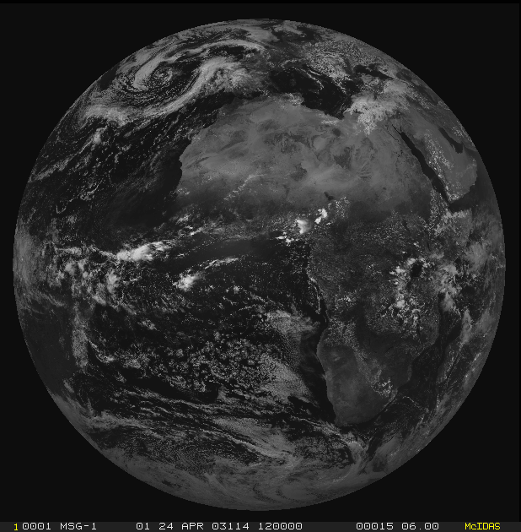
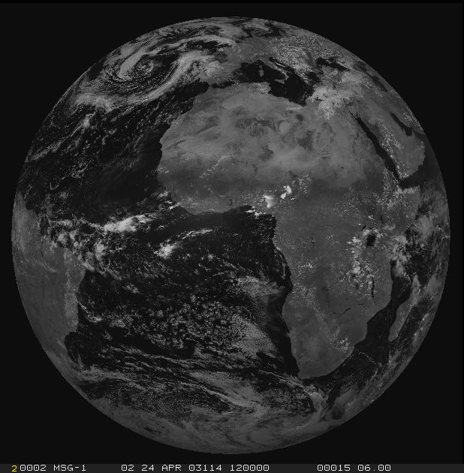
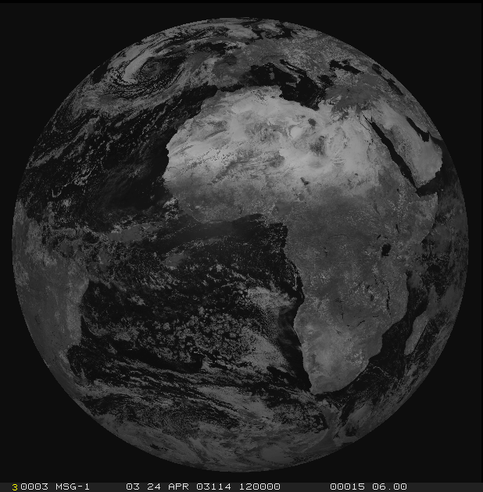
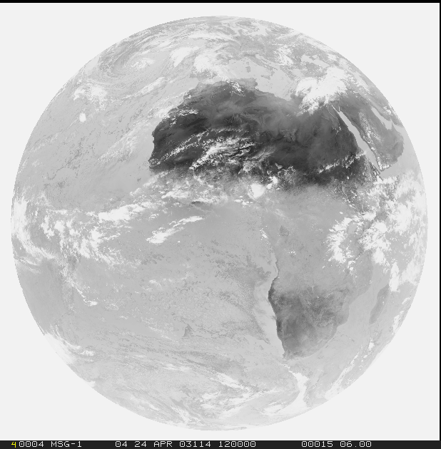
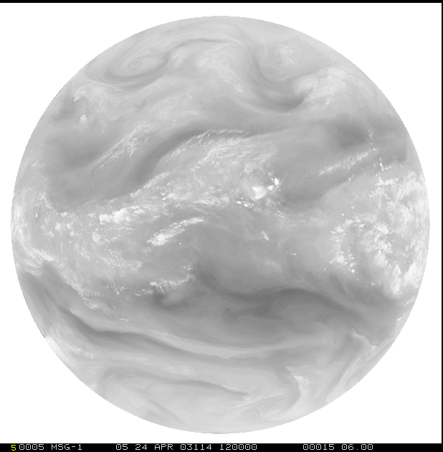
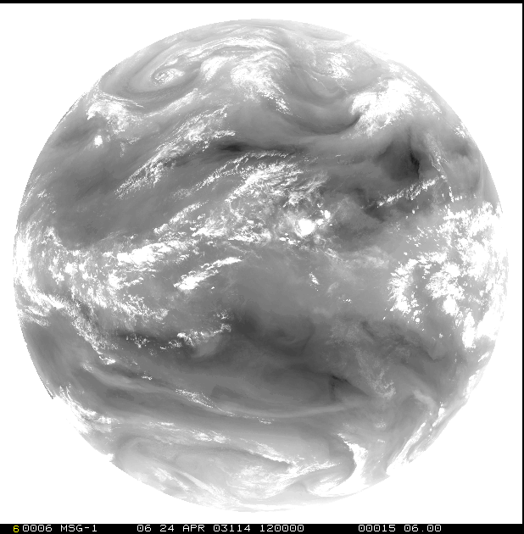
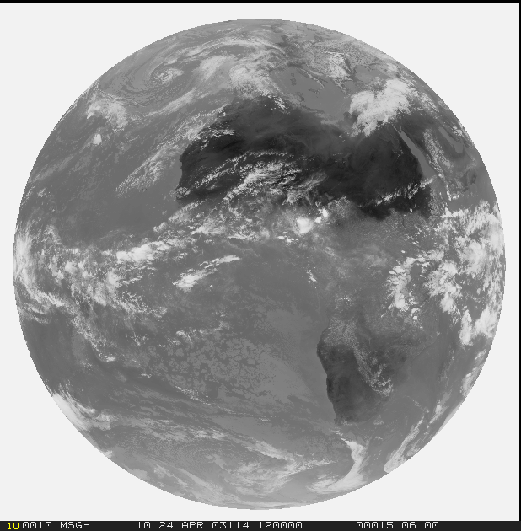
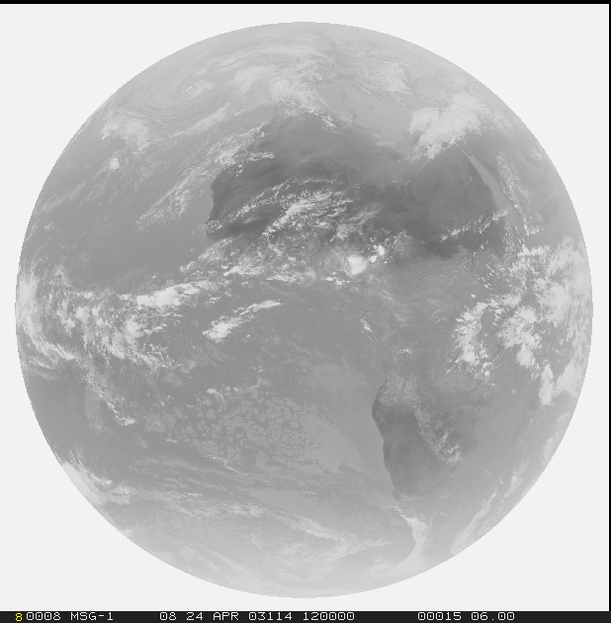
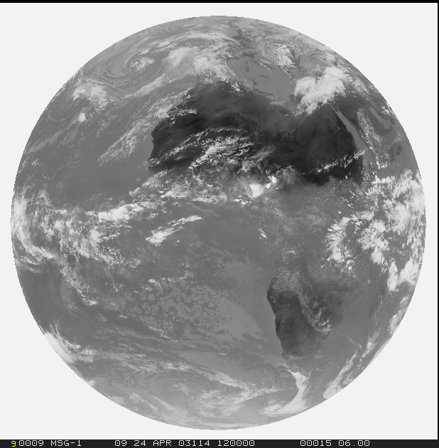
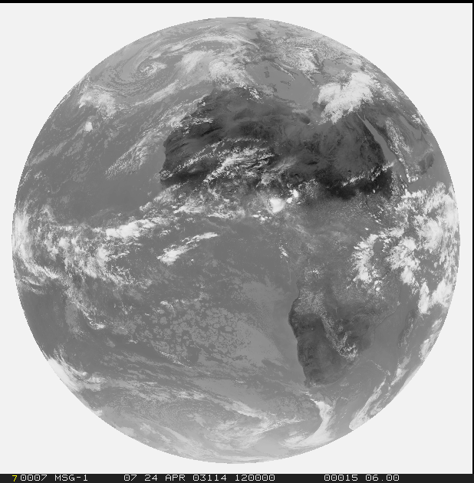
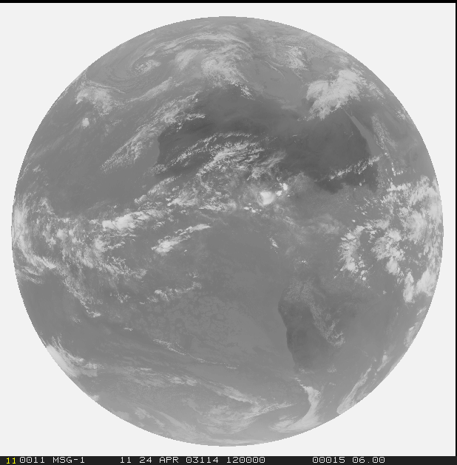
Spectral Resolution
1=VIS0.4
2=VIS0.5
3=VIS0.6
4=VIS0.8
5=NIR0.9
6=NIR1.3
Solar
3.0 (1.0/0.5) km
Thermal
3.0 (2.0/1.0) km
7=NIR1.6
8=NIR2.25
9=IR3.8
10=WV6.2
11=WV7.3
12=IR8.7
13=IR9.7
14=IR10.5
15=IR12.3
16=IR13.3

Slide 21
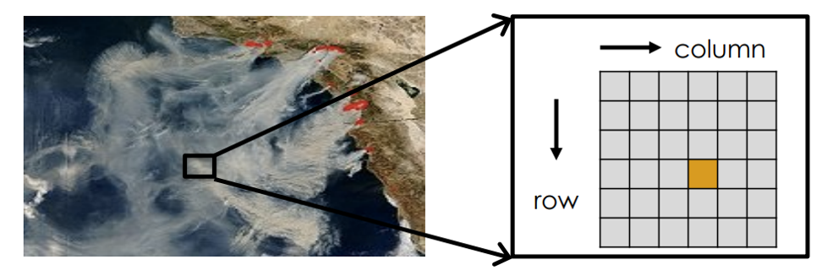

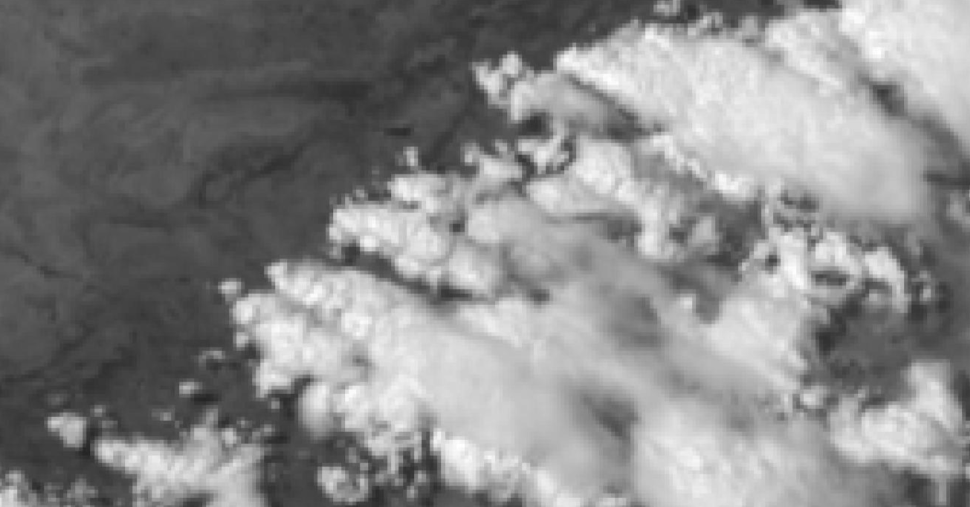
Spatial Resolution
Spatial Resolution Comparison
MSG-0
MTG

Slide 22
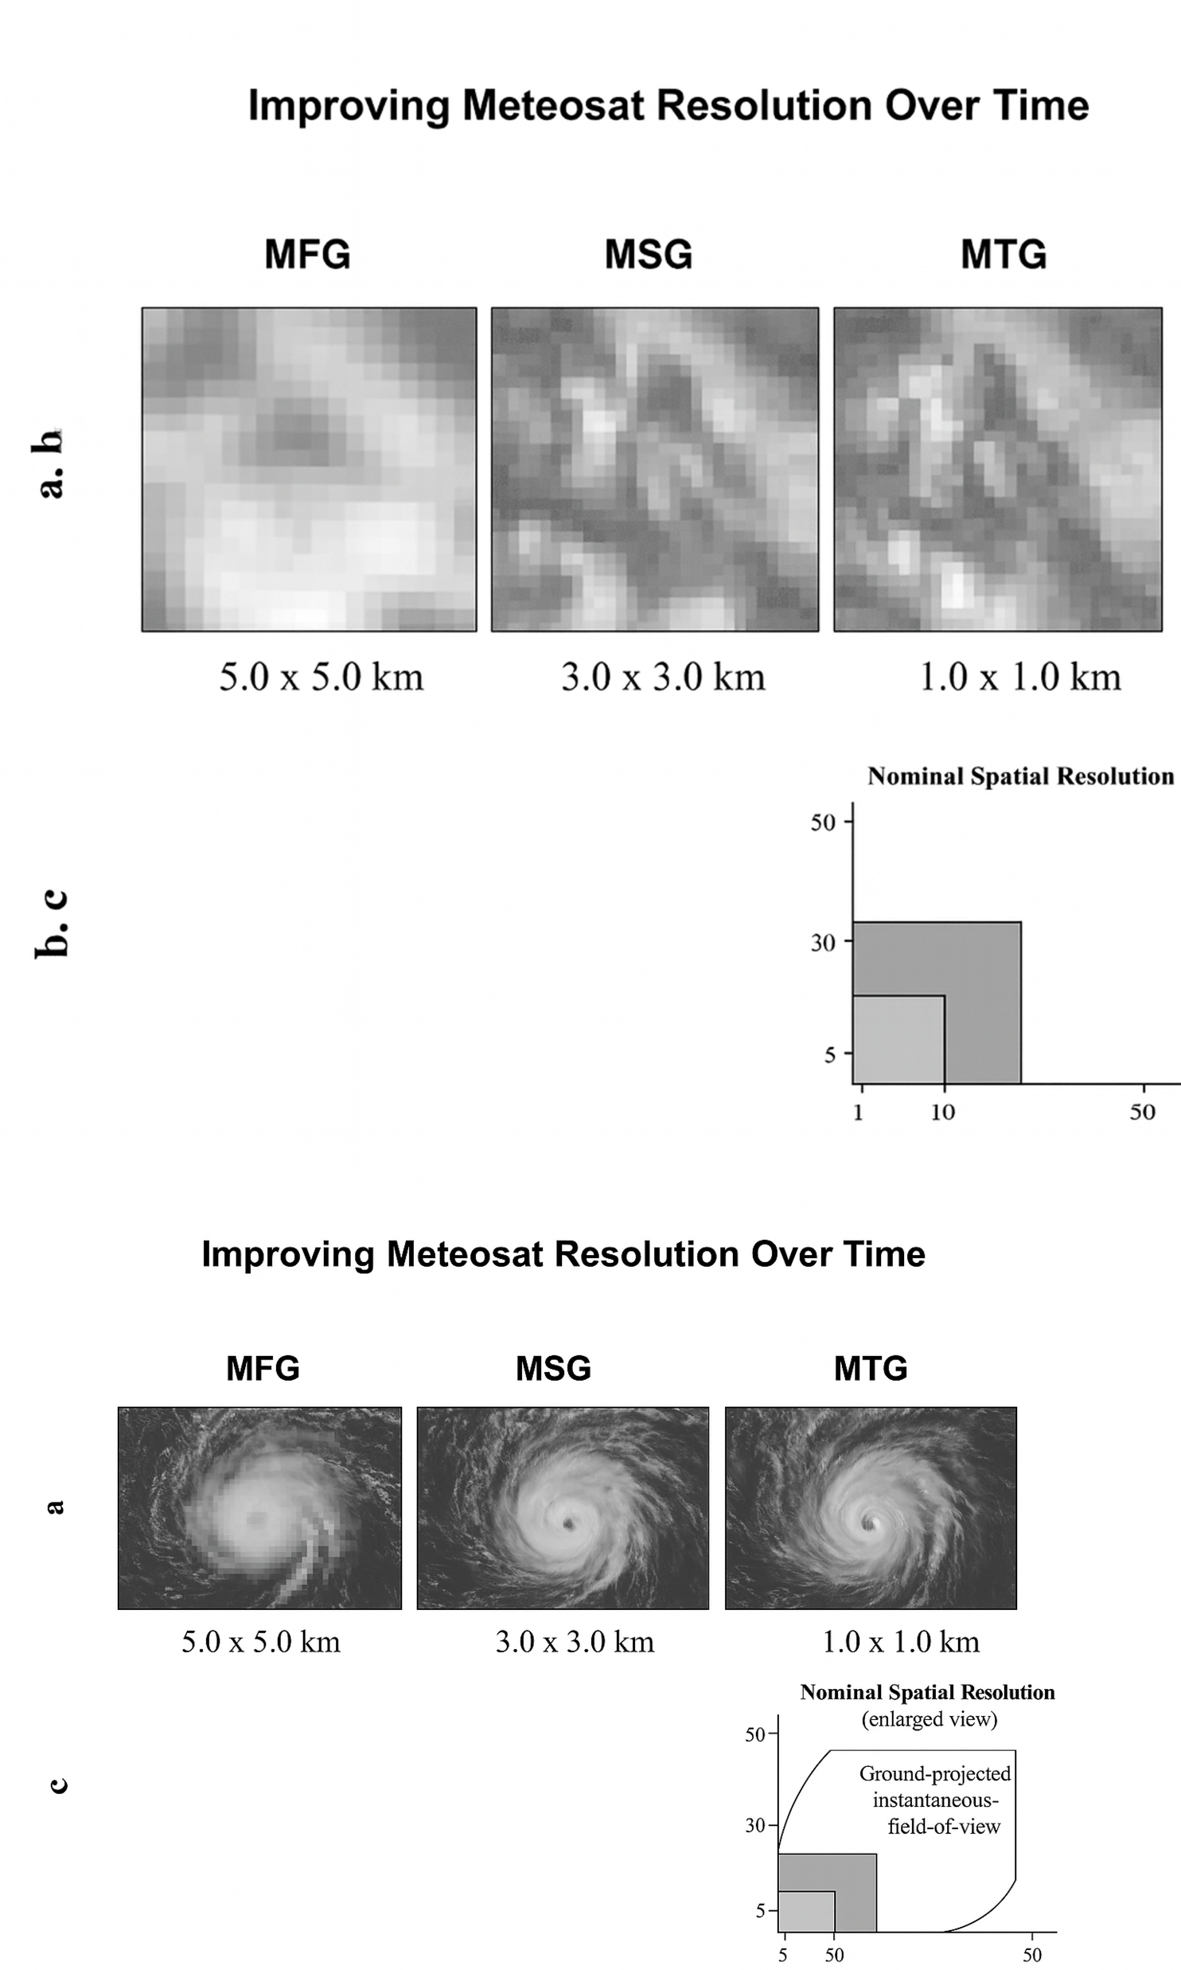


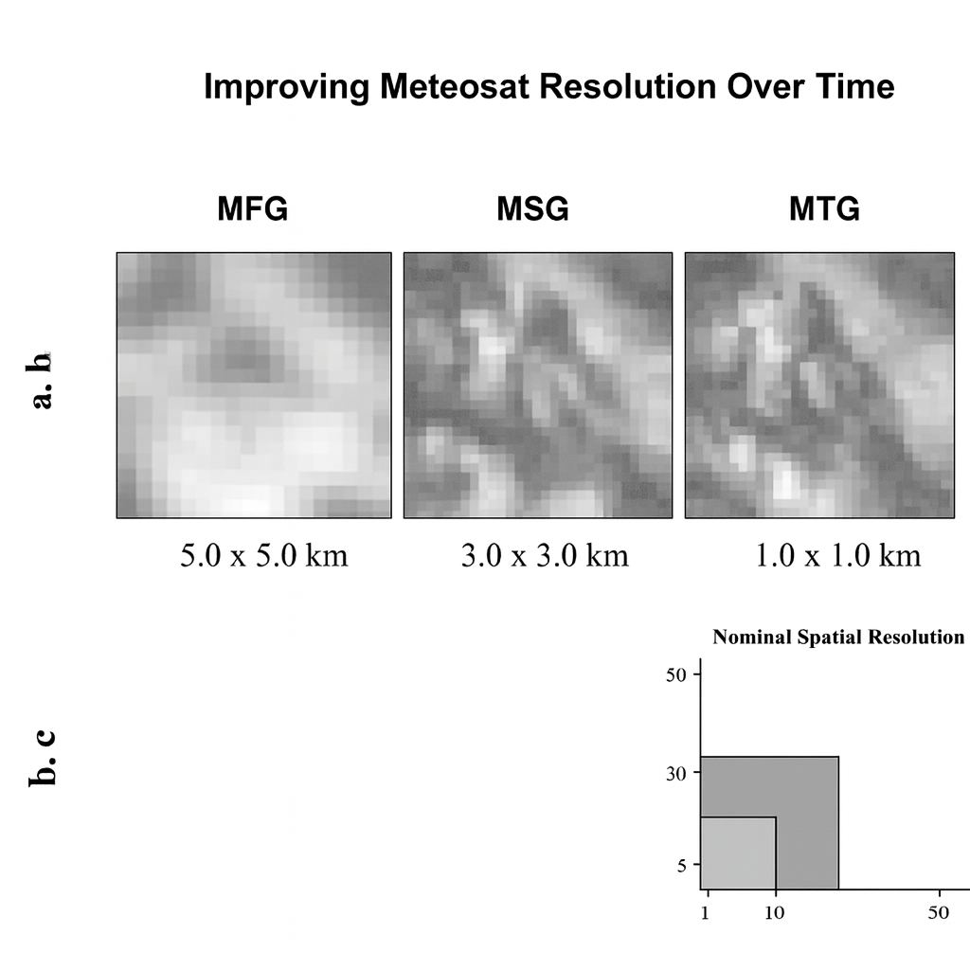
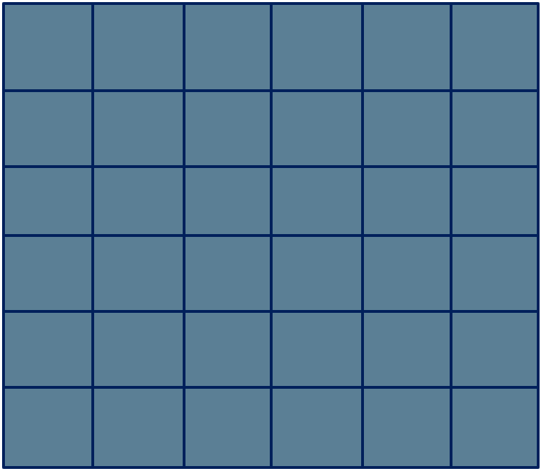
Spatial Resolution (FCI vs SEVIRI
What’s new? – High Resolution Mode:
0.6 um and 2.3 um in 1.0 km resolution ( and 0.5 km in Hi-Re mode)
3.8 um and 10.5 um in 2.0 km resolution ( and 1 km in Hi-Re mode)
2km
3km
0.5km
1km

Slide 23
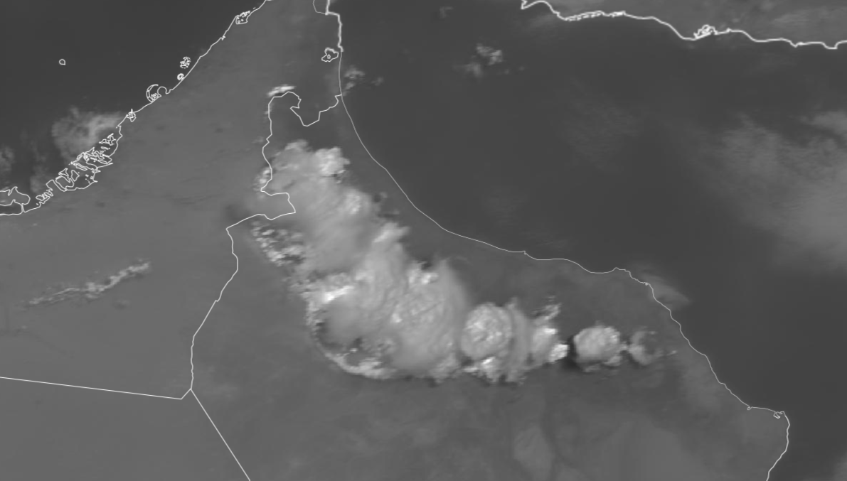
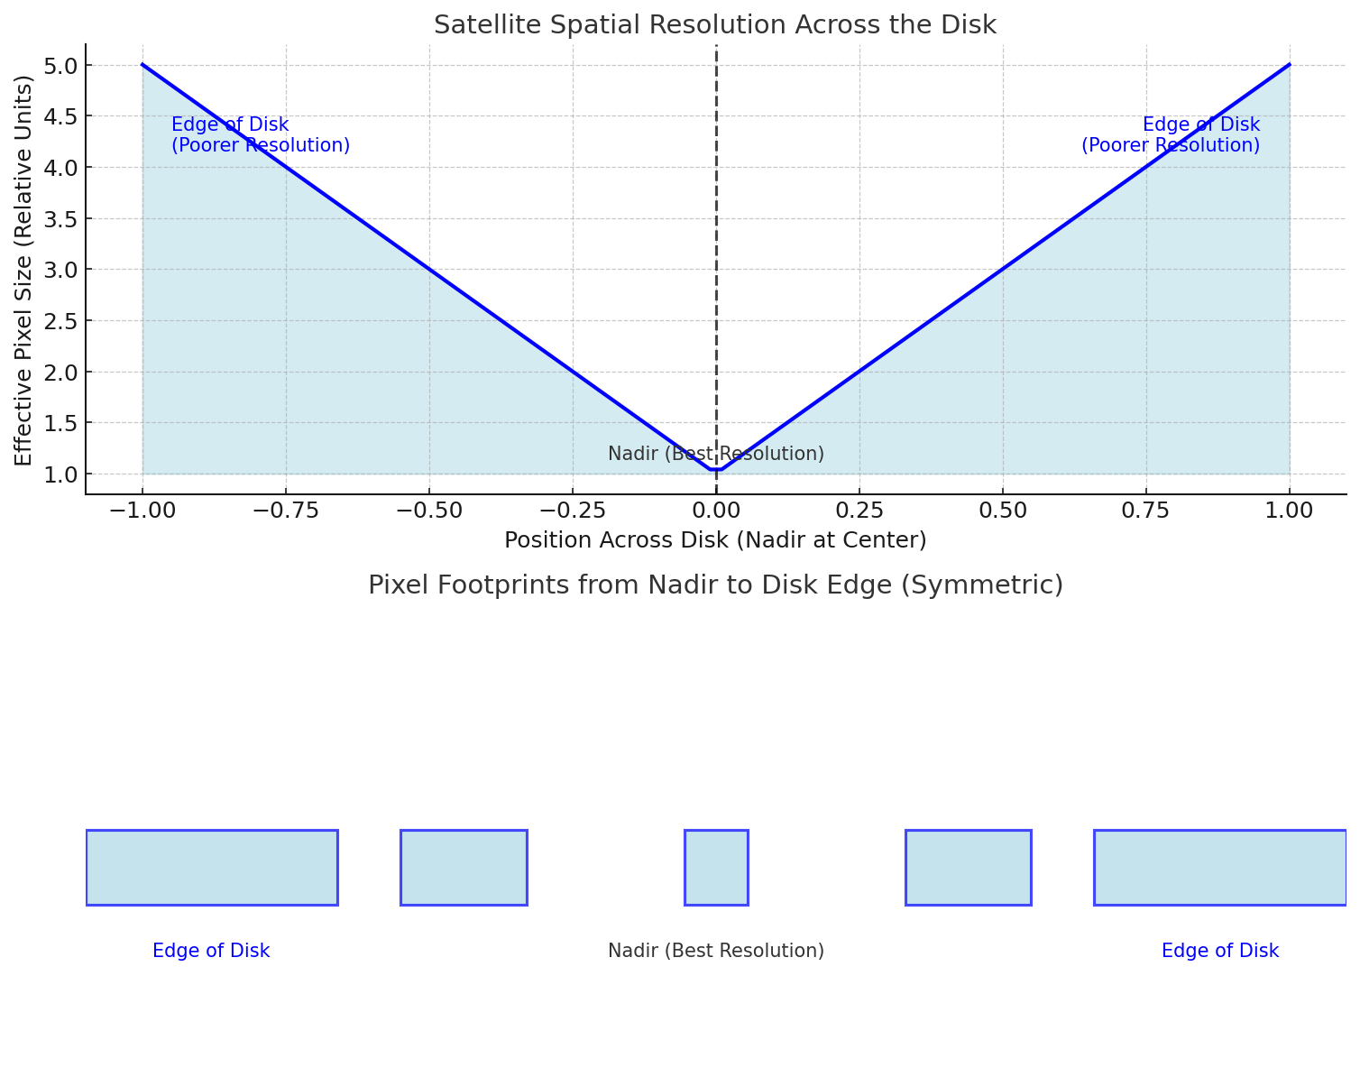
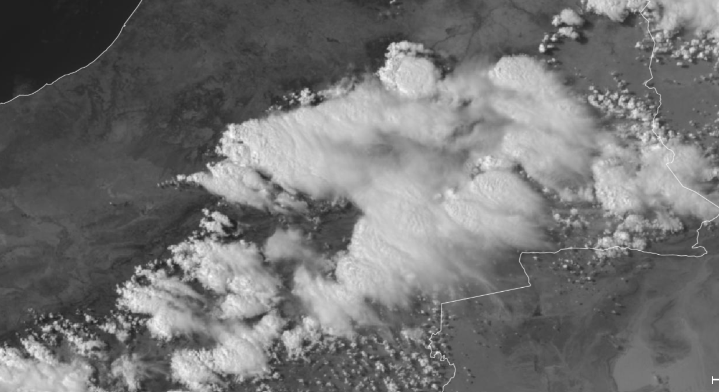
Spatial Resolution

Slide 24
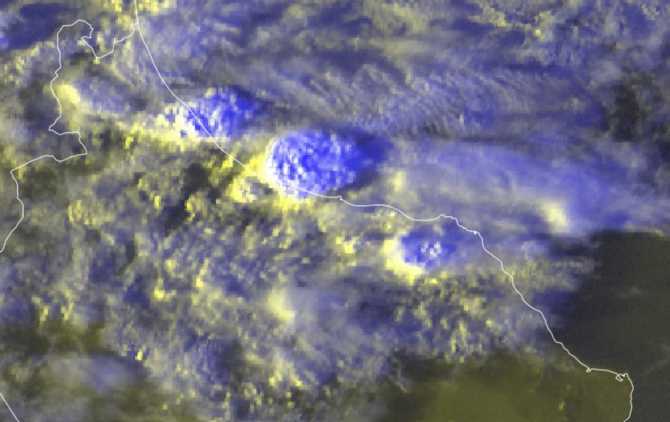
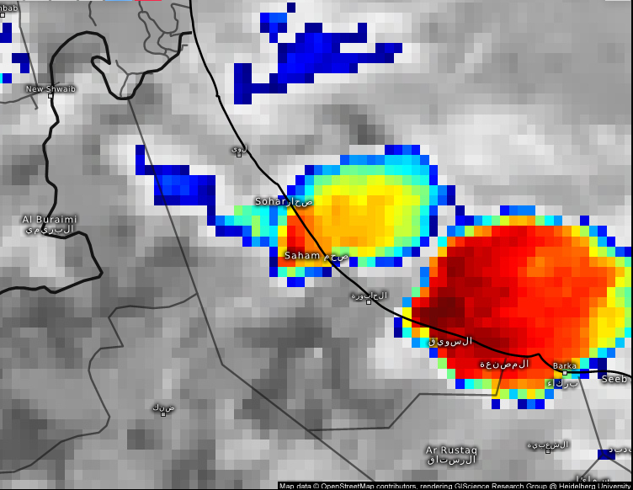
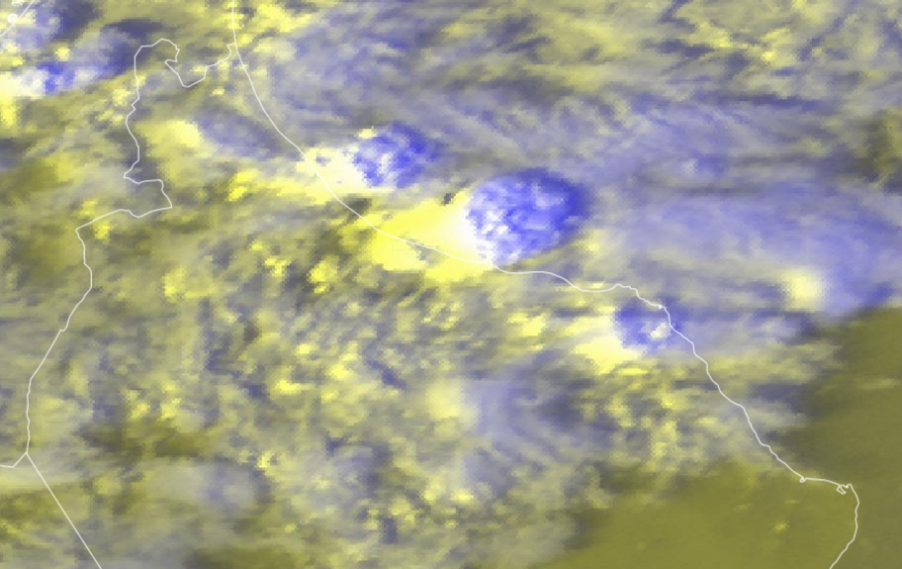
Parallax Shift :

Slide 25
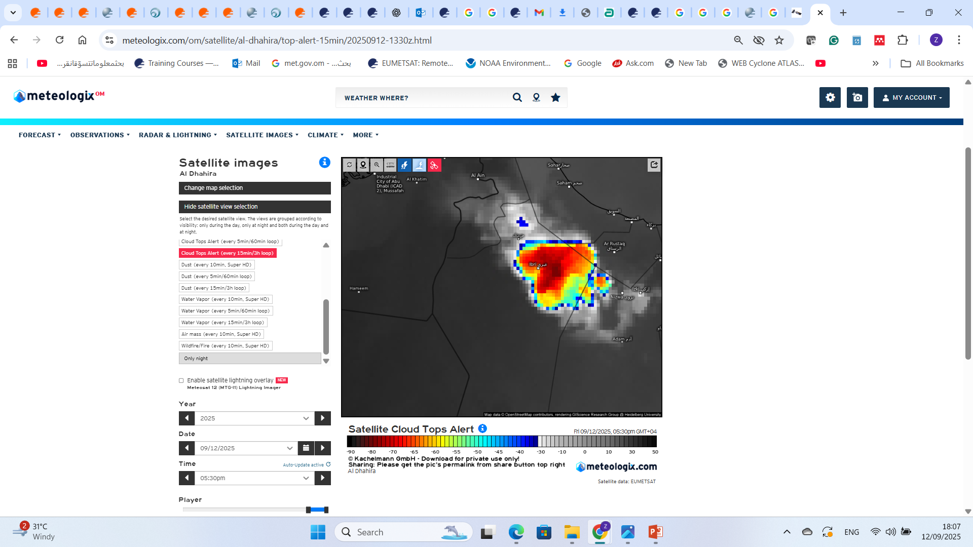


Slide 26


Parallax Shift :

Slide 27





Slide 28





Limb View :
Meteosat 10
Meteosat 9
Meteosat 10
Meteosat 9

Slide 29

Radiometric resolution :
The ability of a sensor to detect small differences in radiance (number of gray levels per pixel).
MSG SEVIRI has 10-bit resolution (~1024 levels),
while MTG FCI has 12-bit resolution (~4096 levels).
0
255

Slide 30

Temporal resolution :

