Slide 1
Thunderstorm over Haima
April 11 2023

Slide 2
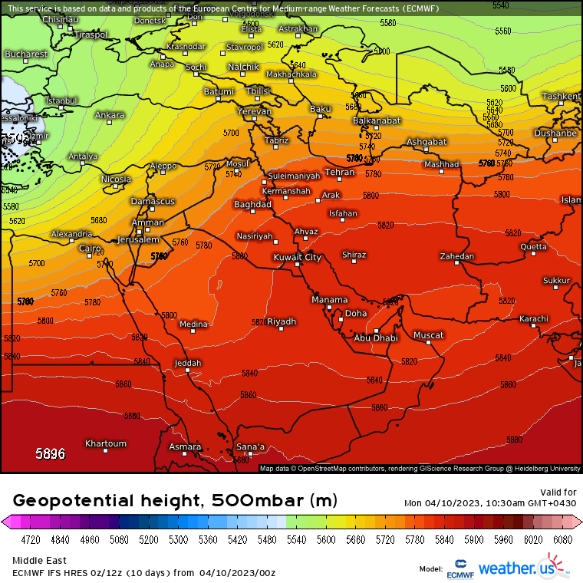
Synoptic Situation
30 stations around the country recorded rains
- AL Ashkharah: 18 mm
- Alhamra: 28.8 mm
- Haima: 18 mm.
- Zamaim: 19.8 mm

Slide 4
Meteosat-9. Enhanced ir 10.8 um produced by McIDAS-V

Slide 5
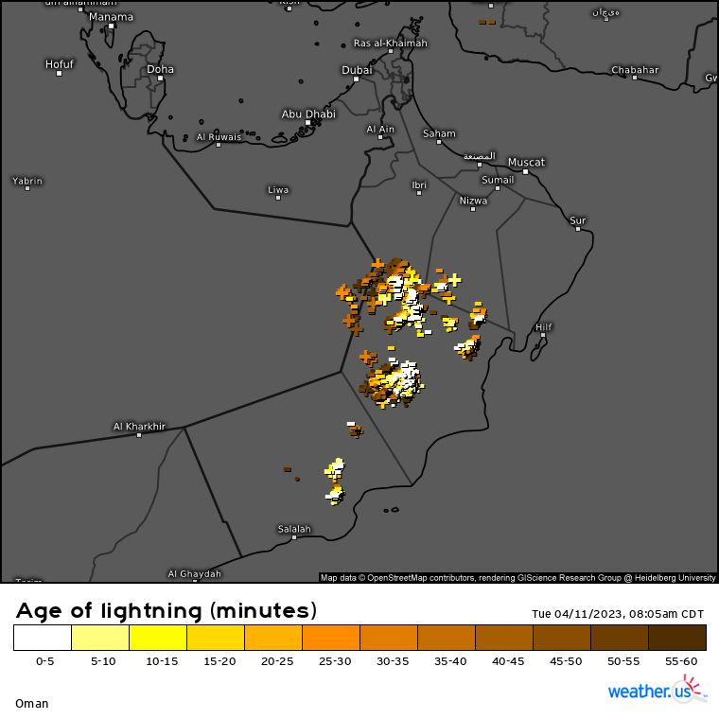

Slide 6
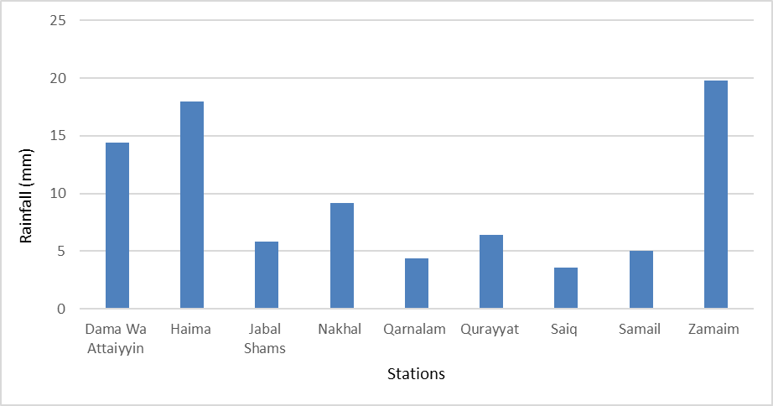
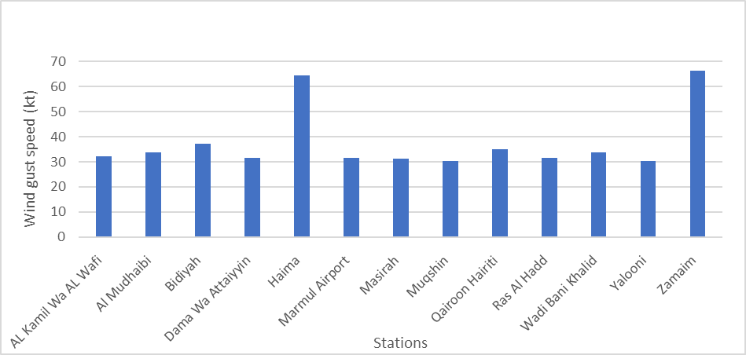
8-11 April 2023 accumulated rains and maximum wind gust

Slide 8
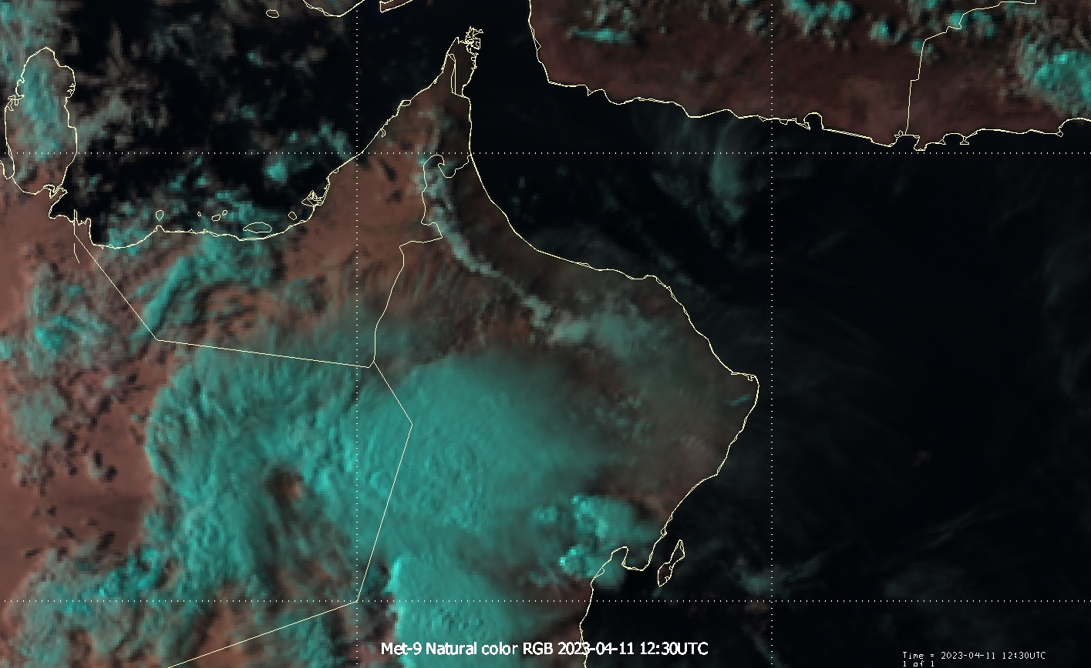

Slide 9
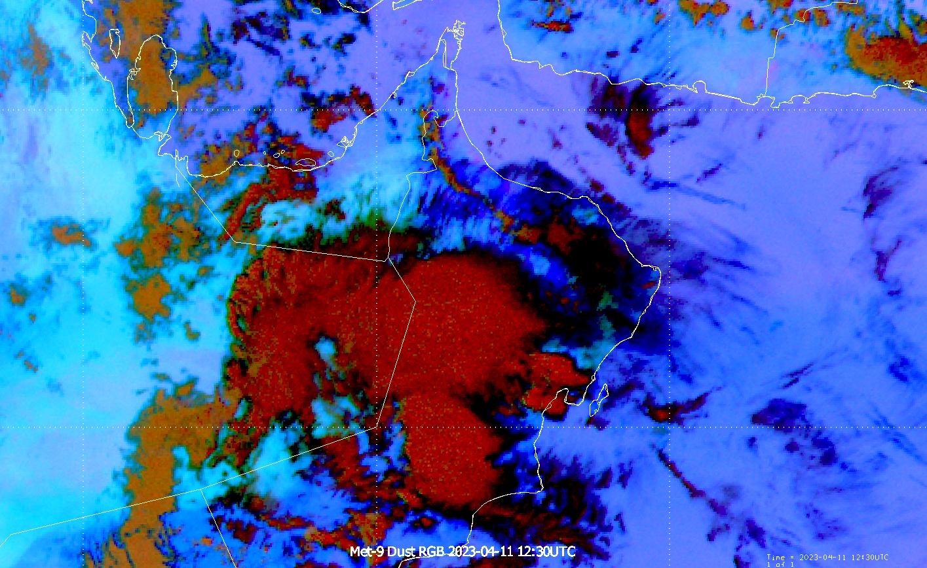

Slide 10
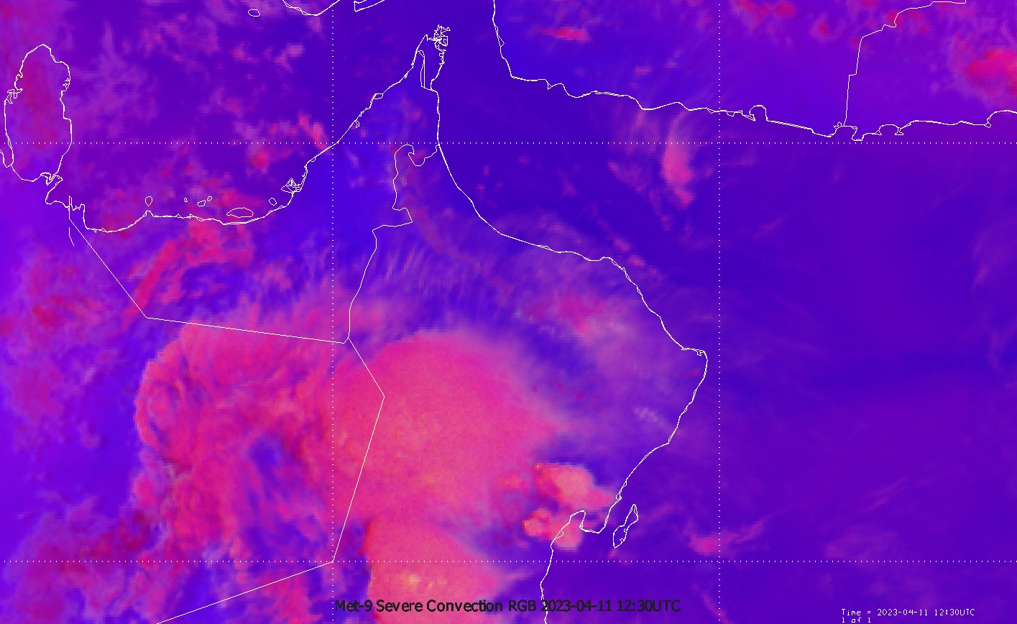

Slide 11
@sas985099
@a_albdwawi_8

Slide 12
Alkabourah_09042023_@storm_alaasf

Slide 14
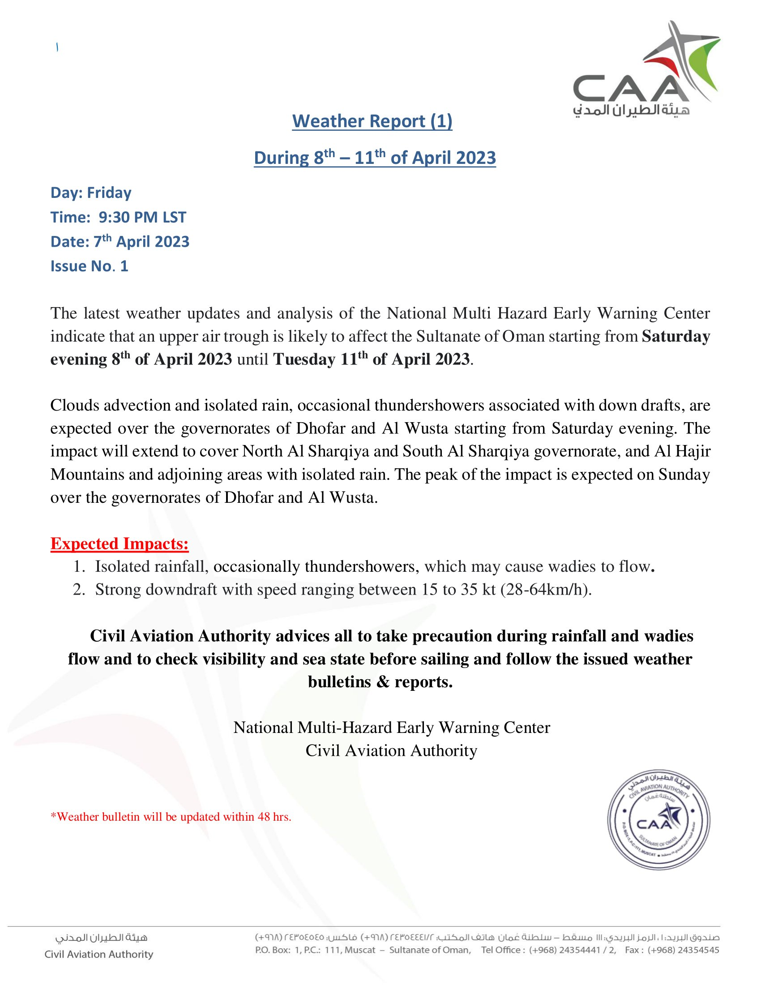

Slide 15
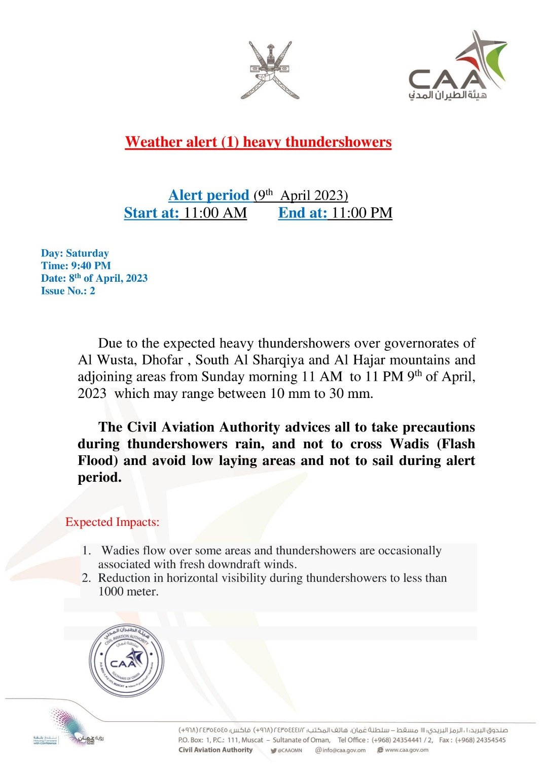

Slide 16
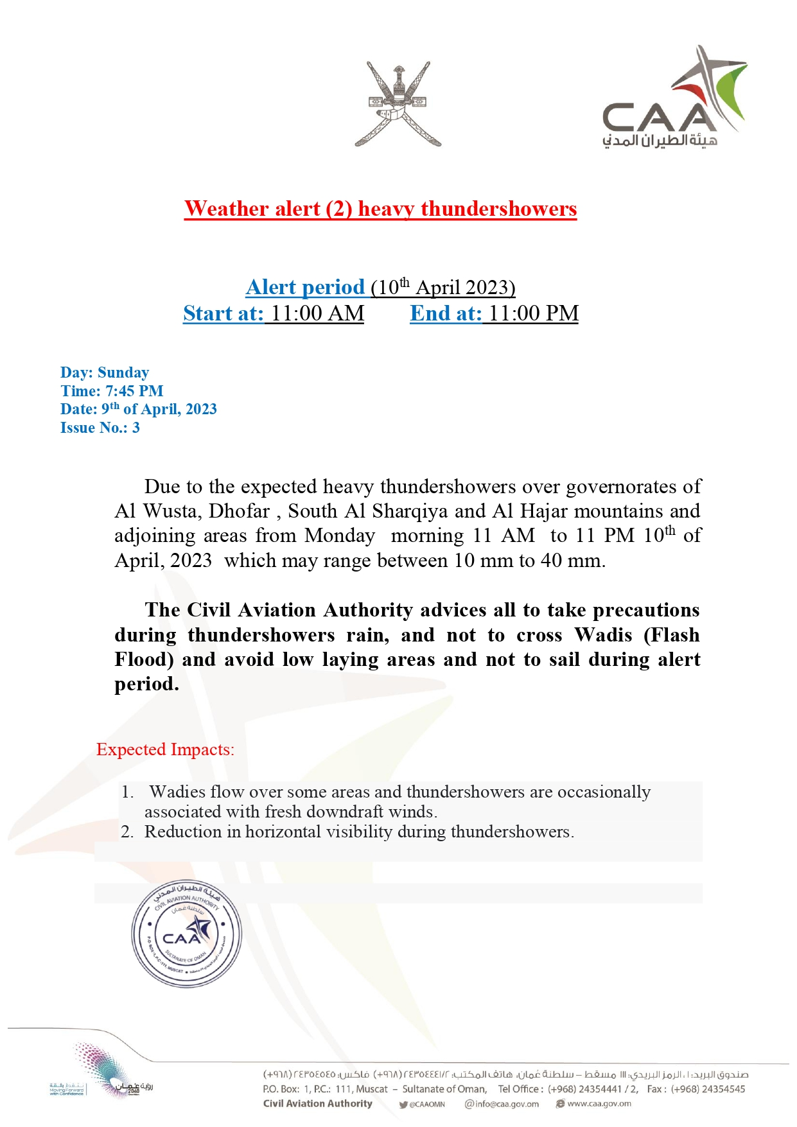

Slide 17
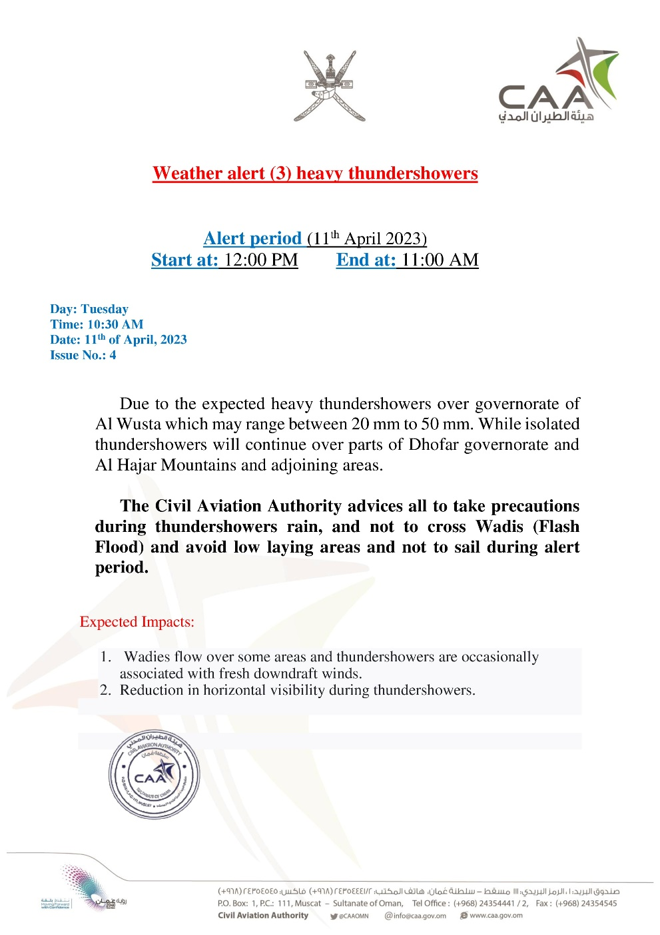

Slide 18
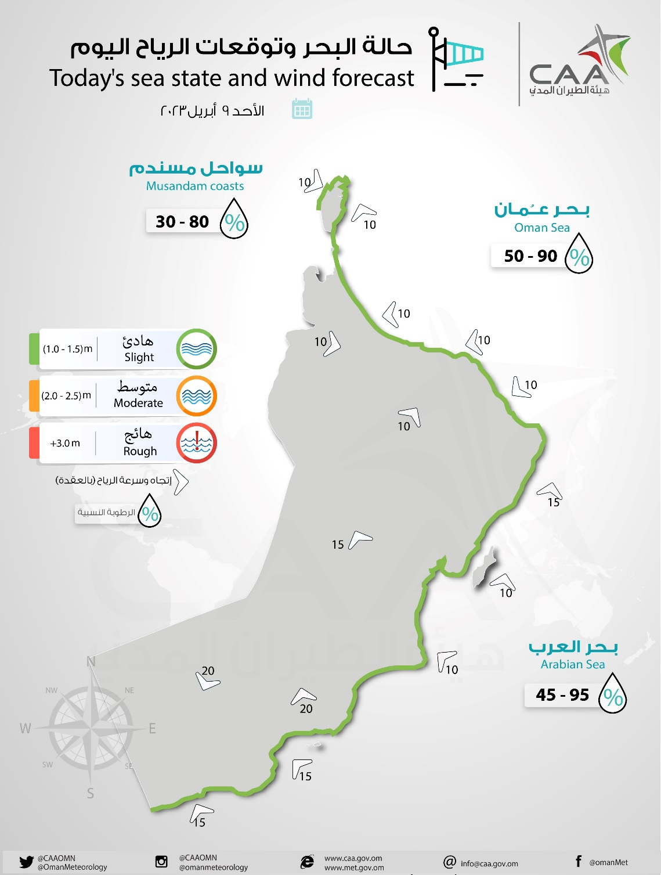
@OmanMeteorology

Slide 19
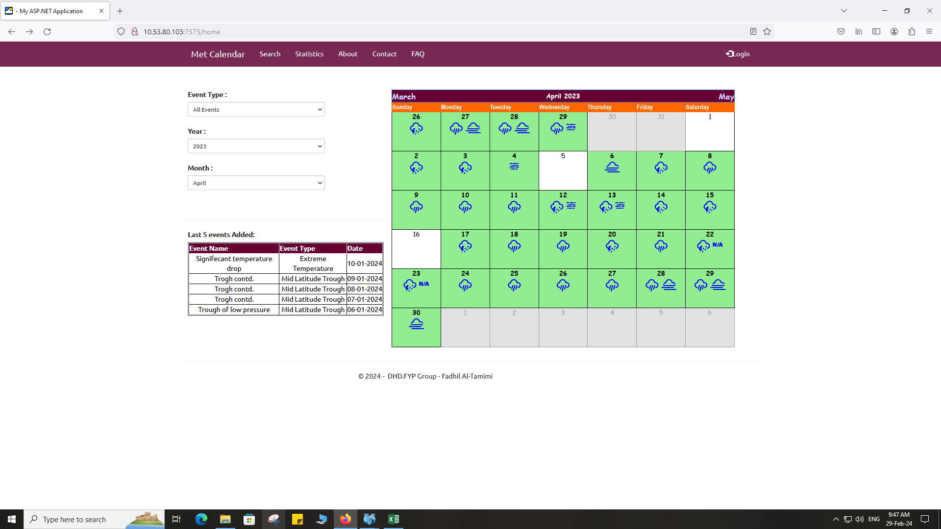
Archiving Significant weathers

Slide 20
Cases archived as:
Blog
Calendar wise
https://cimss.ssec.wisc.edu/satellite-blog/
https://www.eumetsat.int/conferences-events/previous-events

Slide 21
Thanks

