Slide 1
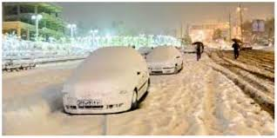
Snow Event 25 Feb 2024 Tehran, Iran
19th Satellite Application Course
25-29 Feb 2024

Slide 2
Event Discription
Time 5:00 UTC 25 Feb
High humidity
Wind:20 km/h NE
Temperature (at surface): 0 C degree (North Tehran:-3 C)
Temperature (at 500m, 950 hPa): 5 degree

Slide 3
Natural Color RGB

Slide 4
Snow RGB

Slide 5
Day Microphysics RGB

