Slide 1
Case of Feb 12, 2024

Slide 2
(Magenta, red, orange, yellow) weaker convection to stronger convection
Stronger convection started from Al Buraimi crossing North Al Batinah (Saham),

Slide 3
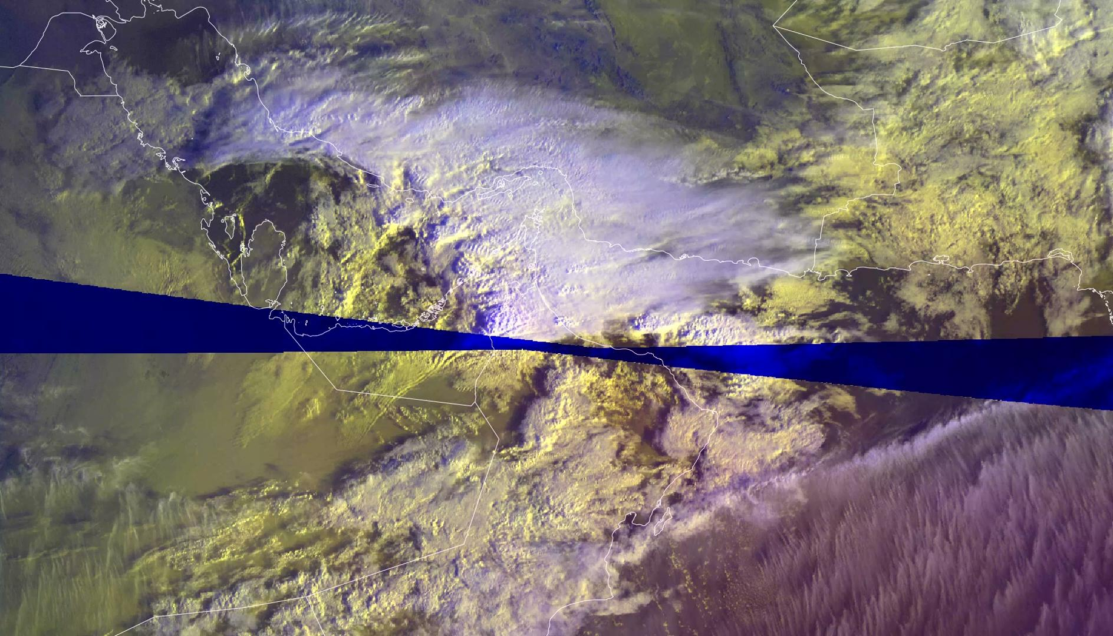
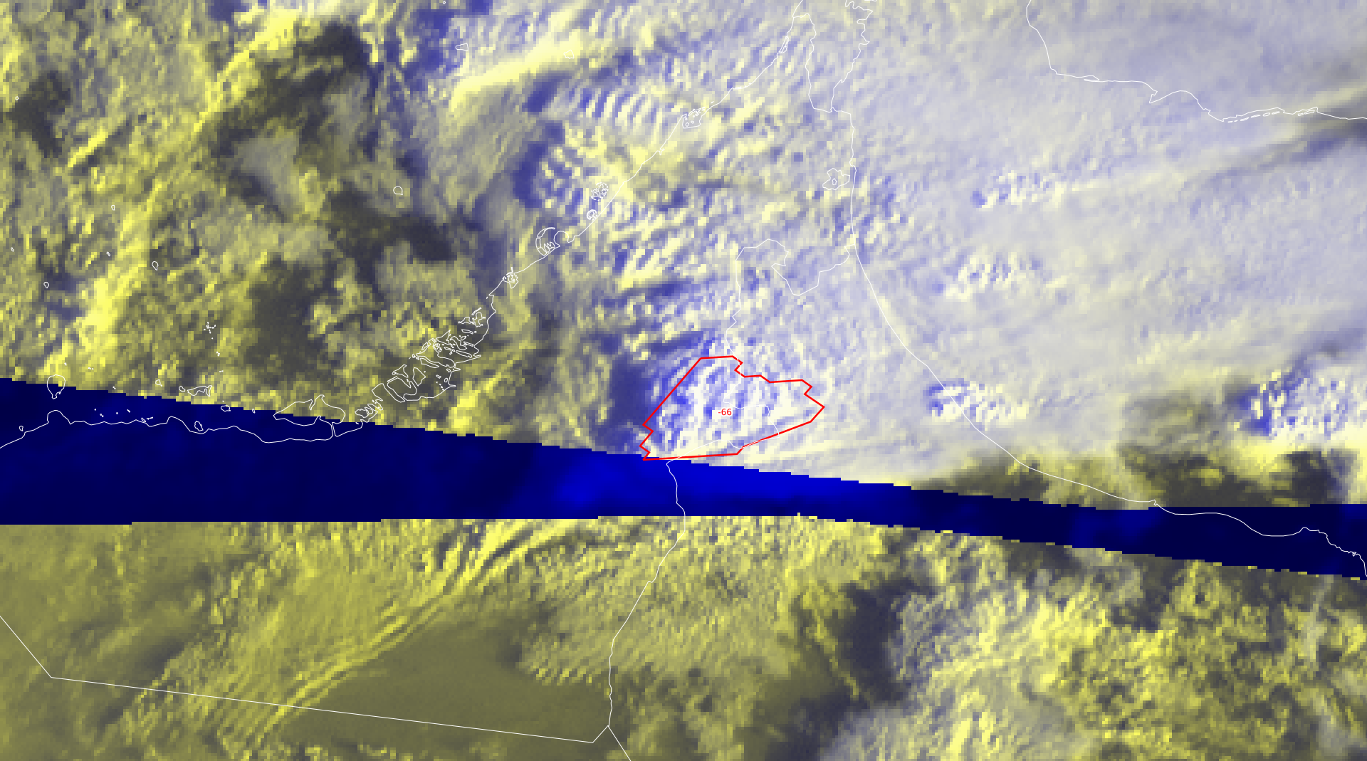
High thick clouds + High thin clouds (Whitesh and light blue)
Image emphasis extended vertical structure (showed by the shadow)
The highlighted area is the coldest temperature (showinf freezing along the cloud - Hail expectation)

Slide 4
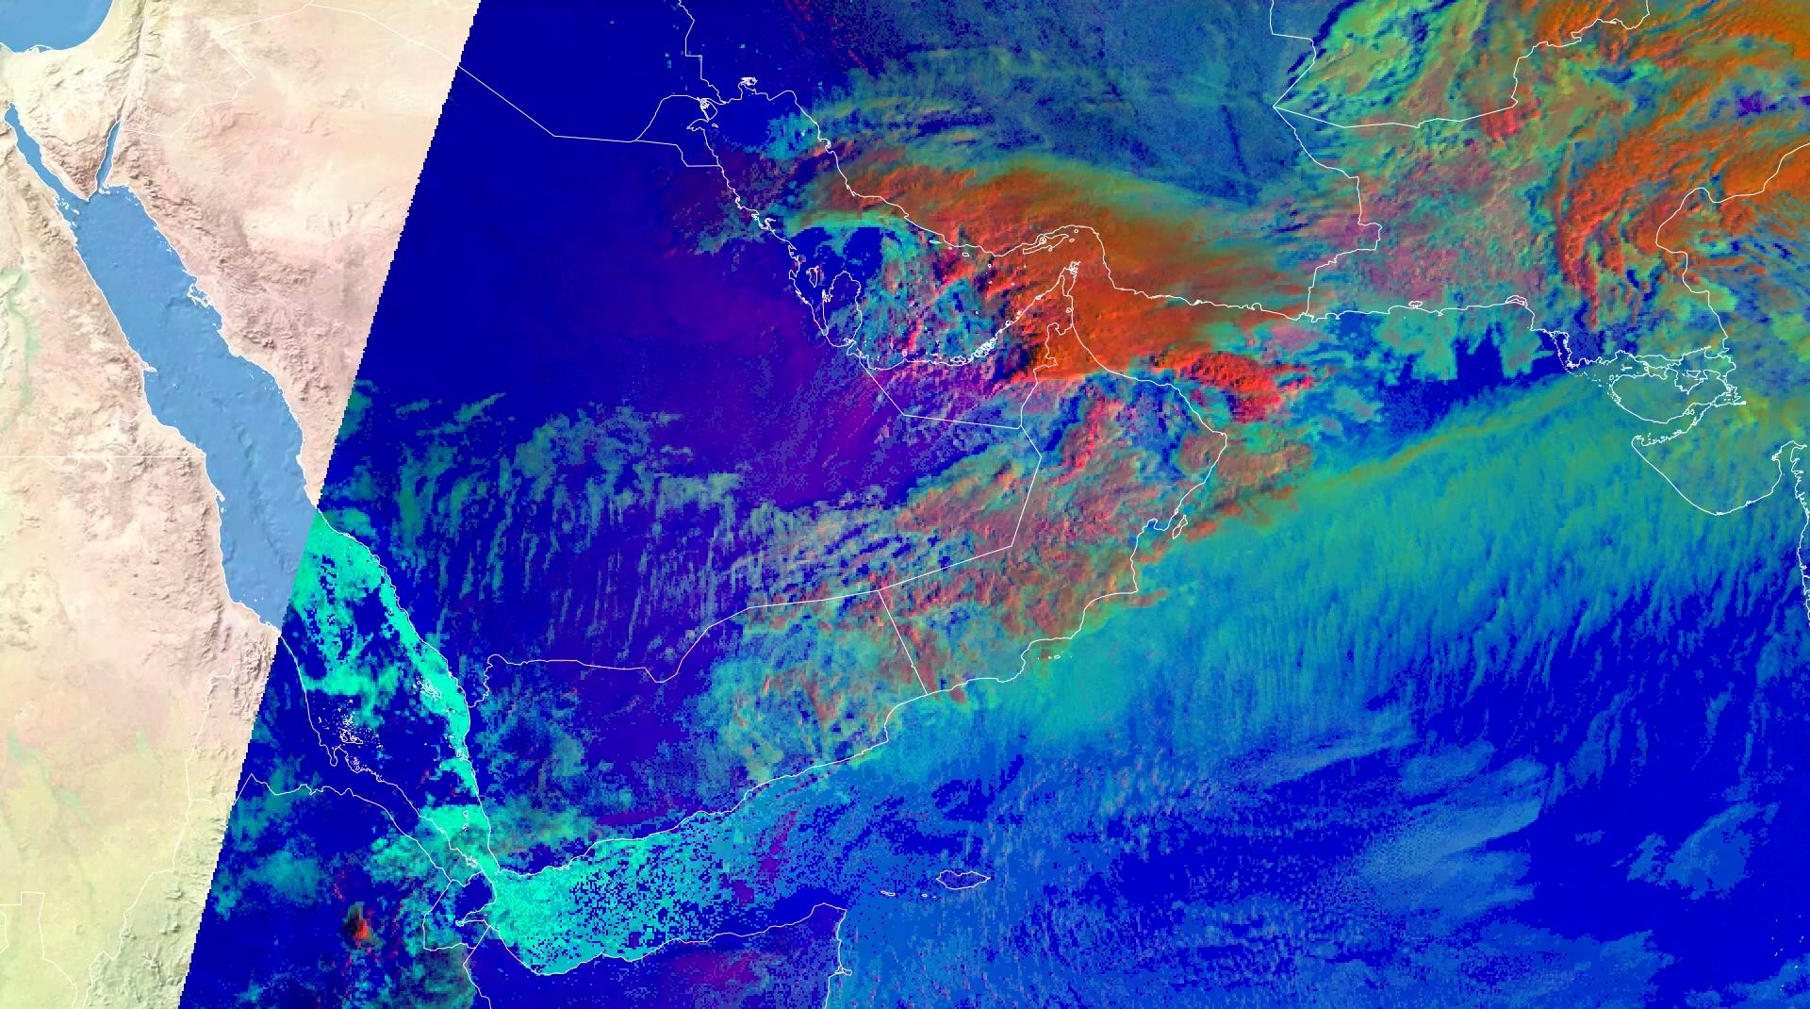
Hot +Moist Band (Blue)
Thick, High ice Clouds

Slide 5
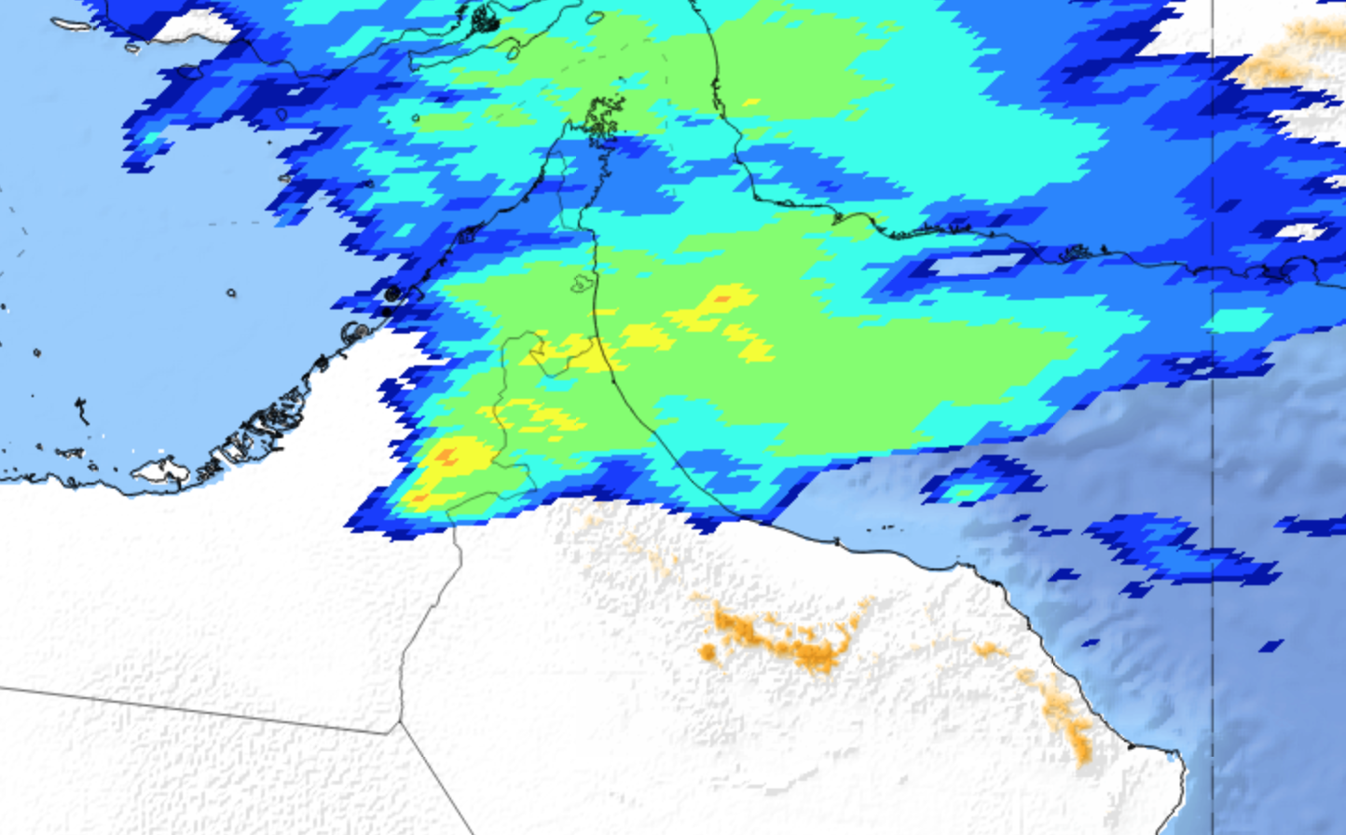
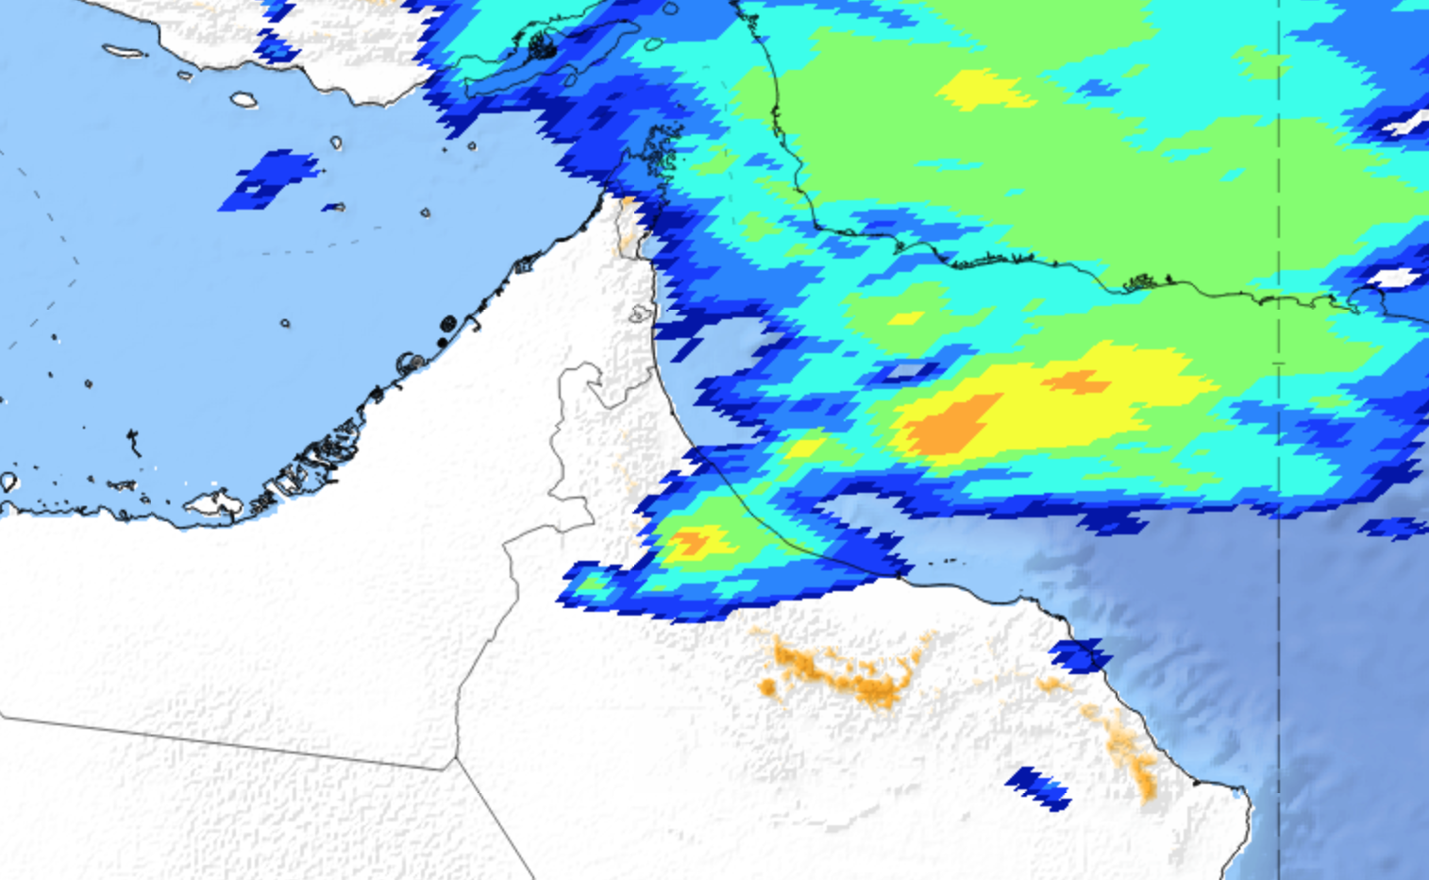
Enhanced color IR : Min temperature of 210-200 K (-63 C)
Caused Hail Saham

Slide 6
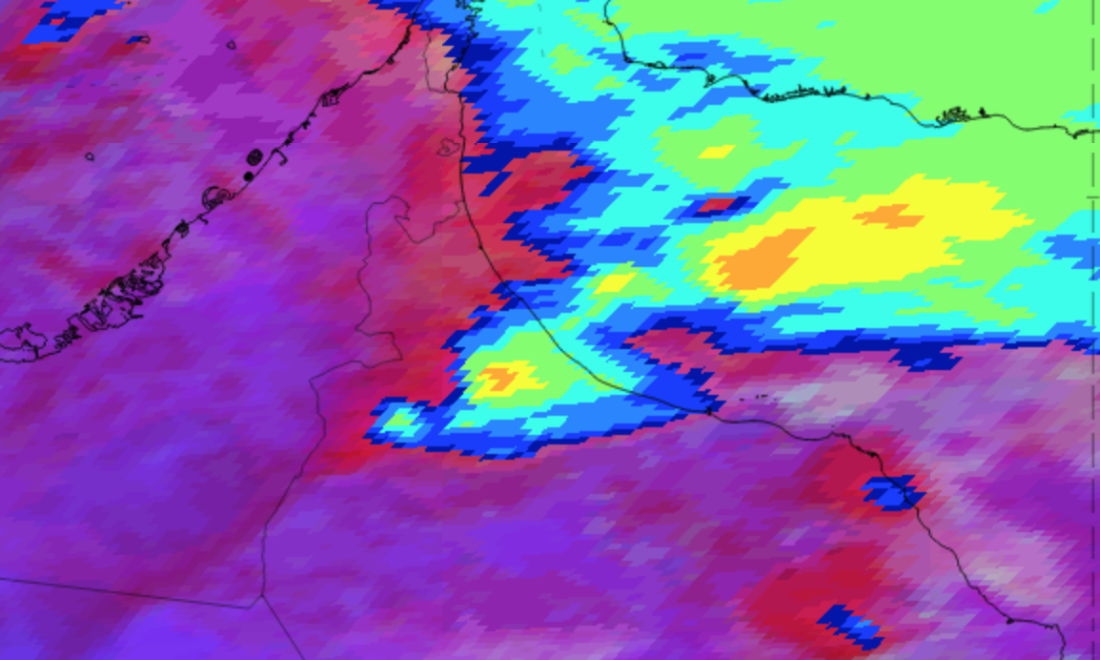
CLEAR SUPERCELL STRUCTURE!! :)

Slide 7
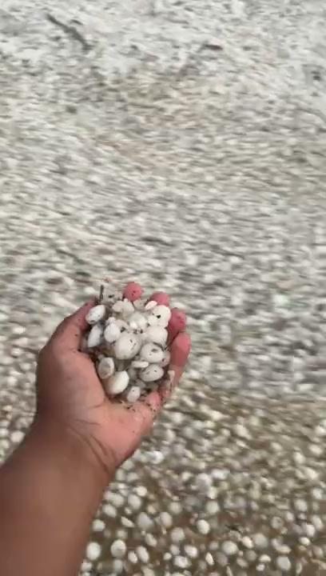
AlBuraimi (155mm)

Slide 8
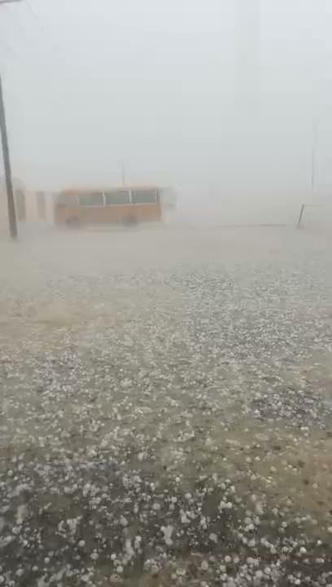
Saham

