Slide 1
FCI view on Fires
Exploring the fire monitoring detection

Slide 2
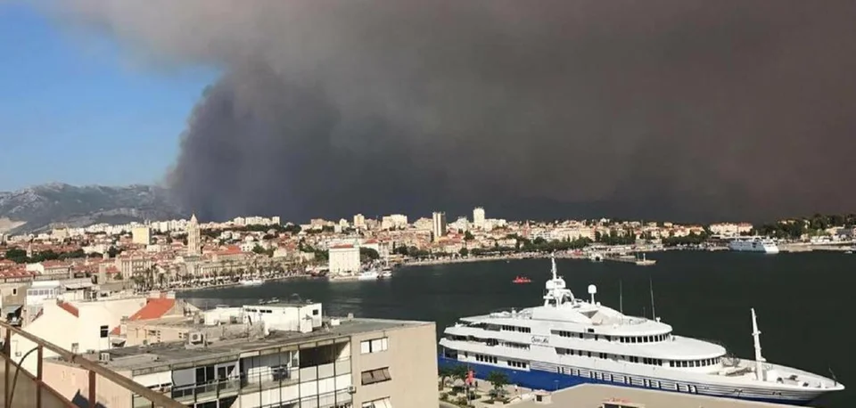
Fire detection
Fire parameters?
What to use to detect fires?

Slide 3
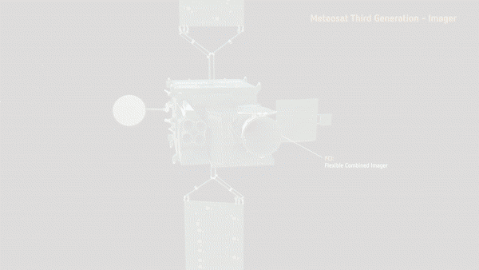

Flexible Combined Imager - Overview
The FCI imager is one of the two main payloads onboard the Meteosat Third Generation Imaging (MTG-I) satellites.
First FCI on MTG-I1: full disk scanning service (FDSS) with 10min temporal resolution.
Second FCI on MTG-I2: rapid scanning service (RSS) over Europe with 2.5min temporal resolution.
The entire fire cycle can be observed by FCI
with unprecedented
temporal detail!

Slide 4
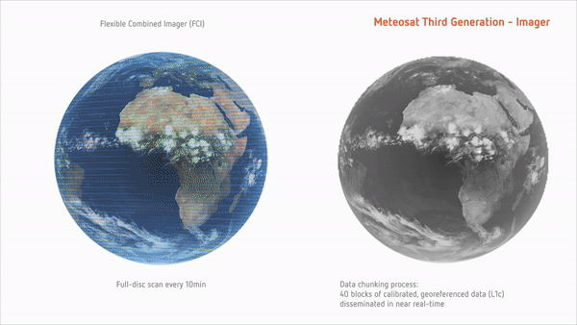

FCI – Overview – A big step forward!
8 channels in the solar VIS-NIR domain (0.4µm - 2.2µm),
1km spatial resolution at nadir (FDHSI).
8 channels in the thermal IR domain (3.8µm - 13.3µm),
2km spatial resolution at nadir (FDHSI).
4 channels are also available at higher spatial resolution (HRFI):
  VIS0.6 and NIR2.2: 0.5km (nadir)
  IR3.8 and IR10.5: 1km (nadir)
2 km
1 km
0.5 km
No. | Central λ / μm | λ width / μm | Resolution / km
1 | 0.44 | 0.06 | 1.0
2 | 0.51 | 0.04 | 1.0
3 | 0.64 | 0.05 | 1.0/0.5
4 | 0.86 | 0.05 | 1.0
5 | 0.91 | 0.02 | 1.0
6 | 1.38 | 0.03 | 1.0
7 | 1.61 | 0.05 | 1.0
8 | 2.25 | 0.05 | 1.0/0.5
No. | Central λ / μm | λ width / μm | Resolution / km
9 | 3.80 | 0.40 | 2.0/1.0
10 | 6.30 | 1.00 | 2.0
11 | 7.35 | 0.50 | 2.0
12 | 8.70 | 0.40 | 2.0
13 | 9.66 | 0.30 | 2.0
14 | 10.50 | 0.70 | 2.0/1.0
15 | 12.30 | 0.50 | 2.0
16 | 13.30 | 0.60 | 2.0
Fires and hotspots can be observed by FCI with unprecedented spatial detail!
All channels have the same reference grid

Slide 5
In another words
More sensitivity with IR3.8 channel for sub-pixel signals/fires
Larger dynamic range to maximise detection performance (with double detector array)
More channels for fire intensity (IR3.8, NIR2.25, NIR1.6)
Main instrument improvements on FCI compared to SEVIRI:
  Better spatial resolution
    -> from 3km to 1km (9 times more pixels!) for 3.8µm channel
    -> from 3km to 500 m (36 times more pixels!!) in the near-IR region
  Higher saturation brightness temperature -> from ~335K to ~490K (TBC)
  Less CO2 absorption and limb cooling for 3.8µm channel (central wavelength shift from 3.9µm to 3.8µm)
  Higher radiometric resolution for 3.8µm channel -> from 10 bits to 13 bits (10 bits to 12 bits improvement for rest of the channels)
  Less “blinding” effect -> from spinning to 3-axis stabilised platform

Slide 6

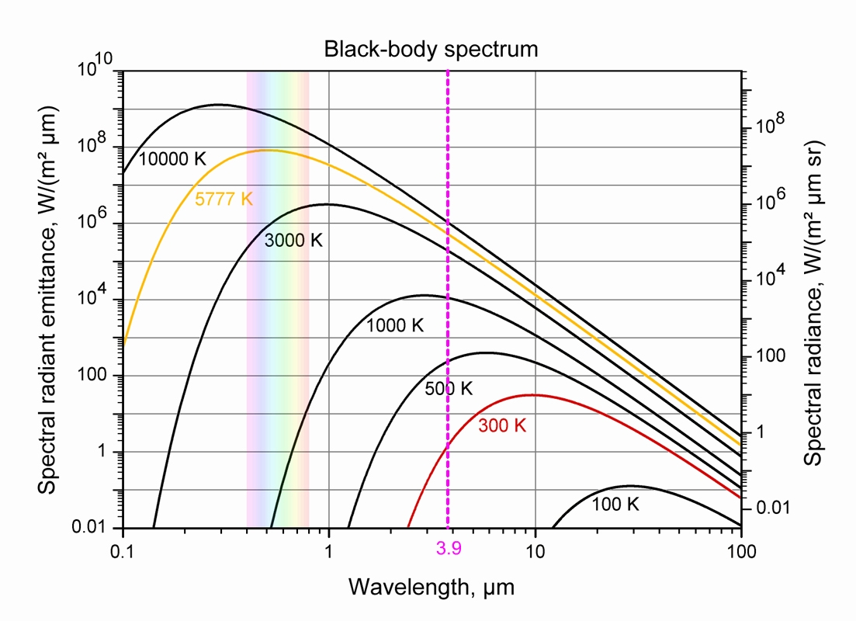

Fire (blackbody) Radiation
Planck/Wien’s law:
the hotter the object ( ), the shorter the wavelength at which it emits the most
Typical temperature: 600K-1300K
→ ~ 3.9µm is the most suitable wavelength range!
  Highest emission
  Highest sensitivity to sub-pixel fires
But hot(ter) fires will appear also in the NIR range
↑ Temperature ↓ Peak Wavelength

Slide 7
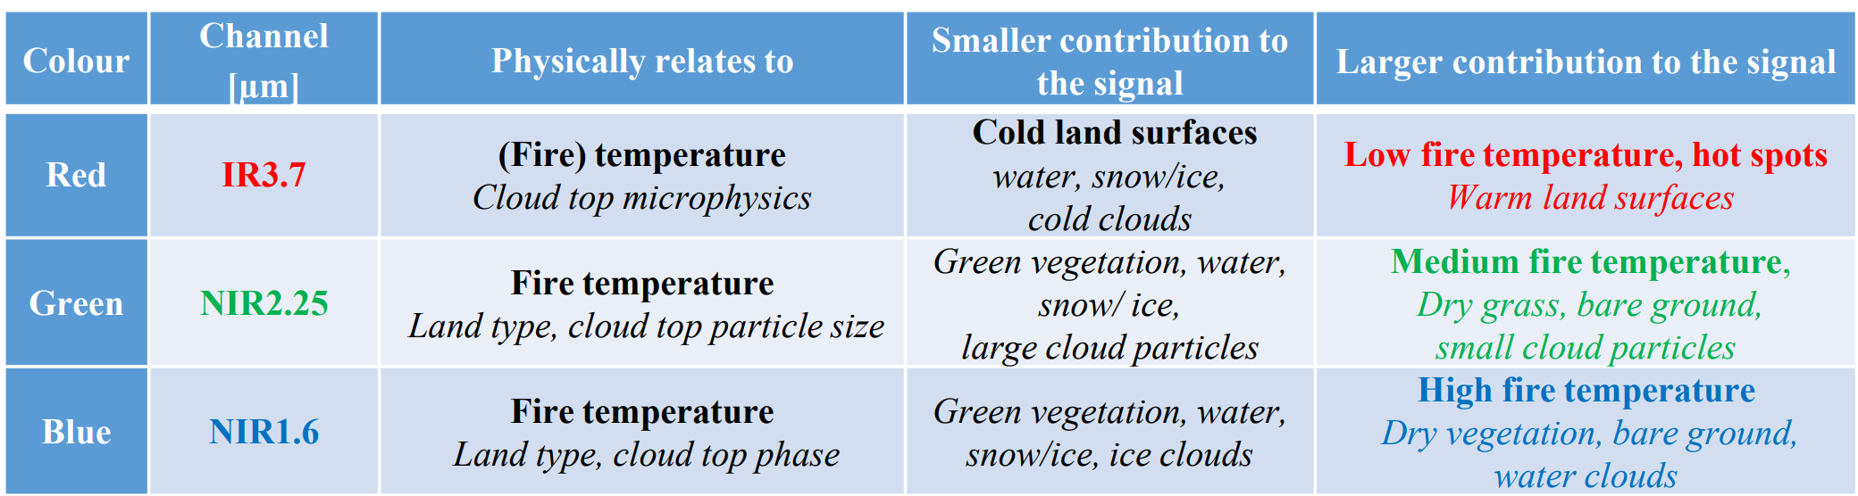
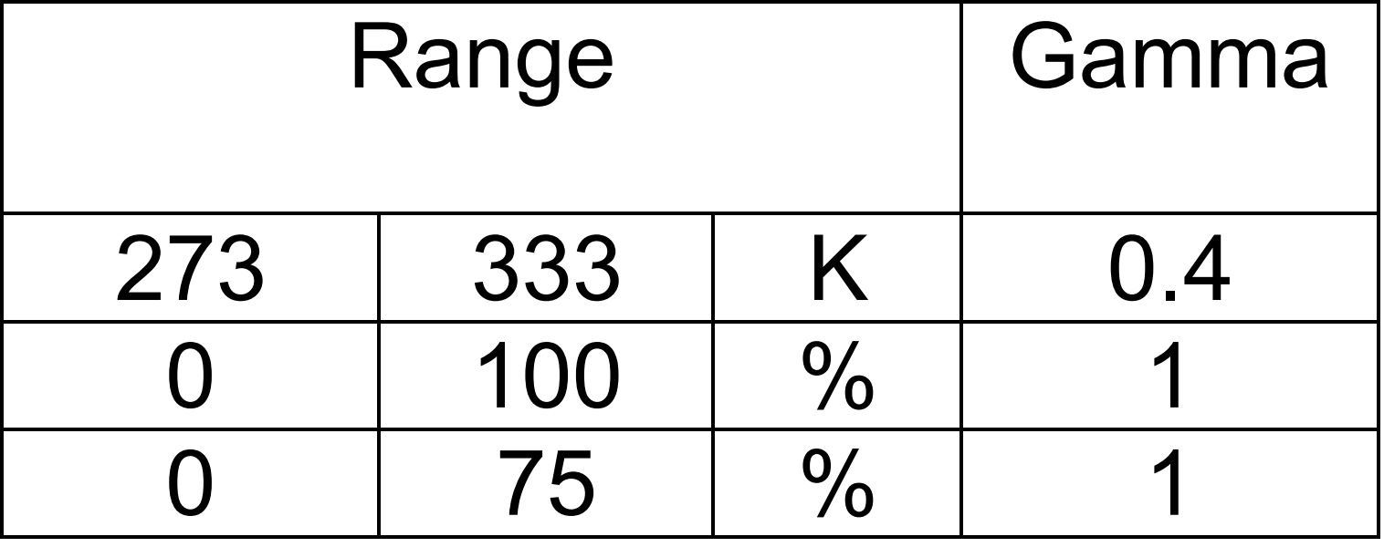
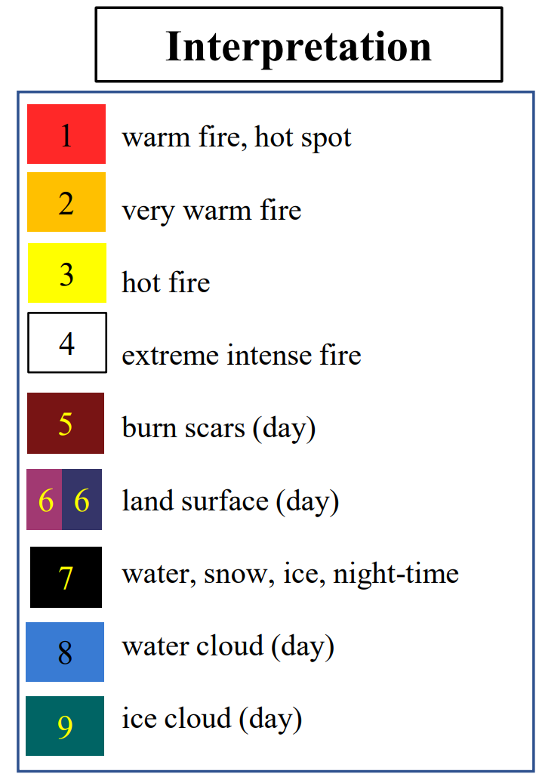
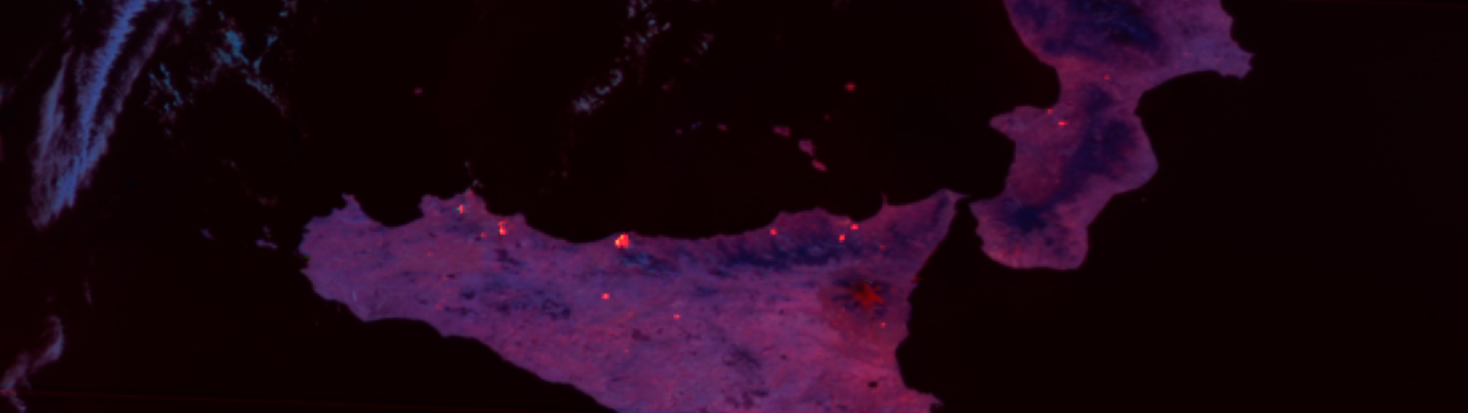
Fire RGB Visualisation Techniques: Fire Temperature RGB
Quick Guide: https://resources.eumetrain.org/rgb_quick_guides/quick_guides/FireTemperatureRGB.pdf
… or search for “fire temperature rgb eumetrain“
“Classic” Fire Temperature RGB:
  Combination of 3.8, 2.2 and 1.6 to show fire temperature
  in classic RGB scheme
  New for EUM-GEO, heritage from e.g. VIIRS and ABI

Slide 8
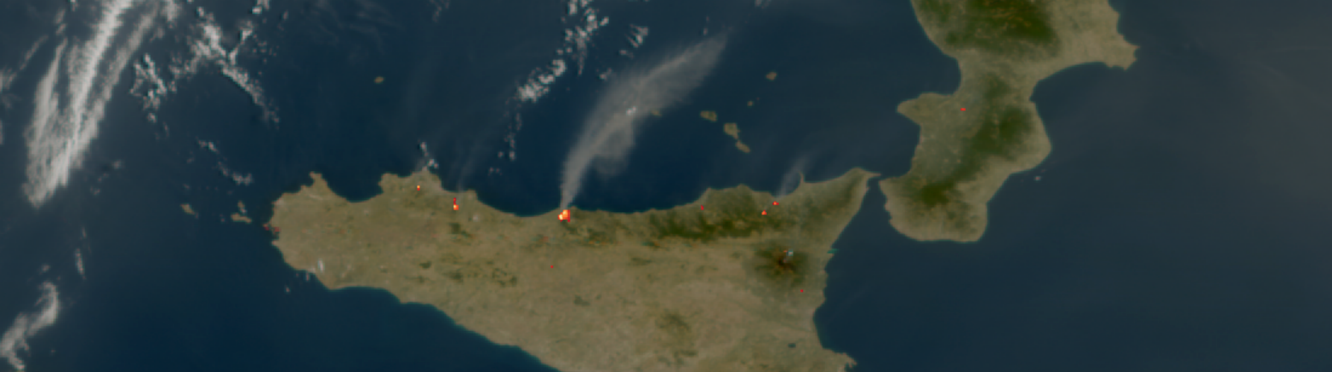
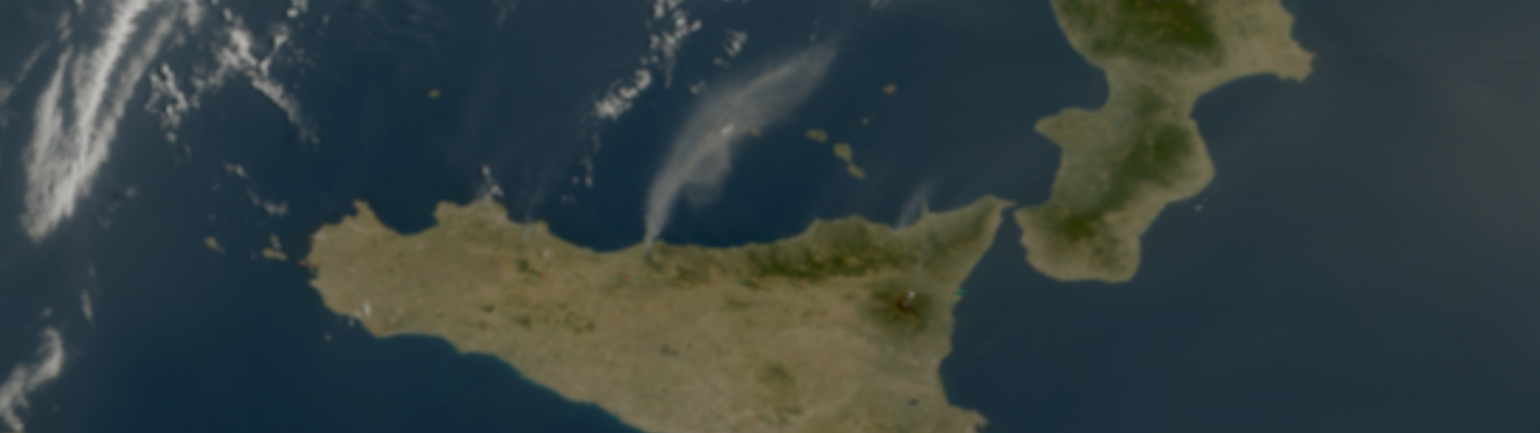
Fire RGB Visualisation Techniques: True Color + Fire Temp
True-/Geo-Color in background + Fire Temp representation blended on top
Fire Temperature Representation:
  Addition of 3.8µm BT + 2.2µm Refl
  Colorisation using Red-to-Yellow colorbar: 330 430
Blending of True Color with Fire Temp needs a fire mask!
  Simple fire detection using thresholds on 3.8µm, 10.5µm and 0.6µm
Preliminary, further tuning and enhancement needed
  developments will be pushed to Satpy asap!
Advantages compared to Fire Temperature RGB:
Easier interpretation of background for better situational awareness
Smoke is much more visible (wind direction!)
Clouds are more visible and easier to interpret
…
Disadvantages:
Requires solid fire mask for blending (integration of L2?)
Burn scar age not interpretable
…

Slide 9
Application benefits FCI vs SEVIRI – example 1 (Portugal fire)
Scenario: You are in-house developer/technician and you are assigned with two tasks. T1: Choose the most useful FCI channel for fire detection. T2: Choose one RGB you want to implement for your colleagues to use it in operational environment. You are provided with the imagery samples below.
Focus on the advanced spatial and spectral resolution of FCI:
  Spatial resolution benefits:
    the shape of the fires, fire fronts and burn scars
    detection of smallest fires
  Spectral resolution benefits:
    information about the fire intensity (indication of most active fires, ie fire fronts) with additional NIR 2.25 channel –> Fire Temperature RGB
    better smoke detection through additional VIS0.4 and VIS0.5 channels -> True Colour RGB

Slide 10

FCI IR3.8 1km
22.09.2023 10:40 UTC
273-333K, 0.4 Gamma
Demonstrating FCI’s capabilities
Observing Fires in Sicily
Preliminary results

Slide 11
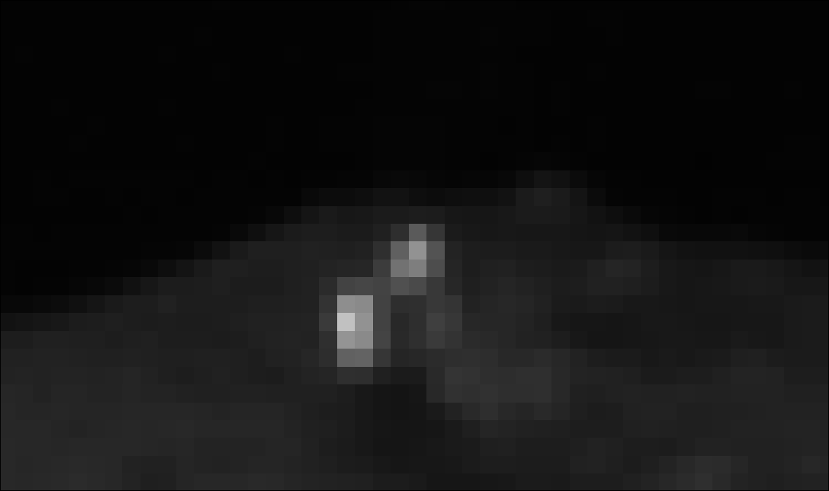
FCI NIR2.2 500m
22.09.2023 10:40 UTC
0-100% Refl
Demonstrating FCI’s capabilities
Observing Fires in Sicily
Preliminary results

Slide 12

FCI NIR1.6 1km
22.09.2023 10:40 UTC
0-75% Refl
Demonstrating FCI’s capabilities
Observing Fires in Sicily
Preliminary results

Slide 13
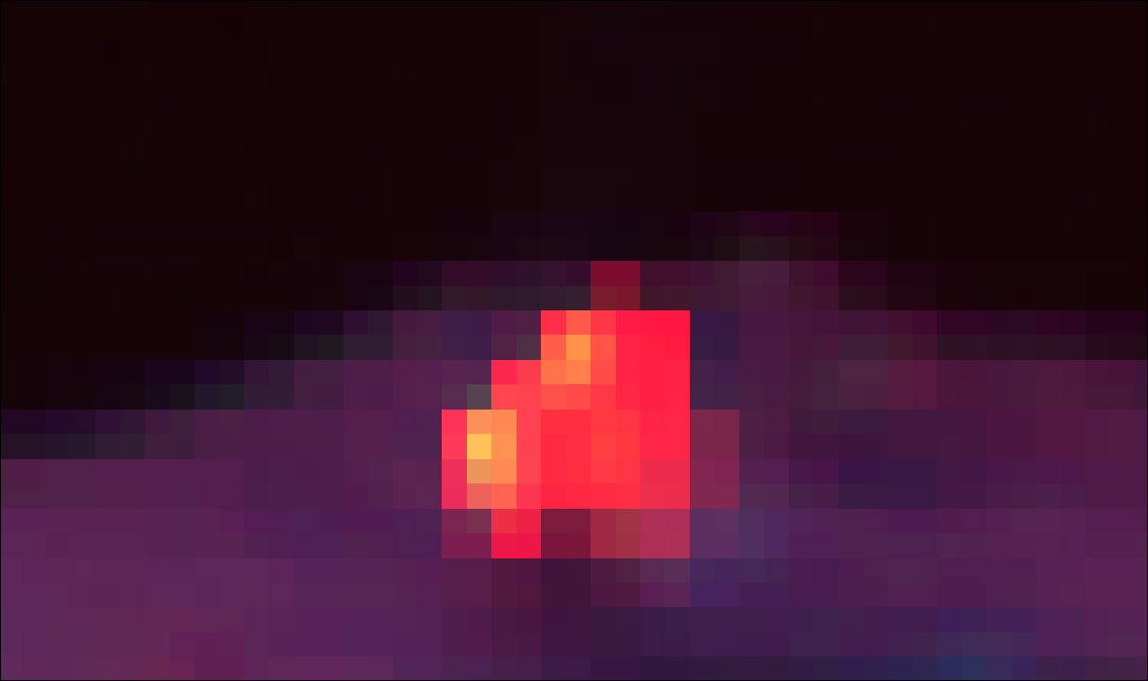
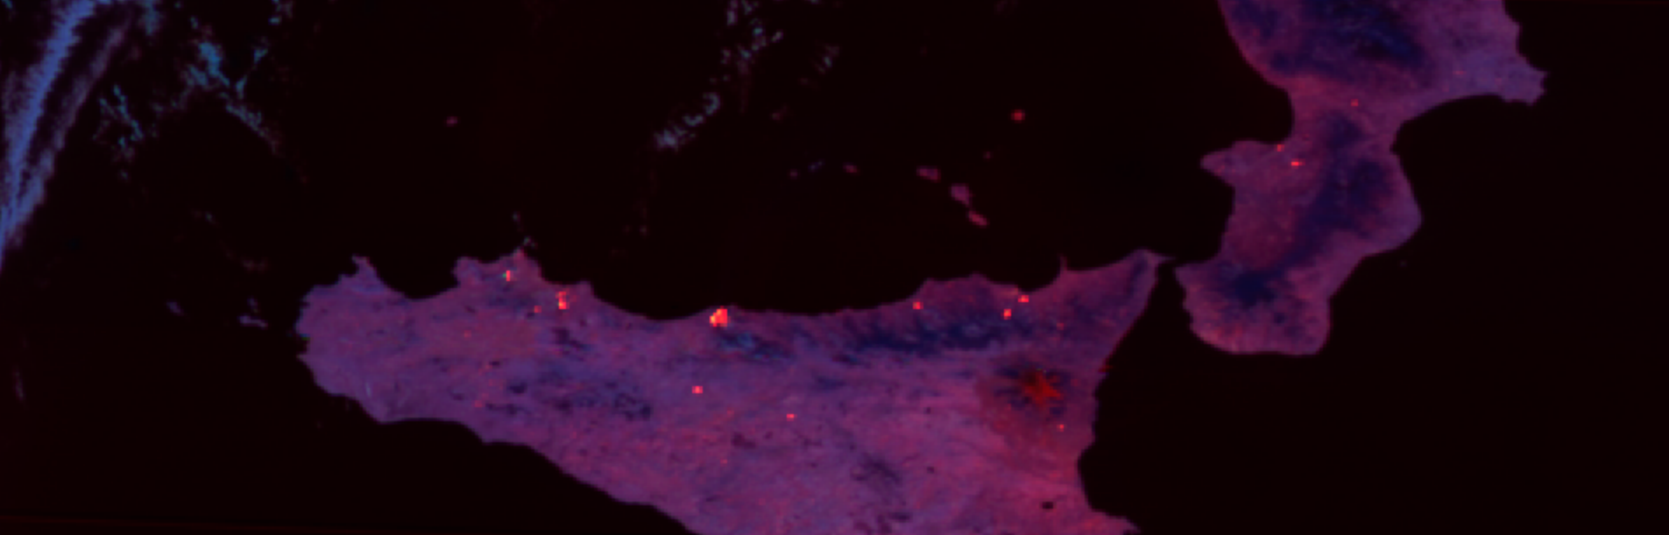
FCI Fire Temperature RGB 500m
22.09.2023 10:40 UTC
Demonstrating FCI’s capabilities
Observing Fires in Sicily
Preliminary results

Slide 14
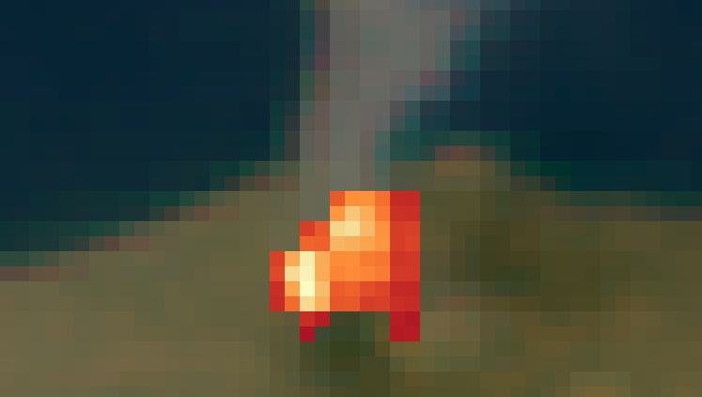
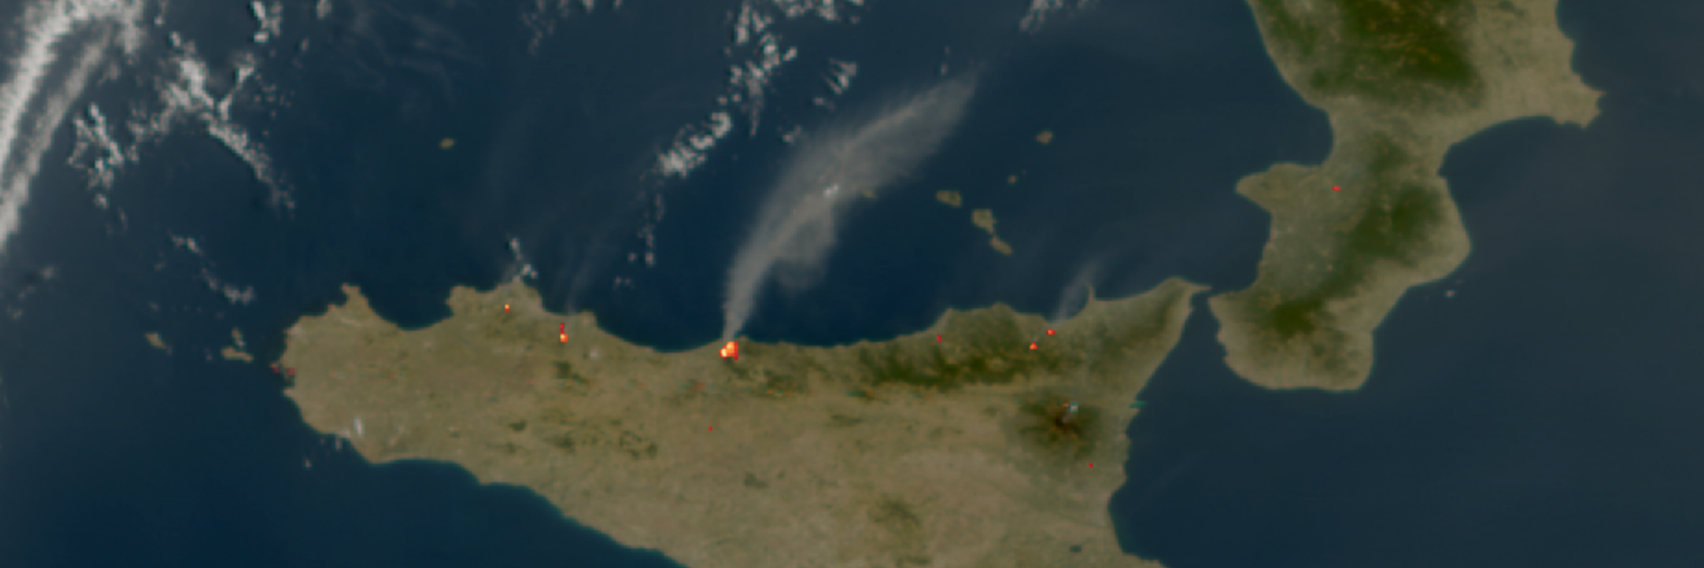
FCI True Color 0.5km
Fire Temperature 0.5km
22.09.2023 10:40 UTC
Demonstrating FCI’s capabilities
Observing Fires in Sicily
Preliminary results

Slide 15
Application benefits FCI vs SEVIRI – example 3 (Portugal aerial firefight)
Scenario: You are in charge of giving the flight routes and dump locations for aerial firefighting in your country? Based on SEVIRI data, think of the flight routs form the sea to the fires (avoiding smoke if possible), and locate the water dump locations (based on the location of most intense fires)?
Focus on the advanced spatial, spectral and radiometric resolution of FCI:
  Spatial resolution benefits:
    the shape of the fires, fire fronts and burn scars
    detection of smallest fires
  Spectral resolution benefits:
    information about the fire intensity (indication of most active fires, ie fire fronts) with additional NIR 2.25 channel –> Fire Temperature RGB
    better smoke detection through additional VIS0.4 and VIS0.5 channels -> True Colour RGB
  Radiometric resolution benefits:
    better fire intensity information –> Fire Temperature RGB
  Temporal resolution benefits:
    fire intensity dynamics (fires intensifying / diminishing)
    fire front dynamics (direction of fire spread / low level winds)
    fire initiation (quicker initial detection)
    smoke dynamics (smoke spread and thickness monitoring)
    wind dynamics (tracking the smoke and surrounding clouds advection (rate))

Slide 16
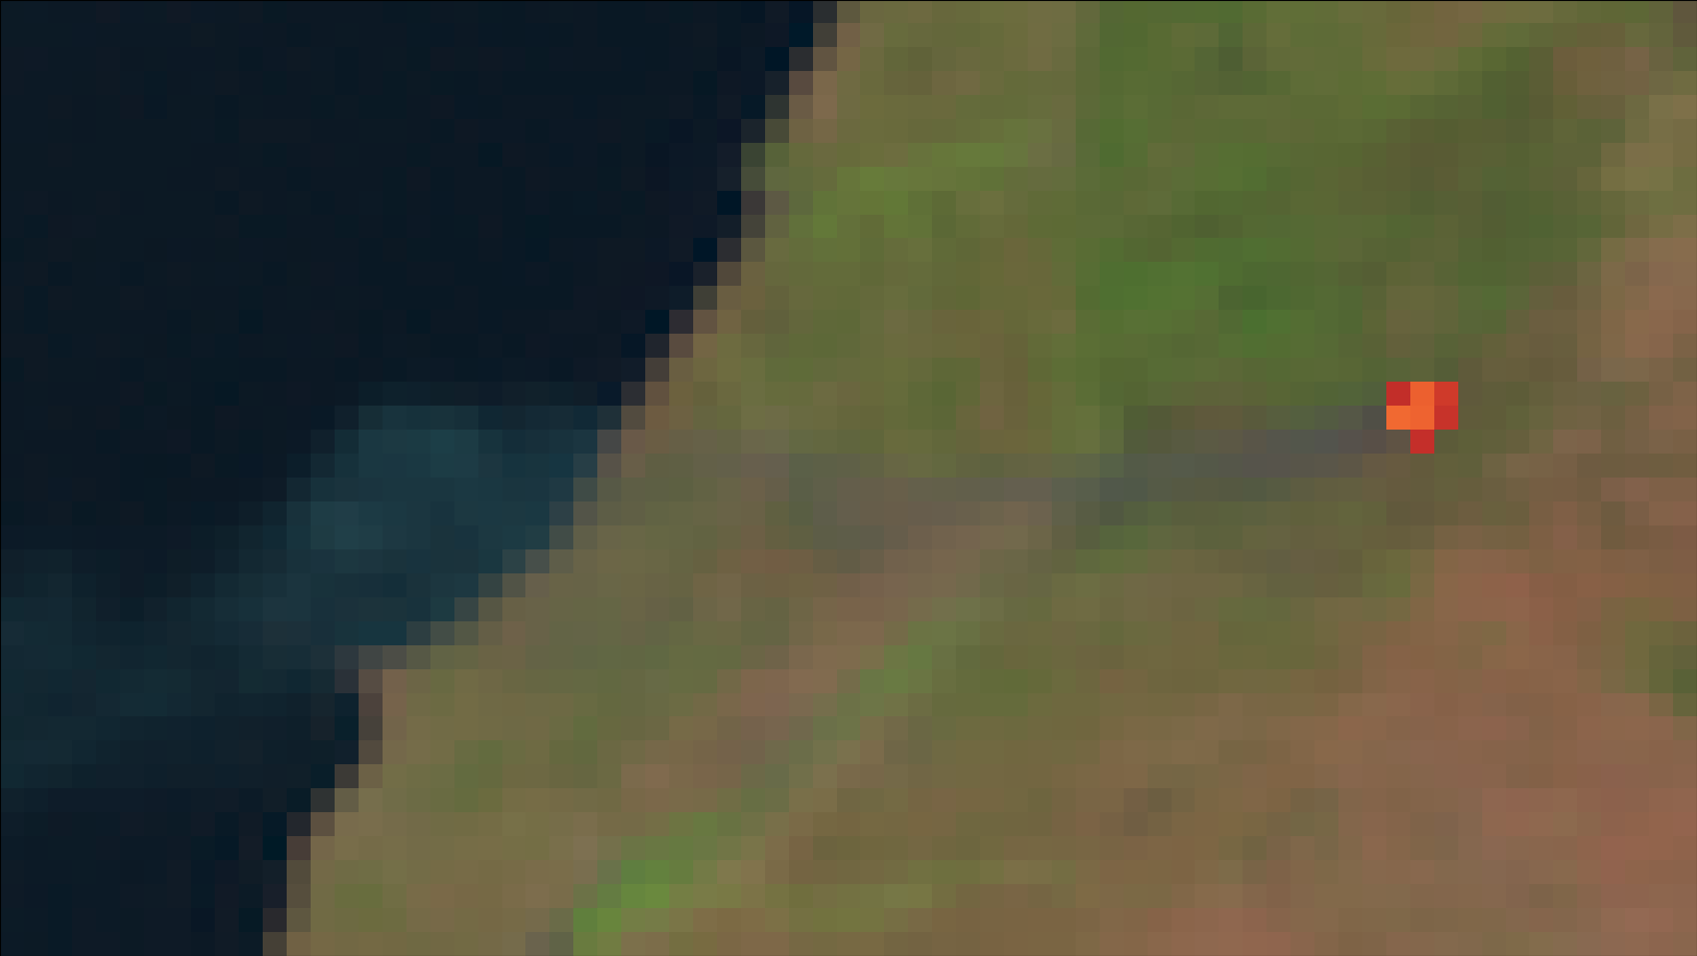
SEVIRI Natural Color 3km
Fire Temperature 3km
(3.8µm)
05.08.2023 10:00 UTC
MSG-SEVIRI
For comparison
Intense fires at the core?
Smoke?

Slide 17
Application benefits FCI vs SEVIRI – example 4 (Botswana fire front)
Scenario: You need to send ground troops to clear the vegetation in front of the fires to stop its spread. Based on one SEVIRI image available, where would you send firefighters, to which side of the fire?
Focus on the advanced spatial, spectral and radiometric resolution of FCI:
  Spatial resolution benefits:
    the shape of the fires, fire fronts and burn scars
    detection of smallest fires
  Spectral resolution benefits:
    information about the fire intensity (indication of most active fires, ie fire fronts) with additional NIR 2.25 channel –> Fire Temperature RGB
    better smoke detection through additional VIS0.4 and VIS0.5 channels -> True Colour RGB
  Radiometric resolution benefits:
    better fire intensity information –> Fire Temperature RGB
  Temporal resolution benefits:
    fire intensity dynamics (fires intensifying / diminishing)
    fire front dynamics (direction of fire spread / low level winds)
    fire initiation (quicker initial detection)
    smoke dynamics (smoke spread and thickness monitoring)
    wind dynamics (tracking the smoke and surrounding clouds advection (rate))

Slide 18

SEVIRI Natural color 3km
Fire Temperature 3km
(3.8µm)
18.03.2023 15:45 UTC
Demonstrating FCI’s capabilities
Observing fires in the sub-Saharan region
Preliminary results

Slide 19
Application benefits FCI vs SEVIRI – example 7 (Tenerife fire alert)
Scenario: Local newspapers call in your office asking about the time when major fire started in Tenerife. At your desk you have a SEVIRI IR3.9 loop from that night – when you would opt for a first fire signal in this loop?
Focus on the advanced spatial and temporal resolution of FCI:
  Spatial resolution benefits:
    the shape of the fires, fire fronts and burn scars
    detection of smallest fires
  Temporal resolution benefits:
    fire intensity dynamics (fires intensifying / diminishing)
    fire front dynamics (direction of fire spread / low level winds)
    fire initiation (quicker initial detection)
    smoke dynamics (smoke spread and thickness monitoring)
    wind dynamics (tracking the smoke and surrounding clouds advection (rate))

Slide 20
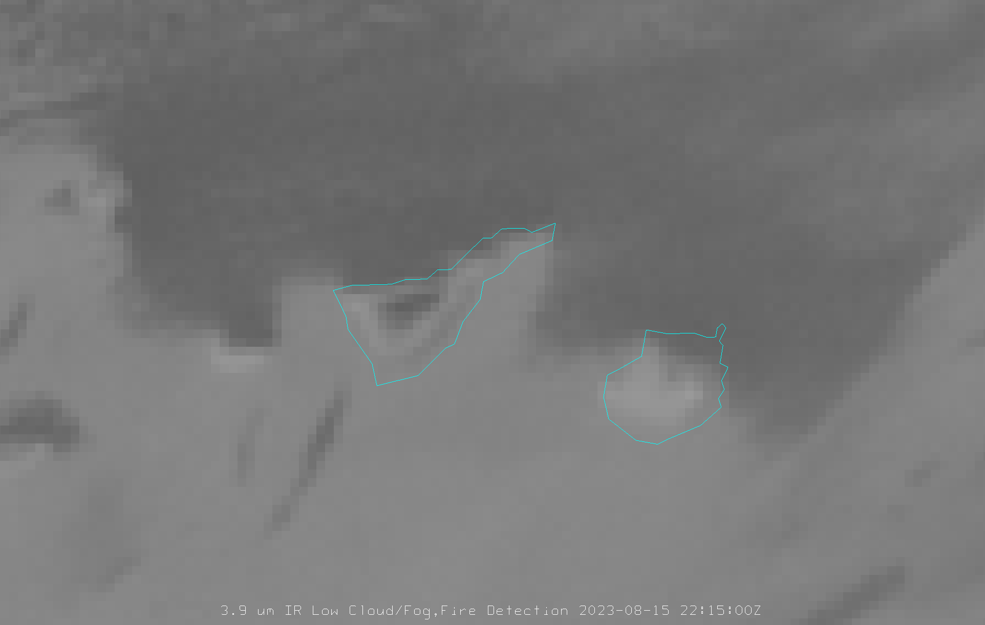
SEVIRI 3.9µm (3km)
15.08.2023 22:15 UTC
Demonstrating FCI’s capabilities
Observing the Tenerife Fire
Preliminary results
Demonstrating FCI’s capabilities
Observing the Tenerife Fire
Preliminary results
Demonstrating FCI’s capabilities
Observing the Tenerife Fire
Preliminary results
Demonstrating FCI’s capabilities
Observing the Tenerife Fire
Preliminary results

Slide 21

SEVIRI 3.9µm (3km)
15.08.2023 22:30 UTC
Demonstrating FCI’s capabilities
Observing the Tenerife Fire
Preliminary results
Demonstrating FCI’s capabilities
Observing the Tenerife Fire
Preliminary results
Demonstrating FCI’s capabilities
Observing the Tenerife Fire
Preliminary results
Demonstrating FCI’s capabilities
Observing the Tenerife Fire
Preliminary results

Slide 22
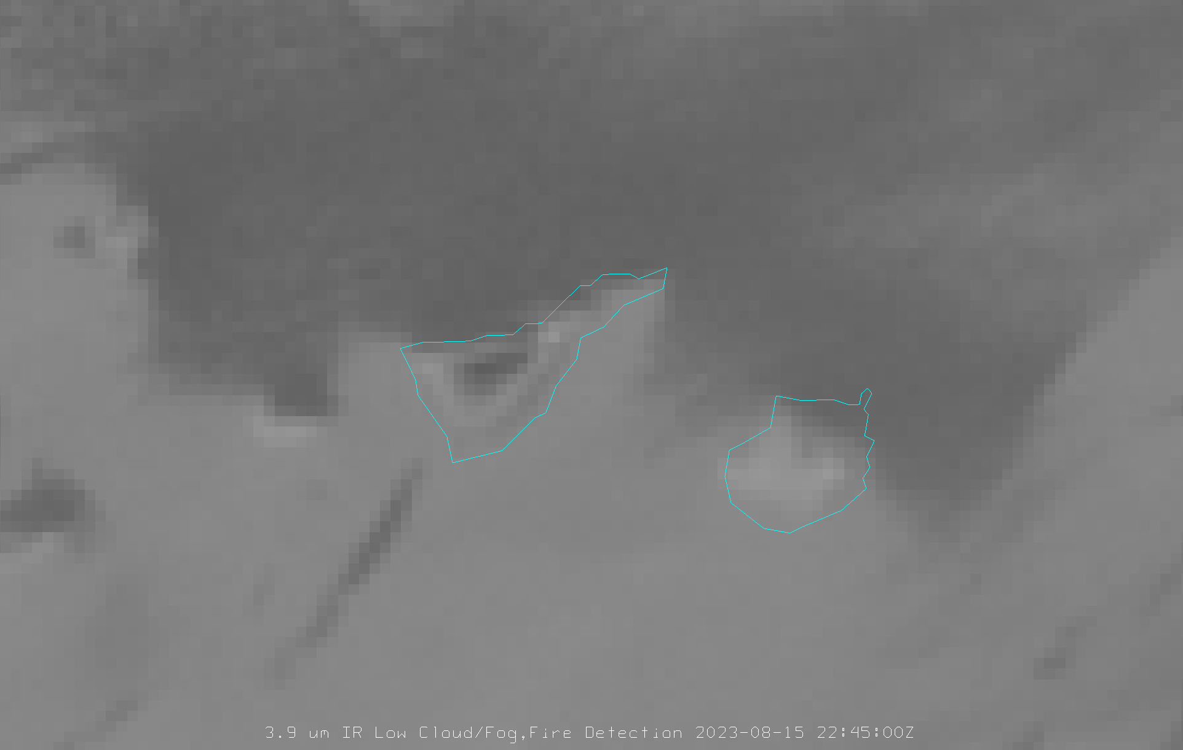
SEVIRI 3.9µm (3km)
15.08.2023 22:45 UTC
Demonstrating FCI’s capabilities
Observing the Tenerife Fire
Preliminary results
Demonstrating FCI’s capabilities
Observing the Tenerife Fire
Preliminary results
Demonstrating FCI’s capabilities
Observing the Tenerife Fire
Preliminary results
Demonstrating FCI’s capabilities
Observing the Tenerife Fire
Preliminary results

Slide 23
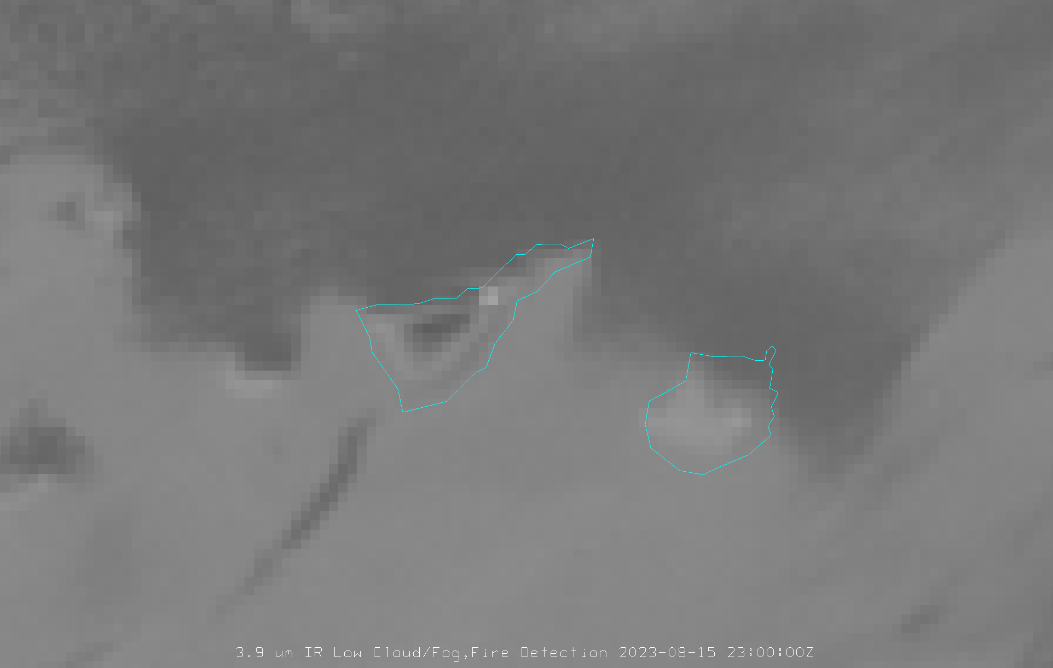
SEVIRI 3.9µm (3km)
15.08.2023 23:00 UTC
Demonstrating FCI’s capabilities
Observing the Tenerife Fire
Preliminary results
Demonstrating FCI’s capabilities
Observing the Tenerife Fire
Preliminary results
Demonstrating FCI’s capabilities
Observing the Tenerife Fire
Preliminary results
Demonstrating FCI’s capabilities
Observing the Tenerife Fire
Preliminary results

Slide 24
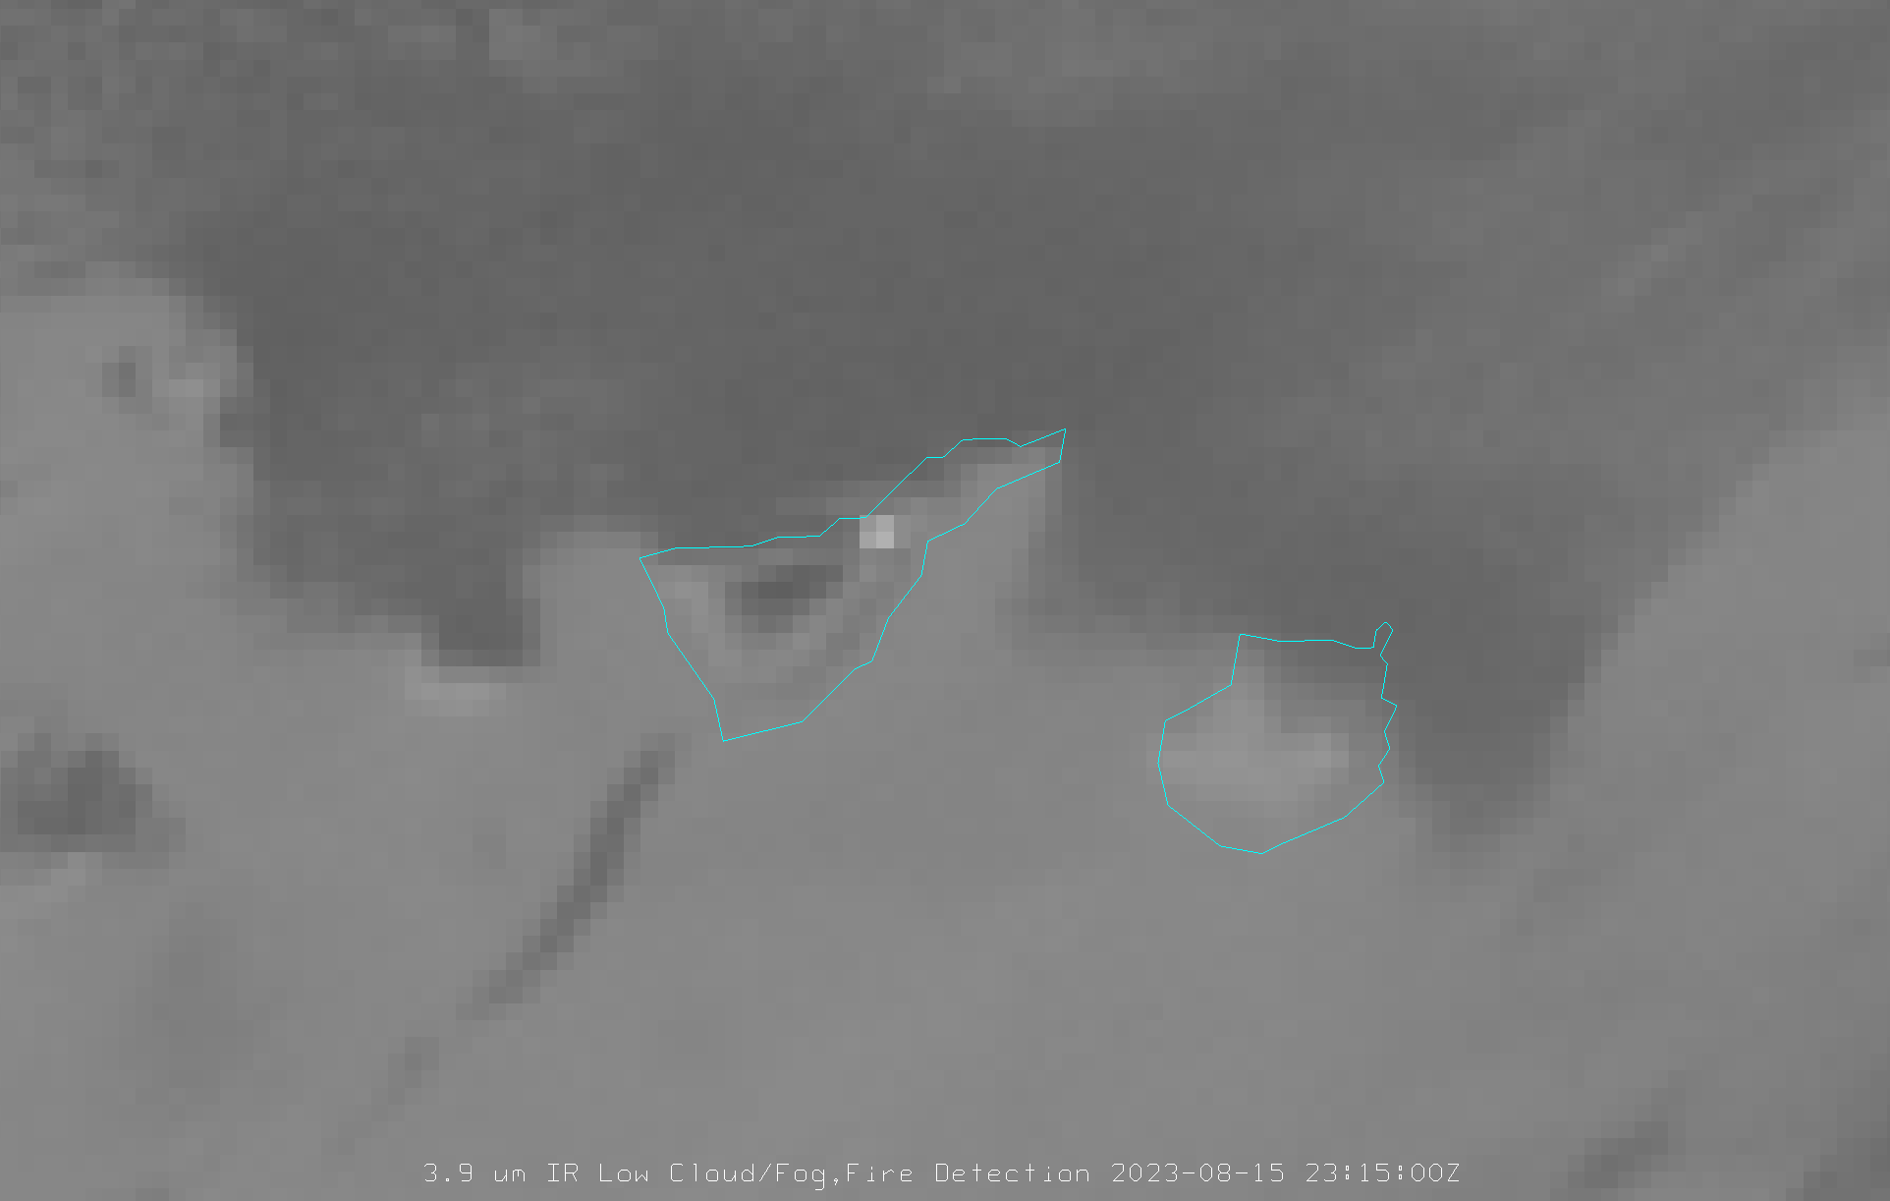
SEVIRI 3.9µm (3km)
15.08.2023 23:15 UTC
Demonstrating FCI’s capabilities
Observing the Tenerife Fire
Preliminary results
Demonstrating FCI’s capabilities
Observing the Tenerife Fire
Preliminary results
Demonstrating FCI’s capabilities
Observing the Tenerife Fire
Preliminary results
Demonstrating FCI’s capabilities
Observing the Tenerife Fire
Preliminary results

Slide 25
Application benefits FCI vs SEVIRI – example 8 (Botswana RGB lecture)
Scenario: You gave a lecture on Fire Temperature RGB using the imagery below. Now you need to answer the question from the student: “Why NIR1.6 channel is used at all, while it seems that NIR2.25 captured all the hotter fires, even at higher resolution of 500 m? We could add another channel instead, that would eg show a smoke signal (eg VIS0.4).”
Focus on the advanced spatial and spectral resolution of FCI:
  Spatial resolution benefits:
    the shape of the fires, fire fronts and burn scars
    detection of smallest fires
  Spectral resolution benefits:
    information about the fire intensity (indication of most active fires, ie fire fronts) with additional NIR 2.25 channel –> Fire Temperature RGB
    better smoke detection through additional VIS0.4 and VIS0.5 channels -> True Colour RGB

Slide 26
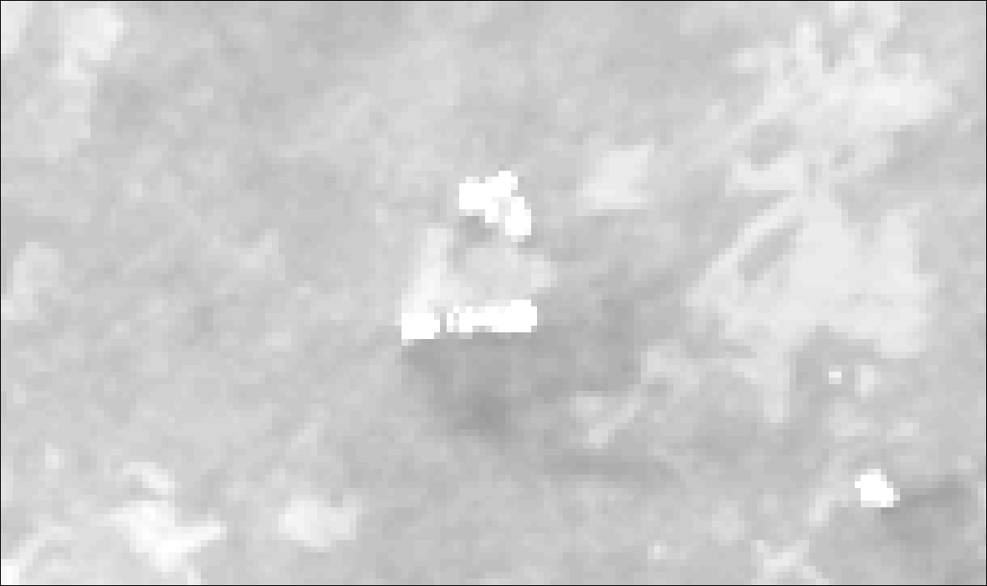
FCI IR3.8 1km
22.09.2023 10:40 UTC
273-333K, 0.4 Gamma
Demonstrating FCI’s capabilities
Observing Fires in Botswana
Preliminary results

Slide 27
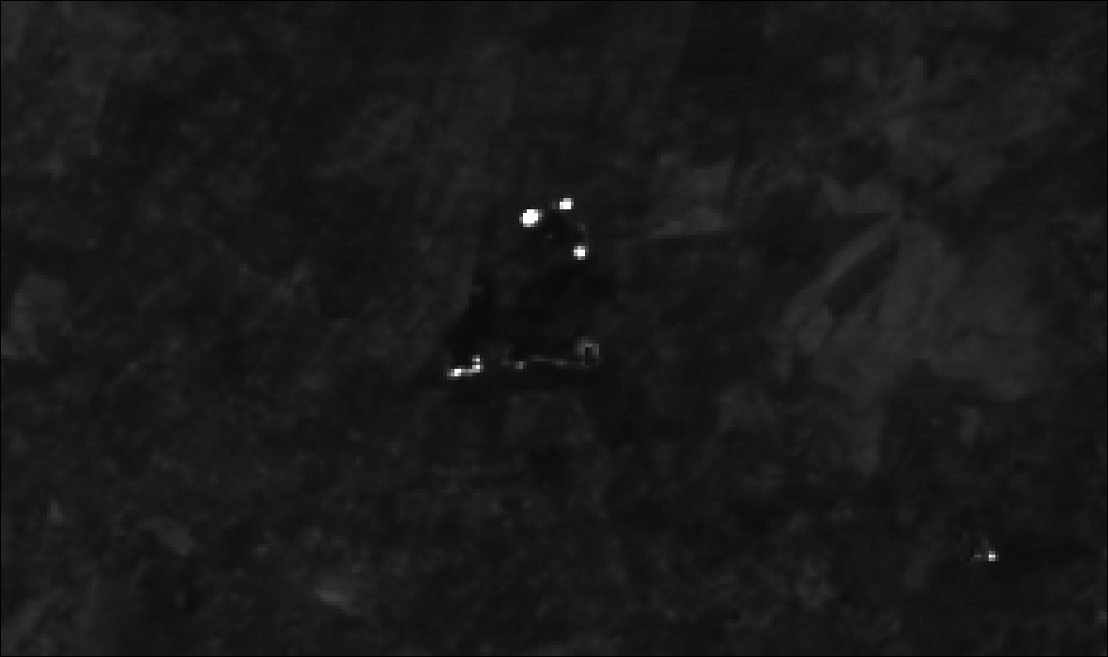
FCI NIR2.2 500m
22.09.2023 10:40 UTC
0-100% Refl
Demonstrating FCI’s capabilities
Observing Fires in Botswana
Preliminary results

Slide 28
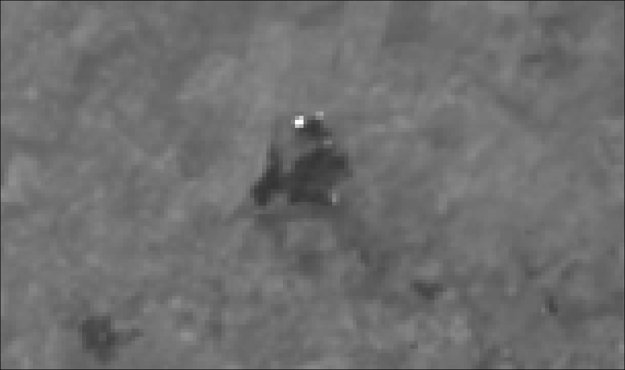
FCI NIR1.6 1km
22.09.2023 10:40 UTC
0-75% Refl
Demonstrating FCI’s capabilities
Observing Fires in Botswana
Preliminary results

Slide 29
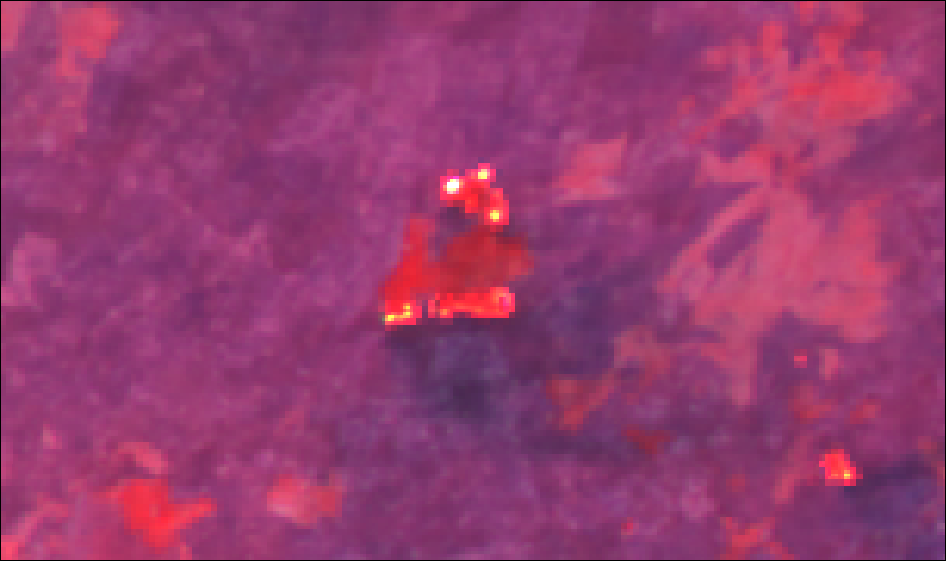
FCI Fire Temperature RGB 500m
22.09.2023 10:40 UTC
Demonstrating FCI’s capabilities
Observing Fires in Botswana
Preliminary results

Slide 30
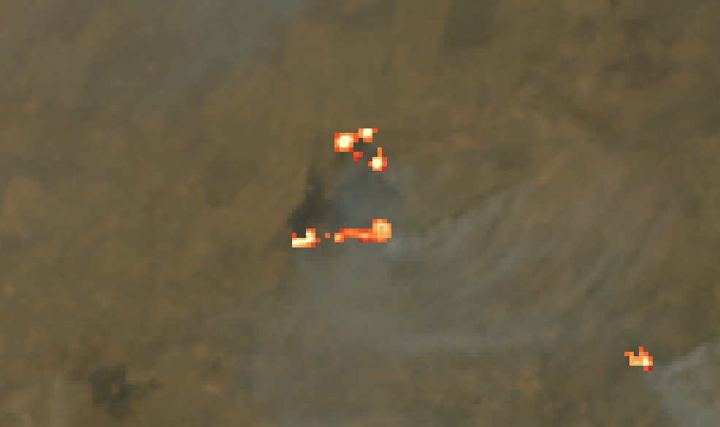
FCI True Color 0.5km
Fire Temperature 0.5km
22.09.2023 10:40 UTC
Demonstrating FCI’s capabilities
Observing Fires in Botswana
Preliminary results

Slide 31
