Slide 1
Principles of Satellite
Channels and RGBs
Ivan Smiljanić
Satellite applications and training expert
25 February 2024, Satellite Applications Course, CoE Muscat
Notes:
Title slide template 2 of 2 with presentation title/information on the right. Please choose between slide 1 or 2 for the title slide and delete the other.

Slide 2
Agenda
Why satellites?

Slide 3
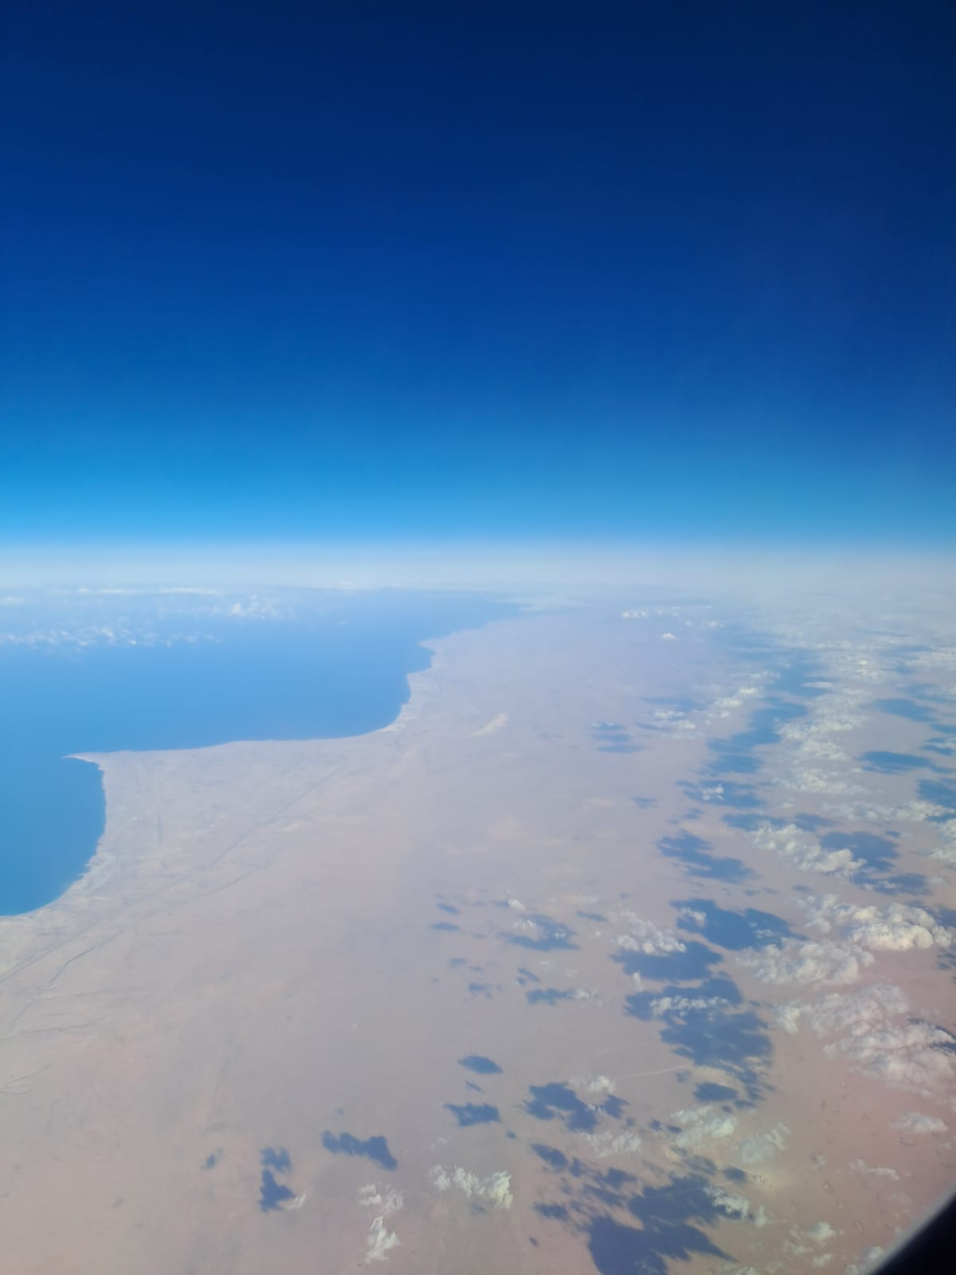
Applications – what are you interested in?
Nairobi flight, 16 Nov 2023

Slide 4
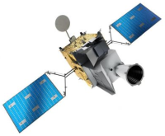
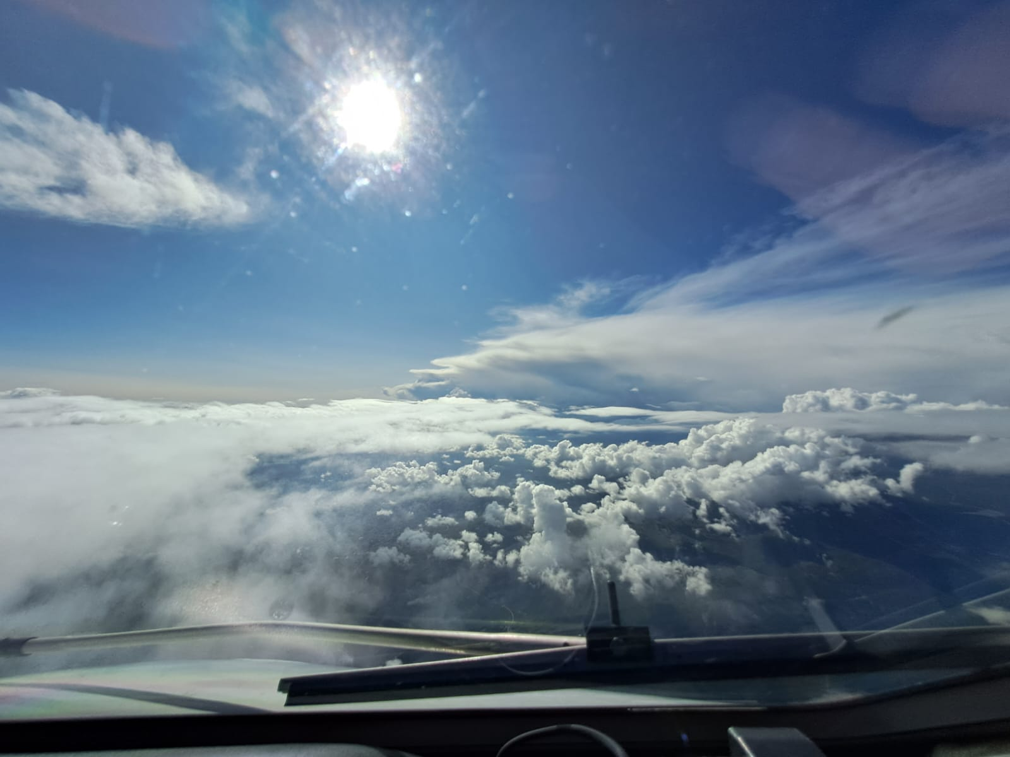
Applications – what are you interested in?
12 May 2023, 13:50 UTC, Romania/Serbia

Slide 5
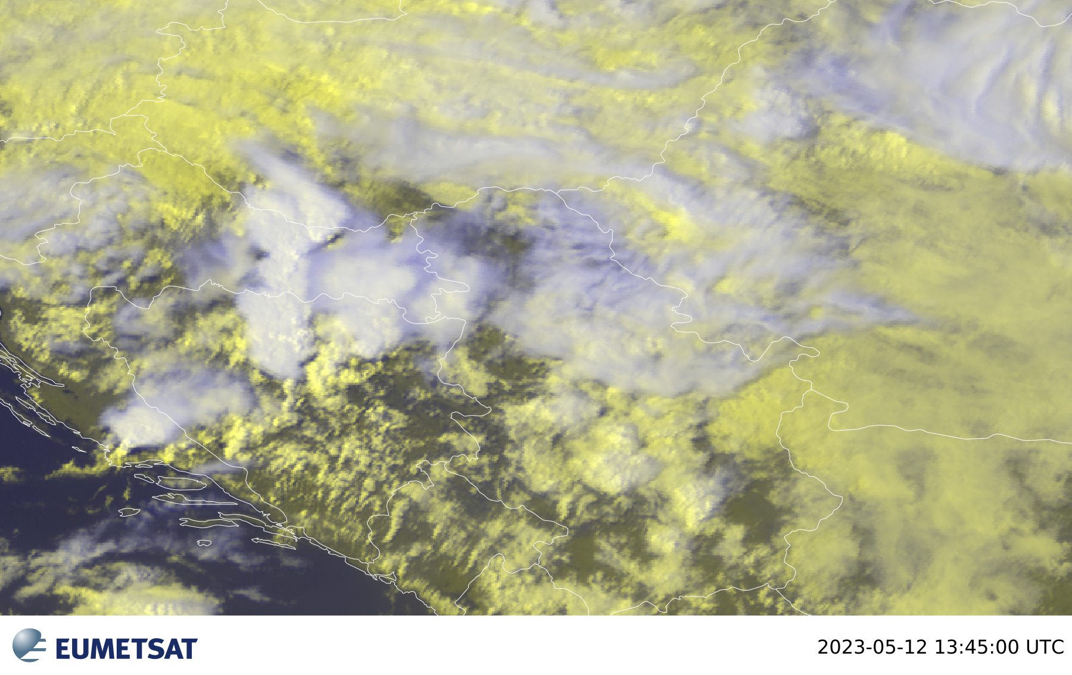
Applications – what are you interested in?
12 May 2023, 13:50 UTC, Romania/Serbia

Slide 6
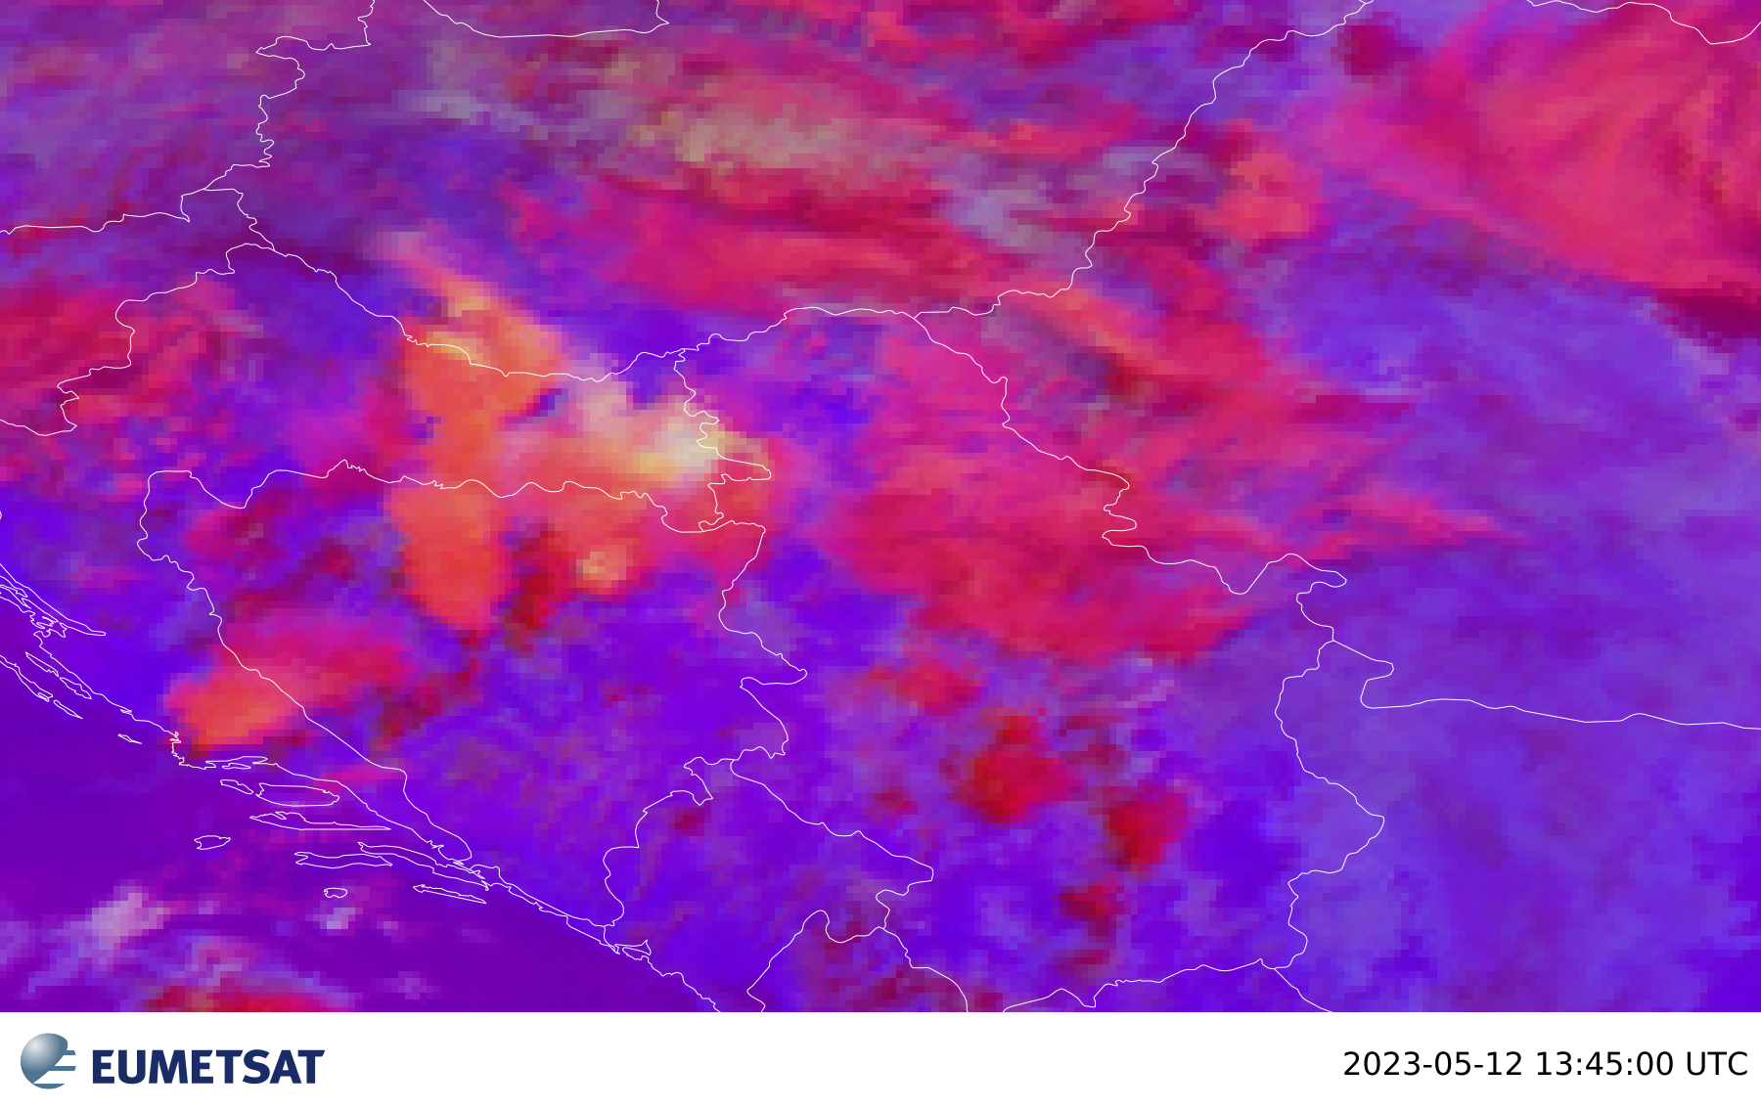
Applications – what are you interested in?
12 May 2023, 13:50 UTC, Romania/Serbia

Slide 7
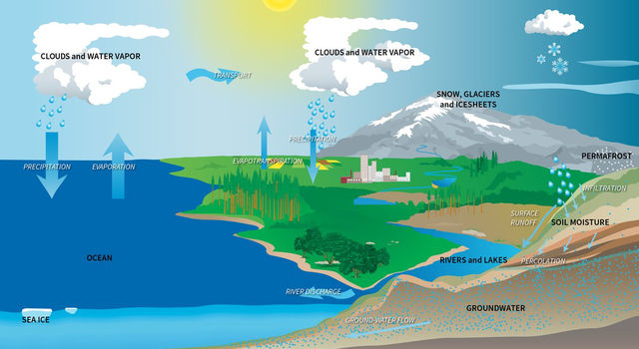
Applications – what are you interested in?
- VS -

Slide 8
Agenda
Spectral information

Slide 9
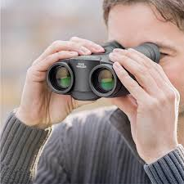
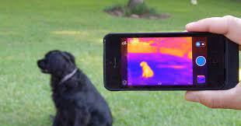
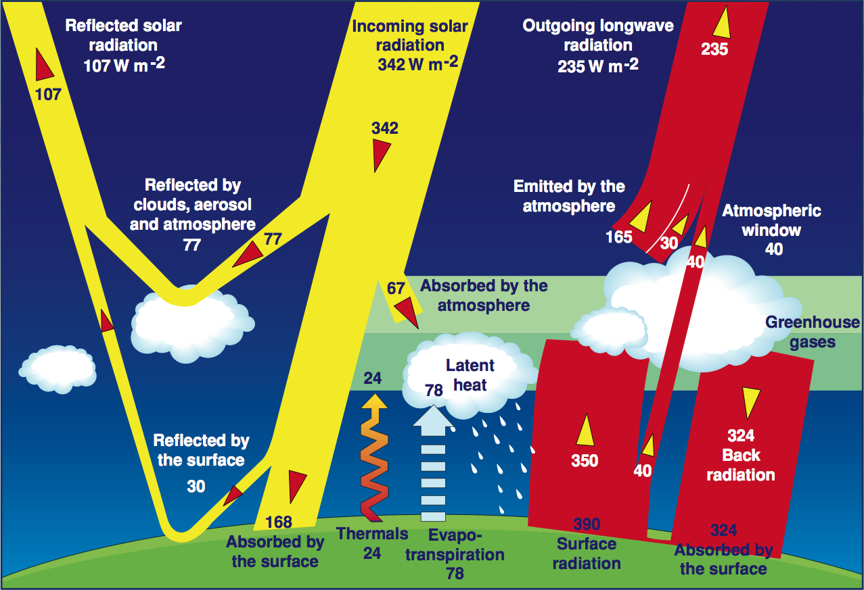
Spectral view from satellites
VIS
IR

Slide 10
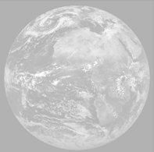
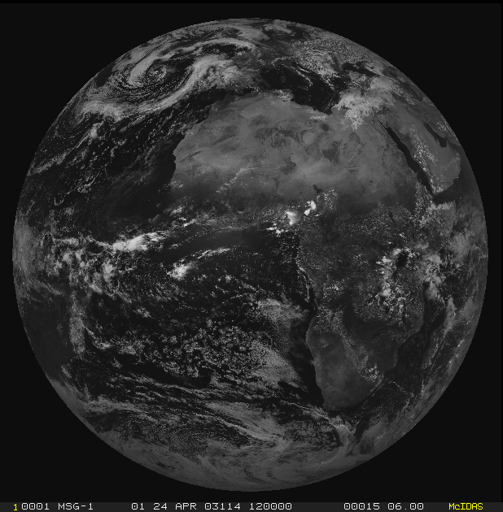
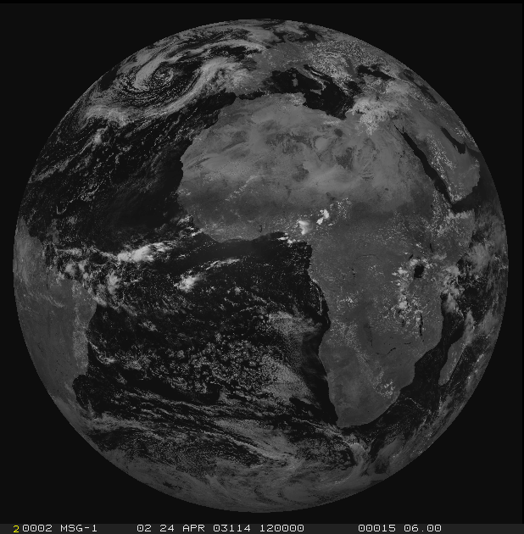
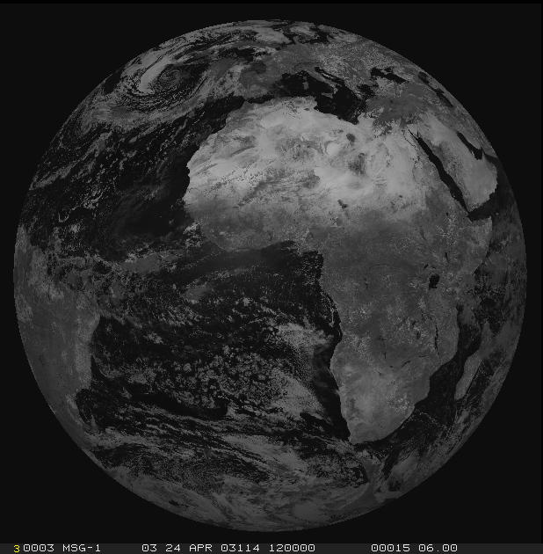
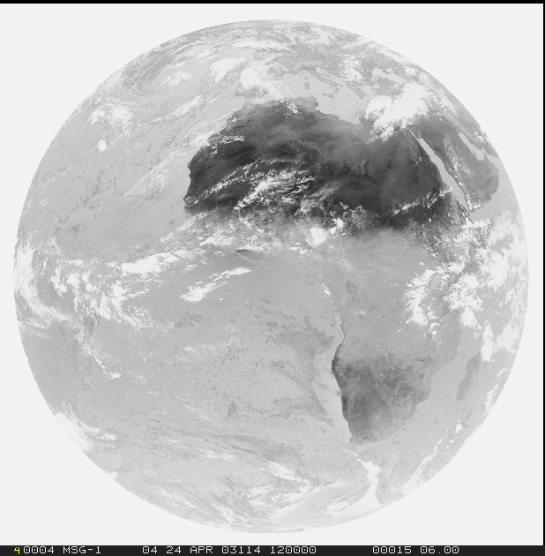
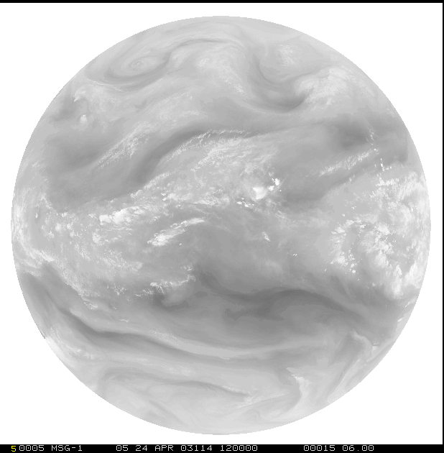
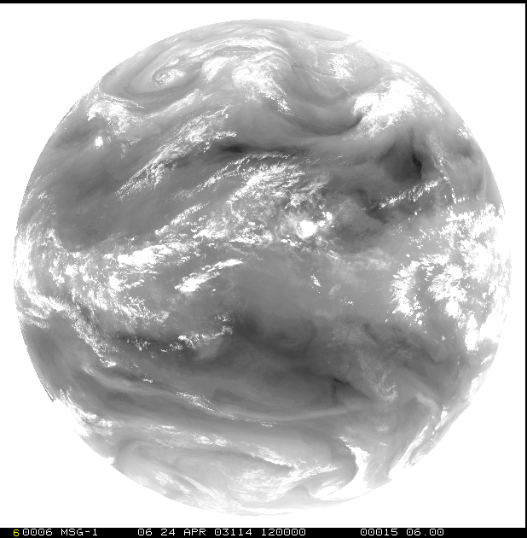
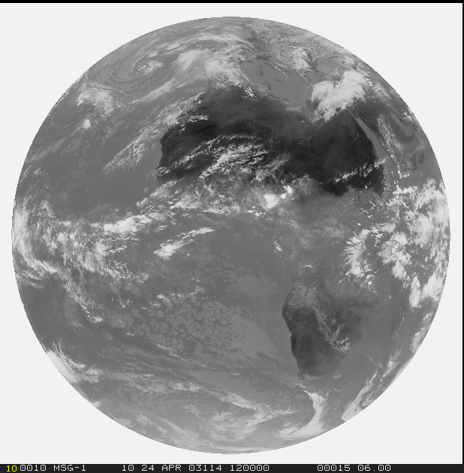
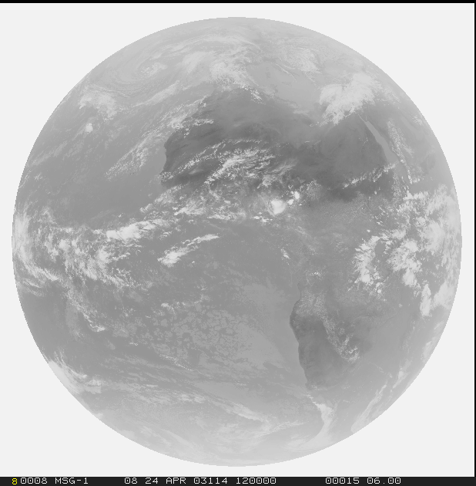
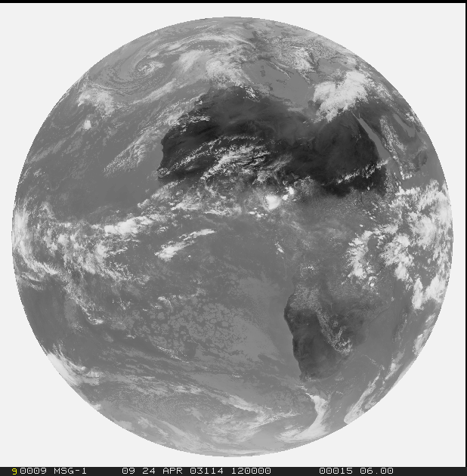
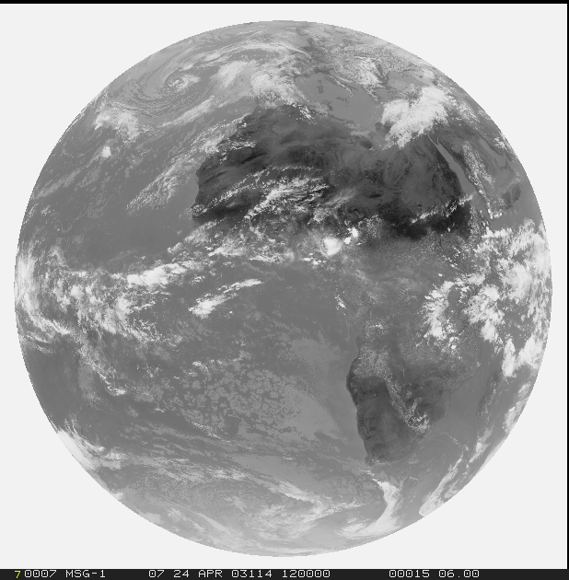
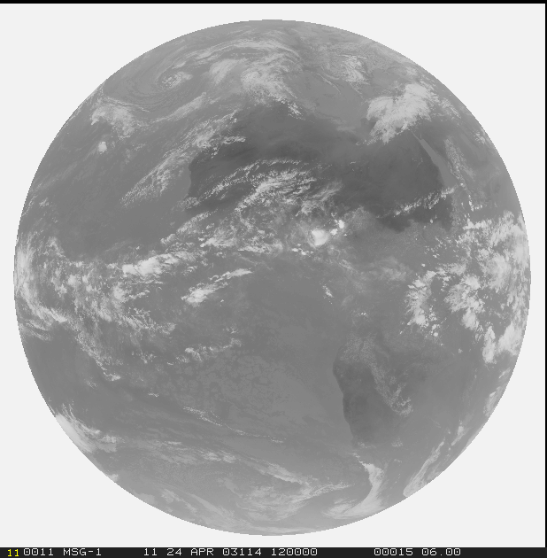
RGBs - Spectral channels
1=VIS0.4
2=VIS0.5
3=VIS0.6
4=VIS0.8
5=NIR0.9
6=NIR1.3
Solar
3.0 (1.0/0.5) km
Thermal
3.0 (2.0/1.0) km
7=NIR1.6
8=NIR2.25
9=IR3.8
10=WV6.2
11=WV7.3
12=IR8.7
13=IR9.7
14=IR10.5
15=IR12.3
16=IR13.3

Slide 11
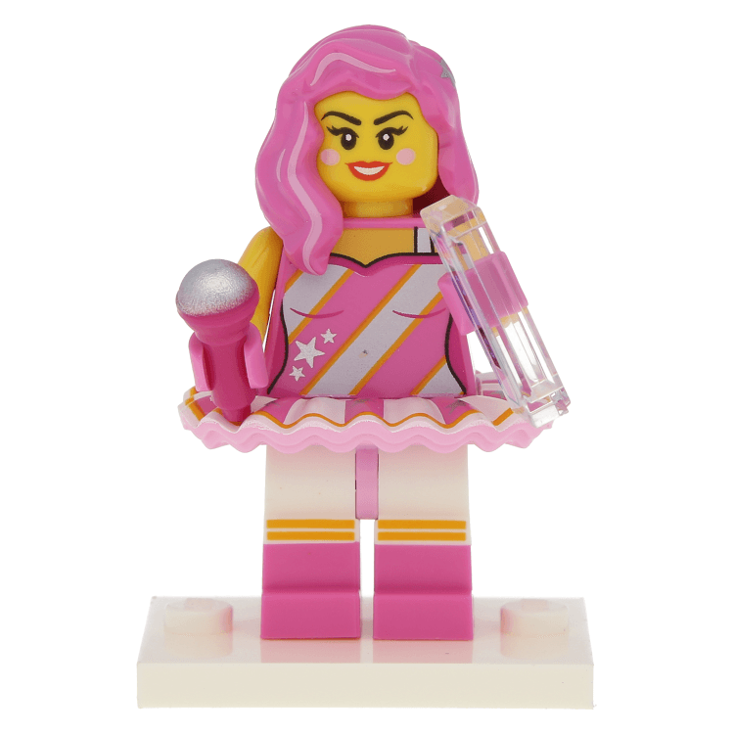
Spectral utility
Experts
1=VIS0.4
2=VIS0.5
3=VIS0.6
4=VIS0.8
5=NIR0.9
6=NIR1.3
Solar
3.0 (1.0/0.5) km
Thermal
3.0 (2.0/1.0) km
7=NIR1.6
8=NIR2.25
9=IR3.8
10=WV6.2
11=WV7.3
12=IR8.7
13=IR9.7
14=IR10.5
15=IR12.3
16=IR13.3

Slide 12
Spectral utility
a
1=VIS0.4
2=VIS0.5
3=VIS0.6
4=VIS0.8
5=NIR0.9
6=NIR1.3
d
b
f
7=NIR1.6
8=NIR2.25
e
c
9=IR3.8
10=WV6.2
11=WV7.3
12=IR8.7
13=IR9.7
14=IR10.5
15=IR12.3
16=IR13.3

Slide 13
Spectral utility
1=VIS0.4
2=VIS0.5
3=VIS0.6
4=VIS0.8
5=NIR0.9
6=NIR1.3
Solar
3.0 (1.0/0.5) km
Thermal
3.0 (2.0/1.0) km
7=NIR1.6
8=NIR2.25
9=IR3.8
10=WV6.2
11=WV7.3
12=IR8.7
13=IR9.7
14=IR10.5
15=IR12.3
16=IR13.3

Slide 14
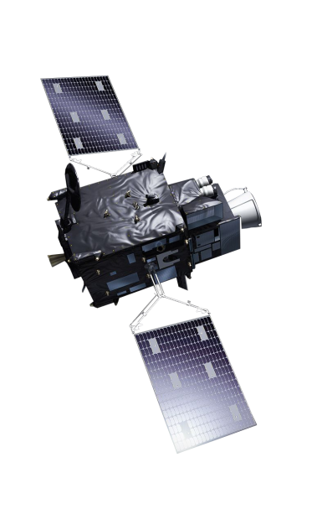
Except spectral?
RESOLUTION:
Spatial
Temporal
Spectral
Radiometric

Slide 15
Agenda
Data utilisation

Slide 16
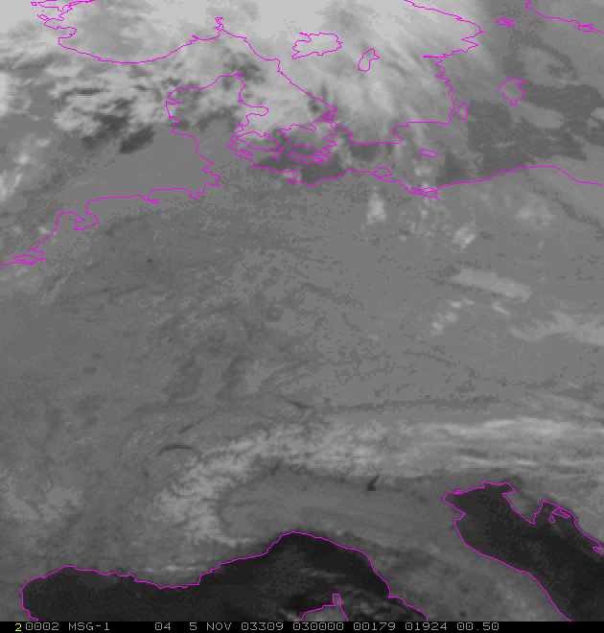
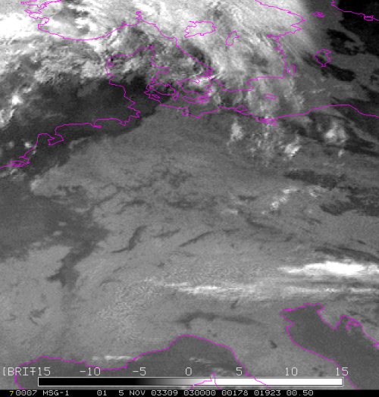
Data exploration
How to use data?
Single channel??
…
..?

Slide 17
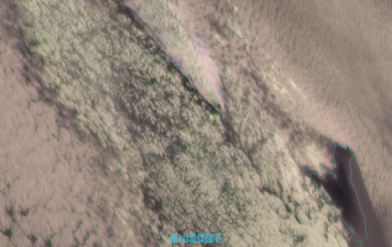
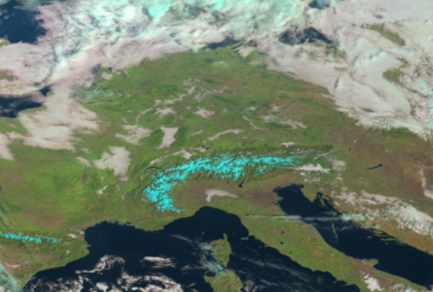
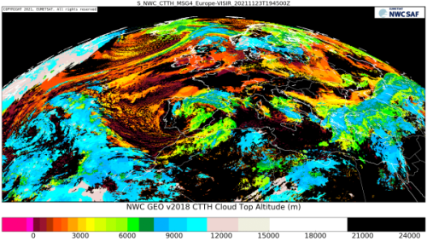
Data exploration
How to use data?
Single channel
Channel difference/ratio
Sandwich products
RGB products
...
-
L2(+) / Geophysical products

Slide 18
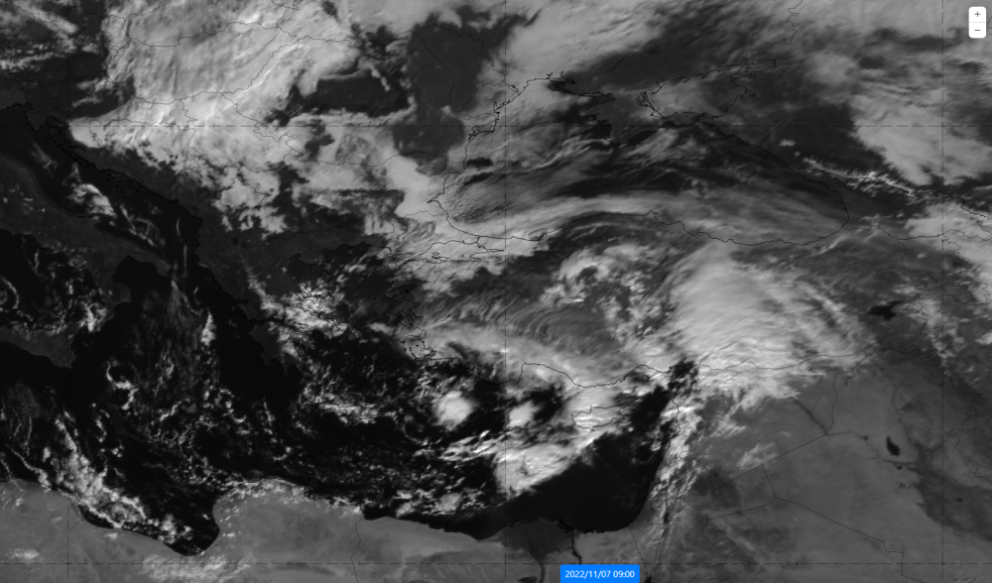
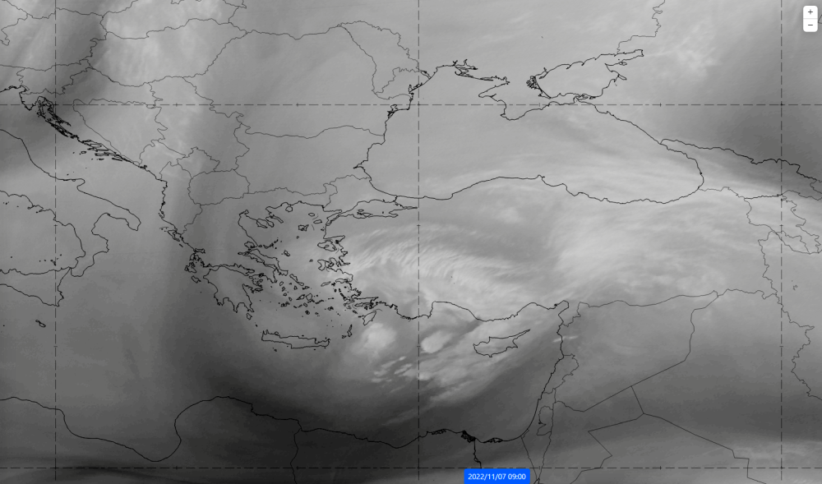
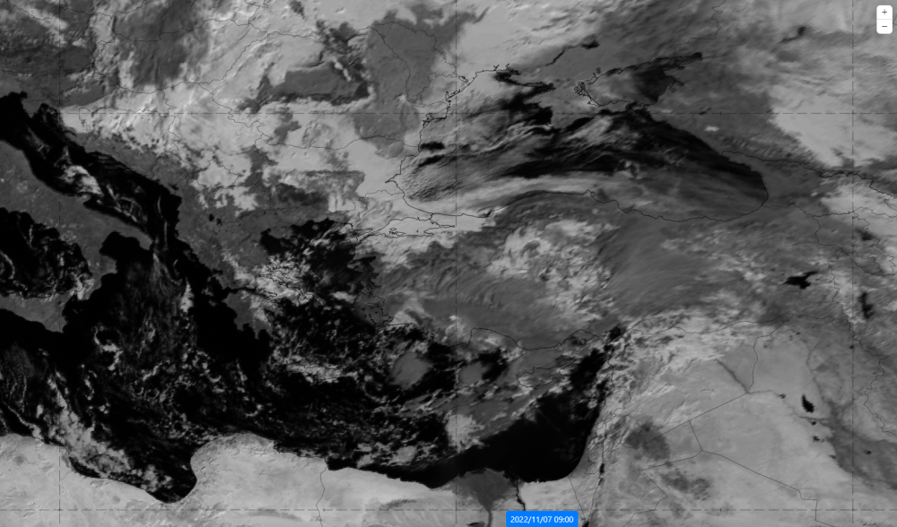
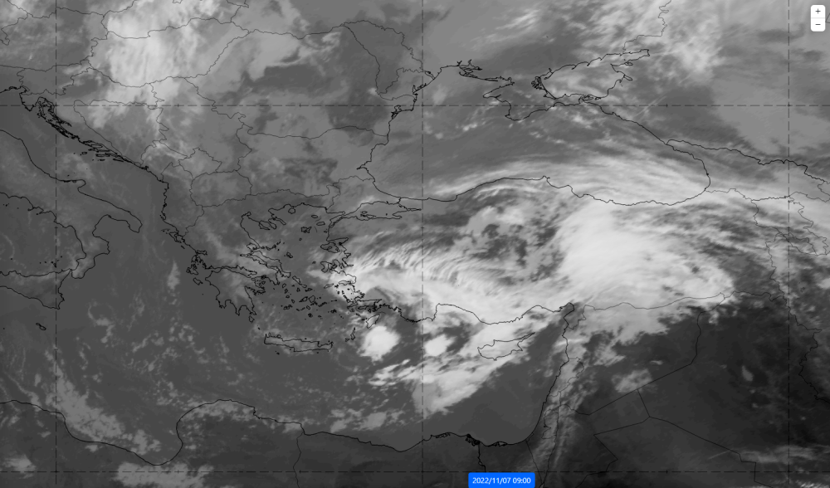
#Single channel(s) – what part of spectra?
a)
b)
c)
d)

Slide 19
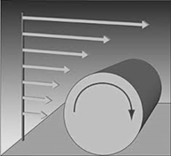
Single channel(s) – wind shear detection, storm dynamics

Slide 20
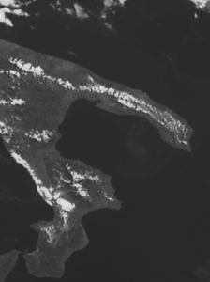
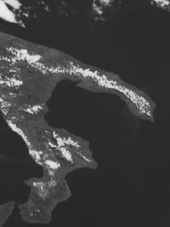
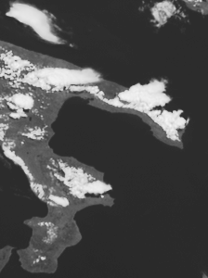
Single channel(s) – convergence line detection
Seabreeze Convergence, Southern Italy (Salento)
09:05 UTC 09:40 UTC 10:55 UTC
12 June 2007, HRV Channel (Met-8 Rapid Scans)

Slide 21
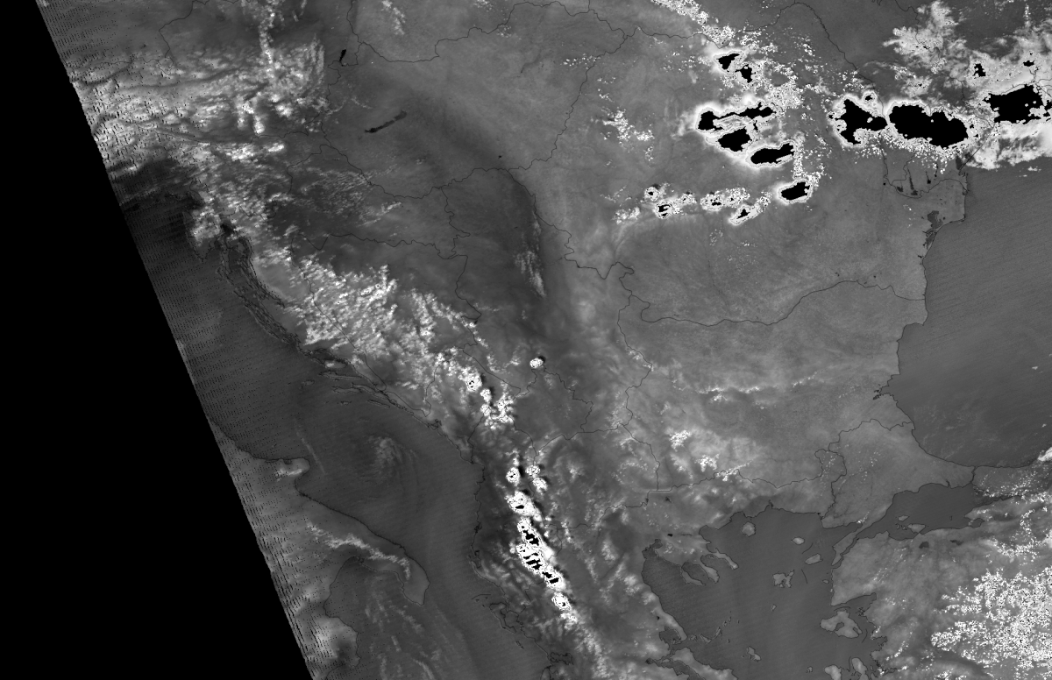
#Channel difference/ratio
Enhances the certain signal from single channels
Ratio 0.905/0.8585 – low level moisture signal
Aqua MODIS, 30 Jun, 11:10 UTC

Slide 22
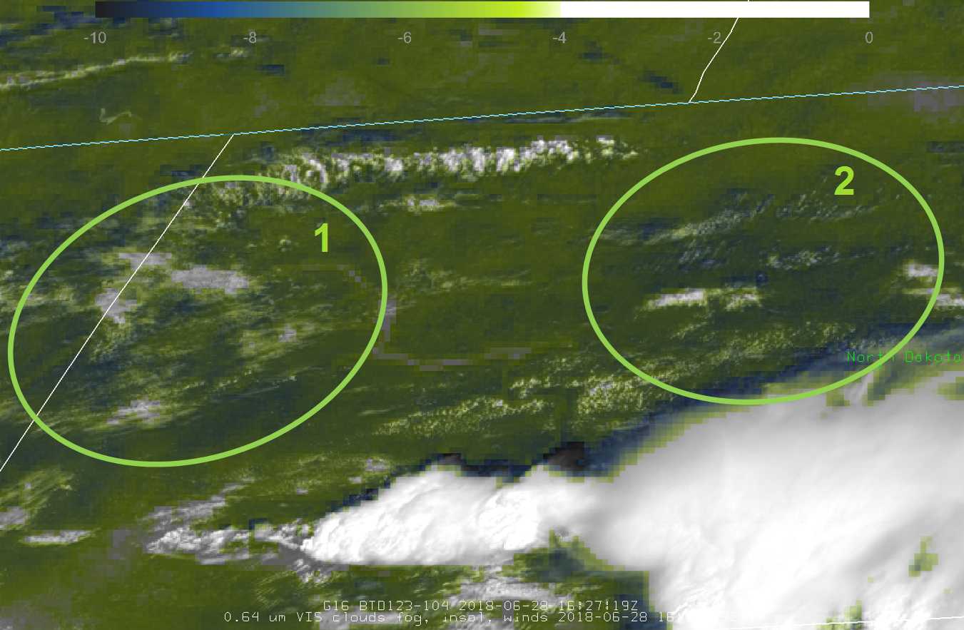
Channel differenc/ratio
Enhances the certain signal from single channels
BTD 12.0-10.8
28 June 2018
16:27 UTC
North Dakota

Slide 23
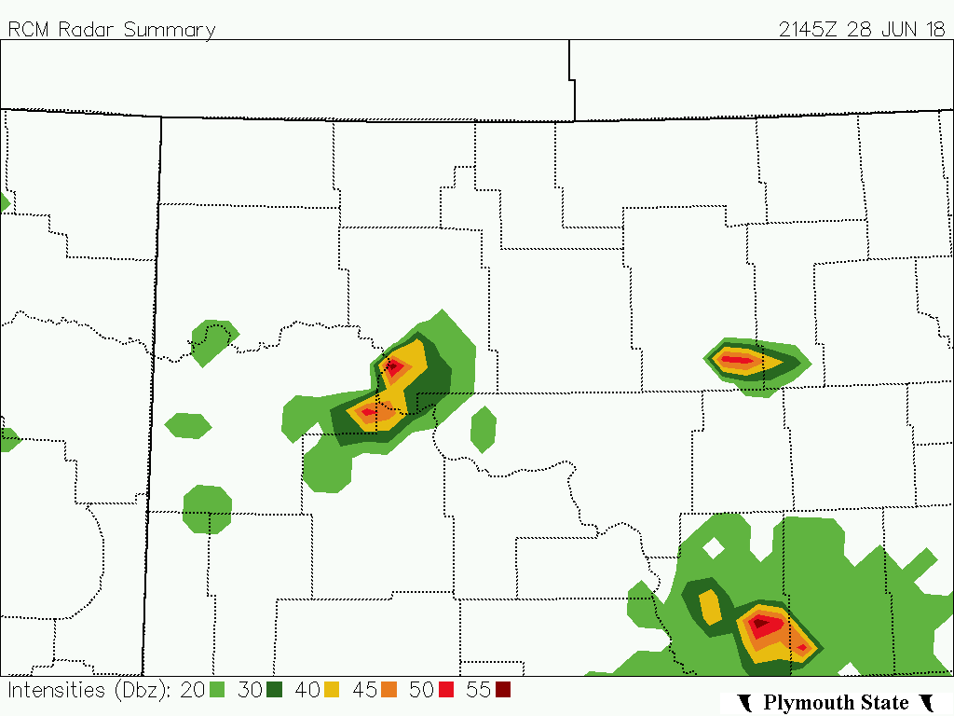
Channel differenc/ratio
Confirmation ca. 5h later from
Radar refl.
28 June 2018
21:45 UTC
North Dakota

Slide 24
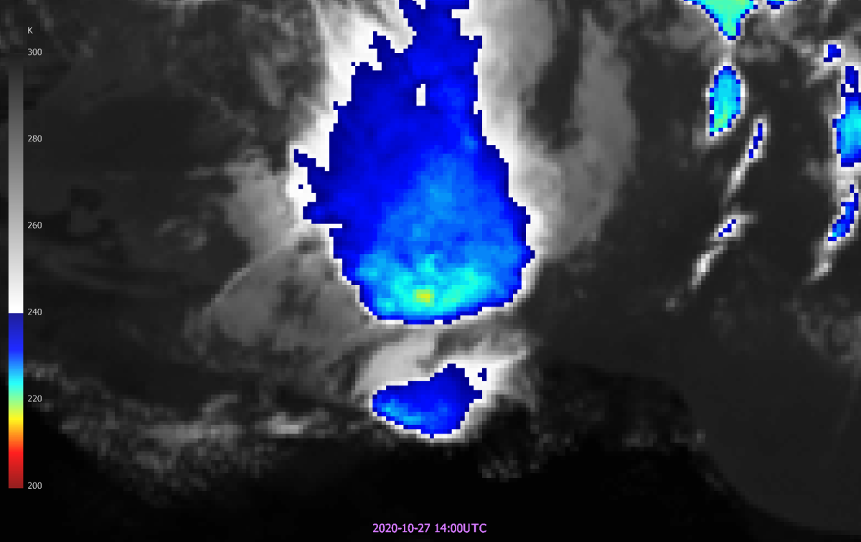
#Sandwich product
Sandwich:
IR temperature
+
enhanced spatial resolution through
HRV channel

Slide 25
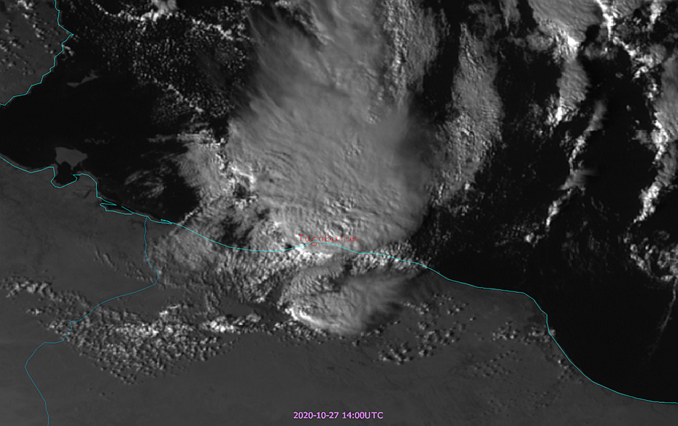
‘Sandwich’ product
Sandwich:
IR temperature
+
enhanced spatial resolution through
HRV channel

Slide 26
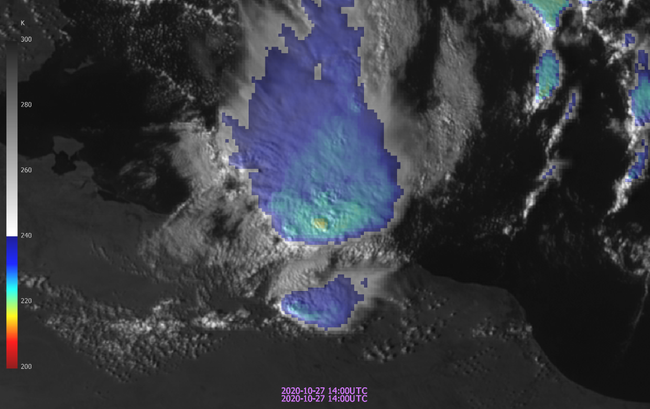
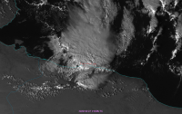
‘Sandwich’ product
Sandwich:
IR temperature
+
enhanced spatial resolution through HRV channel
+

Slide 27
‘Sandwich’ product
Sandwich:
IR temperature
+
enhanced spatial resolution through HRV channel
+

Slide 28
‘Sandwich’ product
Sandwich:
BTD12-10
+
enhanced spatial resolution through HRV channel
28 June 2018
North Dakota

Slide 29
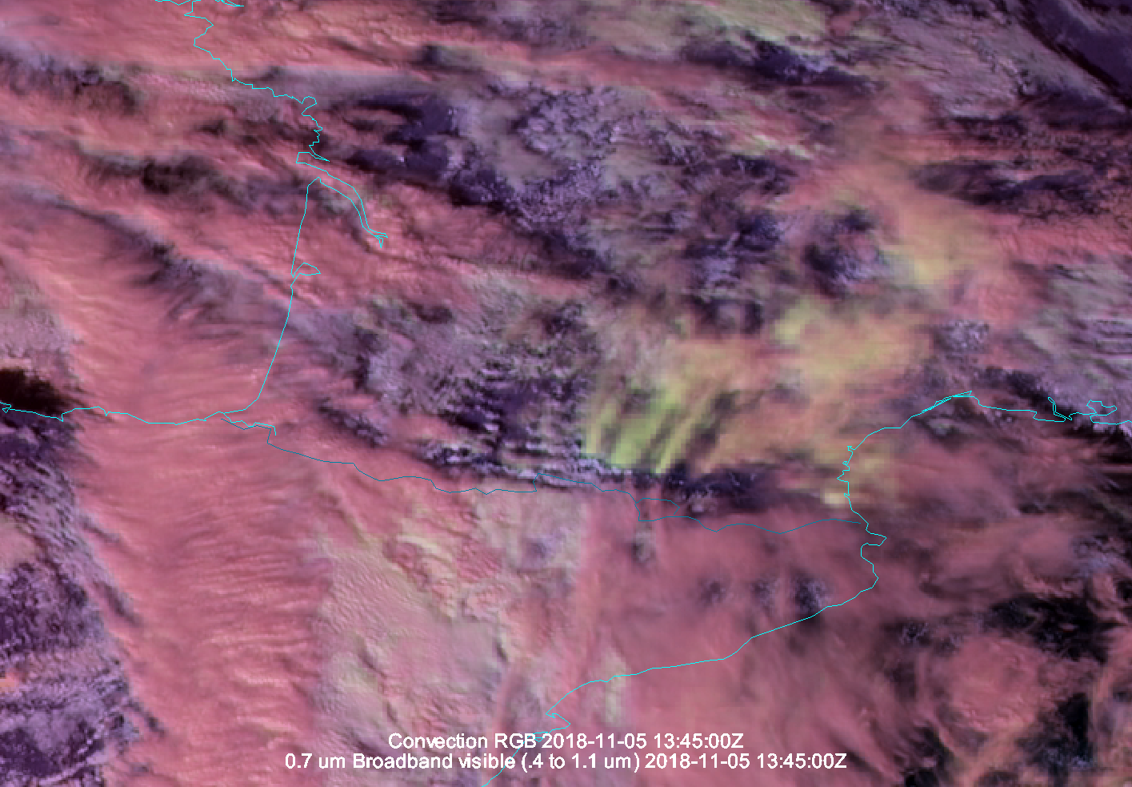
‘Sandwich’ product
Sandwich:
Convection RGB
+
enhanced spatial resolution through HRV channel
Wave clouds over Pyrenees mountains (small ice particles in yellow)

Slide 30
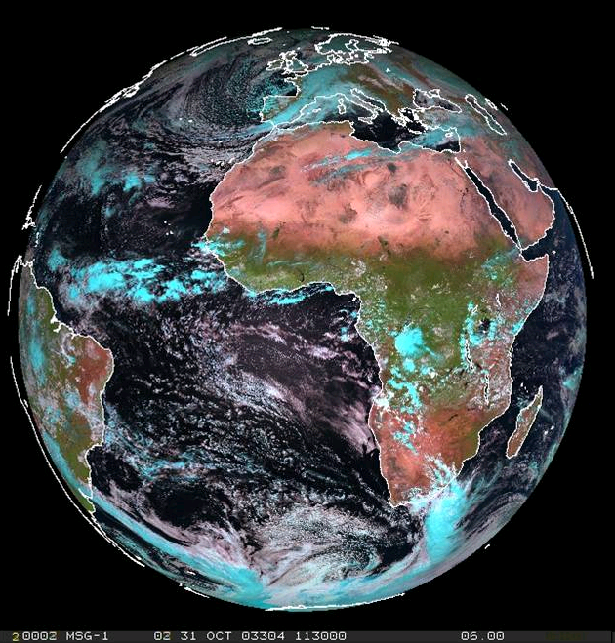
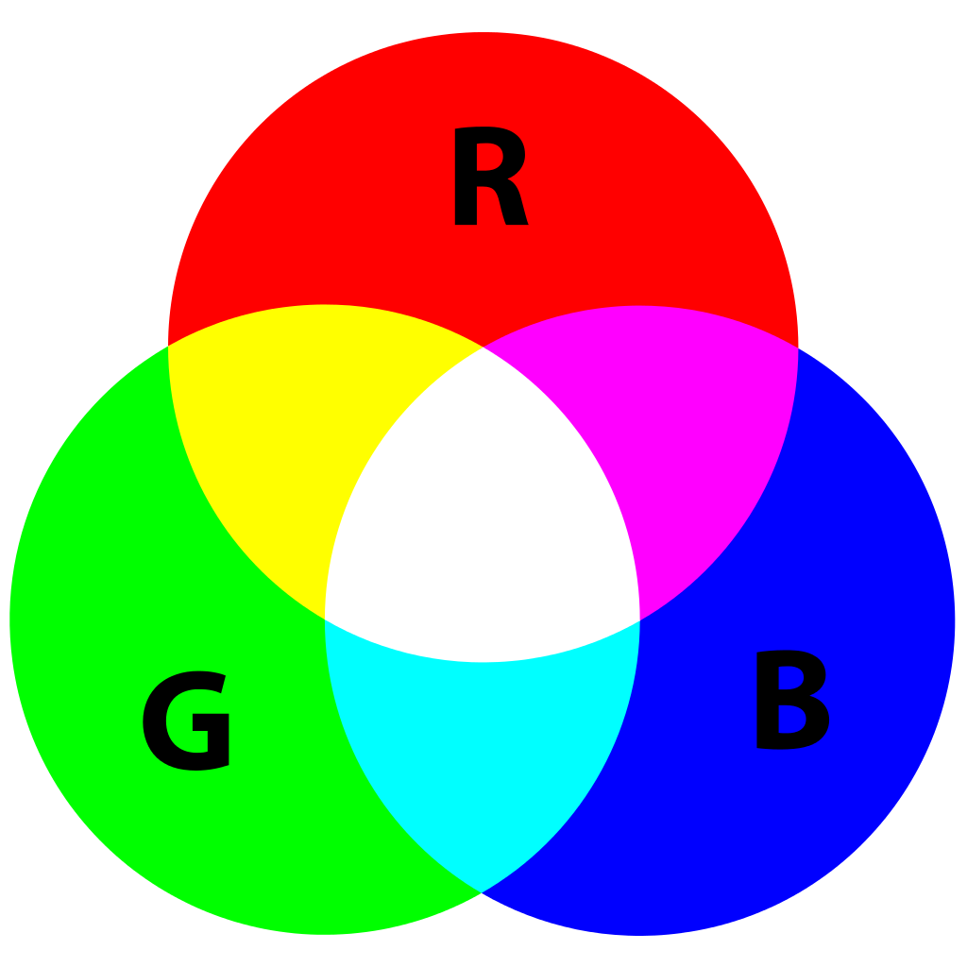
RGB products – generic example
XY RGB
Red: …
Green: …
Blue: …
-

Slide 31
RGB products – applications - which channels..?
1=VIS0.4
2=VIS0.5
3=VIS0.6
4=VIS0.8
5=NIR0.9
6=NIR1.3
Convective storm?
Fire
monitoring?
Solar
3.0 (1.0/0.5) km
Thermal
3.0 (2.0/1.0) km
7=NIR1.6
9=IR3.8
10=WV6.2
11=WV7.3
12=IR8.7
13=IR9.7
14=IR10.5
15=IR12.3
16=IR13.3

Slide 32
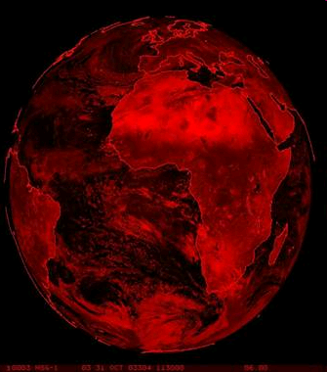
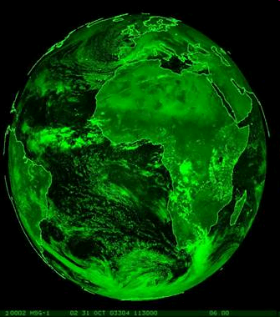
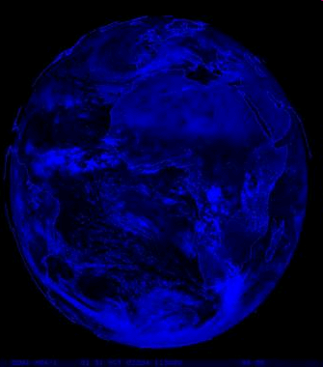
RGB products - example
Natural Colour RGB
Red: NIR 1.6 μm
Green: VIS 0.8 μm
Blue: VIS 0.6 μm

Slide 33
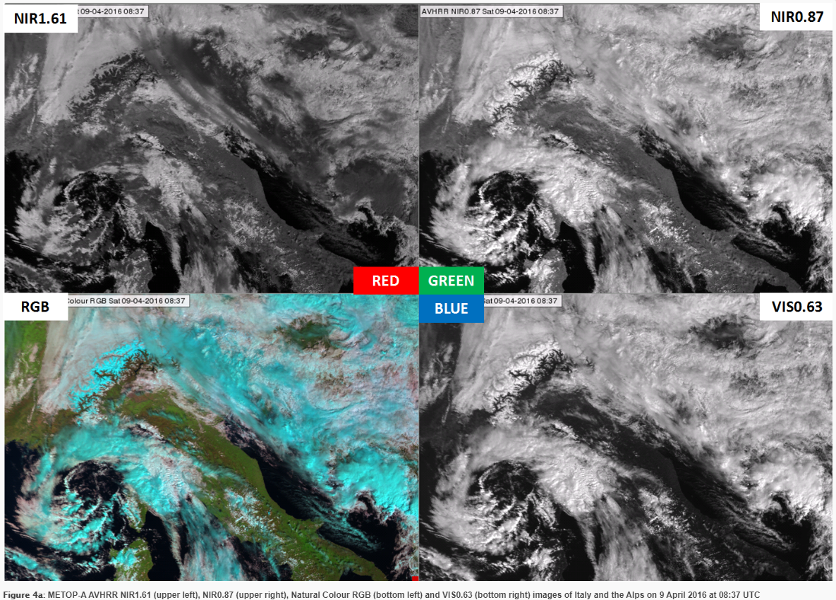
RGB products – components

Slide 34
Geophysical (L2+) products
Quantitative values derived from satellite data (height, temperature, pressure, humidity, chlorophyll, wind vector, etc.)
Includes multiple inputs (aside from the original satellite data):
Auxiliary satellite data
NWP variables
Look-up tables
Climatology
Background maps
Parametrization parameters
Corrections
…

Slide 35
Geophysical (L2+) products

Slide 36
Geophysical (L2+) products

Slide 37
Geophysical (L2+) products
E.g.

Slide 38
Geophysical (L2+) products
CI (Convective Initiation) Product
> Probability for a cloudy pixel to become a thunderstorm?
Mecikalski at al. 2010
• yellow for [0-25%] probability of Convection initiation, • orange for [25-50%] probability of Convection initiation, • red for [50-75%] probability of Convection initiation, • magenta for [75-100%] probability of Convection initiation.
Main limitations of the product?
• In cases of cold air masses (fast-moving fractional clouds) • High FAR inherent to CI, particularly at the edges of cold cloud systems • Lack of validation

Slide 39
Geophysical (L2+) products
Upper-level divergence product
> Automated divergence assessment
> Subjective divergence assessment
=> Anvil growth as a proxy for upper level divergence process
=> Thin cirrus ring in case of very abrupt vertical (turned into horizontal) flow
=> Divergence indicate variations in anvil dynamics and related vertical motions beneath
=> Out of different satellite-related products, storm top divergence seems to be the best discriminator
=> Meaningful only with advanced temporal/spatial resolution -> FCI
Divergence product
Cirrus outflow
c. Jason M. Apke; John R. Mecikalski; Kristopher Bedka; Eugene W. McCaul, Jr.; Cameron R. Homeyer; Christopher P. Jewett

Slide 40
G-16 VIS06 view
Shukran!
Questions are welcome.
Notes:
- Side view on the storm (that is sometimes doable J)

