Slide 1
Tsunami Early Warning System and Stakeholder Website
n
Noura Alkaabi
Noura Alkaabi

Slide 2
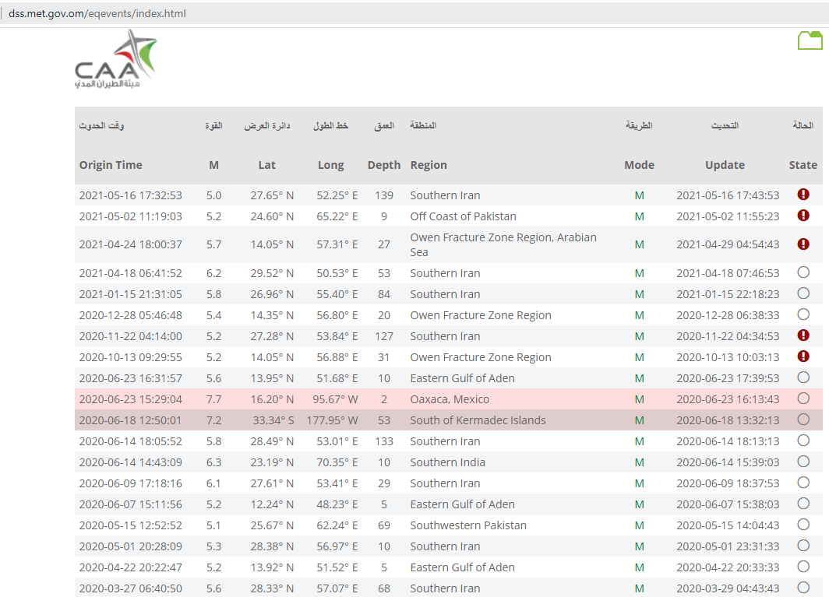
Stakeholder Website
https://dss.met.gov.om/eqevents/index.html
الموقع الالكتروني الخاص بمتخذي القرار
دليل المستخدم

Slide 3
Tsunami Early Warning System
1. Earthquake Analysis using seiscomp5

Slide 4
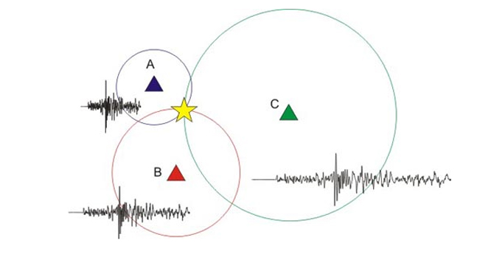
1. Earthquake Analysis
Seismic stations
Epicenter

Slide 5
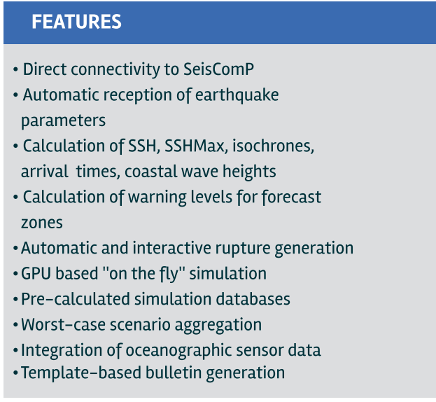
Tsunami Early Warning System
2. Tsunami Simulation using TOAST
TOAST (Tsunami Observation And Simulation Terminal) is a software for tsunami simulation and verification giving a quick hazard assessment

Slide 6
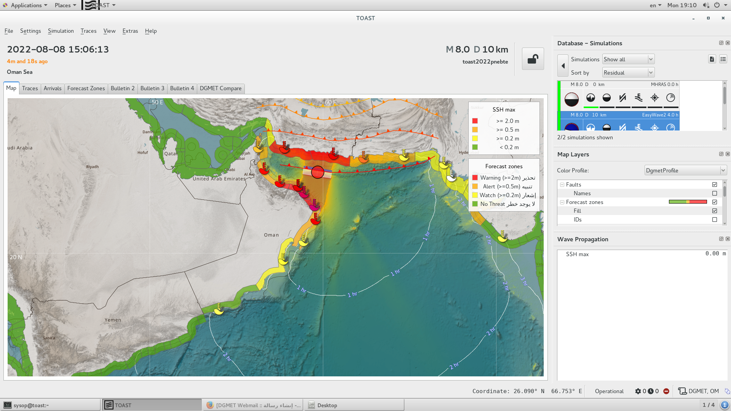
Tsunami Early Warning System
2. Tsunami Simulation using TOAST

Slide 7
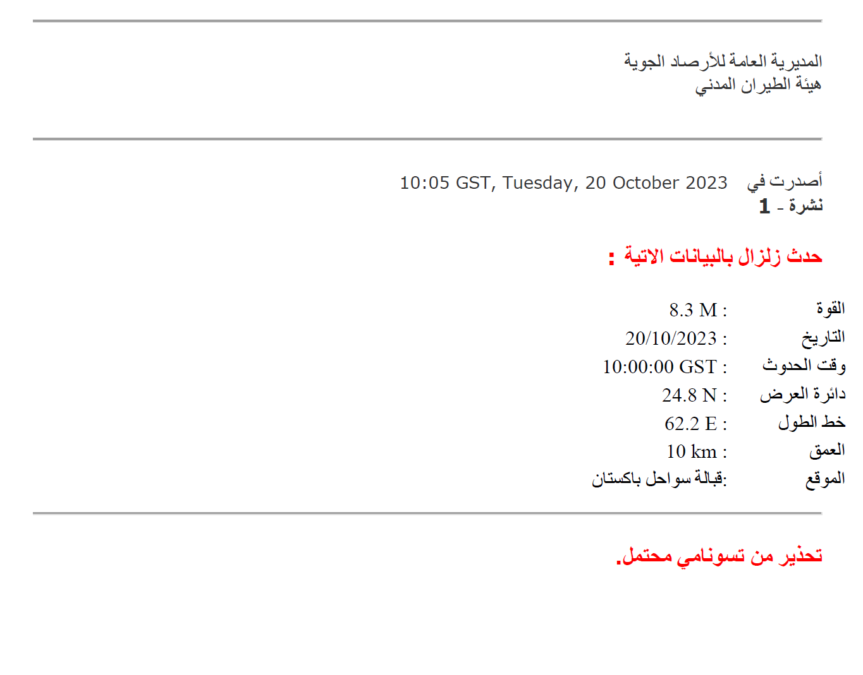
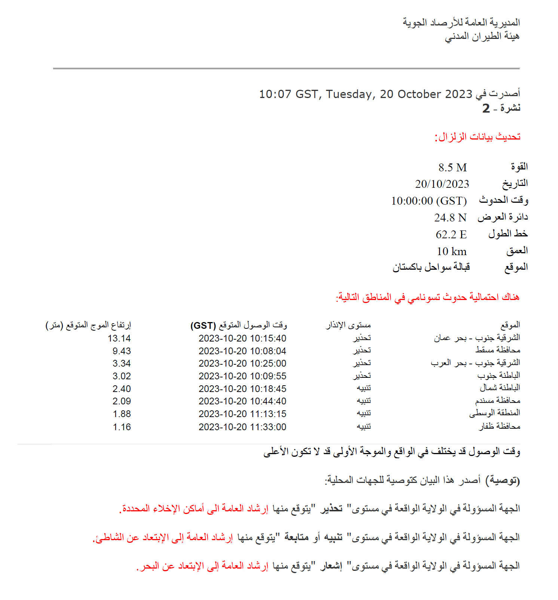
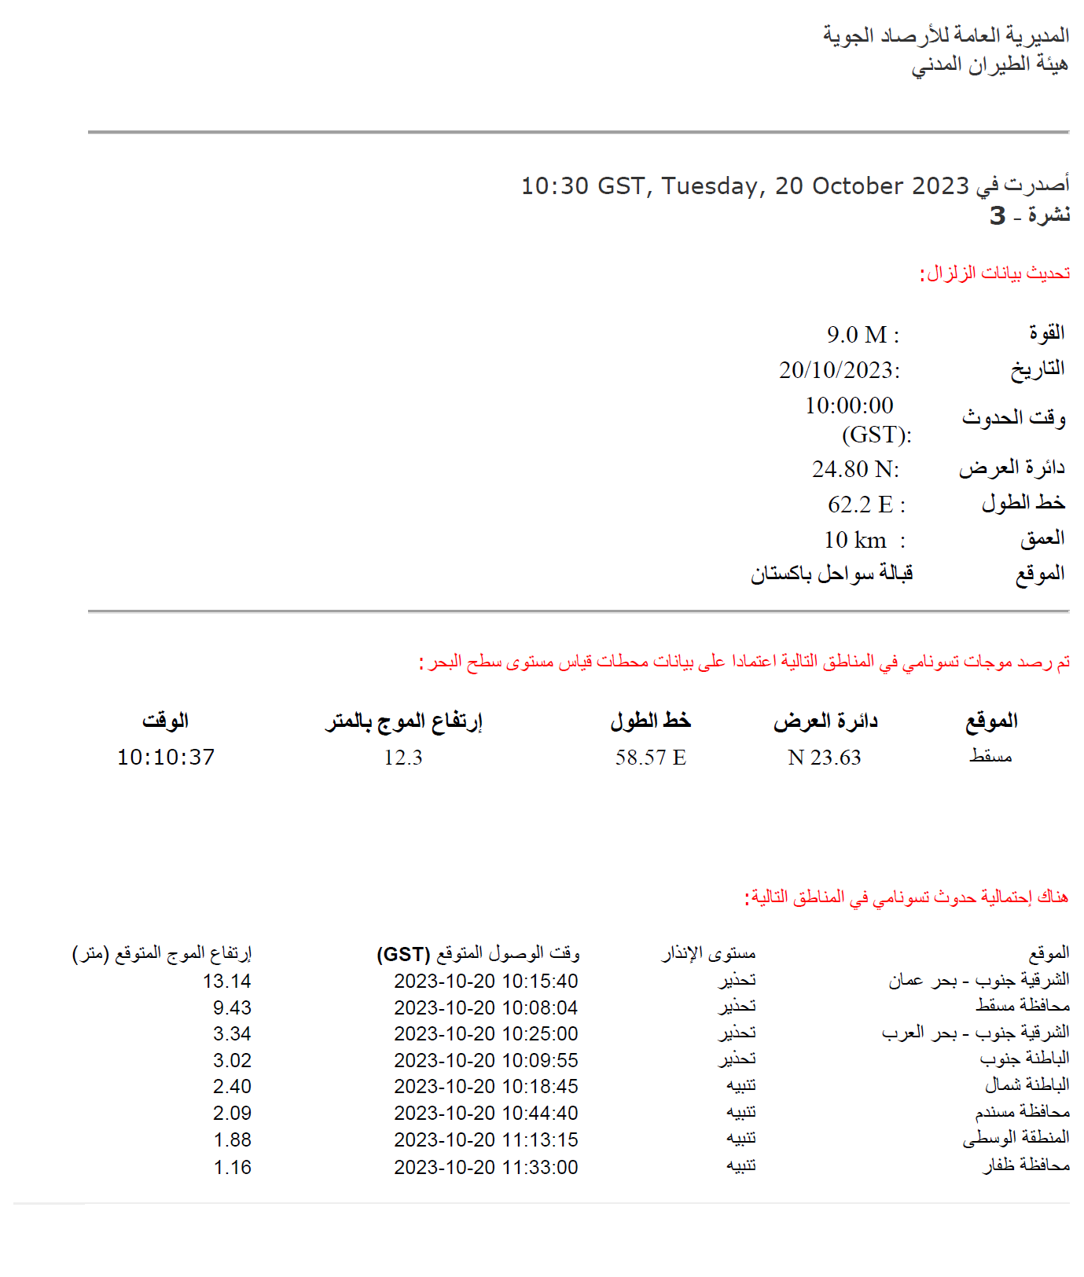
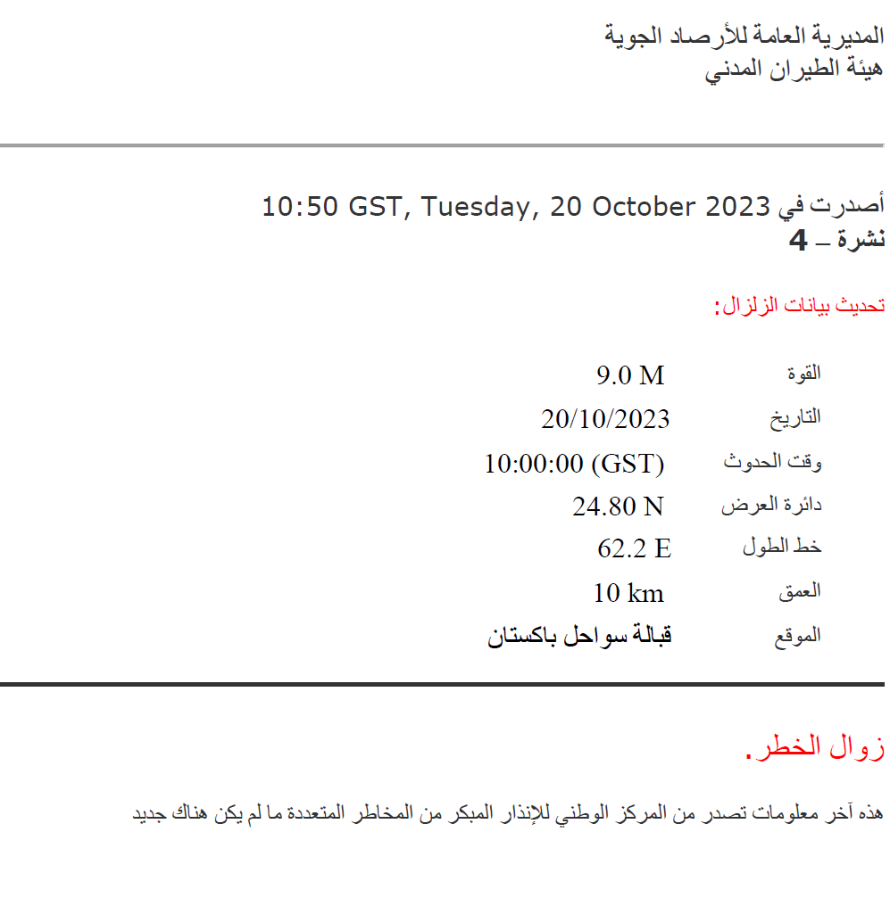
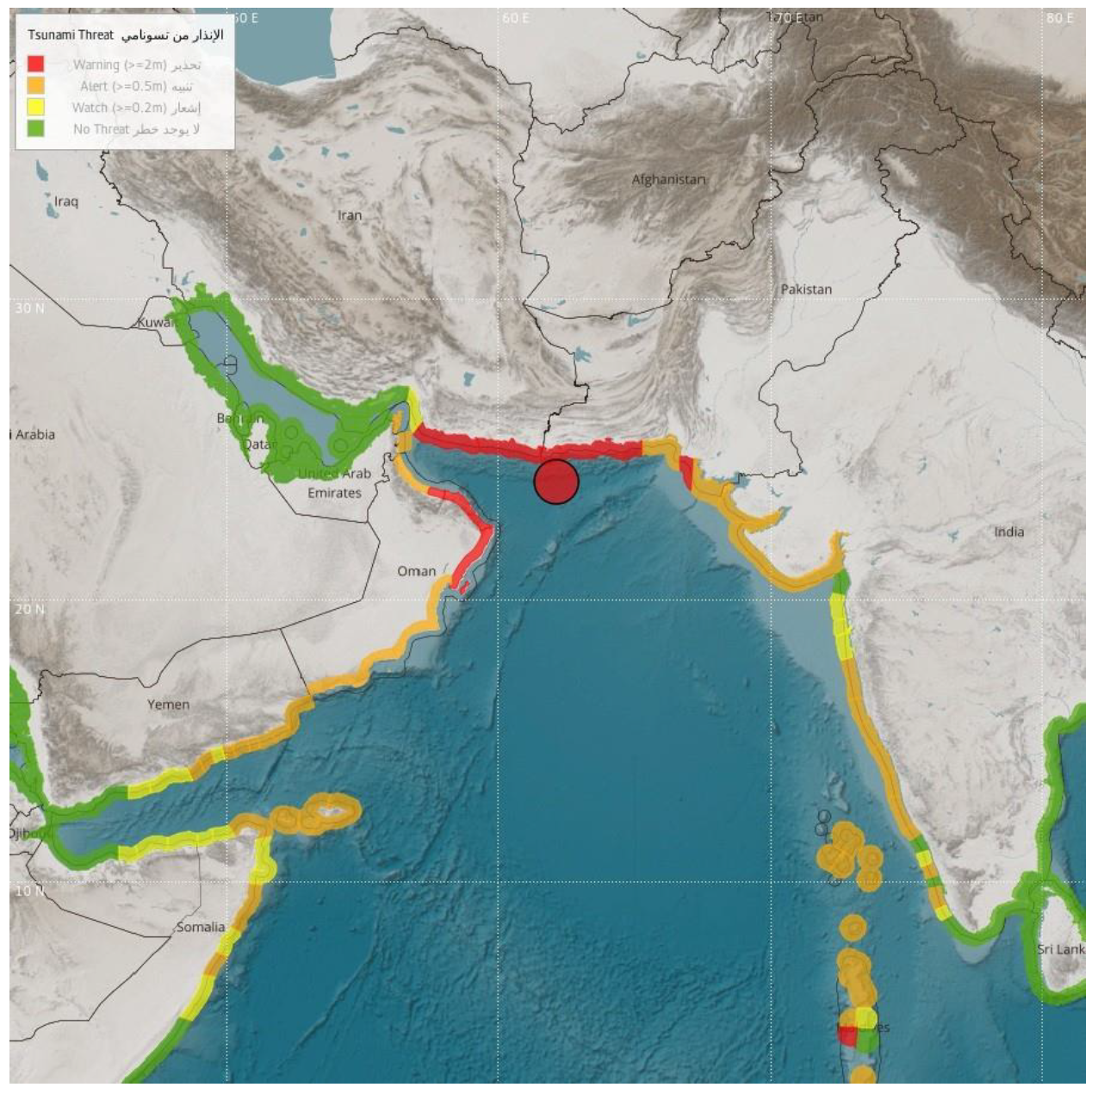
النشرات Bulletins
Send Via
Fax
Email
SMS
Social Media
Website

Slide 8
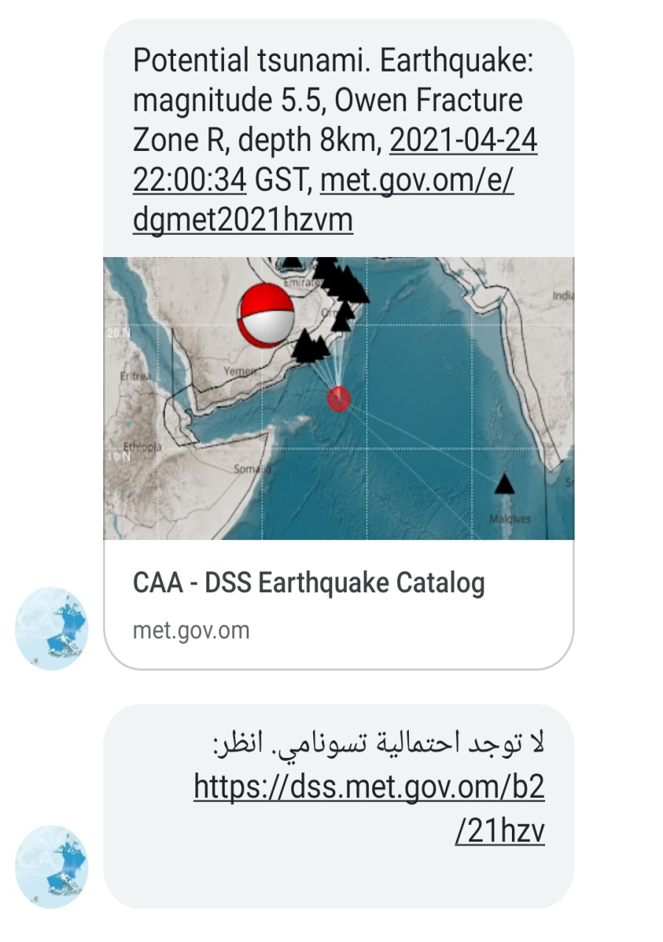
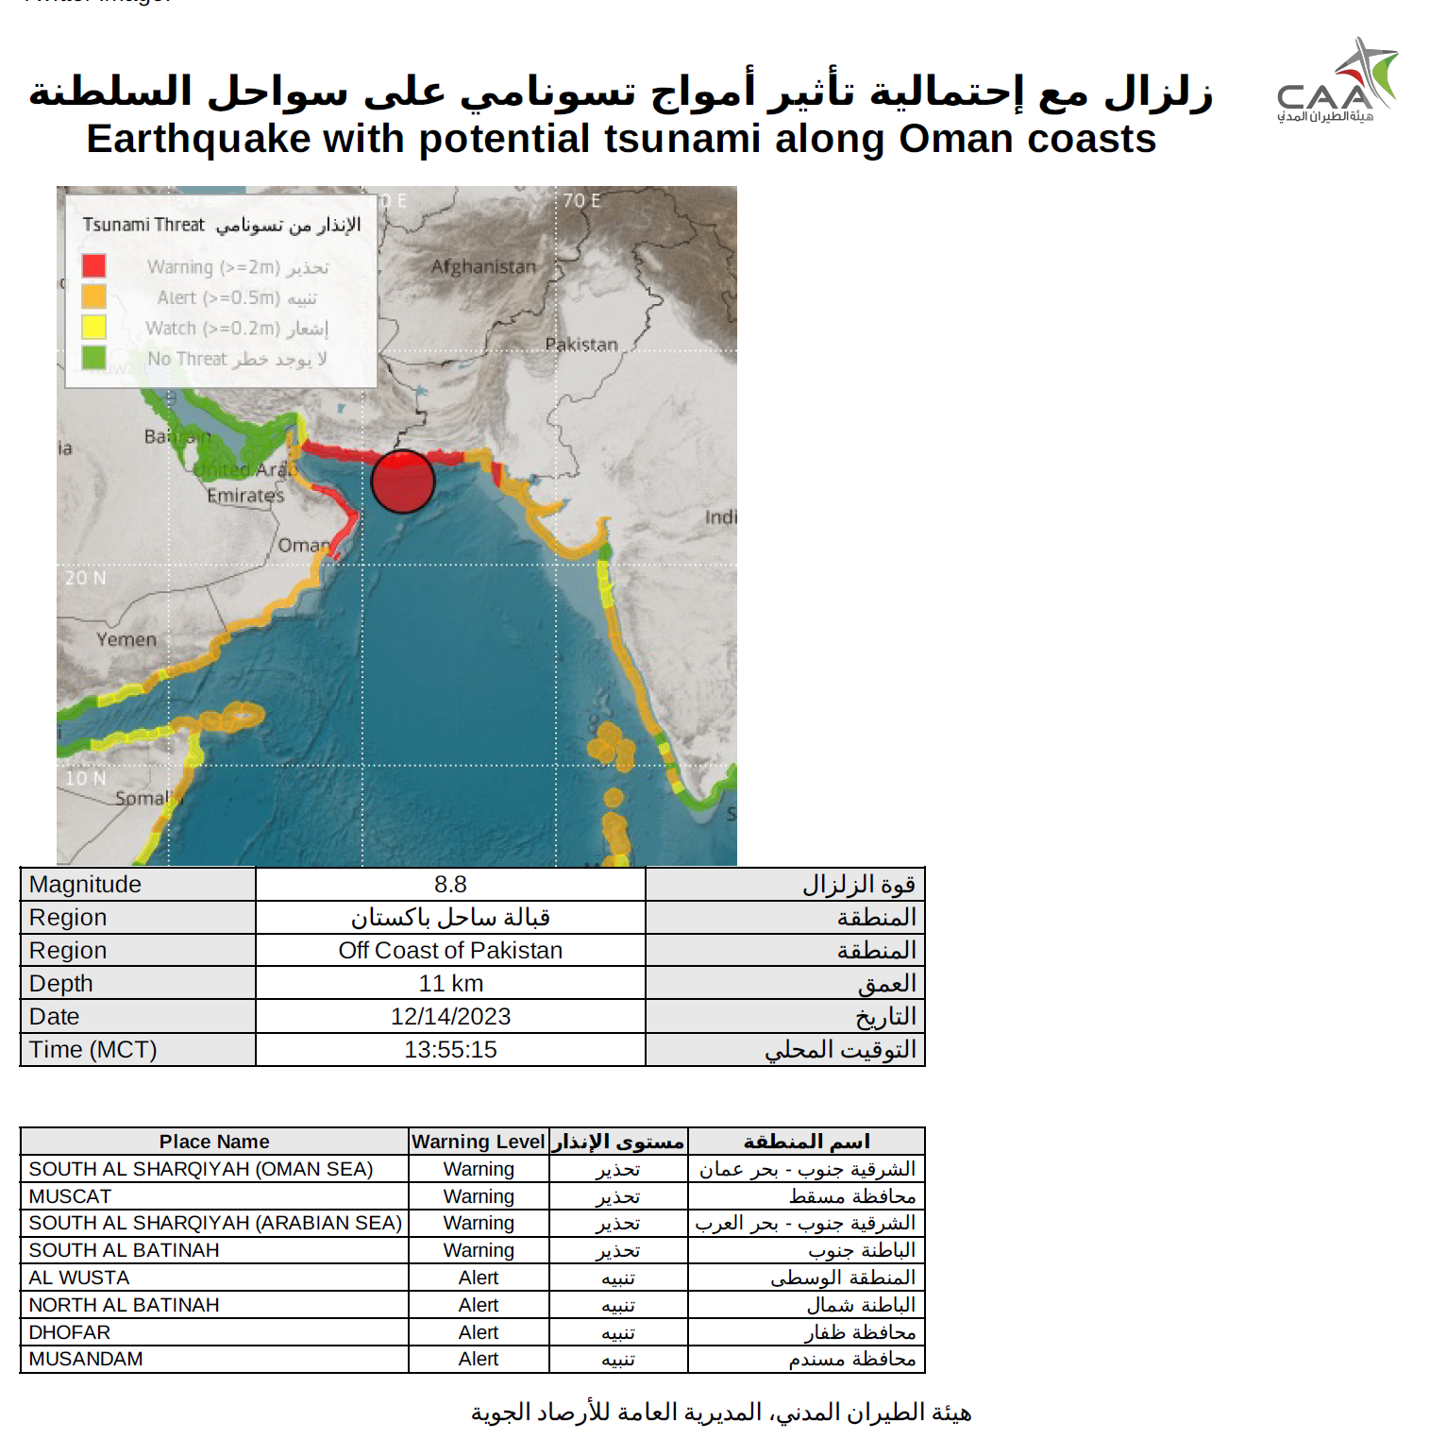
Example of SMS
Social Media
TV and Radio
B1
B2

Slide 9
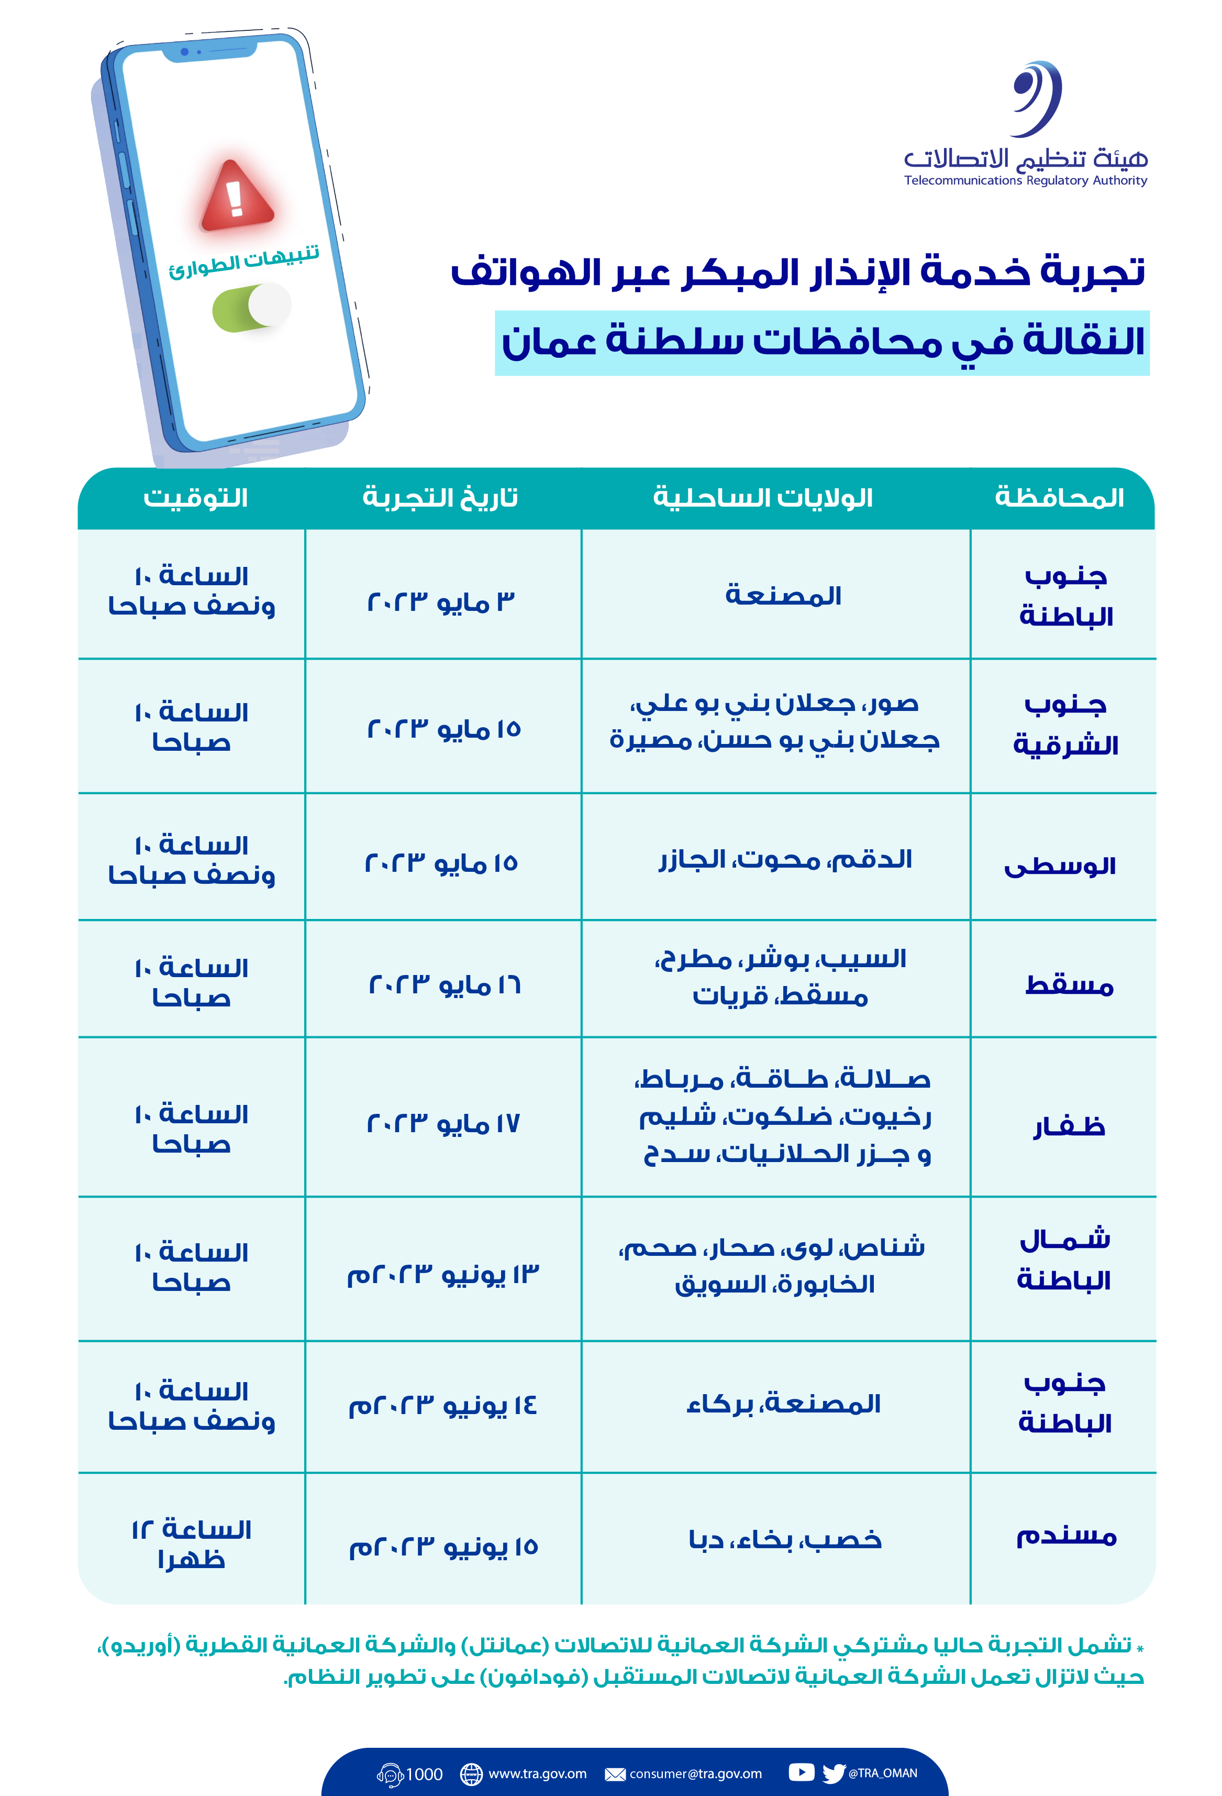
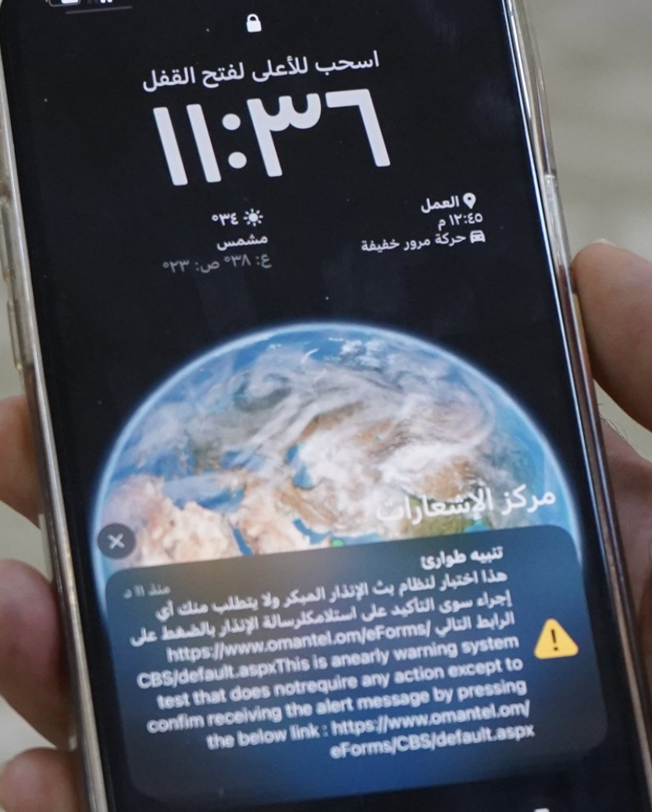
بث الإنذارات بتقنية Cell-broadcast
a technology that broadcasts messages to all mobile phones within a specific geographical area, and is identified with a distinctive ring tone, and an alert content is made on the phone screen immediately. It is capable of transmitting alerts to thousands of mobile subscribers in a few seconds.
عبارة عن تقنية تسمح ببث الرسائل في وقت واحد إلى جميع الهواتف المحمولة داخل منطقة جغرافية معينة، وهي محددة بنغمة رنين مميزة ومخصصة لحالات الطوارئ وسيتم عرض التحذير تلقائياً على شاشة الهاتف حتى يتم التعرف على محتوى التحذير فوراً. يعتبر البث الخلوي تقنية متطورة تمكن الجهة المُرسلة من وصول التنبيهات او التحذيرات إلى آلاف المشتركين في بضع ثوانٍ.

Slide 10
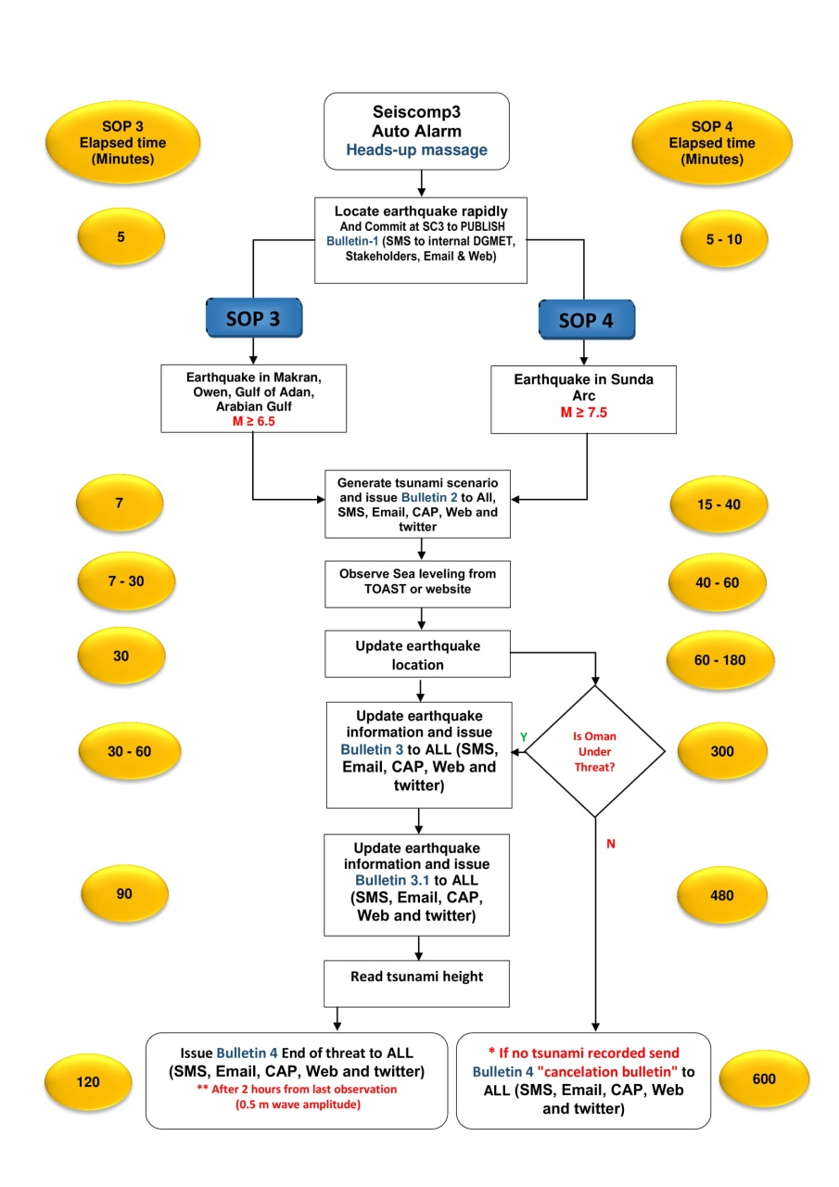
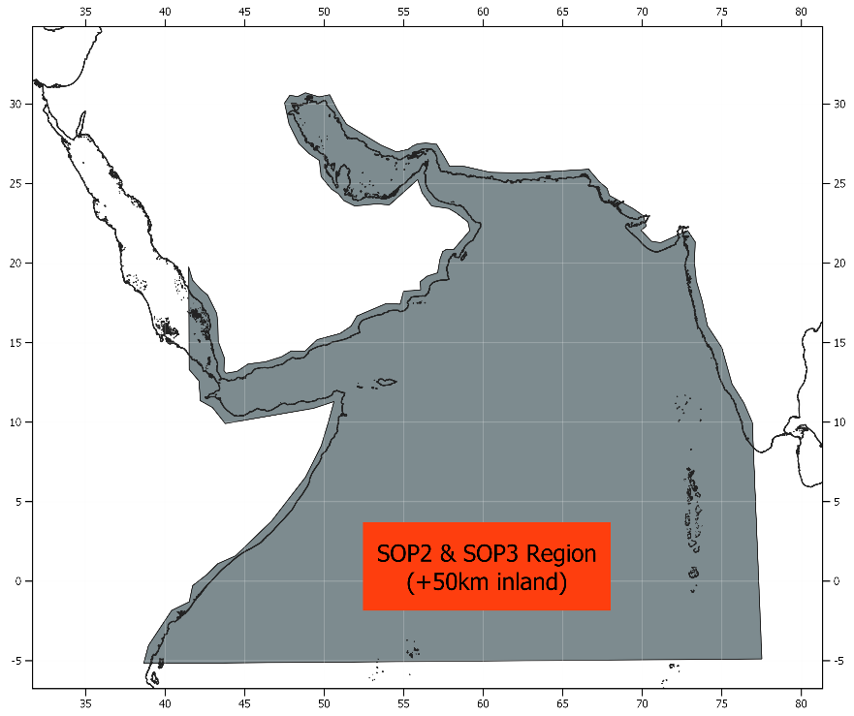
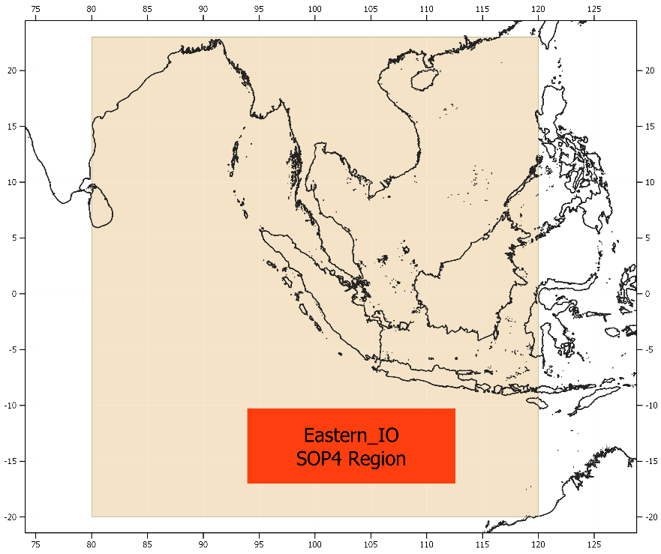
Standards Operating Procedures
الإجراءات رقم 3
زلزال بقوة أكبر او يساوي 6.5 (قريب المصدر)
الإجراءات رقم 4
زلزال بقوة أكبر او يساوي 7.7 (بعيد المصدر)

Slide 11
Test Timeline
Local Time (GMT+4) | Bulletin Number | Bulletin Type
10:00 |  | Announcement Message
10:05 | 1 | Earthquake Info Bulletin
10:07 | 2 | Potential Threat Bulletin
10:30 | 3 | Confirmed Threat Bulletin
10:40 | 3.1 | Confirmed Threat Bulletin
10:50 | 4 | End of Threat - Final Bulletin
11:00 |  | End of Exercise Message

Slide 12
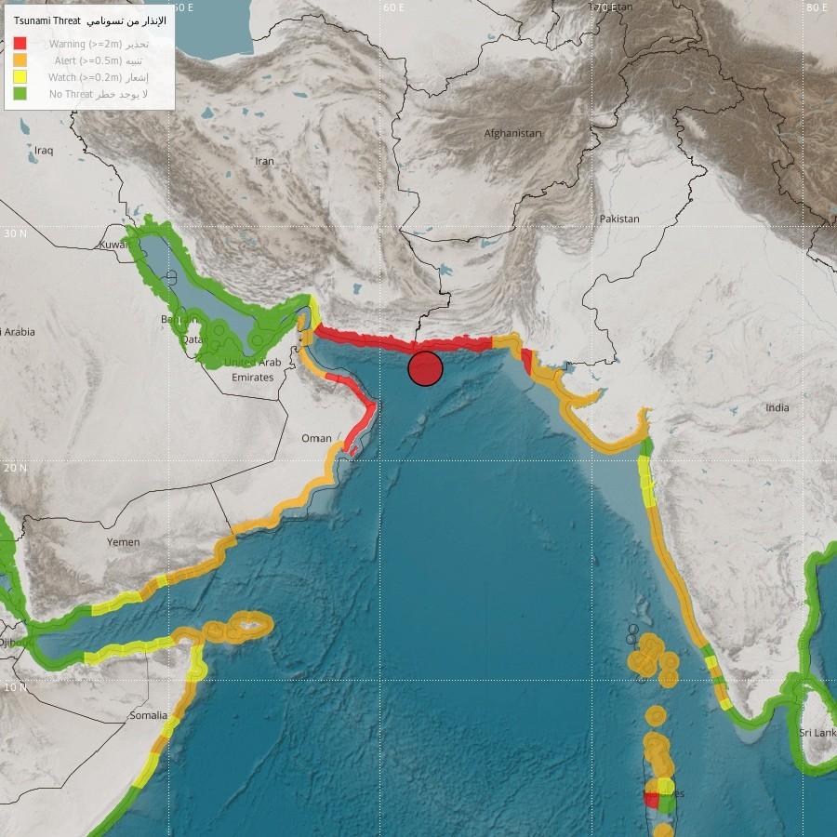
Task
سناريو صدع مكران -20 أكتوبر
Write the information you find in each bulletin:
Earthquake of magnitude 9.0 occurs off coast of Pakistan in 20th of October, 2023 10:00 local time and causes huge tsunami waves of 12 meters in less than 15 minutes.
2. RNO Standards Operating Procedures – Discussions.

Slide 13
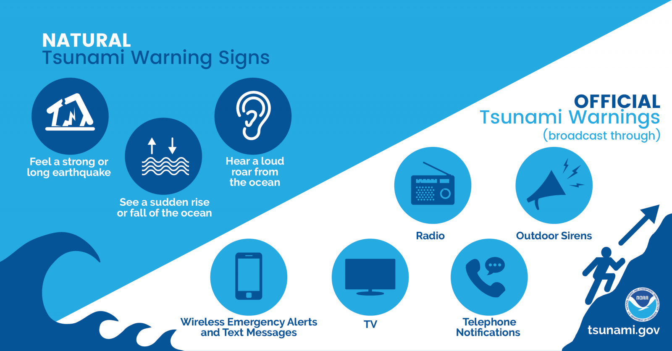
Tsunami Safety | onshore
Public Awareness through drills is the essential for the community readiness and resilience

Slide 14
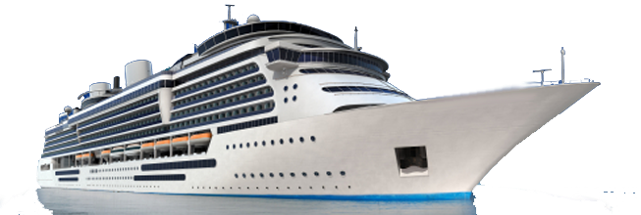
Tsunami Safety | offshore
What to do ?
You may feel the earthquake through the hull of your ship
You may see a rapid or extreme shift in currents and simultaneous changes in wind wave heights
You may receive official warning
If you are on land or tied up at the dock: Do not attempt to take your vessel offshore. Leave your boat and go to high ground on foot as soon as possible.
If you are in deep water or close to deep water: Take your vessel further offshore beyond the “minimum offshore safe depth”. Typically, this depth is 50 to 100 fathoms (90 to 180 meters), then you are safe from tsunamis.
If you are on the water but near shore: Use your best judgment to decide between the two options: safely beach/dock the vessel and evacuate to high ground or get to the minimum offshore safe depth.

Slide 15
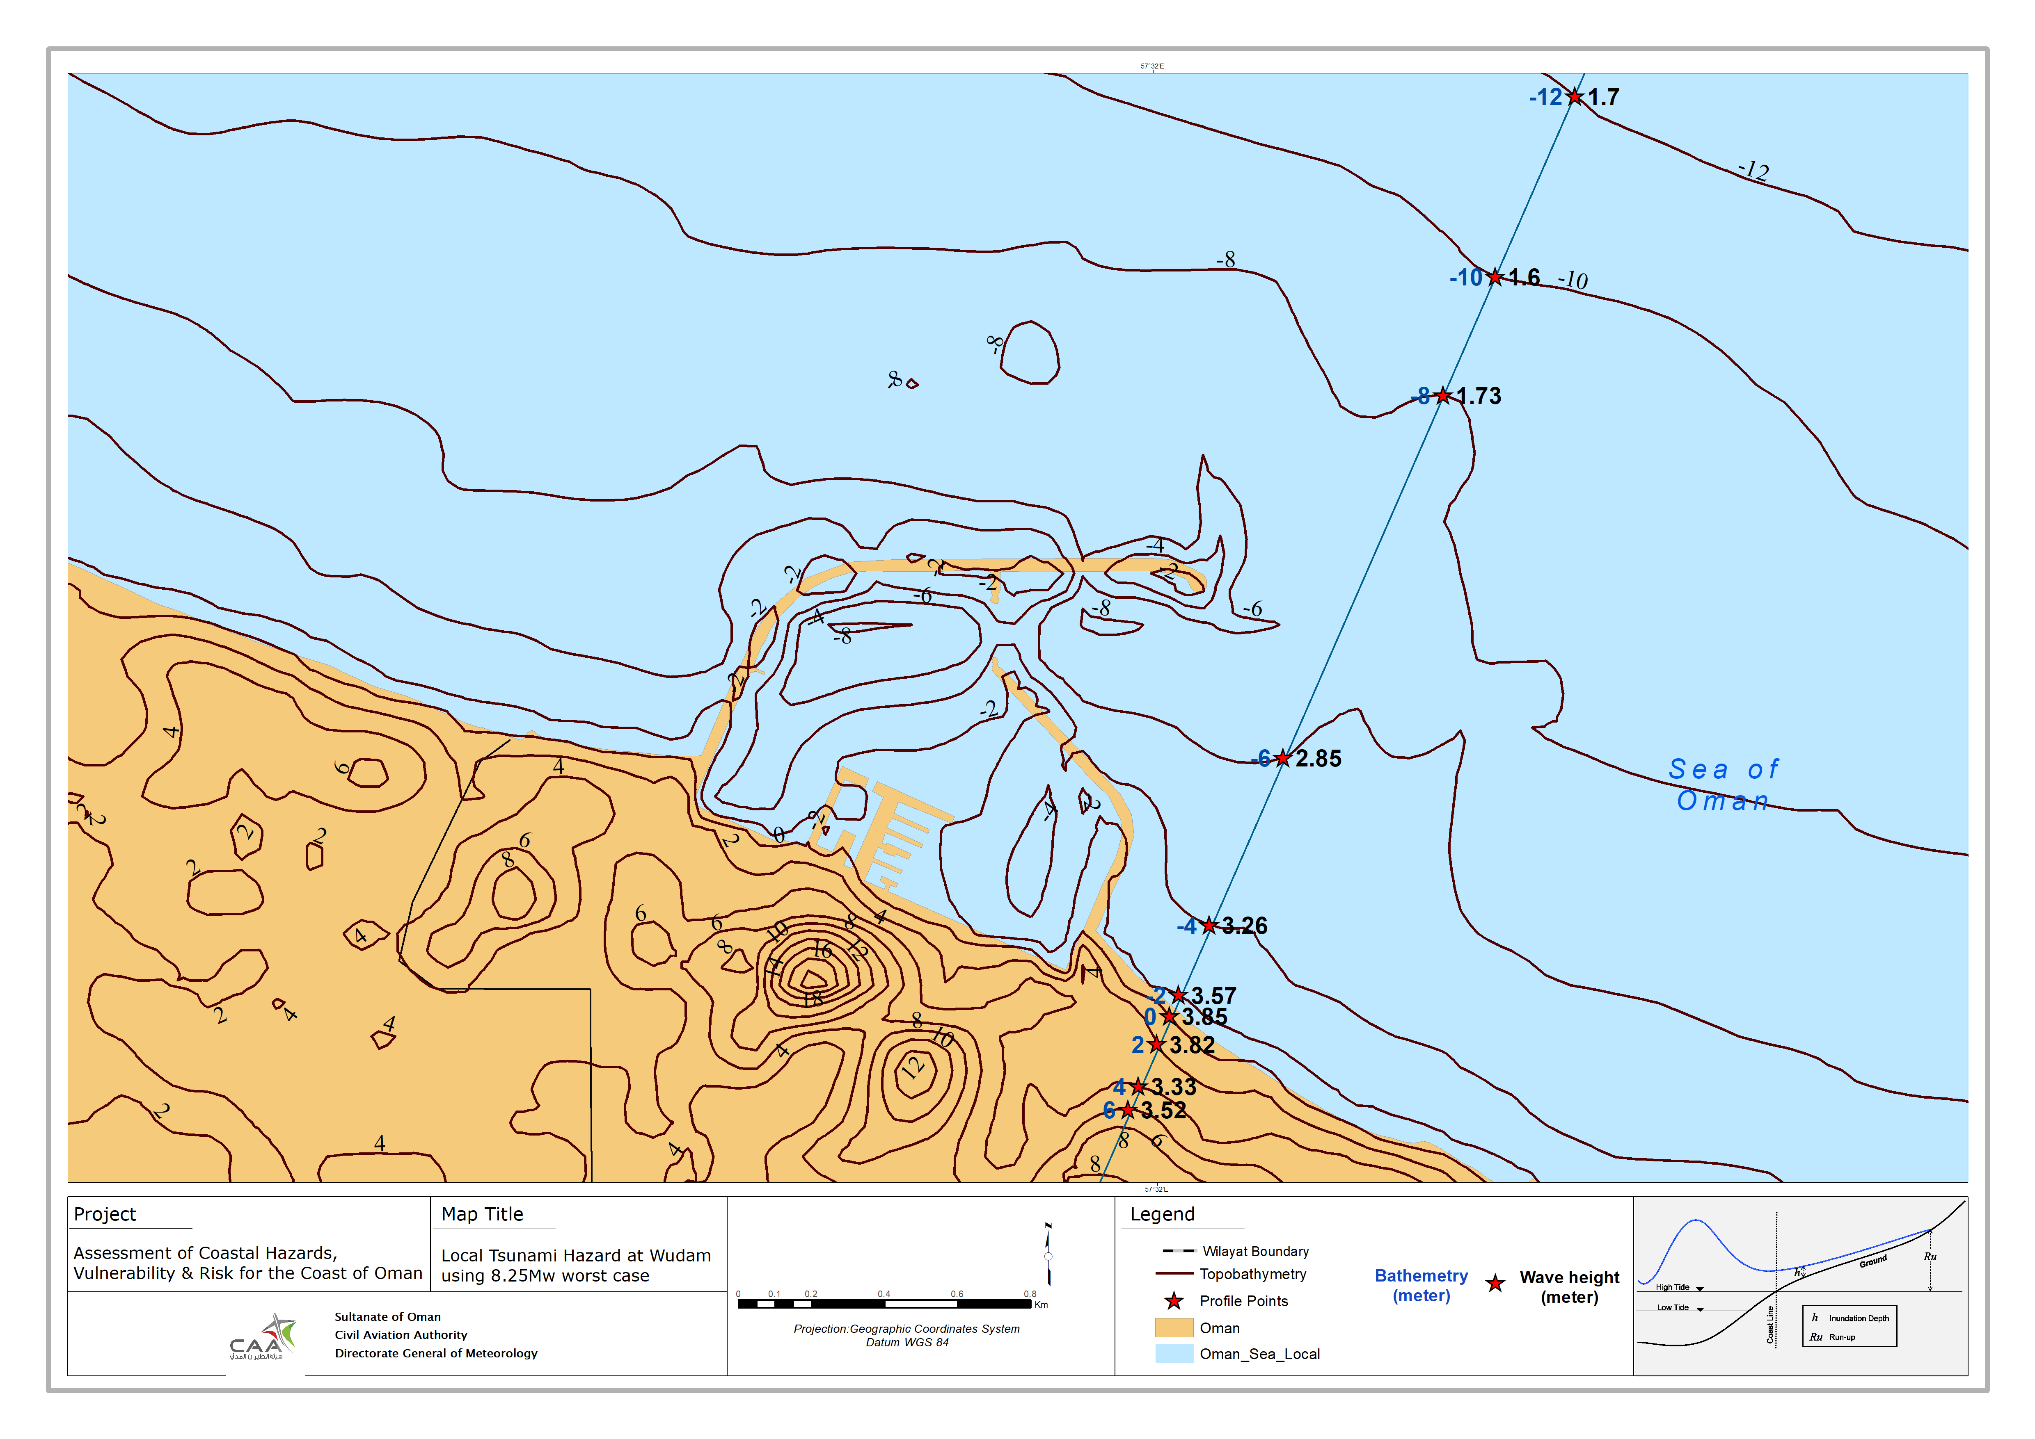
Case Study - Wudam

Slide 16
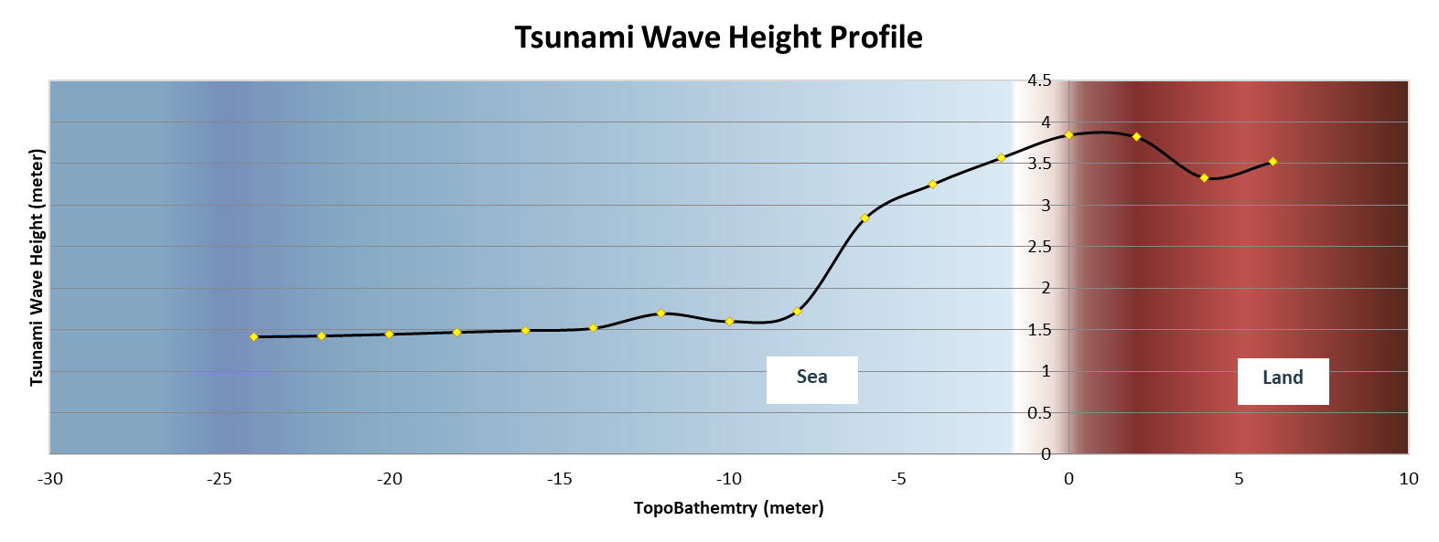
Case Study - Wudam

Slide 17
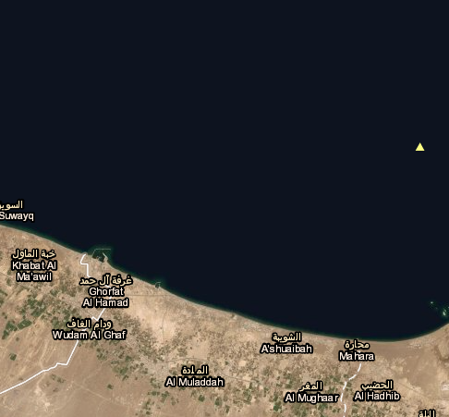
Case Study - Wudam
Maximum beach = Maximum positive wave amplitude at the shoreline depth =1 m
Maximum deep = Maximum positive wave amplitude in the deep water at approximately 30 m depth

Slide 18
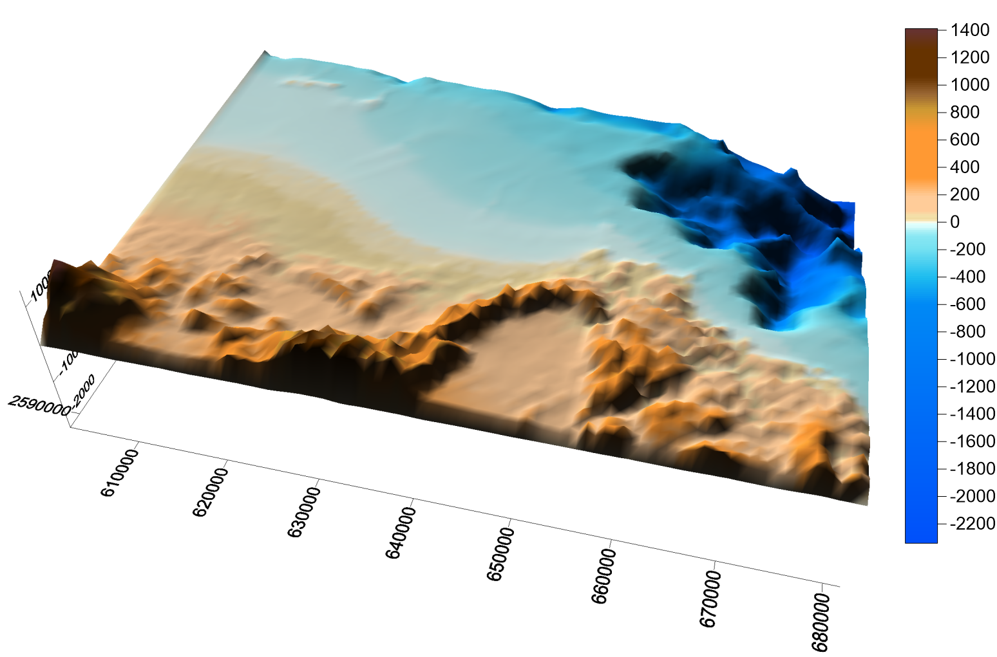
3D Bathymetry

Slide 19
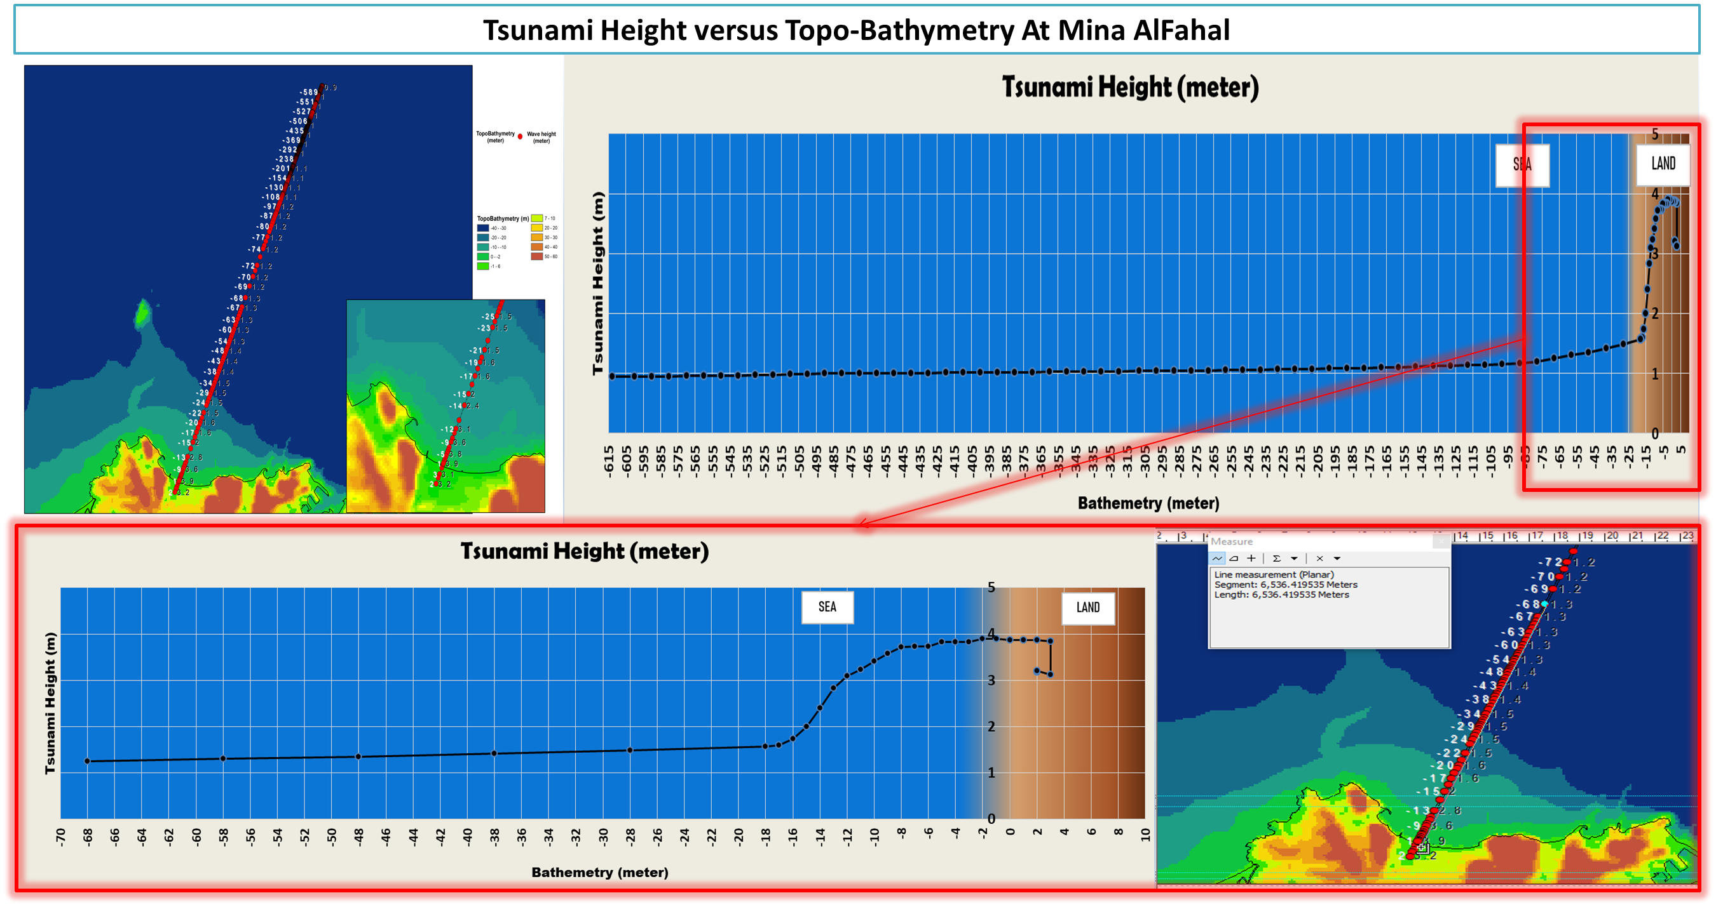
Case Study- Seeb vs Matrah

Slide 20
