Slide 1
Exploring the weather RADAR
Afada AlHubaishi
Afada AlHubaishi

Slide 2
What is Weather RADAR?
RADAR: Radio Detection And Ranging
A methodology that uses Electromagnetic waves to detect, determine the location, intensity, and movement of precipitation and meteorological phenomena in the atmosphere.
Weather RADAR is used to provide meteorologist and weather forecasters with real information about the current weather conditions and to track the development of the storms.

Slide 3
Historical Development of Weather RADAR
World War II: Was developed for military purposes during World War II, then noticed that radar could also detect precipitation in the atmosphere.
Weather RADAR
Doppler RADAR: Allows meteorologists to measure the speed and direction of precipitation particles.
Dual Polarization RADAR: This technology provides more detailed information about the size and shape of precipitation particles, enhancing the accuracy of precipitation type identification.
Advancements in RADAR Technology: Improvements in radar resolution, computer processing capabilities, and data visualization.

Slide 4
Why we need Weather RADAR?
Clouds and mesoscale phenomena are too small to be resolved by conventional surface and upper-air networks, and too large to be observed locally
Radar is most effective instrument for obtaining observations in cloud systems.
Radar can observe the precipitation with mesoscale coverage (~200km) and convective-scale resolution (~1km)

Slide 5
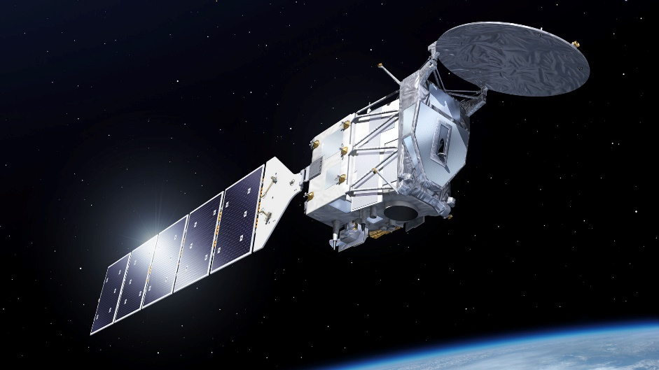
Weather Radar Types:
Ground-Based Radar
Airborne Radar
Satellite Radar

Slide 6
How RADAR Works?
Weather radar operates based on the principles of:
Radio wave transmission
Reflection
Reception

Slide 7
Weather RADAR Applications : Weather monitoring and forecasting
Precipitation Detection: Detecting and monitoring various forms of precipitation, such as rain, snow, hail, and sleet.
Storm Tracking: It helps meteorologists monitor storm intensity, movement, and potential hazards. Doppler radar is particularly valuable for tracking severe weather detection.
Severe Weather Warnings: Timely warnings for severe weather events. Doppler radar helps identify rotation in thunderstorms, indicating the potential for tornado formation. This information is vital for public safety and emergency preparedness.
Hydrology and Flood Prediction: Weather radar data is used in hydrology to monitor rainfall patterns and assess the potential for flooding. This information is valuable for flood prediction, early warning systems, and water resource management.

Slide 8
Weather RADAR Applications : Aviation
detecting and avoiding hazardous weather conditions
Pilots use radar information to navigate around thunderstorms, turbulence, and other weather-related challenges during flight.

Slide 9
Weather RADAR Applications : Agriculture
monitor precipitation patterns and make informed decisions about irrigation, planting, and harvesting.
This helps optimize agricultural practices and manage water resources efficiently.

Slide 10
More Weather RADAR Applications
Research and Scientific Studies
Environmental Monitoring
Disaster Management
Public Information and Education

Slide 11
RADAR Applications

Slide 12
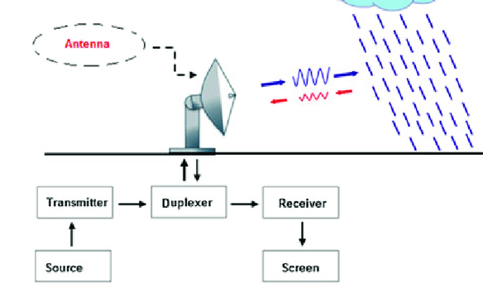
Basic RADAR Components
Transmitter
Antenna
Duplexer
Receiver
Signal Processer
Display System

Slide 13
Basic RADAR Components
Transmitter: The transmitter generates short pulses of electromagnetic waves (with specific power, frequency, and duration). These pulses are directed into the atmosphere to interact with precipitation particles.
Antenna
Duplexer
Receiver
Signal Processer
Display System

Slide 14
Basic RADAR Components
Antenna: The radar antenna is responsible for both transmitting the radar pulses and receiving the signals that are scattered back by precipitation particles waves.
Duplexer
Receiver
Signal Processer
Display System

Slide 15
Basic RADAR Components
Duplexer: The duplexer is a switching device that alternates the radar system between the transmission and reception modes.
Receiver
Signal Processer
Display System

Slide 16
Basic RADAR Components
Receiver: The receiver is a critical component for interpreting the radar echoes and extracting meteorological information
Signal Processer
Display System

Slide 17
Basic RADAR Components
Signal Processer: The signal processor analyzes the data received from the receiver. It performs various functions such as filtering, amplification, and signal processing algorithms to enhance the quality of the radar data and extract meaningful information about precipitation.
Display System

Slide 18
Basic RADAR Components
Display System: Maps or images with different colors on the display represent different levels of precipitation intensity, allowing meteorologists to interpret and analyze the information.

Slide 19
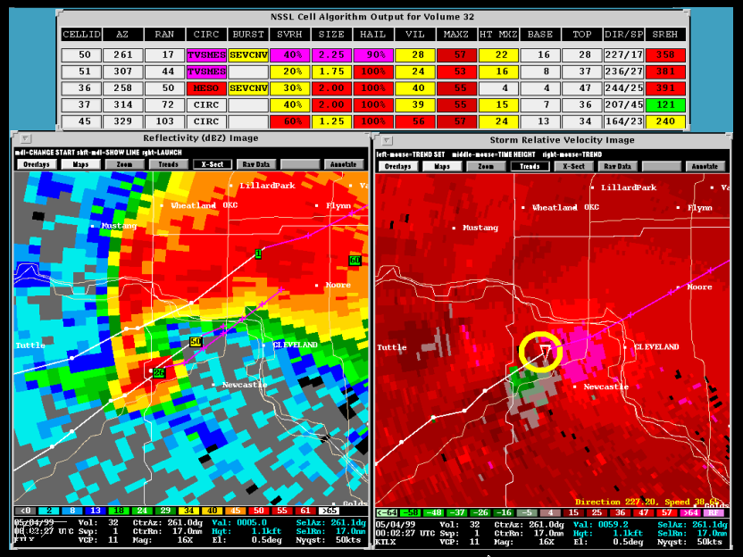
Basic RADAR Components
Display System: Maps or images with different colors on the display represent different levels of precipitation intensity, allowing meteorologists to interpret and analyze the information.

Slide 20
Basic RADAR Components
Transmitter
Antenna
Duplexer
Receiver
Signal Processer
Display System

Slide 21
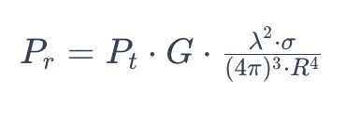
RADAR Equation

Slide 22
RADAR Equation
P_{t​} - Transmitted power (Watts)
This is the power of the radar signal transmitted by the radar transmitter.
Unit: Watts (W).

Slide 23
RADAR Equation
G - Antenna gain
Represents how effectively it concentrates the transmitted power in a particular direction
It is dimensionless.

Slide 24
RADAR Equation
λ - Wavelength of the radar signal (meters)
The length of one cycle of the radar signal. It is inversely proportional to the radar frequency
Unit: Meters (m).

Slide 25
RADAR Equation
σ - Radar Cross Section (meters squared)
A measure of the reflectivity of the target. It represents the effective area that scatters the radar signal back to the radar.
Unit: Square meters (m²).

Slide 26
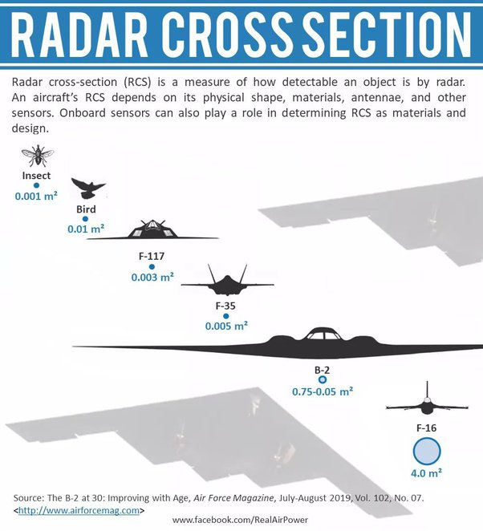
RADAR Equation
σ - Radar Cross Section (meters squared)
A measure of the reflectivity of the target. It represents the effective area that scatters the radar signal back to the radar.
Unit: Square meters (m²).

Slide 27
RADAR Equation
R - Distance from the radar to the target
The radial distance from the radar to the point in the atmosphere where the radar signal is scattered
Unit: Meters (m)

Slide 28
RADAR Equation
R - Distance from the radar to the target
The radial distance from the radar to the point in the atmosphere where the radar signal is scattered
Unit: Meters (m)

Slide 29
RADAR Equation
P_{r}​ - Received power
This is the power of the radar signal after it has interacted with the atmosphere and targets and is received by the radar receiver
Unit: Watts (W)

Slide 30
RADAR Equation
P_{t​} - Transmitted power (Watts)
G - Antenna gain
λ - Wavelength of the radar signal (meters)
σ - Radar Cross Section (meters squared)
R - Distance from the radar to the target (meters)
P_{r}​ - Received power (Watts)

Slide 31
RADAR Equation

Slide 32
RADAR Reflectivity
Radar reflectivity is a measure of how well a target reflects radar waves.
When radar beams encounter precipitation particles in the atmosphere, such as raindrops or snowflakes, some of the radar energy is scattered back towards the radar site
The amount of energy returned, or reflected, is measured and represented as reflectivity.

Slide 33
Reflectivity Scale
Reflectivity is typically measured in decibels of Z (dBZ)
The reflectivity scale is logarithmic, and higher dBZ values correspond to larger and more reflective precipitation particles
Signal varies with 6th power of raindrop diameter

Slide 34
Interpretation of Reflectivity
Light precipitation: Reflectivity values below 20 dBZ usually indicate light rain, drizzle, or light snow.
Moderate precipitation: Reflectivity values between 20 and 40 dBZ suggest moderate rain or snowfall.
Heavy precipitation: Reflectivity values above 40 dBZ often indicate heavy rain or intense snow.

Slide 35
Interpretation of Reflectivity
Light precipitation: Reflectivity values below 20 dBZ usually indicate light rain, drizzle, or light snow.
Moderate precipitation: Reflectivity values between 20 and 40 dBZ suggest moderate rain or snowfall.
Heavy precipitation: Reflectivity values above 40 dBZ often indicate heavy rain or intense snow.

Slide 36
RADAR to Rainfall
R = Rainfall Rate
A and b are empirical constants

Slide 37
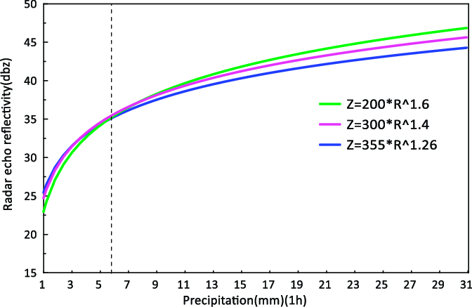
RADAR to Rainfall
R = Rainfall Rate
A and b are empirical constants

Slide 38
RADAR Limitations
Range Limitations
Resolution
Clutter
Weather Interference
Limited Elevation Coverage
Cost and Complexity

Slide 39
Doppler Effect
The Doppler Effect in weather radar helps measure the velocity of moving precipitation particles, providing valuable information about the dynamics of the atmosphere.
As the radar waves interact with the moving particles, the frequency of the reflected waves is shifted. If the particles are moving toward the radar, the frequency increases (positive Doppler shift). If the particles are moving away, the frequency decreases (negative Doppler shift).

Slide 40
Velocity Calculation by Doppler Effect
By measuring the Doppler shift, the radar system can calculate the radial velocity of the precipitation particles along the radar beam. Radial velocity is the component of motion along the line of sight between the radar and the moving particles.

Slide 41
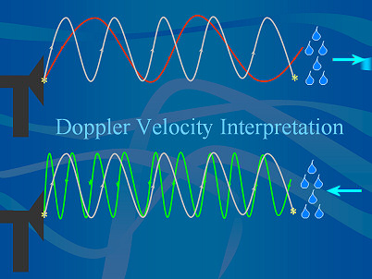
Velocity Calculation by Doppler Effect
By measuring the Doppler shift, the radar system can calculate the radial velocity of the precipitation particles along the radar beam. Radial velocity is the component of motion along the line of sight between the radar and the moving particles.

Slide 42
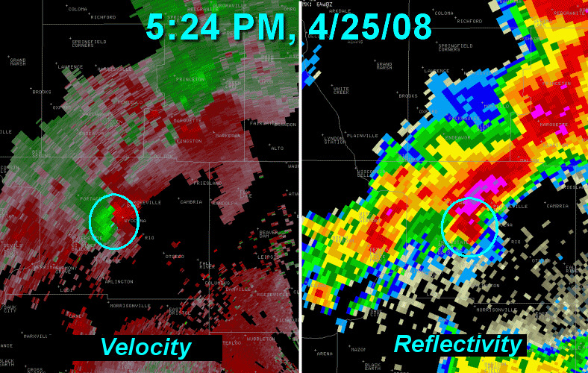
Velocity Calculation by Doppler Effect
By measuring the Doppler shift, the radar system can calculate the radial velocity of the precipitation particles along the radar beam. Radial velocity is the component of motion along the line of sight between the radar and the moving particles.

Slide 43
Dual Polarization
Dual-polarization radar is an advancement in radar technology that utilizes both horizontal and vertical polarizations of radar waves
Doppler velocity measurements, dual-polarization radar provides information about the shape, size, and type of precipitation particles.

Slide 44
Dual Polarization

Slide 45
Dual Polarization
New Variables available
1- Differential Reflectivity (ZDR)
2- Correlation Coefficient (CC)
3- Differential Phase (DP)

Slide 46
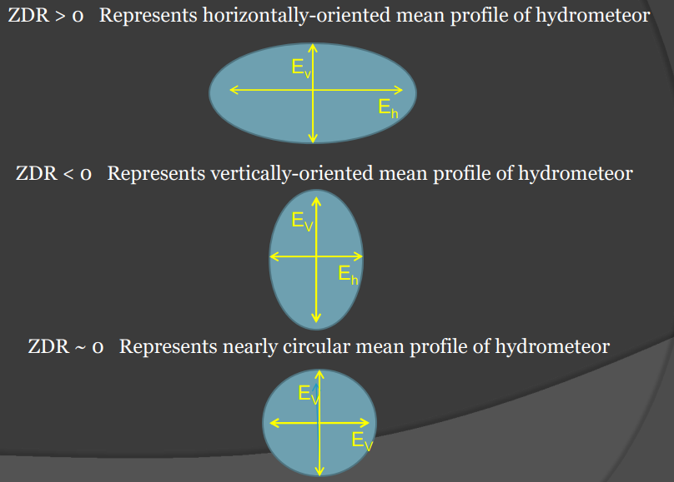
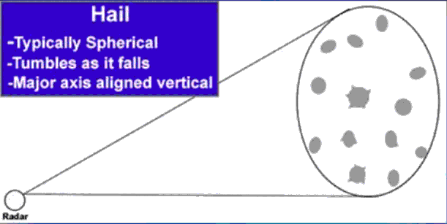
Dual Polarization
New Variables available
1- Differential Reflectivity (ZDR)
2- Correlation Coefficient (CC)
3- Differential Phase (DP)

Slide 47
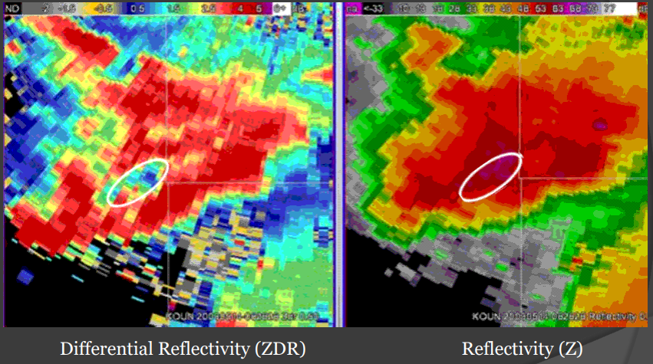
Differential Reflectivity (ZDR)

Slide 48
Dual Polarization
New Variables available
1- Differential Reflectivity (ZDR)
2- Correlation Coefficient (CC)
3- Differential Phase (DP)

Slide 49
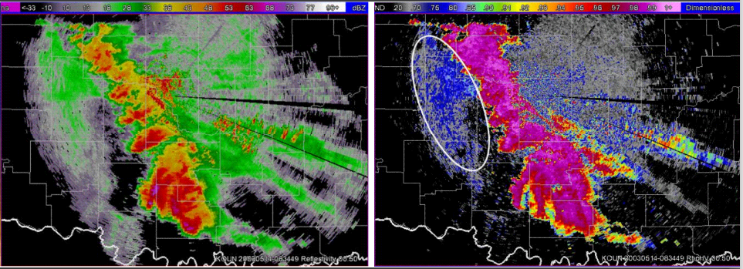
Correlation Coefficient (CC)

Slide 50
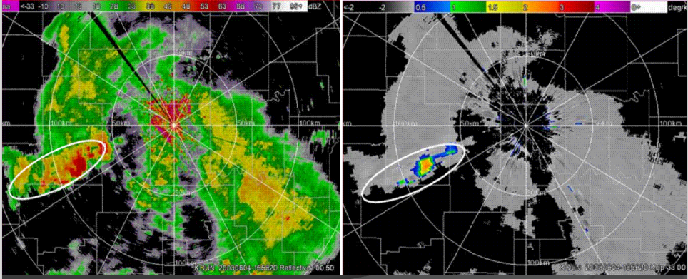
Differential Phase (DP)

Slide 51
exercise

