Slide 1
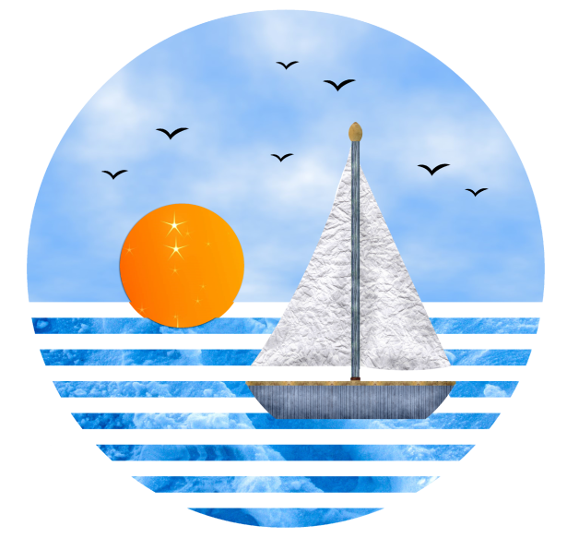
Ocean surface waves
Marine Meteorological Course for Royal Oman Navy
Content creator: Jamal Alhinai
Lecturer: Jamal Alhinai
Notes:
What mean of wave state?

Slide 2
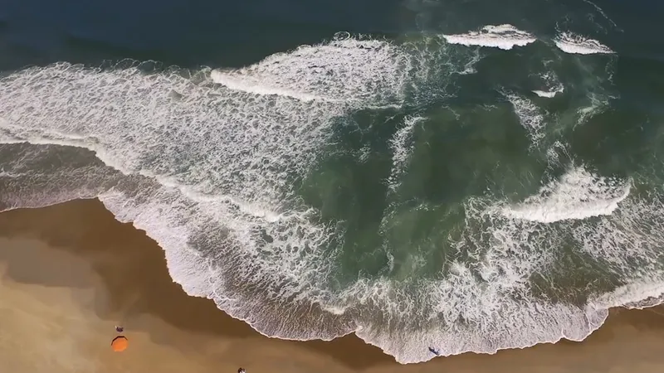
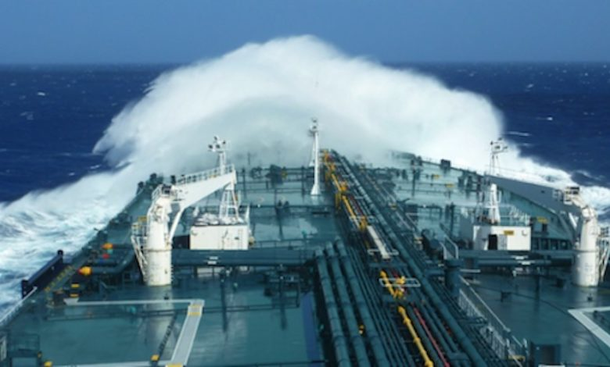
Content
Basic of waves and Current.
Wave Modelling.
How get knowledge of sea state.
Predict wave state for next three days.
Example of wave Impacts.

Slide 3
Basic of waves and Current

Slide 4
Basic of waves and Current
What is a wave? What is current ?
A wave is a periodic process.
Current is a non periodic process.

Slide 5
Basic of waves and Current
A wave is an oscillation of water particles around a position of equilibrium.
The individual particle remains roughly at its original position.
The wave propagation follows a law of dispersion.
Current is the transport of water particles along stream lines.
The individual particle never again reaches its original position.
For current no law of dispersion may be defined.

Slide 6
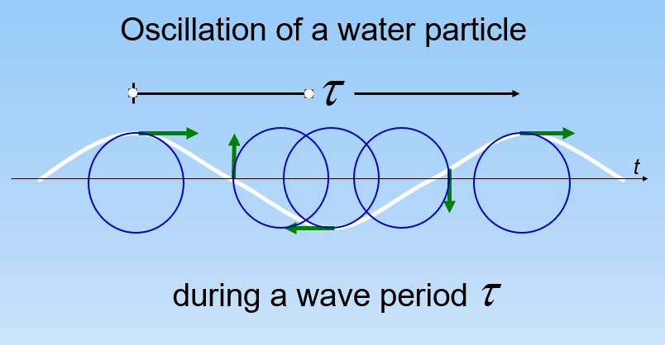
Basic of waves and Current - wave

Slide 7
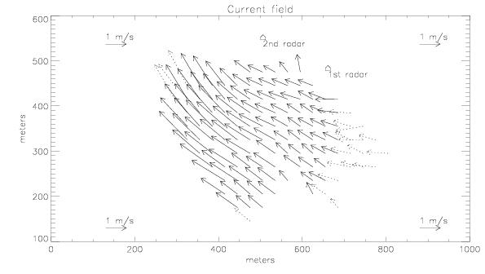
Basic of waves and Current
Current transports water particles The current speed depends from the water depth:

Slide 8
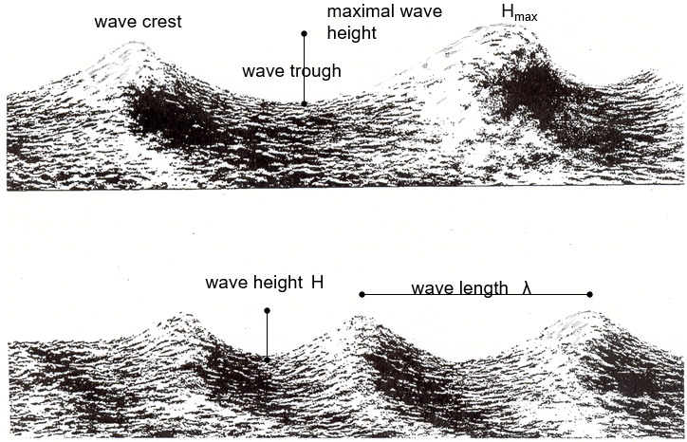
Basic of waves and Current

Slide 9
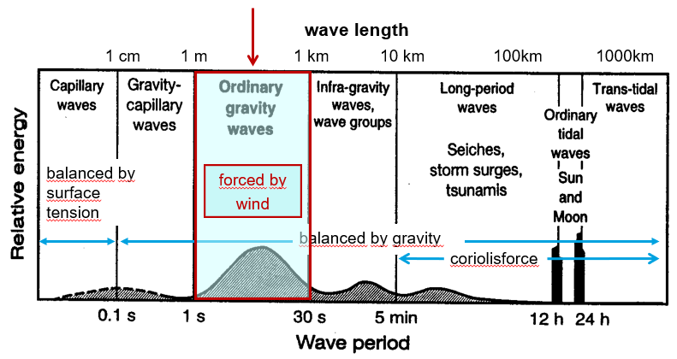
Basic of waves and Current

Slide 10
Basic of waves and Current

Slide 11
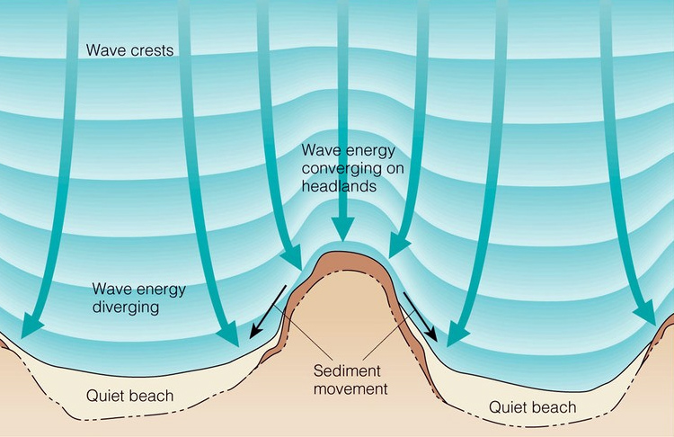
Basic of waves and Current
Refraction
The bending of a wave-front as it travels at different speeds over water of different depths

Slide 12
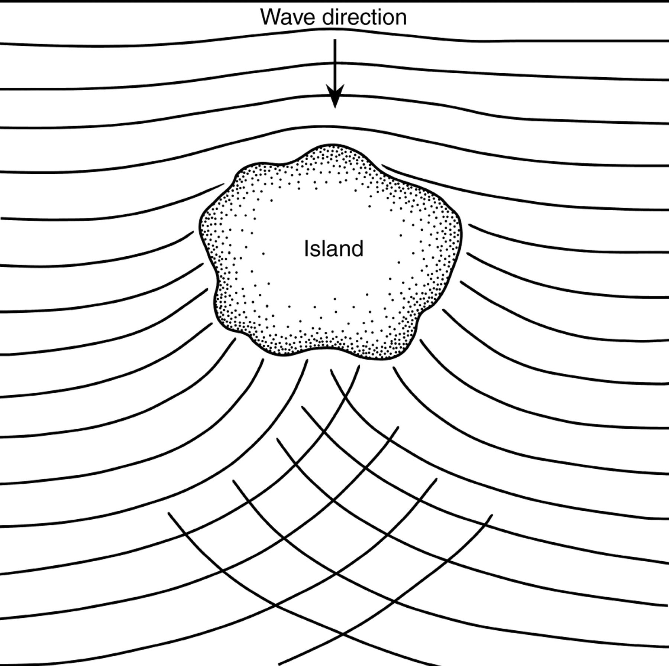
Basic of waves and Current
Diffraction
A sudden change in the direction and intensity of waves after passing by a coastal feature or offshore obstruction.

Slide 13
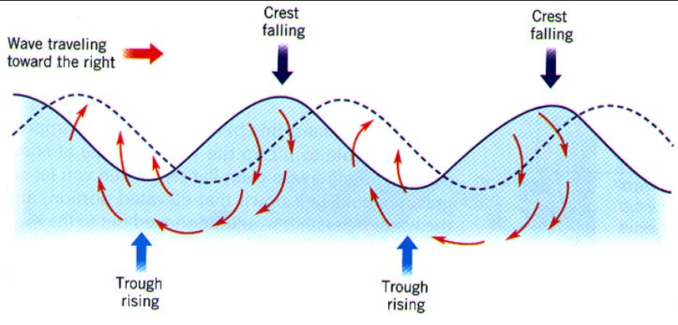
Basic of waves and Current
Reflection
Result when two equal waves are going in opposite direction and in this case you get the usual up/down motion of the water surface but the waves don't progress.

Slide 14
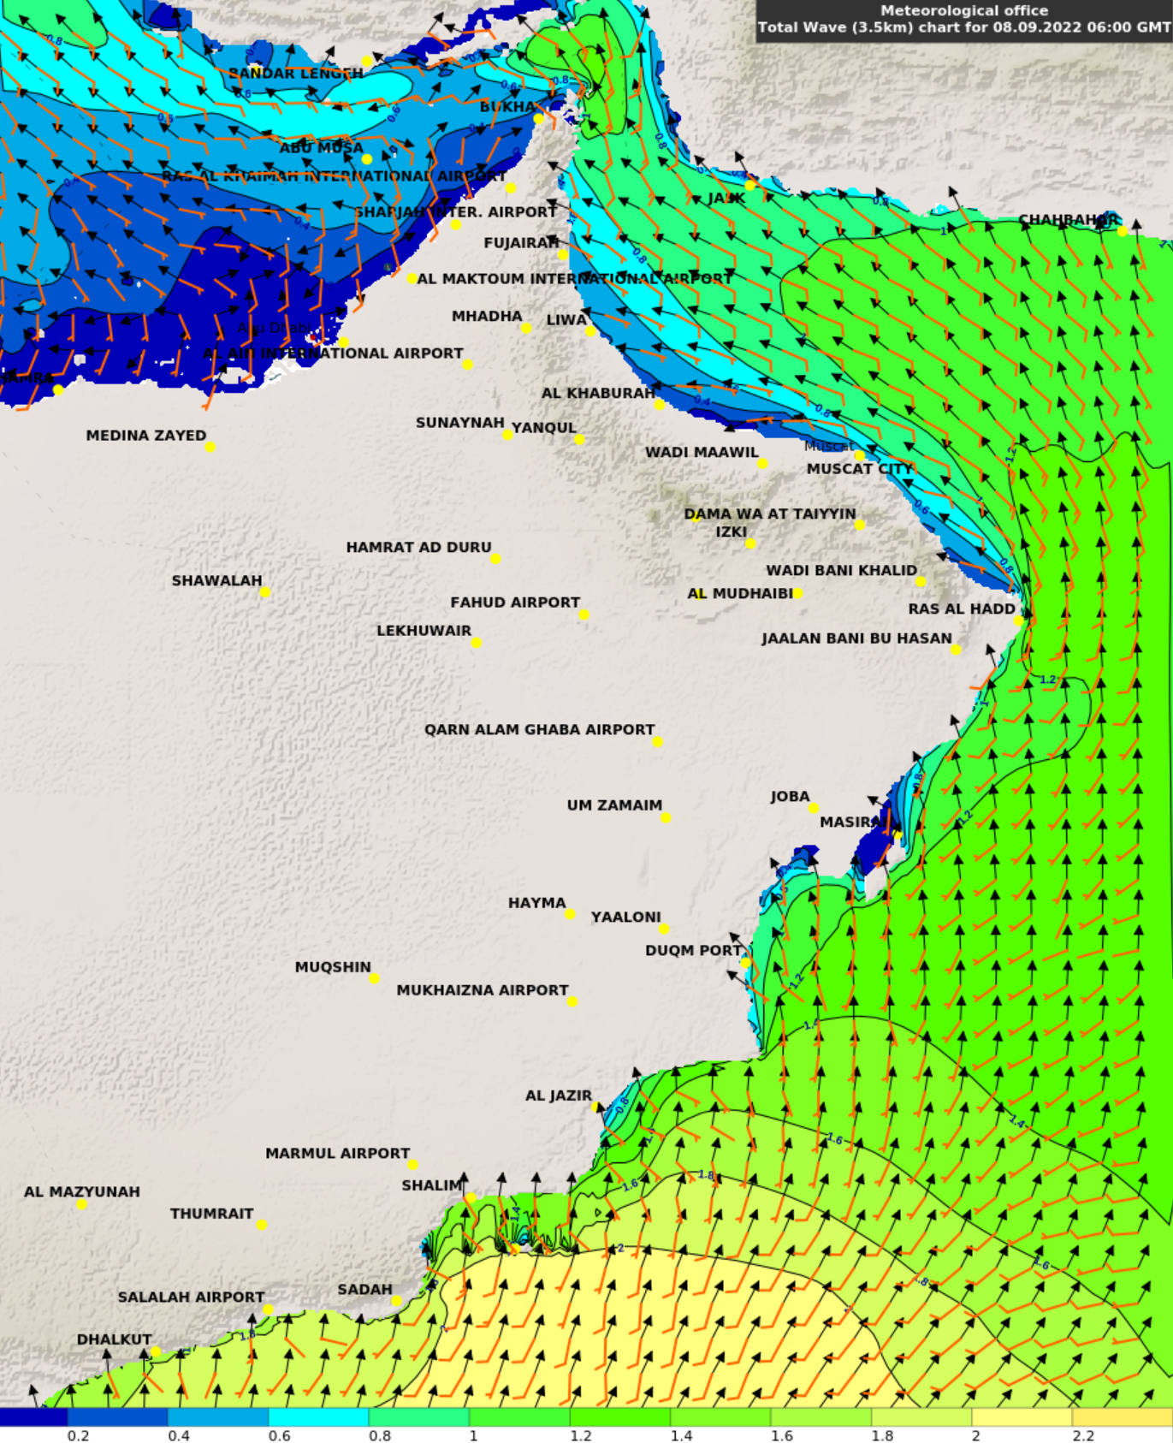
Wave Modelling

Slide 15
Wave Modelling: (Types)

Slide 16
How get knowledge of sea state.

Slide 17
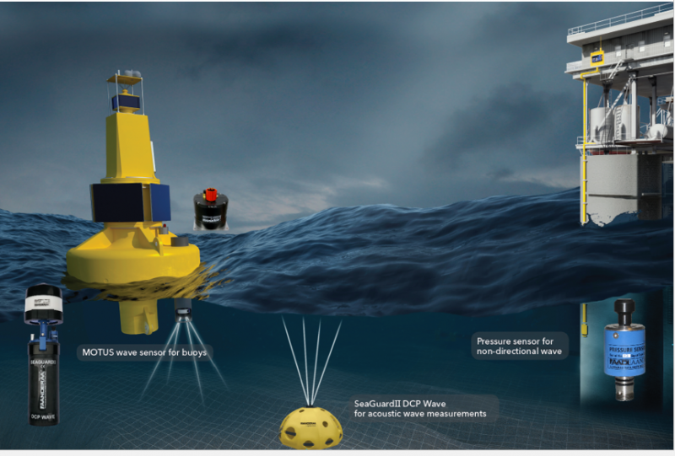
Obs. ( marine station - tide gauges - wave radar - ship – Satellite)
Model - WAM and SWAN WATCHIII

Slide 18
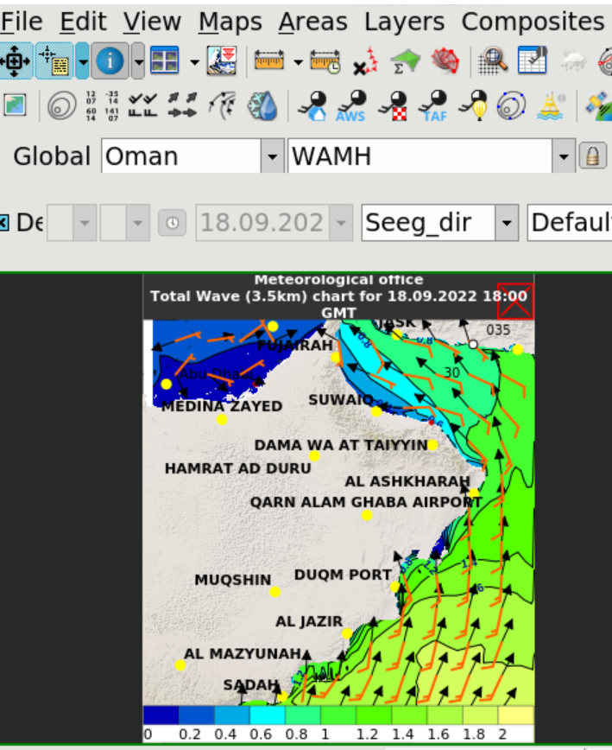
Predict wave state for next three days.

Slide 19
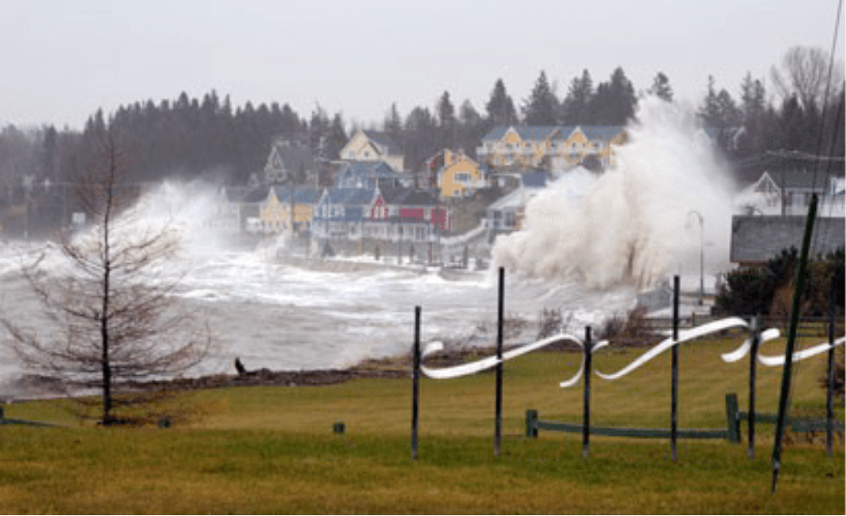
Example of sea wave Impacts.

Slide 20
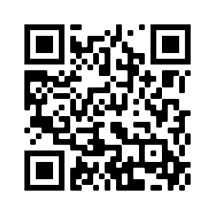
Scan this
Kindly scan this “QR code” to evaluate this lecture.
Thank You!

