Slide 1
Oman Summer Season
Marine Meteorological Course for Royal Oman Navy
Content creator: Jamal Alhinai & Mohammed Almashaykhi
Lecturer: Mohammed Al-Mashaykhi

Slide 2
Content
Introduction
Cloud formation
Oman Summer phenaman
Local convective cloud formation.
Fog and blowing dust.
High waves Arabian sea.
Al khareef.
Monsoon

Slide 3
introduction:
When is summer season?
Met:
Summer is the hottest of the four temperate seasons, occurring after spring and before fall.
Astronomical:
The time between 21 june to 22 september.
Notes:
Personal definition: Where the average maximum temperature reach 40 degree and more from May to end of August). meanwhile the minimum temperatures varies between (23-33).

Slide 4
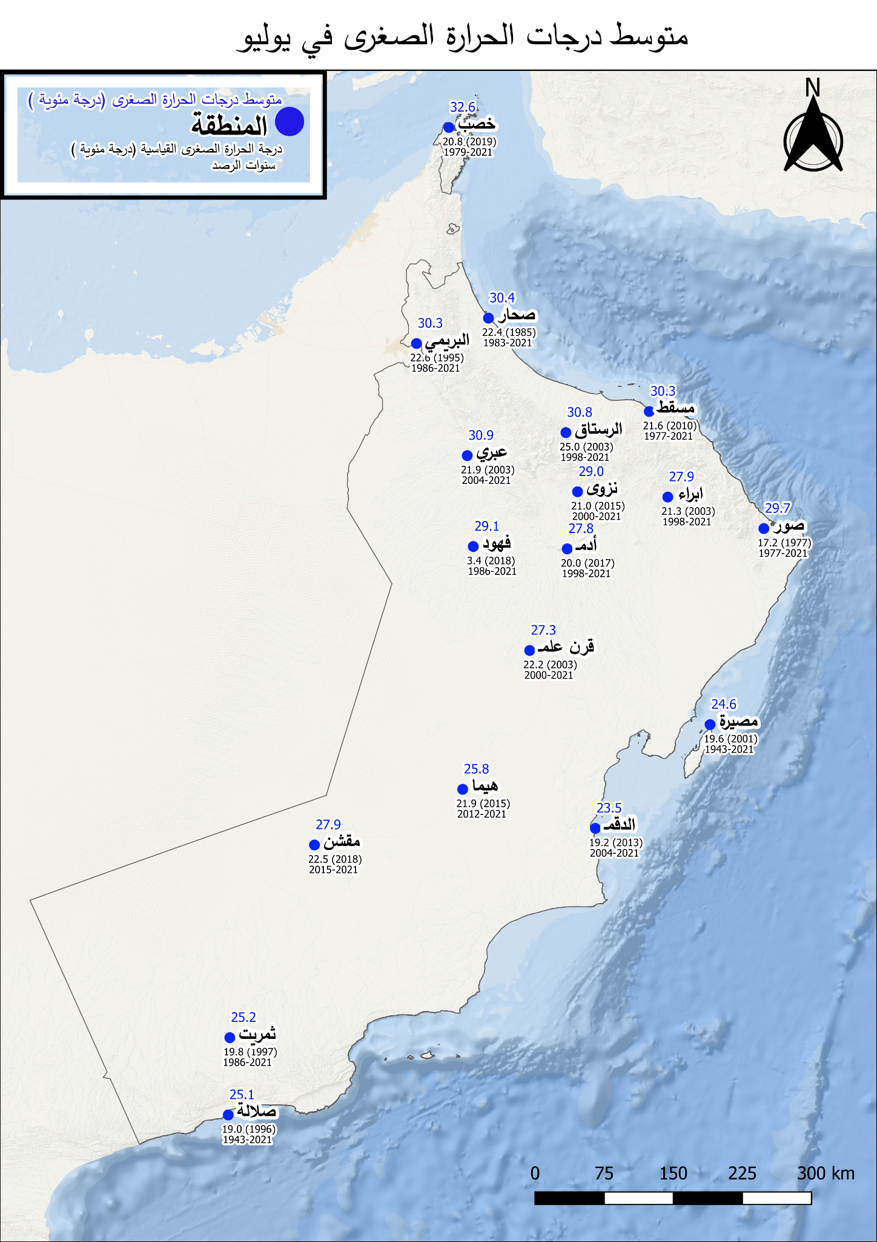
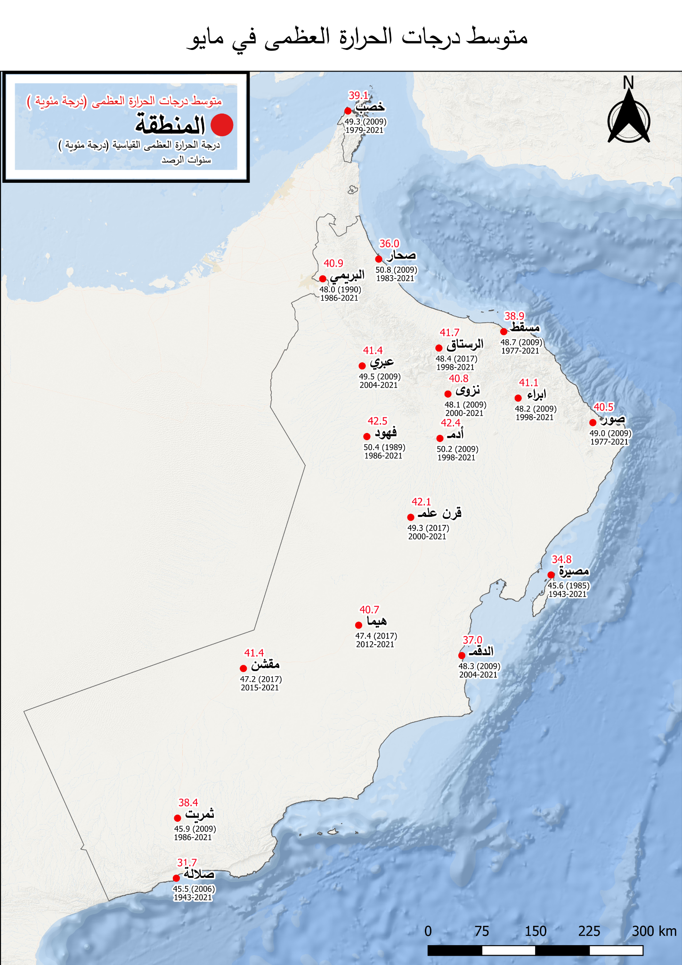
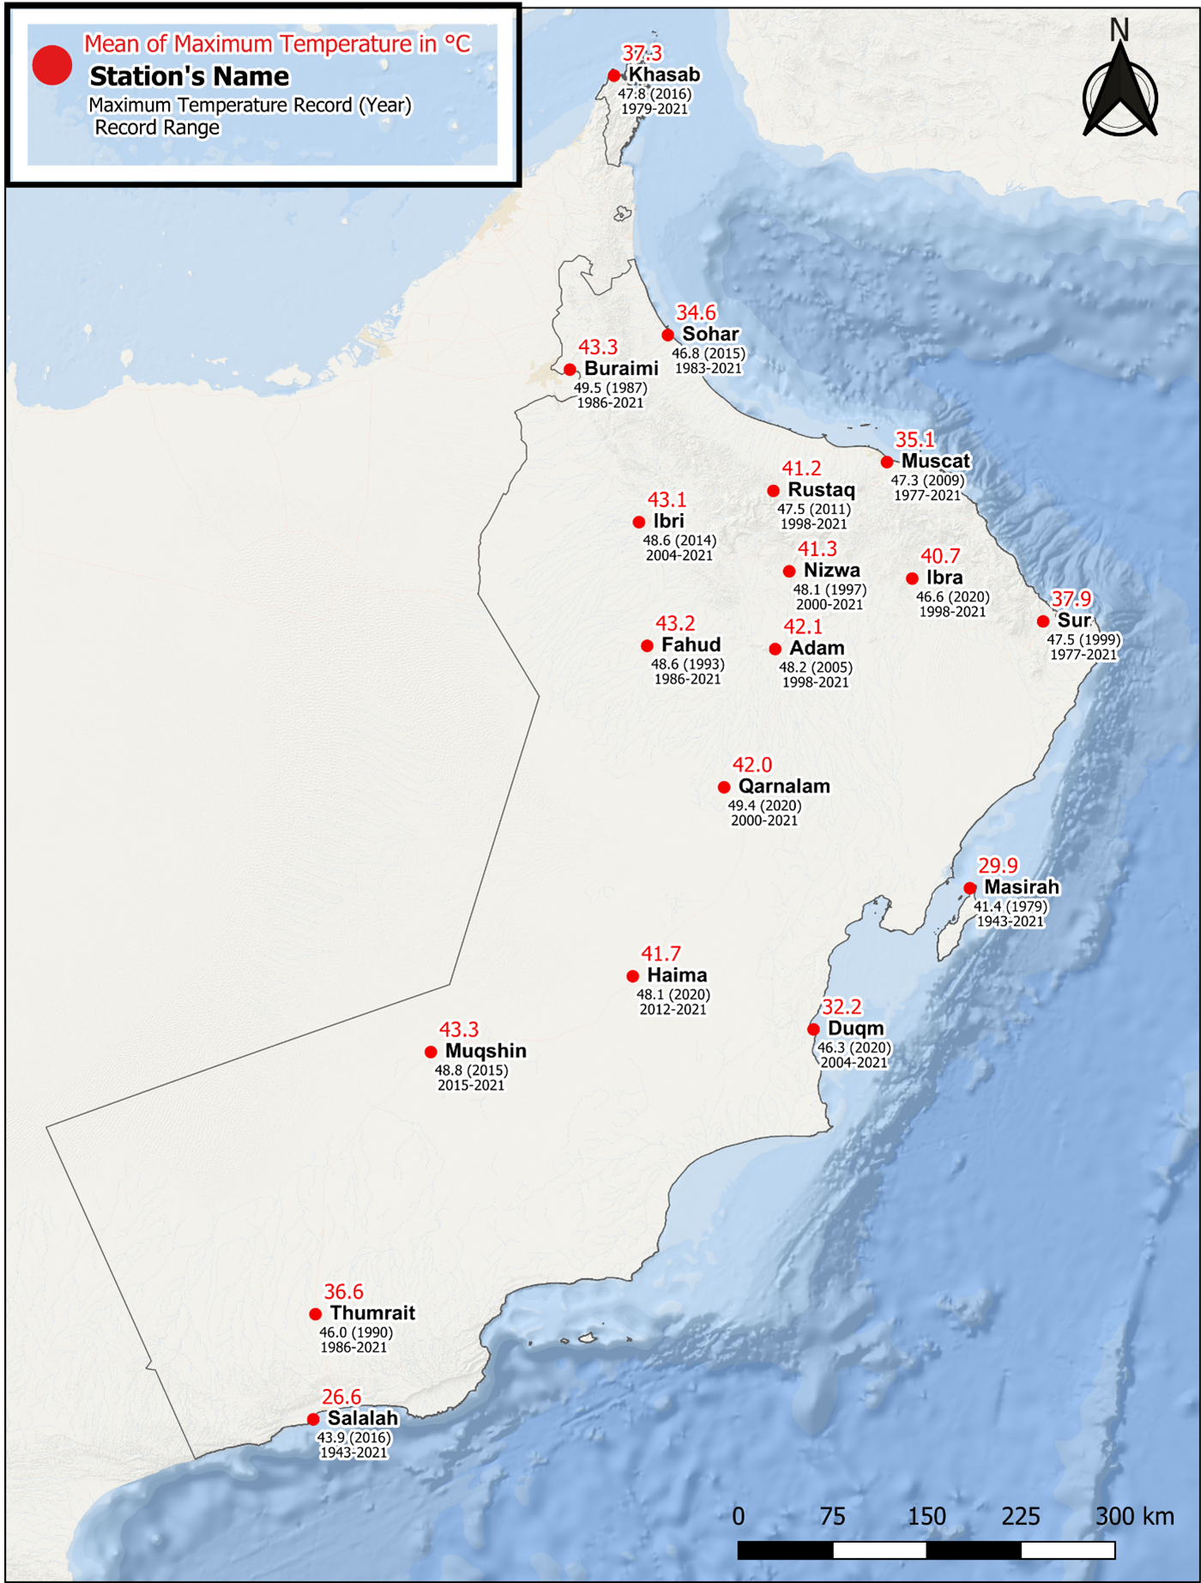
Notes:
Upon personal definition of summer , summer starts from may up to august , the images shows a difference between the max temperatures near arabian sea and inland station where the seasonal wind play a big role in reduction of maximum temperatures along arabian sea. And for the record Qraiat recorded the highest minimum temperature 43 degree at night.

Slide 5
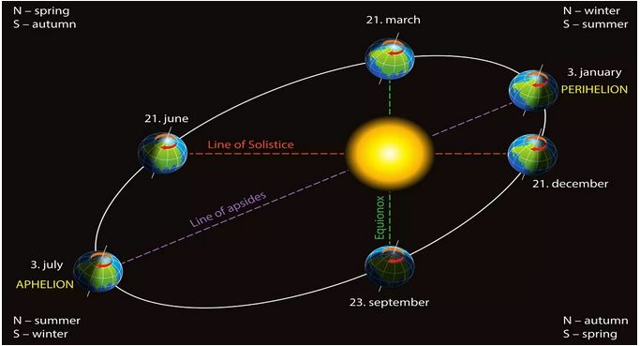
Why summer hotter where the sun is farthest from the earth?
Notes:
The main reason is the tilt of the earth in which determine the angle of the radiation hitting the surface .in summer the sun radiation is perpendicular to the earth surface.

Slide 6
Cloud Formation:
What clouds need to be formed?
Water vapor.
Any form of lifting.
Orographic lifting
Convection
Frontal lifting
Convergence
Condensation
Cold temperature
Condensation nuclei

Slide 7
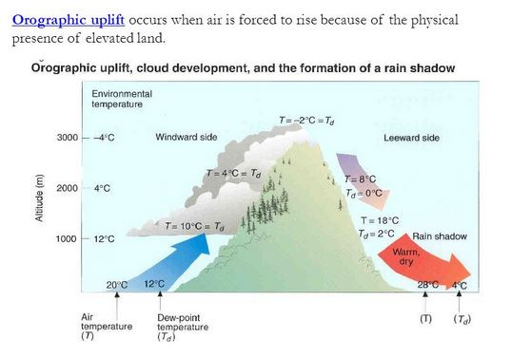
How orographic lifting occur?:
Notes:
Orographic lifting occur when moist wind blows into mountains which lift up the moist air and condense the the moisture due to the lower temperatures in the upper levels . also this create leewarde phenomena where the downward wind blow dry and warm in the other side of the mountain. Usually this happens in oman where southeasterly or southerly wind coming from arabian sea blows into alhajar mountains and create cloud along the mountain range.

Slide 8
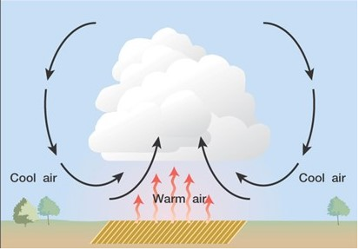
convection:

Slide 9
Frontal Lifting:
Notes:
This kind of lifting usually take a place in winter.

Slide 10
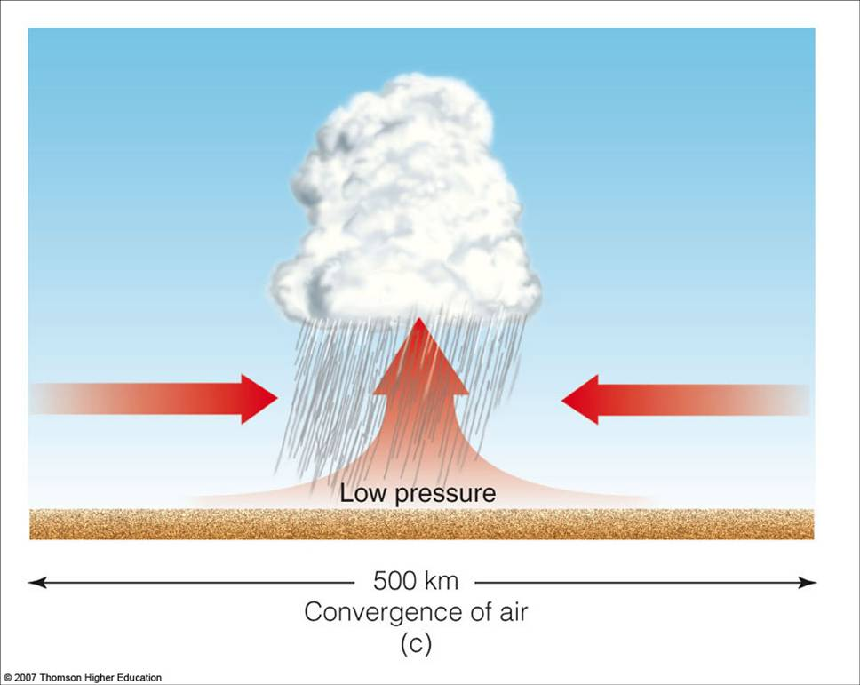
convergence:

Slide 11
Oman Summer Phenomena
Local cloud formation along Al Hajar mountains . Usually starts May and weakened by the end of August.

Slide 12
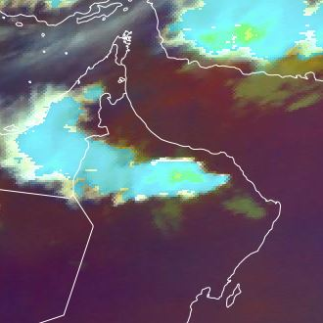
Local convective clouds formation:
Notes:
Local clouds formation usually take a place along al hajar mountains and starts on May up to the end of August. Since clouds form in different conditions , local clouds formation is a combination of three ways
Orographic lifting , convection lifting and convergence lifting.local clouds formation can be savere enhanced with upper trough indian ocean. Also the precipitation type is rain and hail up to ½ diameter.

Slide 13
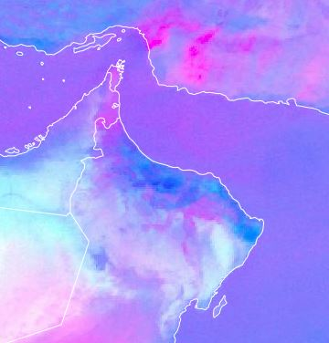
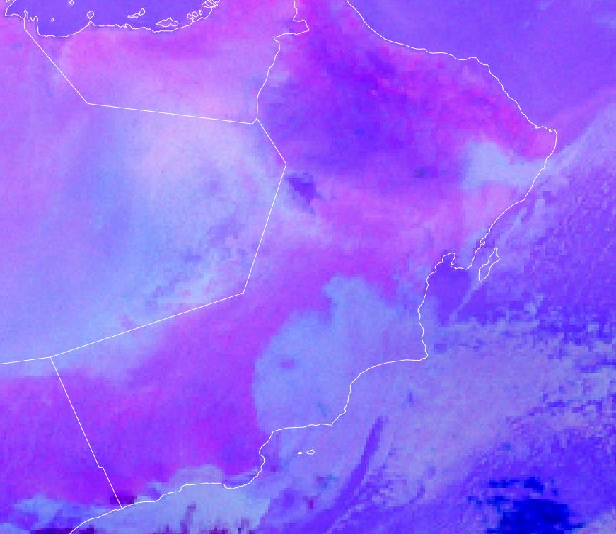
Fog and dust:
Dust
fog

Slide 14
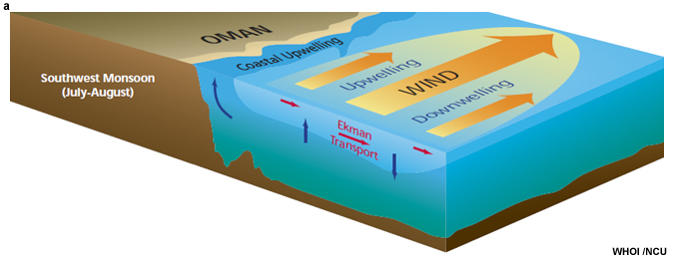
Arabian sea high waves:
Due to continuous (15-35 kt) SW blowing wind in Al Khareef Season (Indian monsoon) upwelling will form along the coastal areas of arabian sea .

Slide 15
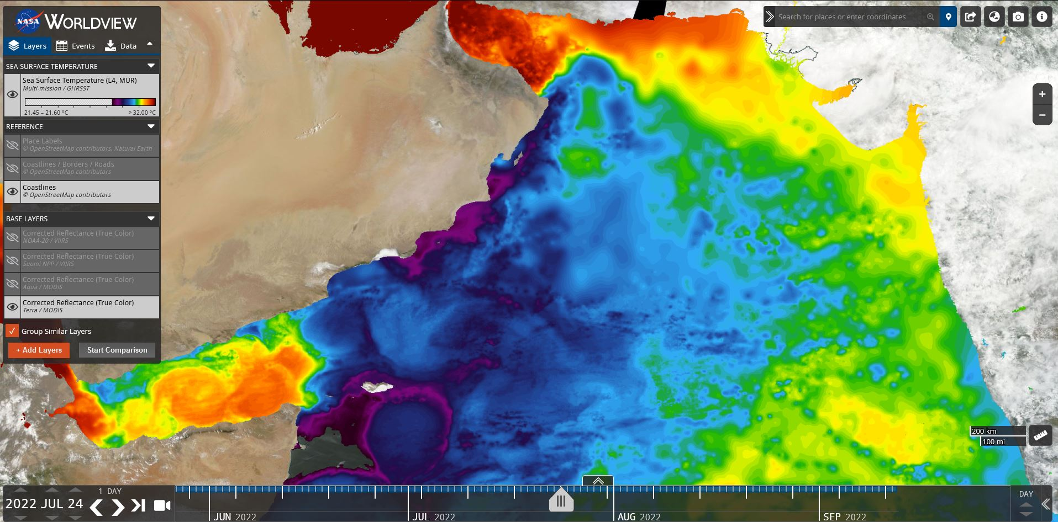

Slide 16
Al Khareef:
As the monsoon starts al khareef starts in southern part of oman (Dhofar).the temperature of the affected region is between 20 to 30 degree . The shape of the mountain range of dhofar and the blowing wind over cold water body create low level clouds and fog.

Slide 17
Monsoon
A monsoon is a seasonal change in the direction of the prevailing, or strongest, winds of a region. Monsoons cause wet and dry seasons throughout much of the tropics.
Notes:
The word monsoon is derived from the arabic word musim (season).

Slide 18
Components of the Monsoon:
Trough over north india.
Mascarene anticyclone system (high).
Low level cross-equatorial jet (SLLJ).
Tibetan High pressure system (upper).
Tropical easterly jet.

Slide 19
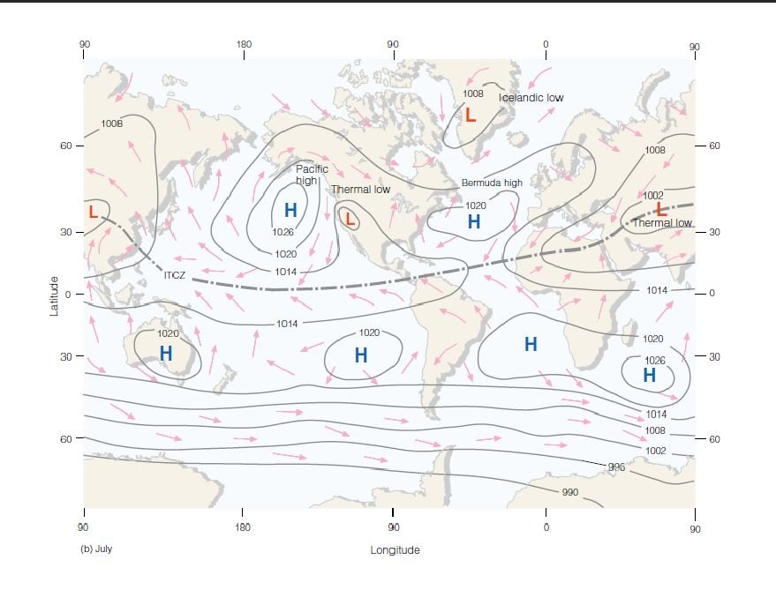
Trough over india & Mascarene High system:
The Thermal low over north of india . (anticlock)
Mascarene High pressure system southern hemisphere (anticlock)
The wind blow from high pressure in southern hemisphere to the thermal low in north of india crossing Arabian sea.(warm moist)
Mascarene high

Slide 20
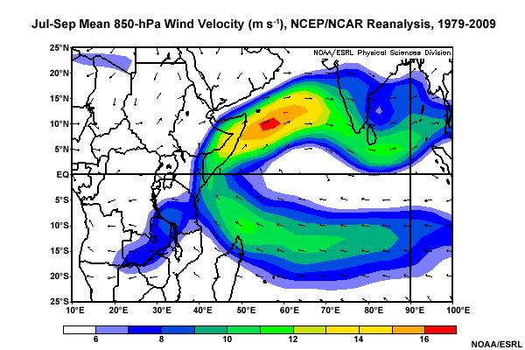
3 low level cross equatorial jet (SLLJ):
The Somali jet occurs during the summer over northern Madagascar and off the coast of Somalia. The jet is most intense from June to August with average monthly maximum speeds of 18 m s⁻¹ even though daily speeds can reach the order of 50 m s⁻¹.
Notes:
The Somali jet occurs during the summer over northern Madagascar and off the coast of Somalia. The jet is most intense from June to August with average monthly maximum speeds of 18 m s⁻¹ even though daily speeds can reach the order of 50 m s⁻¹. Key features of the low level flow are:
Maximum wind speed near the northern tip of Madagascar and off the Somali coast.
A major cross-equatorial flow from the southern Indian Ocean to the central Arabian Sea.
A relative minimum in speed along the axis of strong winds near the equator.
A split in the axis of the jet over the Arabian Sea, the more northern branch intersecting the west coast of India near 17°N, while the southerly branch moves eastward just south of India

Slide 21
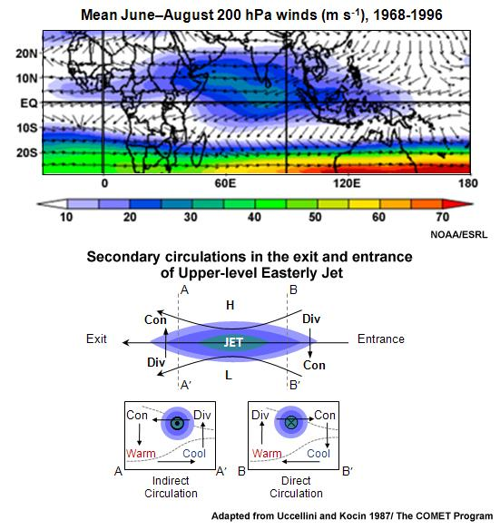
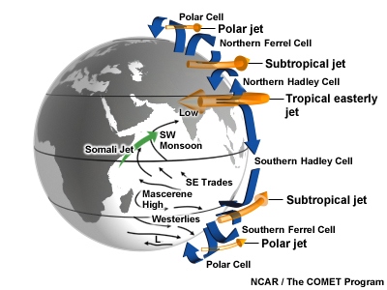
Tropical easterly jet:
Notes:
The TEJ is found near between 5° and 20°N and in 100-200 hPa layer. Its maximum speeds of 40-50 m s-. And about 150 hpa over arabian sea.

Slide 22
Thanks
Thank you for paying attention
Special thank to my colleagues whom helped to create this content.

Slide 23
Scan this
Kindly scan this “QR code” to evaluate this lecture.
Thank You!

