Slide 1



Atmospheric Pressure & Wind
Marine Meteorological Course for Royal Oman Navy
Content creator: Ibrahim Alabdulsalam - Meteorologist
Lecturer: Moza Al Marhoobi - Meteorologist

Slide 2
Content
AIR PRESSURE
1
Air pressure measurements
High and Low air pressure
2
WIND
Wind speed and Direction
Wind measurements
Forces Governing and Affecting Wind
Sea breeze and land breeze
Monsoon
Wind and Sea Waves
Thunderstorms
Funnel wind

Slide 3
Subject 1:
Air Pressure
Air pressure measurements
High and Low air pressure

Slide 4
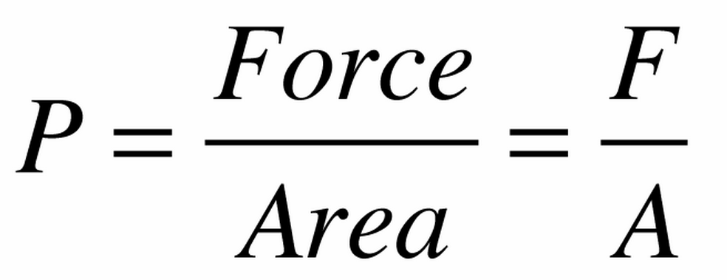
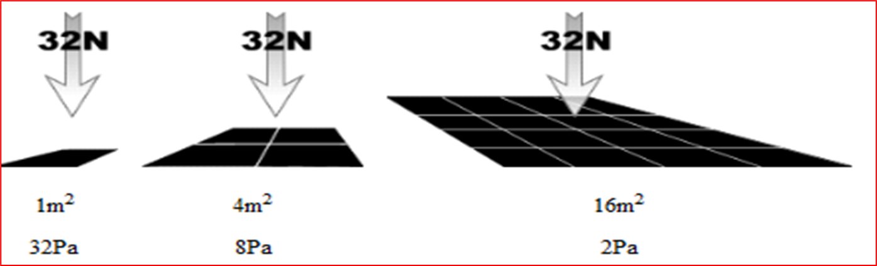
Air Pressure
Pressure is the amount of force acting per unit area.
The symbol of pressure is P
Mathematically:

Slide 5
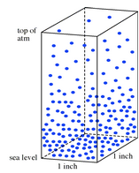
Air pressure
Air pressure ,or atmospheric pressure , is the force per unit area exerted on a surface by the weight of air above that surface.

Slide 6
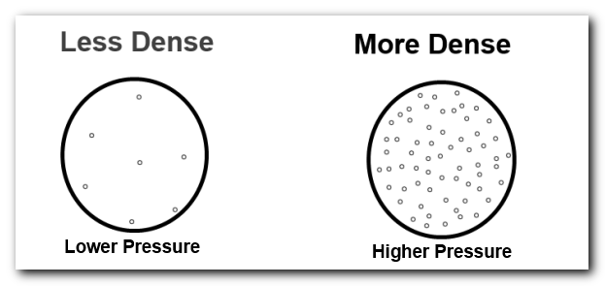
Air pressure and Density
As the number of air molecules in column of air decreases, the air pressure decreases and vise versa
1013.25mb

Slide 7
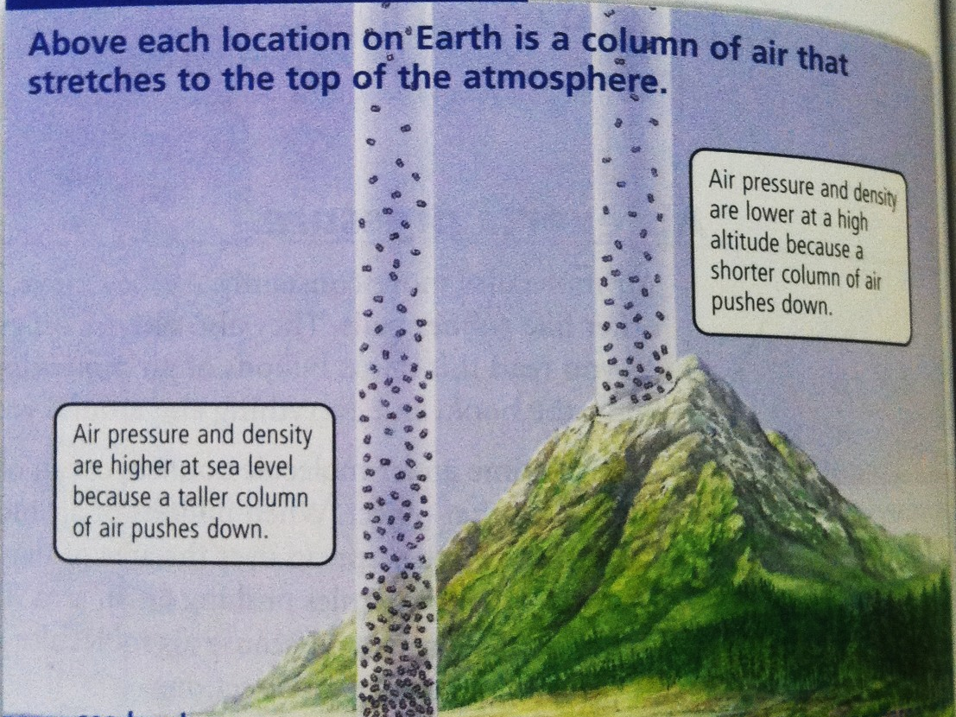

Slide 8

Air pressure and air molecules
Air pressure is Equal in all direction

Slide 9
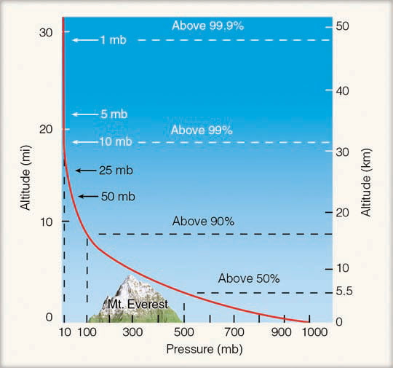
Pressure and Altitude (Height)

Slide 10
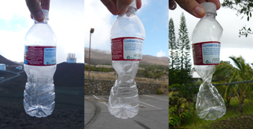
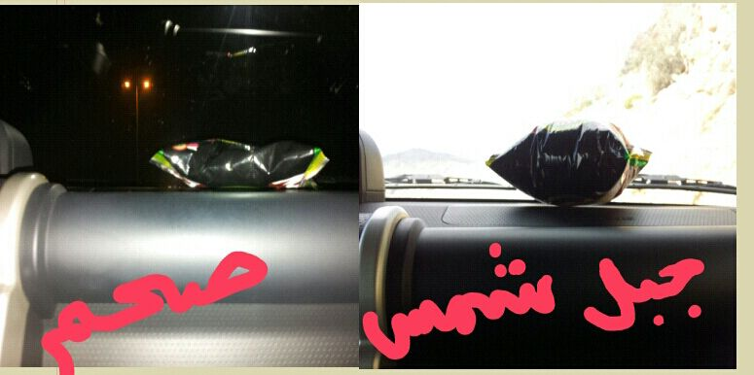
Experimental examples
جبل شمس صحم
Notes:
The air pressure in the bags will likely be the same as the air pressure at the altitude at which they were closed. The ambient air pressure lessens as one rises in altitude. When the air pressure outside the bags is lesser than that inside the bags, like at higher altitude, the air in the bags expands causing the bags to inflate in size.

Slide 11
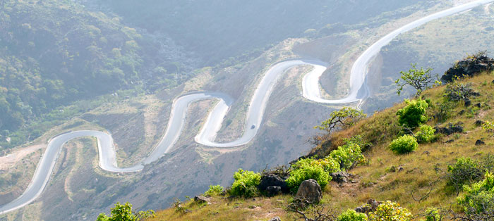
Why do my ears pop?
Notes:
https://youtu.be/4I9wqVohGOc

Slide 12
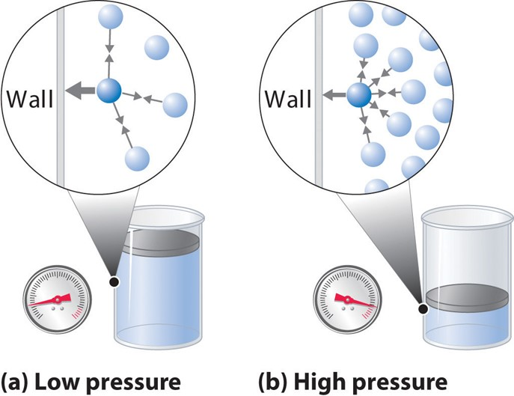
Pressure and Volume

Slide 13
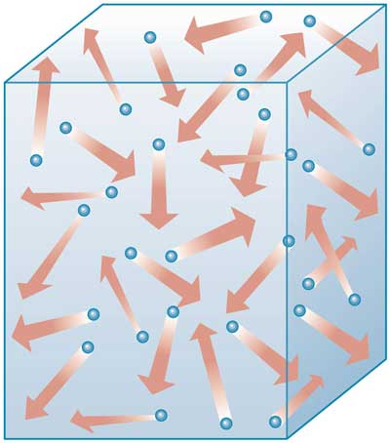
Pressure and Volume
A gas will expand to fill whatever space it is given.
Thus, if we take a certain amount of gas out of one container and place it into another container that is twice the volume the gas will expand, filling the larger container.
We still have the same number of gas molecules, but now, they are filling as a twice of the volume of the smaller container . Thus, the gas density is halved.
What will be the pressure then?

Slide 14
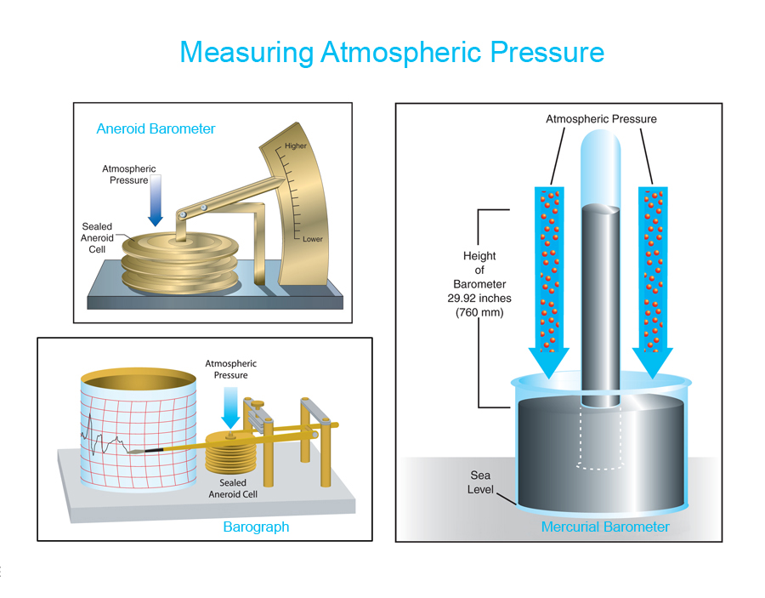
Air Pressure Measurements
1.1.
Reading and recording instruments

Slide 15
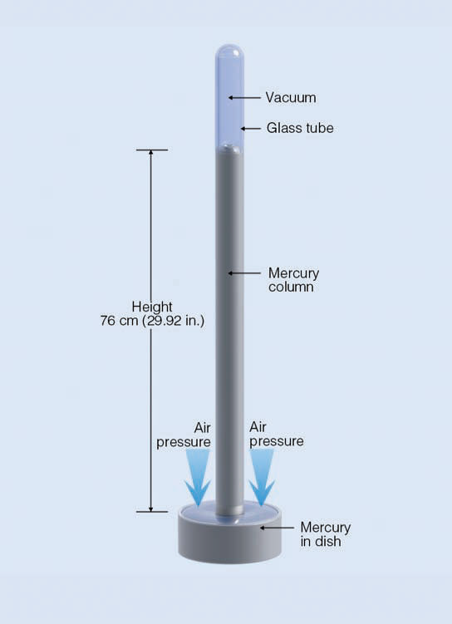
Mercury Barometer
The height of the mercury column is a measure of atmospheric pressure.
Pressure Reading

Slide 16
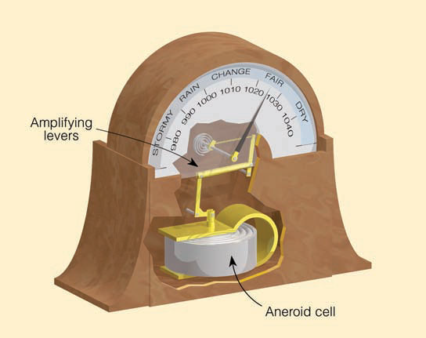
Aneroid Barometer
Pressure Reading
Notes:
An aneroid barometer is an instrument used for measuring air pressure as a method that does not involve liquid. Invented in 1844 by French scientist Lucien Vidi,^{[21]} the aneroid barometer uses a small, flexible metal box called an aneroid cell (capsule), which is made from an alloy of beryllium and copper.

Slide 17
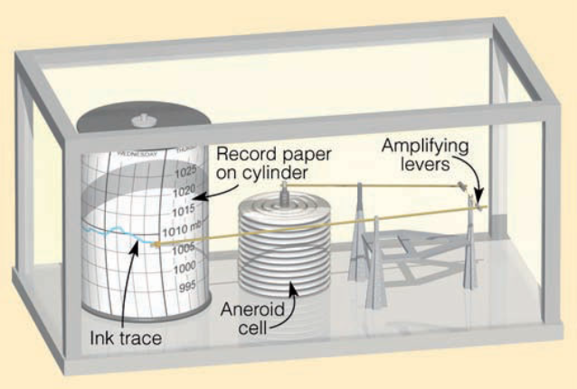
Recording barograph
continuous records of pressure on a chart paper.
Notes:
A barograph is a recording aneroid barometer where the changes in atmospheric pressure are recorded on a paper chart.

Slide 18
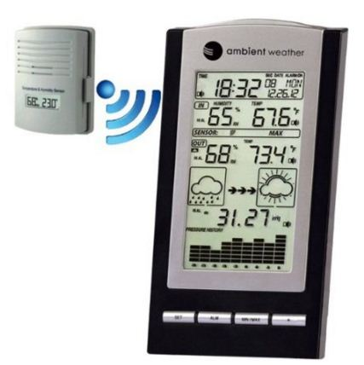

Slide 19
Air pressure units
Inches of mercury (in.Hg).
Millibar (mb).
Hectopascal (hPa).
1 atm = 29.92 in.Hg = 1013.25 hPa = 1013.25 mb
1 hPa = 1 mb

Slide 20

Why do we need to measure atmospheric pressure?
Notes:
To define high and low pressure areas

Slide 21
1.2.
High and Low Pressure
Low molecules number / low pressure

Slide 22
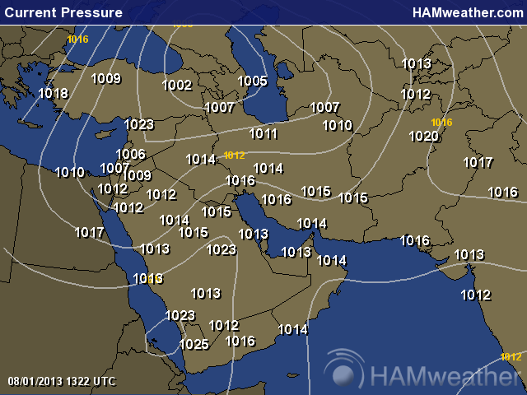
Pressure Charts
Pressure chart is drown in one atmospheric level

Slide 23
Pressure Charts

Slide 24
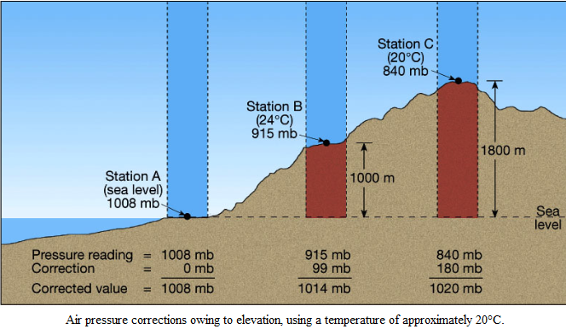
Pressure Correction
Notes:
1mb for 10 metres
QFE field elevation (station level)
QNH nautical height (sea level)

Slide 25
What is the main relationship between air Pressure and Weather?
Notes:
Atmospheric pressure is an indicator of weather. When a low-pressure system moves into an area, it usually leads to cloudiness, wind, and precipitation. High-pressure systems usually lead to fair, calm weather.

Slide 26
Subject 2:
Wind
Wind speed and Direction
Wind measurements
Forces Governing and Affecting Wind
Sea breeze and land breeze
Monsoon
Wind and Sea Waves
Thunderstorms
Funnel wind

Slide 27
Wind
Wind is air in motion.
Wind is the most important relation between air pressure systems and weather.
Wind can be dry, moist, warm and cold etc..
Creates or brings Storms , hurricanes , tornados, wave , dust, cloudiness, clearness , rain and etc..

Slide 28

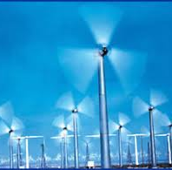
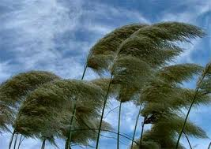
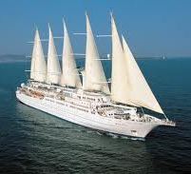
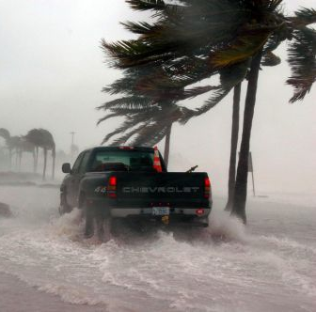
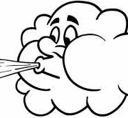
What do you think cause wind?

Slide 29
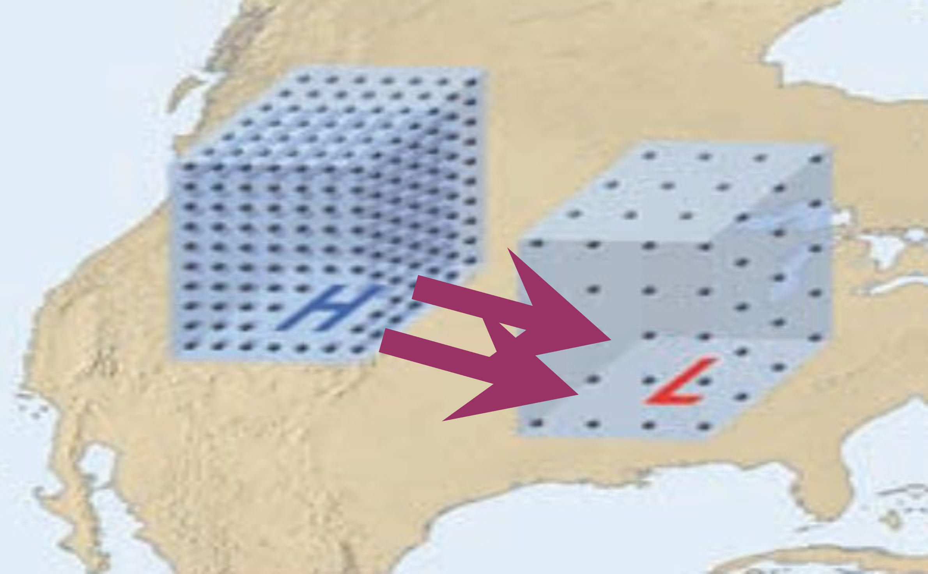
What do you think cause wind?
Air moves (wind) in response to differences in air pressure.
When there are high- and low-pressure systems, the air will move from higher toward lower pressure.
When it is windy outside, often there is a low-pressure system that air is moving toward.

Slide 30
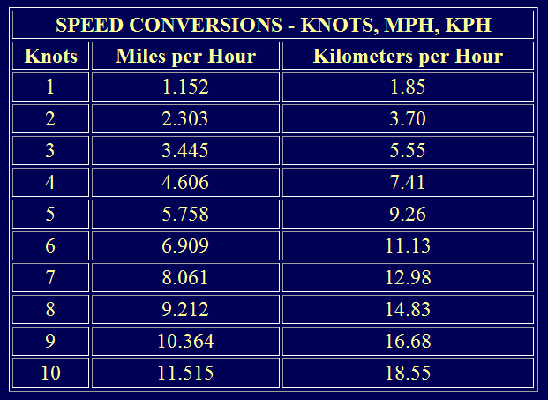
Wind speed and Direction
2.1.
Units of wind speed:
Knot is a nautical mile per hour.
1 Nautical mile = 1852 m =1.852 km
1 mile = 1.6 km
1 knot = 0.51389 m/s

Slide 31
Wind direction is expressed in degrees,
From which wind is coming

Slide 32
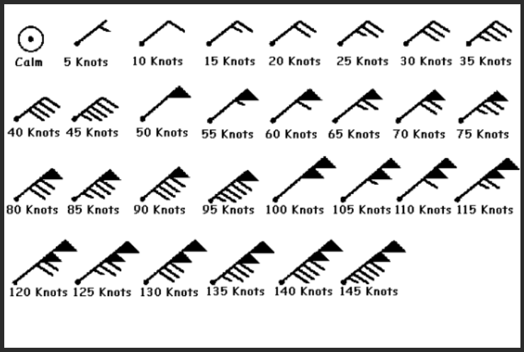

Slide 33
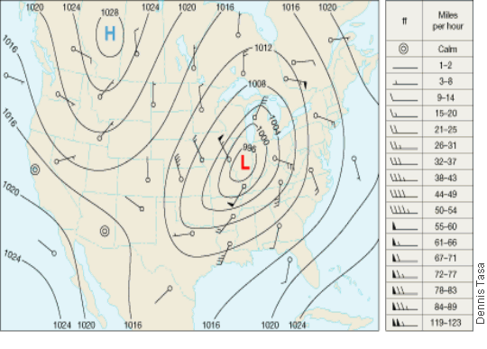
Wind in Weather Maps

Slide 34
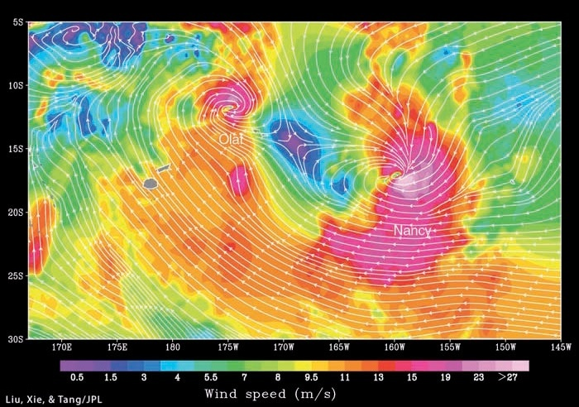
Wind Estimation by Satellite

Slide 35
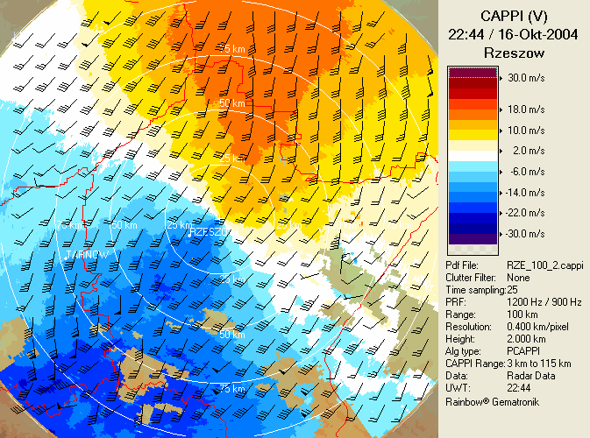
Wind can be Estimated by Radar

Slide 36
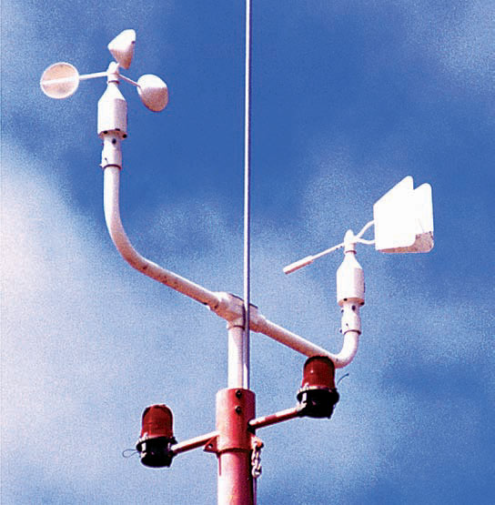
2.2.
Wind Measurement
Cup anemometer (speed)
Wind vane (direction)

Slide 37
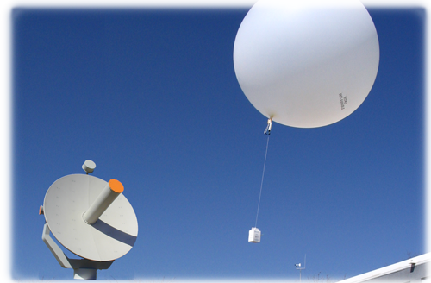
Upper Air Measurements
“Radiosonde”

Slide 38
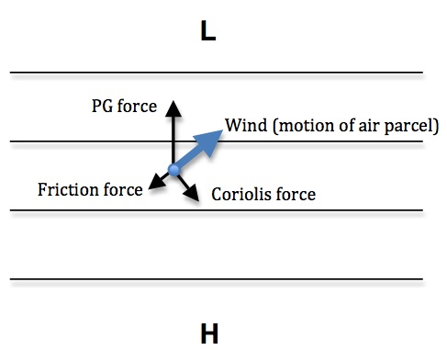
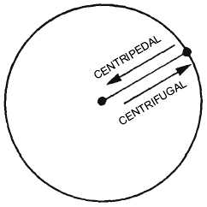
Forces Governing and Affecting Wind
2.3.
Pressure gradient force “PGF”
Always from H to L
FF
CF
acts opposite to the wind direction
90º to the RIGHT in NH and 90º to the LEFT in SH
Other forces:
  Centripetal force aka Gravity force “GF” “acts toward Earth center”
  Centrifugal force “CentriF” “acts outward from the radius of curvature”

Slide 39
The effect of the Coriolis Force
The farther from the equator the object is, the greater the deflection, and the faster an object is moving, the greater the deflection

Slide 40
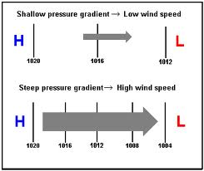
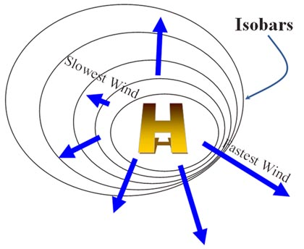
Pressure Gradient Force
Which pressure gradient would result in greater wind velocity?
Notes:
The pressure gradient force works to move blobs of air from higher pressure toward lower pressure
The gradient wind is a balance of the Pressure Gradient Force, centrifugal and Coriolis. A geostrophic wind becomes a gradient wind when the wind begins flowing through curved height contours. The curving motion introduces a centrifugal (outward fleeing) force

Slide 41
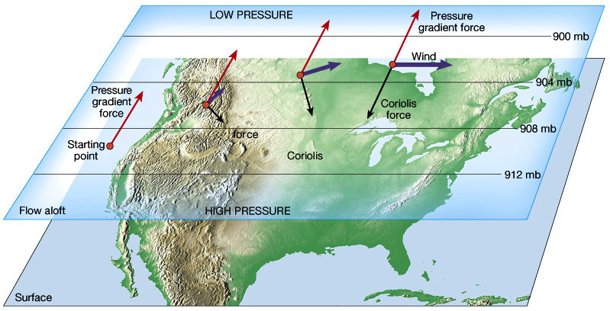
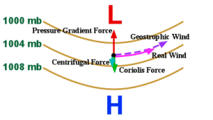
Geostrophic wind
Gradient wind
Notes:
geostrophic wind: a wind whose direction and speed are determined by a balance of the pressure-gradient force and the force due to the earth's rotation.
The gradient wind is a balance of the Pressure Gradient Force, centrifugal and Coriolis. A geostrophic wind becomes a gradient wind when the wind begins flowing through curved height contours. The curving motion introduces a centrifugal (outward fleeing) force

Slide 42
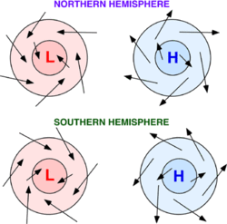
High, low and Wind Flow

Slide 43
Northern Hemisphere
Southern Hemisphere

Slide 44
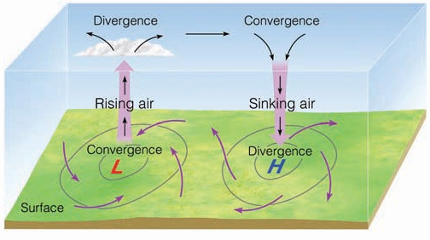
Convergence and Divergence

Slide 45
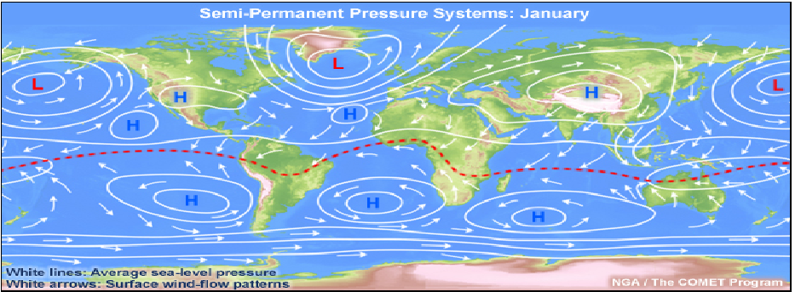
Global distribution of pressure systems “winter”

Slide 46
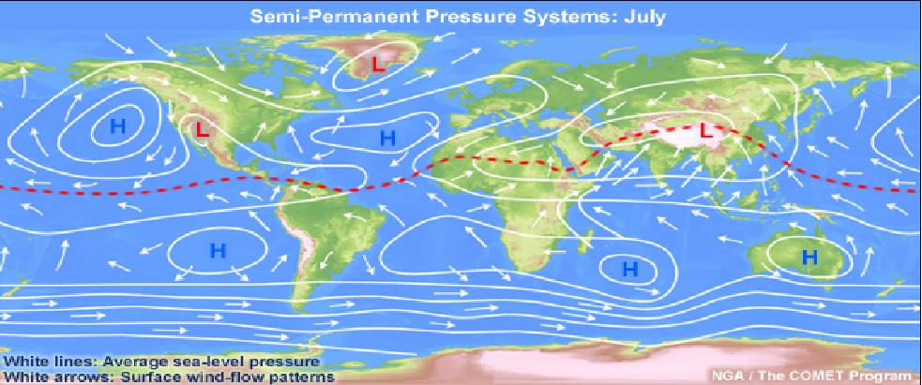
Global distribution of pressure systems
“summer”

Slide 47
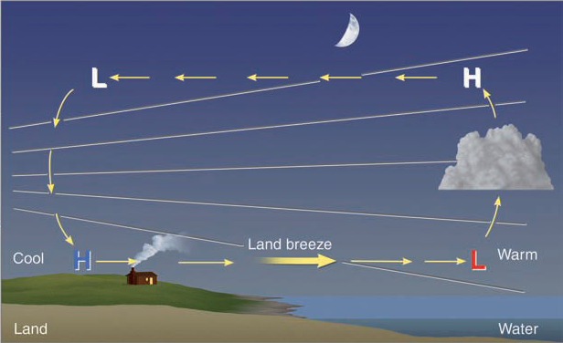
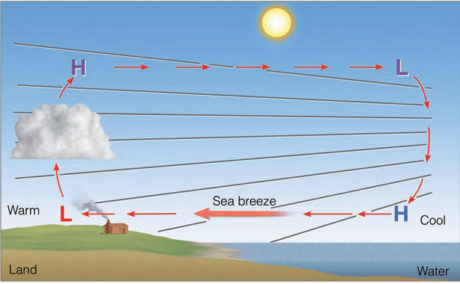
Sea Breeze and Land Breeze
2.4.
Sea breeze
Land breeze

Slide 48
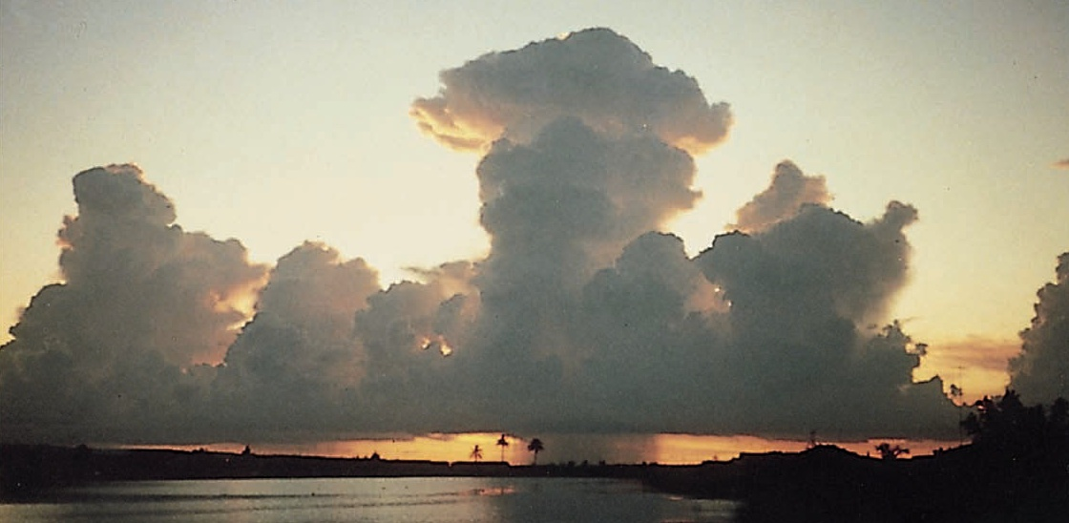

Slide 49
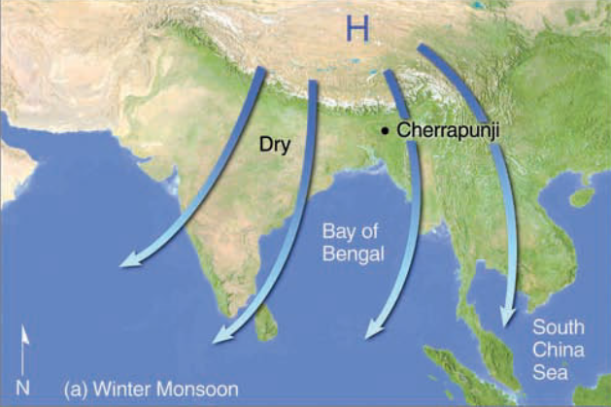
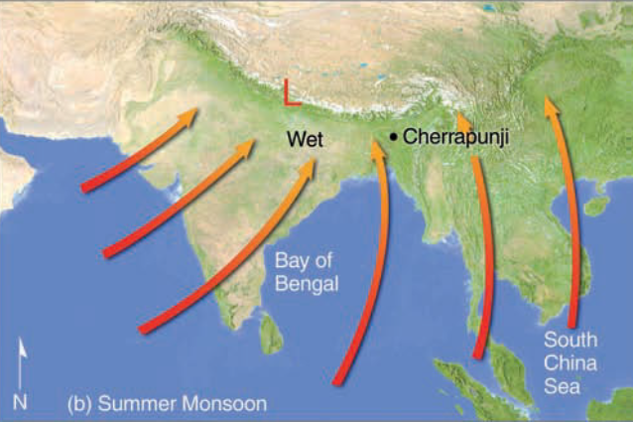
2.5.
Monsoon
Summer Monsoon
Winter Monsoon
9/6/2022
Moza Al Marhoobi
49

Slide 50
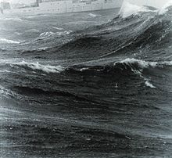
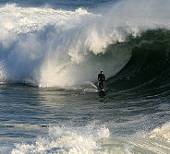
Wind and Sea Wave
2.6.
What’s the relationship between wind and sea waves?
  Direct (the stronger the wind, the higher the waves)

Slide 51
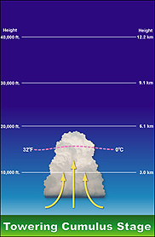
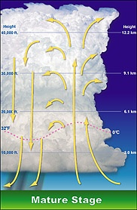

Thunderstorm
2.7.
Thunderstorm Stages
All updraft
No rain/wind yet
Cumulonimbus/anvil
Heavy rain/wind/hail
All downdraft
Light rain/weak winds

Slide 52
Up and Down draft

Slide 53



Outflow boundary
Haboob
Mammatus

Slide 54



FUNNEL EFFECT
2.8.
Notes:
the phenomenon where winds will tend to increase in speed as they squeeze through narrow valleys

Slide 55

Scan this please
Kindly scan this “QR code” to evaluate this lecture.
Thank You!

