Slide 1
Numerical Weather Prediction (NWP)
Marine Meteorological Course for Royal Oman Navy
Content creator: Khalifa Al Sudairi
Lecturer: Khalifa Al Sudairi

Slide 2
Content
What is NWP Model?
NWP Flowchart
NWP initial data
NWP grids and resolution
NWP output
Super computer for NWP
Errors of the NWP
Guidance in Using NWP

Slide 3
What is NWP Model?

Slide 4
What is NWP Model?
Take the equations that describe atmospheric processes.
Convert them to a form where they can be programmed into a large computer.
Let the computer to solve them
This is called a “model” of the atmosphere

Slide 5
NWP Flowchart

Slide 7
NWP initial data

Slide 8
NWP initial data
The actual situation used by the model to start integrate equations.
It is created by techniques called data assimilation.
The process of initial data creation (analysis and data assimilation) is more complicate than the forecast model itself, and more consumer in term of CPU time.

Slide 9
NWP initial data

Slide 10
NWP grids and resolution

Slide 11
Subject 2:
NWP consists in :
Subdividing a chosen geographic 3D area in thousands (or millions) of little cubes.

Slide 12
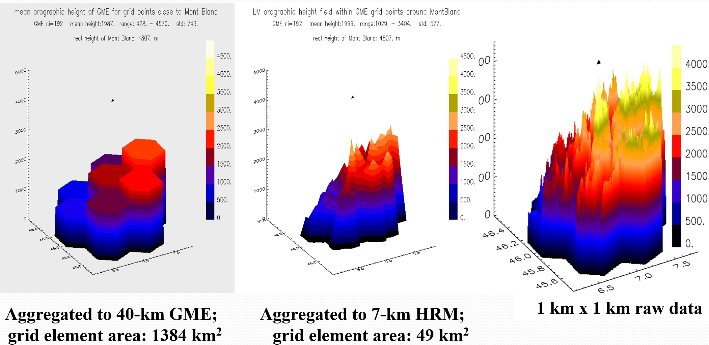
Subject 2:

Slide 13
NWP output

Slide 14
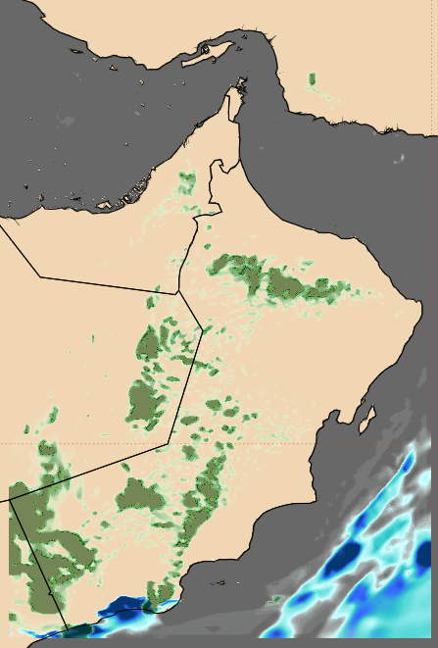
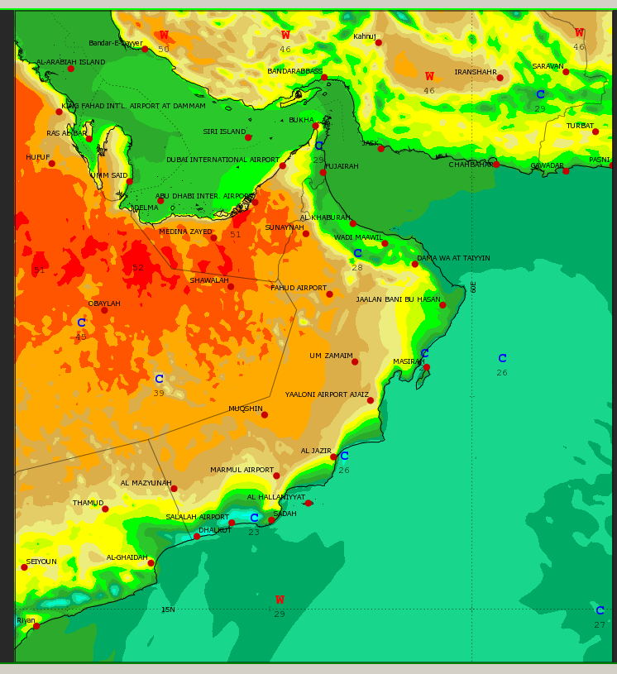
NWP output

Slide 15
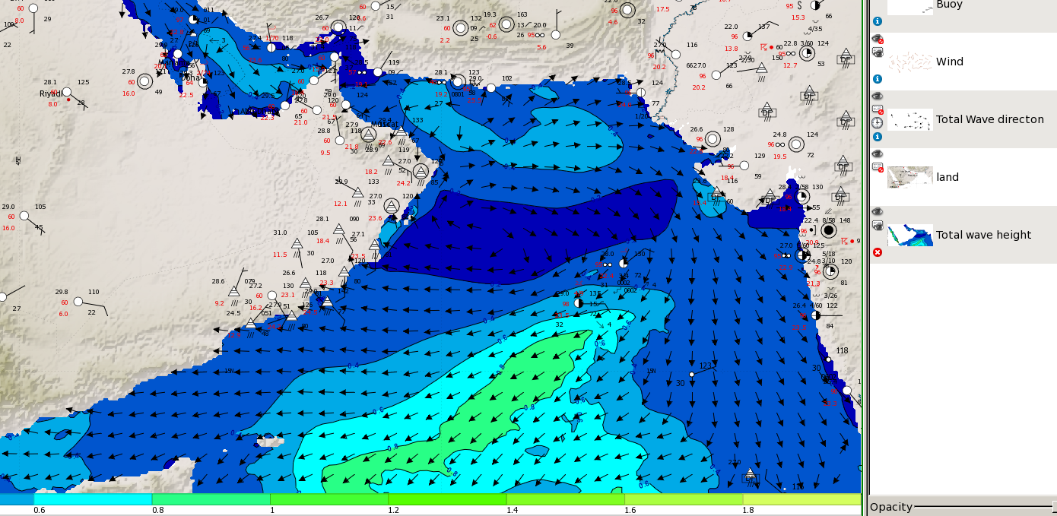
NWP output

Slide 16
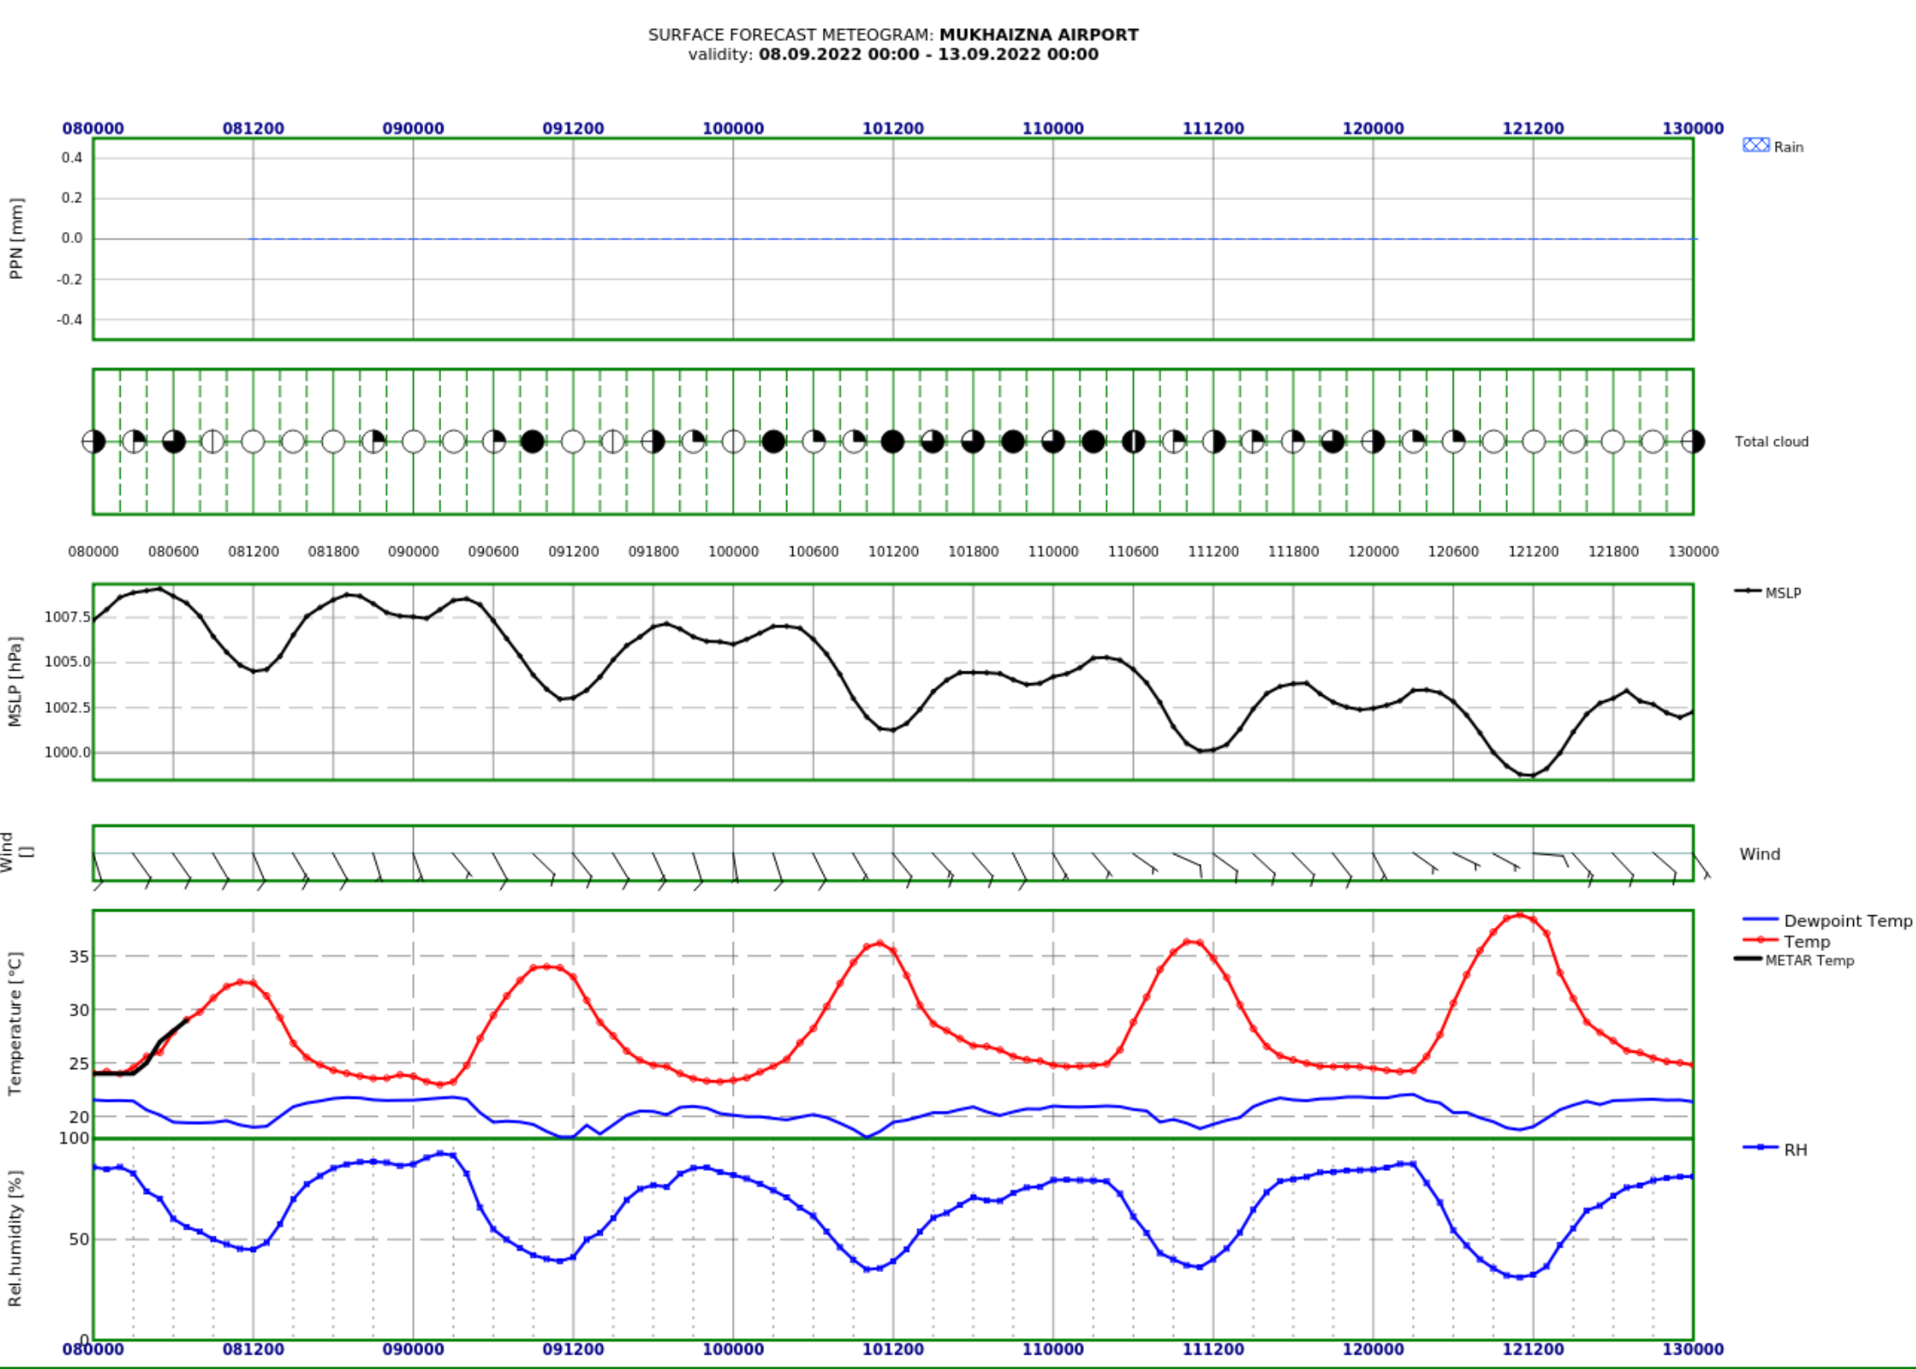
NWP output

Slide 17
Super computer for NWP

Slide 18
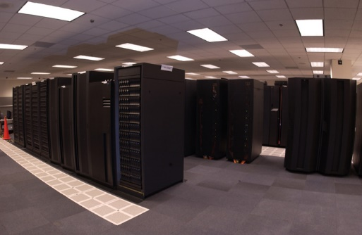
Super computer for NWP

Slide 19
Errors of the NWP

Slide 20
Errors of the NWP
Due to model formulation.
Due to uncertainty in the initial state.
Due to errors in lateral boundary conditions.
Due to uncertainties in soil fields (soil temperature and soil water content, …).

Slide 21
Guidance in Using NWP

Slide 22
Guidance in Using NWP
1- Verify each of the models you are intended to use
2- Use different NWP sources, as many as you could
3- Remember the error margin when you do the forecast

Slide 23
Scan this
Kindly scan this “QR code” to evaluate this lecture.
Thank You!

