Slide 1


Oman winter weather
Marine Meteorological Course for Royal Oman Navy
Content creator: Zamzam Al Rawahi, Meteorologist
Lecturer: Bushra Al Saadi, Meteorologist

Slide 2
Content
Air masses affecting Sultanate of Oman
Westerly disturbance
Cold front
Cold air over Warm Sea
Shamal wind/Dust
Fog
Siberian high

Slide 3
The Seasons
2nd transitional period
From 22nd September to 20th December
Winter
21st December to 21st March
Summer
1st transitional period
21st June to 21st September
From 22nd March to 20th June

Slide 4
Subject 1:
Air masses
Air masses influence Sultanate of Oman Climate
Air masses affecting Sultanate of Oman

Slide 5
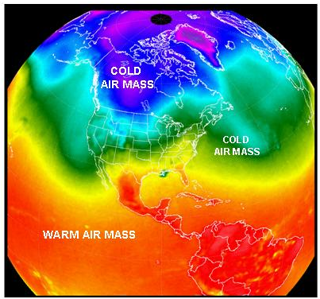
Subject 1: Air masses
Air masses are…
  A large body of air sits over an area of
  land or water for a long period of
  time, it will take on the characteristics
  of the land or water beneath it.
  Named for their SOURCE REGION
      Continental (c)
      Maritime (m)
      Arctic (A)
      Polar (P)
      Tropical (T)
When Air Masses move they bring their temperature and humidity to new areas.

Slide 6
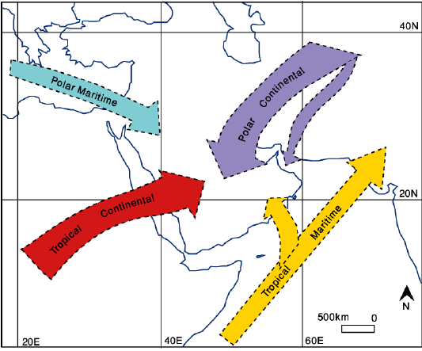
Subject 2:Air masses influence Sultanate of Oman Climate:
During winter
Originates over central Asia
low temperatures at the surface
Stable atmosphere
Occasionally out break
Frequently active During winter
North Atlantic
Cold front with TS developing
Strong winter Shamal wind
During Summer
north Indian Ocean
low temperatures + rain
Oman SE Coasts
late First Transitional and early summer
North Africa
low humidity , very high temperatures (often in excess of 45°C)
Hazy conditions invariably prevail, Dust

Slide 7
Subject 2:
What is Westerly disturbance?
How it Develop? And Its Effects
Westerly disturbance

Slide 8
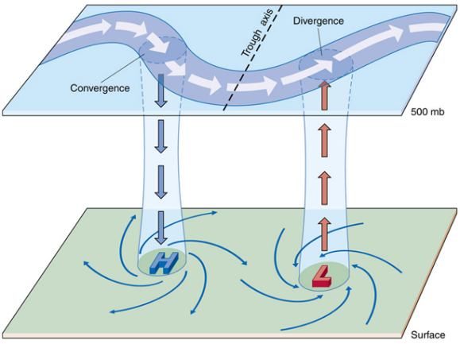
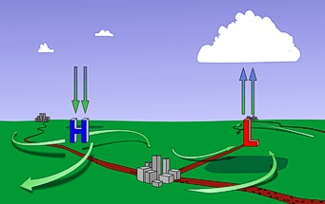
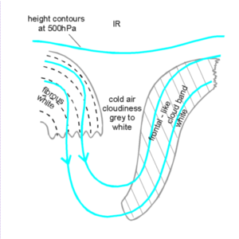
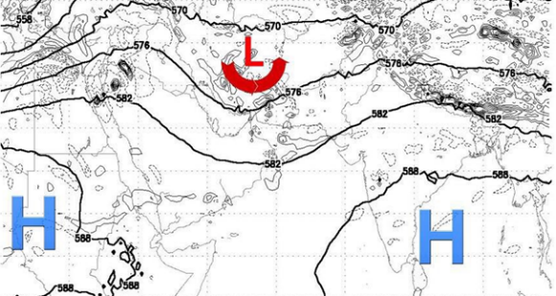
Subject 2: What is Westerly disturbance?
low pressure system that originates over the Mediterranean sea and moves eastwards
A passage of upper air troughs of low pressure area.
Passing from west to east.

Slide 9
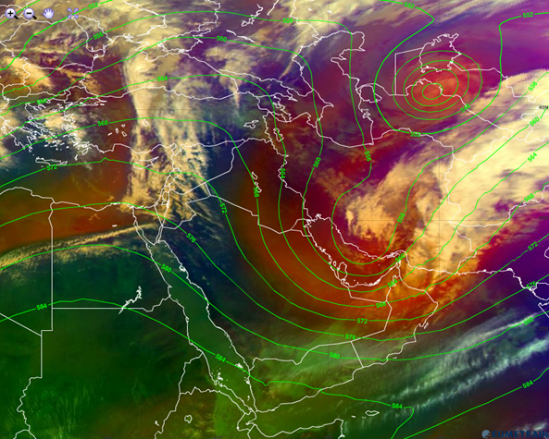
Air mass RGB image

Slide 10
Subject 2: How it Develop?
1. Deep trough
3. Upper air cold air mass
2. Amount of moisture
4. High temperatures
Develop If:
Effects:
Deep convection and thunderstorms.
Lightening.
Hail.
Strong downdraft.
Flash flood.

Slide 11
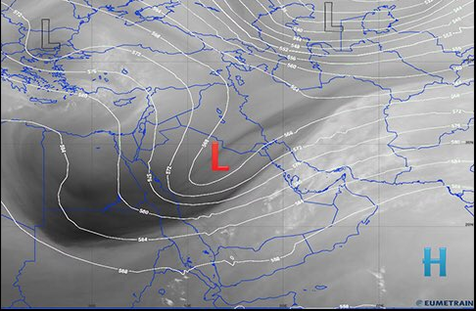
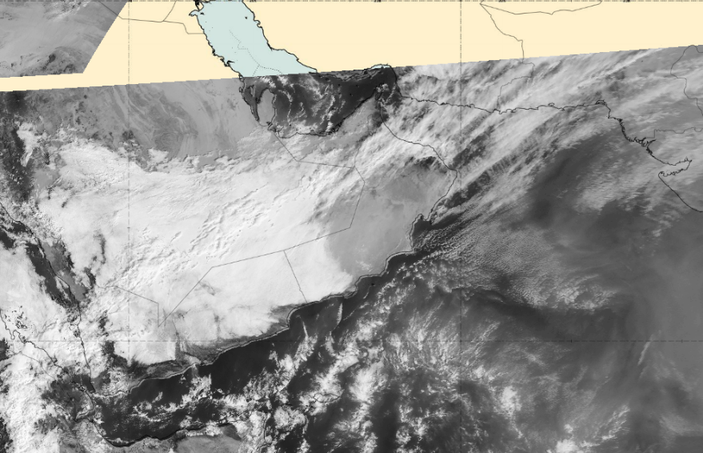
26th -27th Dec 2015
Less humidity
Light to moderate rain
Khasab recorded 8.8mm

Slide 12
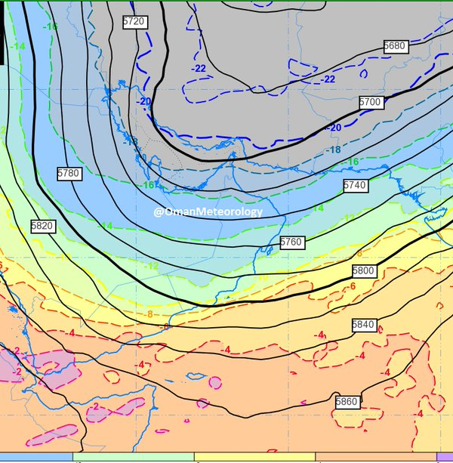
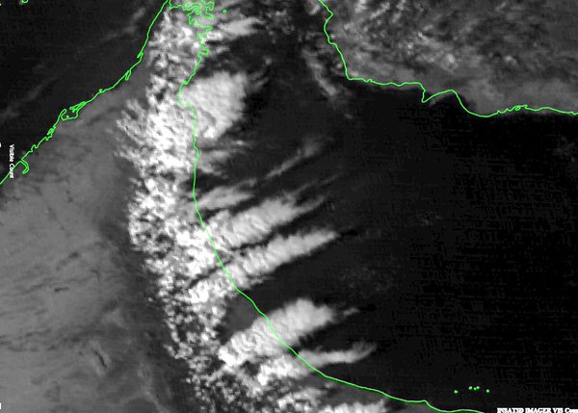
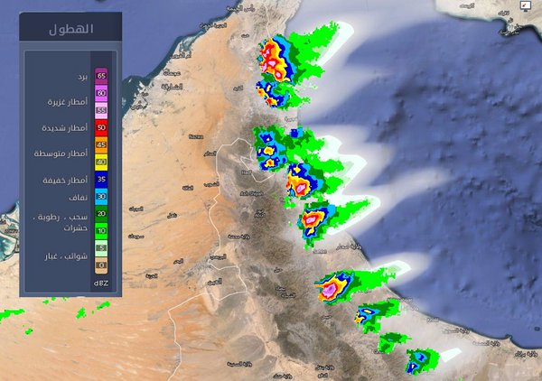
16th Feb 2015
(cold air mass)
Geopotential height 500mb
Satellite Image
Radar Image

Slide 13
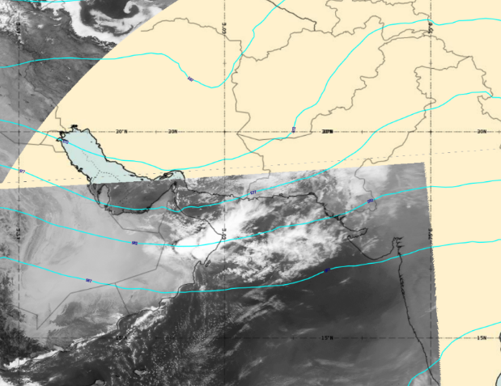
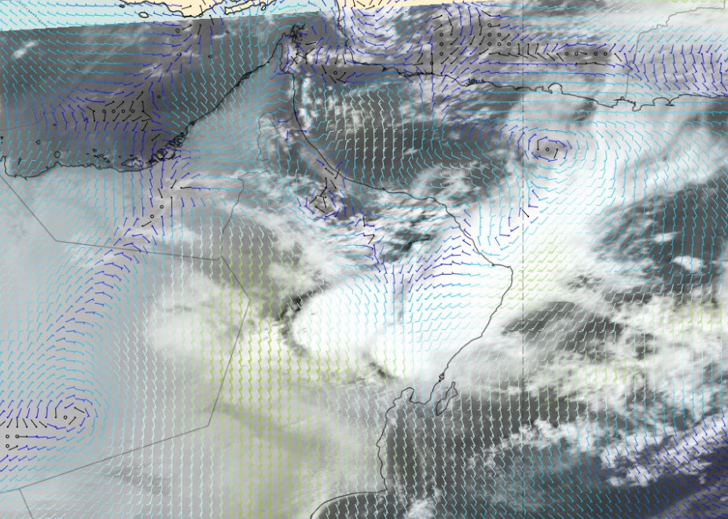
7th -10th March 2016
Warm humid surface
Effect extended to cover AL-Wusta and Dhofar
HRV & geopotential Height 500hpa 10 March 2016 0600UTC
HRV & 10m wind 10 March 2016 0600UTC

Slide 14
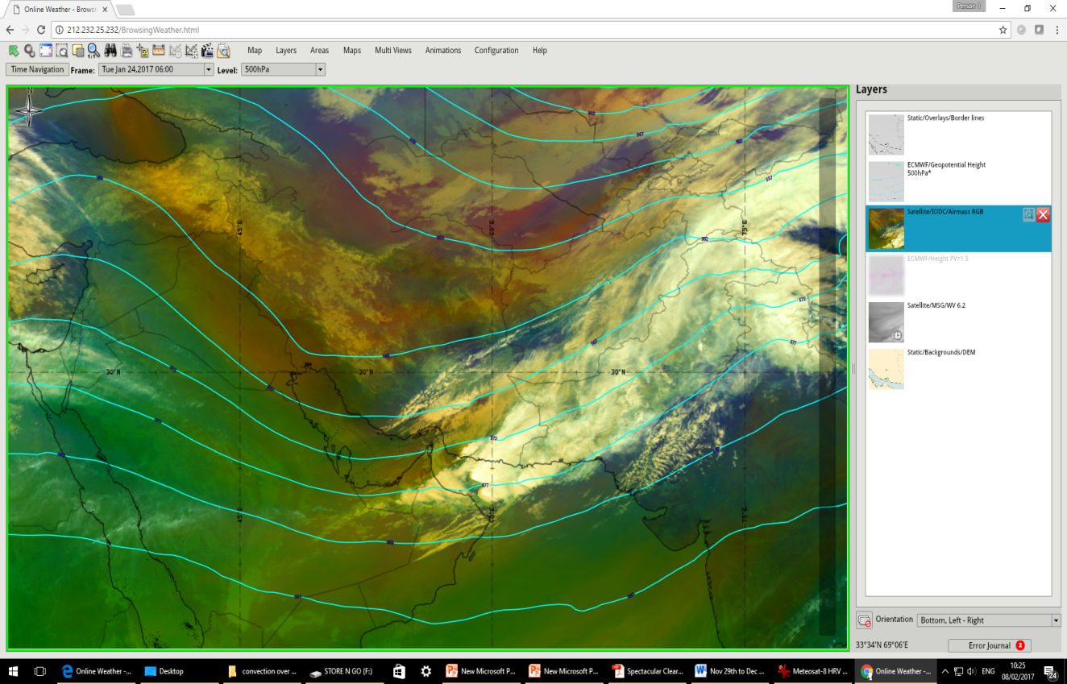
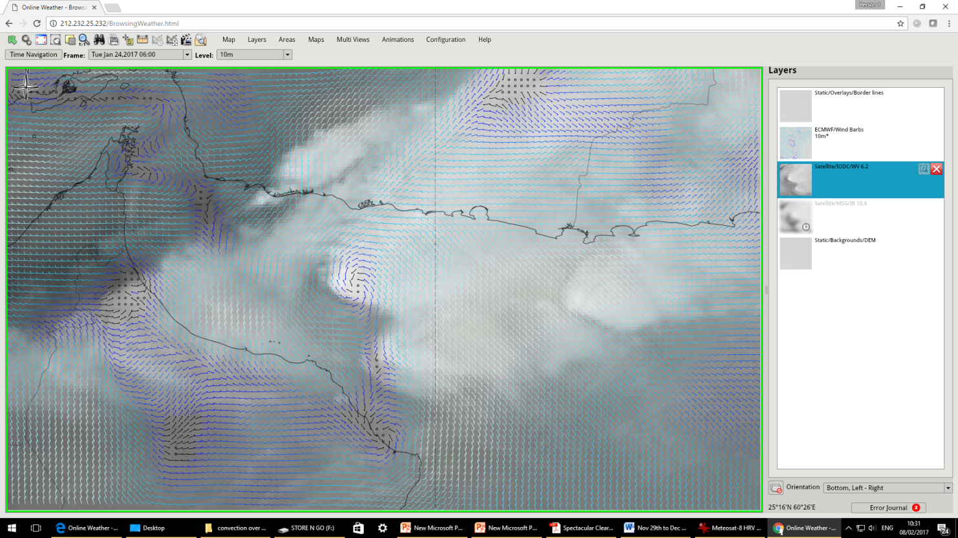
Westerly disturbance ( 24th -26th Jan 2017)
( warm + humid surface)
Air mass RGB & Geopotential height 24th Jan 2017 0600UTC
IR10.8 & 10m wind 24th Jan 2017 0600UTC
Easterly South-easterly flow ( moist warm)
Cold air advection(upper air)

Slide 15
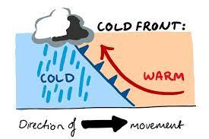
Subject 3:
Is the leading edge of a cold air mass.
Cold front
https://www.youtube.com/watch?v=YJCW4zuoMM0
https://www.youtube.com/watch?v=YJCW4zuoMM0

Slide 16
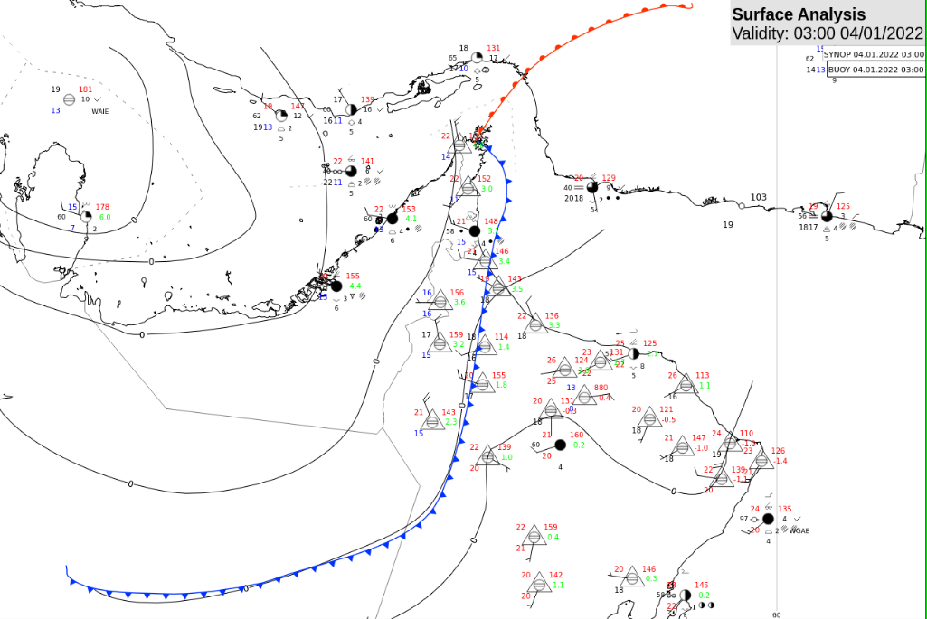
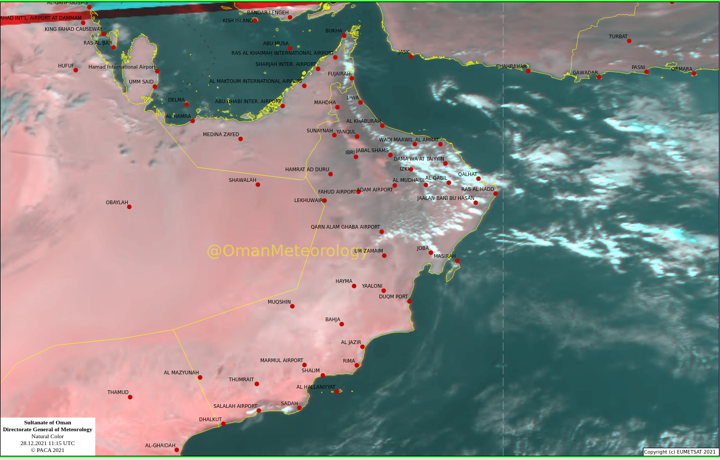
Al Azam Trough

Slide 17
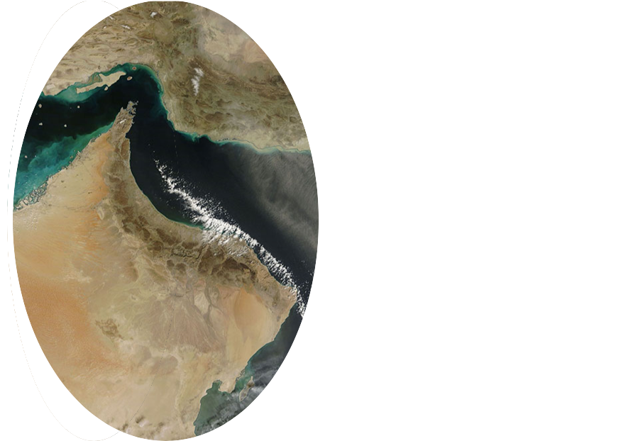
Subject 4:
During passage of trough
N/NW wind
Cold air flow
Warm sea
Clouds band(Shower rain)
Cold air over Warm Sea
https://www.youtube.com/watch?v=YJCW4zuoMM0

Slide 18
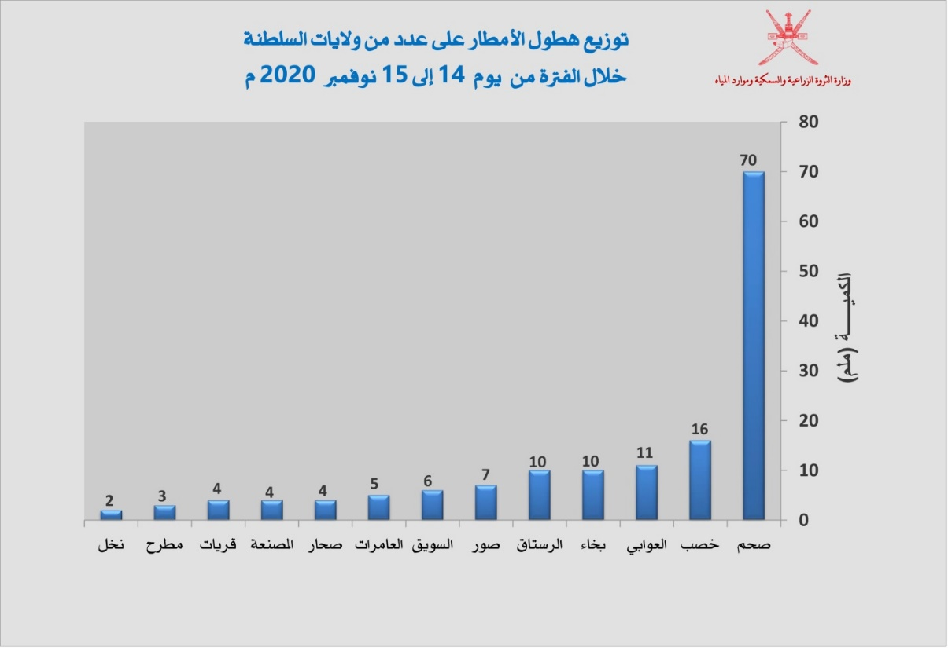
After passage of Al Tayibat Trough
Effects:
Varied intensity of rainfall over coastal areas of Oman Sea during 14th to 15th November 2020 as shown below in figure #1.
Moderate to rough sea state along coastal areas of Musandam and Oman Sea.
Figure 1: Rainfall during 14th to 15th Nov 2020.

Slide 19
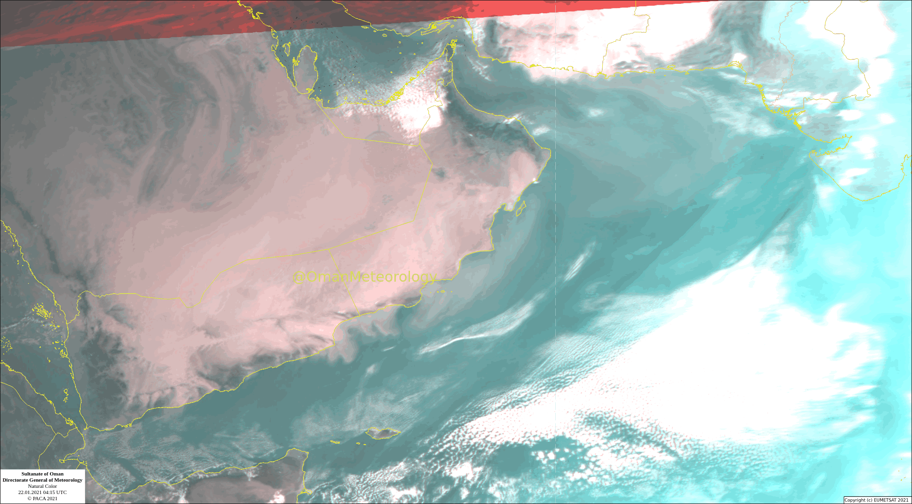
Band of clouds over Oman sea/ Dust on 22nd Jan 2021

Slide 20
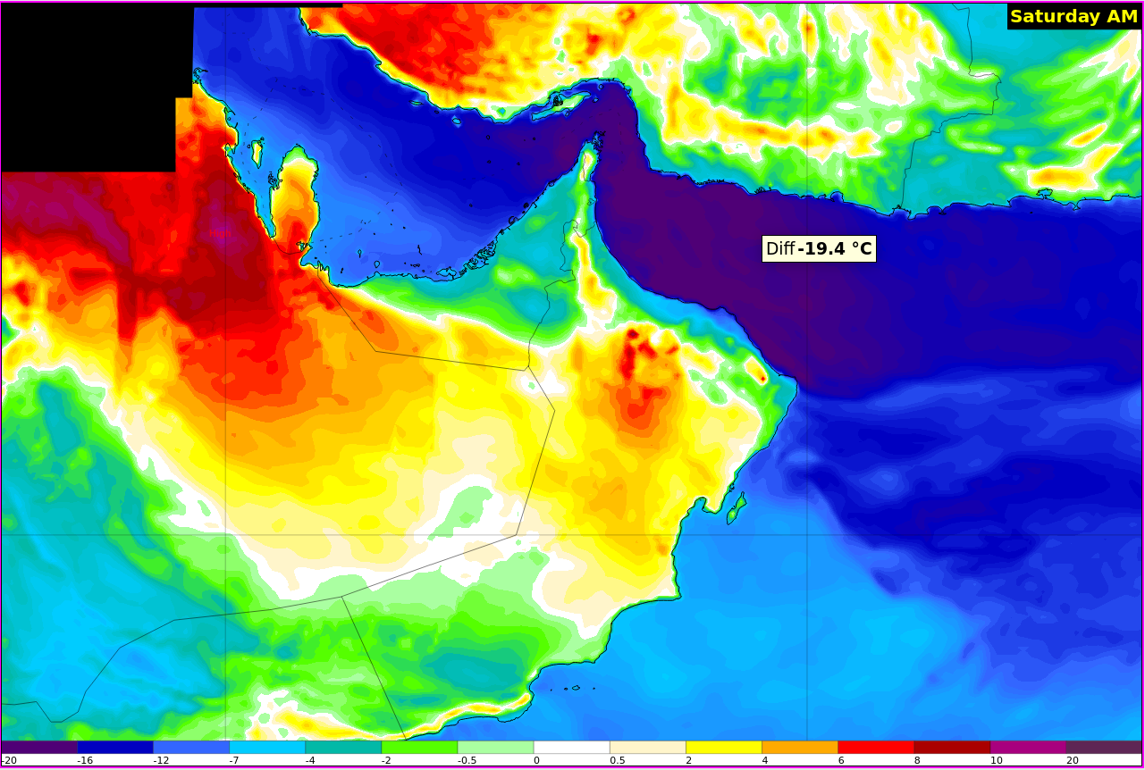
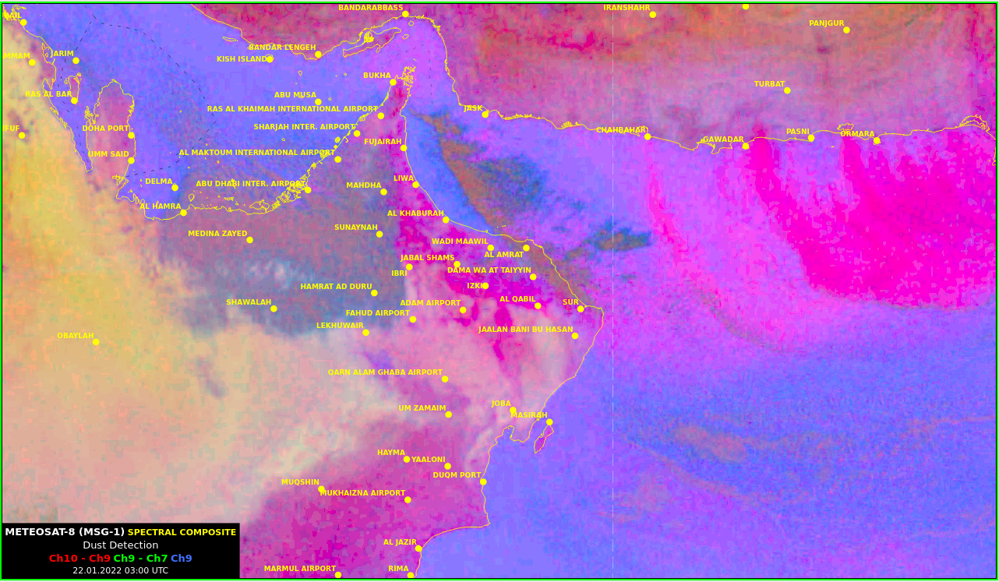
Band of clouds over Oman sea/ Dust on 22nd Jan 2022

Slide 21
Subject 5:
General background and its effects?
Shamal wind/Dust

Slide 22
Shamal wind/ Dust
Background
Effects
Cold air
Decrement in Temperatures.
Is a northwesterly wind blowing over Iraq and the Arabian Peninsula, often strong during the day and weaken at night.
This weather effect occurs anywhere from once to several times a year, mostly in summer but sometimes in winter.
The resulting wind typically creates large sandstorm and dust storm over the region.
Band of clouds ahead of blowing dust
Blowing dust
Disrupted human activities.
Increases wave heights

Slide 23
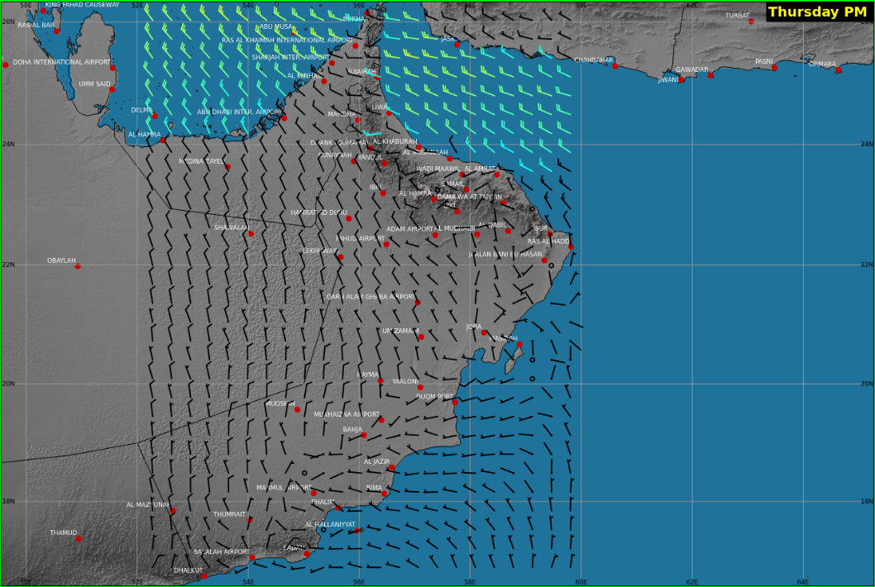
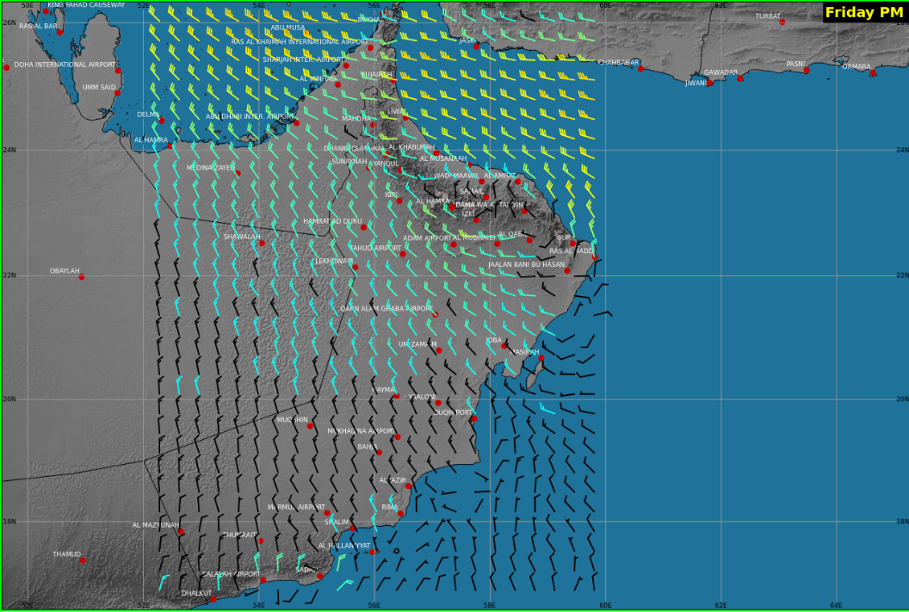
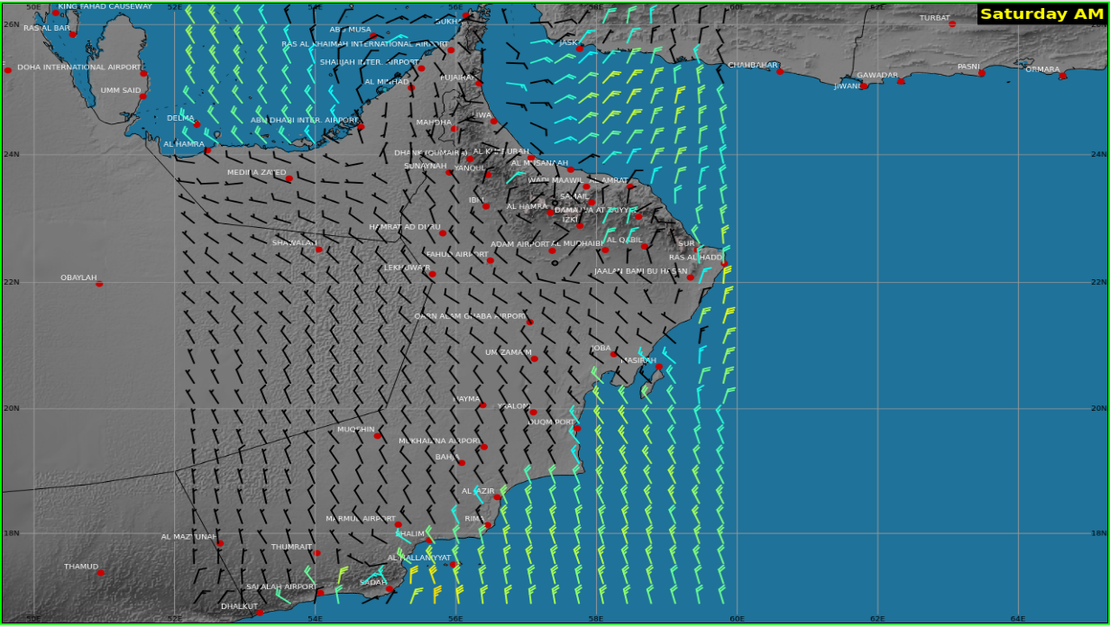
Wind (20th, 21st & 22nd Jan 2022)

Slide 24
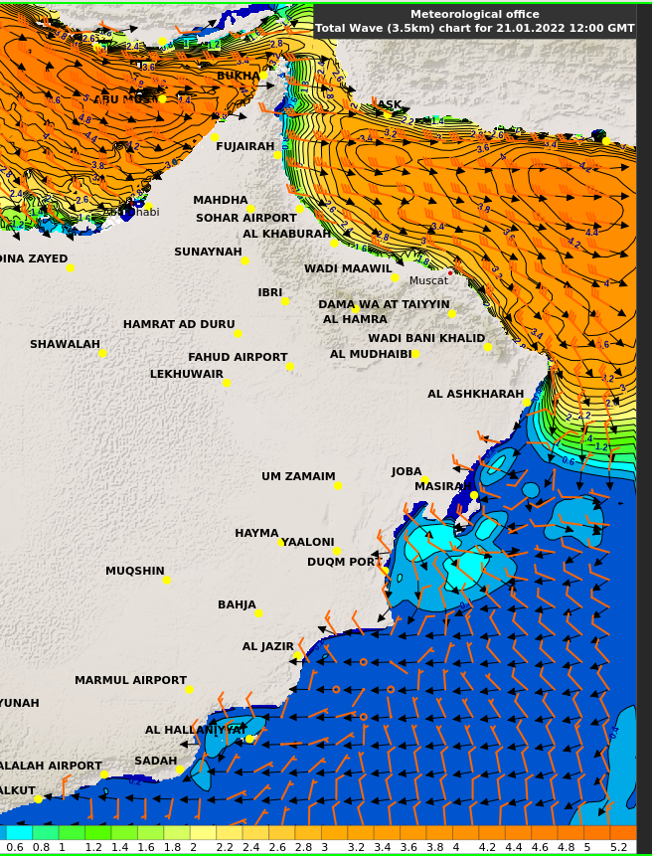
Waves on 21st Jan 2022

Slide 25
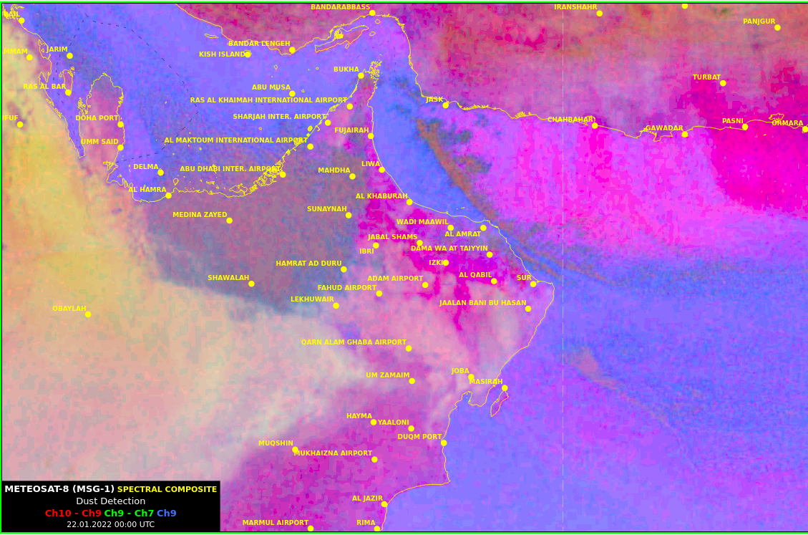
Dust on 22nd JAN 2022
Dust RGB Satellite image’s

Slide 26
Subject 6:
Fog Formation
Its effects
Fog

Slide 27
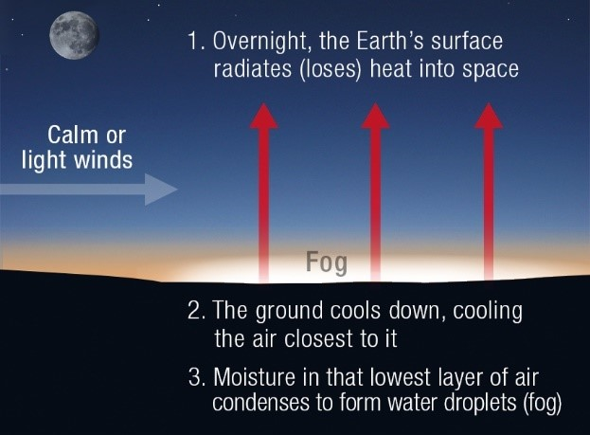

Subject 2: Fog Formation
Ideal condition for Fog Formation....
Stability (inversion )
High humidity (Saturation)
Calm to light surface wind
Low temperature
Timing: late night to early morning

Slide 28
Subject 2: Effects
Reduce visibility
Air traffic disruption
Traffic danger
Example:
https://www.eumetsat.int/widespread-fog-over-parts-uae-and-oman

Slide 29
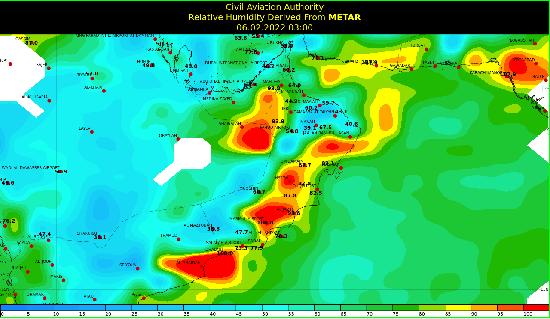
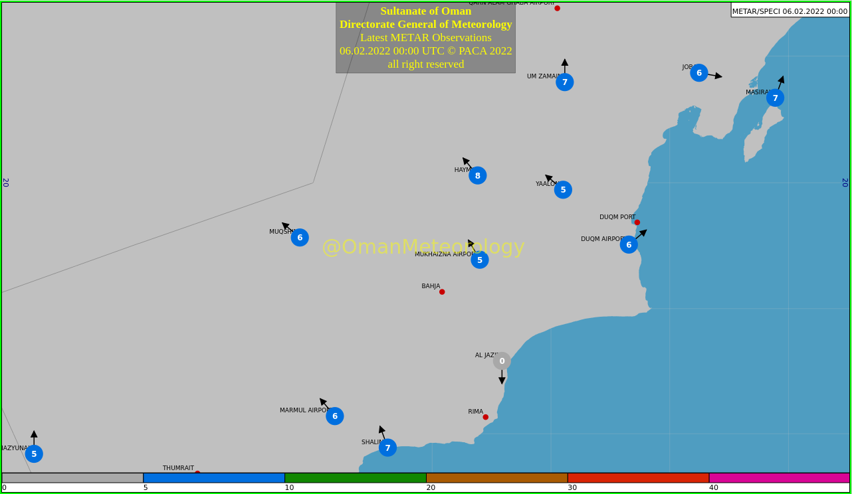
Fog over Hayma on 06/02/2022

Slide 30
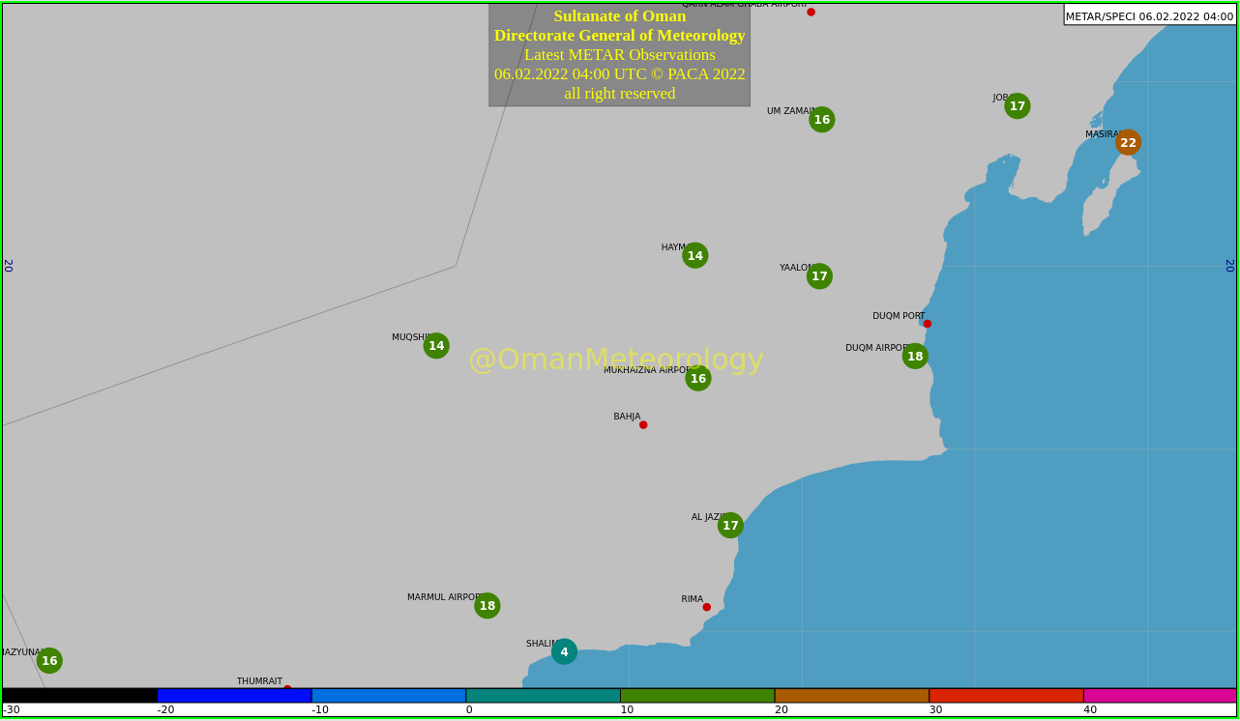
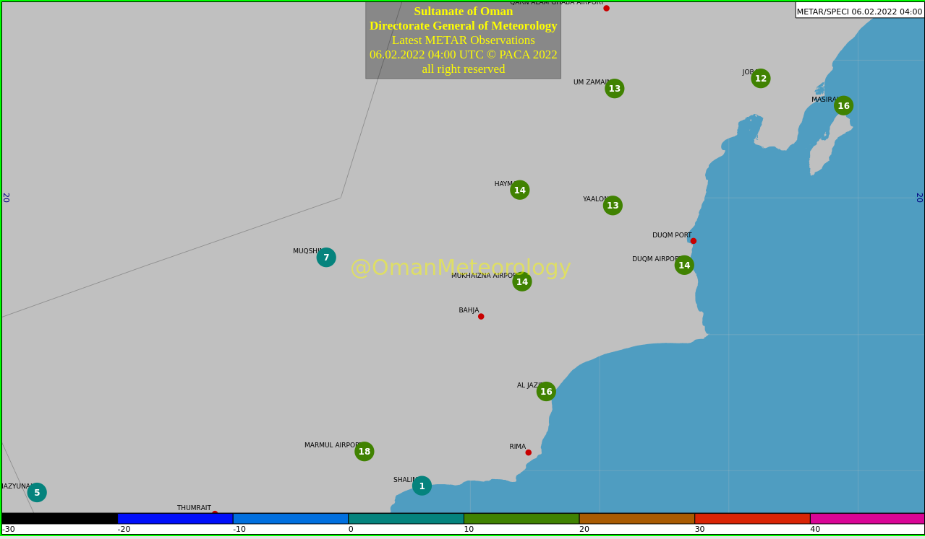
Temperature
Dewpoint

Slide 31
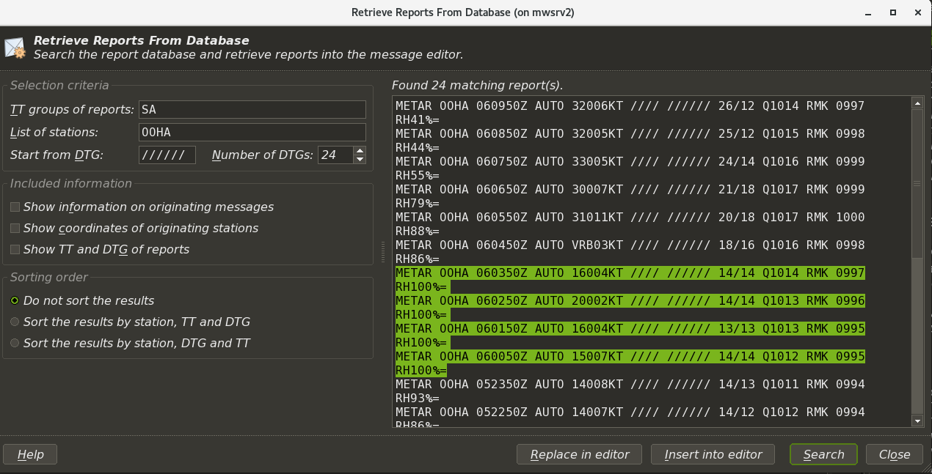
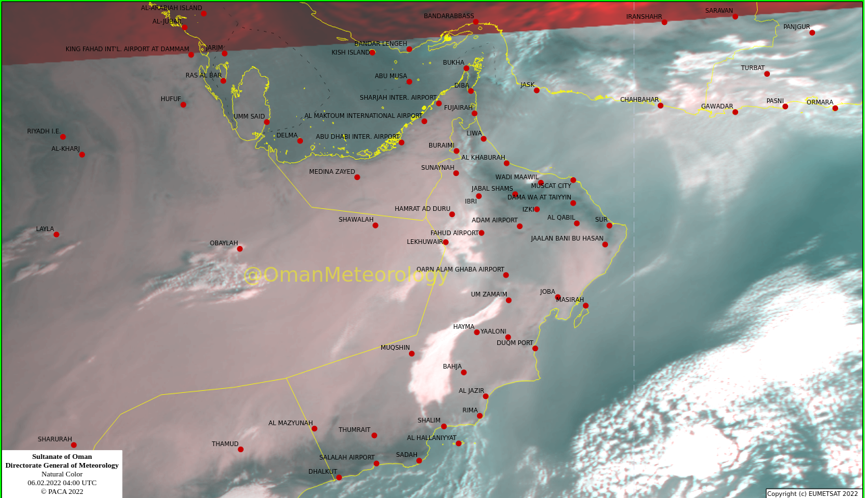
METAR
Satellite Image

Slide 32
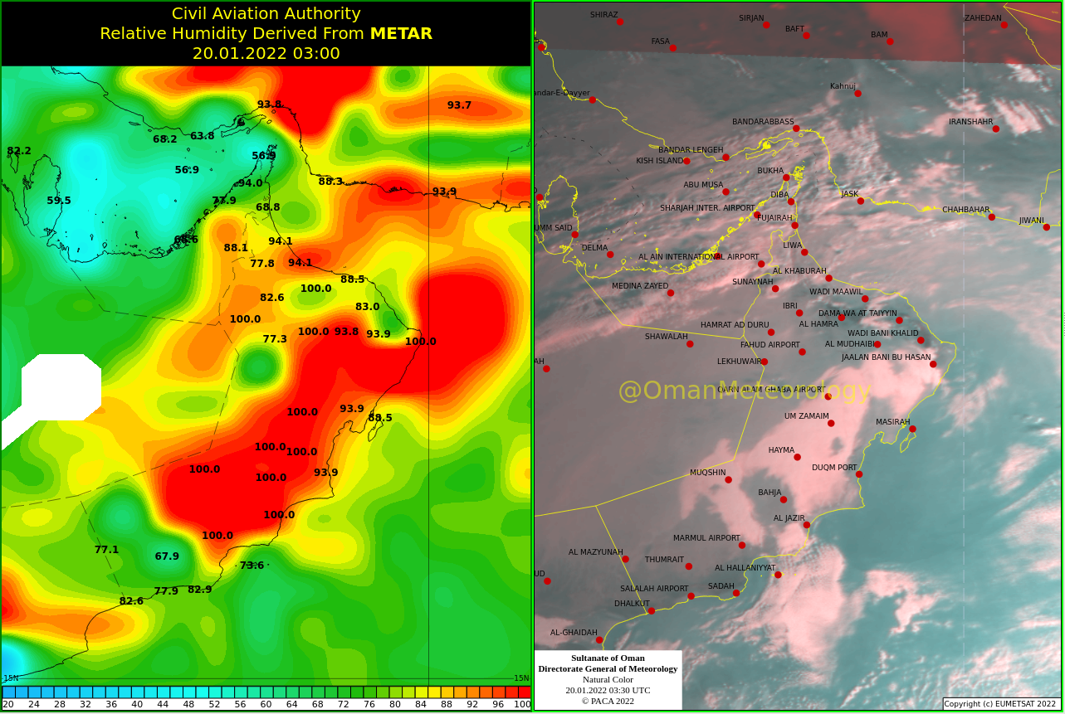
Overnight widespread fog 20/01/2022

Slide 33
Subject 6:
What is Siberian high?
Winter monsoon
Siberian high

Slide 34
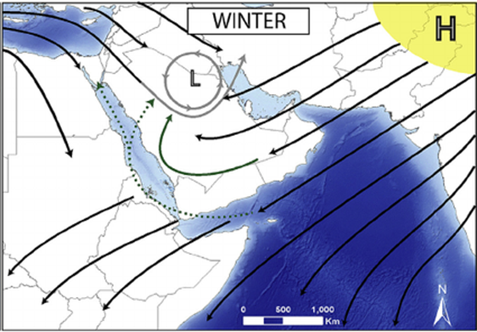
Subject 6: What is Siberian High
A strong High pressure (Siberian high ) develop overs Asia.
It’s a cool and dry continental air mass causes the winter monsoon.
Expected from End of Nov to Mar .

Slide 35
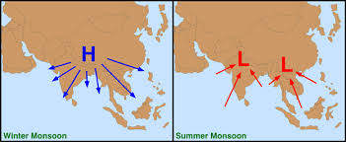
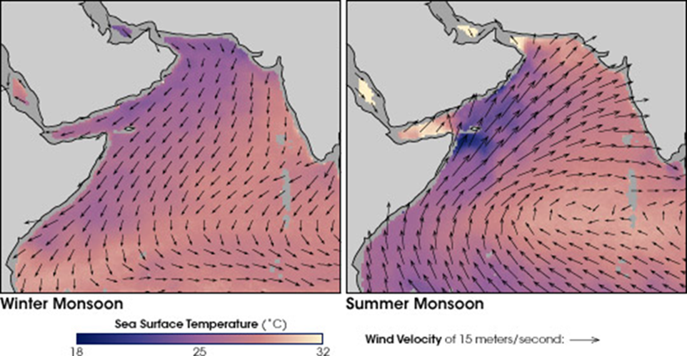
Subject 6: Winter monsoon
Wind direction (arrows) and ocean temperatures (colors).
Dark purple indicates cooler sea surface temperatures(SST), and pinkish-yellow indicates warmer SST temperatures.

Slide 36

Scan this
Kindly scan this “QR code” to evaluate this lecture.
Thank You!

