Slide 1



Standard Weather Parameters
Marine Meteorological Course for Royal Oman Navy
Content creator: Afada Al Hubaishi- Meteorologist
Lecturer: Moza Al Marhoobi - Meteorologist

Slide 2
WHAT IS WEATHER & CLIMATE?
WEATHER
Atmosphere conditions at a certain place for SHORT period of time.
CLIMATE
Atmosphere conditions at a certain place for LONG period of time.

Slide 3
MAIN DUTIES OF A MET SERVICES?
Early warning
Aviation
Marine
Private Forecasts
Climatology

Slide 4
SO WHAT CAN WE MEASURE?
WE CANNOT SEE AIR
Temperature
Air Pressure
Wind Speed & Direction
Relative Humidity
Dew Point
Clouds
Precipitation

Slide 5

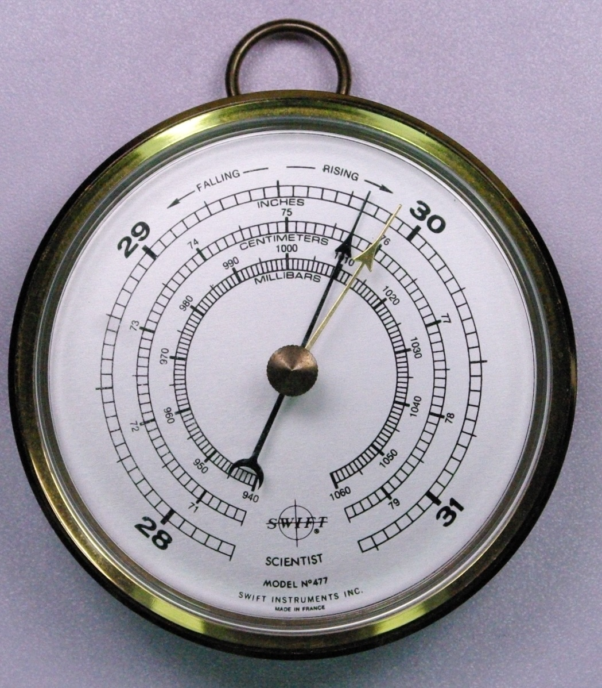
Air Pressure
Air molecules push down on objects (Air Weight).
How to obtain it:
Barometers

Slide 6

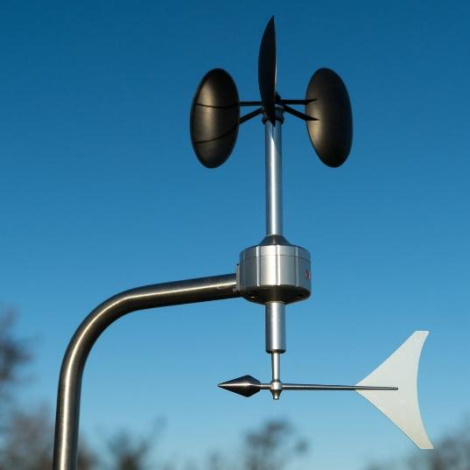
Wind Direction and Speed
The natural movement of Air.
How to obtain it:
Anemometer
Vane

Slide 7

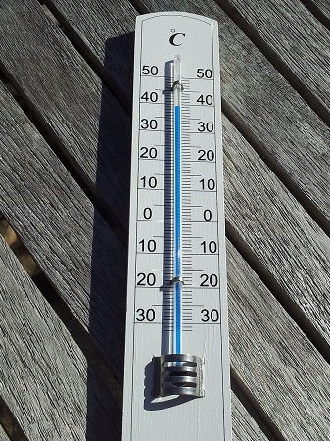
Temperature
A measurement of how much heat energy the air molecules.
How to obtain it:
Thermometer (Mercury – Liquid in glass)

Slide 8

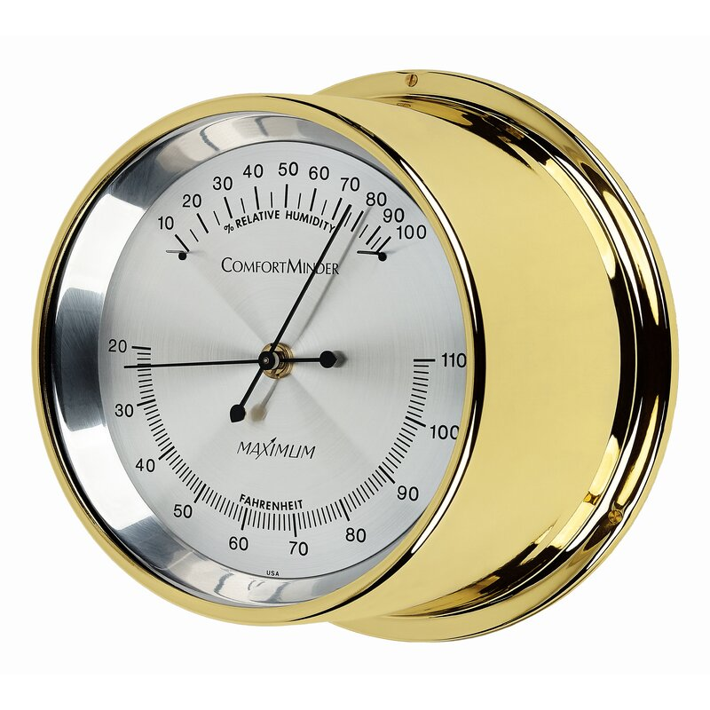
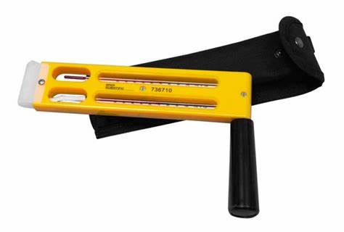
Relative Humidity
Water vapor content in the atmosphere.
How to obtain it:
Hygrometer
Sling psychrometer

Slide 9
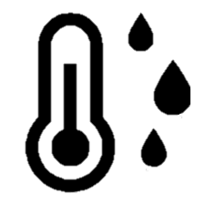
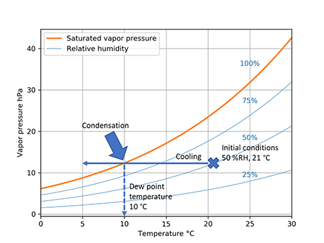
Dew Point
The temperature to which air must be cooled to become saturated
How to obtain it:
Clausius-Clapeyron equation

Slide 10

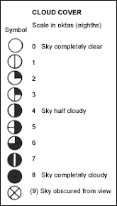
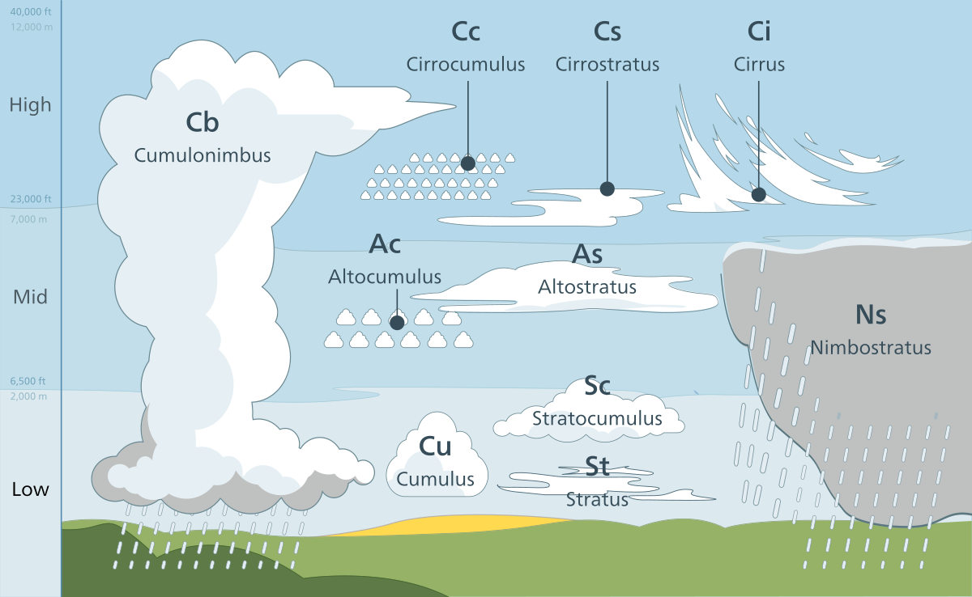
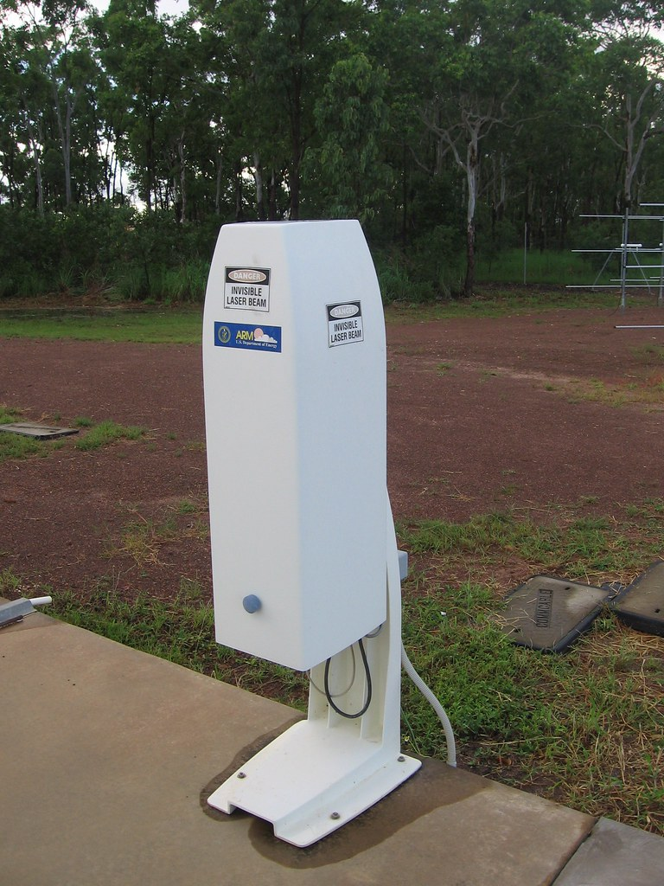
Height
Type
Cover
Cloud
A mass of condensed watery vapor floating in the atmosphere

Slide 11

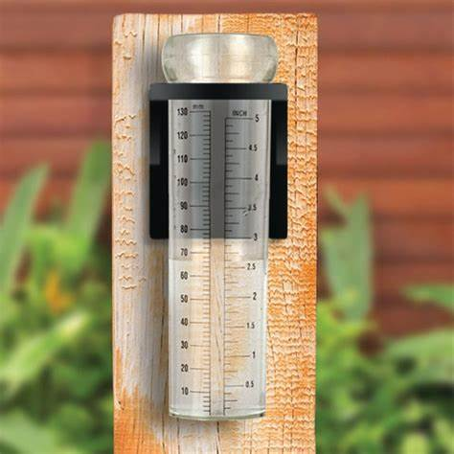
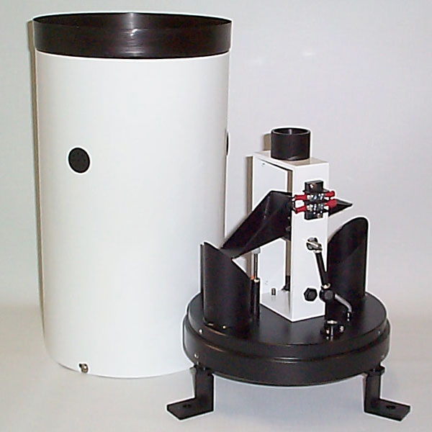
Precipitation
rain, snow, sleet, or hail that falls to or condenses on the ground
How to obtain it:
Rain Gauge
Tipping Bucket

Slide 12
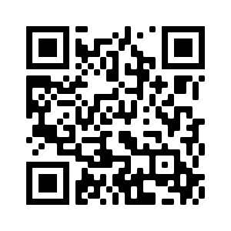
Scan this please
Kindly scan this “QR code” to evaluate this lecture.
Thank You!

