Slide 1
Meteosat Third Generation
WV absorption solar channels
NIR0.9 and NIR1.3
Ivan Smiljanic, (EUMETSAT)

Slide 2
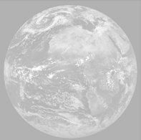
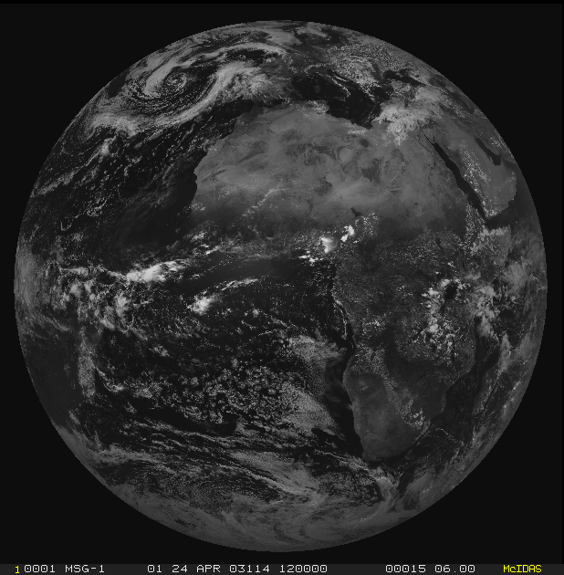
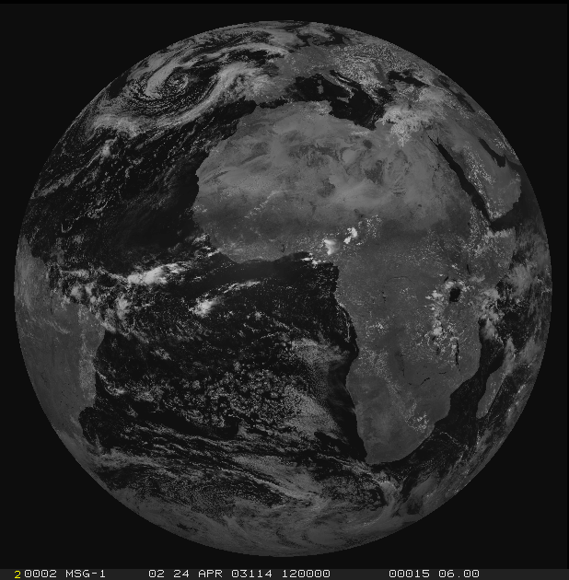
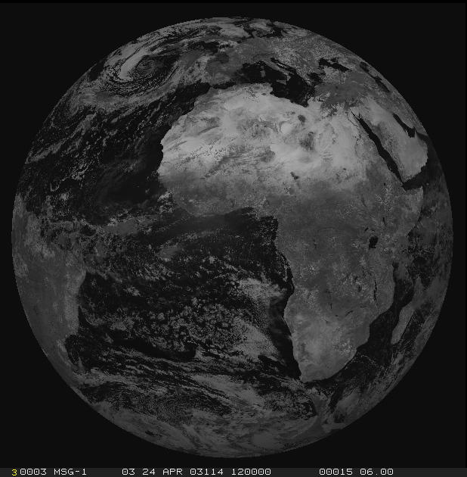
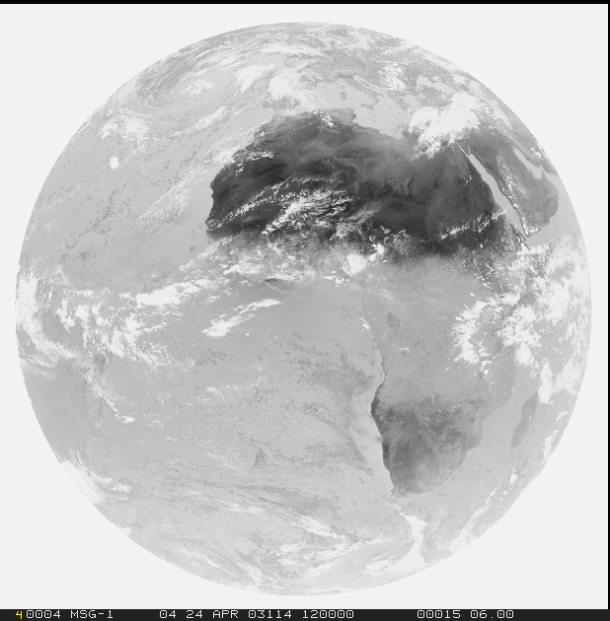
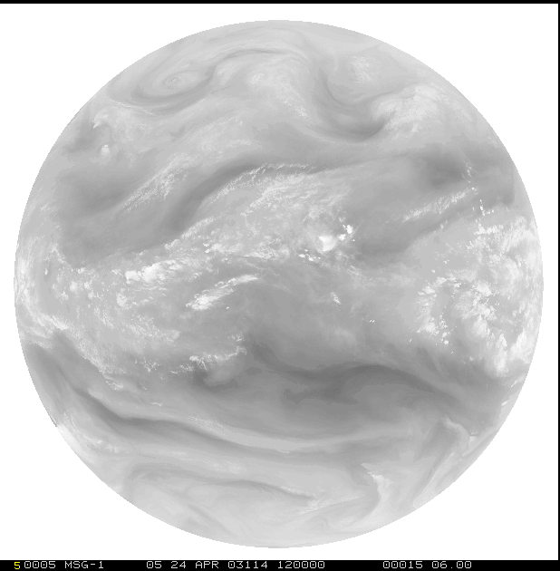
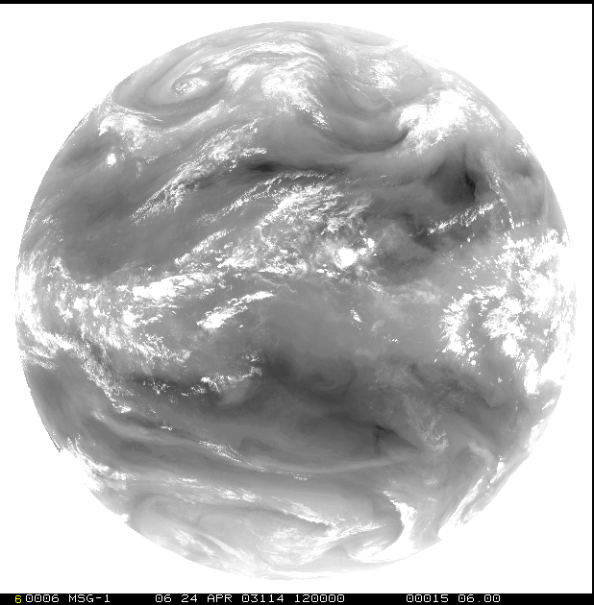
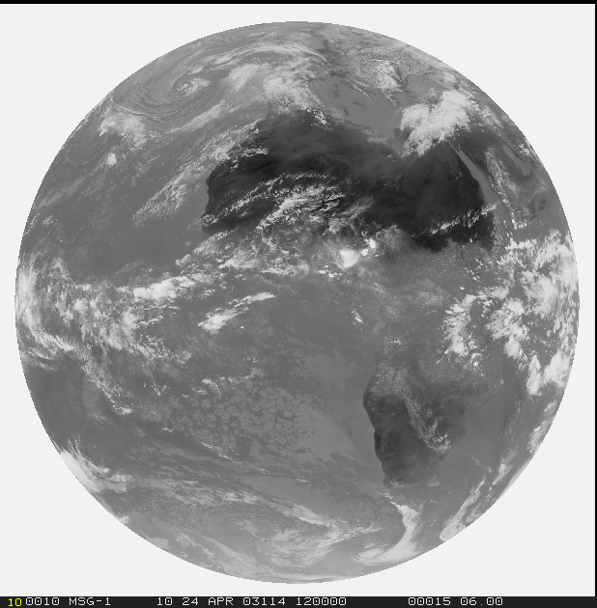
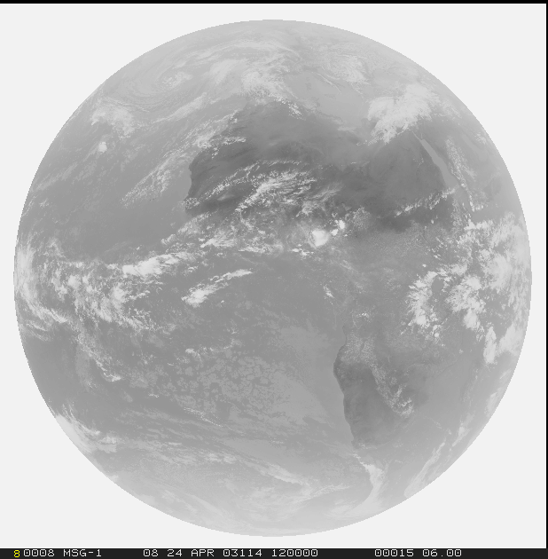
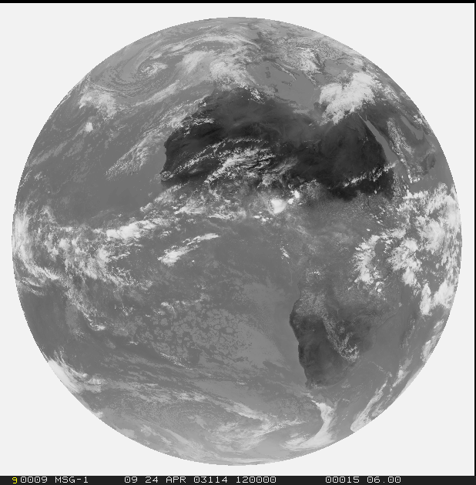
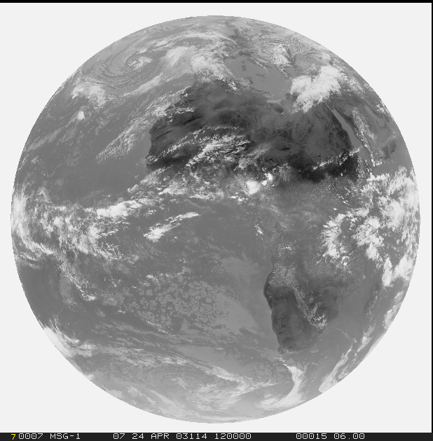
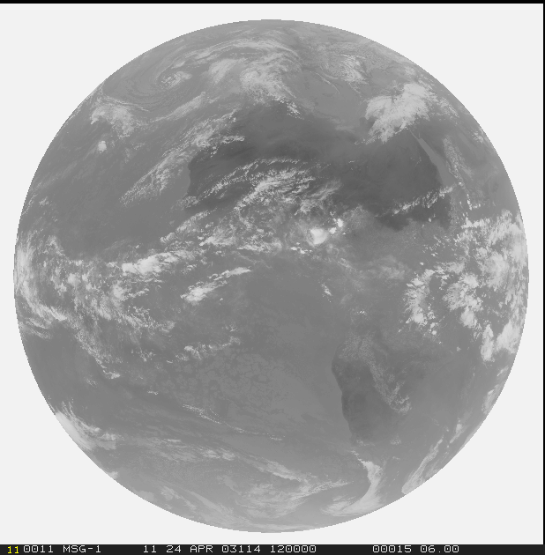
Current and future imagers channels: MSG SEVIRI and MTG FCI
1=VIS0.4
2=VIS0.5
3=VIS0.6
4=VIS0.8
5=NIR0.9
6=NIR1.3
solar
channels
provided in
0.5 km / 1.0 km
resolution
7=NIR1.6
8=NIR2.2
thermal
channels
provided in
1 km / 2 km
resolution
9=IR3.8
10=WV6.2
11=WV7.3
12=IR8.7
13=IR9.7
14=IR10.5
15=IR12.3
16=IR13.3

Slide 3
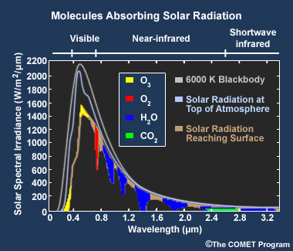
Absorption bands in the Near-infrared

Slide 4
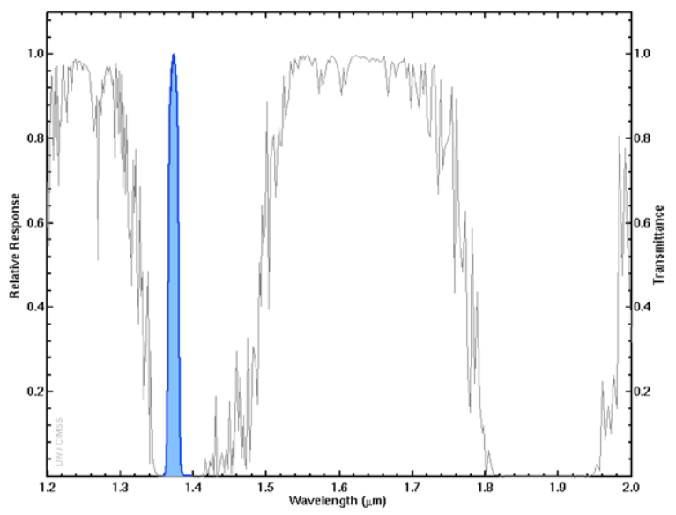
Near Infra-Red (1.37 µm) ‘Cirrus’ channel
Detection of very thin cirrus clouds during the day
Strong water vapor absorption spectral region (see the image on the right)
Does not routinely sense the lower troposphere, where there is substantial water vapor
Provides excellent daytime sensitivity to high, very thin cirrus under most circumstances, especially in warm, moist atmospheres
Correction for the presence of contrail and thin cirrus
It can be used to distinguish between low and high clouds or other bright objects and high clouds
Useful in detecting other upper-level features
Under certain conditions can also detect smoke and ash plumes

Slide 5
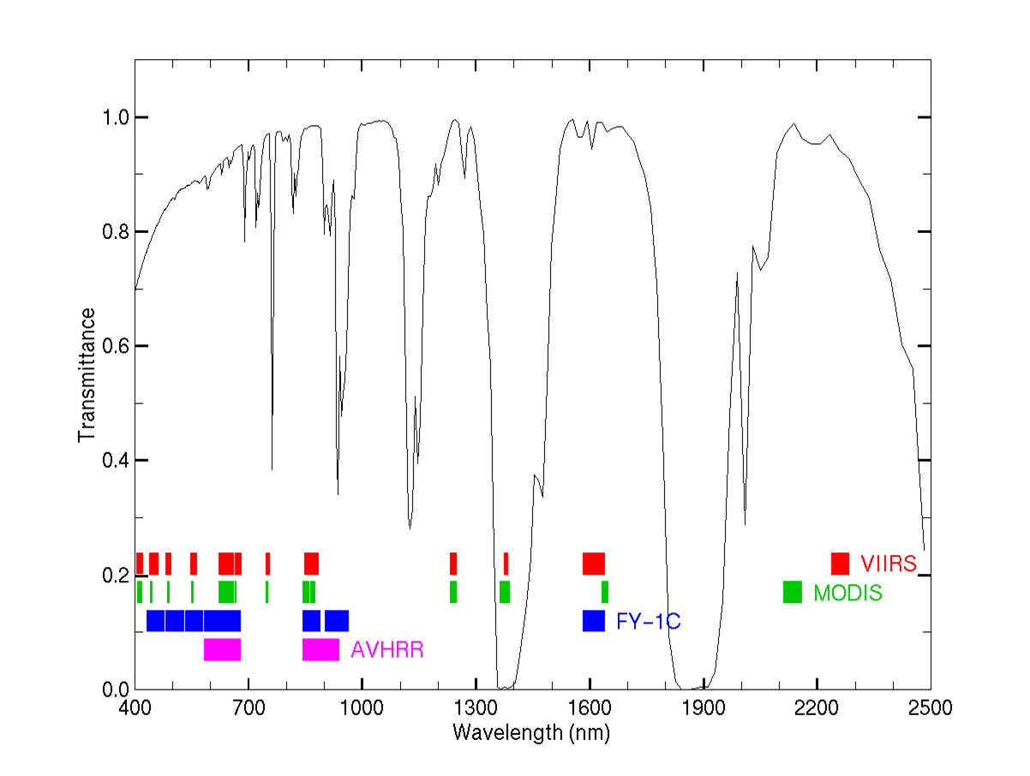
Transmission
910 nm
1375 nm
SEVIRI
MTG FCI extras
H₂O
H₂O
H₂O
H₂O
H₂O

Slide 6
Transmission: what does it mean?
100
100
100
38
32
16
DRY Atmosphere
WET Atmosphere
WET Atmosphere
98
40
96
36
96
18
94
92
92
44
40
20
88
80
80
Reflectivity = 50%
Reflectivity = 50%
Reflectivity = 25%

Slide 7
Cirrus clouds at 1.38 μm: Strong water line: Low Transmission
Cloud-free
1-path T=0
NO SIGNAL
Low Cloud
2-path T=0
NO SIGNAL
High Cloud
2-path T>0
SIGNAL!
100
100
100
8
80
00
80
10
High cloud, R=25%
30
30
10
Low cloud, R=33%
00
Sfc Reflectivity = 50%
Sfc Reflectivity = 50%
Sfc Reflectivity = 50%
1
Transmission
0
1
Transmission
0
1
Transmission
0

Slide 8
1.38 μm: If we see a cloud, what can we say about it?
… maybe not so much, except that it must be high
Brighter
Darker
0 hPa
Same cloud;
Different heights
1000 hPa
1
Transmission
0

Slide 9
1.38 μm: If we see a cloud, what can we say about it?
… maybe not so much, except that it must be high
Brighter
Darker
Darker
Brighter
0 hPa
Same cloud; same height
Different atmosphere
Same cloud;
Different heights
Moist atmosphere
Dry atmosphere
1000 hPa
1
Transmission
0
1
Transmission
0

Slide 10
1.38 μm: If we see a cloud, what can we say about it?
… maybe not so much, except that it must be high
Brighter
Darker
Darker
Brighter
Darker
Brighter
0 hPa
Same cloud; same height
Different atmosphere
Same cloud; same height
same atmosphere; different view angle
Same cloud;
Different heights
Moist atmosphere
Limb View
Dry atmosphere
Nadir View
1000 hPa
1
Transmission
0
1
Transmission
0
1
Transmission
0

Slide 11
1.38 μm compared to 0.8 μm
Brighter
Fewer 0.8 μm photons
get to here and
back because they are
scattered by cloud
particles
1
Transmission
0

Slide 12
1.38 μm compared to 0.8 μm
Darker
Brighter
0 hPa
1.38 μm photons
do not get to here and
back because they are
absorbed by H₂O
molecules
Fewer 0.8 μm photons
get to here and
back because they are
scattered by cloud
particles
1000 hPa
1
Transmission
0
1
Transmission
0

Slide 13
NIR1.3 example

Slide 14
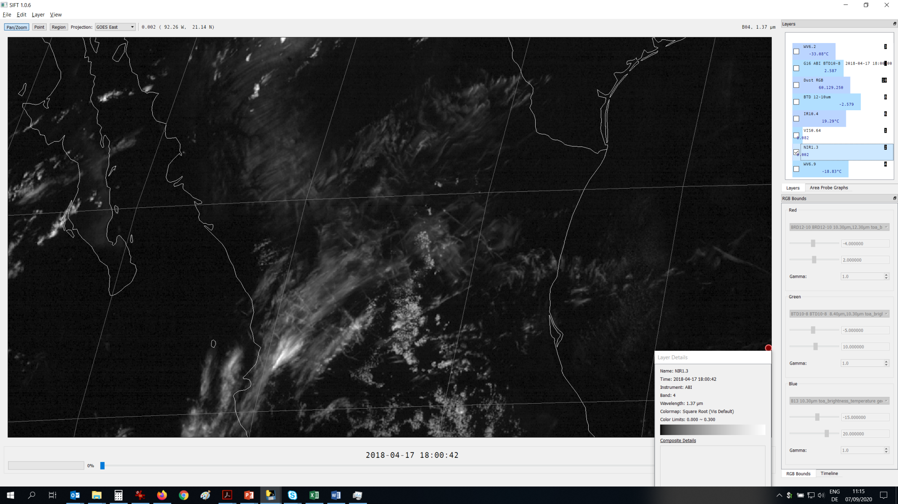

Slide 15
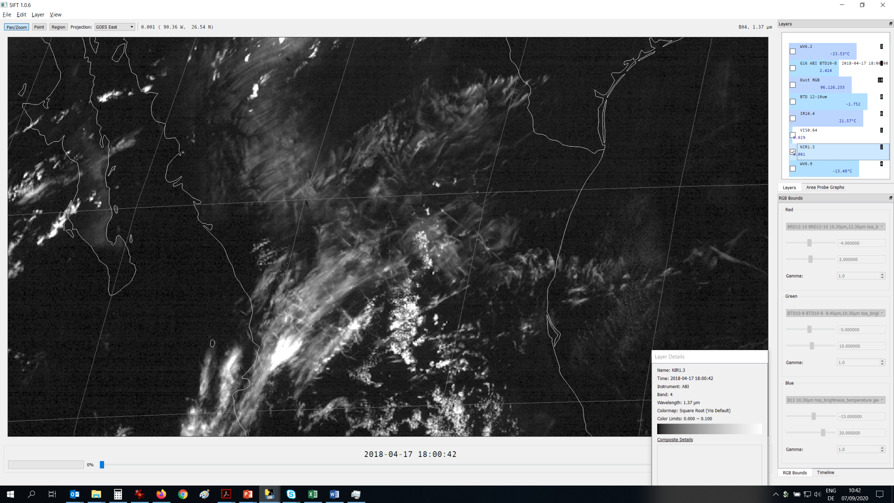

Slide 16
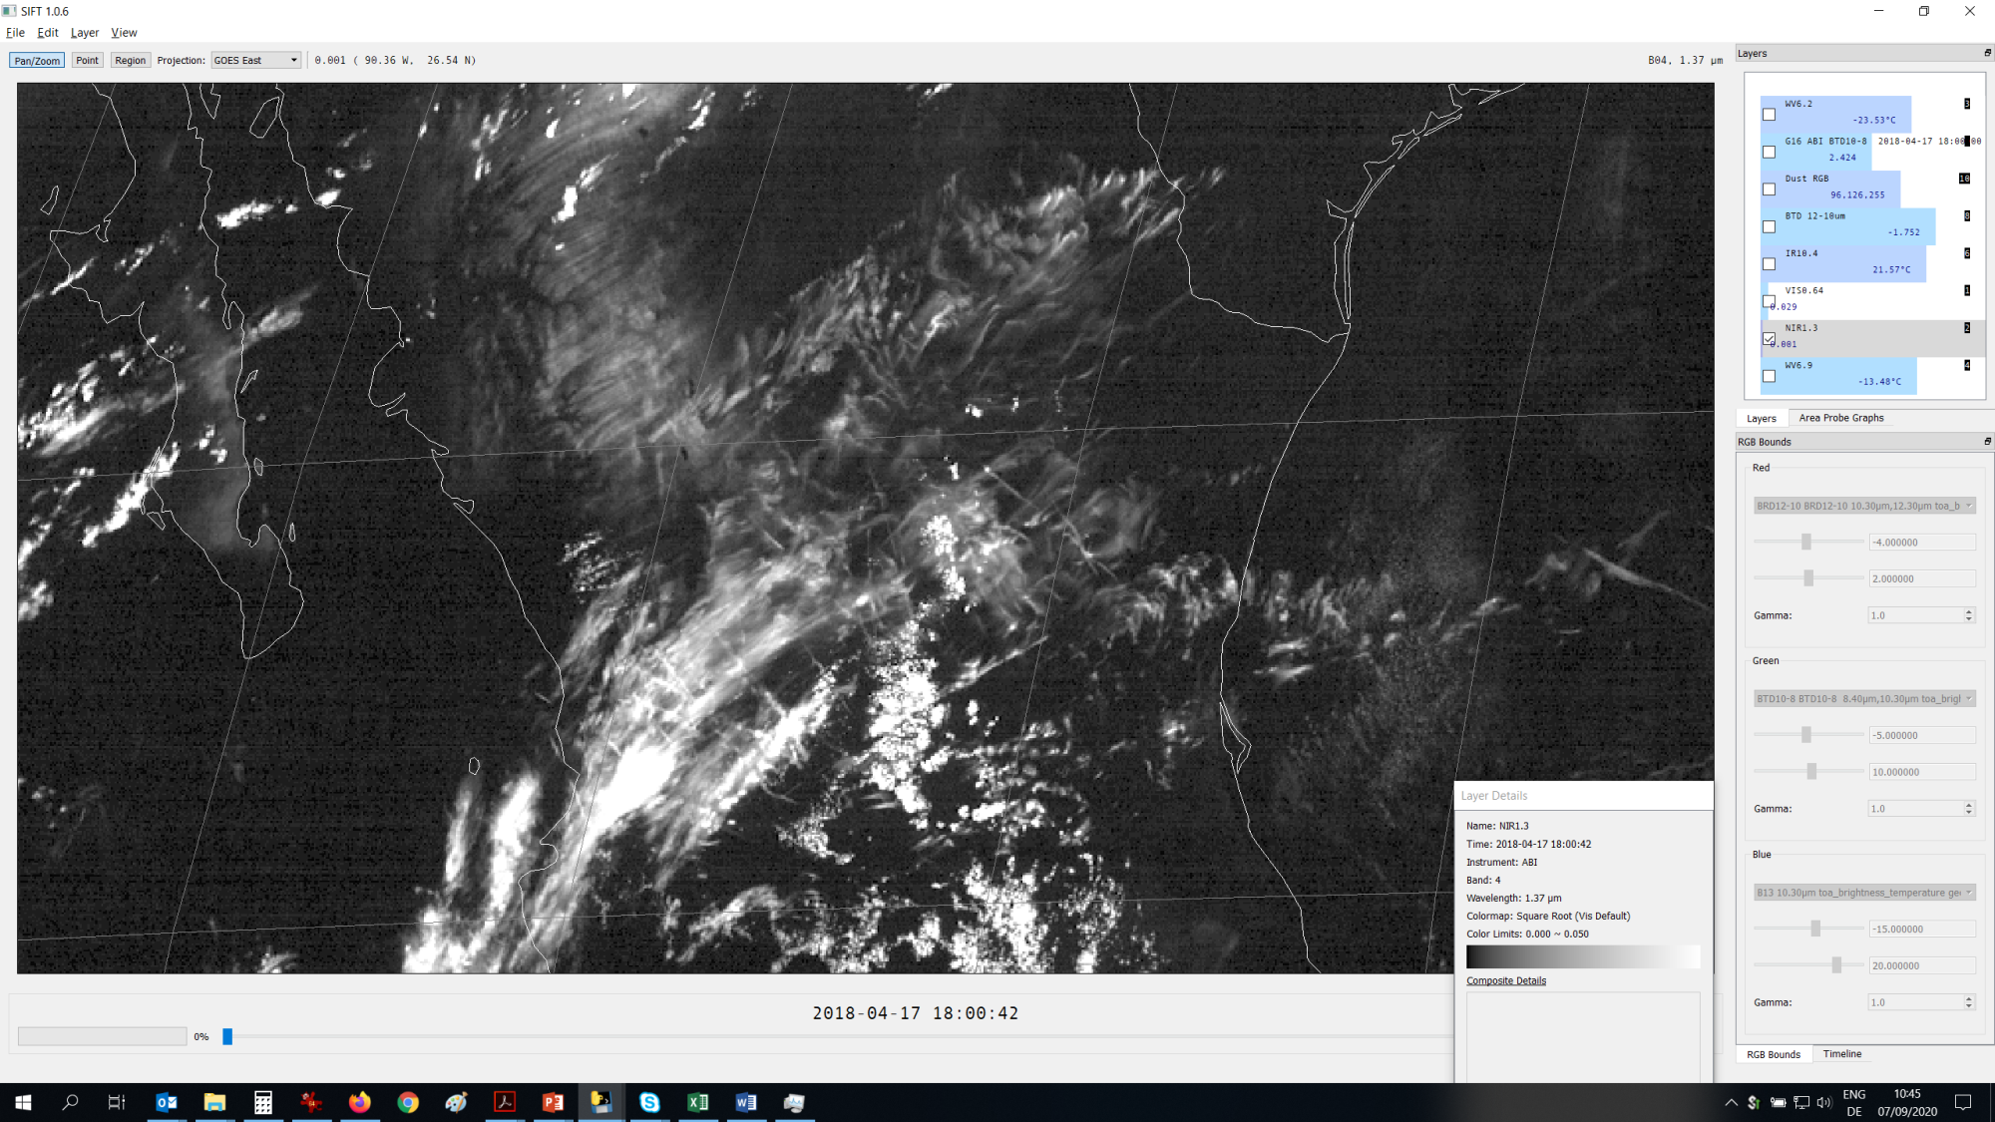

Slide 17
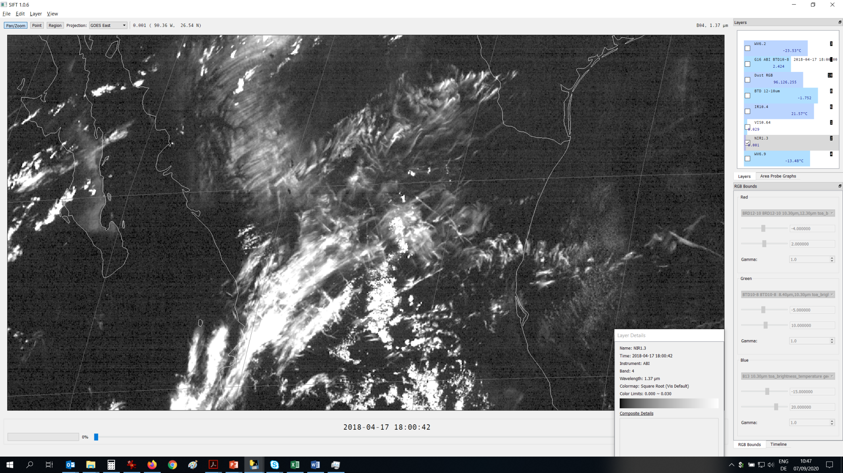

Slide 18
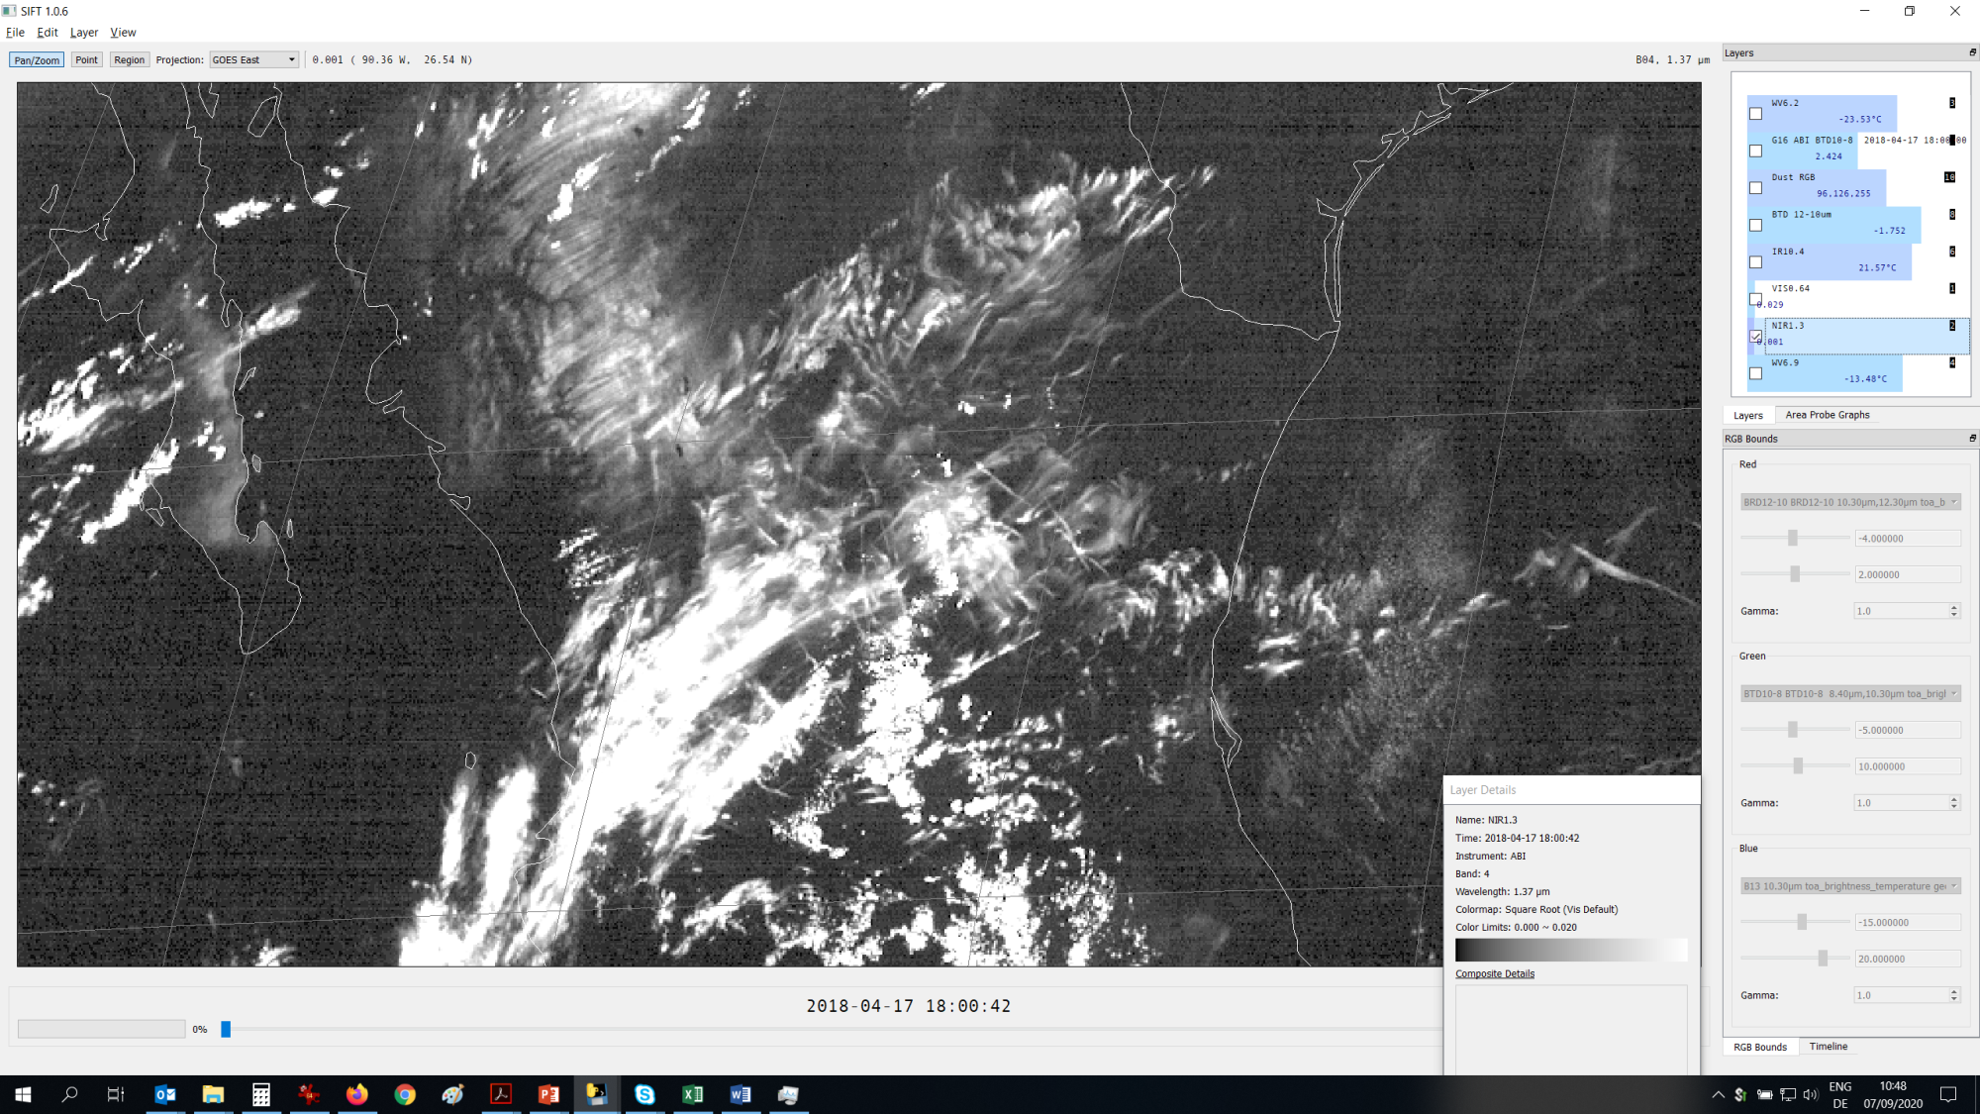

Slide 19
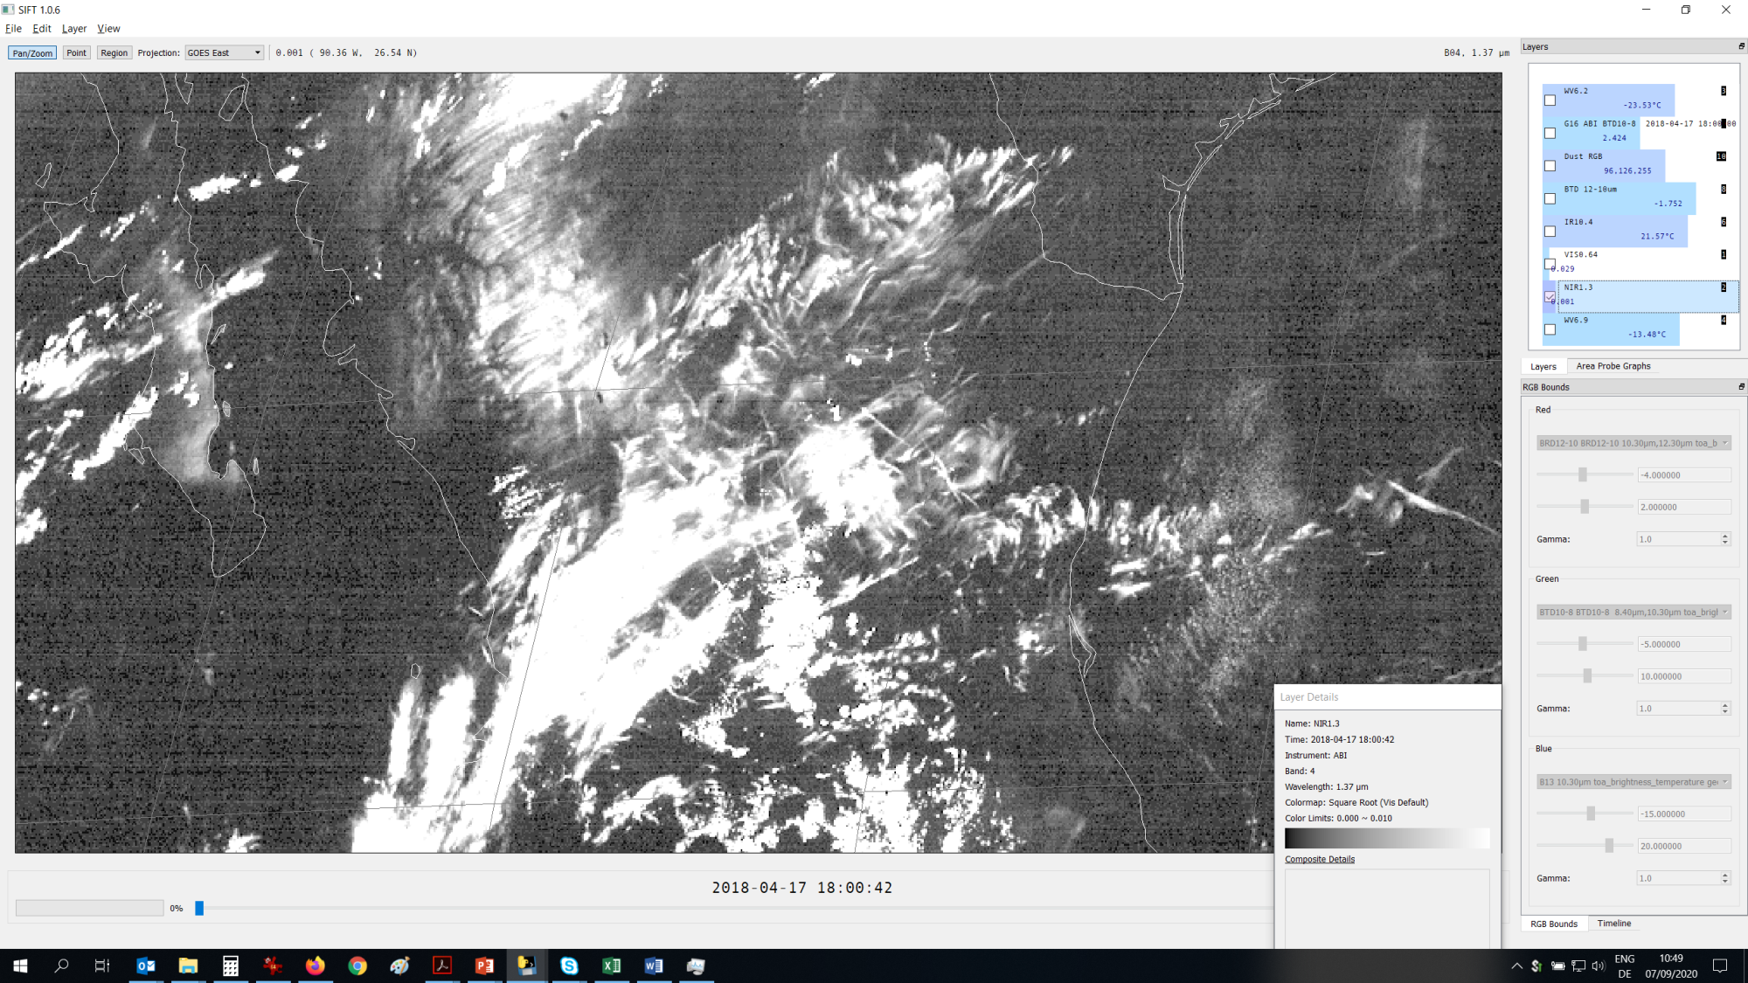

Slide 20
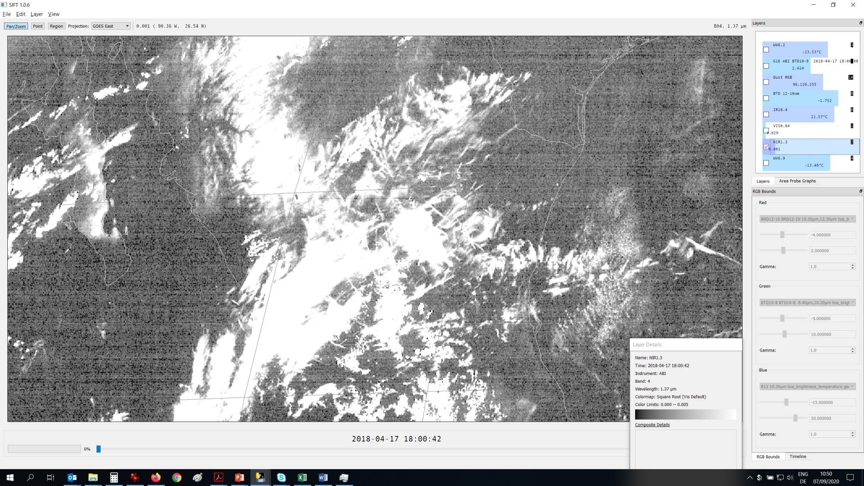

Slide 21
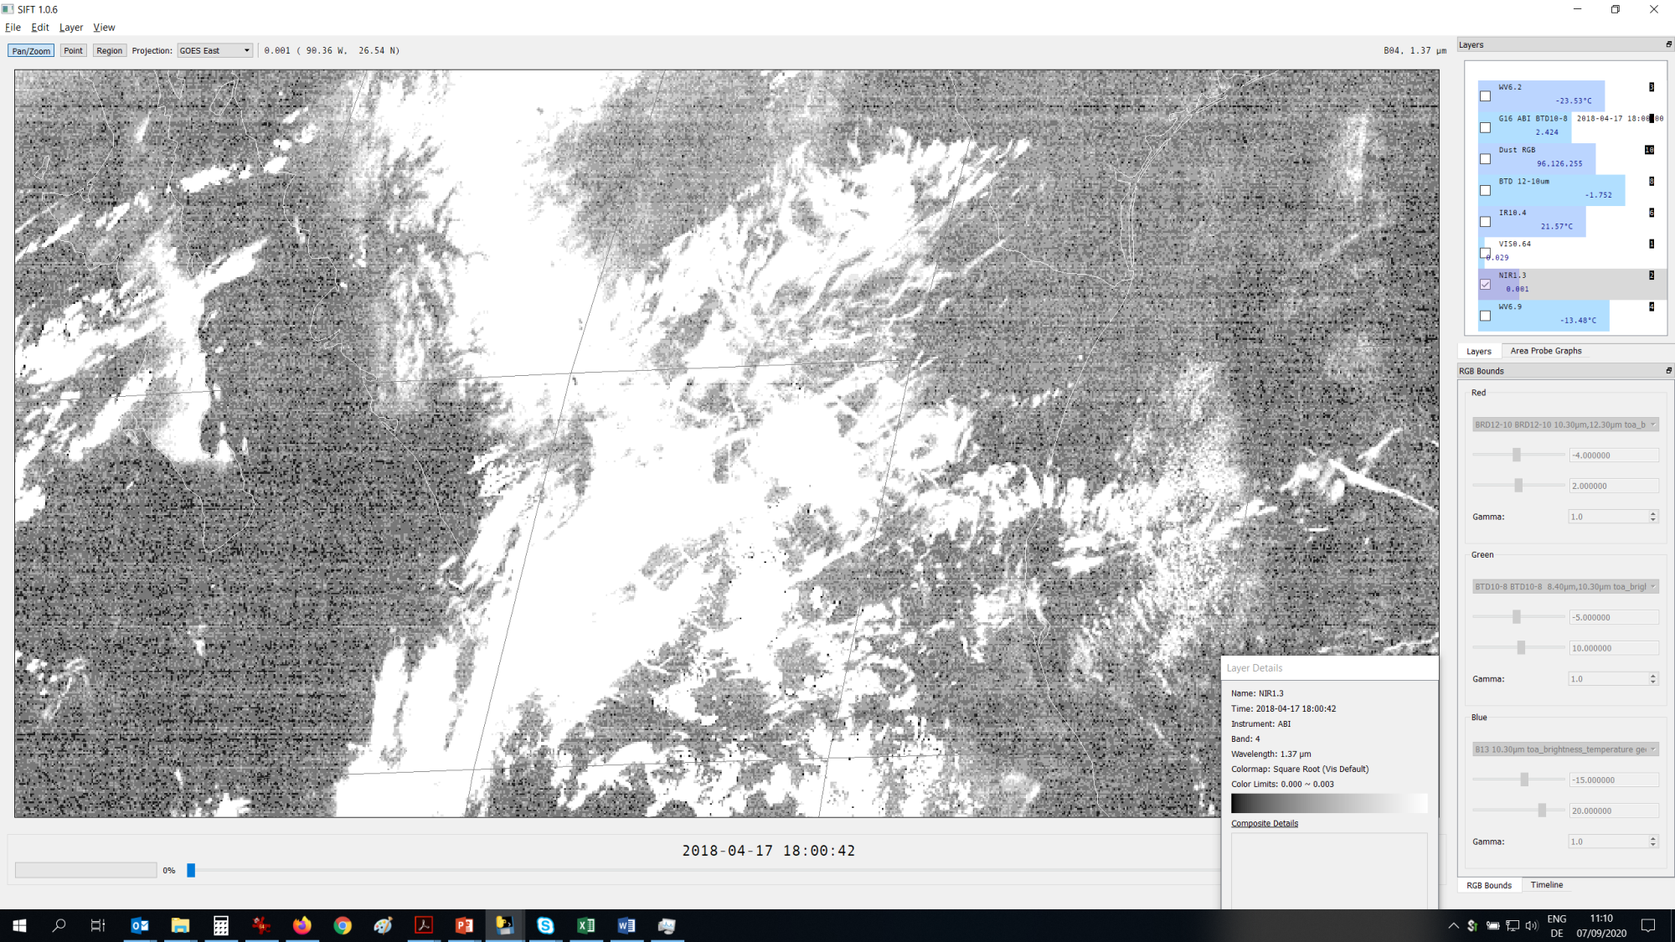

Slide 22
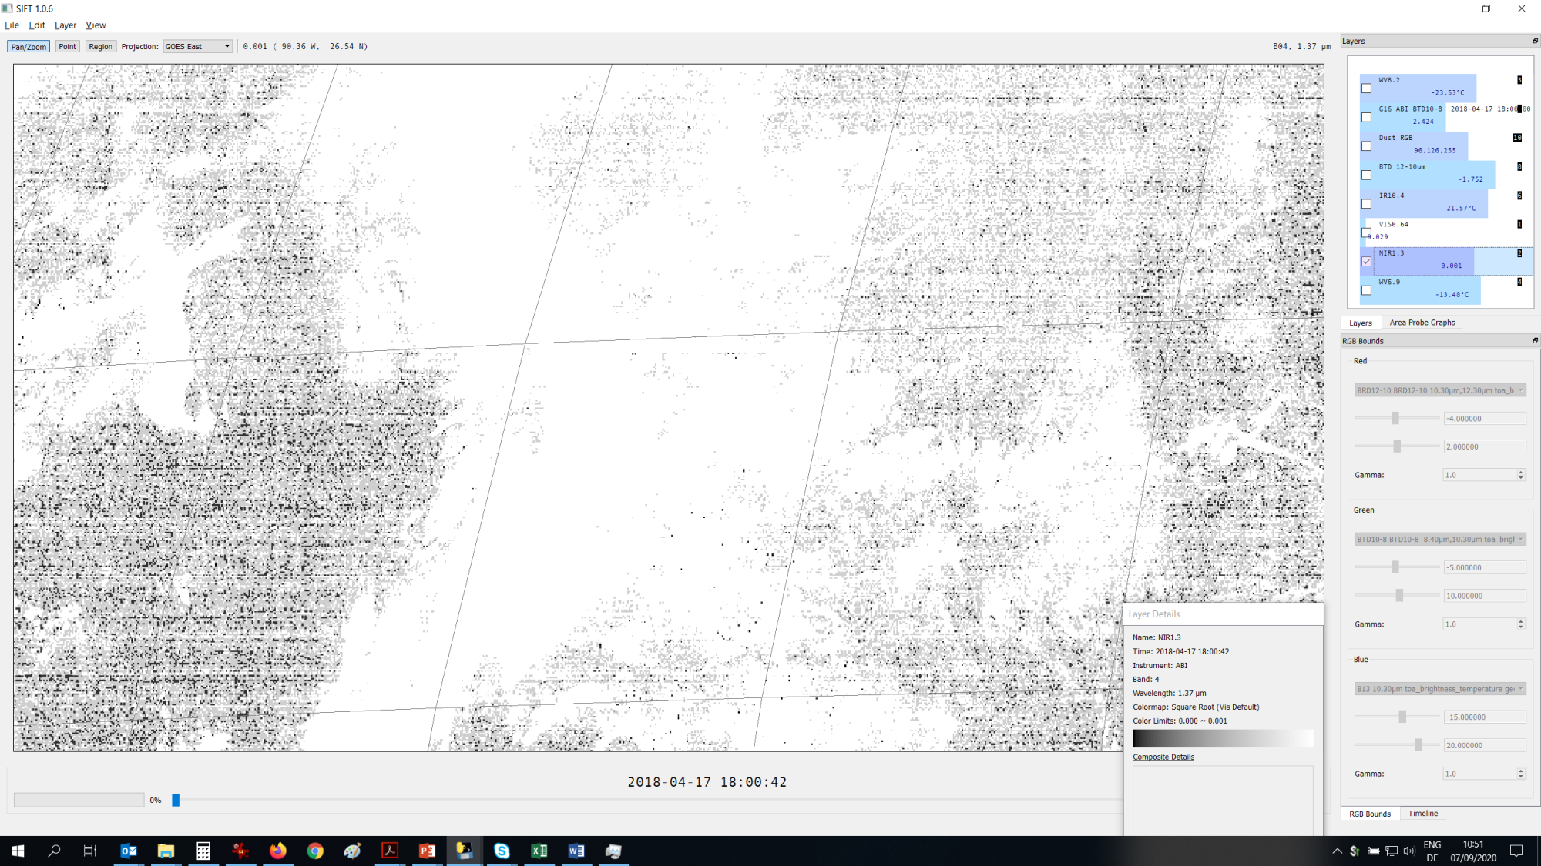

Slide 23
NIR0.9 example

Slide 24
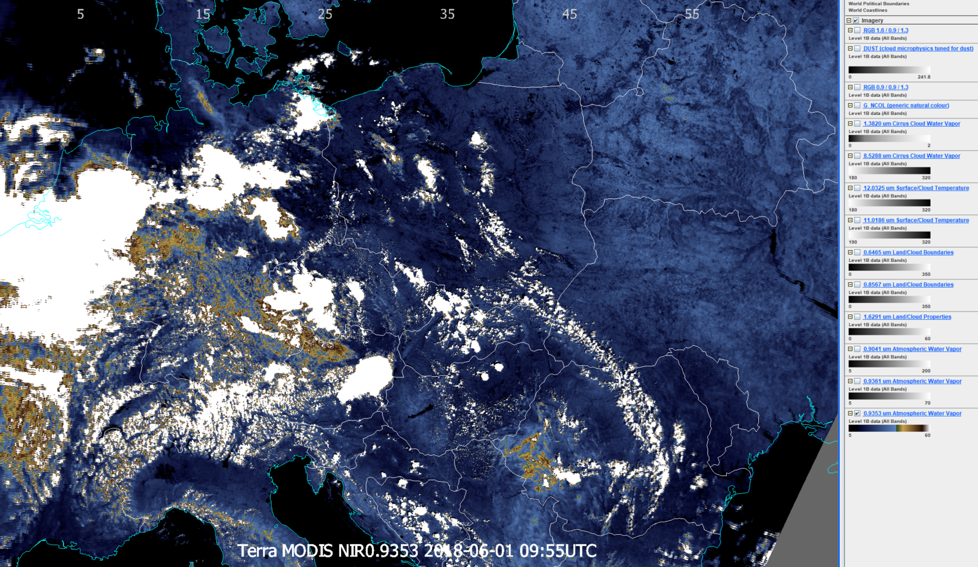
Comparison to highly WV-sensitive channel > 0.9353 µm channel – colour enhanced
High-level cloud field
Moisture boundary visible?
Reflection by thin cirrus??
thin cirrus
thin cirrus

Slide 25
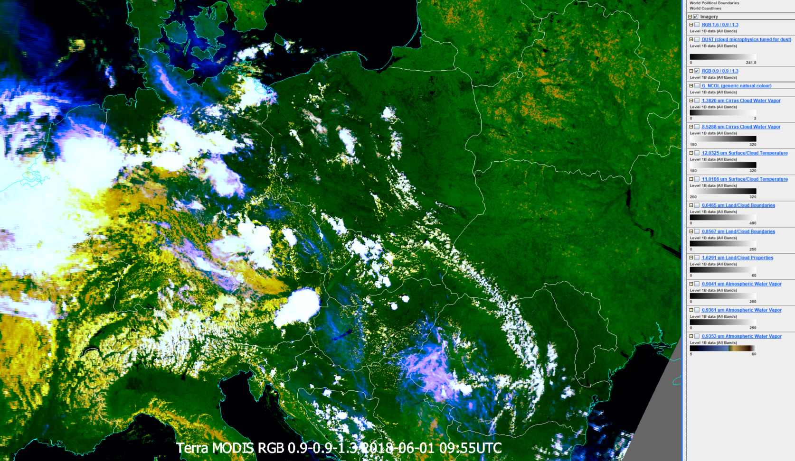
Testing new 0.9µm RGB(s) > 0.93r30-250% - 0.93r5-70% – 1.38r0-3% µm RGB
Scene overview (‘one-man-band’ RGB)
Vegetation signals?
Phase differentiation?
thin cirrus
vegetation
ice clouds
water clouds
thin cirrus

Slide 26
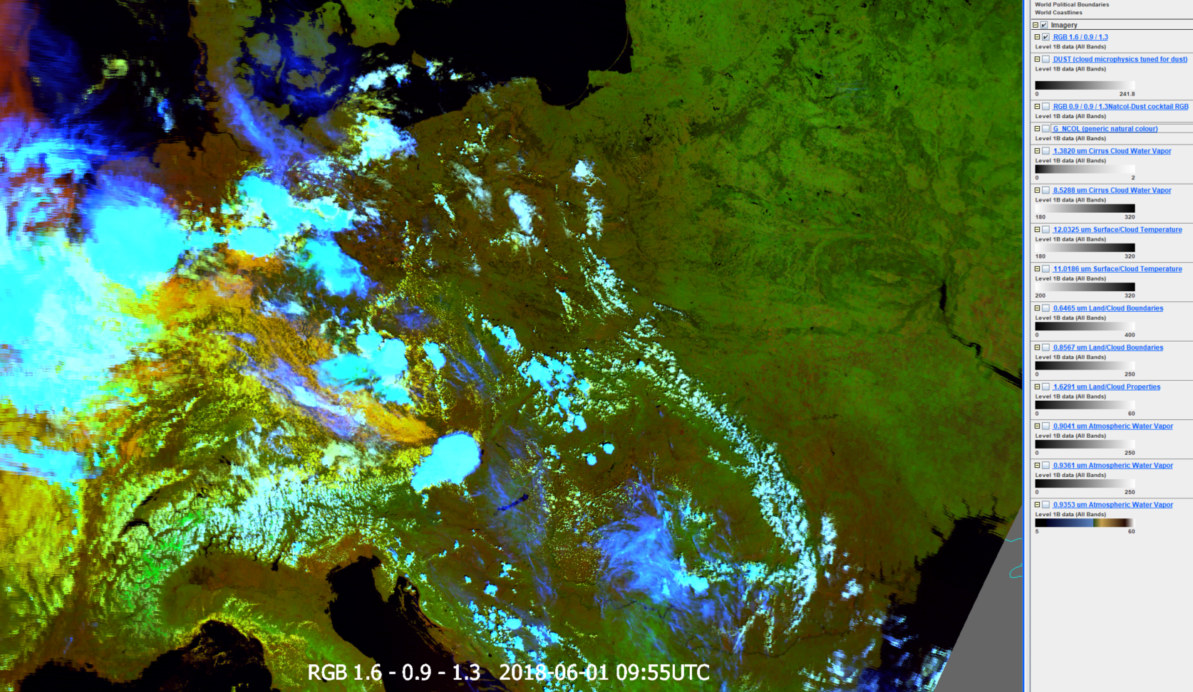
Testing new 0.9µm RGB(s) > 1.64r0-60% - 0.93r5-70% – 1.38r0-3% µm RGB
Scene overview (‘one-man-band’ RGB)
Vegetation signals?
Phase differentiation?
Serving NWC?
thin cirrus
vegetation
ice clouds
water clouds
thin cirrus

Slide 27
Thank you for your attention.

