Slide 1
Google Earth Engine

Slide 2
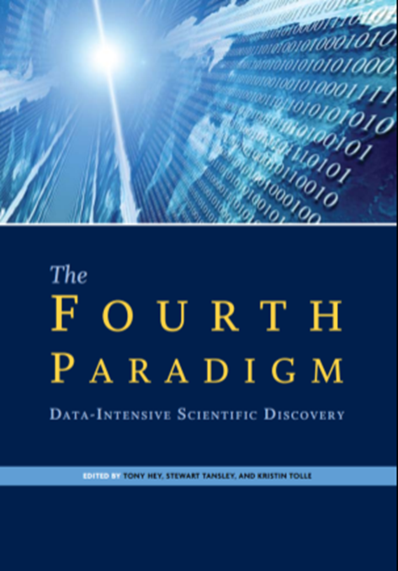
Introduction to Google Earth Engine
There are 40+ years of remotely sensed data available.
To organize the world's information and make it universally accessible and useful.
“Often it turns out to be more efficient to move the questions than to move the data.” Editors: Tony Hey, Stewart Tansley, Kristin Michele Tolle
Jim Gray elaborated on this idea in the influential book by Hey et al., director of research at Microsoft. Earth Engine implements this plan.
This platform has been working since 2010
Notes:
1-There are 40+ years of remotely sensed data available from a constellation of satellites and sensors, but many facilities still lack capacity for downloading and analyzing data.
2-Organizing geospatial data is part of Google's mission! On of the fundamental goals of Earth Engine is to organize all that satellite imagery and make it accessible and useful.
.
3-The most efficient way to make the data accessible and useful is to "move the question to the data." Jim Gray elaborated on this idea in the influential book by Hey et al., director of research at Microsoft. Earth Engine implements this plan

Slide 3
What is GEE?
Cloud-based platform for geospatial analysis.
Access over 40 years of satellite imagery.
Upload own data sets to integrate with publicly available data.
Apply range of common algorithms to data.
Export images, tables, charts, map outputs.
Notes:
In this system there is no need for latest process or the latest software, also it is possible more than 40 years satellite images ,which is access online, be analyzed with large scale and high speed. So that scientist and researcher are able to analyze real –time change on Earth’s surface

Slide 4
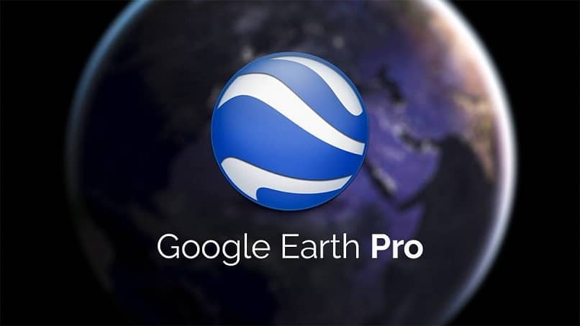
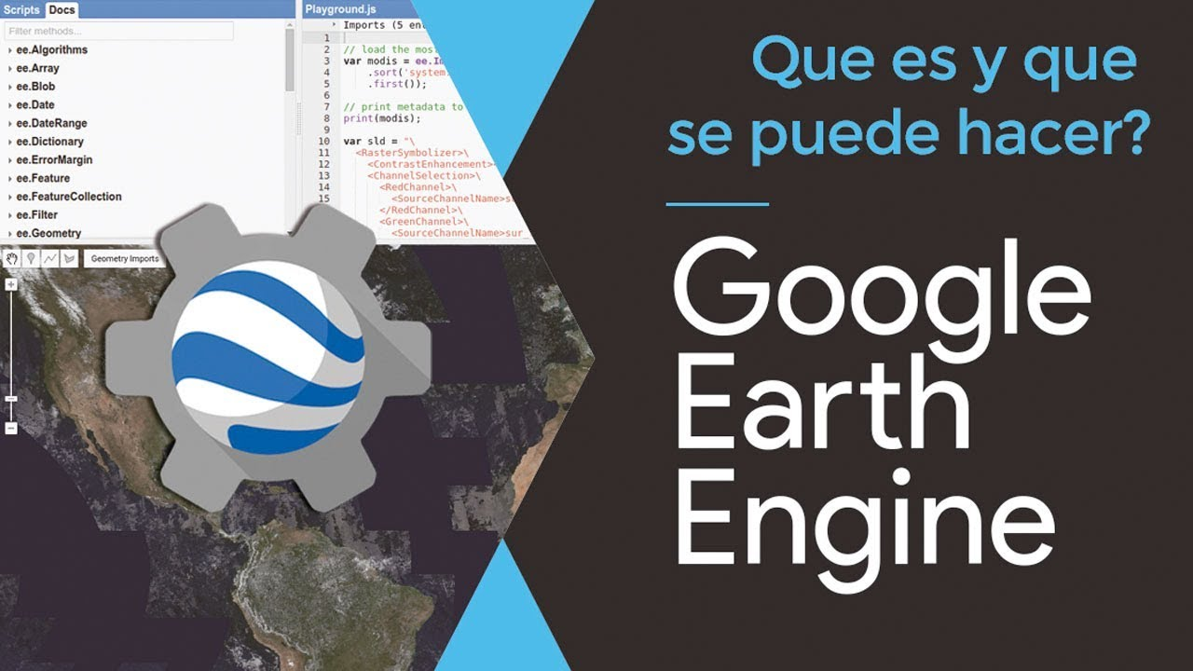
The differences between Google Earth, Google Earth Engine
Notes:
There has been a lot of confusion lately about the differences between Google Earth and Earth Engine. While Google Earth uses products created in Earth Engine (for example, a global cloud-free Landsat mosaic at 15m resolution), they are not directly connected.

Slide 5
ENVI software
Spending much cost and time for collecting data and processing.
Requires powerful processor systems.
The need to perform preprocessing such as radiometric and geometric corrections.
Spending much cost and time for collecting data and information.
Envi software is much better than Google earth engine in processing base spectrum analysis such as mineralogical processing.
Notes:
In ENVI software, the user first prepares the required images, then introduces the images to the software and performs pre-processing and final processing.
However, this process associated with some issues:

Slide 6
The main components of Google Earth Engine
1. Dataset: A collection of satellite images and other data in petabyte-scale is available for free.
2. API: A set of communication methods defined by JavaScript and Python scripting languages for accessing and communicating between different components.
3. Code Editor: An online integrated development environment for complex spatial analyzes using the Javascript API.
4. Computational power: Google Earth Engine computing infrastructure is optimized for parallel processing of geographic data.

Slide 7
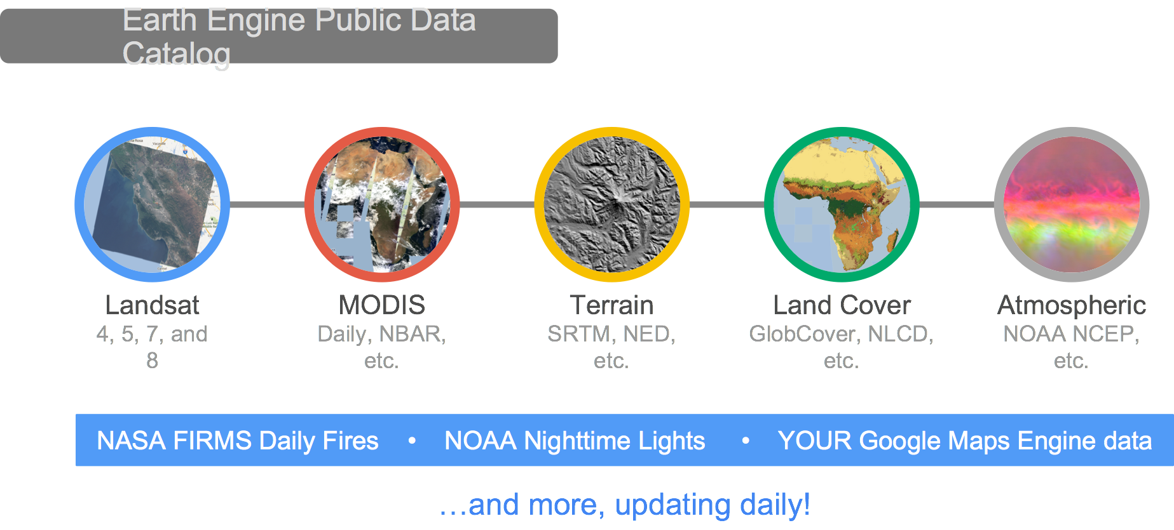
1. Earth Engine Public Data Catalog
Imagery
Geophysical
Climate & Weather
Demographic
Vector Data
> 5 million images
> 4000 new images every day
> 200 public datasets
> 7 petabytes of data
Notes:
In the data catalog, there is over 40 years of current and historical imagery and data in the Earth Engine data library. Available data sets include
Imagery – these imagery sets include both raw and pre-processed, georeferenced data products that are ready for use. Examples include NAIP, comprehensive Landsat archive, and MODIS data and ancillary products such as global composites and max NDVI.
Geophysical data – such as digital elevation models, surface temperature, and land cover
Climate and weather – NASA’s TOMS atmospheric data and – forecast weather and climate model data
Demographic data – such as population density estimates
Users are also able to load in their own data – both imagery and vector files to use for analysis.
Landsat data. Whatever USGS has, Earth Engine has. Landsats 1-8. Raw, TOA reflectance, surface reflectance. Sentinels 1-2. TOA reflectance. SAR data from Sentinel-1 processed to backscattering coefficients. Most MODIS terrestrial composites. Global DEMS at a variety of resolutions. Multiple land cover datasets. Atmosphere and climate data. And growing daily. There is a one or two day latency between scene acquisition and when it is ingested to the catalog

Slide 8
Data in earth engine
There are two main categories of data in the Google Earth Engine:
1. Satellite data such as Landsat, MODIS, Sentinel
2. Assimilation data: These data are produced by combining satellite data and ground station such as GLDAS, FLDAS, NLDS

Slide 9
2. API
API requried to analyse data more fully
Mainly uses a version of JavaScript but some Python
Do not have to be a coding genius to use GEE
Notes:
You need an API to be able to implement your geospatial workflows.

Slide 10
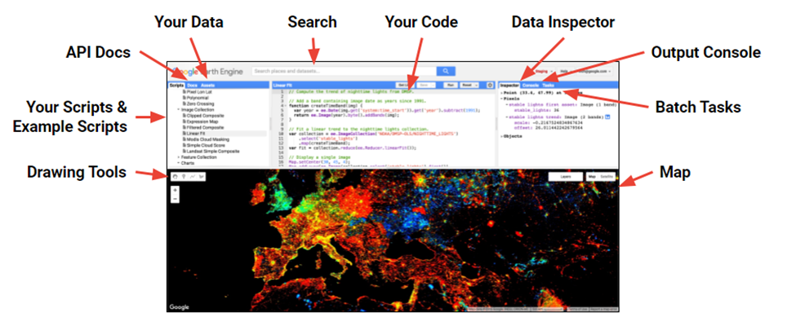
3. Code Editor
What is it?
Web based IDE for the Earth Engine API
Access many pre-made geospatial tools
JavaScript
Python
Notes:
Docs tab (API reference docs), Assets tab (upload your own data),
Inspector tab (locate information about the layers in your map, ), Console tab (return messages as the scripts run and record any errors,
), Tasks tab (execute long running tasks),
Code Editor (for JavaScript, but there's also a Python API),
Map (visualize the results of your query or analysis)
Get Link button (send it to your friends!), Search bar, Help button

Slide 11
Some Code Editor Benefits
Allows user to create extremely complex workflows (batch tasks) using
any data in Earth Engine, and
its extremely high speed computation engine
Workflows can be shared easily between users
Some Code Editor Disadvantages
Requires programming knowledge
Need to be aware of unique GEE classes and methods

Slide 12
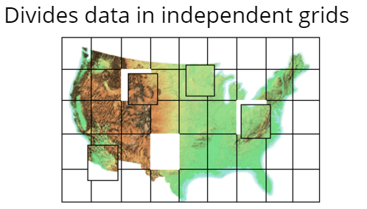
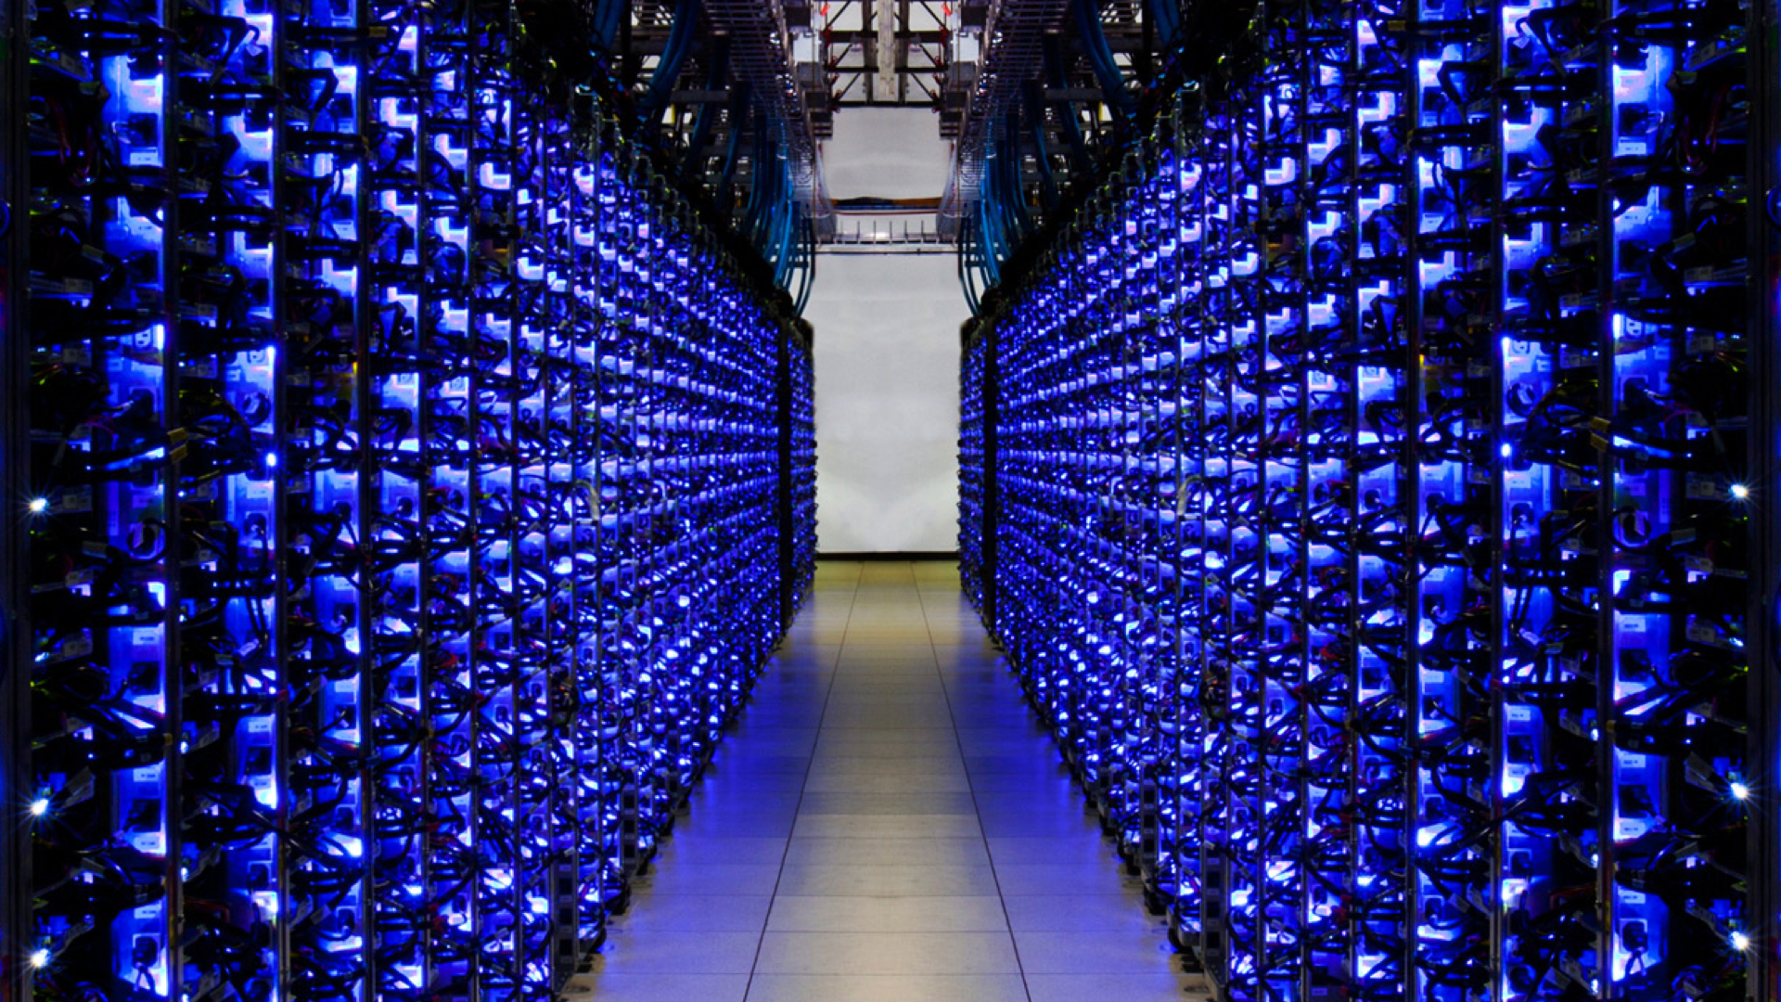
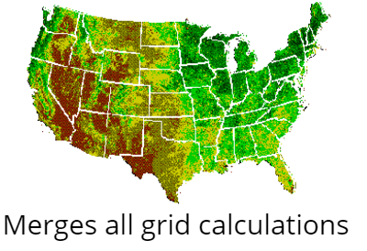
4.computational power
“The computation engine is a just in time distributed computation model, a cloud-based processing infrastructure that automatically parallelizes analyses on many CPUs across many computers in Google’s data centers.”
Storage Clusters (petabytes of data)
Computing clusters (1,000’s of CPUs
Notes:
This means that the analysis requests are sent out to many different computers; each computer runs the calculations on a small area (small number of pixels) and returns the results. Requests are also efficient – it only computes for the input data of your requested values or to the extent of your screen. Results are then cached so that multiple requests for the same image or values do not result in re-computation. This results in:
– unprecedented speed: reduce processing times by orders of magnitude by using the cloud-based computing power
– Ease of use and lower costs. Online platform with easy access to data, scientific algorithms, computational power.

Slide 13
Some Training Concepts
Notes:
In the following, some of the concepts and functions available in Google are described

Slide 14
Variables
You can use variables to hold data in and reduce the amount of instructions in two lines
variables store values such as strings, numbers and can be called in the script
to define a variable start with var
var landsat8 = ee.ImageCollection('LANDSAT/LC8_L1T');

Slide 15
Image
In GEE, you can either access directly one image or a collection.
Access an image:
image = ee.Image('LANDSAT/LC08/C01/T1_TOA/LC08_044034_20140318')
Notes:
Raster data are represented as Image objects in Earth Engine. Images are composed of one or more bands and each band has its own name, data type, scale, mask and projection. Each image has metadata stored as a set of properties
In addition to loading images from the archive by an image ID, you can also create images from constants, lists or other suitable Earth Engine objects. The following illustrates methods for creating images, getting band subsets, and manipulating bands.

Slide 16
Image collections
A stack or time series of images are called Image Collections. Each data source available on GEE has it’s own Image Collection and ID (for example, the Landsat 5 SR collection, or the GRIDMET meteorological data collection). You can also create image collections from individual images or merge existing collections.
ee.ImageCollection('LANDSAT/LC8_L1T'),

Slide 17
Improving the image view
Resulting image is messy due to overlapping scenes. Two ways to deal with this:
First is to select only a specific time period of images to display
Second is to tell GEE how to deal with overlapping areas.

Slide 18
Improving the image view : Filter by Date
filter by date using .filterDate
filterDate is a method which ee.ImageCollection knows about.
Can find full list of methods in the docs tab under ee.ImageCollection.
but all methods start with .methodName()
var landsat8 = ee.ImageCollection('LANDSAT/LC8_L1T')
. filterDate('2013-06-01','2013-12-31'),

Slide 19
Map
Apply a function to each element of a collection
A "map" (for-each) operation
​
Examples
Compute area of each feature
Cloud cover of each image
Mosaic for each month
Do something to each element in a collection with .map()

Slide 20
Reducers
Aggregate everything in a collection
"Reduction"
​
Examples
Summed area over all features
Median-pixel composite
Train a classifier
Aggregate data (i.e. compute statistics) with reduce().
var landsat8 = ee.ImageCollection('LANDSAT/LC8_L1T')
. filterDate('2013-06-01','2013-12-31'),
.median()

Slide 21
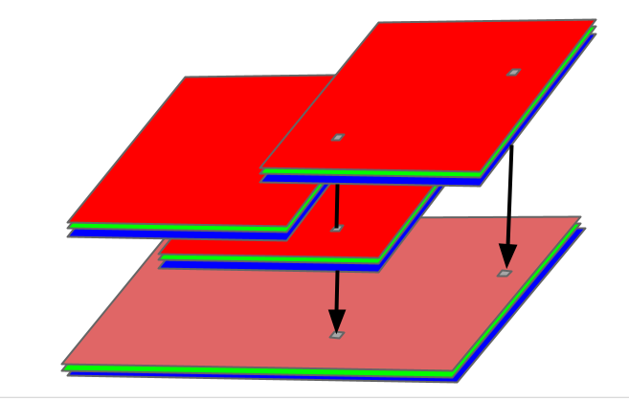
Reducing ImageCollection.reduce
To reduce an Image, use image.reduce().
Reducing an image functions in an analogous way to imageCollection.reduce(), except the bands of the image are input to the reducer rather than the images in the collection. The output is also an image with number of bands equal to number of reducer outputs. For example:
var collection = ee.ImageCollection('LANDSAT/LC08/C02/T1_TOA') .filter(ee.Filter.eq('WRS_PATH', 44)) .filter(ee.Filter.eq('WRS_ROW', 34)) .filterDate('2014-01-01', '2015-01-01');
// Reduce the collection with a median reducer. var median = collection.reduce(ee.Reducer.median());
Notes:
At each location in the output image, in each band, the pixel value is the median of all unmasked pixels in the input imagery (the images in the collection). In the previous example, median() is a convenience method for the following call:
// Reduce the collection with a median reducer. var median = collection.reduce(ee.Reducer.median());

Slide 22
Map.addLayer
You can illustrates an image using Map.addLayer(). If you add a layer to the map without any additional parameters, by default the Code Editor assigns the first three bands to red, green and blue, respectively.
var collection = ee.ImageCollection('LANDSAT/LC08/C02/T1_TOA') .filter(ee.Filter.eq('WRS_PATH', 44)) .filter(ee.Filter.eq('WRS_ROW', 34)) .filterDate('2014-01-01', '2015-01-01');
var median = collection.reduce(ee.Reducer.median());
Map.addLayer(median);

Slide 23
In tutorial sessions:
First session
How to sign up and register
Getting to know the different parts of the code editor environment
Getting to know the data repository section (Data catalog)
Calling image of vector (shape file)
Finding data in the data list (system catalog)
Calling images to the Google Earth Engine system
Getting familiar with basic algorithms and applying various filters on images

Slide 24
In tutorial sessions:
Second session : Climate
Introducing climate data
Preparation of spatial map and time series of precipitation using different climate data such as CHRIPS and...
Production of snow cover map and other parameters related to snow
Preparation of map and time series of land surface temperature (LST)
Spatial and temporal monitoring of soil moisture

Slide 25
In tutorial sessions:
Third session: Climatic hazards
Identifying and time and spatial monitoring of drought with VCI and TCI indices
Spatial and temporal monitoring of dust changes
Identification of flooded zones
Fourth Session: Environmental
Air pollution
Fifth Session: Applications of Google Earth Engine in the agricultural sector
Calculation of various plant indices such as EVI, NDVI

