Slide 1
Common Oceanic Phenomena
AHMED AL BALUSHI
August 29th, 2023

Slide 2
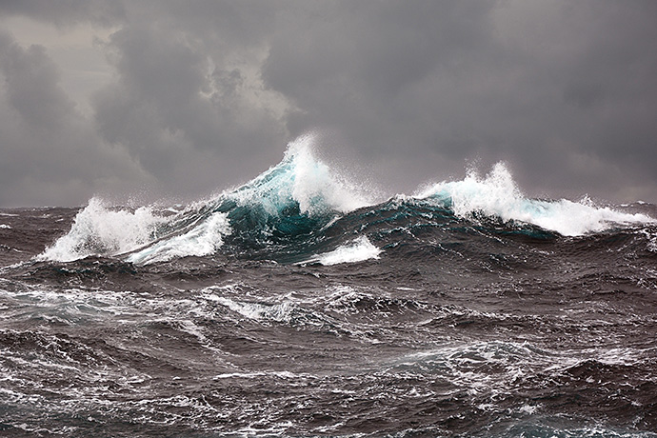
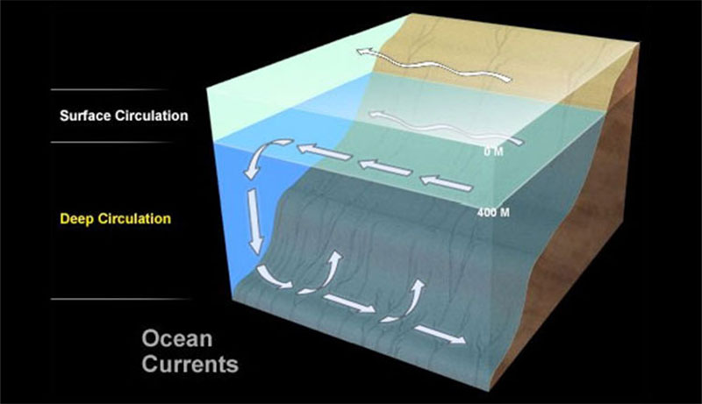
Waves and Currents
What is the different between waves and currents
Waves are caused by energy passing through the water, causing the water to move in a circular motion.
Ocean currents can be caused by wind, density differences in water masses caused by temperature and salinity variations, gravity, and events such as earthquakes or storms.

Slide 3
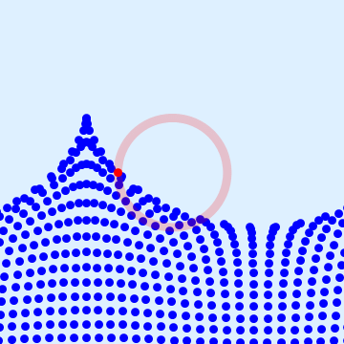
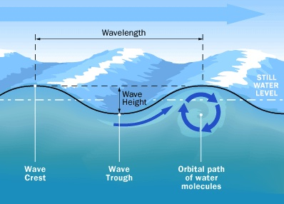
A wave is an oscillation of water particles around a position of equilibrium.
The individual particle remains roughly at its original position
A wave is a periodic process.
The most common waves we see are created by wind

Slide 4
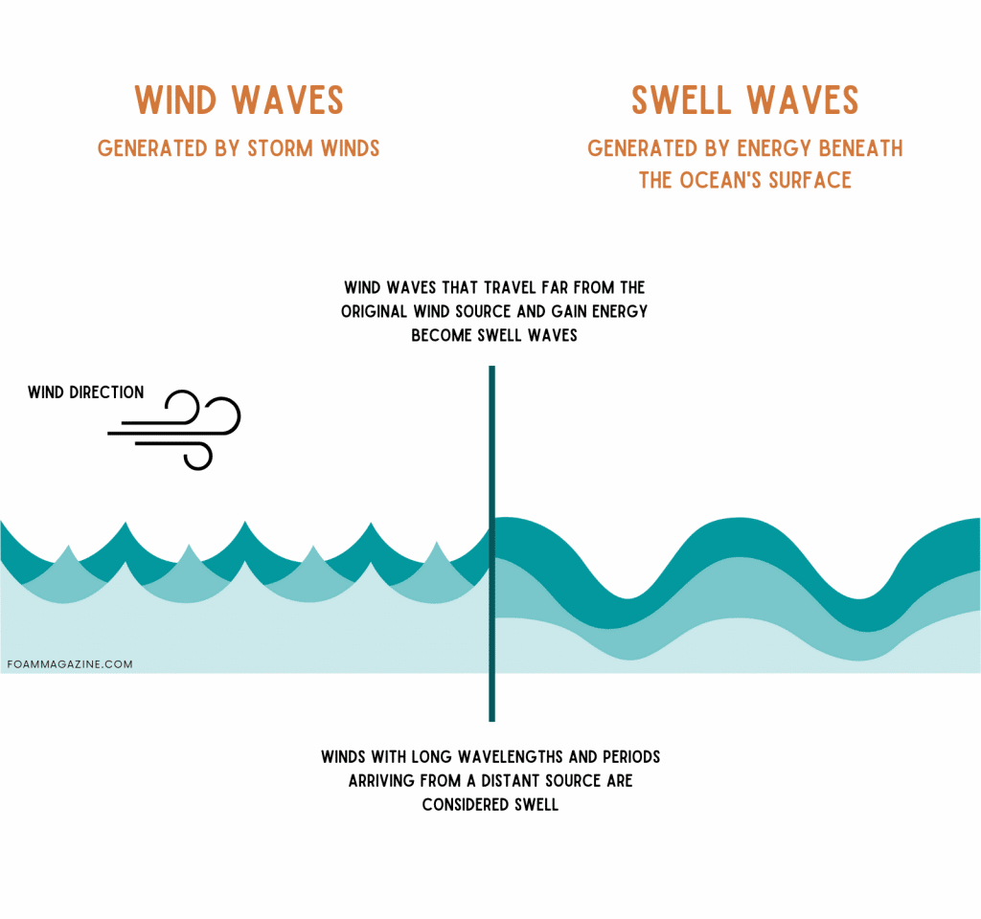
swell
A swell is a series of mechanical or surface gravity waves generated by distant weather systems that propagate thousands of miles across oceans and seas.
Groups of waves with a period between crests of more than ten seconds
Swells are not generated by local winds blowing
result of the interaction of severe storms with a large fetch of water that takes place in the open ocean, thousands of miles away from landmasses.

Slide 5
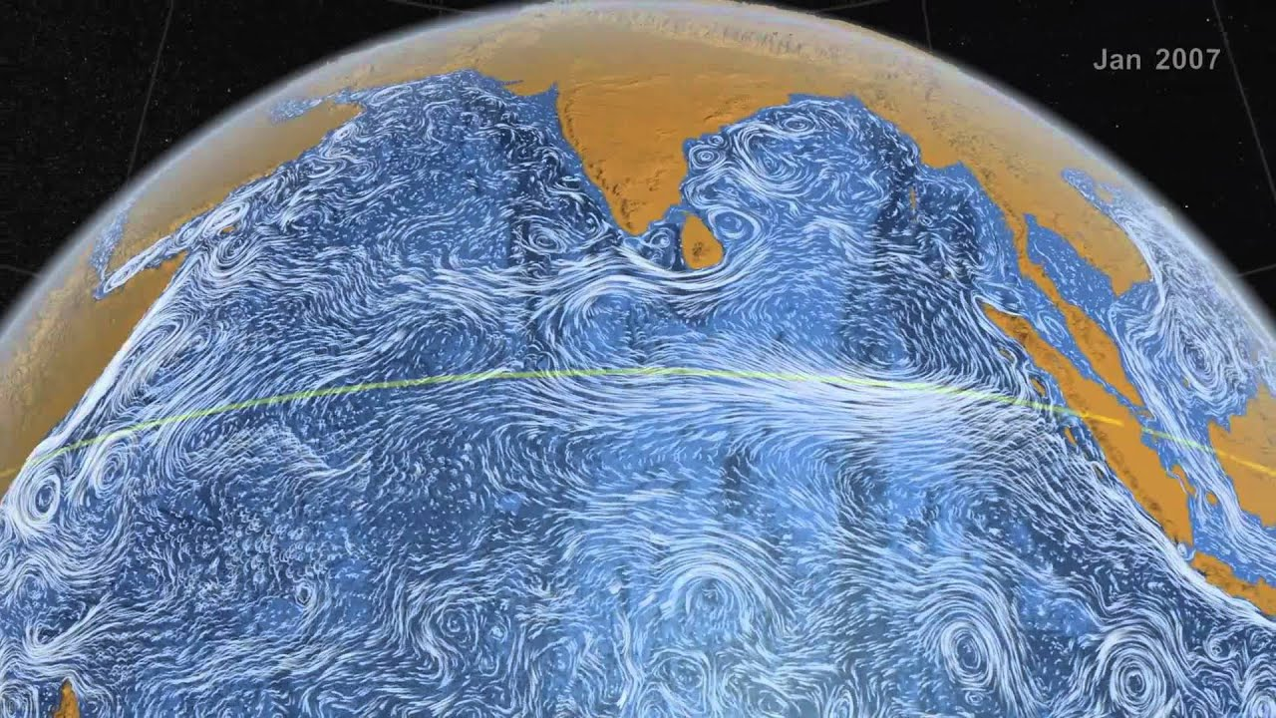
Currents
Current is the transport of water particles along stream lines.
Currents are cohesive streams of seawater that circulate through the ocean. Some are short-lived and small, while others are vast flows that take centuries to complete a circuit of the globe.
Types: surface circulation, which stirs a relatively thin upper layer of the sea, and deep circulation, which sweeps along the deep-sea floor.

Slide 6
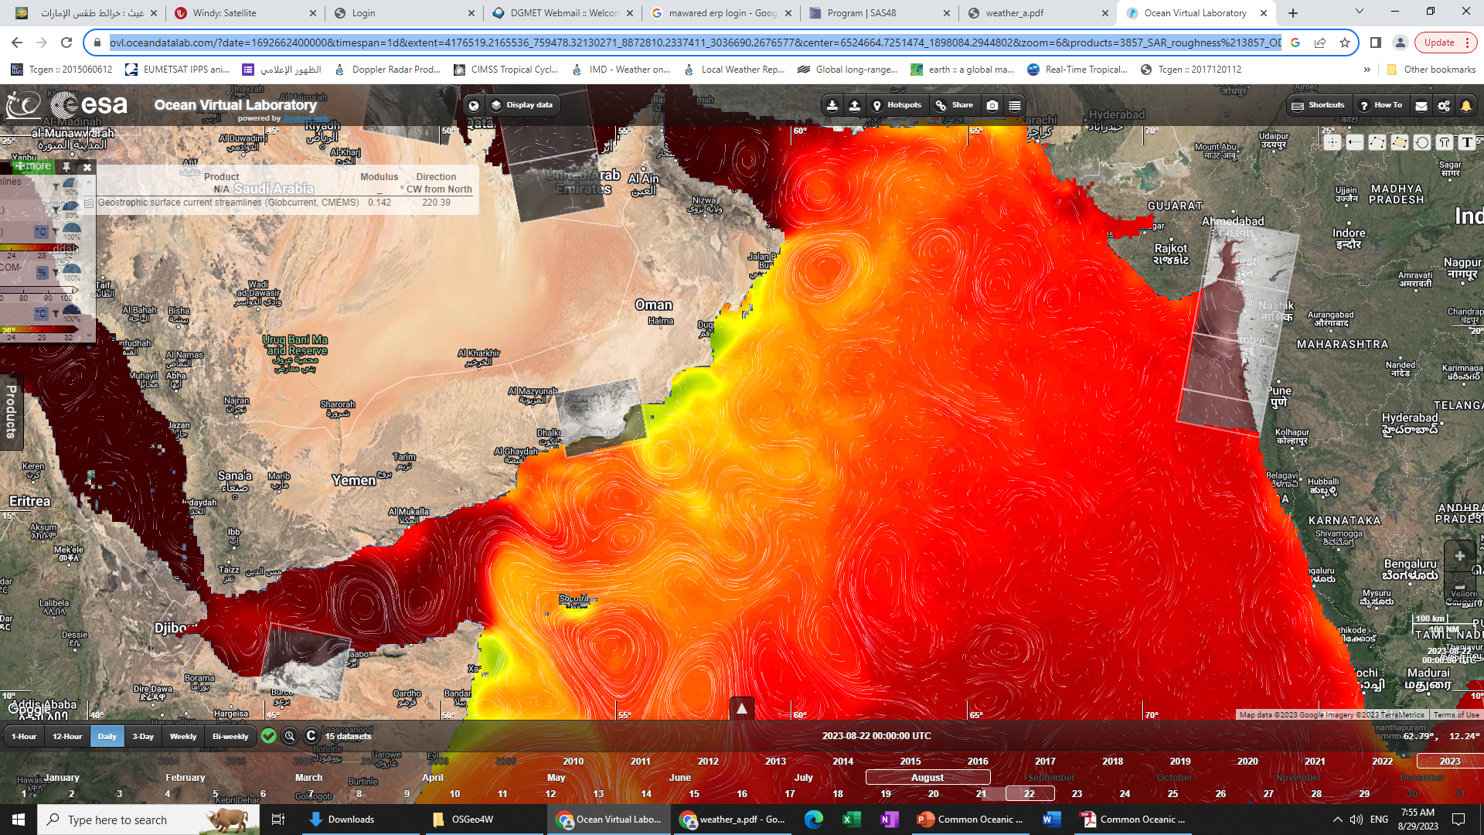
Gyres
A gyre is a circular ocean current formed by Earth's wind patterns and the forces created by the rotation of the planet.
Five major gyres:
North Atlantic
South Atlantic North Pacific
South Pacific
Indian

Slide 7
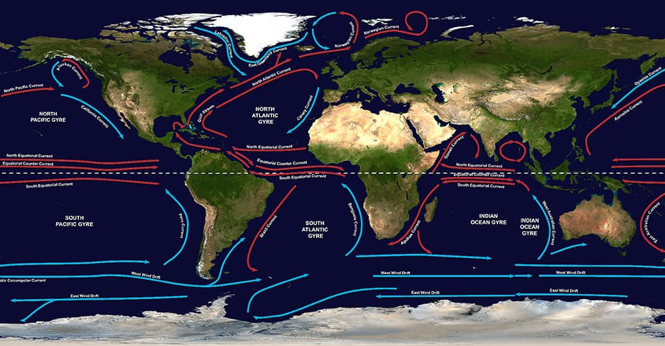

Slide 8
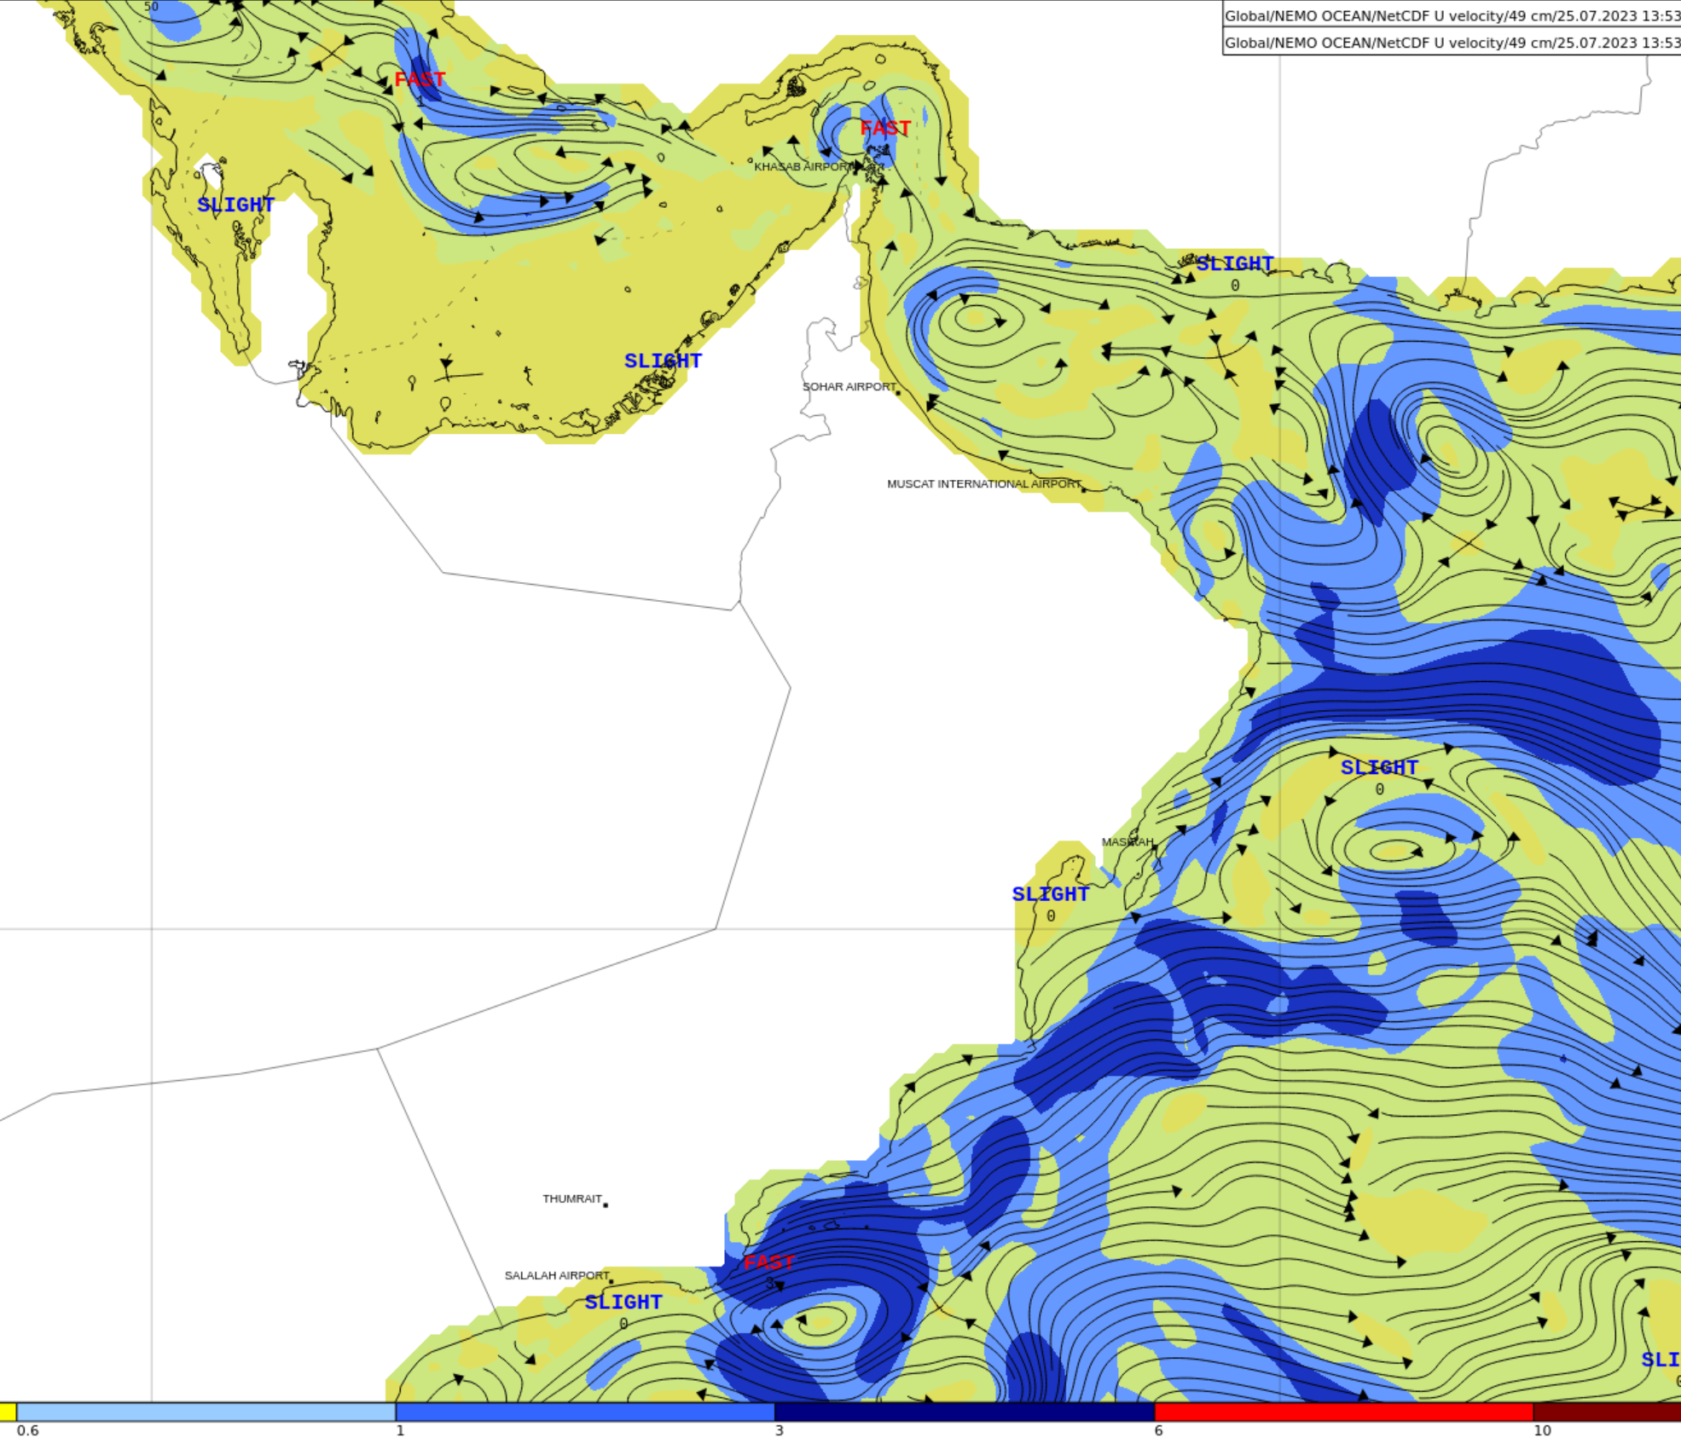

Slide 9
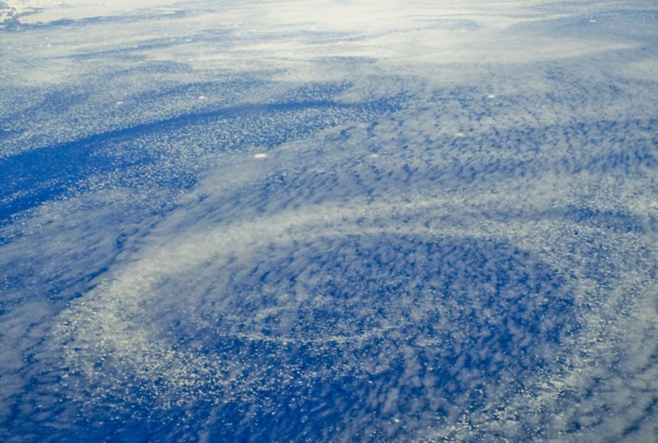
Icebergs form over this ocean gyre in the North Atlantic Ocean, near the southeastern coast of Greenland

Slide 10
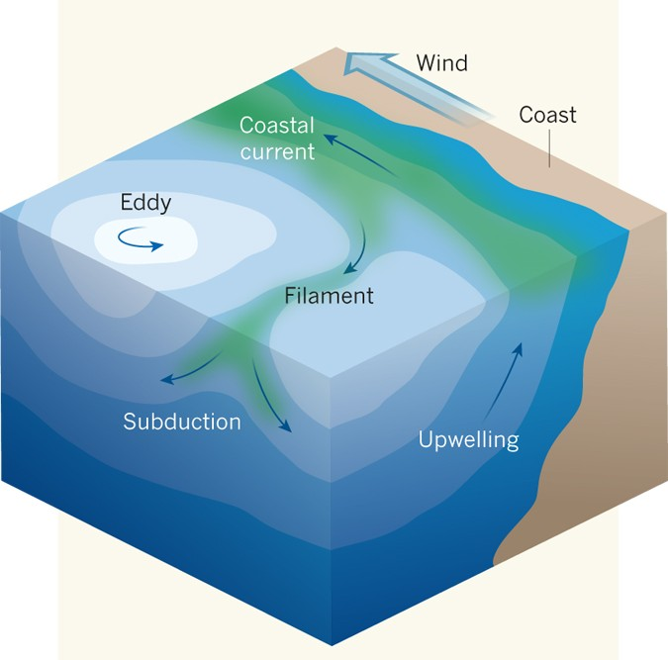
Eddies
Is a loop of current that is cut off from the main current, or a small, spinning current. They are comparatively small, short-lived circulation patterns in the ocean.
The swirling motion of eddies in the ocean cause nutrients that are normally found in colder, deeper waters to come to the surface.

Slide 11
UPWEELING AND DOWNWELLING
upwelling occurs when winds push surface water away from the shore and deeper water rises to fill the gap.
Downwelling occurs when the water on the surface of the sea becomes denser than the water beneath it and so it sinks. Seawater gets denser when it gets colder or saltier.

Slide 12
Upwelling is a process in which deep, cold water rises toward the surface.

Slide 13
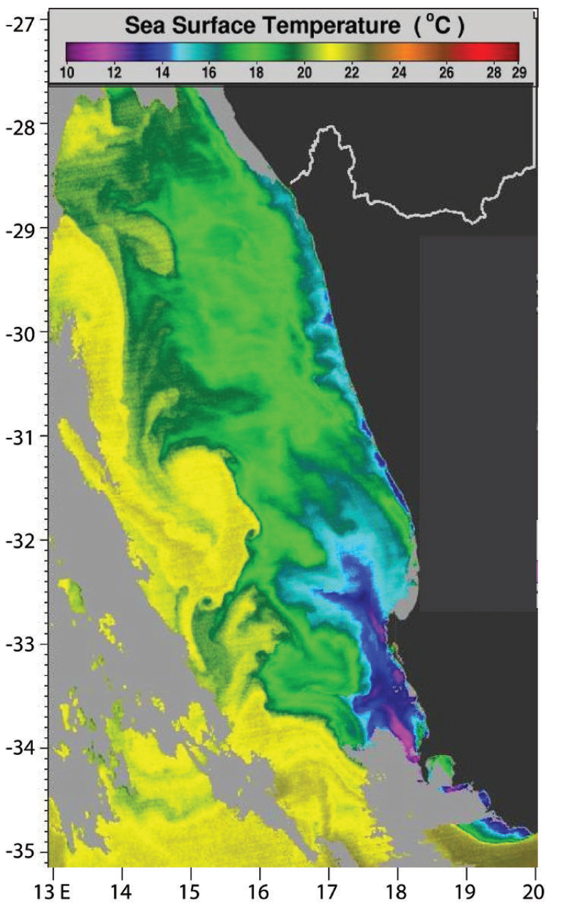
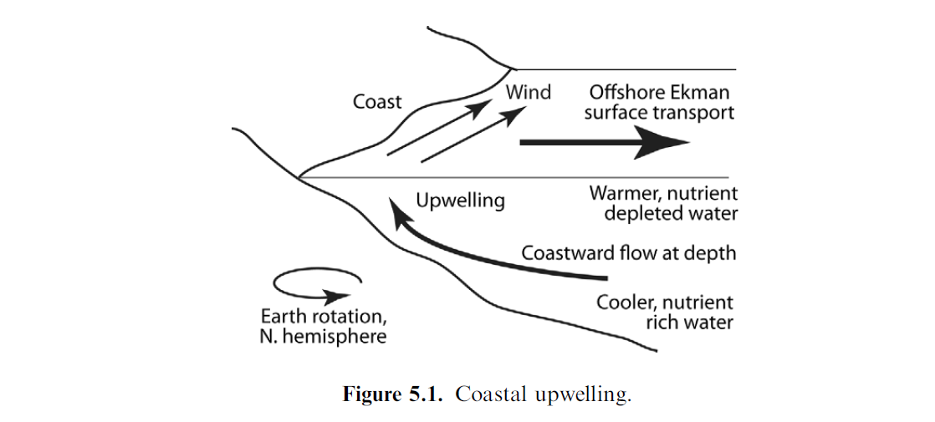

Slide 15
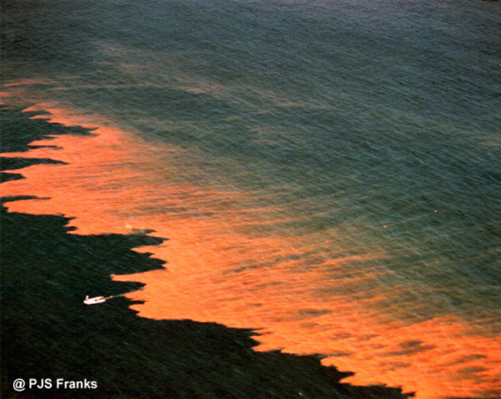
Red Tide
Red tide is a common name for a phenomenon known as an algal bloom (large concentrations of aquatic microorganisms)
The bloom takes on a red or brown color.

Slide 16
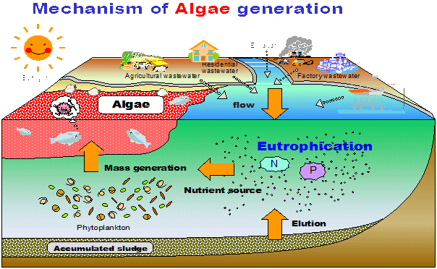
Red Tide have two major causes
*Natural
-Global warming.
*Human activities
-Ballast Water.
-Sewage .

Slide 17
Red Tide In Oman
Introduction: History of Red tide in Oman Period Major Species Area Mortality Aug 1976 - Salalah 7000-1000 tons of fish.
Sep 1988 Ceratium fucus C. macroceros Diatom Seeb to Qurum Mass mortality of marine organisms Aug-Sep 2000 Coscinodiscus spp Barka 15-30 tons of fish Mar 2001 - Sur 250 tons of fish Apr 2001 - Al .
Massive fish kill August 2008-April 2009 Cochlodinium polykrikoides Arabian Gulf , Sea of Oman and Arabian Sea 200 tons of fish and shellfish.

Slide 18
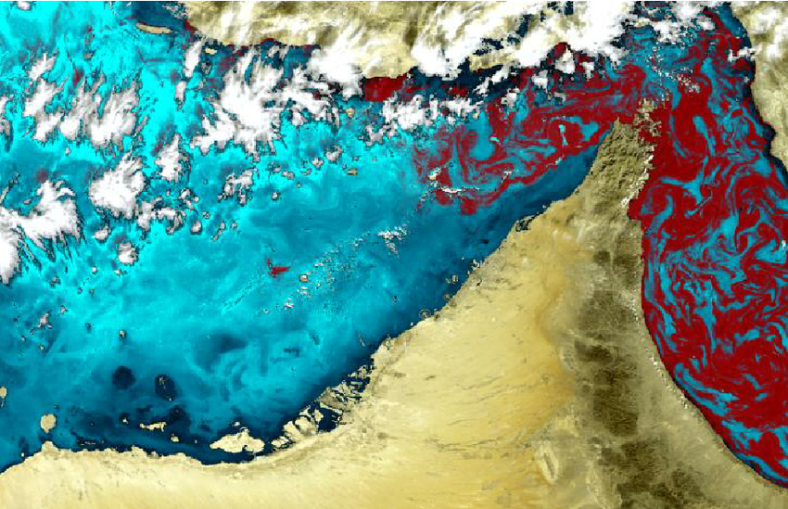
Red Tide In Oman
During the C. polykrikoides blooms, 70 tons of Goldlined seabream were killed inside the cages in qurayat farm, Muscat.
The DO levels were drop suddenly.
All the fish were killed within 30minutes as well as all other wild organisms in this area including shellfish and corals.
Large Red Tide in the Oman sea and Persian Gulf. Composite image resulting from the processing of a MERIS data acquired 22/11/2008

Slide 19
THANKS
Questions?
PLEASE SCAN FOR FEED BACK

