Slide 1
Met observing system weather instruments
Marine Meteorological Course for Royal Navy of Oman
Content creator: Eng. Alazhar Ali Alazri
Lecturer: Eng. Alazhar Ali Alazri

Slide 2
Content
We have three types of observing systems:
Land observing system
- Weather station
Upper Air observing system
- Radiosonde and wind profiler
Marine observing system
- Wave Radar

Slide 3
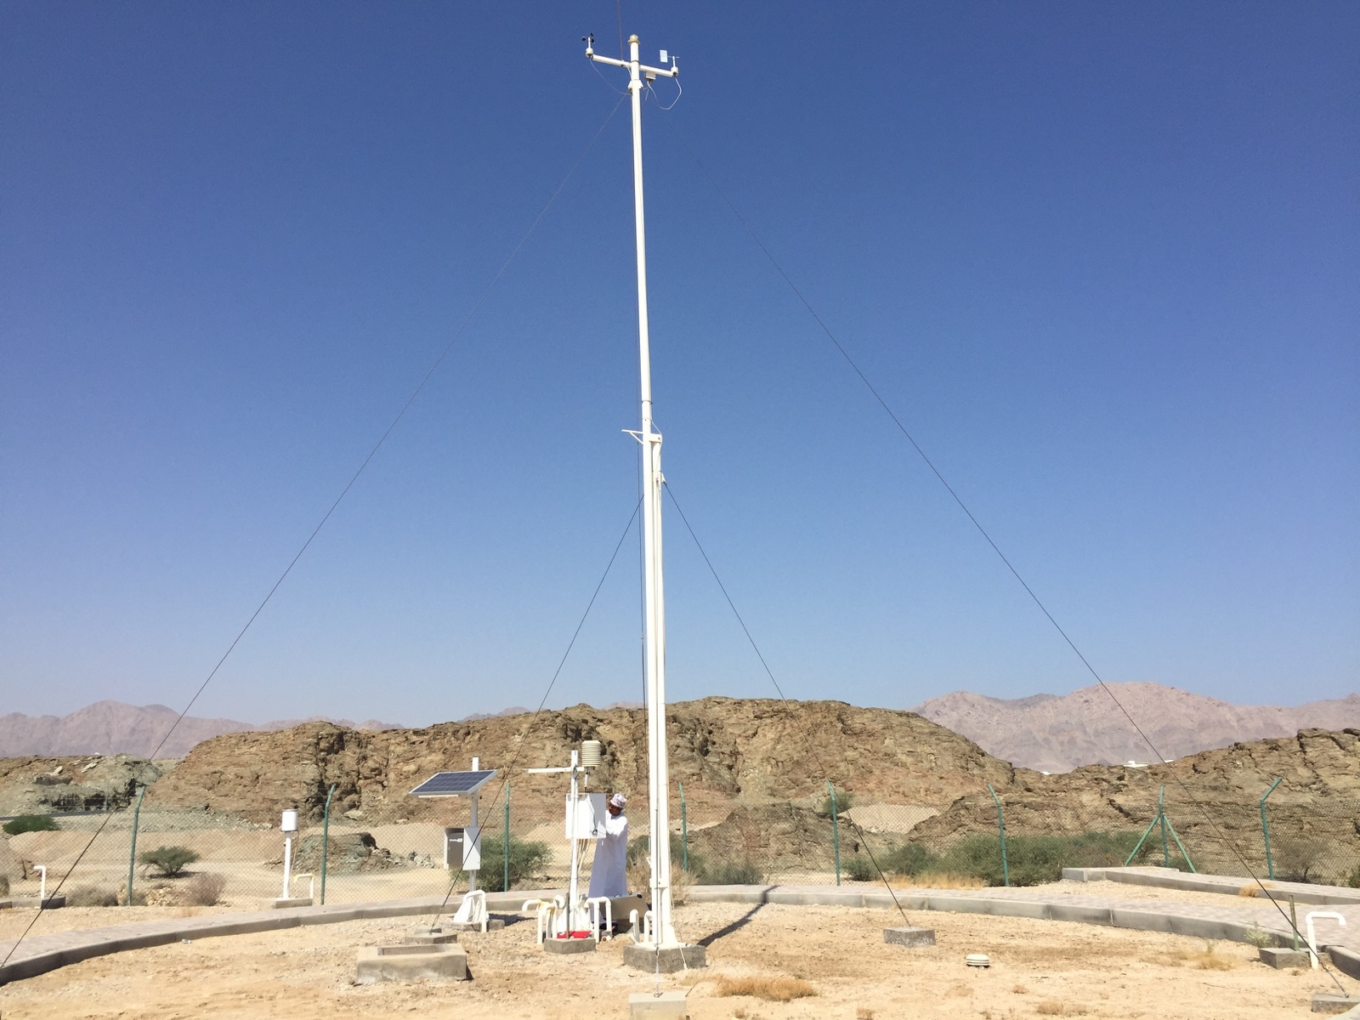
Weather station

Slide 4
We have two types of weather stations:
- Manned weather station
- Automatic weather station

Slide 5
Weather station
- Main parts in AWS
1- data logger
2- Modem (GSM – PSTN )
3 - strip board
4- sensor
- Power source for AWS
1- electricity
2- Solar panel

Slide 6
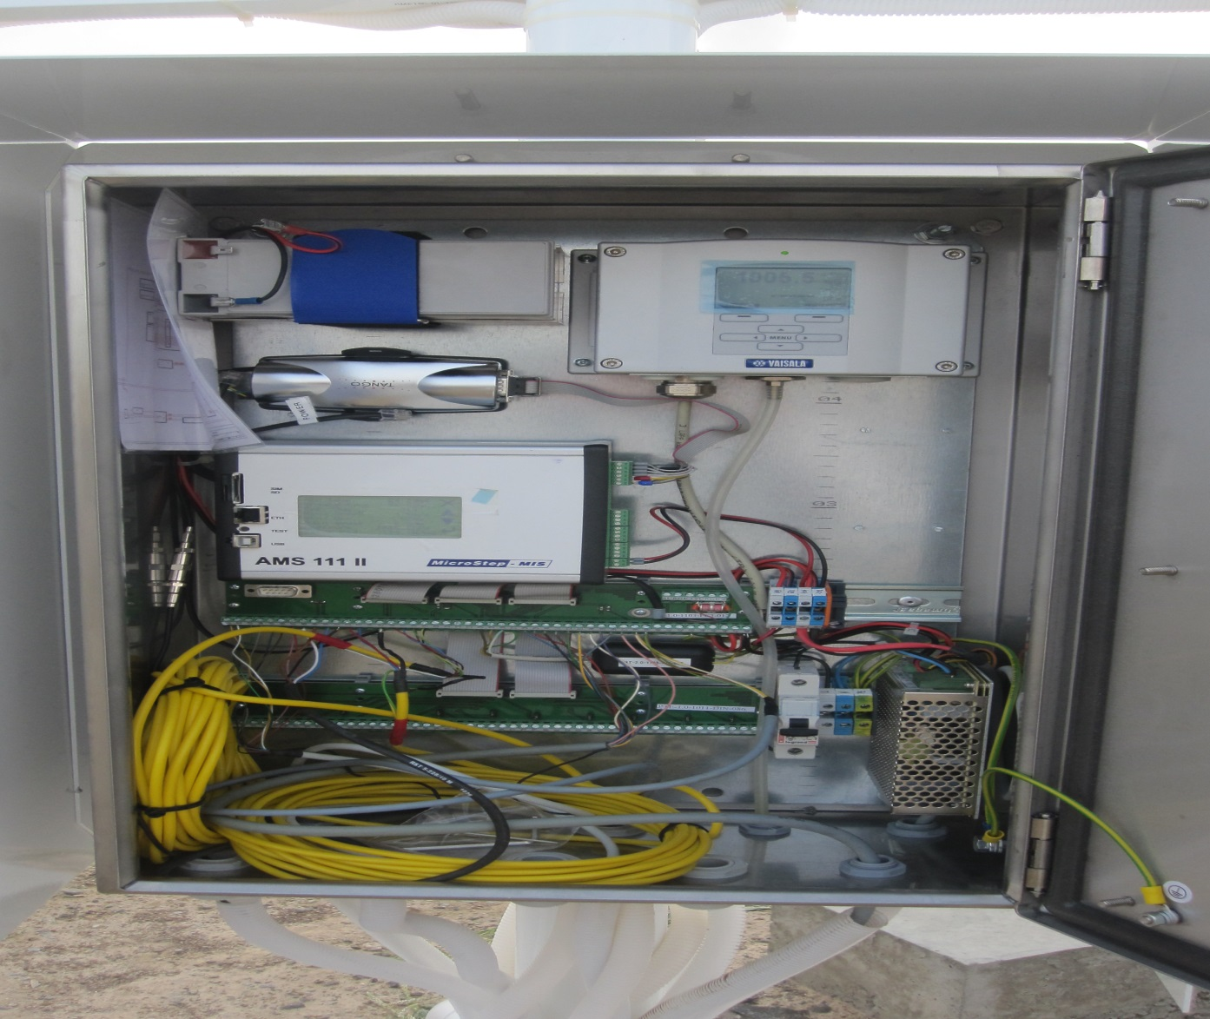
data logger box
GSM modem
Data logger
Strip board

Slide 7
AWS Sensors
1-wind speed and direction sensor
2- pressure sensor
3- humidity and temperature sensor
4-ground temperature sensor
5-rain gauge
6- sun radiation
7- sun duration
8- visibility
9- soil temperature

Slide 8
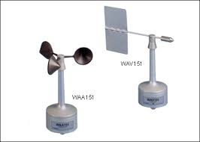
Wind speed and Wind direction

Slide 9
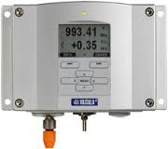
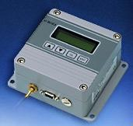
Pressure sensor
- In our station we used two types of pressure sensor
PTB330 PTB220

Slide 10
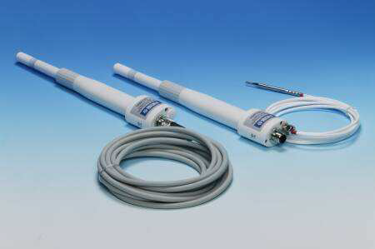
HMP sensor:
HMP45 D
HMP155

Slide 11
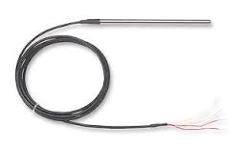
Ground temperature sensor
PT100

Slide 12
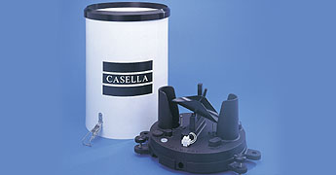
Rain gauge
- RG 13
- tipping bucket
- 0.1 mm and 0.2 mm for light and
moderate rainfall performance

Slide 13
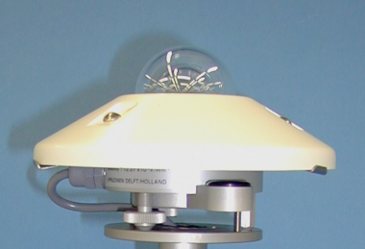
Solar radiation
W/$m^{2}$
CMP21

Slide 14
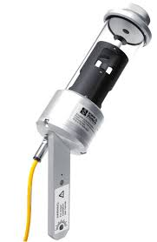
sun duration
CSD3

Slide 15
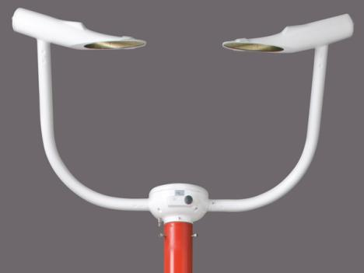
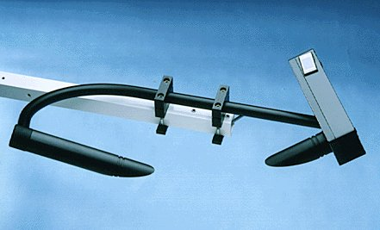
Visibility sensor
FS11

Slide 16
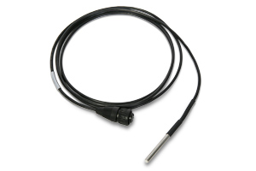
soil temperature sensor
PT100

Slide 17
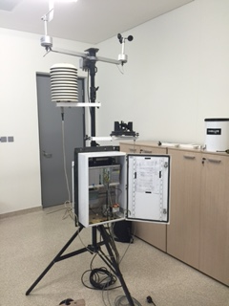
Mobile AWS

Slide 18
airport systems(AWOS). Upper Air observing system
Automated Weather Observing System
1- weather station
2- Wind station
3- wind profiler
4- ceilometer
5- TSS

Slide 19
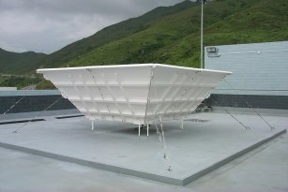
wind profiler
LAP3000

Slide 20
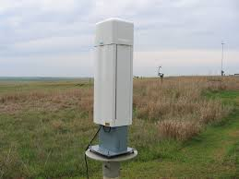
ceilometer
CL31

Slide 21
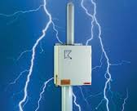
TSS( Thunderstorm sensor ) lightning sensor
TSS928

Slide 22
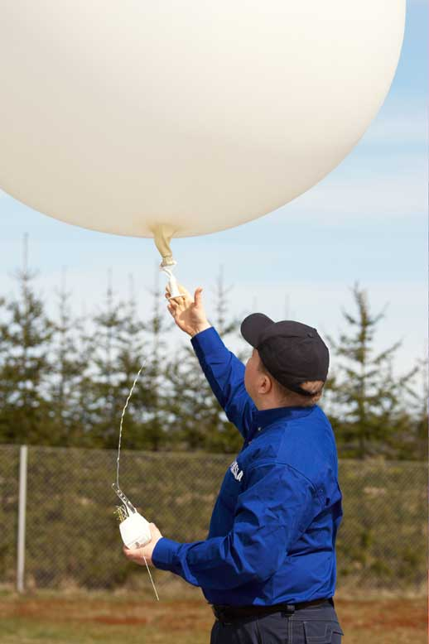
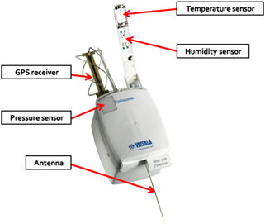
Radiosonde

Slide 23
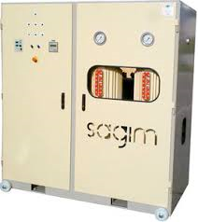
Hydrogen Generator
MP-8

Slide 24
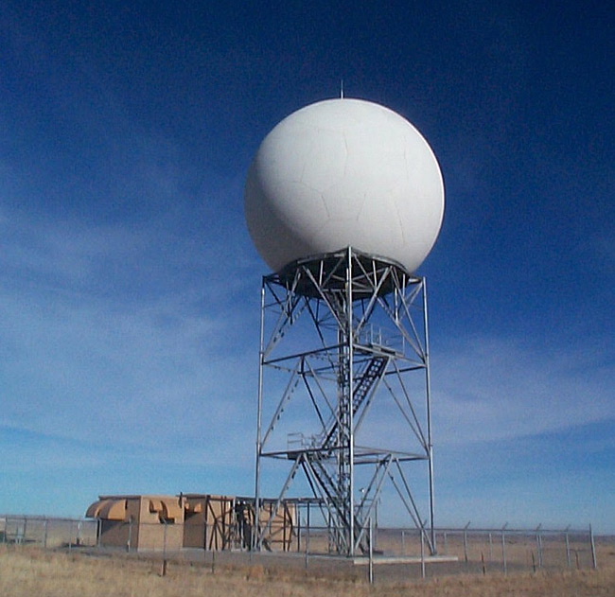
Weather Radar
We have 5 weather radars
- Muscat
- Ras AL-Had
- Fahood
- AL-Duqm
- Salalah

Slide 25
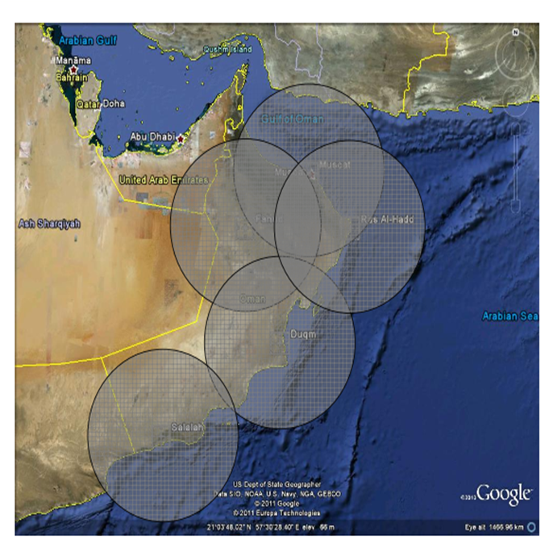
Weather Radar Network

Slide 26
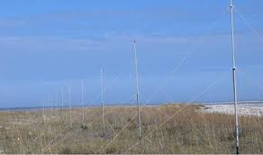
Marine observing system
wave readers (WERA)

Slide 27
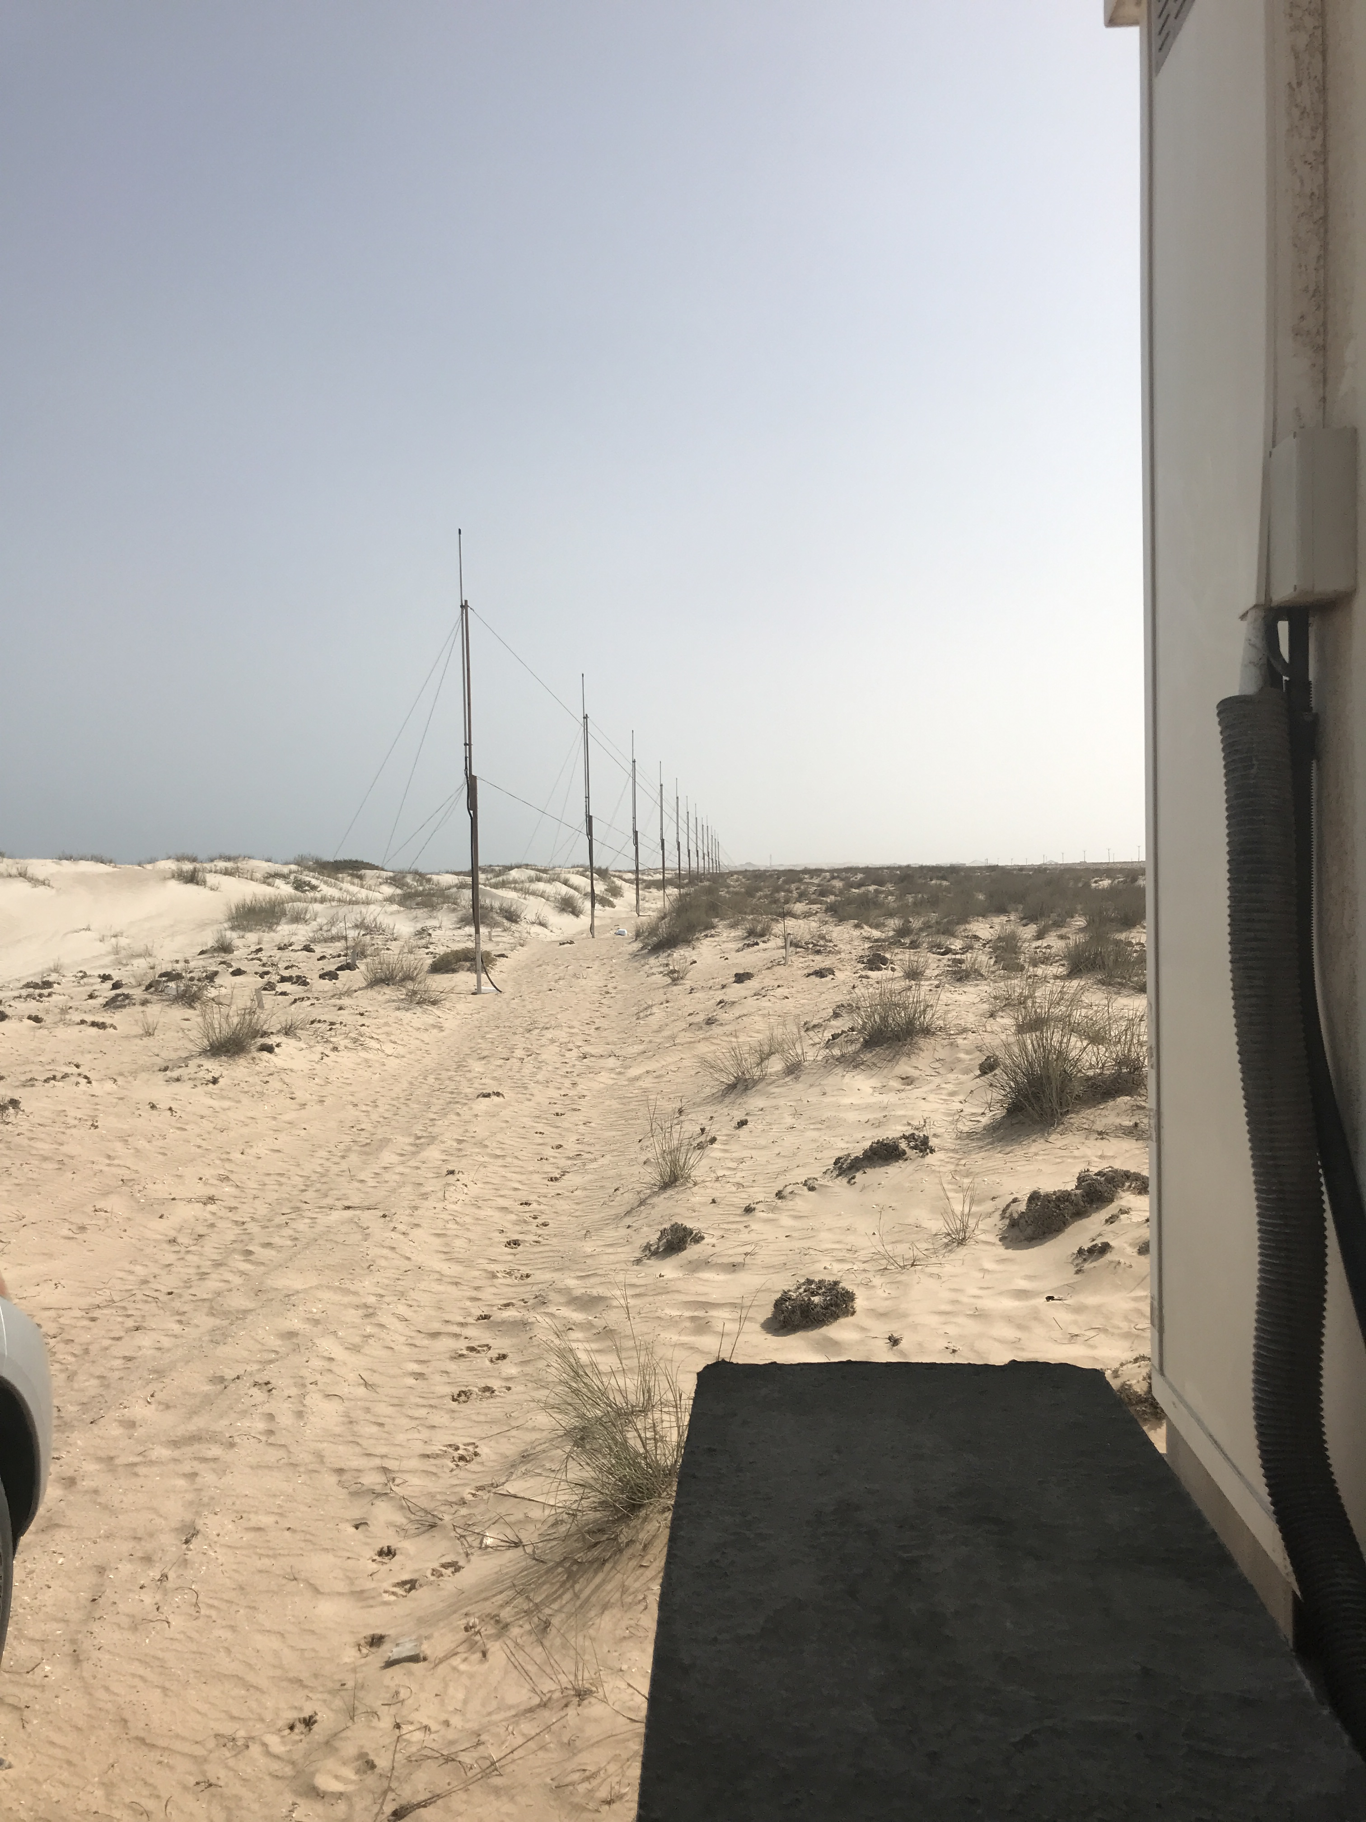
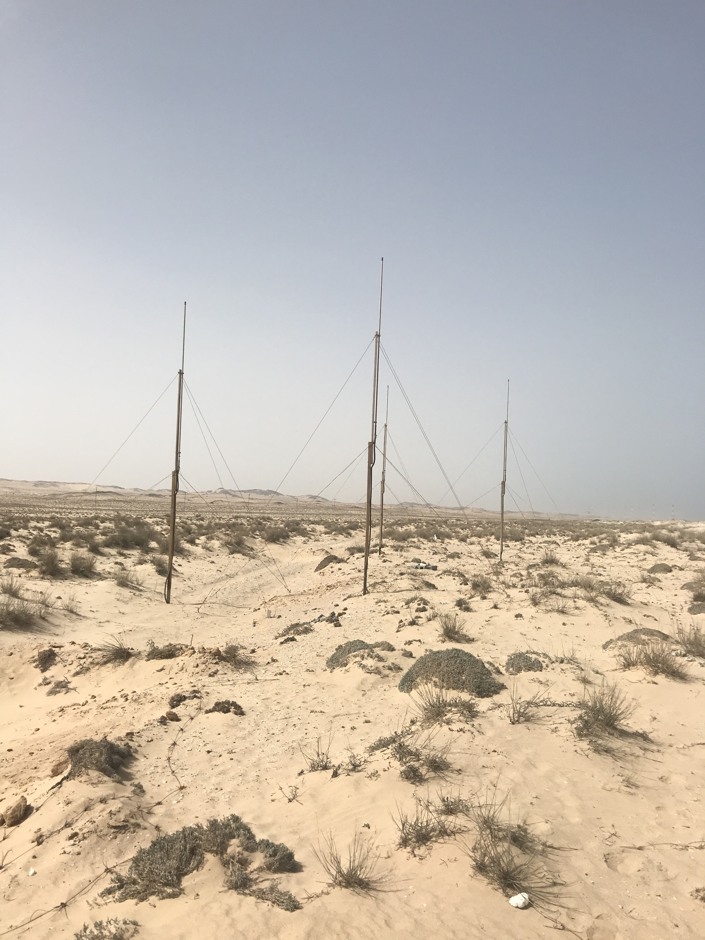
RX TX

Slide 28
Tide gauge

Slide 29
Thanks for your attention if you have any question fell free to ask

Slide 30
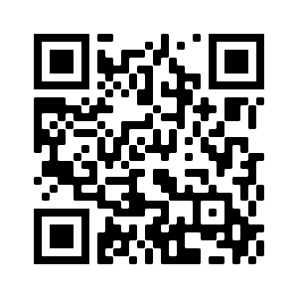
Scan this
Kindly scan this “QR code” to evaluate this lecture.
Thank You!

