Slide 1
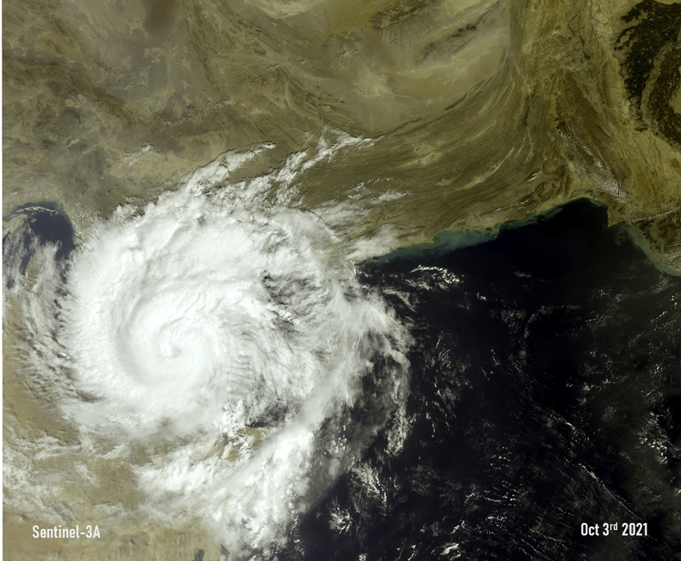
Weather-related Hazards affecting Oman by impacts
Dr. Humaid AlBadi 5 November 2023

Slide 2
Weather-related Hazards affecting Oman by impacts
Flooding
Strong Wind
Dust storms
Heat Waves

Slide 3
Flooding

Slide 4
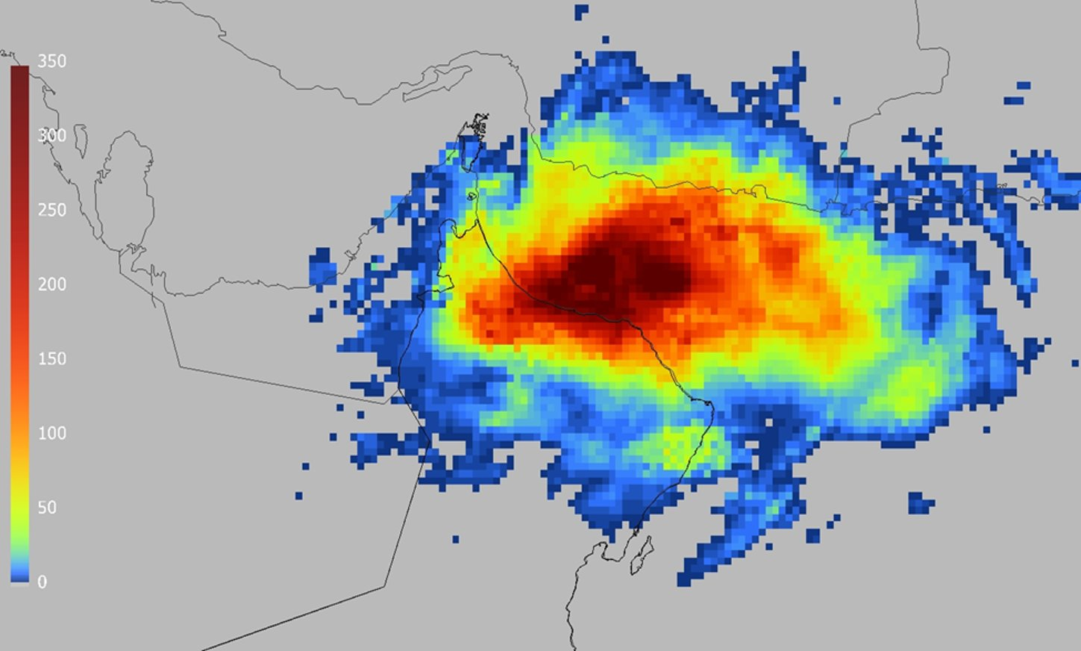
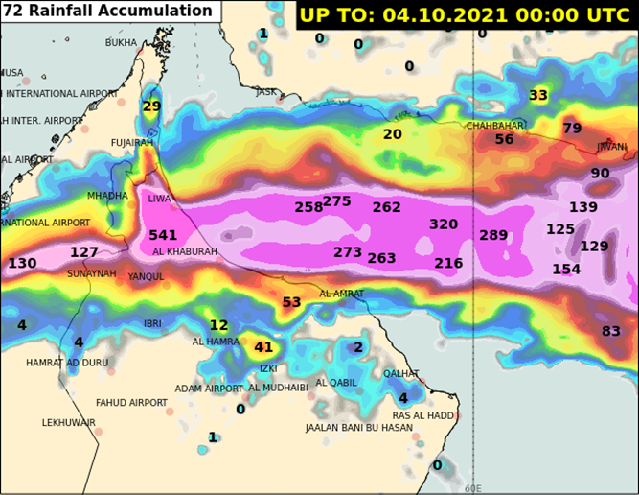
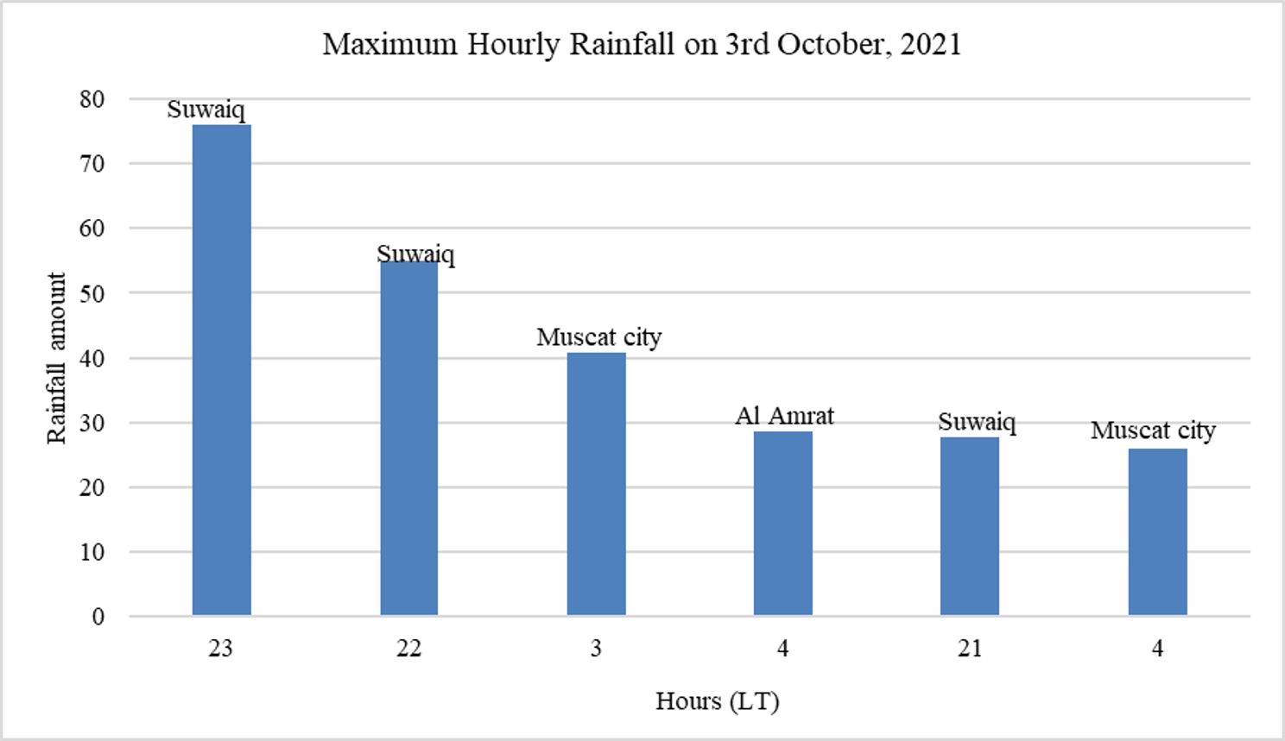
Flooding How?
Annual average rainfall is 85 mm
Rainfall Accumulation for Shaheen, 2-4 October 2021

Slide 5
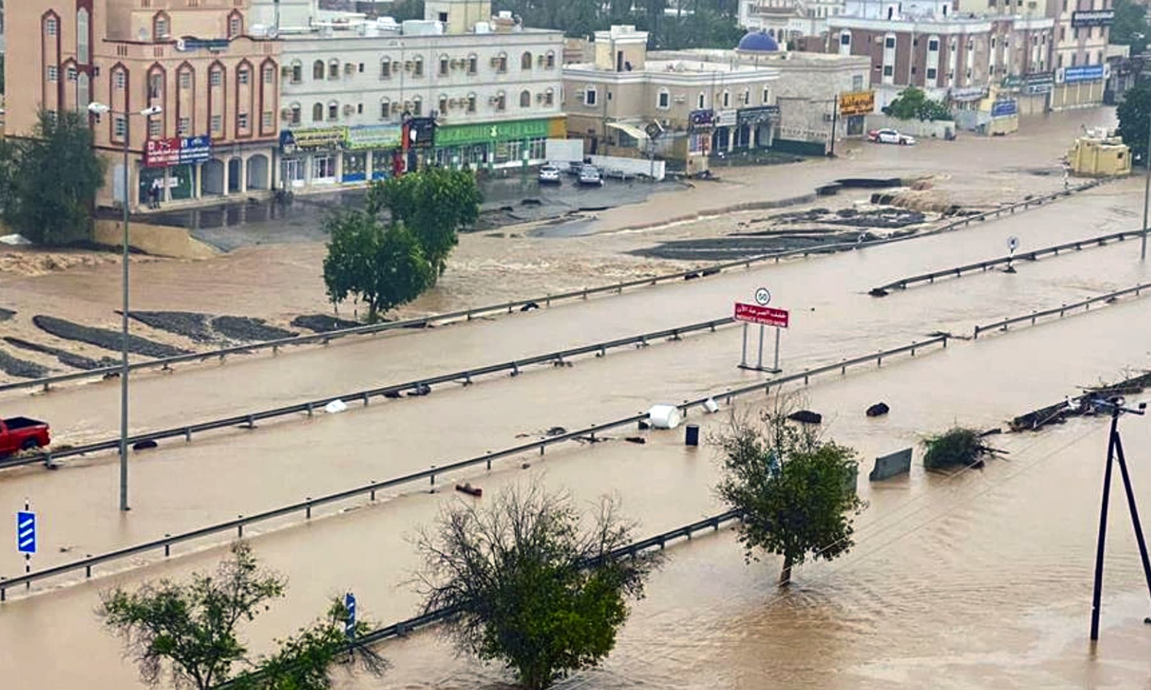
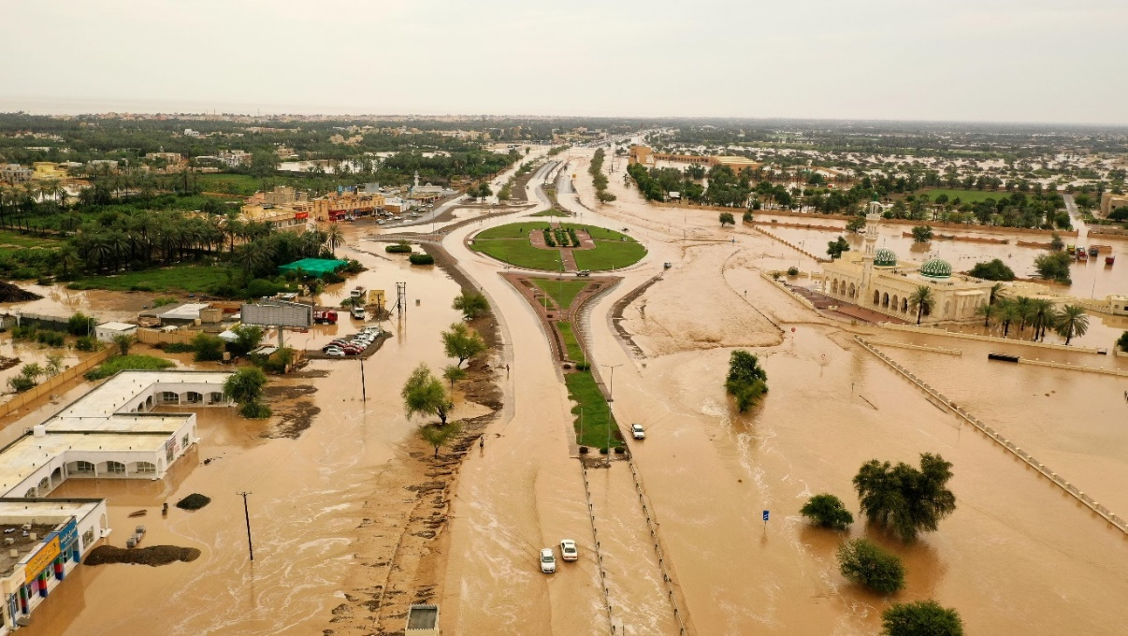
Flooding
Lowlands water stagnation
AL-KHABOURA SAHAM

Slide 6
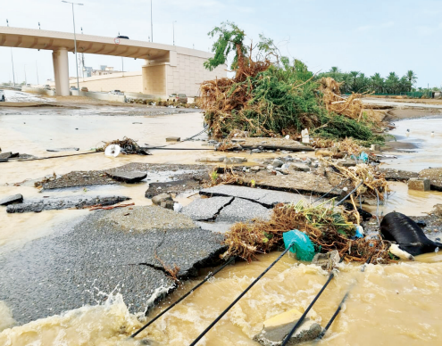
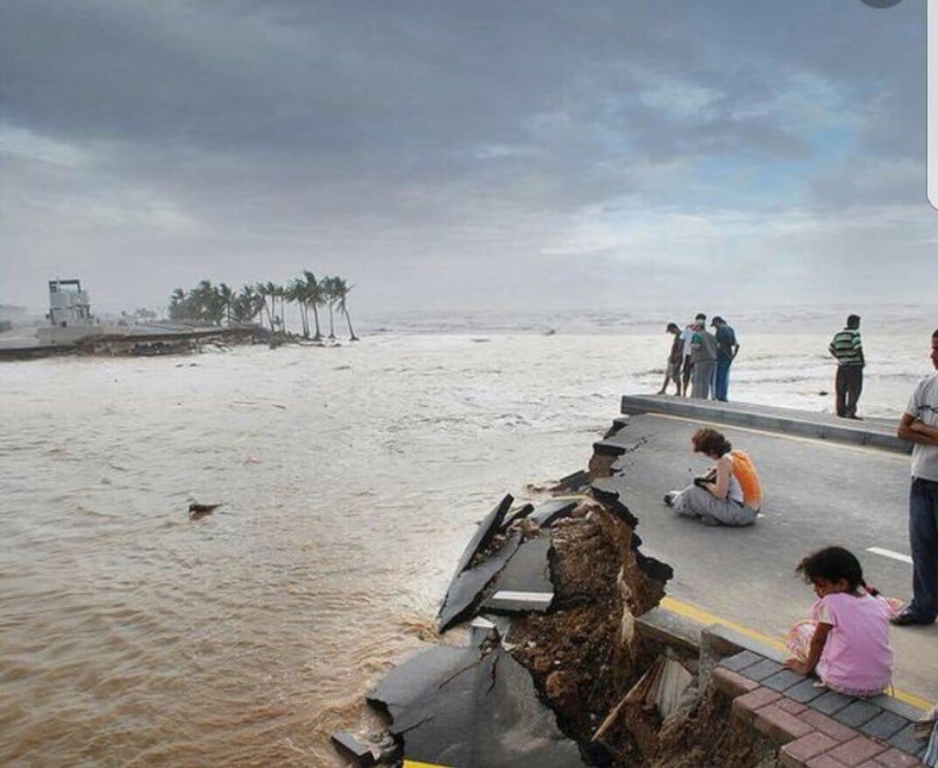
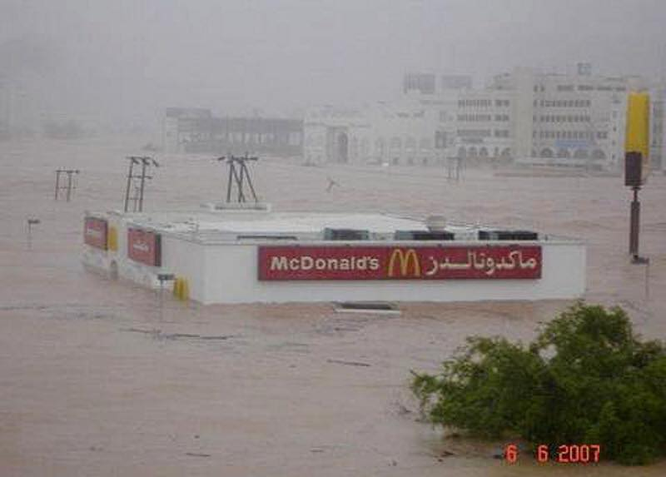
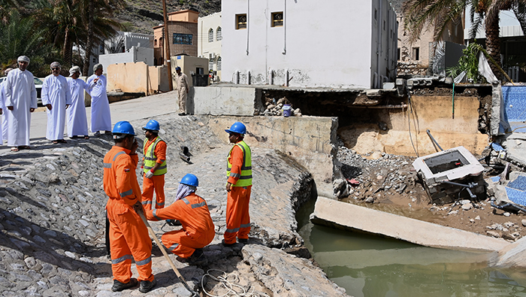
Flooding - Flash Flooding

Slide 7
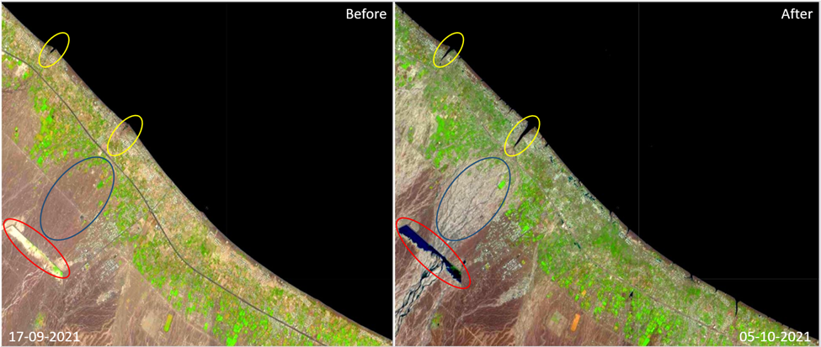
Flooding - Flash Flooding
Sentinel 2 shows the flooded areas in Al Khaboura.
Notes:
Sentinel 2 shows the flooded areas in Al Khaboura. Red circles shows the dam before and after the Shaheen. Blue circles showed how surface charectristics changed after run off. Yellow cirles showed the changes along the coast.

Slide 8
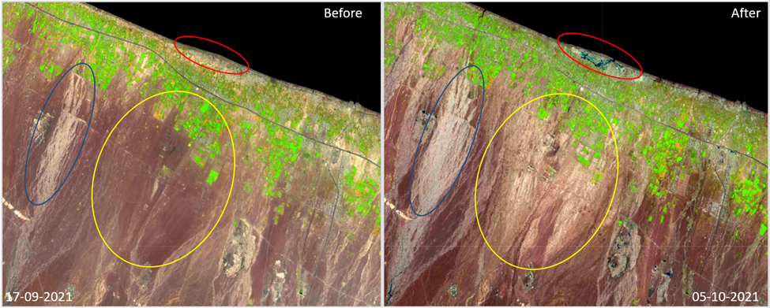
Flooding - Flash Flooding
Notes:
Sentinel 2 images showed
How the runoff affected the area
In Al-Suwaiq which indicated the
Violence of the extreme flooding

Slide 9
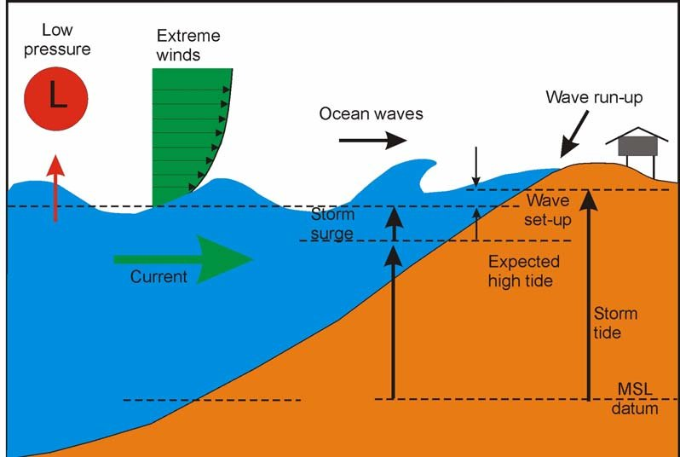
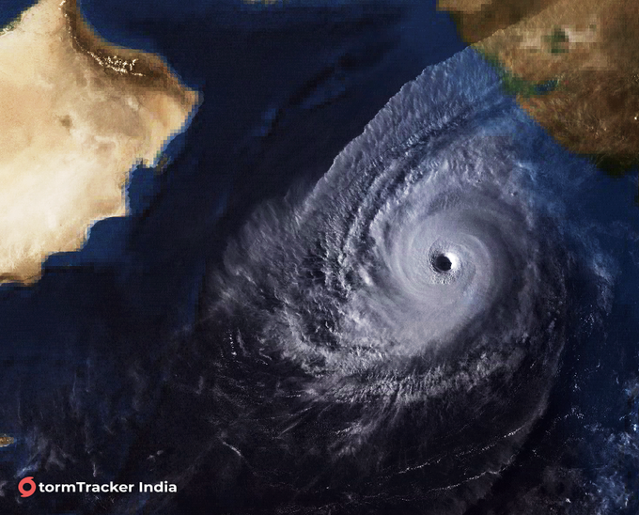
Flooding - Coastal Flooding
Storm Tide
Coastal Flooding induced by strong wind and swell waves over the sea
27-30 October 2019 | Category 4 Tropical cyclone KYARR in the Arabian Sea, created currents and swells that caused floods and damage to Oman Sea coastal areas

Slide 10
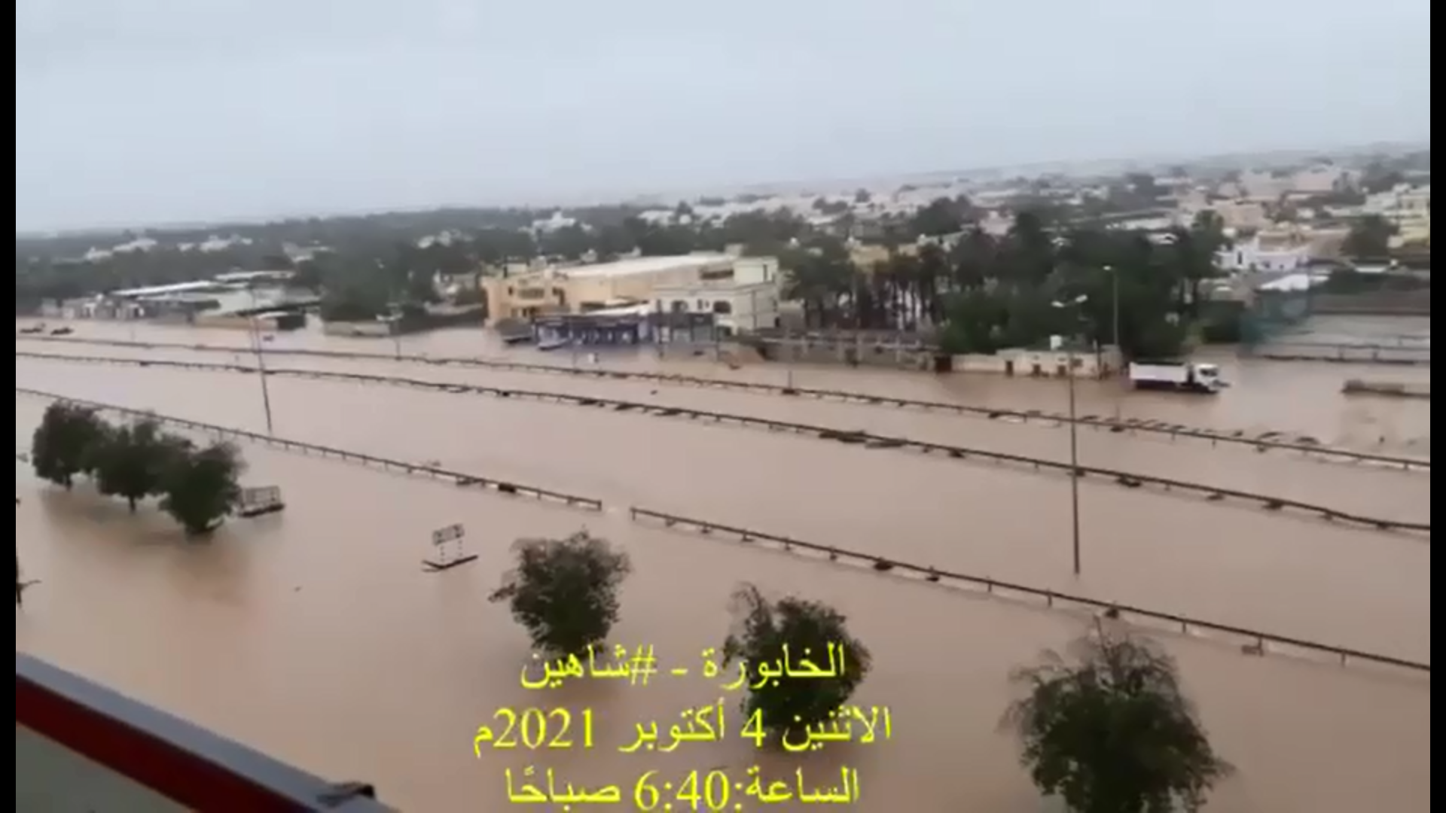
Flooding- Associated Impact
Flood Associated Impact
Loss of lives and damage to properties
Power cut
Clean water shortage
Communication cut
Traffic obstruction.
Significant damage to farms and loss of cattle
Notes:
First photo is for Part of AL Batinah main road which washed away by Flash flooding near AlBidaya in AlSuwaq and the second one is for Al Khabourah flooding on the morning of Oct 4 where the maximum accumulated rainfall was recorded reaching 465 mm during few hours.

Slide 11
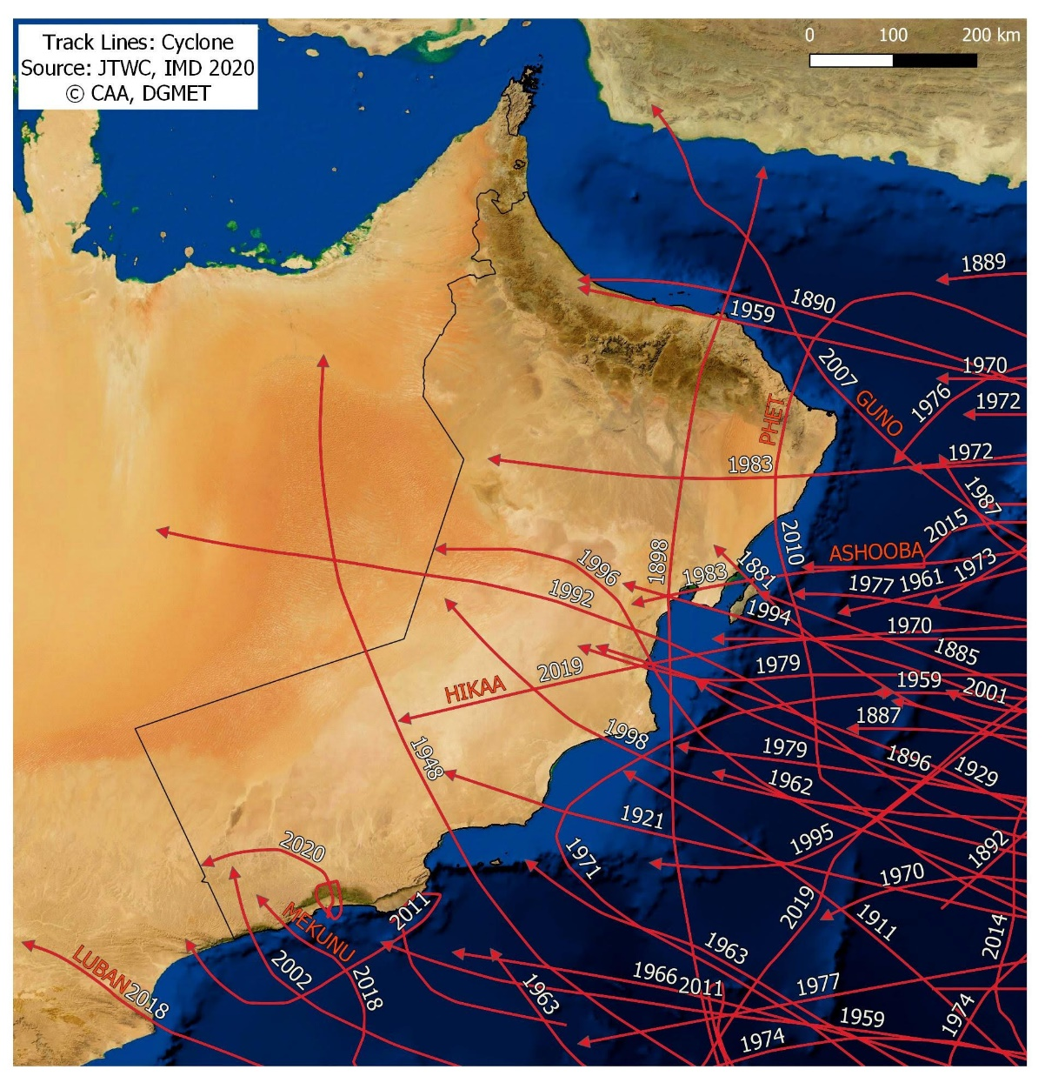
Flooding- Weather Systems
Tropical cyclones
Track Points
(Cyclone eAtlas-IMD, 2020, JTWC 2020)
© CAA- DGMET
1890 | the most severe tropical cyclone impacted Oman in the last 132 years. 727 casualties “it would take 15 years to recover from the agricultural loss” (Blount et al., 2010)
Historical tracks of the tropical cyclones that affected Oman
Notes:
However, excluding the 1890 tropical cyclone, the impact of these tropical cyclones is not well recorded.
The 1890 tropical cyclone track in the Oman Sea is remarkably similar to the Shaheen track. However, comparing the 1890 cyclone death toll (727) with Shaheen (12) and given at least ten times higher population density today, the 1890's tropical cyclone had a much worse effect.

Slide 12
Flooding- Weather Systems
Tropical cyclones
2007 | 2008 | 2009 | 2010 | 2011 | 2012 | 2013 | 2014 | 2015 | 2016 | 2017 | 2018 | 2019 | 2020 | 2021
Gonu |  |  | Phet Nanouk | Killa |  |  | Nilofar | Ashobaa Chapala Megh |  |  | Makuno Luban | Hikaa VAYU Kyarr Maha | Dhofar Depression | Shaheen
Recent tropical cyclones with severe impact
Year | Tropical Cyclone
2007 | Gonu : The second most severe impact on infrastructure after 1890
2021 | Shaheen: The third most severe impact on infrastructure after 1890.

Slide 13
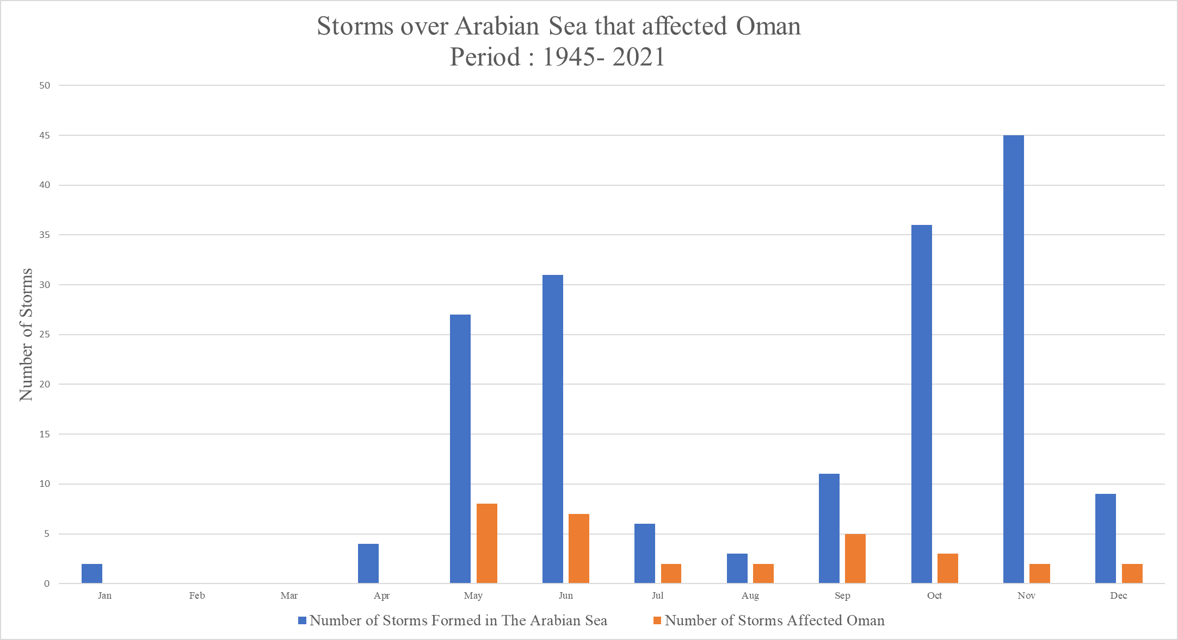
Flooding- Weather Systems
Tropical cyclones
33 cases affected Oman since 1945
Once every 3 years: a tropical cyclone will affect Oman directly or indirectly.
Once every 5 years: a tropical cyclone will make landfall over Oman territory.

Slide 14
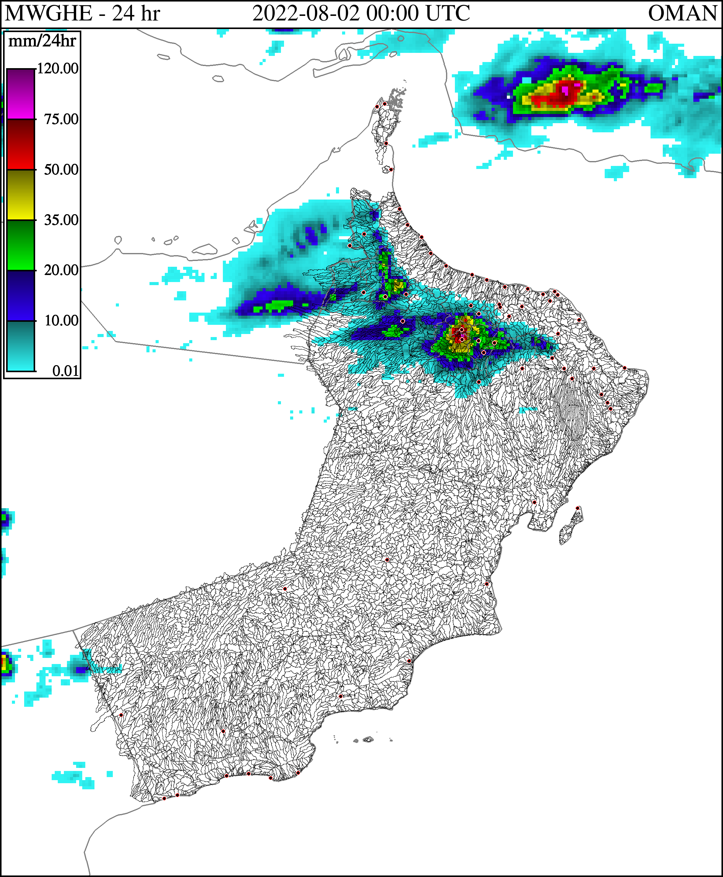
Flooding- Weather Systems
Easterly Waves
Usually causes severe flooding in the adjoining area of AlHajar mountains by enhancing local convection
Example
1 August 2022 | Wadi Bani Kharos in AlAwabi recorded precipitation amount exceeding 260 millimetres in 6 hours

Slide 15
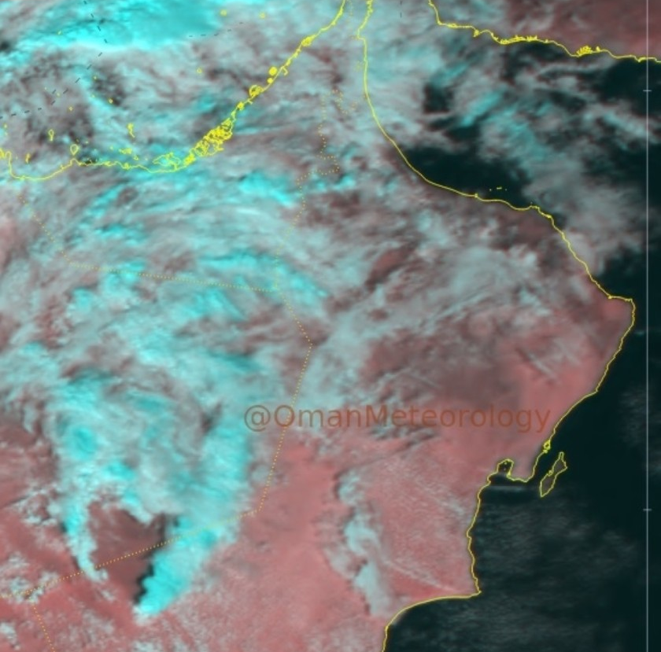
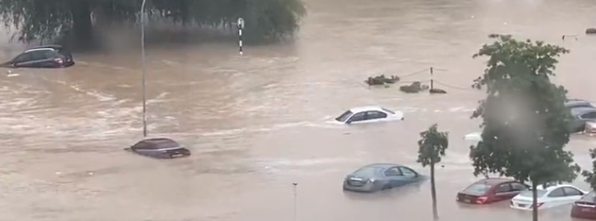
Flooding- Weather Systems
Westerly Waves
Severe cold fronts with high availability of moisture can result in heavy rain and flooding
Example
4 January 2022 | 100 mm recorded in Seeb Muscat
Notes:
However, excluding the 1890 tropical cyclone, the impact of these tropical cyclones is not well recorded.
The 1890 tropical cyclone track in the Oman Sea is remarkably similar to the Shaheen track. However, comparing the 1890 cyclone death toll (727) with Shaheen (12) and given at least ten times higher population density today, the 1890's tropical cyclone had a much worse effect.

Slide 16
Flooding- Weather Systems
Westerly Waves
Severe cold fronts with high availability of moisture can result in heavy rain and flooding
Example
4 January 2022 | 100 mm recorded in Seeb Muscat
Notes:
However, excluding the 1890 tropical cyclone, the impact of these tropical cyclones is not well recorded.
The 1890 tropical cyclone track in the Oman Sea is remarkably similar to the Shaheen track. However, comparing the 1890 cyclone death toll (727) with Shaheen (12) and given at least ten times higher population density today, the 1890's tropical cyclone had a much worse effect.

Slide 17
Strong Wind Impact

Slide 18
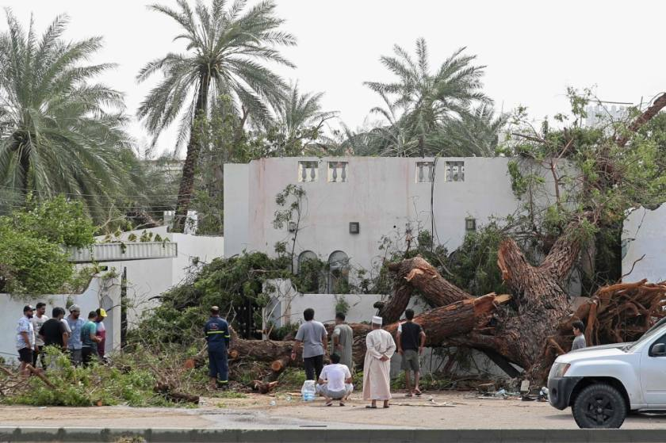
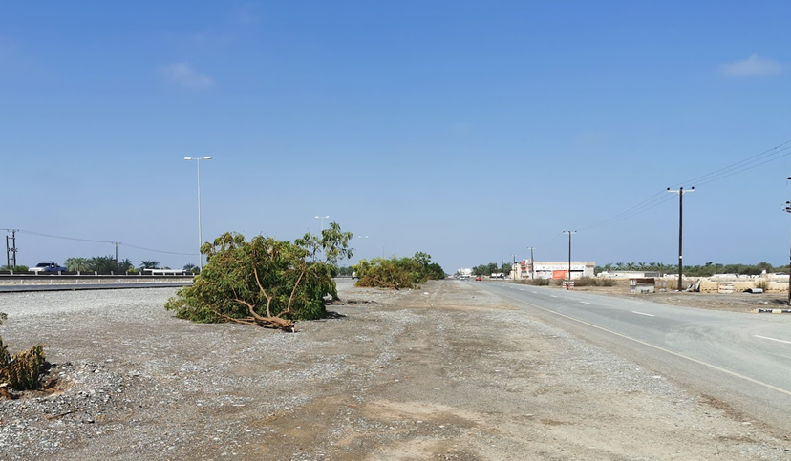
Strong Wind Damage
Wind destruction included:
Uprooting of trees.
Damage to telecom mast network.
Damage to electric power poles.
Notes:
The Photo above is taken in Al Khaboura

Slide 19
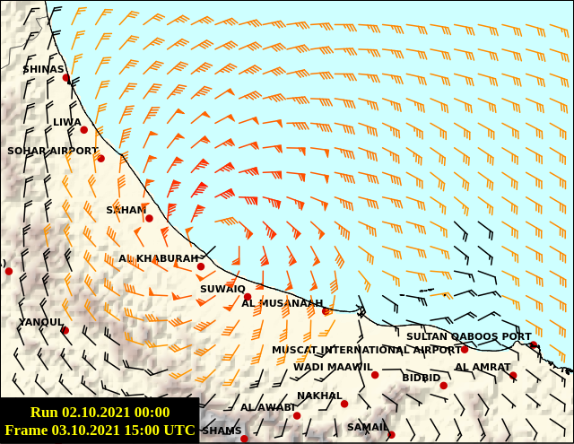
Wind- Weather Systems
Tropical cyclones
Example
3rd October 2021 | Tropical Cyclone Shaheen
Hourly maximum wind observed from Said bin Sultan Naval Base ships (A, B, and C)
during Shaheen cyclone Oct 3, 2021

Slide 20
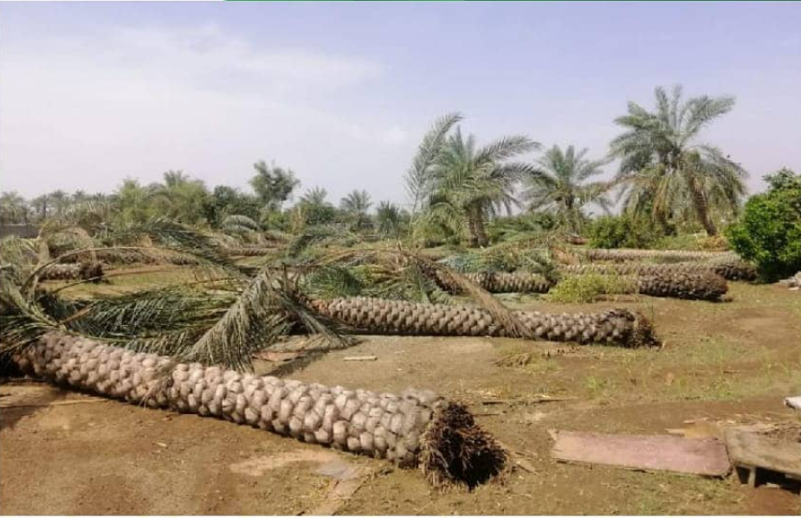
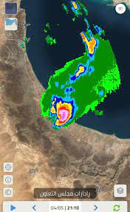
Wind- Weather Systems
Downdraft wind
Example
4 May 2021 | Saham Supercell

Slide 21
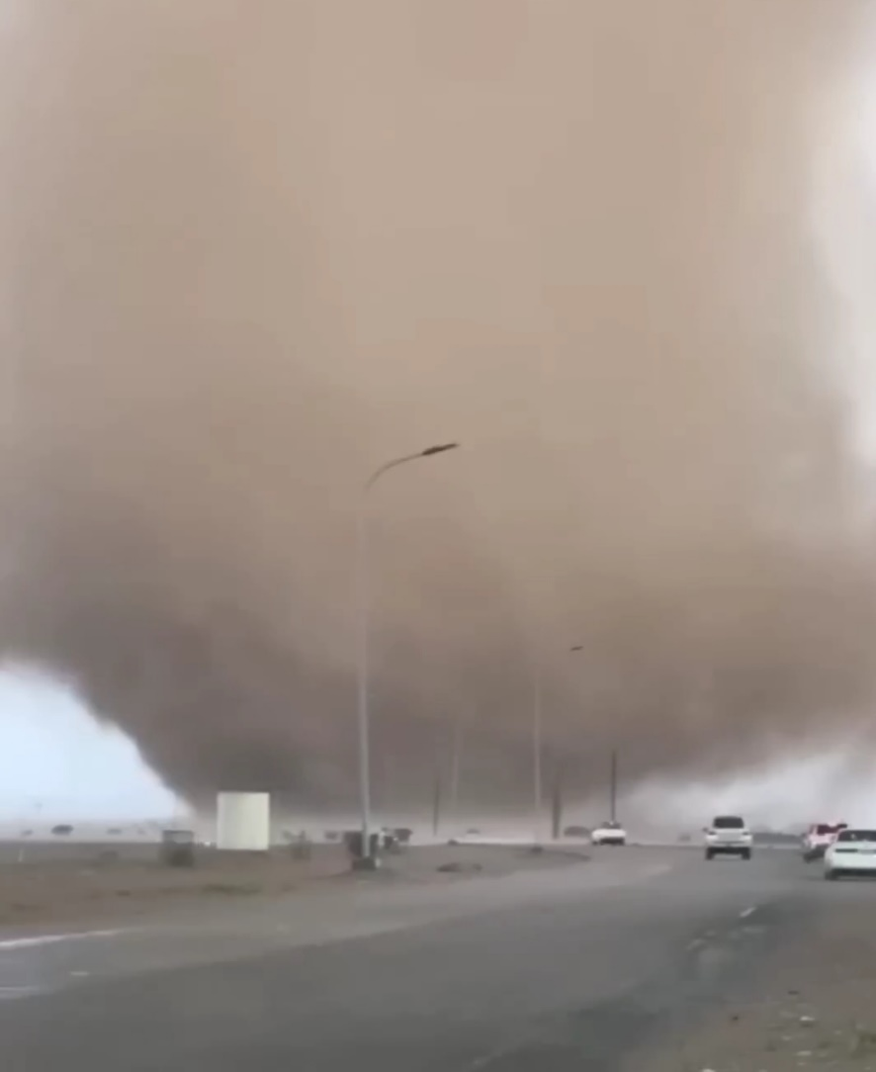
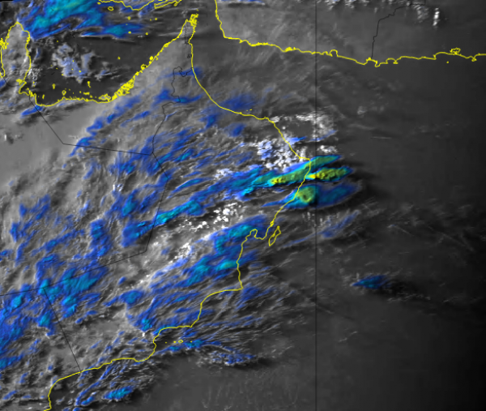
Wind- Weather Systems
Tornadoes
Example
22 April 2022 | Jalan’s Tornado

Slide 22
Dust Storms

Slide 23
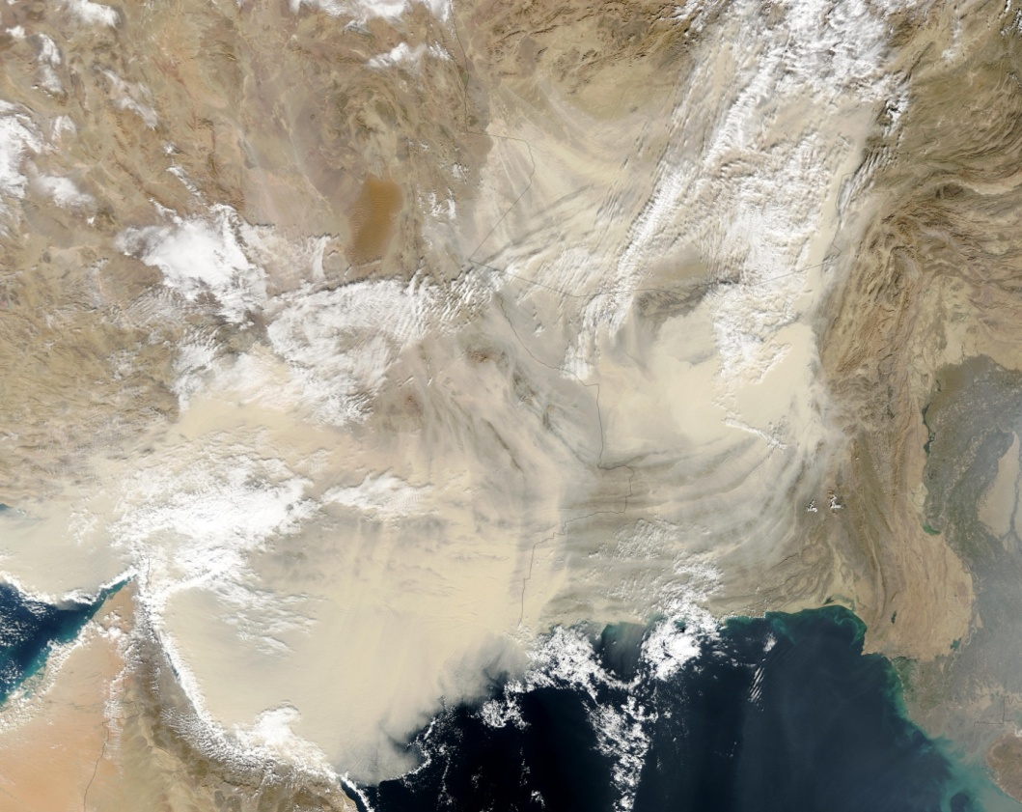
Dust Storms
Health
Direct inhalation has an impact on the respiratory system
Moving germs and pollution from infected areas
Generation of Solar Energy
Reduce equipment efficiency by reducing Heat exchange
Cause leak from the electrical power lines.
Traffic accidents
Notes:
The Photo above is taken in Al Khaboura

Slide 24
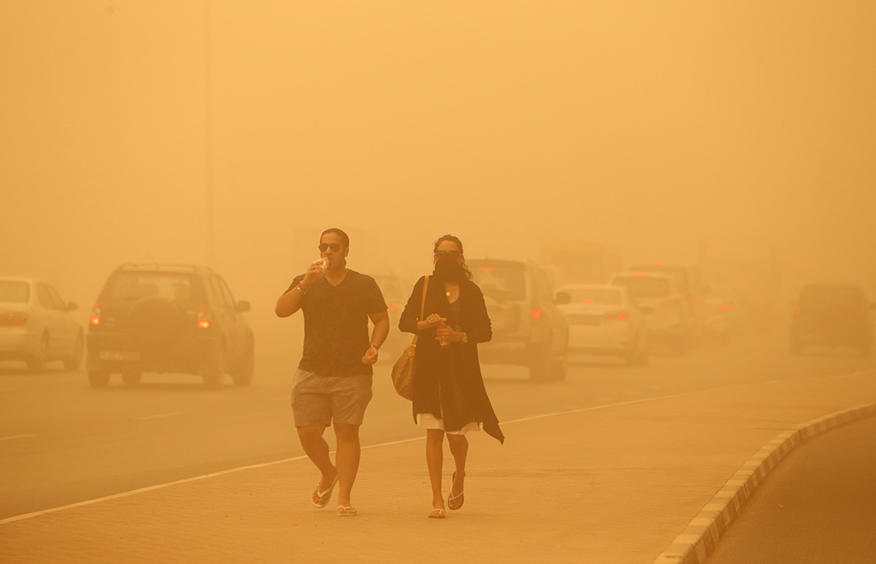
Dust Storms- Weather Systems
Frontal systems (Westerly Disturbances )
Synoptic Scale Dust Storm
Dubai during April 2, 2015 dust storm
by Ahmed Jadallah/Reuters (Slate, 2015)

Slide 25
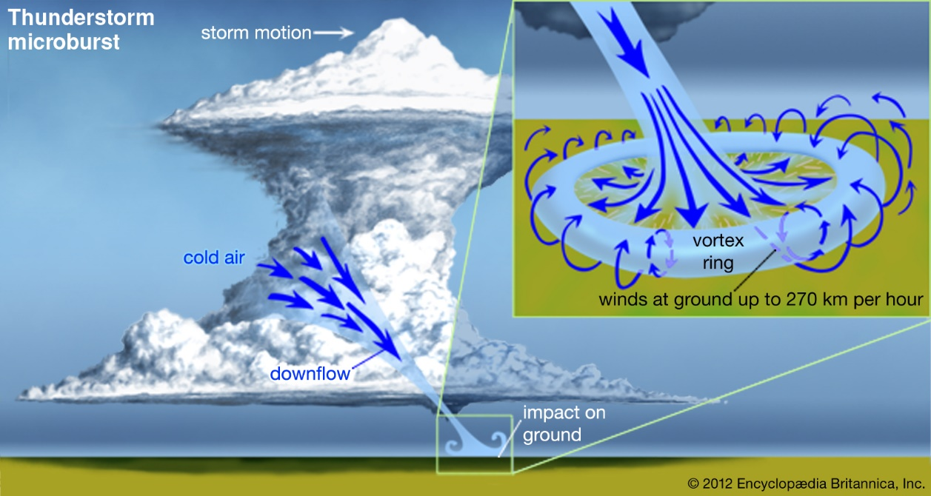
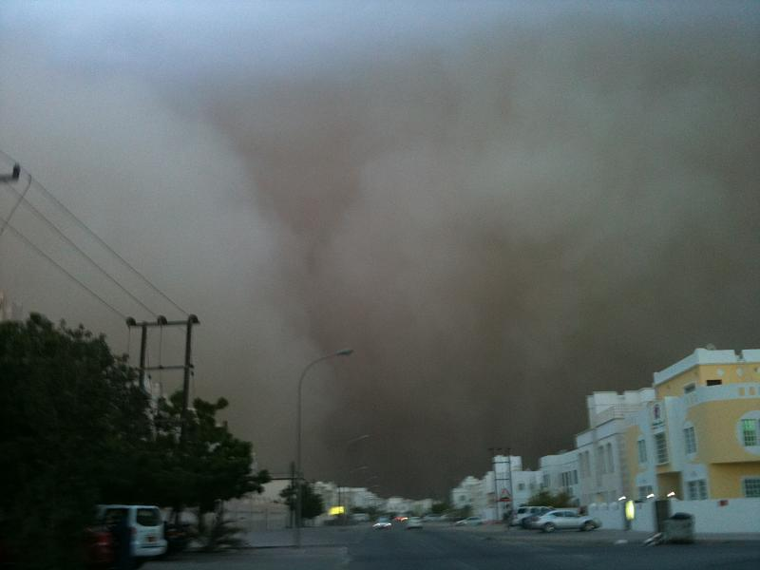
Dust Storms- Weather Systems
Downdraft
Mesoscale Scale Dust Storm
Example
12 October 2011 | Muscat Dust Storm

Slide 26
Heat Waves

Slide 27
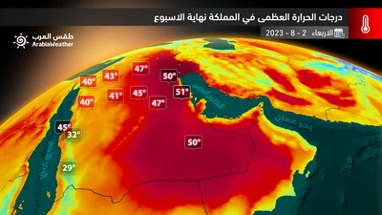
Heat Waves
Health
Sunstruck
exhaustion
Productivity reduction
Notes:
The Photo above is taken in Al Khaboura

Slide 28
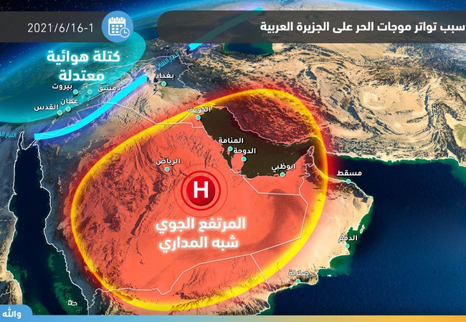
Dust Storms- Weather Systems
High Pressure
Example
16 June 2021 | Joba recorded 51.6 ℃

Slide 29
Thank you

