Slide 1
EARTH ATMOSPHERE
(STRUCTURE AND COMPOSITION)
Lecturer: Afada AL-Hubaishi
Aug,2024
Directorate General of Meteorology
01

Slide 2
Content
What Is Meteorology?
Atmospheric Structure
Atmospheric Composition
Atmospheric Properties
02

Slide 3
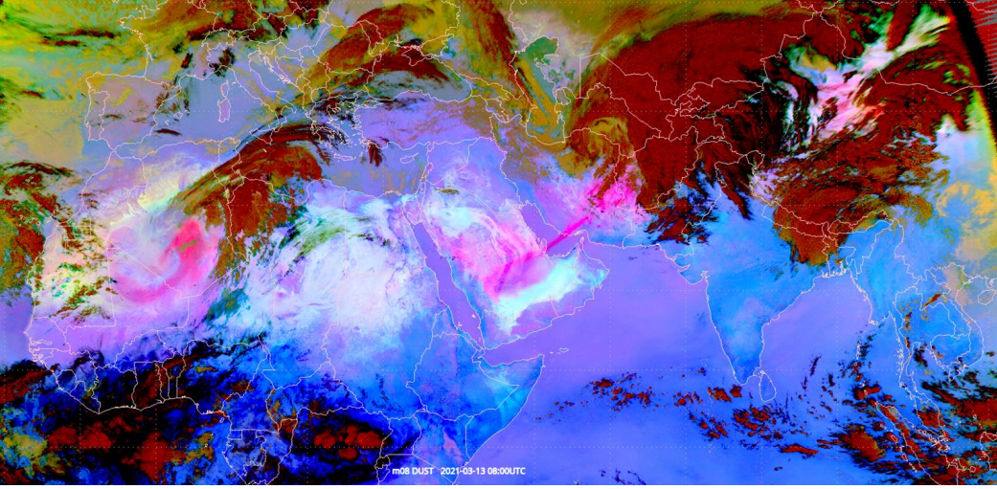
What is Meteorology?
Meteorology is the science that studies Earth's atmosphere and the Weather processes occurring
with it. It involves observing, analyzing, and predicting atmospheric conditions.
03

Slide 4
Weather Versus Climate
04

Slide 5
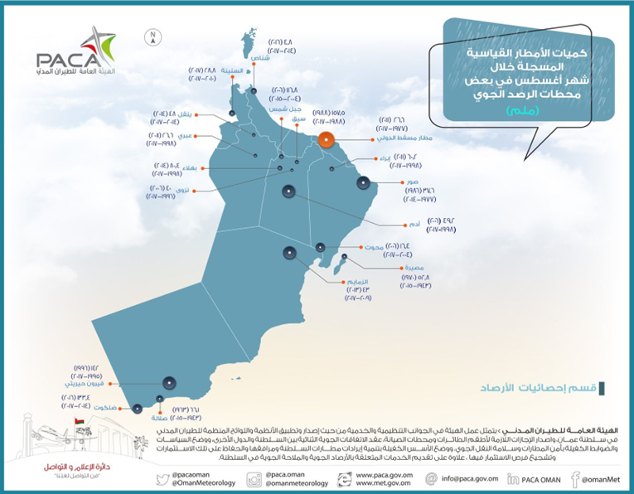
What is Weather and Climate
Weather : Atmospheric Conditions present
at a given time and place.
Climate : Atmosphere conditions at a
certain place for LONG period of time.
05

Slide 6
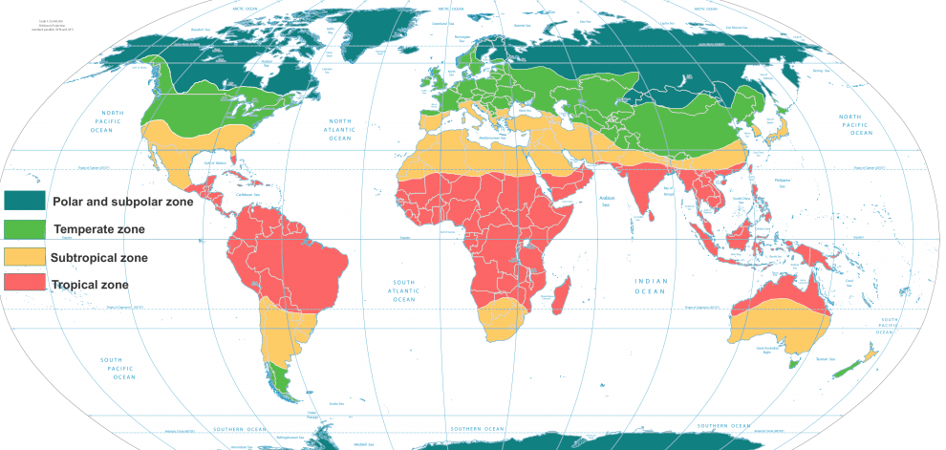
Climate Zones
06

Slide 7
Weather and Climate
So as a science, there are:
Meteorological Study:
Focus on observation and short term forecast for atmospheric condition.
Climatological Study:
Focus on Statistics and long term observation
07

Slide 8
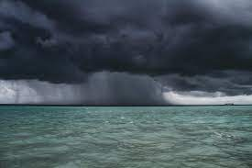
Meteorological Applications
Aviation
Agriculture
Marine
08

Slide 9
EARTH ATMOSPHERE
(STRUCTURE AND COMPOSITION)
Directorate General of Meteorology
09

Slide 10
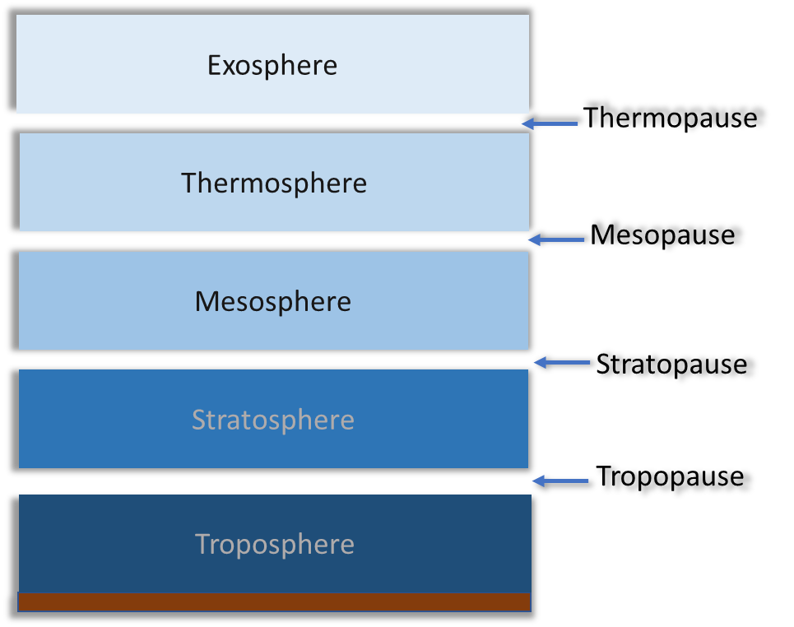
Structure of Earth Atmosphere
Divided into five distinct layers with different characteristics (Temperature , Pressure) and four transition
layers
01.
650 Km
80Km
50Km
10Km
10

Slide 11
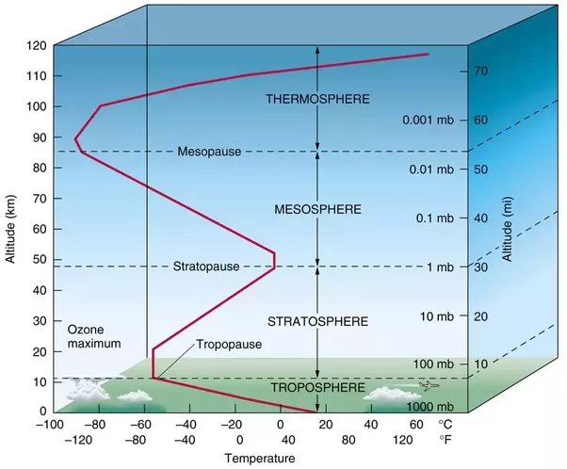
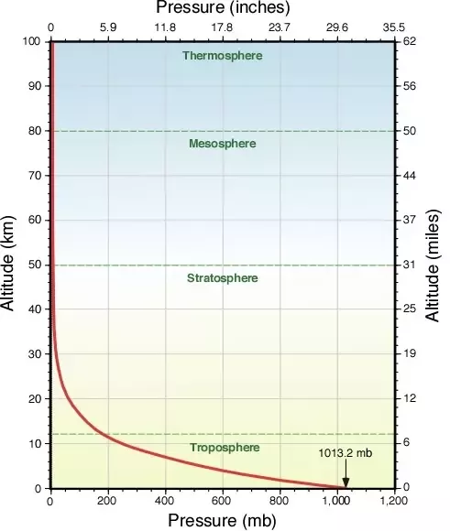
Structure of Earth Atmosphere
Mainly the layers are divided based on: Temperature and Pressure
Each layer has different behavior of temperature
Pressure decreases with altitude at all layers
with higher rate at Troposphere
11

Slide 12
Structure of Earth Atmosphere
Troposphere
lowest layer of Earth’s atmosphere.
Extending from Earth’s surface up to 10 Km
3/4 of mass of atmosphere (densest layer), containing most of the atmospheric mass and water vapor.
Most weather occurs in this layer.
12

Slide 13
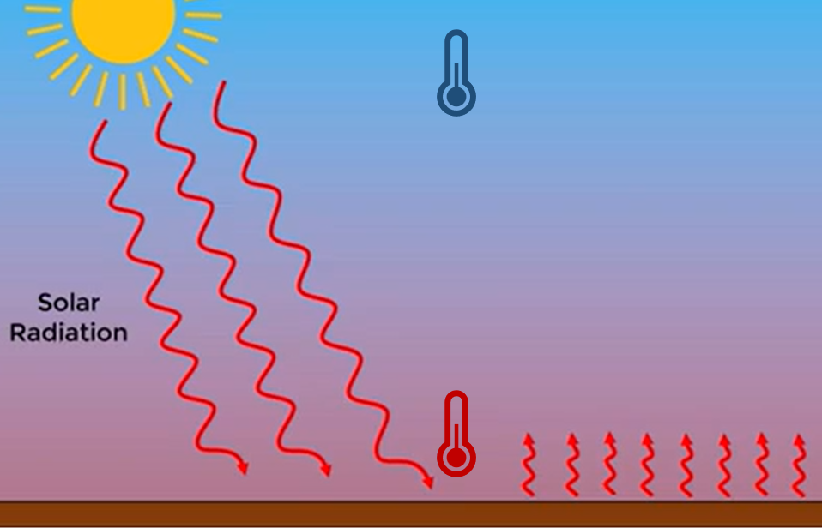
Structure of Earth Atmosphere
Troposphere
Why the temperature near the surface is highest?
Decreases with altitude (6.5C per 1km)
13

Slide 14
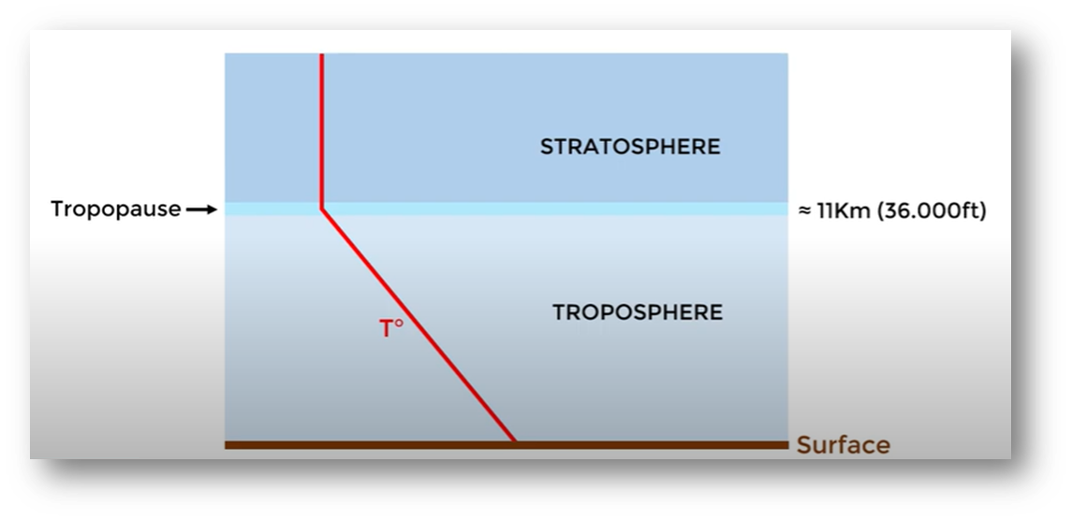
Structure of Earth Atmosphere
TROPOPAUSE (TRANSITION LAYER)
Transition layer between Troposphere & Stratosphere
Temperature tend to remain Constant with altitude
14

Slide 15
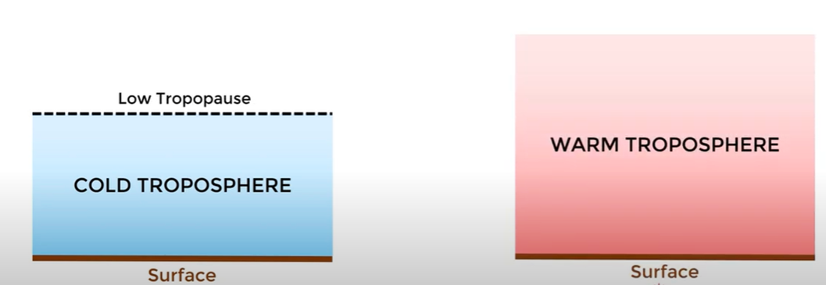
Structure of Earth Atmosphere
TROPOPAUSE (TRANSITION LAYER)
Why the Tropopause is higher at
the equator than the pole?
The altitude of Tropopause varies with temperature
15

Slide 16
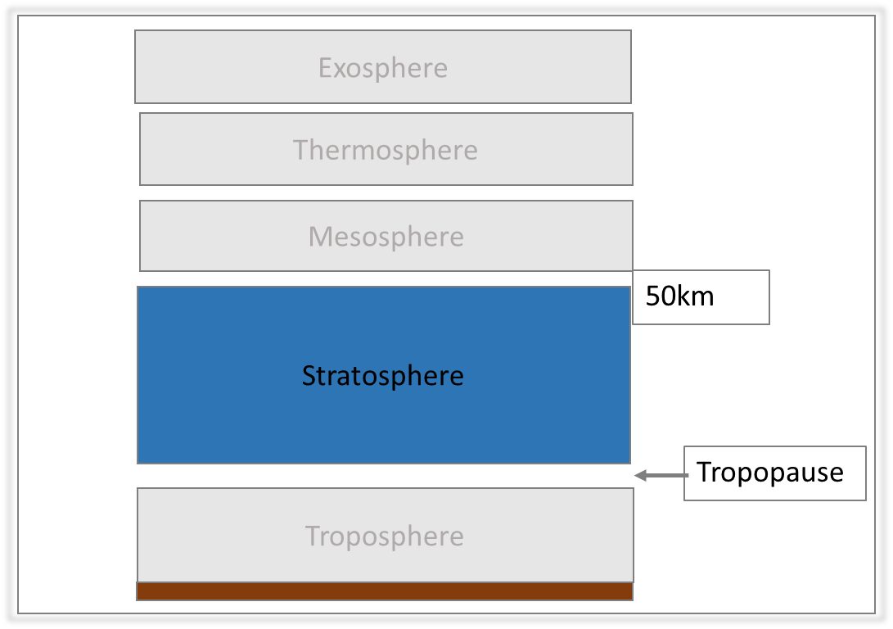
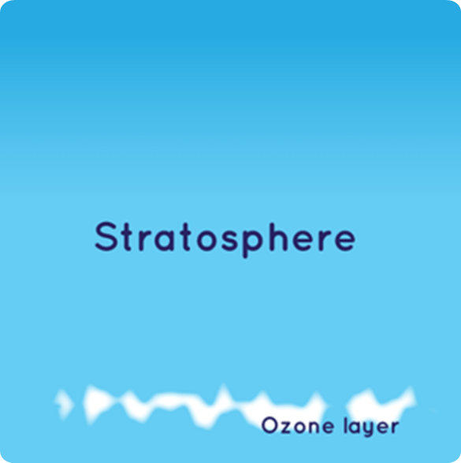
Structure of Earth Atmosphere
Stratosphere
The layer just above the tropopause.
Extends up to 50km above Sea level.
High Concentration
16

Slide 17
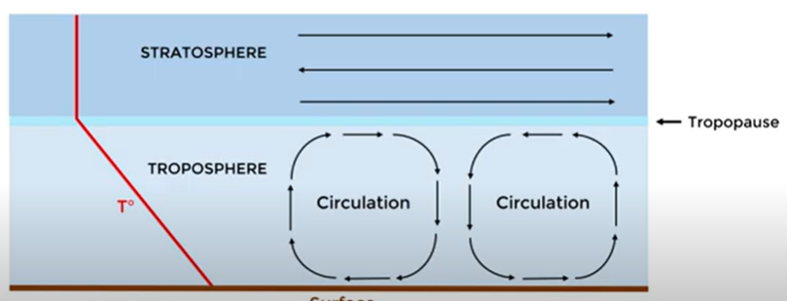
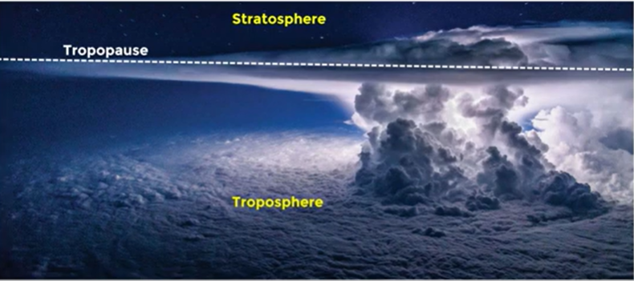
Structure of Earth Atmosphere
Stratosphere
This increase in temperature with height means
warmer air is located above cooler air. This
restricted the vertical movement of air, which
prevents the formation any significant atmospheric
phenomena.
Tropopause act as a limit for atmospheric circulation
(Vertically)
17

Slide 18
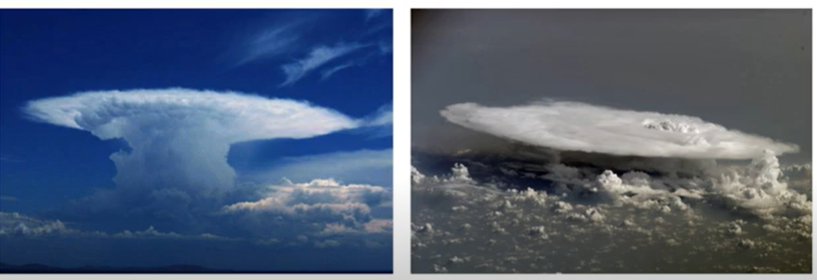
Structure of Earth Atmosphere
Stratosphere
Prevent the Thunderstorm from continuous development vertically
18

Slide 19
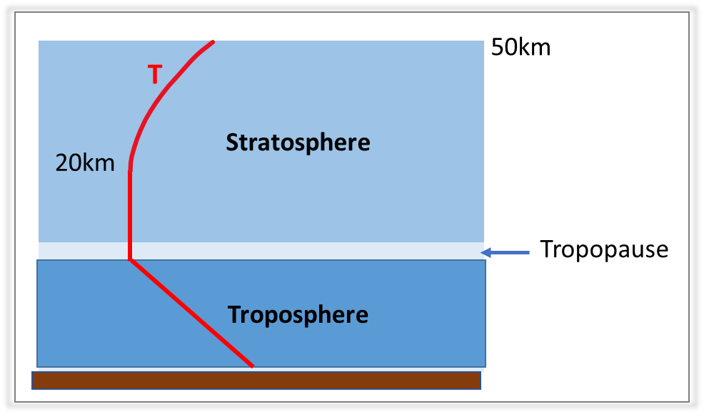
Structure of Earth Atmosphere
Stratosphere
In the lower part the Temperature tends to remain constant
above 20km the temperature increase gradually reaches 0C at level 50km
Heat is produced in the process of the formation of
Ozone, and this heat is responsible for temperature
increases
19

Slide 20
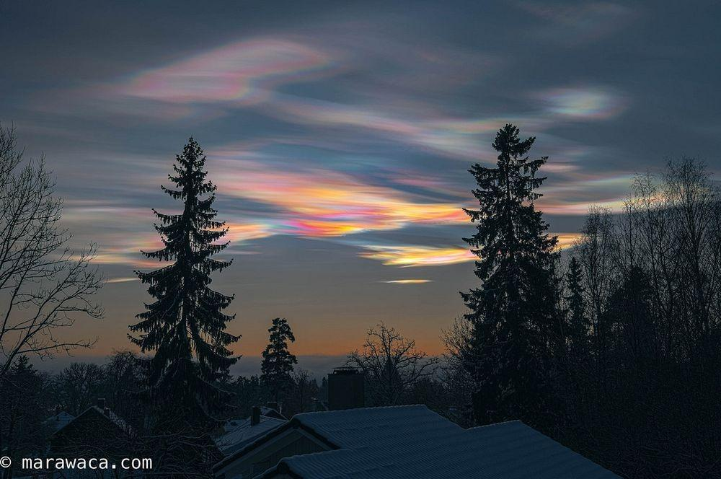
Structure of Earth Atmosphere
Stratosphere
However:
The small amount of water vapor in this layer, can generate shallow cloud with little vertical development known as “polar stratospheric clouds” or “nacreous clouds”
Can only seen in high altitude area
20

Slide 21
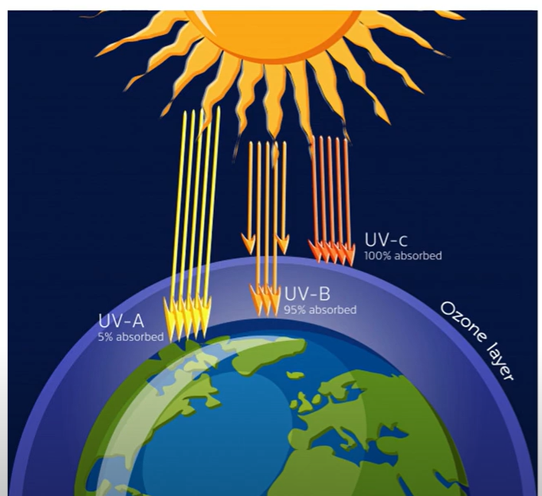
Structure of Earth Atmosphere
Stratosphere
Act As a Filter Layer
Most of the ULTRAVIOLT radiation from the sun absorbed by Ozon
21

Slide 22
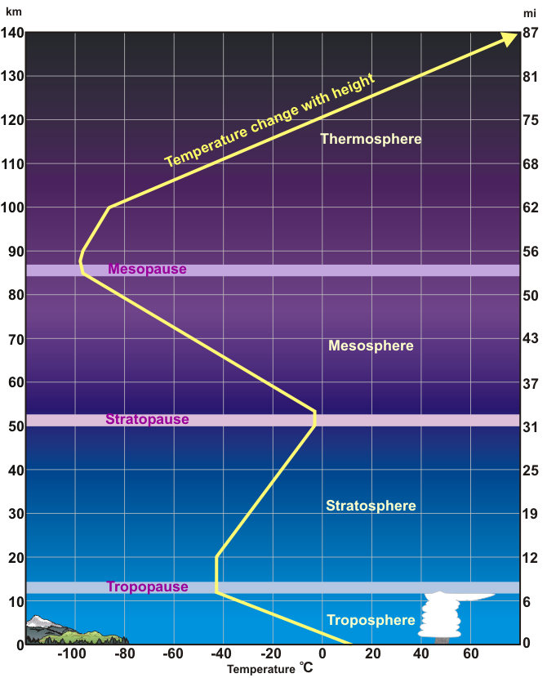
Structure of Earth Atmosphere
The general characteristics of the Earth atmosphere layer
Troposphere
Lowest Layer
This is where we live
8 to 12 miles in height
Weather occurs
Temperature decreases with height
Stratosphere
Second lowest layer
Temperature increases with height
Ozone (03) layer
Absorbs most of the damaging
ultraviolet sunlight (UV-B)
Mesosphere
From ~30 to 53 miles up
Temperature decreases
Majority of meteors burn up
Thermosphere
Upper atmosphere 53 to ~430 miles up
Very few molecules
22

Slide 23
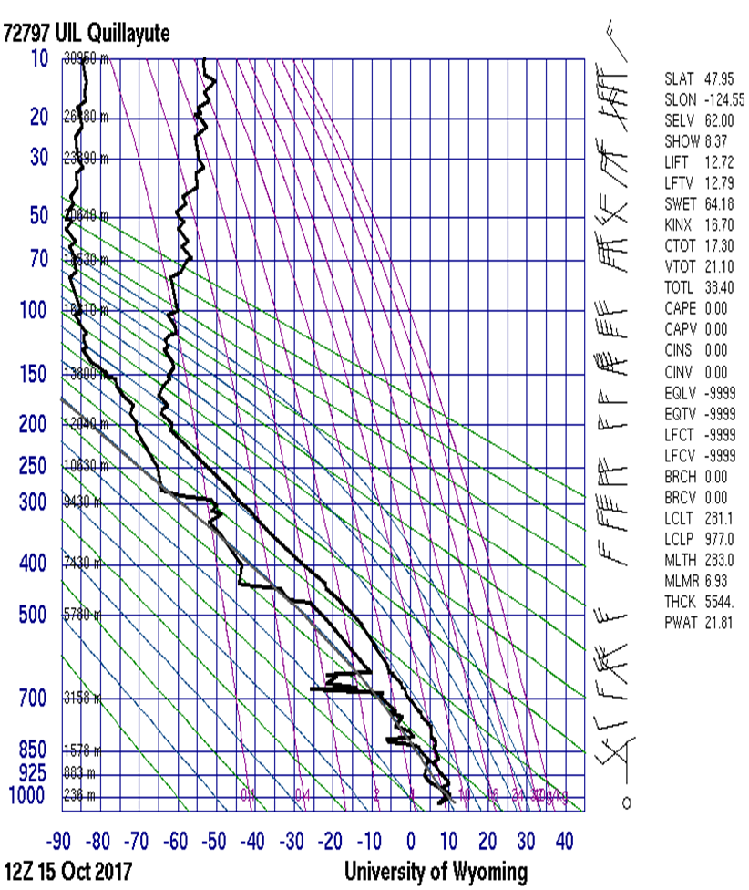
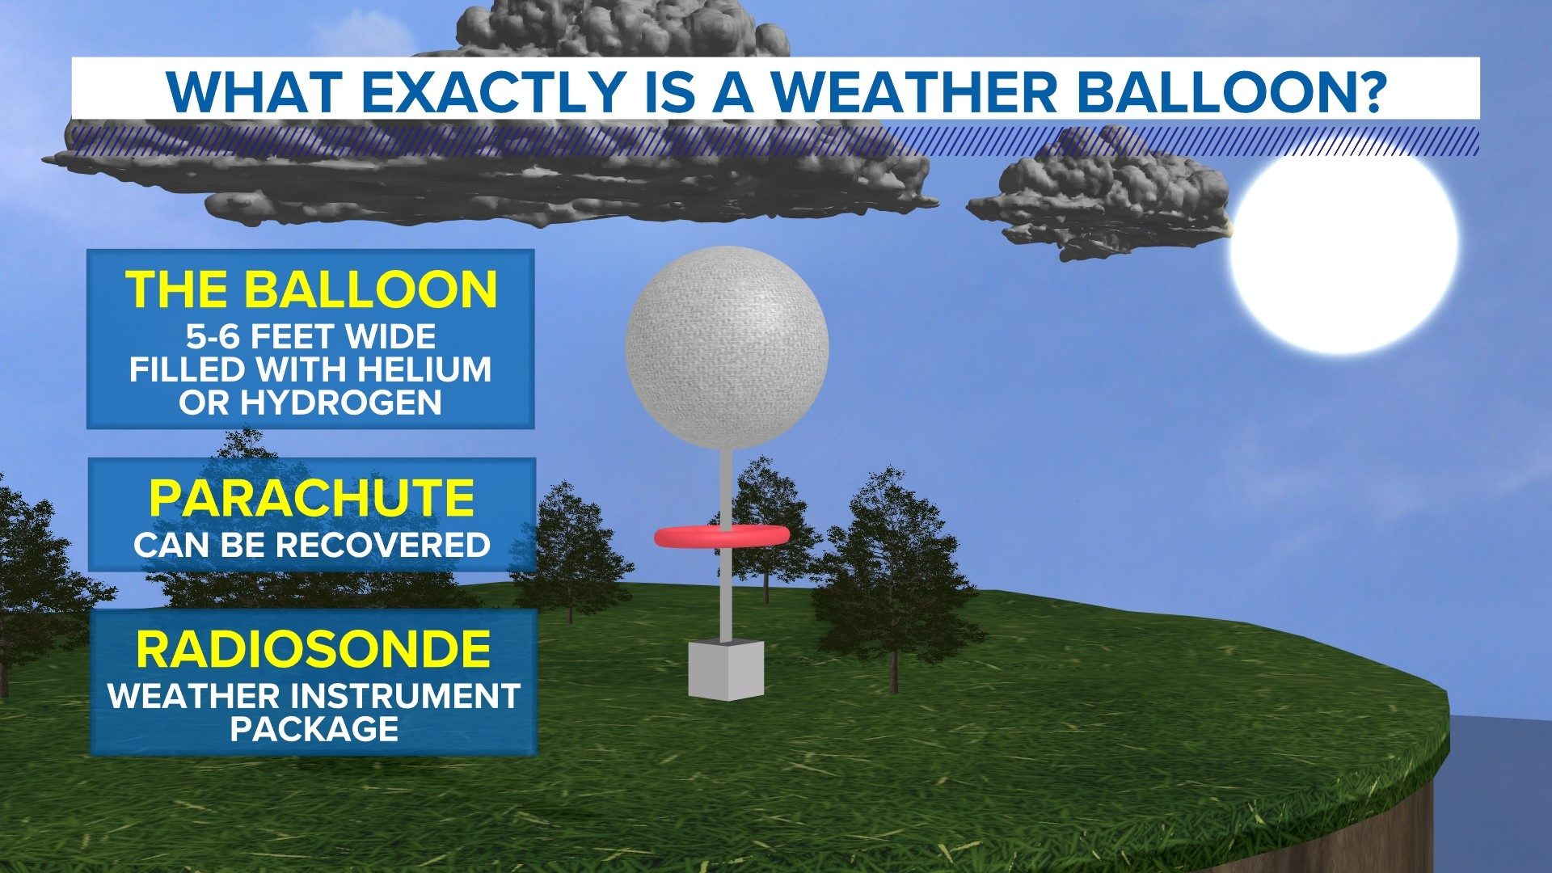
Exploring the Atmosphere Using Weather Ballon
The standard method of obtaining values of temperature and humidity at upper levels is by use of a balloon carrying a small radio transmitter known as a radiosonde
What are measured:
Temperature
Humidity
Pressure
Wind Speed
23

Slide 24
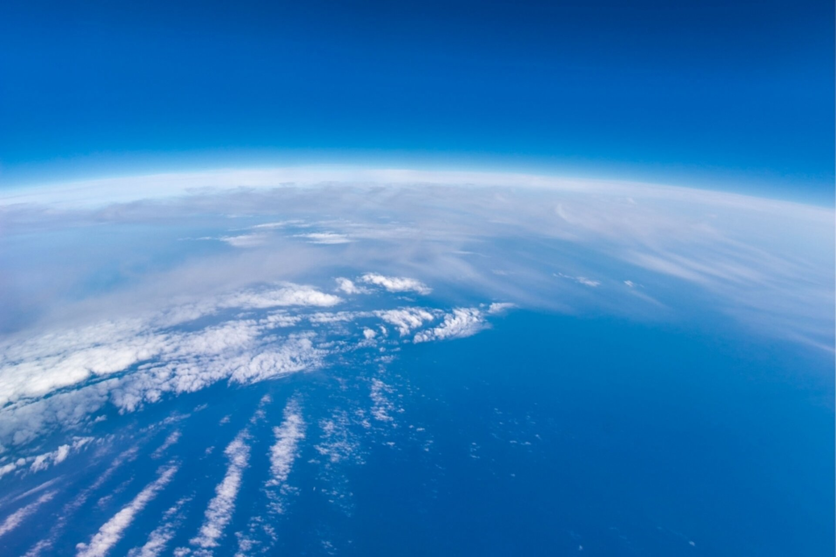
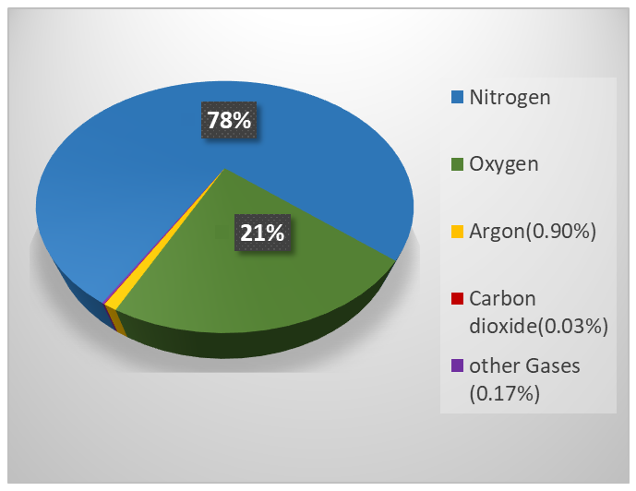
Earth Atmosphere
Composition : Gaseous layer Surrounds the Earth (Air)
01.
Credit : AXA
24

Slide 25
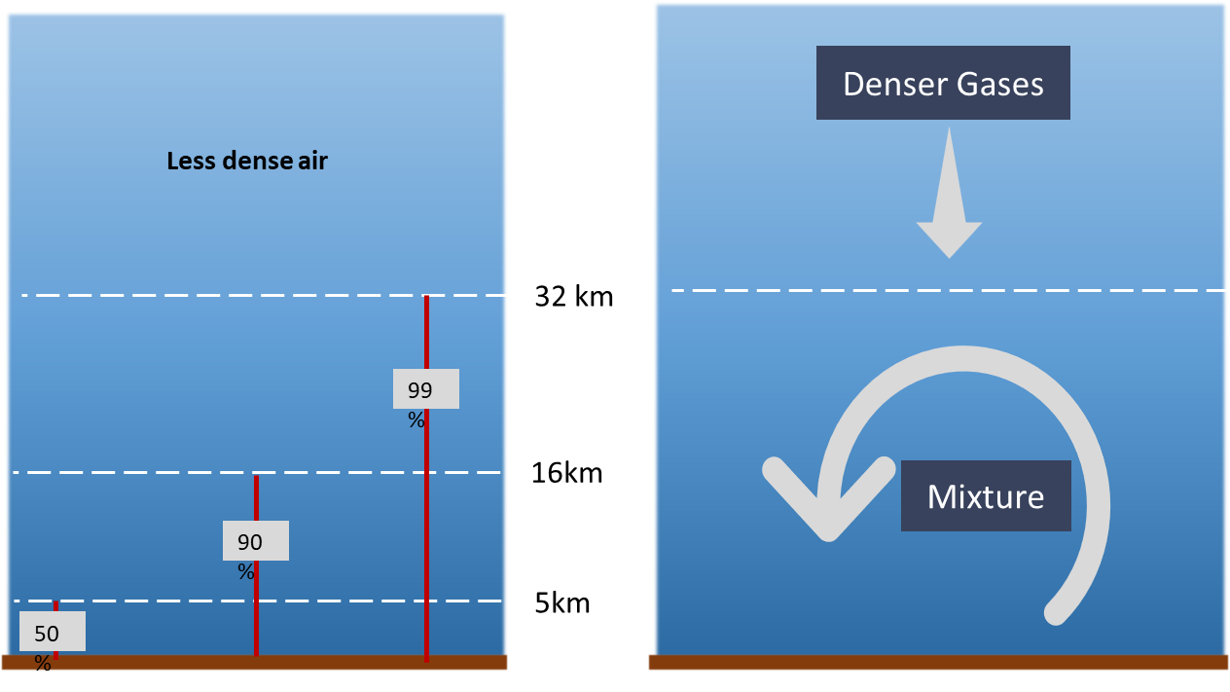
Distribution of Air in Atmosphere
The air become less
dense with altitude
Majority of the air concentrated in the lower
atmosphere (near the surface)
01.
25

Slide 26
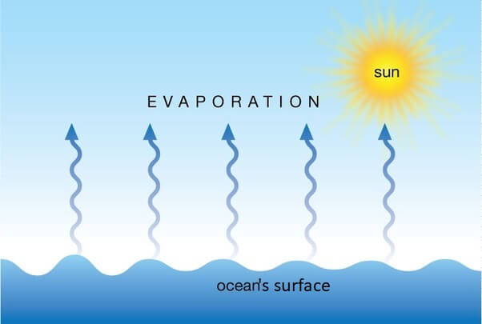
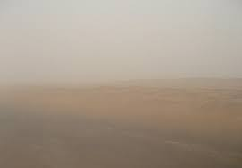
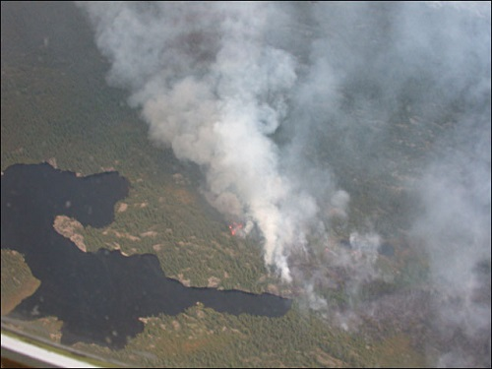
Composition of Atmosphere
At the lower level of air also contain Humidity (Water Vapor) & Aerosols (Dust, Salt, Sand,……..)
01.
The most important parameter for different atmospheric phenomena either moist or dry
Influence the Formation Cloud, Hail, Fog,…..(Condensation Nuclei)
26

Slide 27
Physical Atmosphere Properties
01.
Properties of Air
Density
Pressure
Pressure
Humidity
27

Slide 28
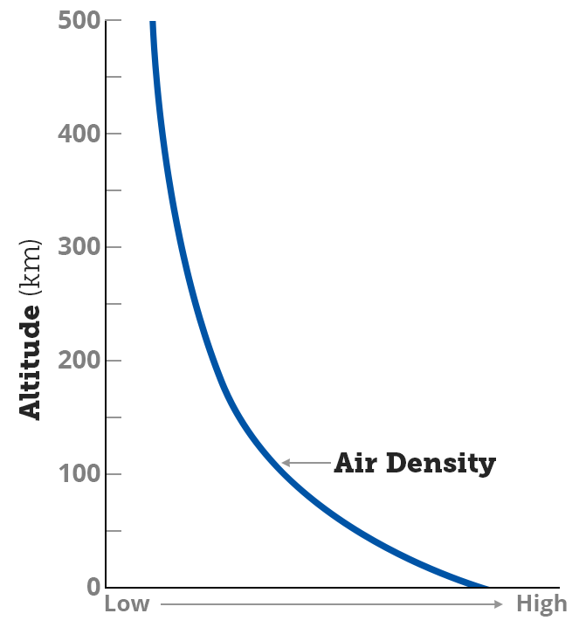
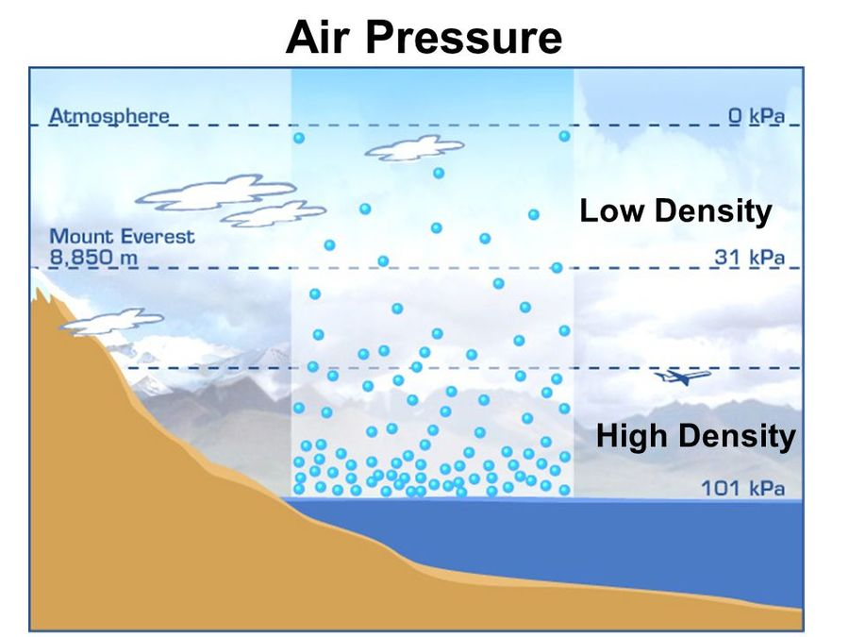
What Is Density?
Air Density : The number of molecules per unit volume
Air density decreases with increasing altitude
01.
28

Slide 29
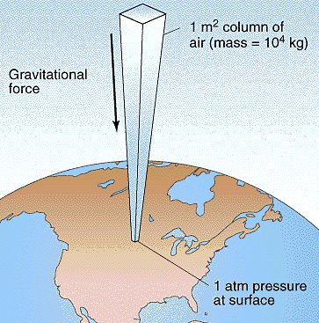
What is Pressure
Pressure : Force applied on surface per unit area
A force per unit area exerted by a column of air
01.
P = F / A
P=Pressure, F=Force, A=area
The greater the force the greater the
Pressure , the larger the area ,the lower the pressure
29

Slide 30
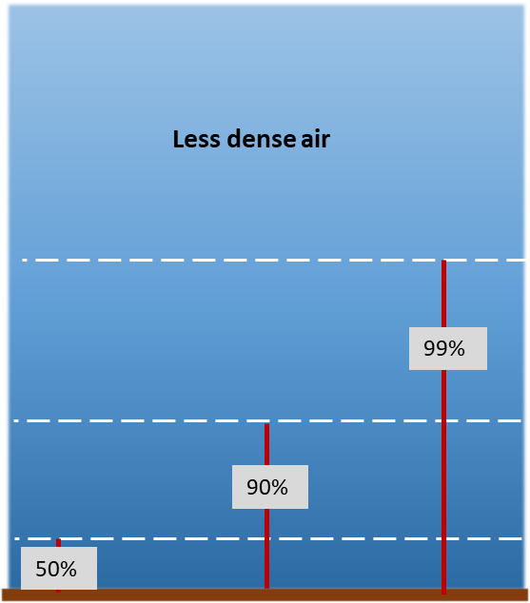
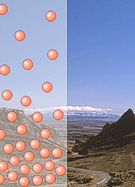
Density and Pressure
It’s the Law: Density vs. Pressure (Boyle’s Low) (P ~ ρ)
As density increases pressure increases
As density decreases pressure decreases
Density
pressure
Density
pressure
The air density is greatest at sea level and decreases with increases elevation
So how the Pressure varies with altitude ?
30

Slide 31
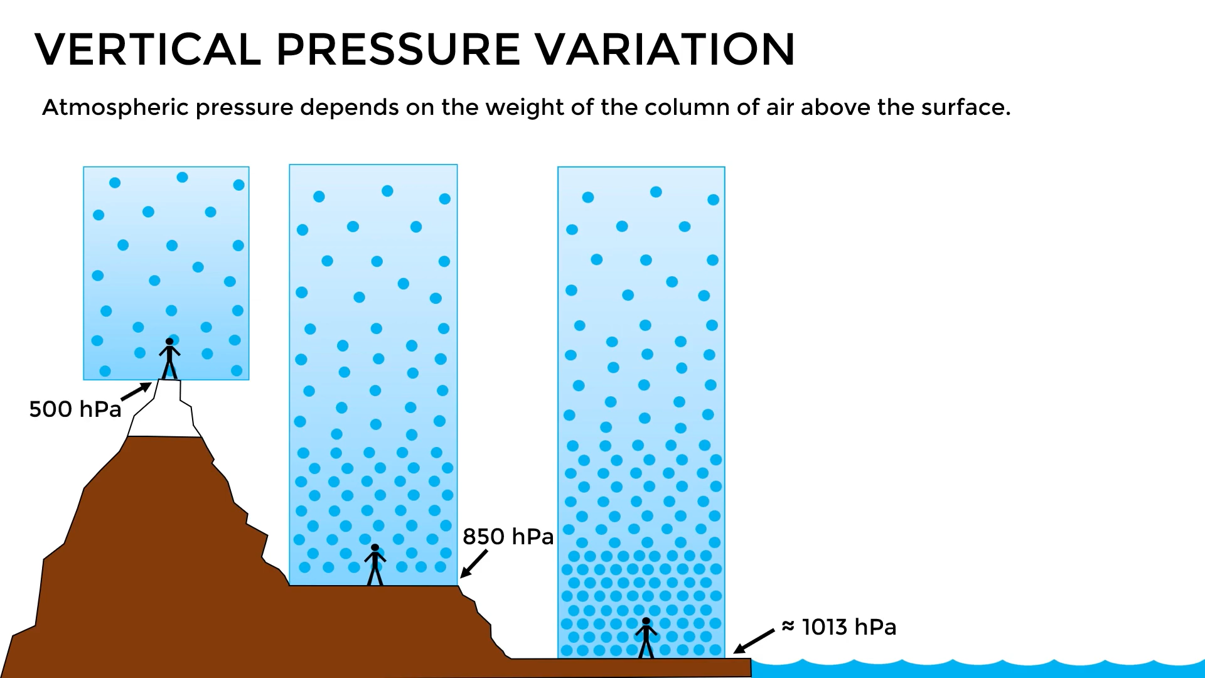
Vertical Pressure Variation
The atmospheric pressure depends on the weight of the column of air above the Surface
The atmospheric pressure decreases with altitude
01.
31

Slide 32
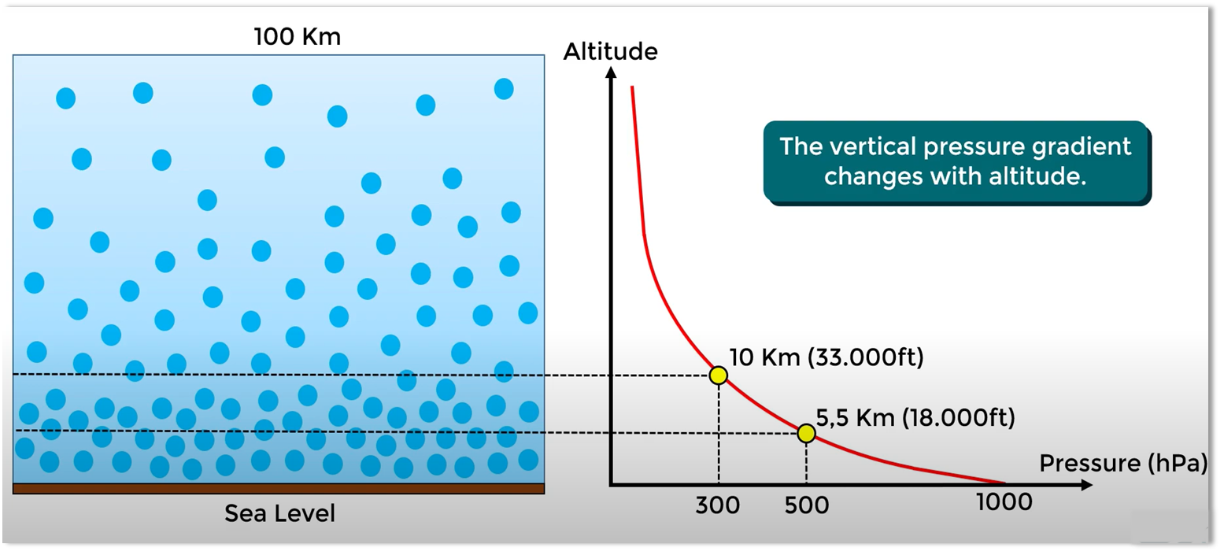
Pressure Rate
01.
32

Slide 33
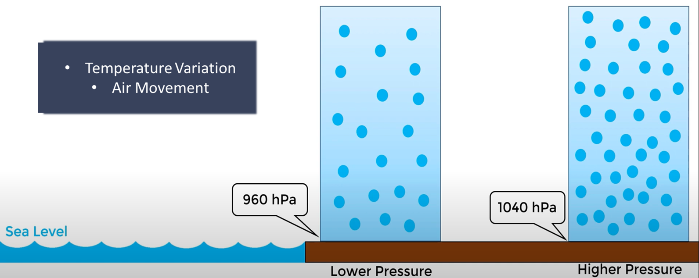
Horizon Pressure Variation
The Atmospheric pressure also varies from one place to another at same level horizontally due to :
Temperature Variation
Air Movement
01.
33

Slide 34
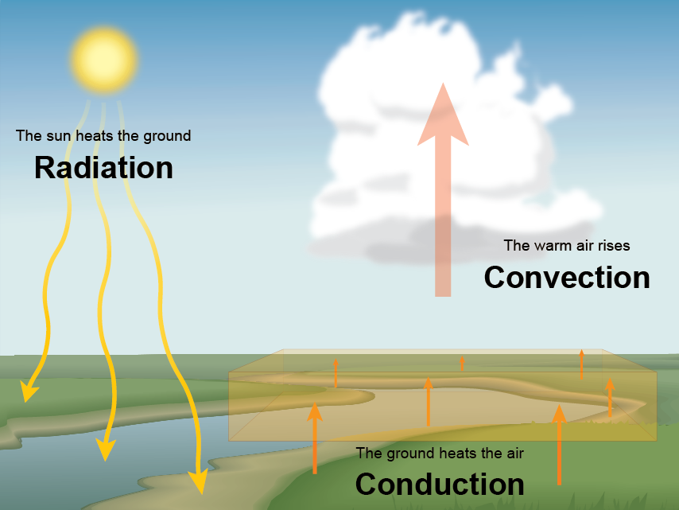
Temperature and Heat
Heat Transfer
01.
The Sun generates energy, which is transferred through space to the Earth's atmosphere and surface. Some of this energy warms the atmosphere and surface as heat. There are three ways energy is transferred into and through the atmosphere:
radiation
conduction
convection
34

Slide 35
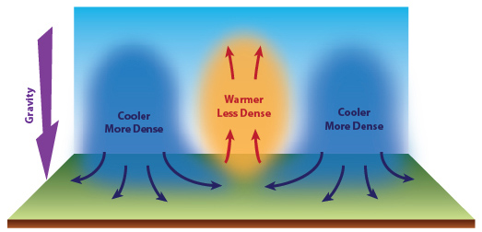
Temperature, Density and Pressure
It’s the Law: Density vs. Pressure (Boyle’s Low) (P ~ ρ)
01.
Temperature
Density
Pressure
H
As the air heated it become lighter and raises causes area of low pressure
35

Slide 36
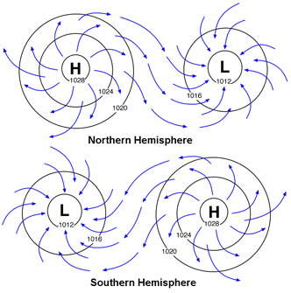
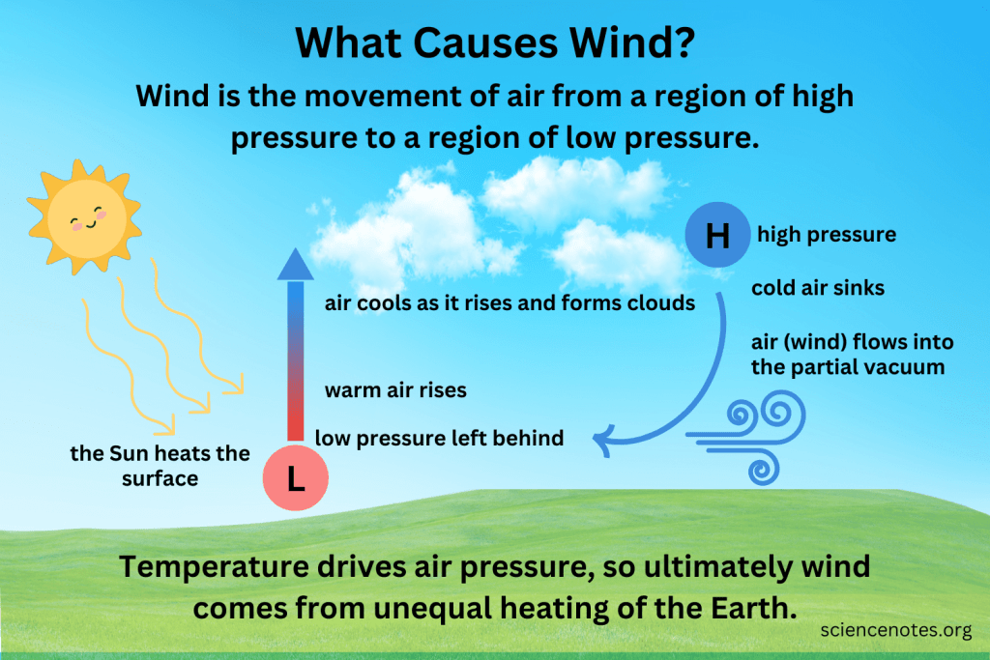
Wind
Wind: Is the movement of air from a region of high pressure to a region of low pressure
01.
36

Slide 37
Pressure, Wind and Weather
Means that the air molecules are close together and are putting a lot of pressure on earth’s surface
Means that the air molecules are NOT pushed together tightly and not a lot of pressure is being put on the surface of the earth
01.
High pressure brings clear skies and no precipitation.
Air moves down and clockwise
Low pressure brings wind, clouds and usually rainy weather for the area
Air moves up and counterclockwise
37

Slide 38
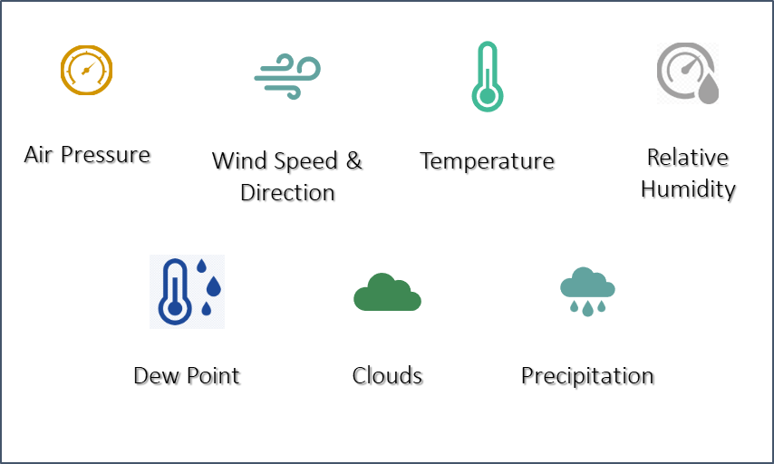
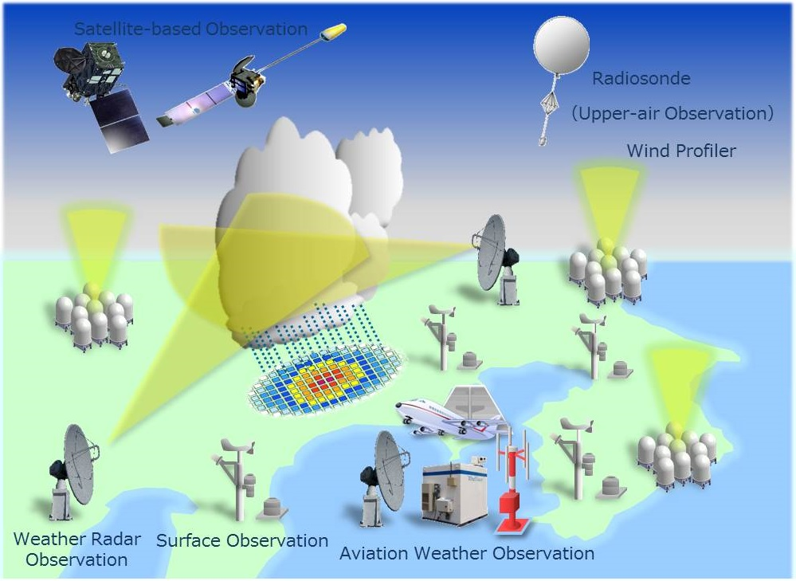
How the Air Parameters Measured?
WE CANNOT SEE THE AIR, SO WHAT CAN WE MEASURE?
01.
Atmospheric Parameters
Meteorological Observation Networks
38

Slide 39
Thanks
Directorate General of Meteorology

