Slide 1
EUMETSAT Data Services
Erdem ERDI
Data Services User Support Officer
(With contributions of Sally Wannop & Ben Loveday)
Notes:
Title slide template 1 of 2 with presentation title/information on the left. Please choose between slide 1 or 2 for the title slide and delete the other.

Slide 2
Agenda
Overview of Data Services
The new portfolio
EUMETCast
The push data services
Pull Data Services
EUMETView, Data Store, Data Tailor, EUMDAC
Conclusions

Slide 3
Overview of Data Services Portfolio
New data services
Existing services
PULL SERVICES
PUSH SERVICES
SHARED SERVICES
EUMETCast
Satellite
Data Centre
Viewing your data…
Improving data
access…
Customising your data…
Near-real time data delivery via terrestrial networks.
Hosted data processing…
CODA
WEkEO
WIS
EUMETSAT Data store
https://data.eumetsat.int/
EUMETView https://view.eumetsat.int/
Data Tailor
EUMETCast
Terrestrial
European Weather Cloud
Direct
Dissem.

Slide 4
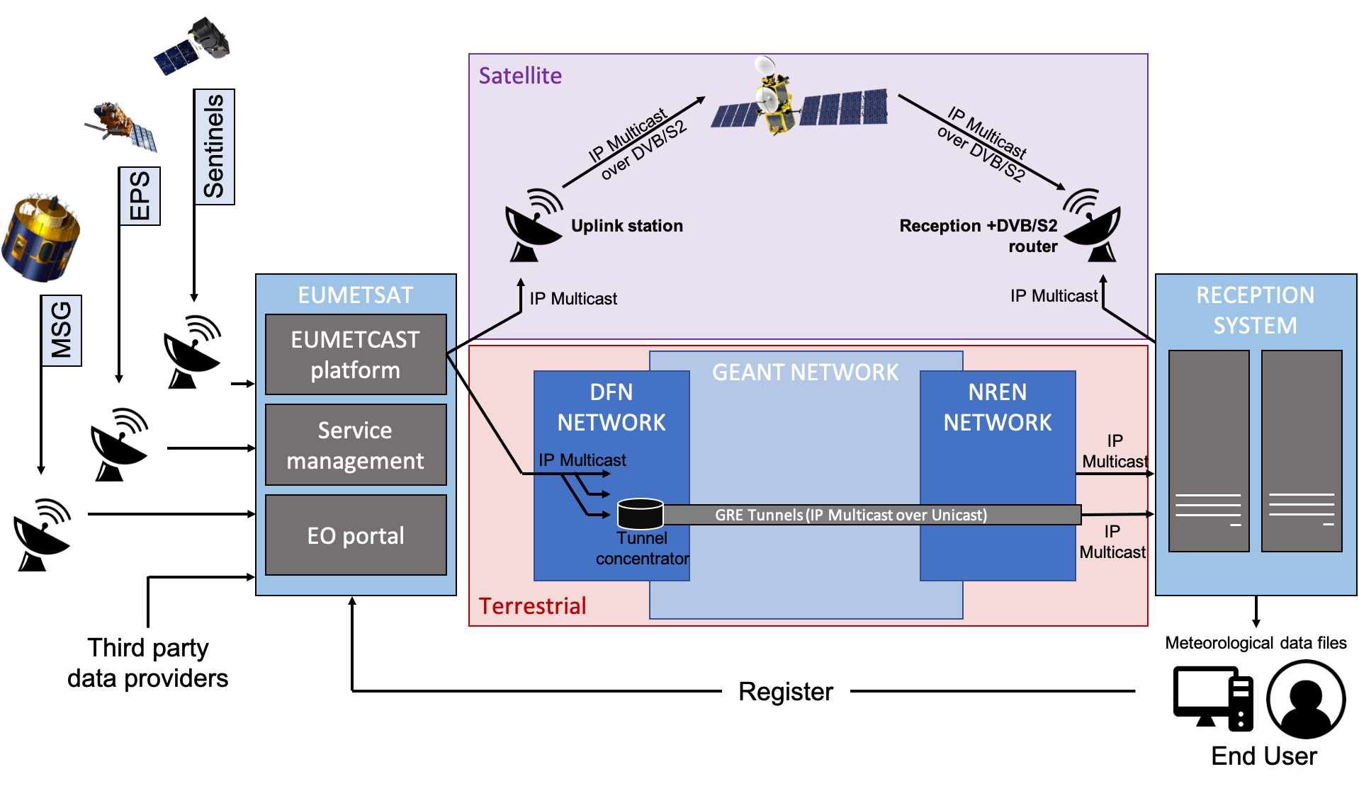
EUMETCast Satellite and Terrestrial

Slide 5
EUMETCast Satellite Users

Slide 6
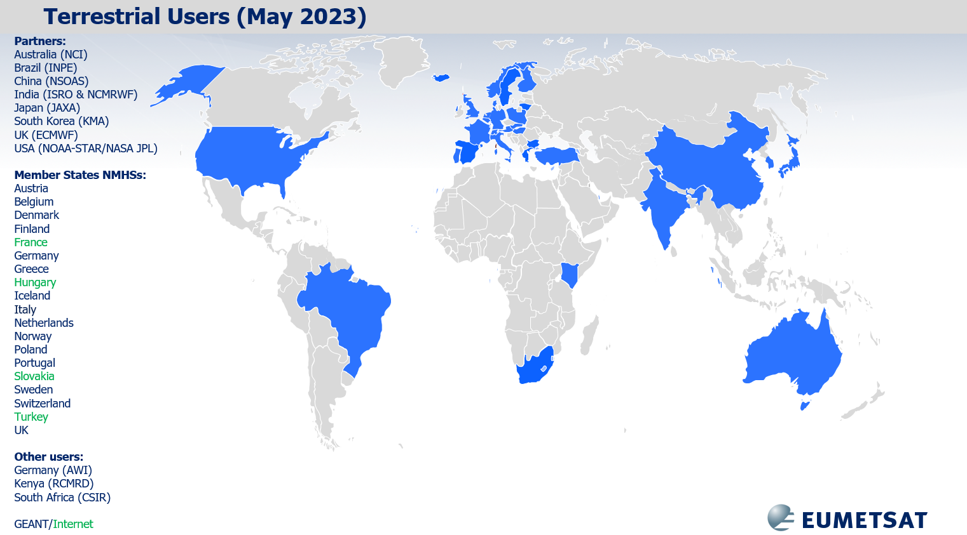
EUMETCast Terrestrial Users

Slide 7
EUMETView

Slide 8
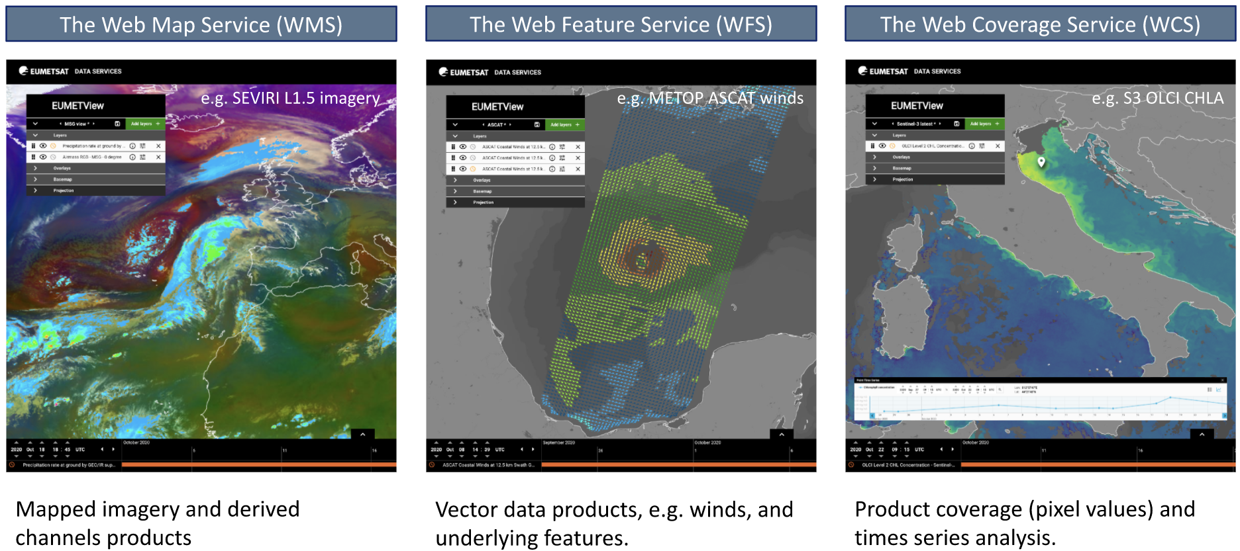
EUMETView

Slide 9
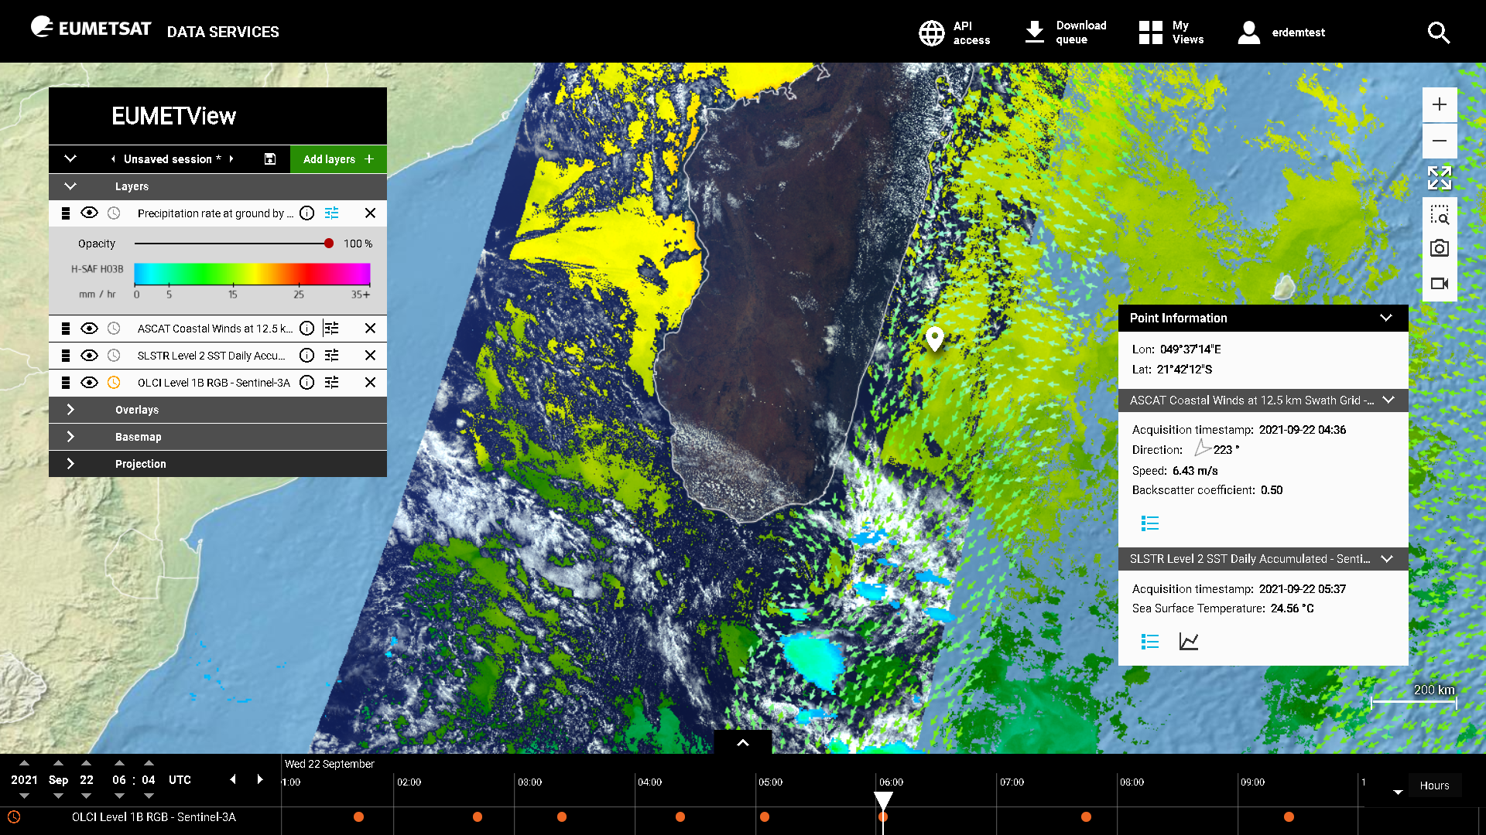
EUMETView

Slide 10
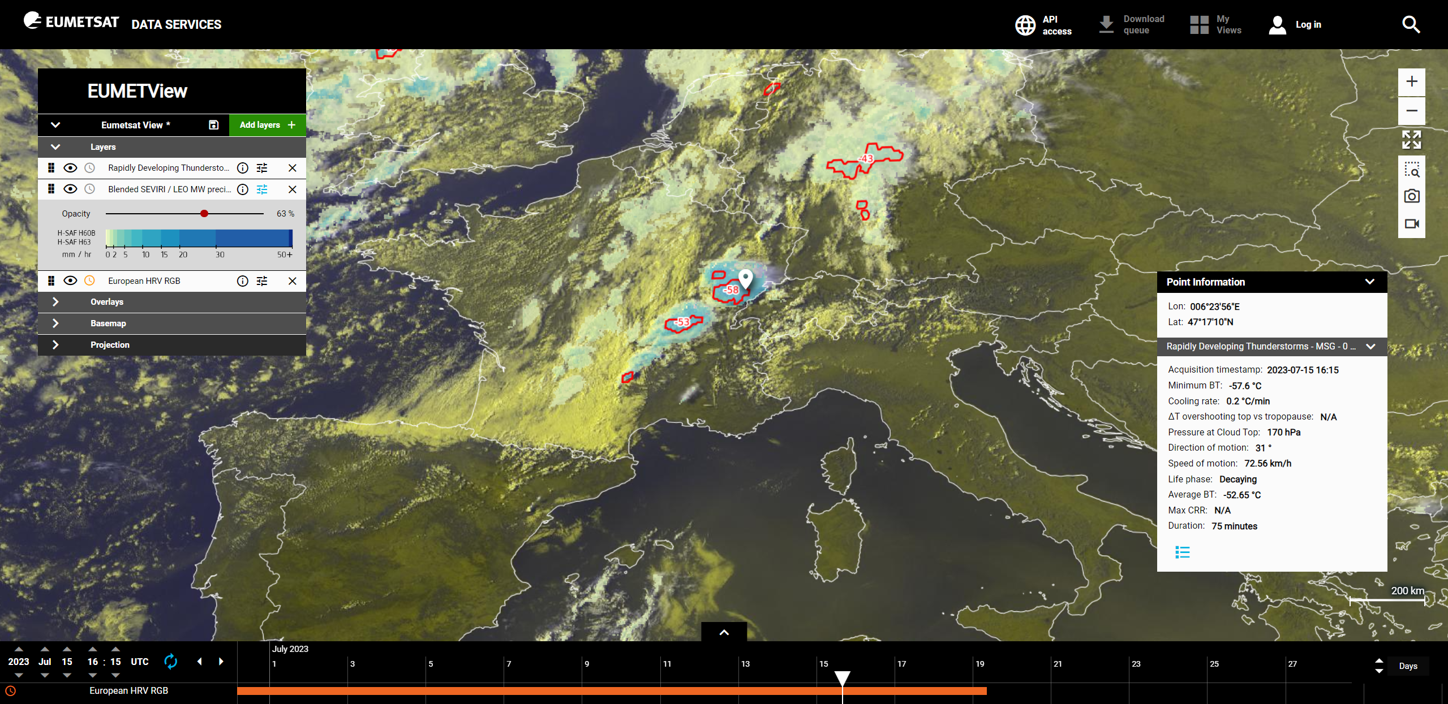
EUMETView

Slide 11
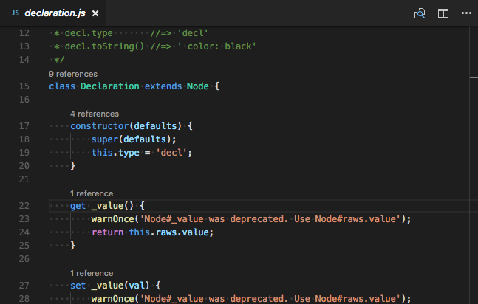
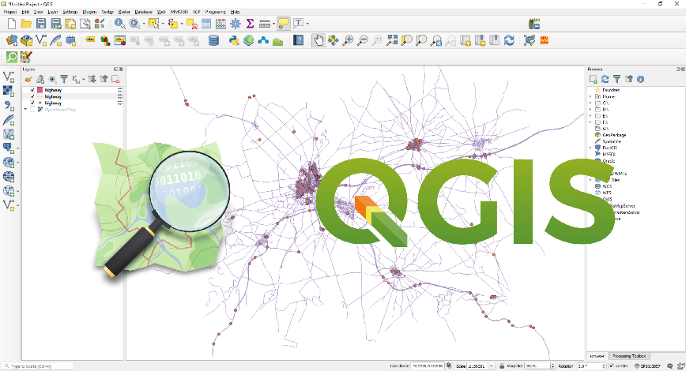
EUMETView
Automated access
to the imagery
and data
WMS, WFS and WCS
(OGC API)
Possibility for
further customized
downstream
use
Web Pages
(Javascript+HTML)
Python Scripts
Desktop GIS
Applications

Slide 12
Data Store

Slide 13
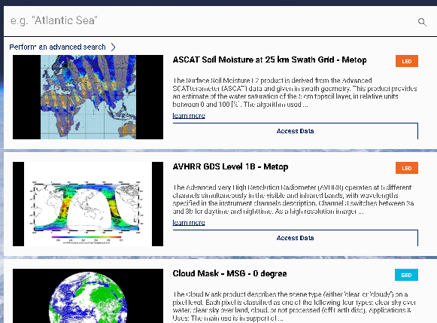
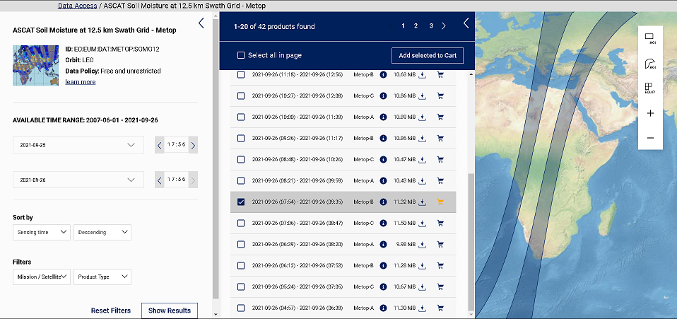
Data Store
Browse the catalogue of NRT, historic and CDR collections
Search data in a collection matching your date&time and ROI selection
Customize data by Data Tailor
Download the files
OR

Slide 14
Data Tailor

Slide 15
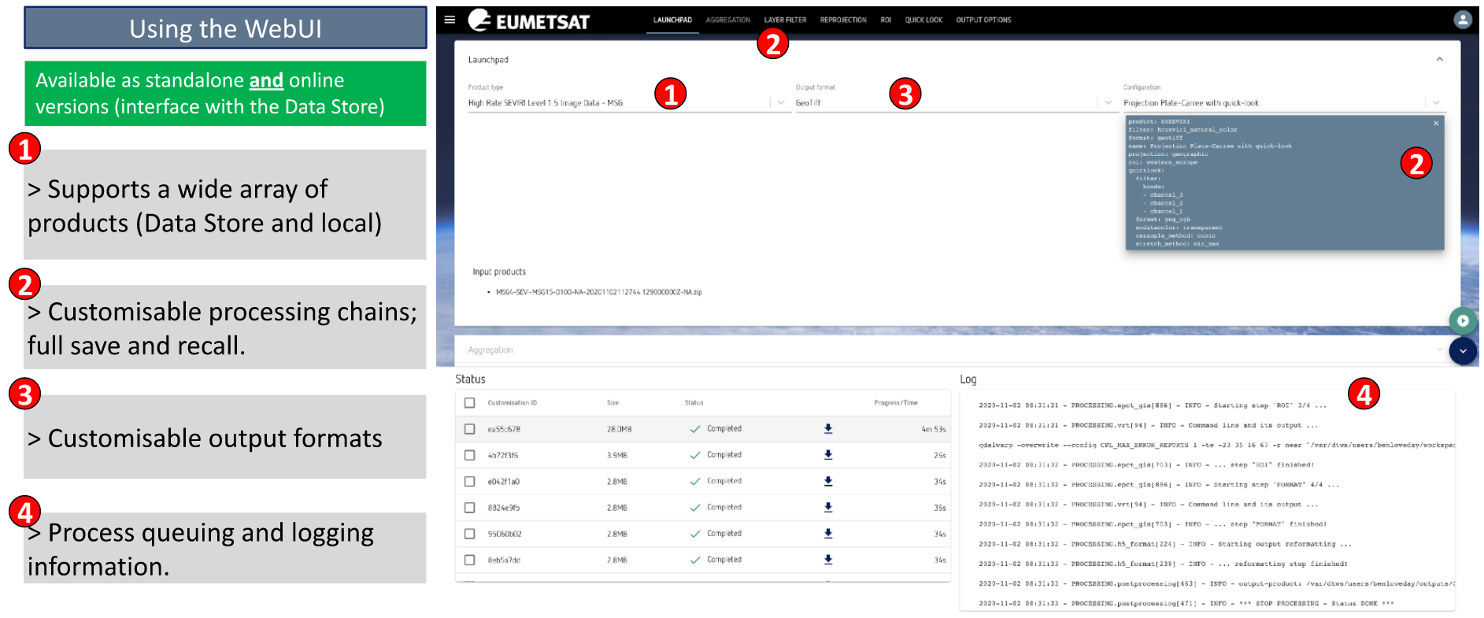
Data Tailor

Slide 16
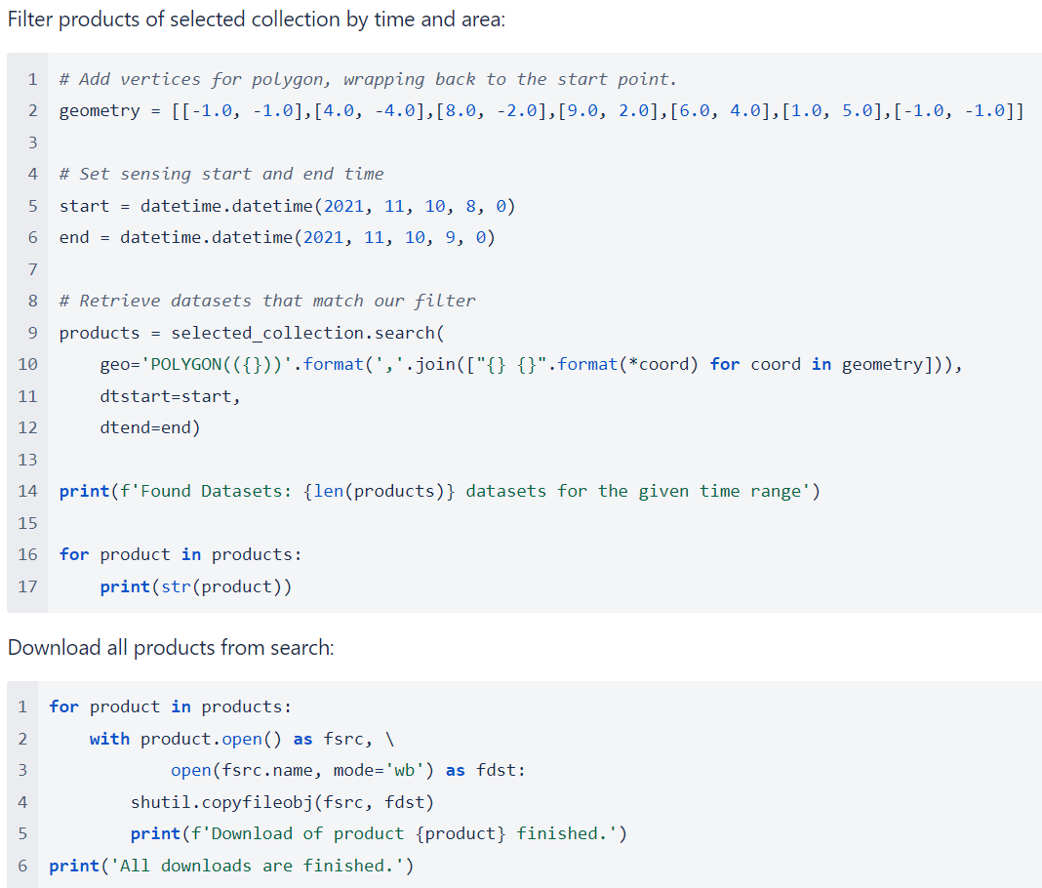
EUMDAC – Data Access Client
It provides simple access to the EUMETSAT data from a variety of satellite missions.
It is available as a python library and also as a stand-alone executable for Windows and Linux
Python library example
Just import eumdac
and start searching and downloading satellite data!

Slide 17
EUMDAC – Data Access Client
For stand-alone executable, there is no need to install anything. Just download the single executable file and start to search and download satellite data! (https://gitlab.eumetsat.int/eumetlab/data-services/eumdac)

Slide 18
Conclusions
More resources on the internet
EUMETSAT Knowledge Base : https://eumetsatspace.atlassian.net/wiki/spaces/EUM/overview
EUMETSAT Youtube Channel : https://www.youtube.com/channel/UCiN59j5b1fAGnXVzIYFpaMw
Feel free to give them a try
Different Data Services that are suitable for operational and research purposes
Helpdesk (ops@eumetsat.int) can be contacted for any question or inquiry.

Slide 19
Thank you!
Questions are welcome.

