Slide 1
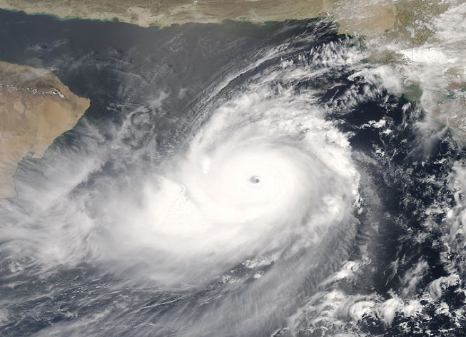
Synoptic Observations

Slide 2
Global Scale
Synoptic
Mesoscale
Microscale
Scale of Motion
Largest
Smallest

Slide 3
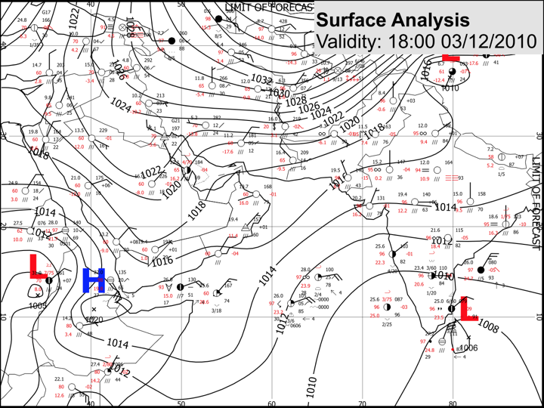

Slide 4
Past Weather
Visibility
Wind Speed
Temperature
Present Weather
Wind Direction
Cloud Cover
Pressure Trend
Precipitation
Barometric Pressure
Relative Humidity
Dew Point

Slide 5
Ship reports (Numbers)
Station Model (Model)

Slide 6
Ship Report / Ship Synoptic Code
Coded report of surface observation from a sea station

Slide 7
Examples of Ship Reports:
BBXX
BRAVO 20123 99252 10595 41494
81412 10285 20269 40100 53012 79586 8587/ 22265 00280 20405 31705 40506 50407=
BBXX
SHIP 24121 99122 71353 31475
82706 10252 20225 40061 55008 76062 83223 91312 22242 00234 20805 31215 40806 51005 62052 80122 ICE 23223

Slide 8
BBXX
BRAVO 20123 99252 10595 41494
81412 10285 20269 40100 53012 79586 8587/ 22265 00280 20405 31705 40506 50407=
Surface report from Coastal Station | AAXX
Surface report from Ship | BBXX
BBXX :
Identifier for Ship weather report

Slide 9
BBXX
BRAVO 20123 99252 10595 41494
81412 10285 20269 40100 53012 79586 8587/ 22265 00280 20405 31705 40506 50407=
BRAVO :
Call sign of the Ship

Slide 10
Code Figure | Iw indicator
0 | Wind Speed Estimated | m/s
1 | Wind Speed from anemometer | m/s
3 | Wind Speed Estimated | knots
4 | Wind Speed from anemometer | knots
BBXX
BRAVO 20123 99252 10595 41494
81412 10285 20269 40100 53012 79586 8587/ 22265 00280 20405 31705 40506 50407=
YYGGiw
20 12 3 :
20: Day of the month (20th)
12: Time of Obeservation in UTC (4 PM Local Time)
3: wind speed type / unit (table1)

Slide 11
BBXX
BRAVO 20123 99252 10595 41494
81412 10285 20269 40100 53012 79586 8587/ 22265 00280 20405 31705 40506 50407=
YYGGiw
20 12 3 :
20: Day of the month (20th)
12: Time of Obeservation in UTC (4 PM Local Time)
3: Wind Speed is estimated / knots

Slide 12
BBXX
BRAVO 20123 99252 10595 41494
81412 10285 20269 40100 53012 79586 8587/ 22265 00280 20405 31705 40506 50407=
99LaLaLa
99 252 :
99: Indicator for sea station position groups (Latitude)
252 : Degrees and tenth (25.2°)

Slide 13
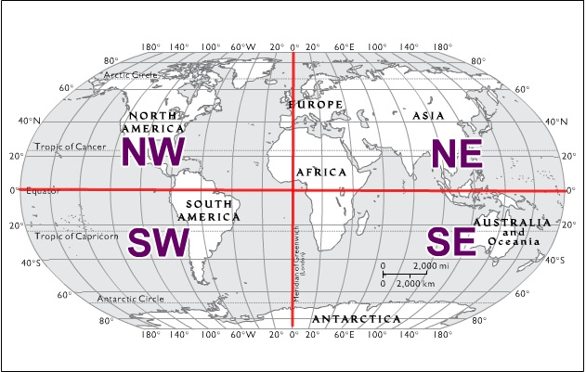
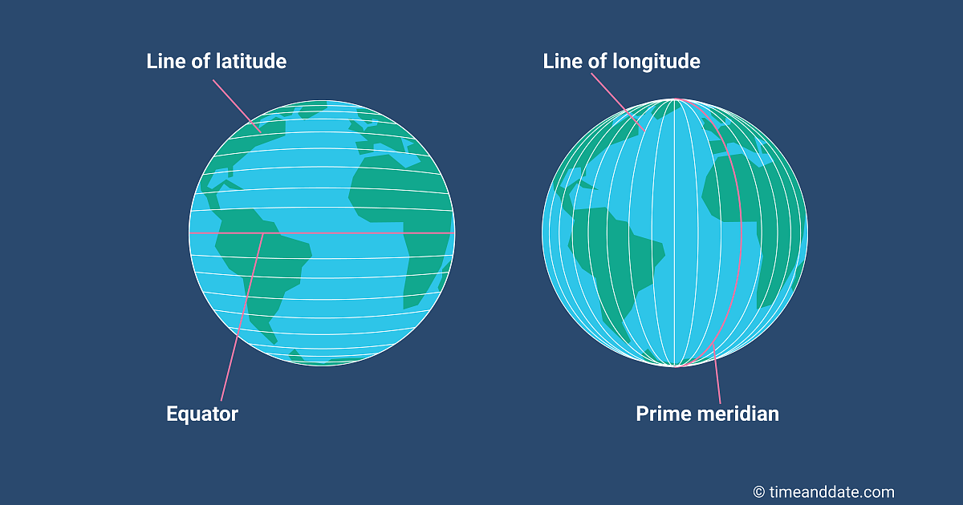
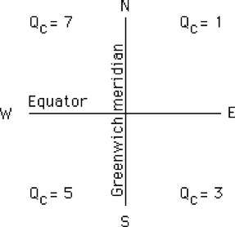
BBXX
BRAVO 20123 99252 10595 41494
81412 10285 20269 40100 53012 79586 8587/ 22265 00280 20405 31705 40506 50407=
QcLoLoLo
1 0595 :
1: Quadrant of the globe
0595: Longitude, Degrees and tenth (59.5°)

Slide 14
BBXX
BRAVO 20123 99252 10595 41494
81412 10285 20269 40100 53012 79586 8587/ 22265 00280 20405 31705 40506 50407=
Latitude:
25.2° N
Longitude:
59.5° E

Slide 15
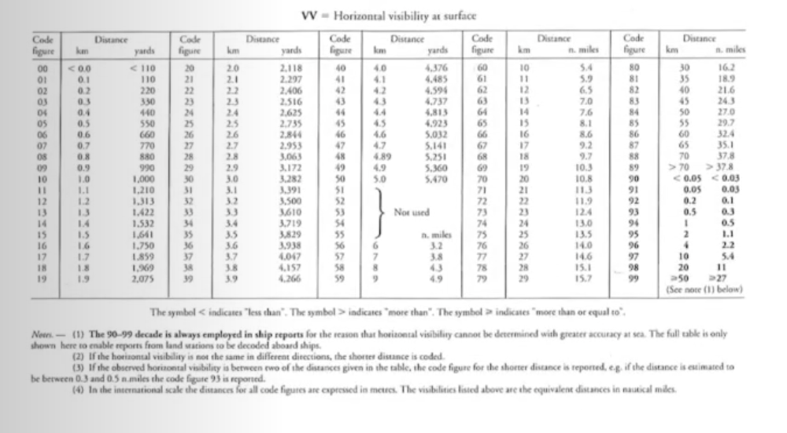
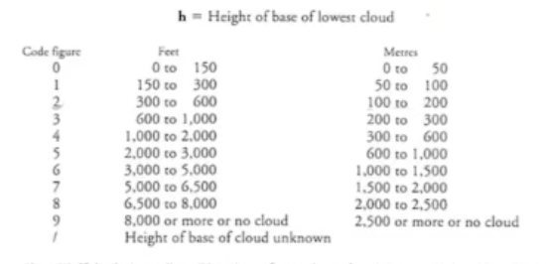
1 | Manned / Included
2 | Manned / Omitted / No Phenome
3 | Manned / Omitted / Not Available
4 | Auto / Included
5 | Auto / Omitted / No Phenome
6 | Auto / Omitted / Not Available
7 | Auto / Included
1 | Precipitation group Included
2 | Precipitation group Included
3 | Precipitation group No Precipitation
4 | Precipitation group Not available
BBXX
BRAVO 20123 99252 10595 41494
81412 10285 20269 40100 53012 79586 8597/ 22265 00280 20405 31705 40506 50407=
iRiXhVV
4 1 4 94 :
4 : Indicator figure for precipitation group (Table 3)
1 : Type of station and present and past weather indicator (Table 4)
4 : height of the base of the lowest cloud (Table5)
94 : horizontal visibility (Table6)
Not Available
Manned/Included
1000 to 2000 ft
1 km

Slide 16
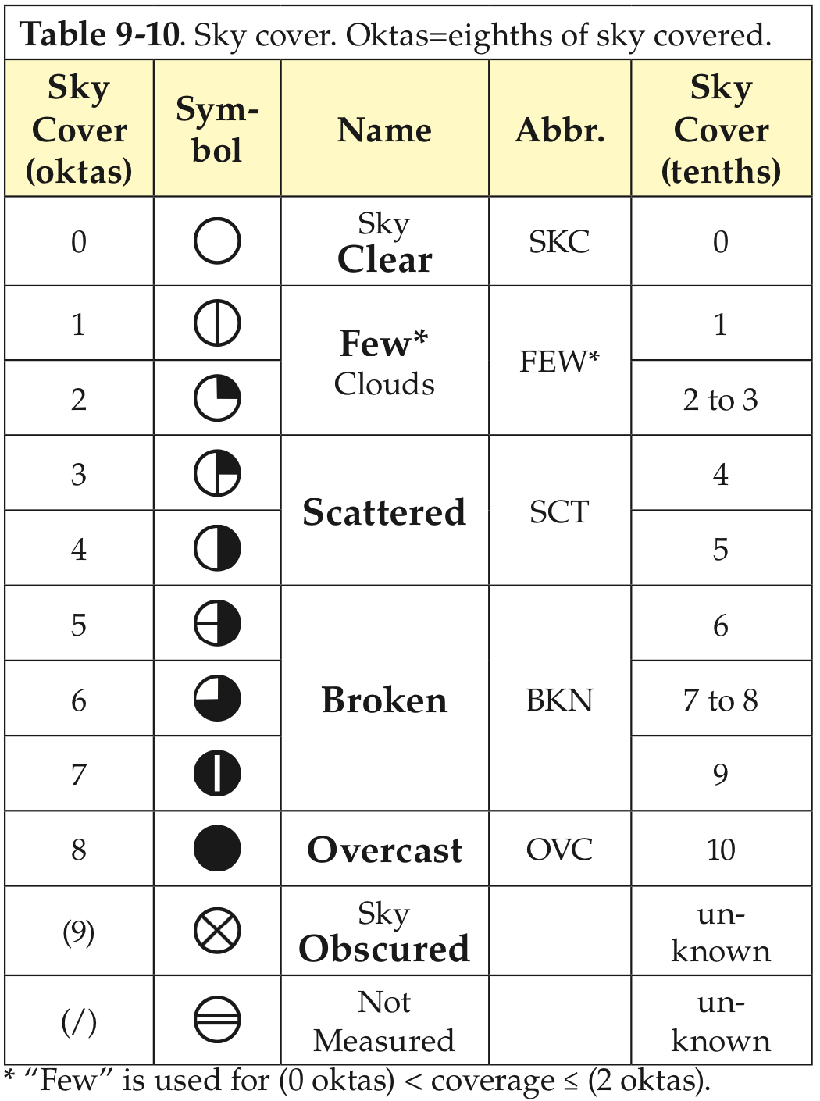
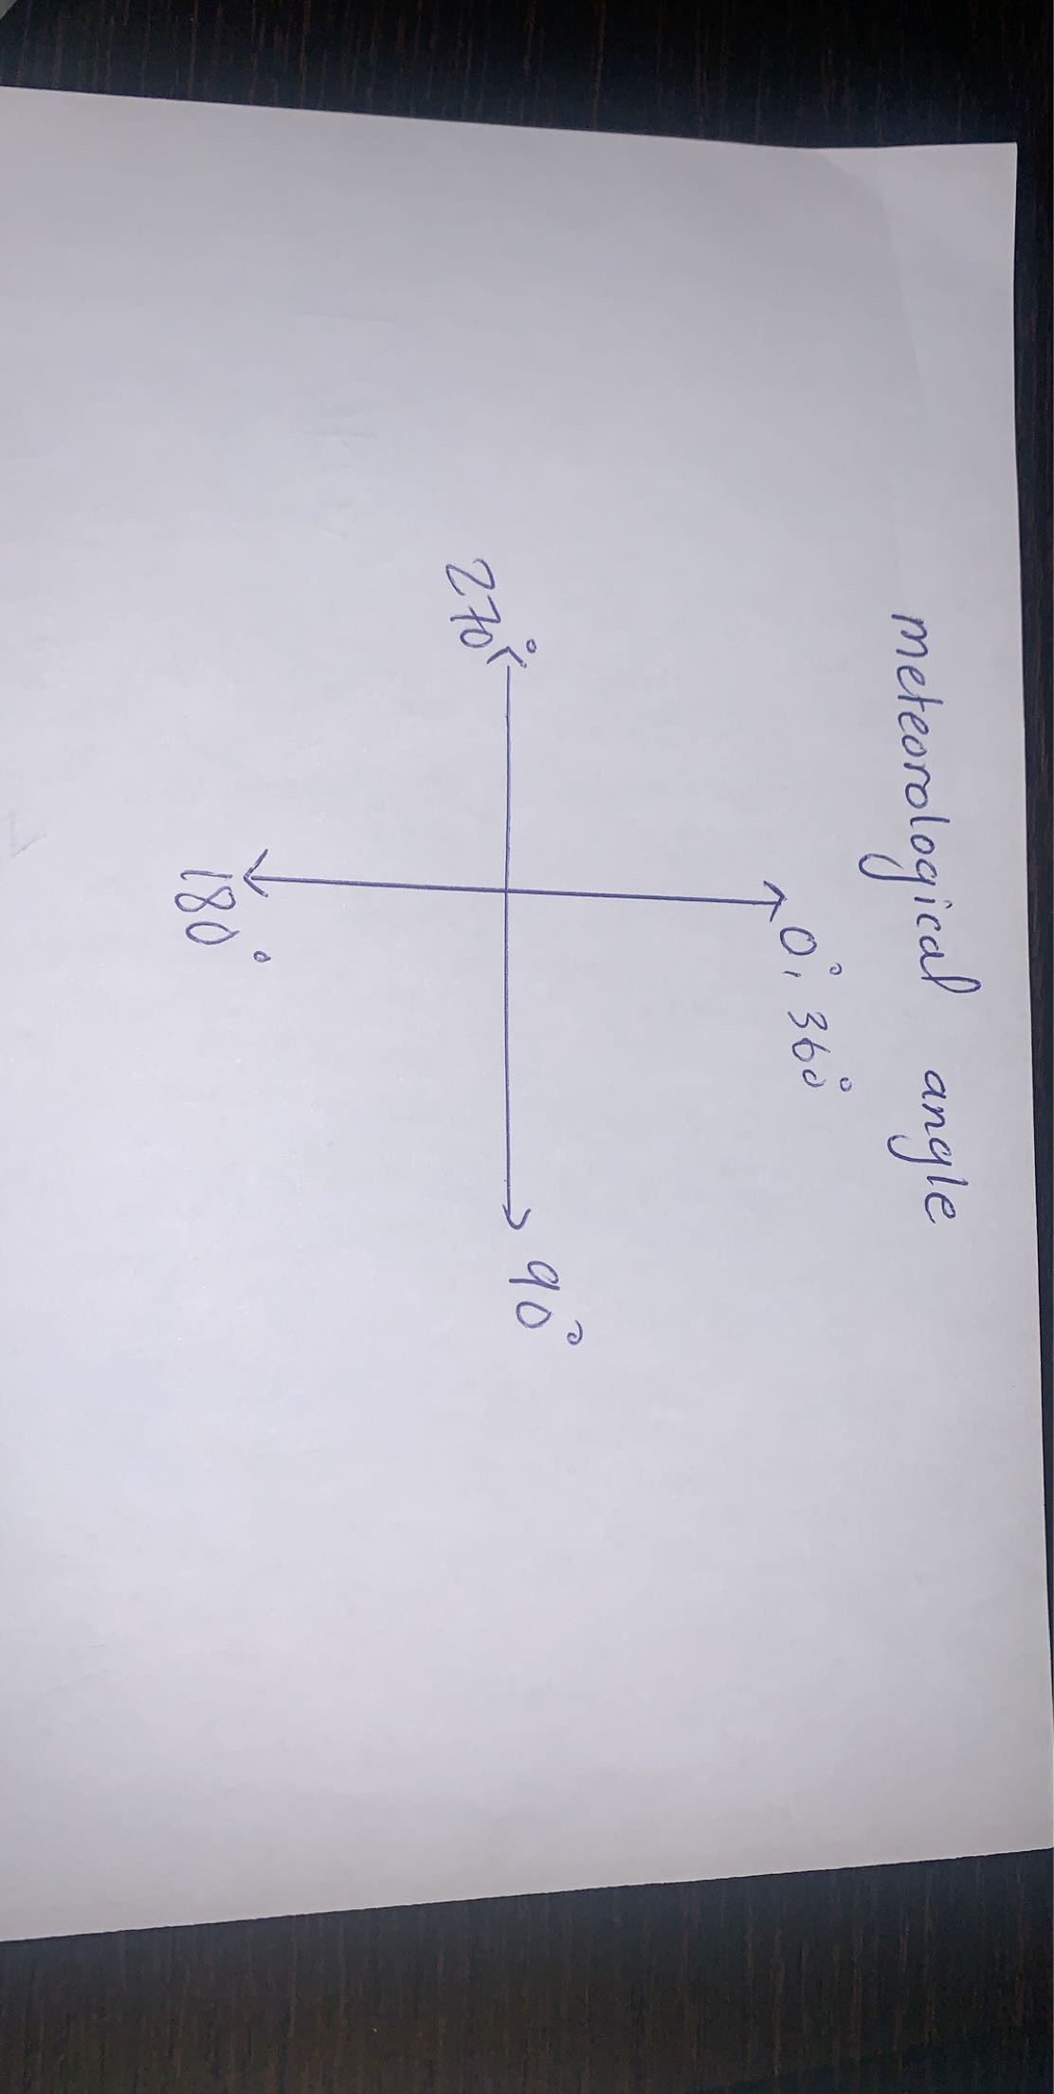
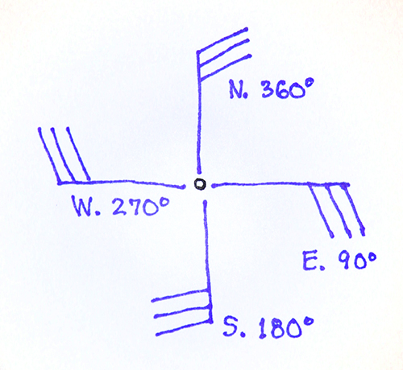
BBXX
BRAVO 20123 99252 10595 41494
81412 10285 20269 40100 53012 79586 8587/ 22265 00280 20405 31705 40506 50407=
Nddff
8 14 12:
8 : Total cloud amount (Table 7)
Overcast
14 : Wind Direction tenth of degrees
140°, SE
12: Wind Speed (12 knots)

Slide 17
BBXX
BRAVO 20123 99252 10595 41494
81412 10285 20269 40100 53012 79586 8587/ 22265 00280 20405 31705 40506 50407=
1snTTT
1 0 285:
1 : Group indicator for air temperature
0 : Temperature sign is + (if 1 Temperature sign is - )
285 : Air Temperature is 28.5 °C

Slide 18
BBXX
BRAVO 20123 99252 10595 41494
81412 10285 20269 40100 53012 79586 8587/ 22265 00280 20405 31705 40506 50407=
2snTdTdTd
2 0 269:
2 : Group indicator for Dew Point Temp
0 : Temperature sign is + (if 1 Temperature sign is - )
269 : Air Temperature is 26.9 °C

Slide 19
BBXX
BRAVO 20123 99252 10595 41494
81412 10285 20269 40100 53012 79586 8587/ 22265 00280 20405 31705 40506 50407=
4PPPP
4 0100:
4 : Group indicator for MSL Pressure
0100 : MSL Pressure of 1010.0 hPa

Slide 20
BBXX
BRAVO 20123 99252 10595 41494
81412 10285 20269 40100 53012 79586 8587/ 22265 00280 20405 31705 40506 50407=
5appp
5 3 012:
5 : Group indicator for Pressure change
3 : Code Identifier (Table 11)

Slide 21
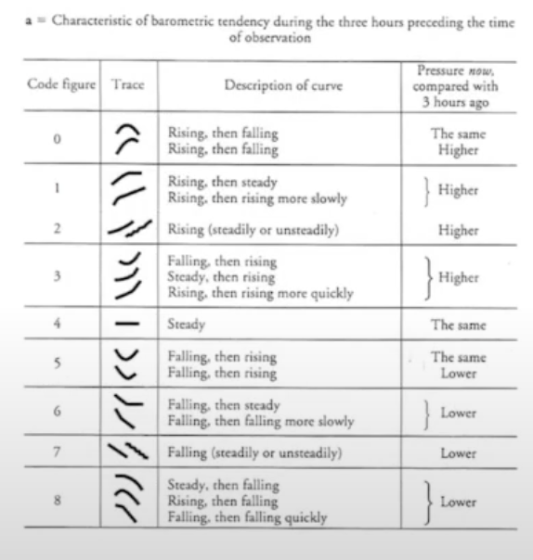
Table 11

Slide 22
BBXX
BRAVO 20123 99252 10595 41494
81412 10285 20269 40100 53012 79586 8587/ 22265 00280 20405 31705 40506 50407=
5appp
5 3 012:
5 : Group indicator for Pressure change
3 : Code Identifier (Table 11) (Pressure increasing)
012 : Pressure change of 0.12 hPa in the last three hours

Slide 23
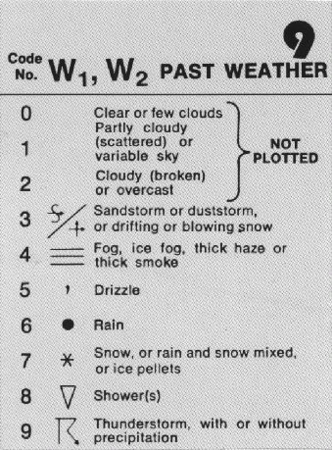
BBXX
BRAVO 20123 99252 10595 41494
81412 10285 20269 40100 53012 79586 8587/ 22265 00280 20405 31705 40506 50407=
7wwW1W2
7 95 86:
7 : Weather Type Indicator
95 : Current weather
Thunderstorm and drizzle
86 : Past weather
Shower and Rain

Slide 24
BBXX
BRAVO 20123 99252 10595 41494
81412 10285 20269 40100 53012 79586 8587/ 22265 00280 20405 31705 40506 50407=
8NhOrCLCMCH
8 : Cloud Indicator
8587/:
5 : Amount of Low or medium Cloud 5/8
8 : low cloud type (Table 14)
7 : medium cloud type (Table 15)
/ : High cloud type (Table 16)

Slide 25
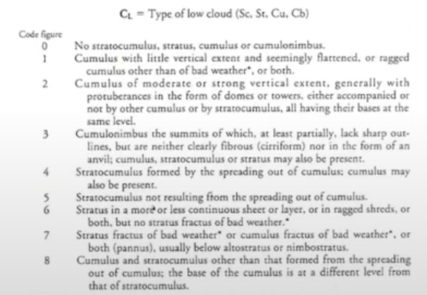
Table 14

Slide 26
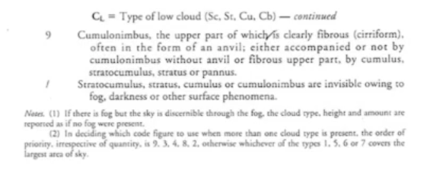
Table 14 conti.

Slide 27
BBXX
BRAVO 20123 99252 10595 41494
81412 10285 20269 40100 53012 79586 8587/ 22265 00280 20405 31705 40506 50407=
8NhOrCLCMCH
8587/:
8 : Cloud Indicator
Cumulus and Stratocumulus
5 : Amount of Low or medium Cloud 5/8
8 : low cloud type (Table 14)
7 : medium cloud type (Table 15)
/ : High cloud type (Table 16)

Slide 28
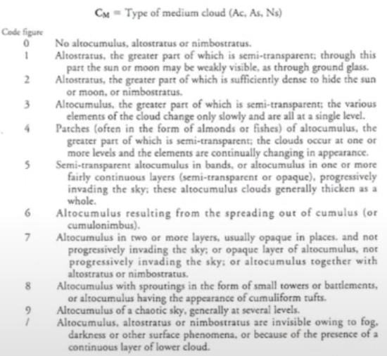
Table 15

Slide 29
BBXX
BRAVO 20123 99252 10595 41494
81412 10285 20269 40100 53012 79586 8597/ 22265 00280 20405 31705 40506 50407=
8NhOrCLCMCH
8597/:
8 : Cloud Indicator
5 : Amount of Low or medium Cloud 5/8
9 : cumulonimbus
7 : Altocumulus
/ : High clouds type (Table 16)

Slide 30
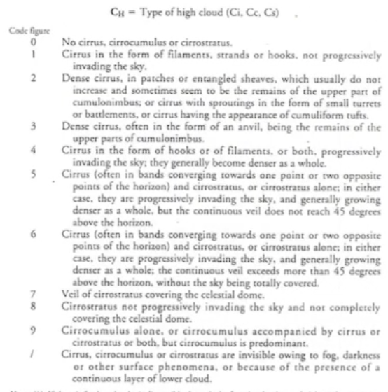
Table 16

Slide 31
BBXX
BRAVO 20123 99252 10595 41494
81412 10285 20269 40100 53012 79586 8597/ 22265 00280 20405 31705 40506 50407=
8NhOrCLCMCH
8597/:
8 : Cloud Indicator
5 : Amount of Low or medium Cloud 5/8
9 : cumulonimbus
7 : Altocumulus
/ : invisible

Slide 32
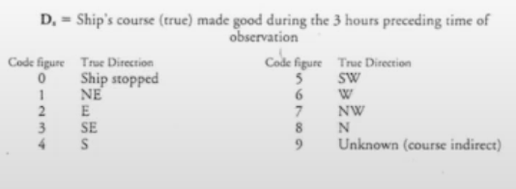
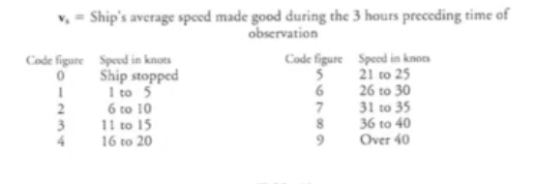
BBXX
BRAVO 20123 99252 10595 41494
81412 10285 20269 40100 53012 79586 8597/ 22265 00280 20405 31705 40506 50407=
222DsVs
222 6 5:
222 : Section indicator of maritime data
6 : Direction where the ship is moving
Ship is moving West in the last 3 hours
5 : Ship average speed last 3 hours
21 to 25 knots

Slide 33
BBXX
BRAVO 20123 99252 10595 41494
81412 10285 20269 40100 53012 79586 8597/ 22265 00280 20405 31705 40506 50407=
OSsTwTwTw
0 0 280:
0 : group indicator of SST
0 : Temperature sign is + (if 1 Temperature sign is - )
280 : SST is 28.0 °C

Slide 34
BBXX
BRAVO 20123 99252 10595 41494
81412 10285 20269 40100 53012 79586 8597/ 22265 00280 20405 31705 40506 50407=
2PwPwHwHw
20405:
2 : group indicator for wind waves
04 : Period of wind wave (4 seconds)
05 : Height of wind wave in units of half meters
(2.5 m/s)

Slide 35
BBXX
BRAVO 20123 99252 10595 41494
81412 10285 20269 40100 53012 79586 8597/ 22265 00280 20405 31705 40506 50407=
3dwdw1//
31705:
3 : group indicator for swell direction
17 : Direction of first Swell
170° , SE
05 : Direction of Second Swell
50° , NE

Slide 36
BBXX
BRAVO 20123 99252 10595 41494
81412 10285 20269 40100 53012 79586 8597/ 22265 00280 20405 31705
40506 50407=
4Pw1Pw1Hw1Hw1
40506:
4 : indicator for period and height of first swell group.
05 : period of first swell (05 sec).
06 : height of first swell in unit of half meter. (06 X 0.5=3 m)

Slide 37
BBXX
BRAVO 20123 99252 10595 41494
81412 10285 20269 40100 53012 79586 8597/ 22265 00280 20405 31705
40506 50407=
5Pw2Pw2Hw2Hw2
5 04 07:
5 : indicator for period and height of nd swell group.
04 : period of second swell (04 sec)
07 : height of second swell in unit of half meter
(07 X 0.5=3.5 meters)

Slide 38
METAR

Slide 39
METAR OOMS 172250Z 22003KT 190V250 CAVOK 24/14 Q1009 NOSIG
OOMS: Muscat International Airport
172250Z :
17 : date of the month
2250Z: Time of observation 22:50 UTC

Slide 40
METAR OOMS 172250Z 22003KT 190V250 CAVOK 24/14 Q1009 NOSIG
22003KT
220: Wind Direction
03KT: Wind speed is 3 knots
190V250
Wind Direction is varying from 190° to 250°

Slide 41
METAR OOMS 172250Z 22003KT 190V250 CAVOK 24/14 Q1009 NOSIG
CAVOK : Clouds and Visibility is OK
* Visibility is 10km or more.
* no cloud below 5000 feet
* No significant weather at or in the vicinity of the aerodrome.

Slide 42
METAR OOMS 172250Z 22003KT 190V250 CAVOK 24/14 Q1009 NOSIG
24 : Temperature
14 : Dew point

Slide 43
METAR OOMS 172250Z 22003KT 190V250 CAVOK 24/14 Q1009 NOSIG
Q1009 : Pressure 1009 mb
NOSIG: No significant change expected

Slide 44
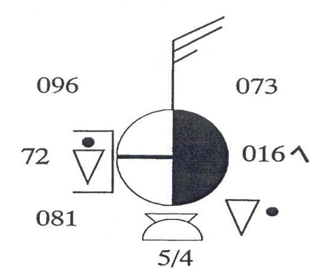
Station Plot
Station Model

Slide 45
Station Model / Surface Plot
Simple symbols to display large amounts of meteorological information in a small area.

Slide 46
Synoptic Observations:
Upper Air Observations
Surface
850 mb
700 mb
500 mb
300 mb

Slide 48
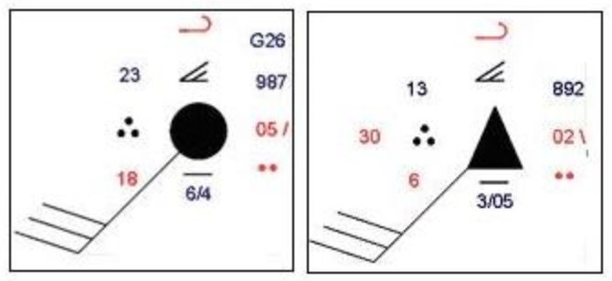
Manual Observation
Automatic Observation

Slide 49
23
871
55
18
25
8/4
10603
090703
Notes:
time between successive occurrences of the same state

Slide 50
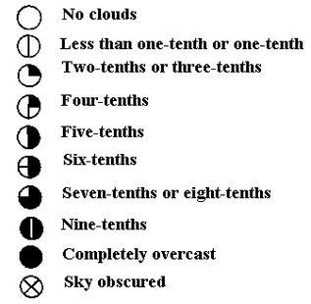
Cloud Cover
Overcast

Slide 51
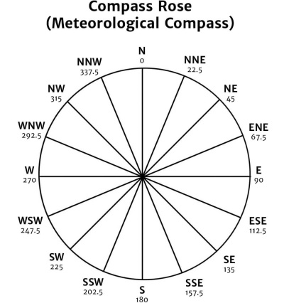
From
Wind Direction
North West

Slide 52
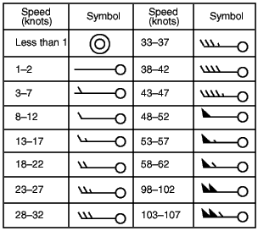
Wind Speed
18-22 Knots
9-11 m/s

Slide 53
Air Temperature
23 °C
23

Slide 54
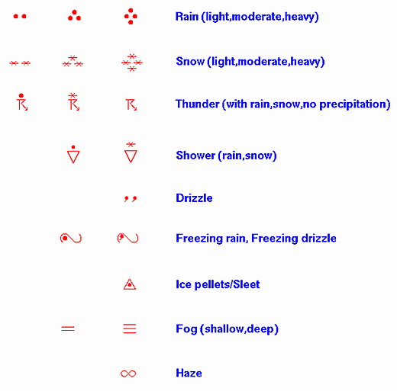
Current Weather
Moderate Rain
23
Notes:
Rain-cloud cover

Slide 55
Visibility
6 km
In either meters or kilometres
Visibilities below five kilometres are recorded to the nearest 100 metres
Visibilities above five kilometres are given to the nearest kilometre
23
56
(0-50)--------(0.0-5.0 km)
(56-80)------(06-30 km)
(81-88)------(35-70 km)

Slide 56
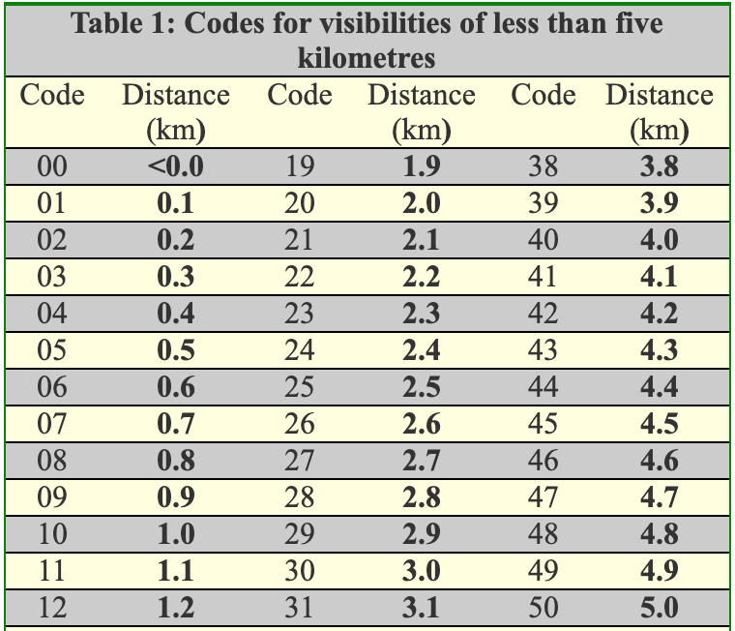
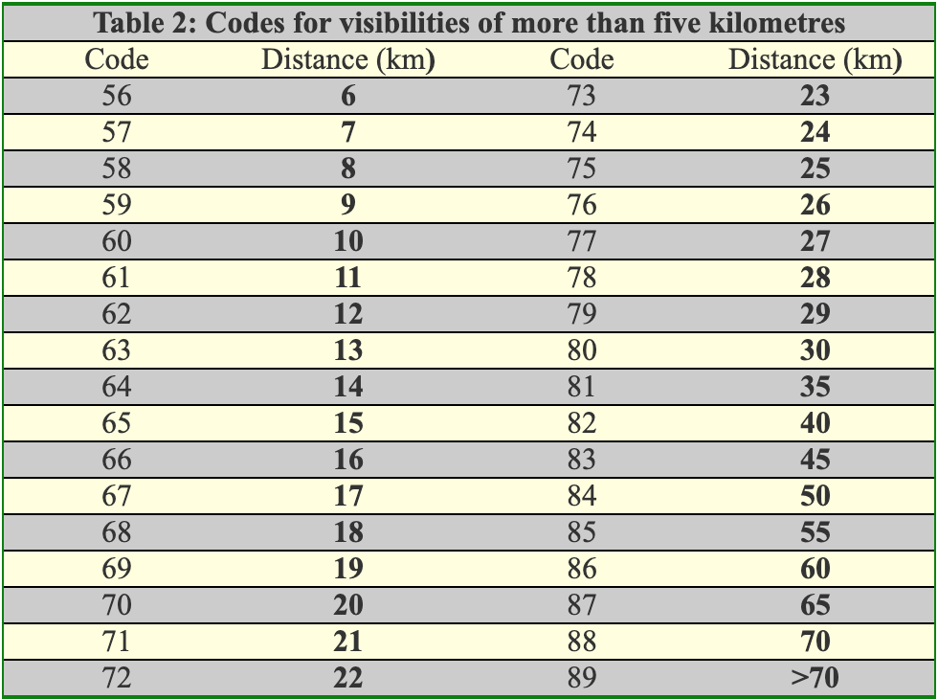

Slide 57
Dew Point
18 °C
23
56
18

Slide 58
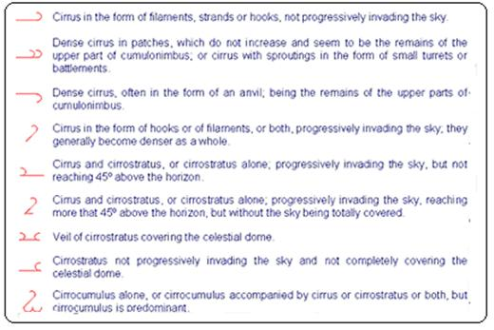
High Cloud Type
23
56
18

Slide 59
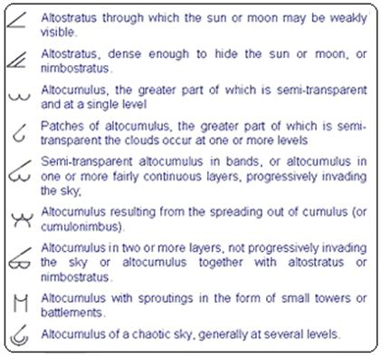
Medium Cloud Type
23
56
18

Slide 60
Low Cloud Type
23
56
18

Slide 61
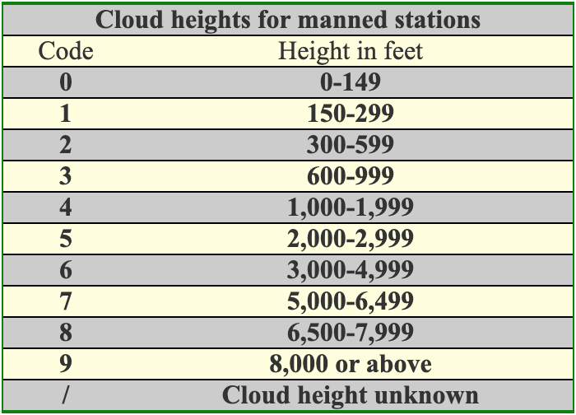
Low Cloud Cover/ Hight
23
56
18
8/4

Slide 62
Pressure
987.1 mb
Pressure is recorded in millibars and tenths and the last three digits are plotted
23
871
56
(0-4)-------- Add 10 and point
(5-9)------ Add 9 and point
18
8/4

Slide 63
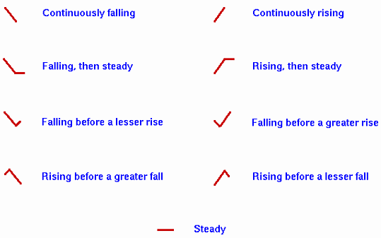
Pressure Tendency
23
871
56
18
8/4

Slide 64
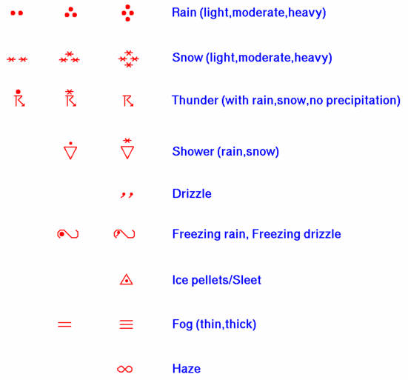
Past Weather
Or Cloud Cover
23
871
56
18
8/4

Slide 65
Sea Surface Temperature
25 °C
23
871
56
18
25
8/4

Slide 66
Wave Information
1: Group Identifier (Bouey)
06: Wave Period 6 Seconds
03: Wave Height 3 Half meters
2: Group Identifier (Ship)
23
871
56
18
25
8/4
10603

Slide 67
Swell Information
09: Swell Direction (From 90°)
07: Swell Period 7 Seconds
03: Swell Height 3 Half meters
23
871
56
18
25
8/4
10603
090703
Notes:
time between successive occurrences of the same state

Slide 68
23
871
56
18
25
8/4
10603
090703
Notes:
time between successive occurrences of the same state

Slide 69
Thank You
Got questions?

