Slide 1
Training for Tropical Cyclones Weighting Functions
Scott Lindstrom, UW-Madison
Cooperative Institute for Meteorological Satellite Studies
( )
Where does Water Vapor information come from?
Plus a teaser on Sounder Data
19 November 2023

Slide 2
Summary of Weighting Functions
Important Information: From what level is the satellite likely sensing information? (Note: if it’s cloudy, then the information is the cloud top!)
3 Water Vapor bands on GOES-R type satellites have different Weighting function peaks. (Same for the 2 on MTG)
Conclusion: water vapor gives three-dimensional view of atmosphere
Use this information to confirm what you assume about the different bands.

Slide 3
The CIMSS Weighting Function Site
https://cimss.ssec.wisc.edu/goes-wf
First Step: Click on ‘Plot Viewer’
Note there are other clickable links

Slide 4
After clicking viewer!
There are three different drop-down menus present
Currently, viewing GOES-17 (that’s a Band 13 image)
Points that are clickable include temperature/moisture profiles from the GFS on a 5-degree lat/lon Grid
A Day/Time (0000 or 1200 is also selectable
Red dots indicate where you can get information – by clicking on the red dot

Slide 5
Three different drop-down menus
When you click on ‘GFS Model’ – you see the 5x5 array of points over the given domain
(Full Disk GOES-17 here, 2022-14Feb, 1200 UTC
If you were to click on RAOB – you’d see clickable red points at each RAOB within the field of view

Slide 6
Three different drop-down menus
If you click on a particular satellite, the view will change to be the full disk viewed by that satellite. You have 3 choices at present
GOES-16
GOES-18 (which replaced GOES-17 this year)
Himawari-09
So this is really just theoretical for Oman – as there aren’t radiosondes or vertical profiles from model data from which to compute weighting functions over Arabia

Slide 7
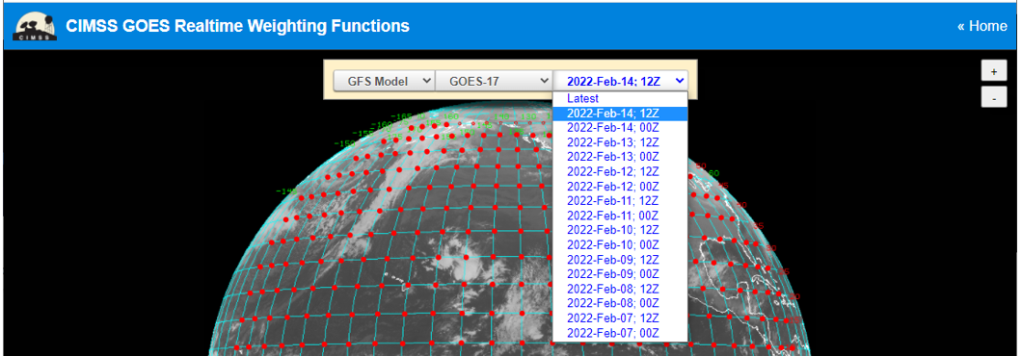
Three different drop-down menus
Click on the time – you can go back about a week. Only 0000 UTC and 1200 UTC imagery is available

Slide 8
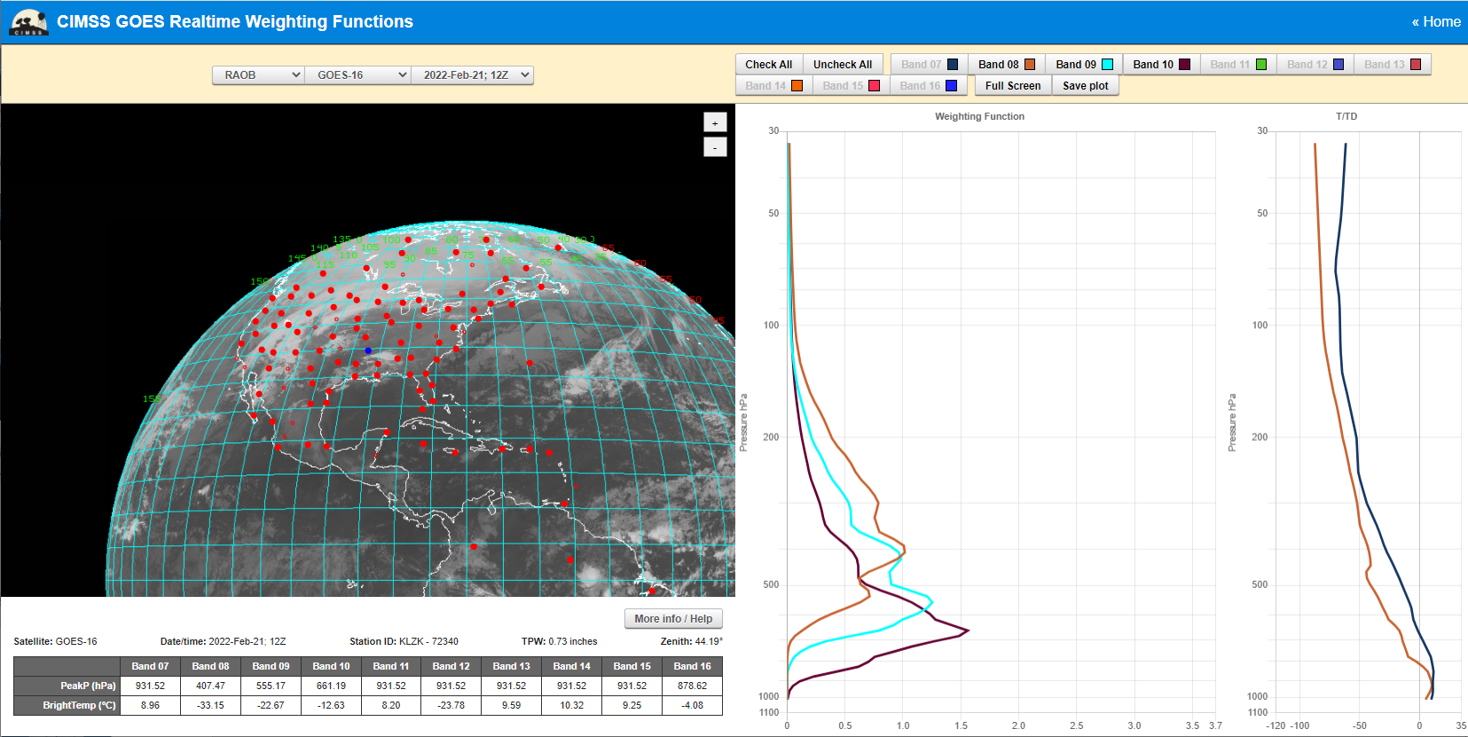
Example: Little Rock

Slide 9
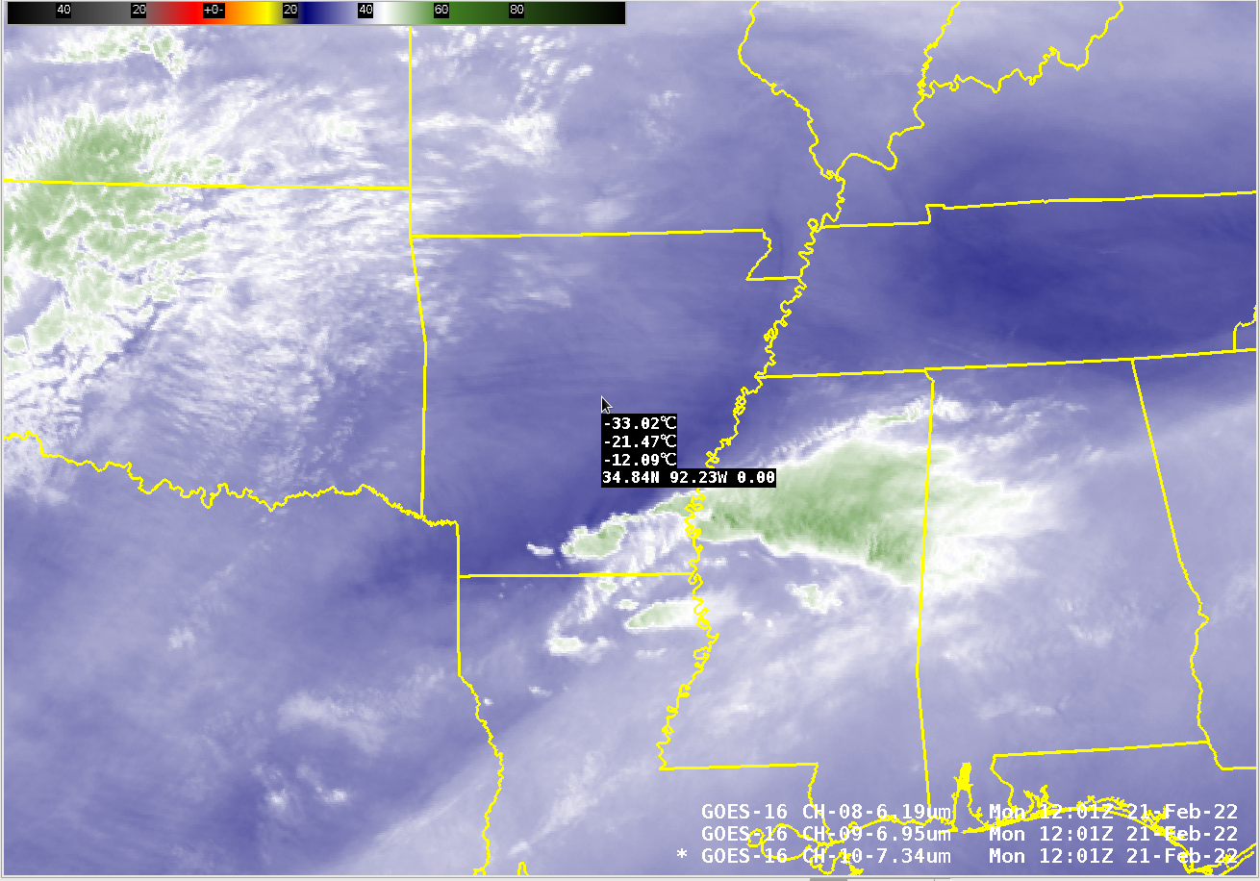
Example

Slide 10
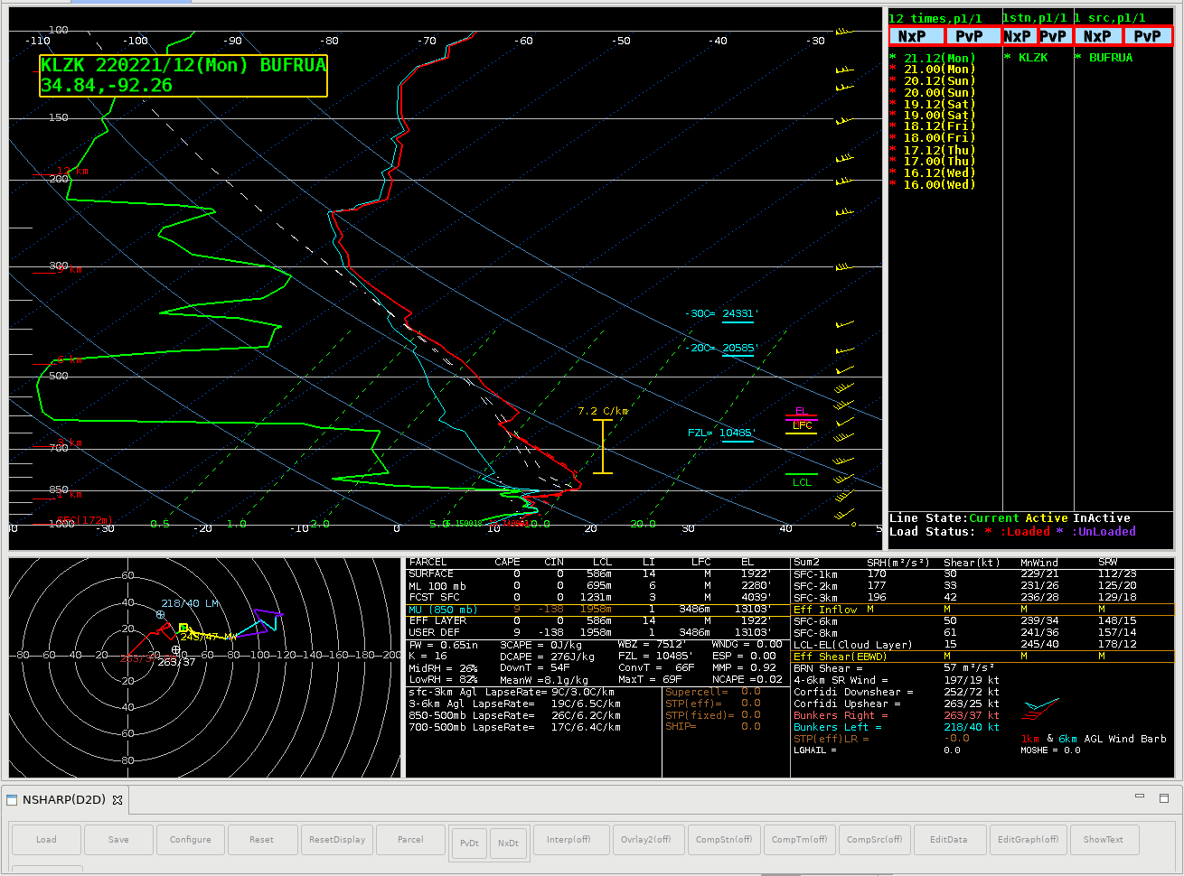
Example
407 mb: -27.3 C
555 mb: -16.5 C
661 mb: -1.9 C
-33.15: 360 mb
-22.67: 437 mb
-12.6: 521 mb
Why are the weighting function values colder than the sounding values?
Energy leaving that level of the sounding is moving up through the atmosphere where it is absorbed by water vapor and re-emitted from higher colder temperatures

Slide 11
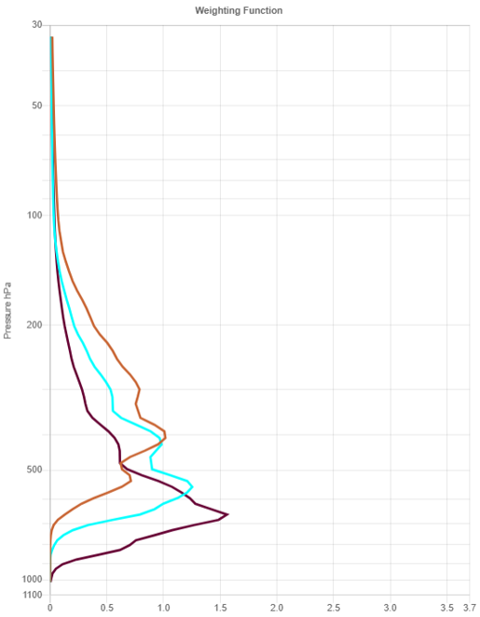
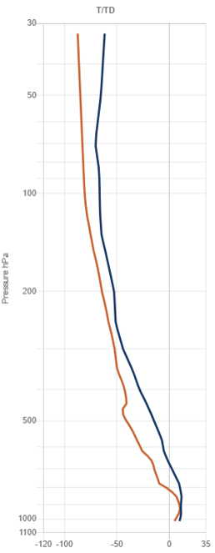
Example
407 mb: -27.3 C
555 mb: -16.5 C
661 mb: -1.9 C
-33.15: 360 mb
-22.67: 437 mb
-12.6: 521 mb

Slide 12
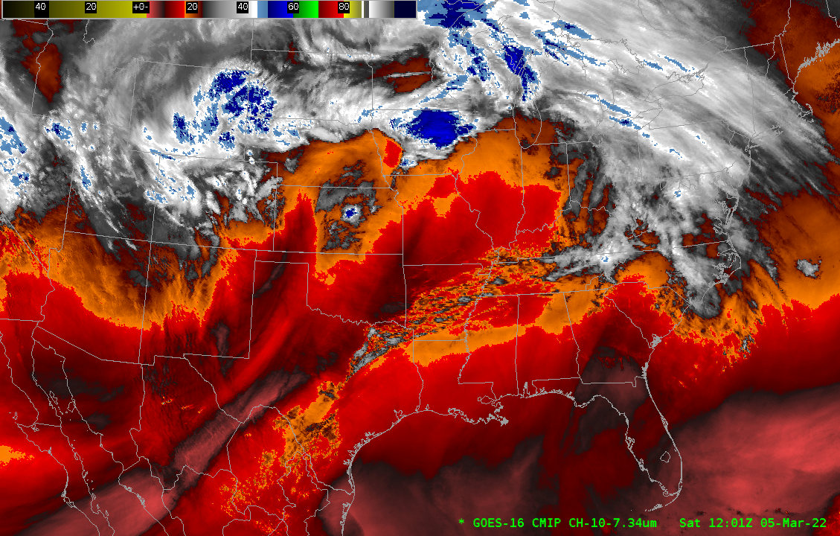
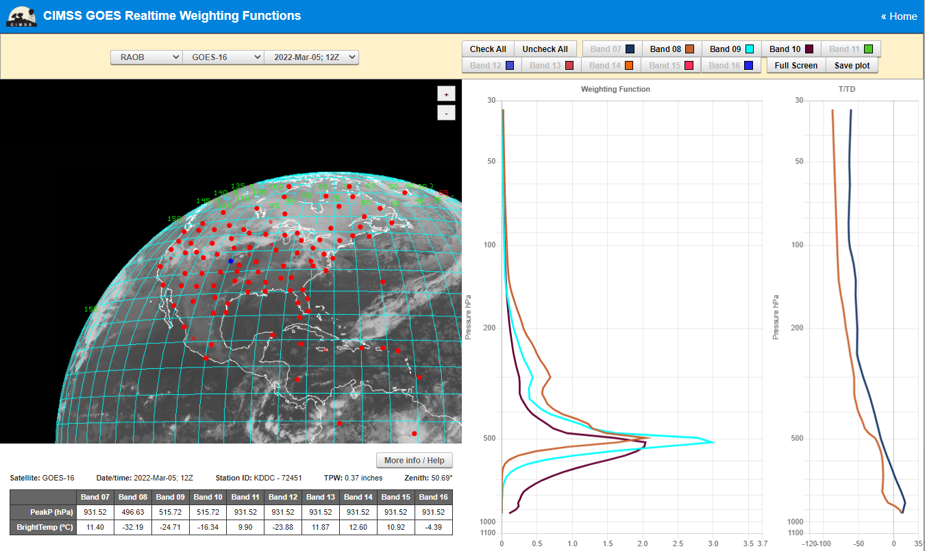
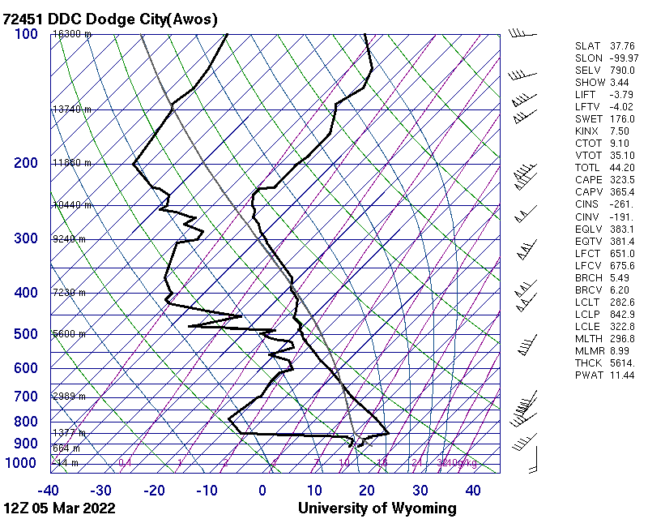
Example 2

Slide 13
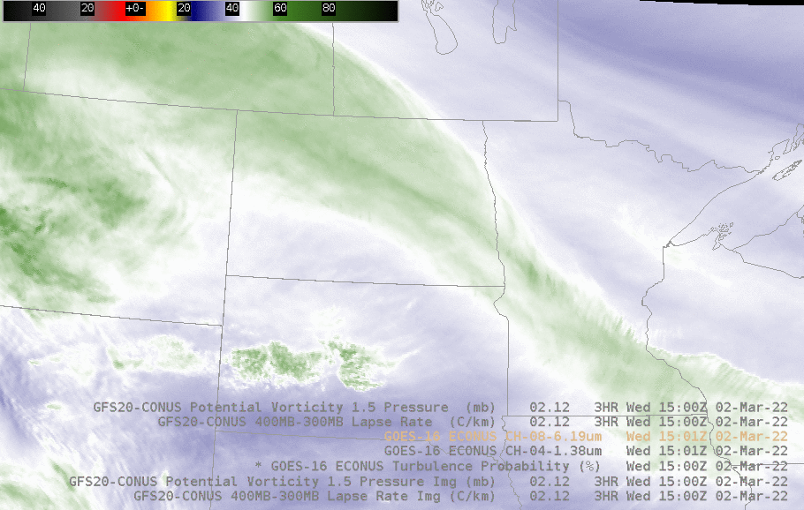
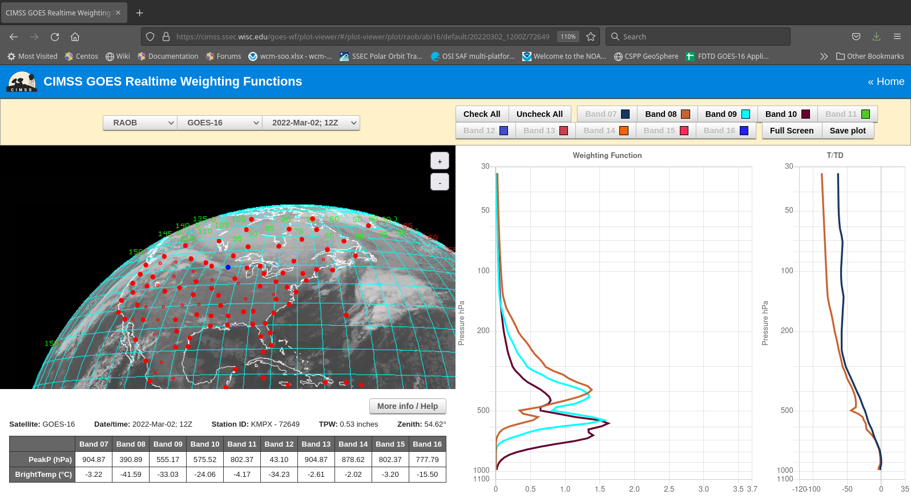
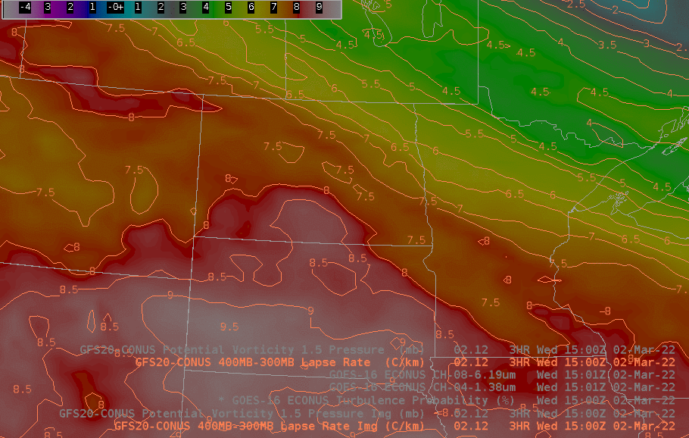
How to use the Weighting Function (example)
Turbulence Probability fields toggling with 400-300 mb lapse rates, and with 6.19 um water vapor fields
Why choose 400-300 mb Lapse Rate? Weighting Function!

Slide 14
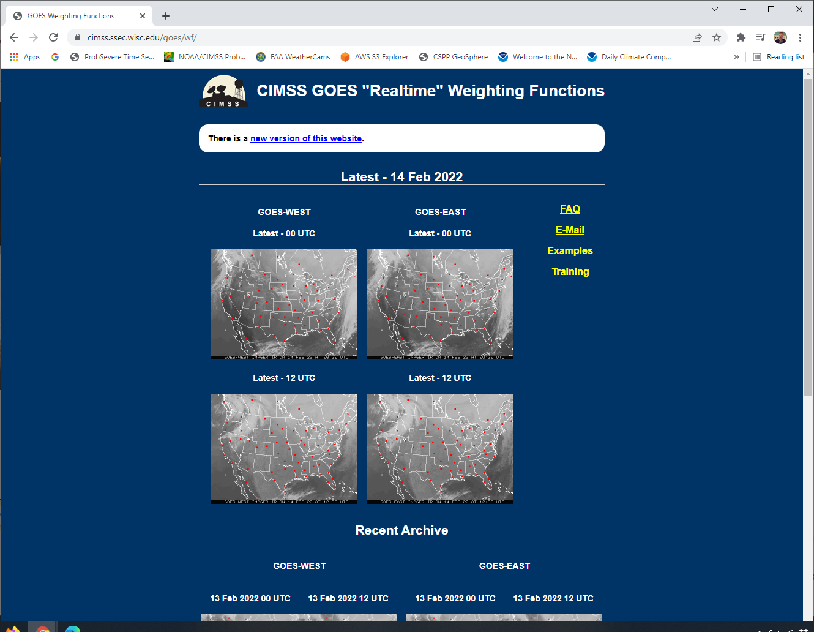
The old site https://cimss.ssec.wisc.edu/goes/wf
You can click on GOES-West or GOES-East at either 0000 UTC or 1200 UTC
4-day archive is available as well (scroll down).
When you click on an image….

Slide 15
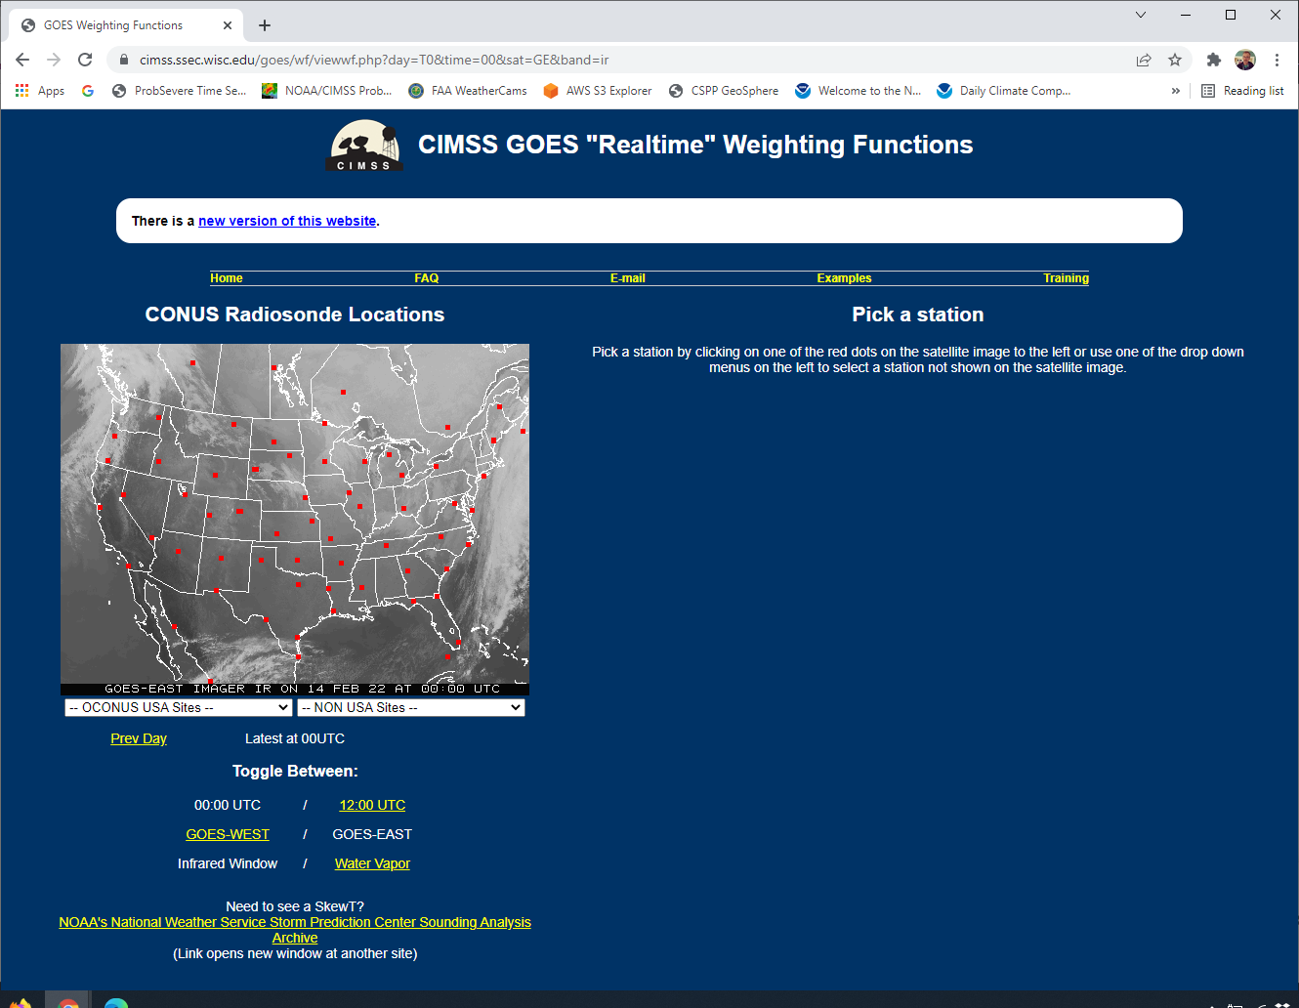
The old site https://cimss.ssec.wisc.edu/goes/wf
Once GOES-East is clicked on, you can choose a Radiosonde site
Let’s choose OUN

Slide 16
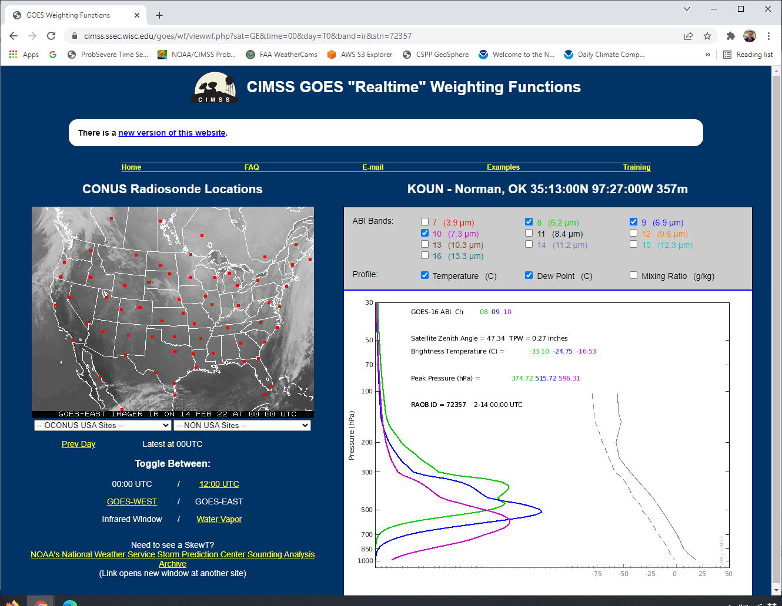
The old site https://cimss.ssec.wisc.edu/goes/wf
OUN Weighting functions shown – only for Water Vapor channels.
Includes the Stuve at OUN

Slide 17
Water Vapor
Water vapor strongly absorbs energy at 6.2 μm
Relatively little can make it through the vapor
Water vapor weakly absorbs energy at 7.3 μm
More can make it through the vapor unabsorbed
water vapor in the atmosphere
Earth’s Surface
6.2 μm
7.3 μm

Slide 18
Bottom Line
Information in the “water vapor channels” (somewhere between 6 and 7.5 micrometers) comes from the mid-troposphere
7.3 micrometers: closer to the surface, maybe might include information from the surface in very dry airmasses
6.2 micrometers: comes from the mid- or upper-troposphere
Really depends on the distribution of water vapor in the atmosphere. If there’s a thin layer high up, most of the information comes from higher up. Only ~5 mm of water vapor will absorb a lot of the upwelling energy

Slide 19
How does absorption change the brightness temperature?
Energy leaves a surface, and is absorbed by a gas higher up in the atmosphere (where it is typically cooler/dryer)
The absorbed energy is then re-emitted from this (cooler/dryer) area
Because it’s cooler, less energy is emitted
This pattern of absorption and re-emission continues until there’s no more gas left to absorb, at which point the energy escapes the atmosphere and is detected by the satellite

Slide 20
What can sounding data give you: Vertical Profiles of temperature and moisture
The >1000 observations of radiances you get from a sounder could represent the emissions from more than one atmosphere
The challenge is to find the most likely combination of temperature and moisture profiles that yield the observations
This is a tricky mathematical problem
For 40+ years this has been achieved using Radiative Transfer Models (RTMs) – that are computationally slow
How to become famous: Devise a speedy way to transform the observations to the most likely atmosphere

Slide 21
Question #3
In clear skies, from where does the information that a ‘water vapor’ infrared channel (for example, Band 8 on AMI at 6.24 μm) detects originate?
A: From the Earth’s Surface
B: From around 900 mb
C: From around 550 mb
D: From around 350 mb
E: I need more information!

Slide 22
Weighting Function
326 mb
344 mb
441 mb
AHI has 3 bands in the part of the spectrum that is sensitive to water vapor absorption
Where does the information sensed by those three channels originate in the vertical?
This is a function of water vapor in the column

Slide 23
Weighting Function
358 mb
460 mb
576 mb
AHI has 3 bands in the part of the spectrum that is sensitive to water vapor absorption
Where does the information sensed by those three channels originate in the vertical?
This is a function of water vapor in the column

Slide 24
The complication of water vapor
“Water Vapor” bands on a satellite are sensing emissions at different wavelengths (6.21, 6.94, 7.33 μm on AMI)
The ability of water molecules to absorb energy at those wavelengths varies as a function of wavelength
A thin region of water vapor might absorb most of the energy at 6.21 μm, but a lot of the 7.33 μm energy will move through it.
What is the temperature of the water vapor. That also affects the absorption.
Are there big gradients in temperature that can be sensed through the water vapor?

Slide 25
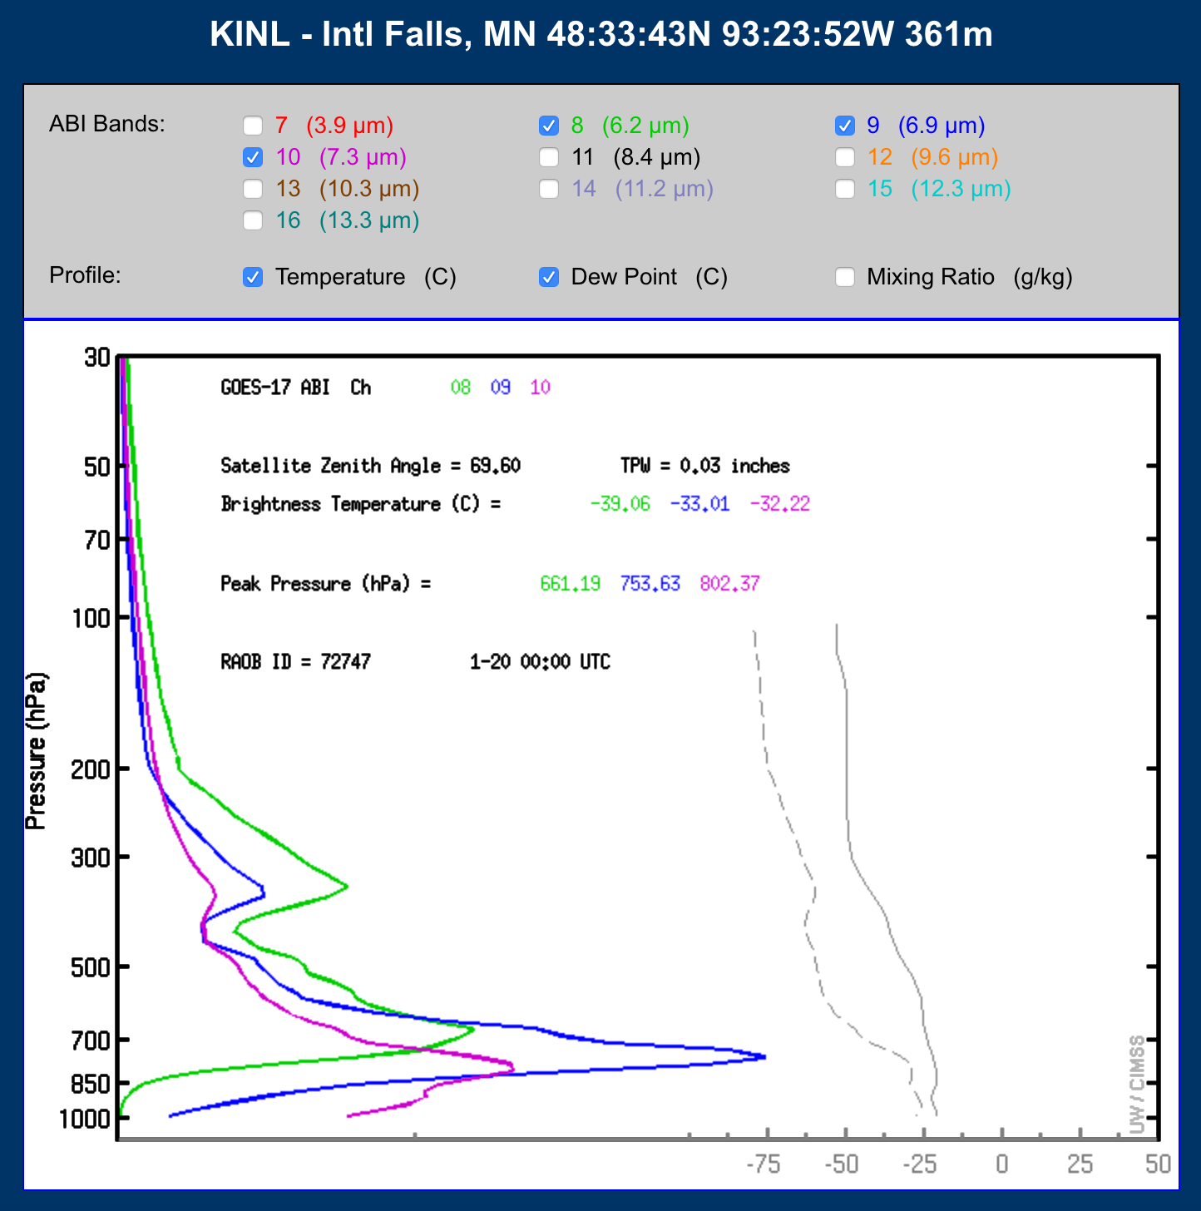
When the air is very very dry (usually it’s cold too) you can see the surface in water vapor imagery

Slide 26
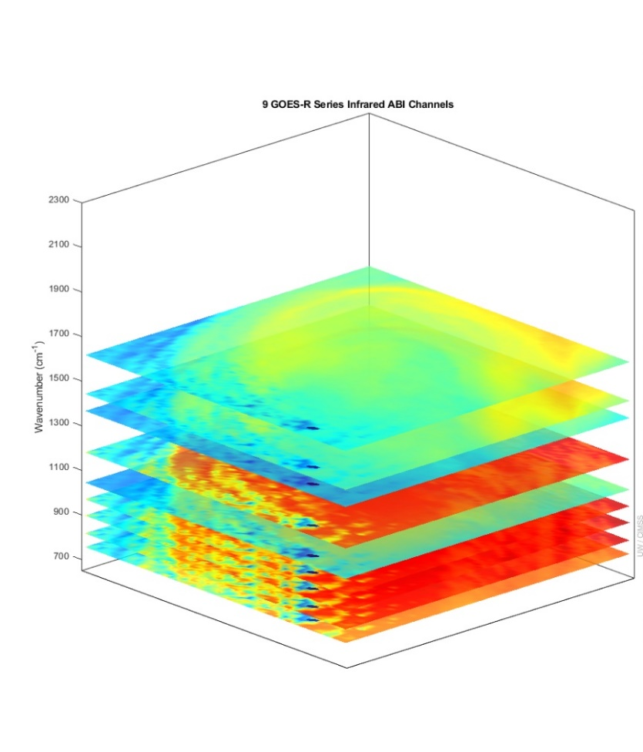
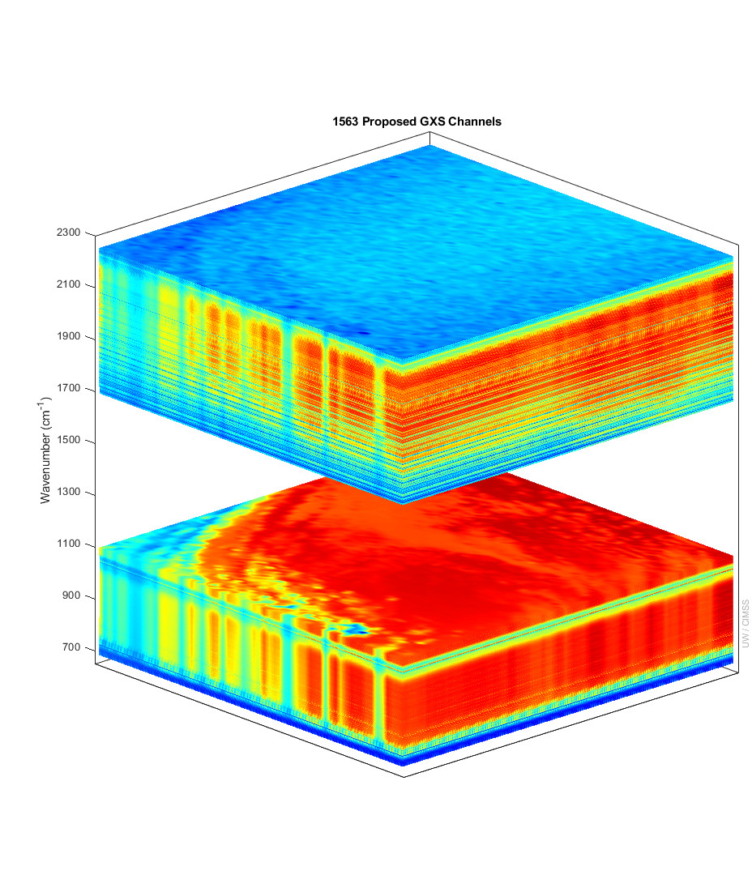
More spectral bands means more temperature/moisture information in the vertical
ABI GXS
9 ABI IR Bands
1000s of GXS Bands
There are more than six times (temperature) and four times (moisture) of number of independent pieces of vertical information in this proposed sounder compared to the ABI.
(And up to 20 times more for thin clouds.)
The weighting functions mean that 3 (overlapping) moisture layers are resolved (in clear skies)
Number of Independent Pieces of Vertical Information
 | GXS | ABI
Temperature | 13 | 2
Moisture | 11 | 2.5
GXS is the sounder on GeoXO
Notes:
Y axis is wavenumber. ABI and GOES Sounder bands within the GXS range are shown. Credit: UW/CIMSS
Vertical pieces recently calculated by Z. Li, UW/CIMSS.

Slide 27
Sounder data is in three dimensions
You can show vertical profiles of information
You can show horizontal fields of information

Slide 28
Summary of Weighting Functions
Important Information: From what level is the satellite likely sensing information? (Note: if it’s cloudy, then the information is from the cloud top)
3 Water Vapor bands on GOES-R type satellites have different Weighting function peaks.
Water vapor gives three-dimensional view of atmosphere

