Slide 1
Specialist Training for Tropical Cyclones
Scott Lindstrom, UW-Madison
Cooperative Institute for Meteorological Satellite Studies
( )
Introductions
19 November 2023

Slide 2
Your instructor: Scott Lindstrom
Undergraduate (B.S.) degrees in Meteorology and Computer Science, Penn State University
Graduate degrees (M.S., PhD) from University of Wisconsin-Madison
Trainer on Synoptic Tropical Meteorology for Dept of Hydrology/Meteorology, Naypyitaw, Myanmar
Lecturer on Tropical Meteorology, Malaysian Meteorological Department, Kuala Lumpur

Slide 3
Things I do
I create blog posts for the CIMSS Satellite Blog
https://cimss.ssec.wisc.edu/satellite-blog/archives/author/scottl
I give lectures to various entities about the benefits of satellite imagery
GOES-R views Canada (vimeo : https://vimeo.com/808066399 )
Using GOES and JPSS data in Alaska (vimeo : https://vimeo.com/806853591 )
How NUCAPS and gridded NUCAPS can help you (vimeo: https://vimeo.com/391356388 )
Training at AOMSUC-13 on Meteorological Sounders
Create Quick Guides on various satellite products, both GOES-R and JPSS
Visible and infrared imagery, Scientific Products
Microwave imagery and derived Products

Slide 4
GOES-R and JPSS “Quick Guides”

Slide 5
Training for Pacific Region
Weekly Telecons to USA National Weather Service (NWS) Weather Service Office (WSO) in Pago Pago, American Samoa
Island in the middle of the south Pacific, to the east of Samoa. Satellite Data gives information in data sparse regions.
Problems include unforecast showers, floods, and tropical cyclones
In-person forecaster training at WFO Guam, WFO Honolulu, WSO Pago Pago

Slide 6
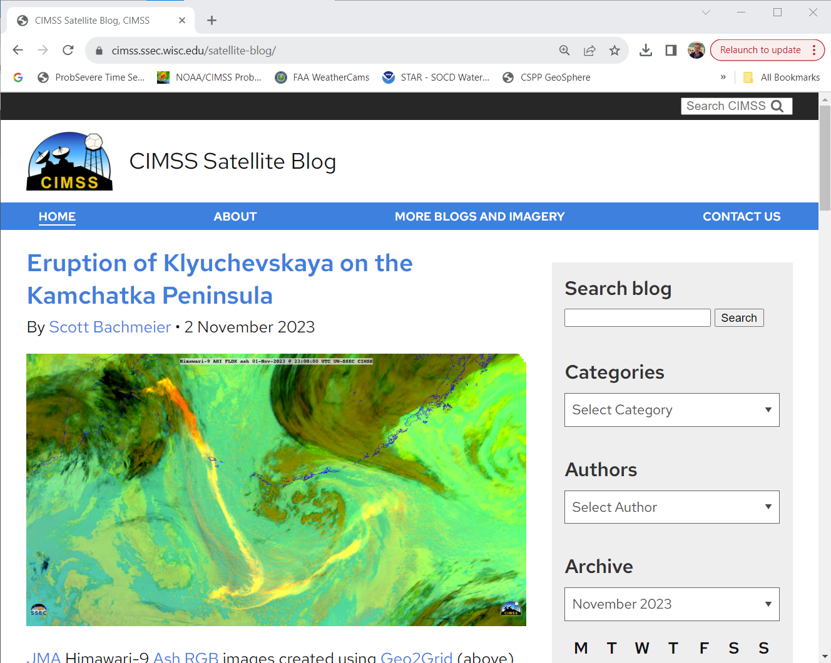
I write about Satellite events
CIMSS Satellite Blog: https://cimss.ssec.wisc.edu/satellite-blog
Satellite Imagery is beautiful
I get to look at it, and then tell the story behind the beauty
I also write about ways to create imagery, i.e., using various software packages

Slide 7
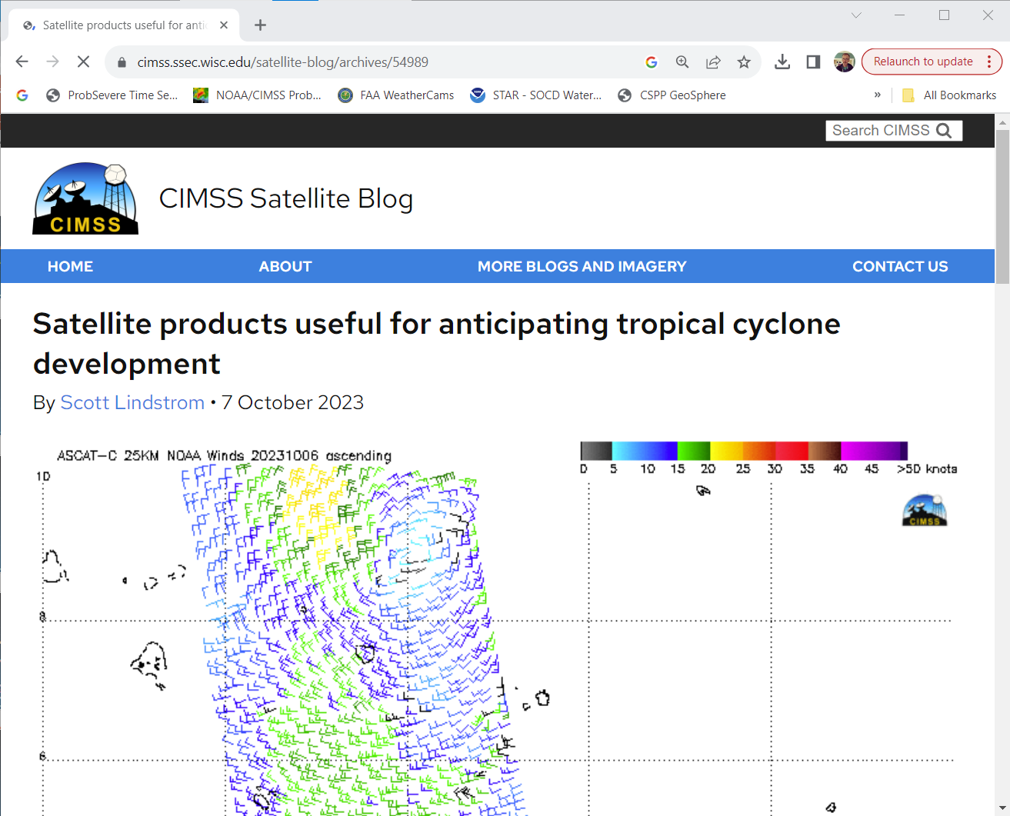
Some blog examples from which I might have taken class material

Slide 8
Also ‘manage’ the development of new software
Community Satellite Processing Package (CSPP)
This is a general package of software that does a variety of things
Takes netCDF data files from different satellites and produces high-quality imagery
Takes netCDF data files from different satellites and produces Science Products (such as gridded GLM data from GOES-R ; LightningCast Probability fields from GOES-R ; HEAP profiles from JPSS data)

Slide 9
Where was I two weeks ago?
AOMSUC-13 Training, and the AOMSUC-13 Conference (Busan Korea)
Gave a training lecture on the importance of Atmospheric Sounders (e.g., CrIS and IASI on Polar Orbiters, GIIRS on FY-4B)
Listened to training on GOES/JPSS data, and on microwave
AOMSUC-14 (next year) will be in Delhi, India, hosted by IMD. (A short flight away from Muscat!)
I hope someone from Oman can attend!

