Slide 1
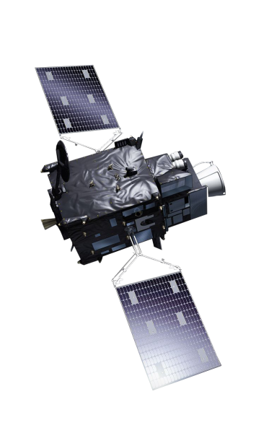
First FCI imagery exploration Group XY

Slide 2
Some hints:
Imagery found here: https://imagine.eumetsat.int/smartViews/view?view=MTG-I1FirstData
Tools for assistance:
EUMETView: https://view.eumetsat.int/productviewer?v=default
RGB Quick Guides (Cloud Phase, Cloud Type, etc.): https://eumetrain.org/user-manual
RGB Colour Selector: https://resources.eumetrain.org/RGBguide/RGBColourTool.zip
Reflect on the following questions:
What is the most interesting feature you found?
Where do you find most striking difference between SEVIRI and FCI?
Which RGB product may be most useful for you/your work and why?

Slide 3
a) What is the most interesting feature you found?

Slide 4
b) Where do you find most striking difference between SEVIRI and FCI?

Slide 5
c) Which RGB product may be most useful for you/your work and why?

