Slide 1
RGB Products Overview
Shima Alyazidi
Train the trainer course, Salalah 3-7 Septemper 2023
Presented By: Olivia Wilson

Slide 2
What satellite channels you routinely use?
What products, RGBs?
Dust RGB
IR image
Natural colour RGB
Severe convection

Slide 3
Visualizing satellite data
• Single channel
• Channel differences
• Sandwich products
• RGB products

Slide 4
IR 10.8 µm – Single channel, colour enhance

Slide 5
“Sandwich” product

Slide 6
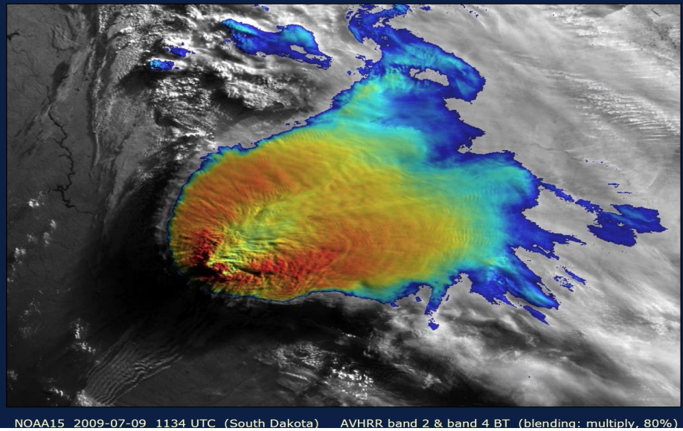

Slide 7
SEVIRI (FCI) spectral channels
Solar
Channels
Thermal
Channels

Slide 8
RGB composites
Every spectral channel (or combination) is assigned to one of the RGB components
All colours are a result of mixing of 3 basic colours:
• Red
•Green
• Blue
• Allows analysis of 3 (or more) spectral characteristics in one image!

Slide 9
RGB composites
KPI # 1

Slide 10
RGBs Quick help
RGB colour tool
RGB colour Guide
https://www.eumetrain.org/rgb-color-guide
https://www.eumetrain.org/rgb-color-guide

Slide 11
Natural Colour RGB
Red = NIR 1.6 μm
Green = VIS 0.8 μm
Blue = VIS 0.6 μm

Slide 12
vis1.6
vis0.8
Green
Red
RGB
Blue
vis0.6

Slide 13
Natural Colour RGB
Usage:
cloud phase,
vegetation,
dust,
smoke,
snow,
fires

Slide 14
Dust
(Day and night)
R: IR12.0 –IR10.8 Range : -4～2 [K]Gamma:1.0
G: IR10.8 –IR8.7 Range: 0～15[K]Gamma: 2.5
B : IR10.8 Range: 261～289[K]Gamma: 1.0

Slide 15
Day and night
cloud analysis,
Dust ,
low-level
moisture

Slide 16
Night Microphysics
（for night-time cloud analysis）
R: IR12.0 –IR10.8 Range : -4～2 [K]Gamma:1.0
G: IR10.8 –IR3.9 Range: 0～10[K]Gamma: 1.0
B : IR10.8 Range: 243～293[K]Gamma: 1.0

Slide 17
night-time cloud analysis,
Fog/low cloud distinction for night-time

Slide 19
Night microphysics
DUST

Slide 20
Day Microphysics
(for day-time cloud analysis
R: VIS0.8 Range : 0～100 [%]Gamma: 1.0
G: IR3.9 Solar reflectance component Range: 0～60[%]Gamma: 2.5（summer）Range: 0～25[%]Gamma: 1.5（winter）
B : IR10.8 Range: 203～323[K]Gamma: 1.0

Slide 21
Day-time cloud analysis,
Convective cloud with
strong updrafts,
Vegetation,
Fire (hot spot)
Snow detection

Slide 22
Examples: microphysics
Airmass
Day Microphysics
Convective Storms
31 March 2019,0700 UTC

Slide 23
Thank you

