Slide 1
Artificial Intelligence in Earth Observation
Manal al Hashmi
Meteorologist | Research and Development department
Directorate General of Meteorology | Civil aviation authority

Slide 2
What is AI?
AI algorithms creates intelligent machines that can perform human-like tasks using:
machine learning, natural language processing, computer vision, and robotics.
AI has the potential to reform industries and improve our lives by making tasks more efficient and accurate.
Notes:
AI stands for Artificial Intelligence. It is a branch of computer science and engineering that deals with the development of intelligent machines that can perform tasks that typically require human-like intelligence.
AI is a multidisciplinary field that incorporates various techniques such as machine learning, natural language processing, computer vision, and robotics to create intelligent machines that can perceive, reason, learn, and act in complex environments.
Some of the applications of AI include speech recognition, image and video recognition, autonomous vehicles, medical diagnosis, fraud detection, and recommendation systems. AI has the potential to revolutionize many industries and make our lives easier and more efficient.

Slide 3
Three Stages of AI
Machine Learning | 2015
User driven big data systems for machine learning
Machine Intelligence | 2020
Advanced networks trained to build ad-hoc systems
Machine Consciousness | 2050
Systems characterizing cognitive self learning

Slide 4
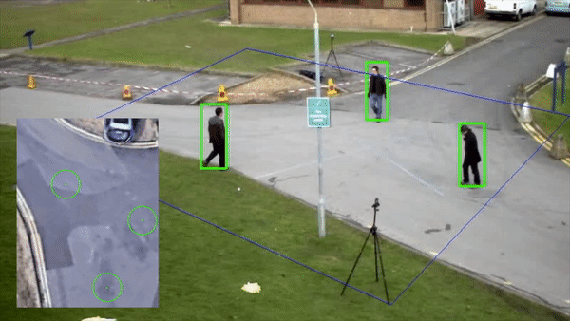
Three Stages of AI
- Artificial Narrow Intelligence - Machine Learning | User driven big data systems for machine learning

Slide 5
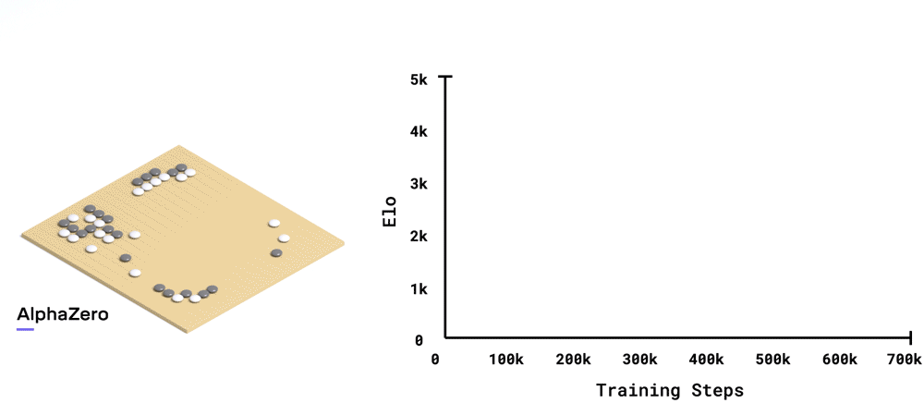
Three Stages of AI
- Artificial General Intelligence - Machine Intelligence | Advanced networks trained to build ad-hoc systems and improve themselves using data

Slide 6
Three Stages of AI
- Artificial Super Intelligence - Machine Consciousness | Systems characterizing cognitive self learning

Slide 7
Applications of Artificial Intelligence
Machine Learning (ML)
Deep Learning (DL)
Neural Networks
Image and Pattern Recognition
Facial Recognition
Hearing
Voice and Speech Recognition
Natural Language Processing (NLP)
Natural Language Understanding (NLU)
Natural Language Generation (NLG)
Robotics
Vision
Expert Systems

Slide 8
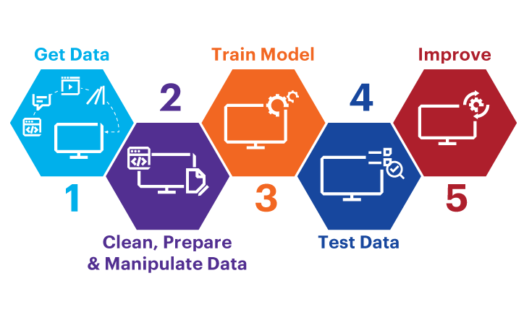
Steps to AI

Slide 9
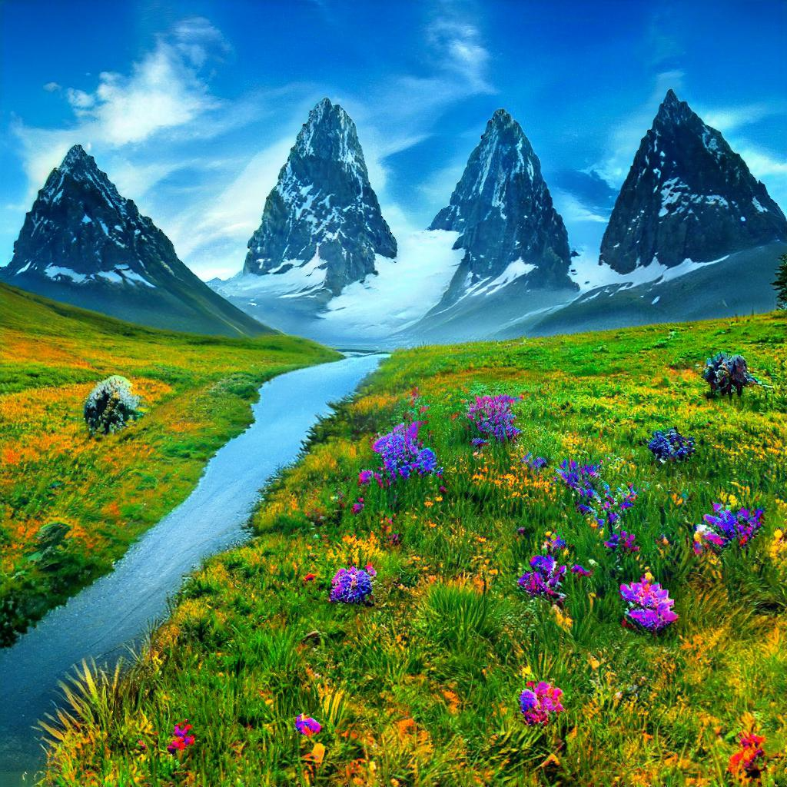

Slide 10
Some AI tools
Drawing (Gaugan)
Gaugan is an AI-powered digital painting tool developed by Nvidia that allows users to create landscapes and scenery with just a few clicks.
http://gaugan.org/gaugan2/

Slide 11
Some AI tools
https://speak.streams.live
(Generate English speech from text)
copy.ai
Free AI-powered copywriting generators
https://app.copy.ai/
For more: https://copy.ai/

Slide 12
Some AI tools
beautiful.ai (The first presentation maker that designs for you)
hotpot.ai (helps you create professional graphics and images)
pfpmaker (Make an awesome profile picture from any photo)
brandmark.io (Create a unique, professional logo for your business)
deep-image.ai (Upscale & enhance images)
bigjpg (allows the images to be enlarged without losing quality)
lumen5 (Video maker built to supercharge your content strategy)
namelix (generate a short, brandable business name using artificial intelligence)

Slide 13
AI systems/products

Slide 14
Artificial Intelligence in Earth Observation
Vegetation Index Maps
AI is crucial in Earth observation as it
analyzes data from remote sensing technologies
detects changes in land use and cover, vegetation, and satellite imagery.
Notes:
Artificial Intelligence (AI) is becoming increasingly important in Earth observation, which is the use of remote sensing technologies to monitor and study the Earth's surface and atmosphere. AI can help to analyze the large amounts of data that are generated by Earth observation satellites and other remote sensing technologies, and can also be used to develop new methods for analyzing this data.
One of the key areas where AI is being applied in Earth observation is in the analysis of satellite imagery. For example, AI can be used to detect changes in land use or land cover, such as deforestation or urbanization, and to track the movement of glaciers and other ice masses. AI can also be used to identify features in satellite imagery, such as roads, buildings, and bodies of water, and to classify different types of vegetation.
AI can also be used to analyze data from other types of Earth observation sensors, such as radar and lidar, which are used to study the Earth's surface and atmosphere. For example, AI can be used to identify and track severe weather events, such as hurricanes and tornadoes, and to analyze patterns of ocean currents and temperatures.
Overall, AI has the potential to revolutionize Earth observation by enabling us to analyze large amounts of data more efficiently and accurately than ever before, and to develop new insights and applications that were previously impossible.

Slide 15
Applications of Artificial Intelligence in Earth Observation
- AI has numerous applications in Earth observation, including weather monitoring, satellite image analysis, and environmental change detection.
- AI can detect changes in land use, identify deforestation and other human-caused disturbances, and predict potential natural disasters like floods or landslides.
- In oceanography, AI can detect changes in ocean temperatures, sea levels, and currents, identify areas of potential coral bleaching or oil spills, and monitor air pollution levels.
Notes:
AI can be used in many applications related to Earth observation. AI can be used to monitor weather patterns, analyze satellite images, and detect changes in the environment over time. AI can also be used to detect changes in land use and land cover, as well as to identify areas of deforestation and other human-caused disturbances. AI can also be used to identify areas of potential natural disasters, such as flooding or landslides.
AI can also be used to detect changes in ocean temperatures, sea levels, and currents. AI can be used to identify areas of potential coral bleaching, as well as to identify areas of potential oil spills and other environmental disasters. AI can also be used to detect changes in air quality, as well as to monitor air pollution levels.

Slide 16
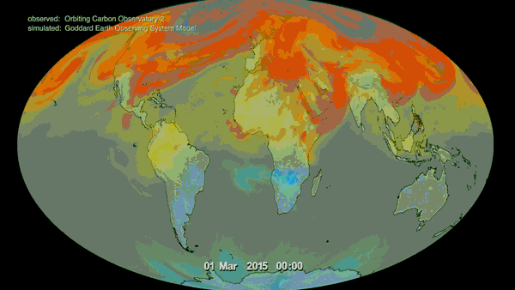
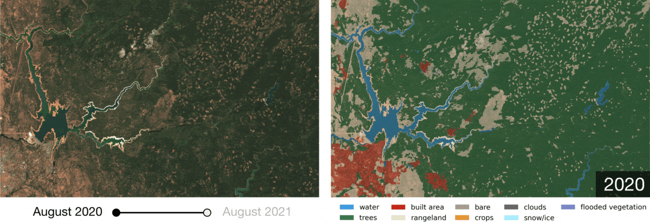
Benefits of Artificial Intelligence in Earth Observation
The use of AI in Earth observation provides many benefits
AI can identify the following events more quickly and accurately than traditional methods:
environmental trends and changes.
changes in land-use and land-cover.
areas of potential natural disasters.
AI can help reduce costs associated with Earth observation by automating parts of the process and reducing the amount of human labor required.
Notes:
The use of AI in Earth observation provides many benefits. AI can help to identify environmental trends and changes more quickly and accurately than traditional methods. AI can also help to detect changes in land use and land cover more quickly and accurately than traditional methods. AI can also be used to identify areas of potential natural disasters more quickly and accurately than traditional methods.
AI can also help to reduce costs associated with Earth observation. AI can be used to automate parts of the Earth observation process, which can help to reduce the amount of time and money spent on manual data collection. AI can also help to reduce the amount of human labor required for Earth observation, which can help to reduce costs associated with hiring and training personnel.

Slide 17
Limitations of Artificial Intelligence in Earth Observation
AI has limitations when it comes to Earth observation:
AI is limited by the data it is given.
limited by its ability to interpret data.
AI is not able to predict the future with 100% accuracy.
and may not be able to detect unknown changes in the environment.
Notes:
AI has some limitations when it comes to Earth observation. AI is limited by the data that it is given, so it may not be able to detect changes in the environment that are not already known. AI is also limited by its ability to interpret data, so it may not be able to accurately identify changes in the environment that are not already known.
AI is also limited by its ability to make predictions. AI is not able to predict the future with 100% accuracy, so it may not be able to accurately predict changes in the environment that are not already known. AI is also limited by its ability to interpret data, so it may not be able to accurately interpret changes in the environment that are not already known.

Slide 18
Future of Artificial Intelligence in Earth Observation
The future of AI in Earth observation is promising and constantly improving:
AI will be used to monitor and analyze the environment, detect changes in land use and land cover more accurately and quickly than ever before.
AI is expected to make more accurate predictions about future events.
Notes:
The future of AI in Earth observation is bright. AI is a rapidly developing field of technology and its applications in Earth observation are constantly improving. AI is being used in many different applications related to Earth observation and its use is only expected to increase in the future.
AI is expected to be used to monitor and analyze the environment more accurately and quickly than ever before. AI is also expected to be used to make more accurate predictions about future events. AI is also expected to be used to detect changes in land use and land cover more quickly and accurately than ever before.

Slide 19
Thank you

