Slide 1
Remote Sensing for weather applications
Shima Alyazidi – PACA
S.Alyazeidi@met.gov.om

Slide 2
Objectives
Remote sensing and Radiation overview
Geostationary and Polar Satellites
Spectral bands and their application
Radar
Future missions and technologies

Slide 3
Remote sensing and radiation overview
Definition
All measurements processes which perform observations about the properties at the location of interest at a distant location
Opposite : in-situ measurements
For meteorology
Most application relies on electromagnetic waves

Slide 5
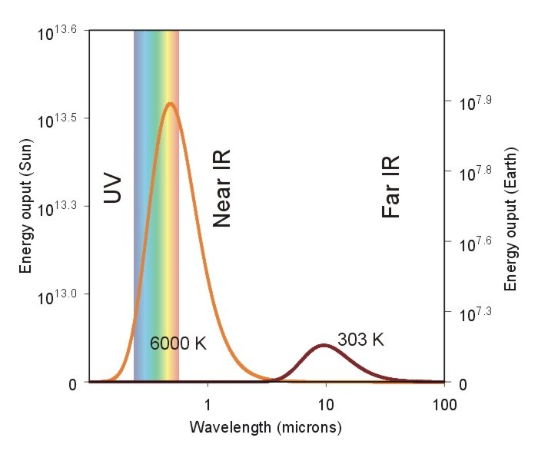
Fundamental radiation law: Planck law
Every object emits radiation at all times and at all wavelengths
The emission spectrum of the sun (orange curve) compared to the earth's emission (dark red curve). The x-axis shows wavelength in factors of 10 (called a "log scale"). The y-axis is the amount of energy per unit area per unit time per unit wavelength. I have kept the units arbitrary because they are quite messy. The important message is that the sun's emission spectrum peaks in the visible spectrum while the earth's emission spectrum peaks in the infrared (because of Wien's Law).

Slide 6
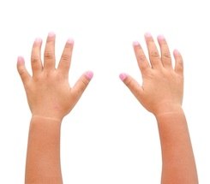
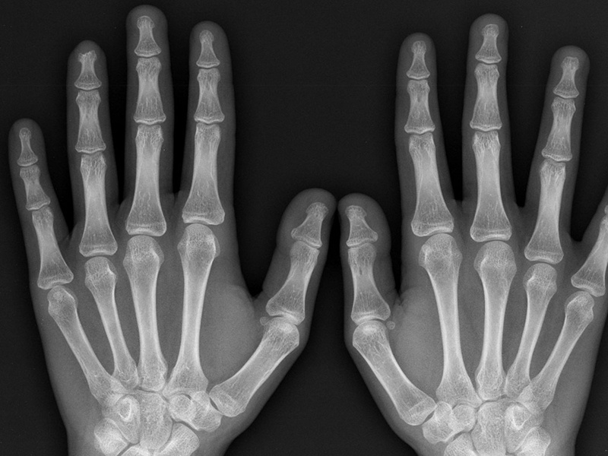
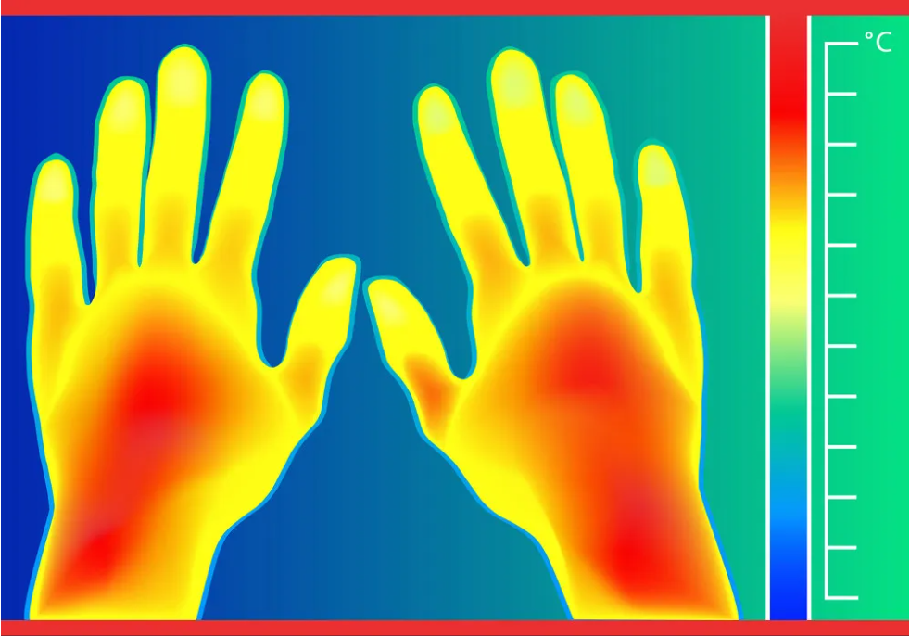

Slide 7
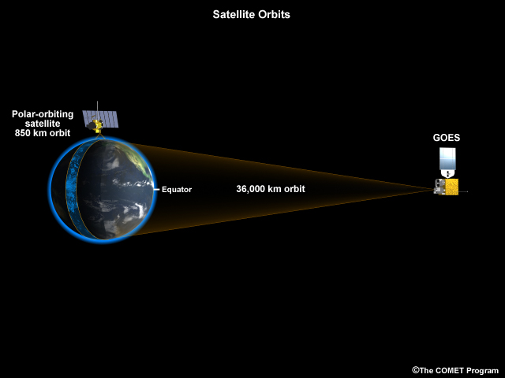
Geostationary and Polar satellite
Meteorologists use two types of weather satellites:
Geostationary satellites
LEO satellites

Slide 8
Recent satellites
Meteosat series
EUMETSAT currently operates Meteosat-9, -10 and -11 in geostationary orbit (36,000km) over Europe and Africa, and the Indian Ocean.
Metop series
EUMETSAT operates Europe’s Metop-B and –C satellites, which circle the globe via the poles and continuously collect data from an altitude of 817 km.
Sentinel series
EUMETSAT is responsible for operating the Copernicus Sentinel-3 and Sentinel-6 ocean monitoring satellites

Slide 9
Satellite radiometer
Radiometer, an instrument which is sensitive to some visible and thermal radiation. The radiometer carefully scans the Earth's surface by taking data about every piece of land as if it were reading a book line by line.
This measurement is digitally coded and transmitted to the ground station. The coding gives each radioactive intensity level a certain grey value giving Meteosat pictures the look of a black-and-white photograph.

Slide 10
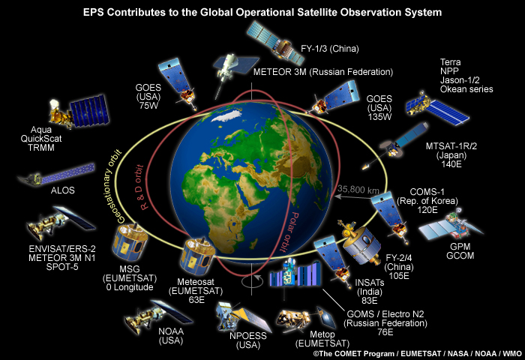
The Global Operational Satellite Observation System

Slide 11
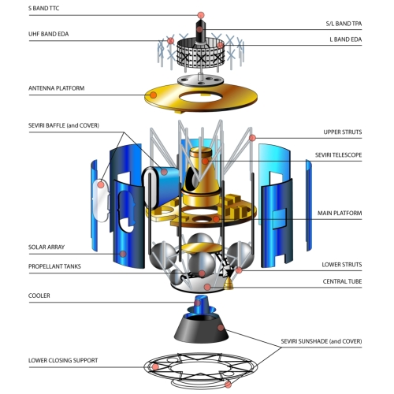
MSG
(MSG) consists of a series of four geostationary meteorological satellites, that will operate consecutively until 2020.
The MSG satellites carry an instruments — the Spinning Enhanced Visible and InfraRed Imager (SEVIRI), which has the capacity to observe the Earth in 12 spectral channels.
permanent visible and infrared imaging of the Earth's disc, with a baseline repeat cycle of 15 minutes

Slide 12
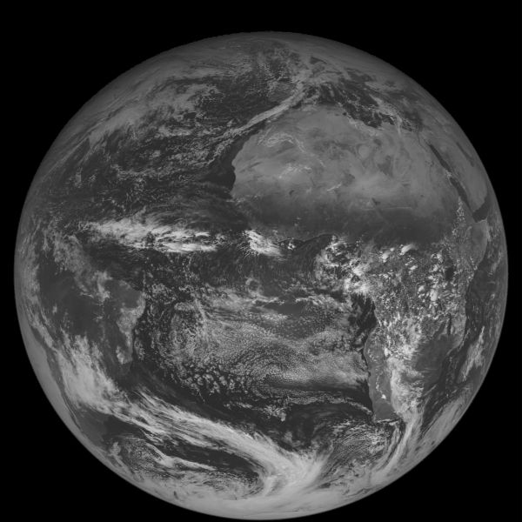
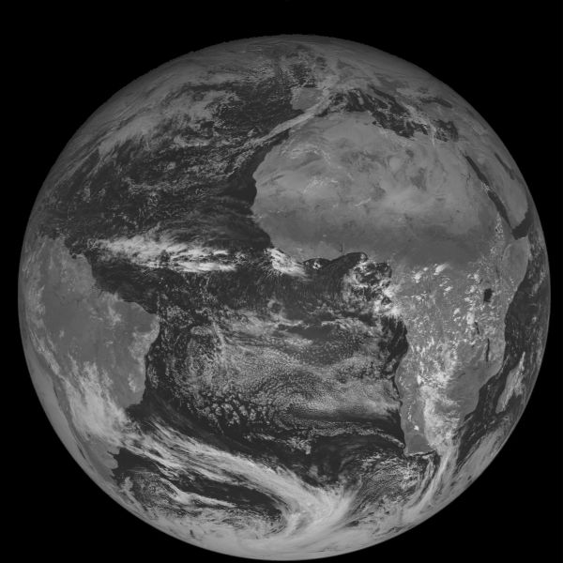
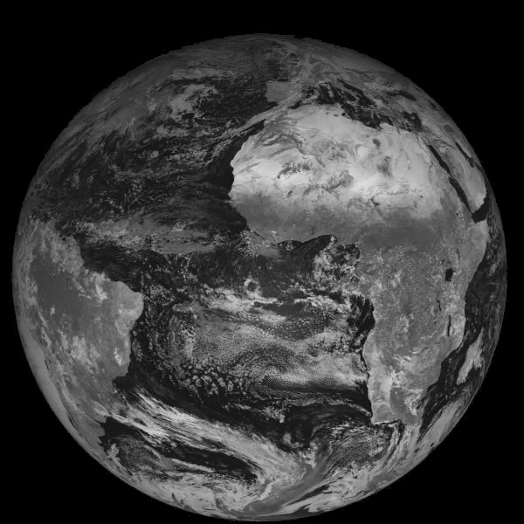
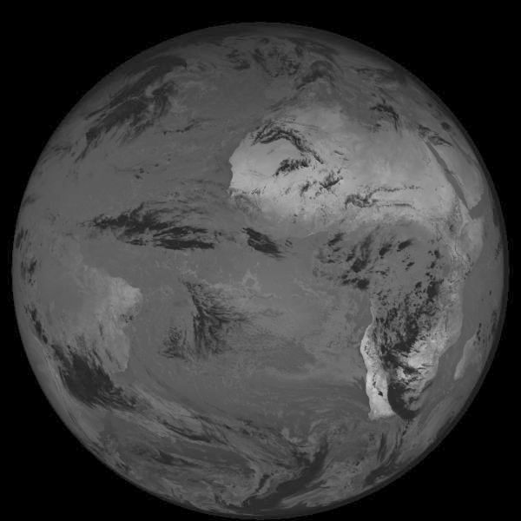
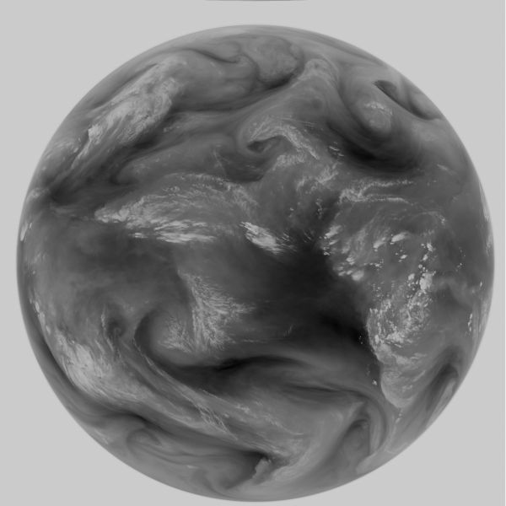
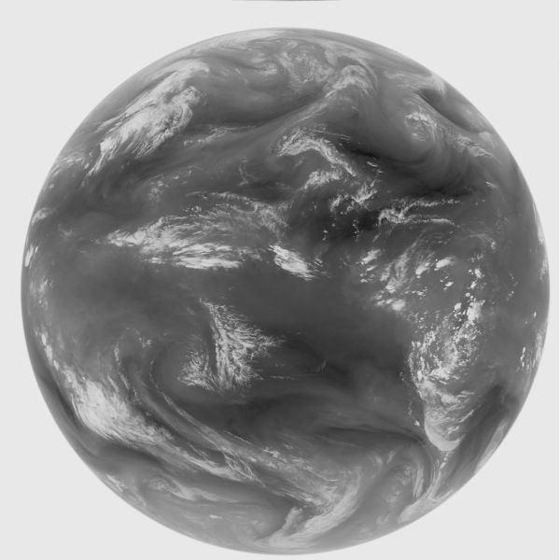
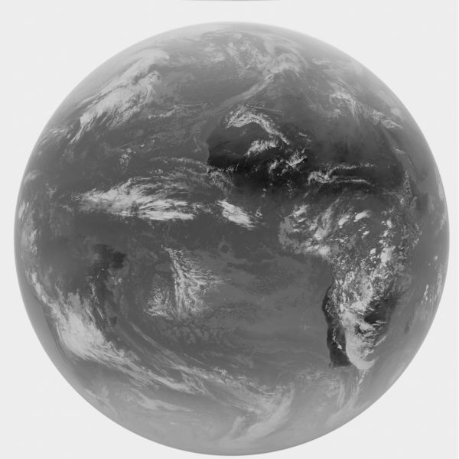
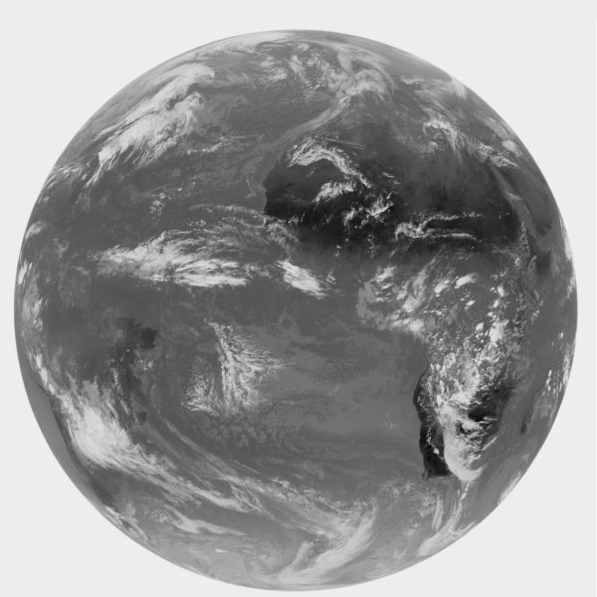
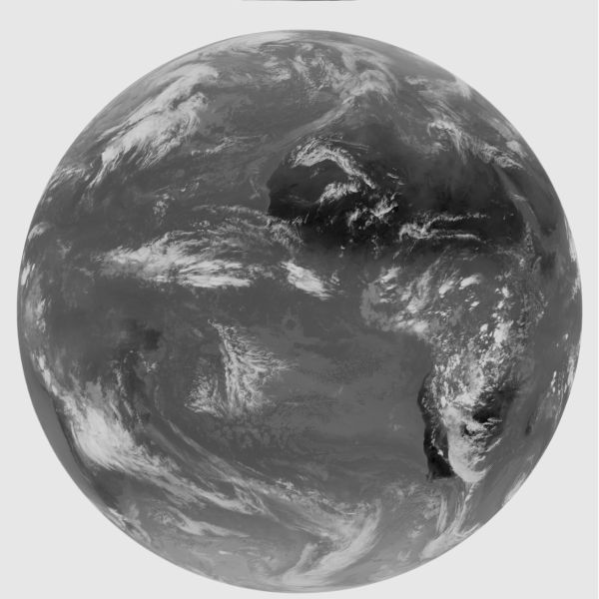
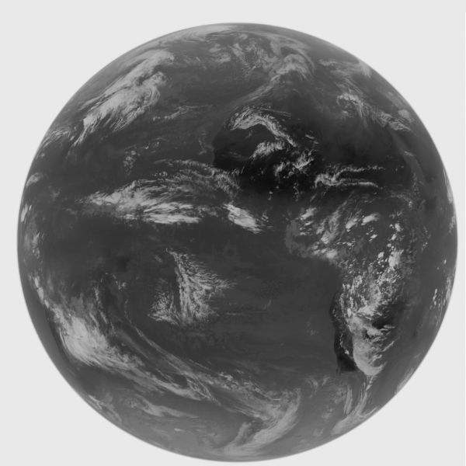
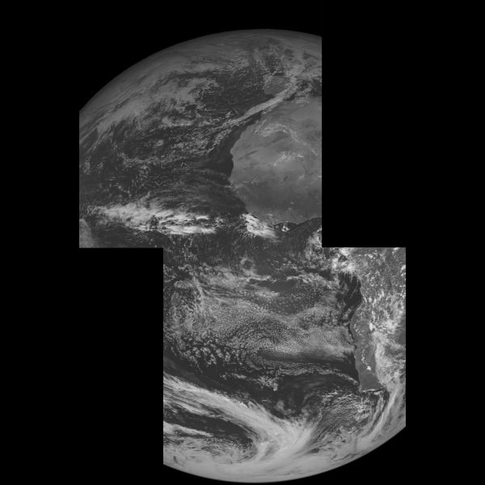
Met-8 First Image on 28 November 2002
VIS 0.6 VIS 0.8 NIR 1.6 NIR 3.9
IR 10.8 IR 12.0 IR 13.4 HRVIS

Slide 13
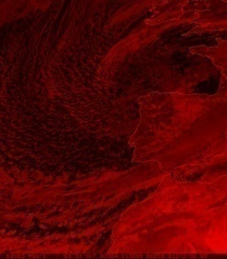
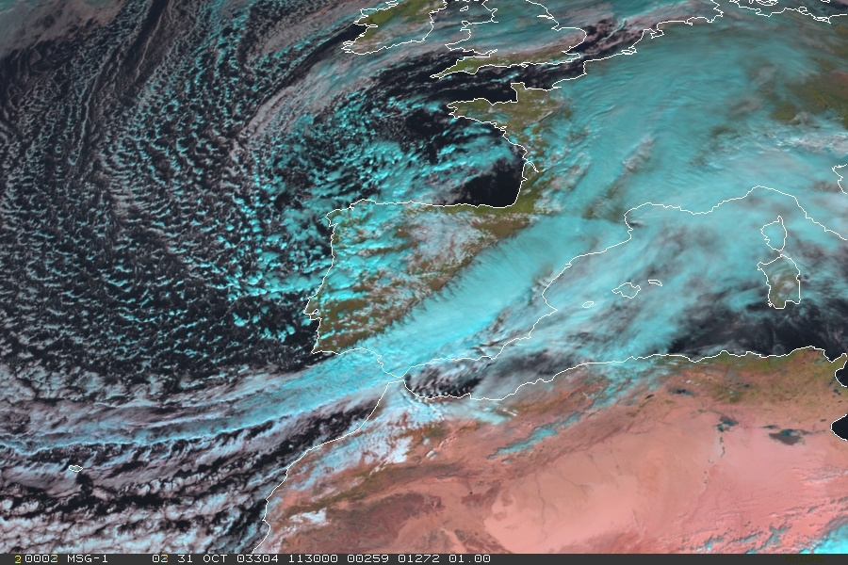
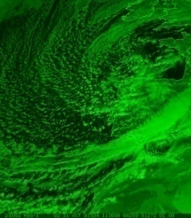
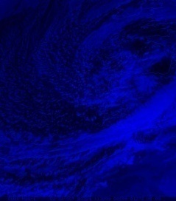
Red Green Blue (RGB) image composites
Channel 03
Channel 02
Channel 01

Slide 14
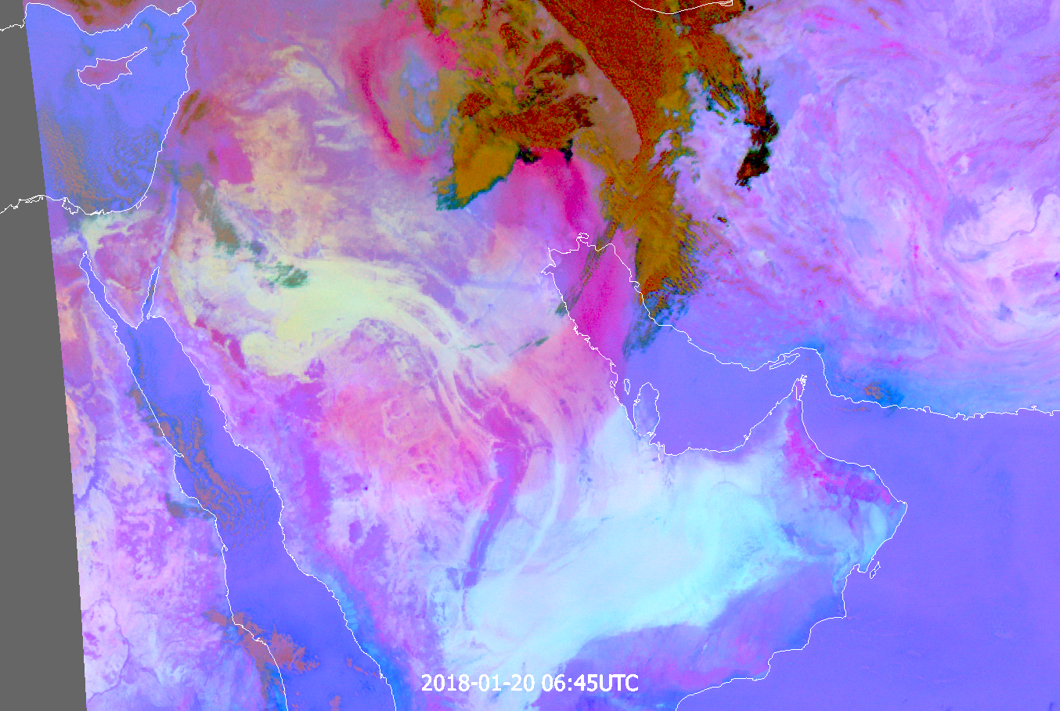

Slide 17
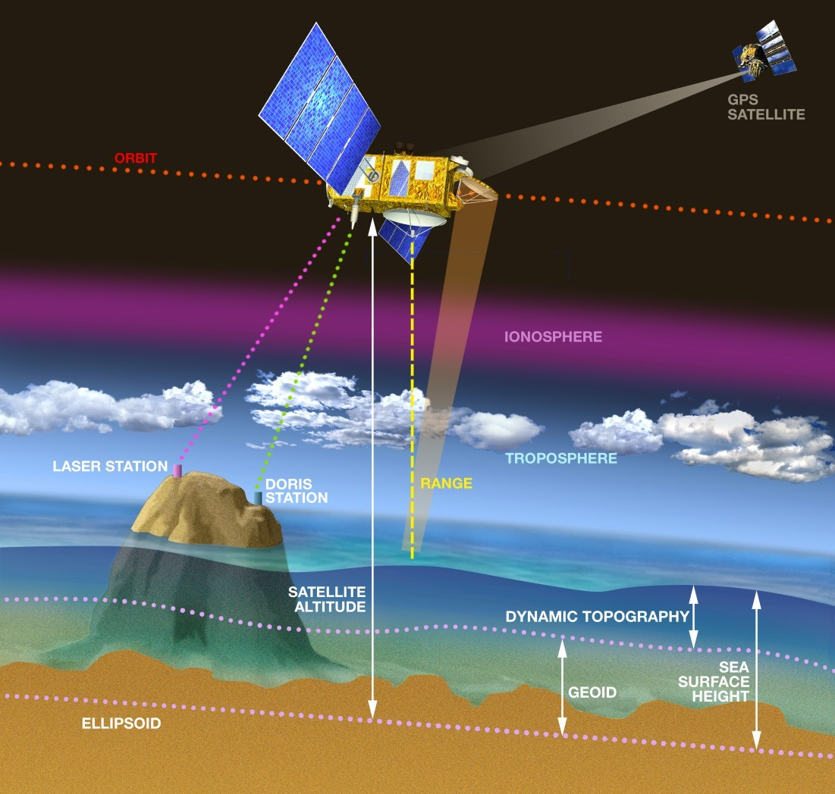
Satellite altimetry
1,250 kilometers altitude.
Sentinel-2
Res 300 m

Slide 18
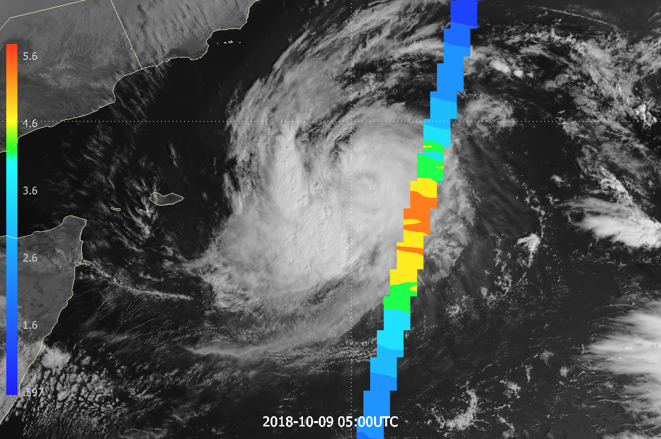
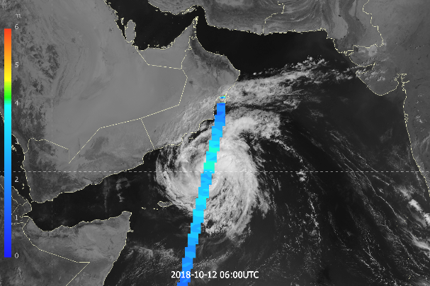

Slide 20
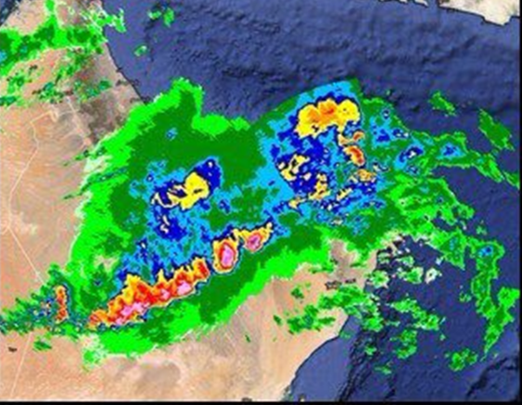
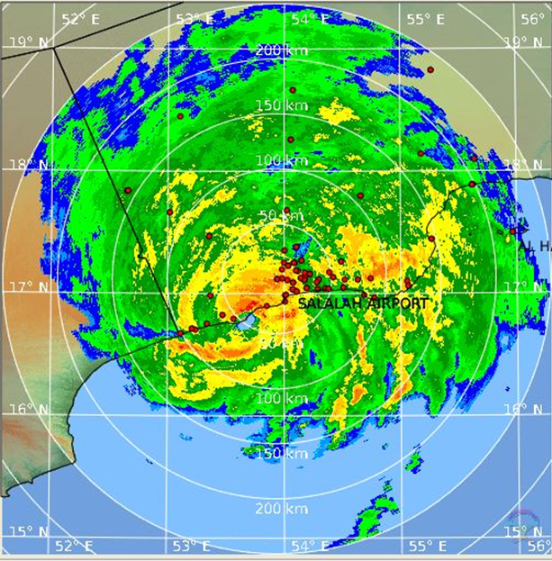

Slide 21
Thank you

