Slide 1
EARTH’S ATMOSPHERIC CIRCULATION
Lecturer: Afada AL-Hubaishi
Aug,2024
Directorate General of Meteorology
01

Slide 2
Content
Differential Heating
Global Air Circulation
Coriolis Effect
Prevailing Wind
Jet Stream
02

Slide 3
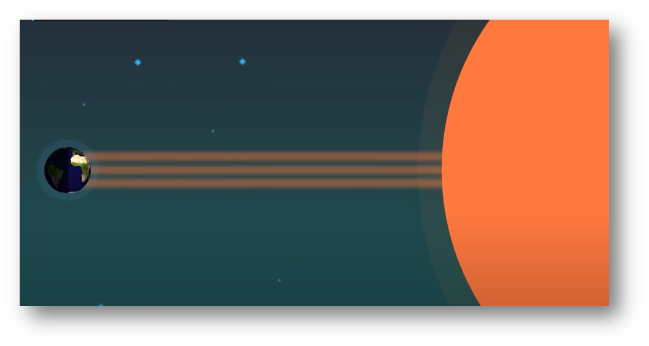
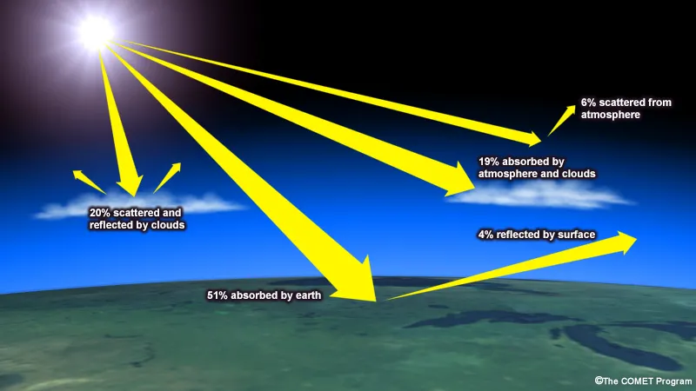
Differential Heating
The main source of heat on the Earth is the Sun Radiation
In the Earth atmosphere, the sun Radiation either ; Scattered, absorbed or transmitted through the cloud, atmospheric gases and Earth surface.
03

Slide 4
Differential Heating
01.
Some Parts of earth receive more radiation than others
This Cause: Big Temperature difference between the Earth Pole and Equator.
What is the Cause of this Difference?
04

Slide 5
Differential Heating
01.
Why there are different temperatures across the Earth’s surface?
Earth Curvature
Interaction with atmosphere
The Earth’s Tilt
The Albedo of Snow and Ice
The combined of all these process led to temperature differences across the Earth’s surface
05

Slide 6
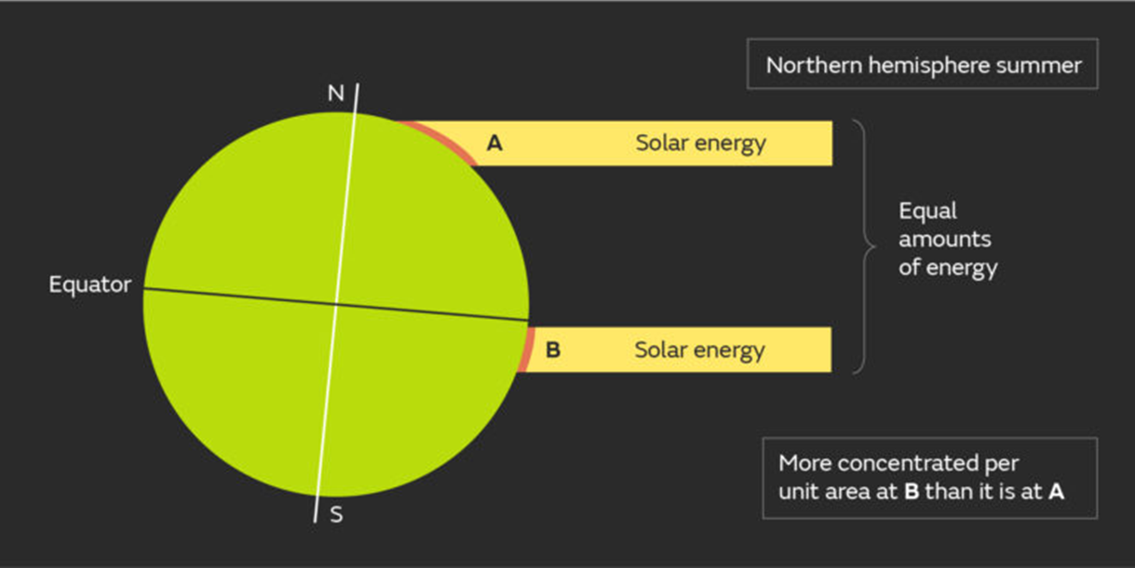
The Curvature Of The Earth
01.
The curvature of the Earth means that at higher latitudes, the solar energy is spread over a much larger surface area, while the same amount of energy is much more concentrated at the equator.
06

Slide 7
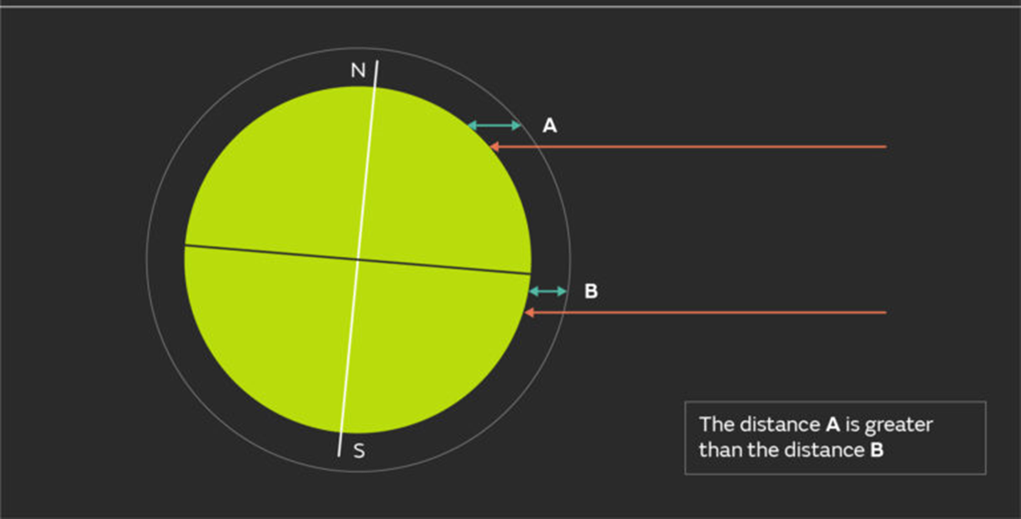
Interaction With Atmosphere
The curvature of the Earth results in solar energy having a larger amount of atmosphere to travel through to reach the Earth’s surface near the poles than towards the equator
01.
More radiation is lost to scattering and absorbing by atmospheric gases at the poles.
07

Slide 8
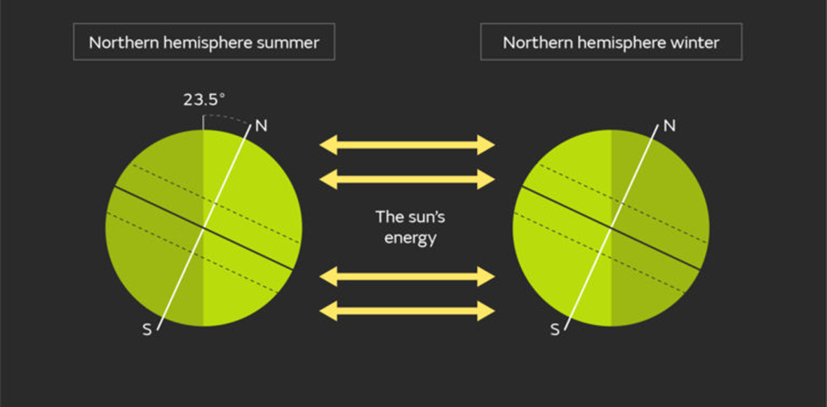
The Earths Tilt
Why there are different temperatures across the Earth’s surface?
01.
The spin of the Earth results in day and night, and the tilt of the axis gives us our seasons
The title of the Earth means the polar region don’t see the daylight during winter
08

Slide 9
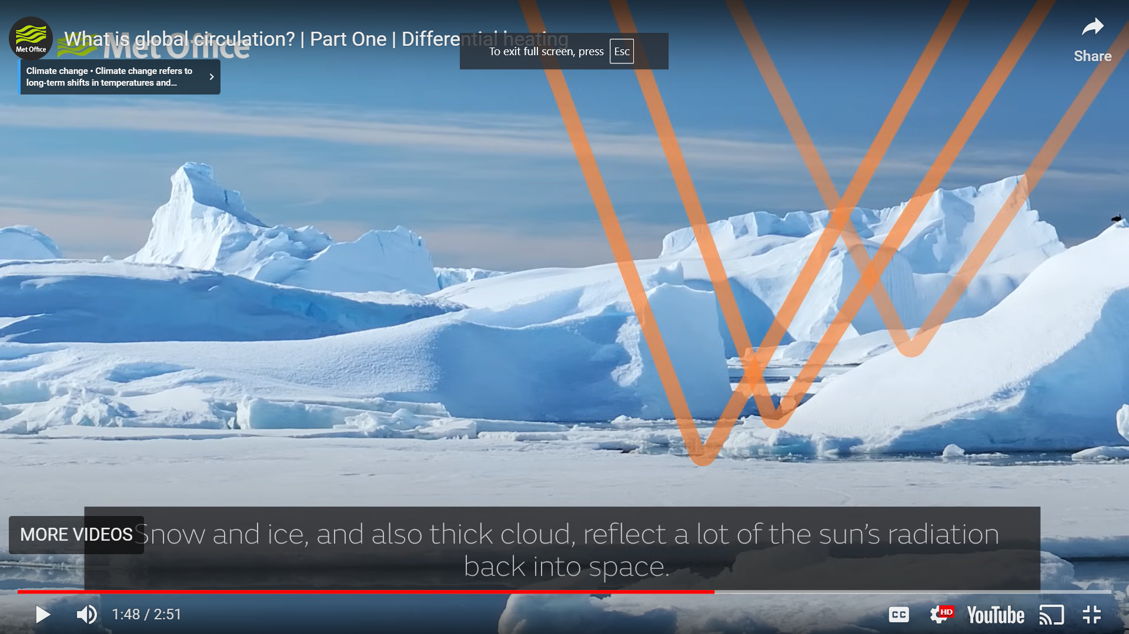
The ALBEDO (REFLECTIVITY) of Underlying Surface
Why there are different temperatures across the Earth’s surface?
Albedo is the fraction of light that a surface reflects
01.
Thick cloud, Snow, Ice has high albedo, reflects a lot of Sun’s radiation to the space
09

Slide 10
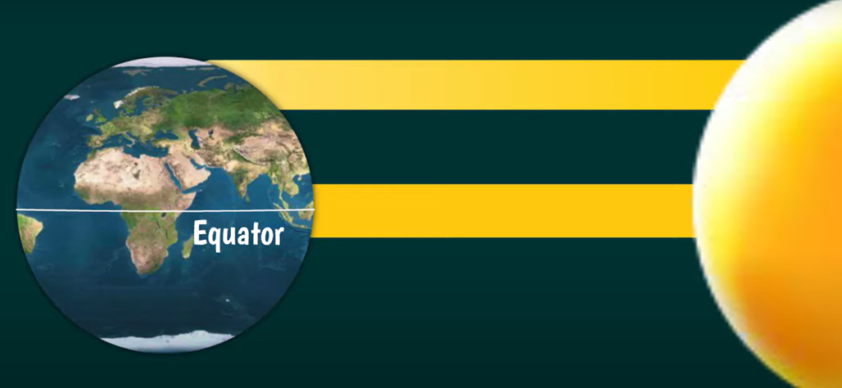
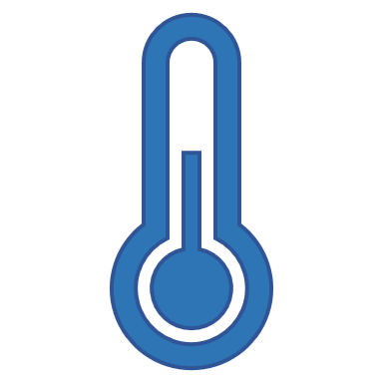
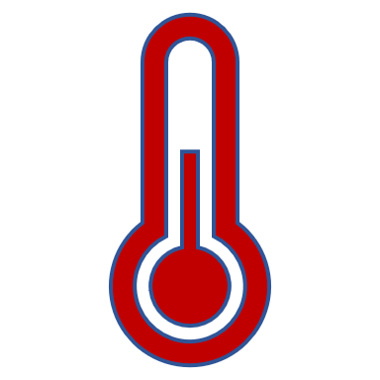
Redistribution of the Heat
Warm expand and become lighter rises and replaced with dense cold air
01.
Hot air rises
Cool air replaces Hot air rises
10

Slide 11
Redistribution of the Heat
01.
Hadley Cell:
At low latitudes, air moves toward the equator, where it is heated and rises vertically up to tropopause.
In the upper atmosphere, air moves poleward. This forms a convection cell that covers tropical and sub-tropical climates.
10 -12 km
11

Slide 12
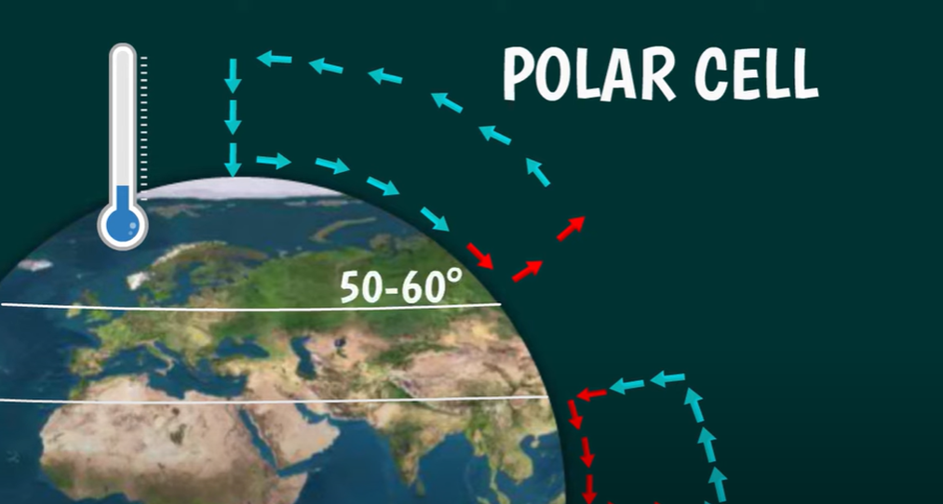
Redistribution of the Heat
Polar Cell:
At higher latitudes (50-60), air rises and travels toward the poles.
Once over the poles, the cool air sinks, forming areas of high atmospheric pressure called the polar highs.
It is the smallest and weakest of the cells.
12

Slide 13
Redistribution of the Heat
Ferrel Cell:
Spin in the opposite direction.
It is not driven by temperature. It only exist because of the presence of Polar and Hadley Cells.
13

Slide 14
Redistribution of the Heat
These Cells prevent the poles from getting colder and the equator from getting hotter.
14

Slide 15
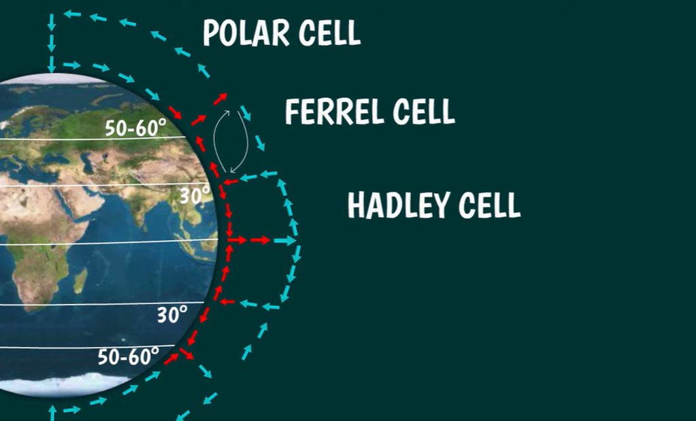
Redistribution of the Heat
The positions of the cells varies with seasons shifts few degrees to North during Summer and to the South during Winter in Northern Hemisphere.
01.2QAZS QSDEEEEEE
Summer
Winter
15

Slide 16
Global Earth Circulation
This large-scale movement of air (Three Cells) that helps distribute heat and moisture around the Earth is called Global Atmospheric Circulation.
Atmospheric circulation - the movement of air around the Earth that distributes heat.
16

Slide 17
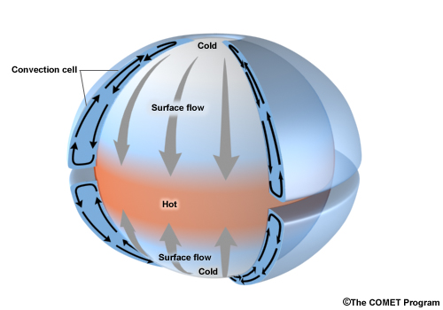
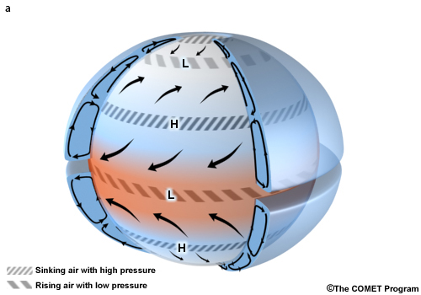
Why Global Air circulation has Three cell?
Effect of earth spinning and tilt
17

Slide 18
Coriolis Effect
Coriolis Effect:
Coriolis Effect is an apparent deflection of the path of an object that moves within a rotating coordinate system. The object does not actually deviate from its path, however, it appears the same because of the motion of the coordinate system.
How Coriolis Force deflect the Wind direction??
The earth complete a rotation cycle each 24hours
The Earth is wider at equator.
< 1km
> 40,000Km
The Earth has to be more faster at the equator than the pole to rotate in a one day.
18

Slide 19
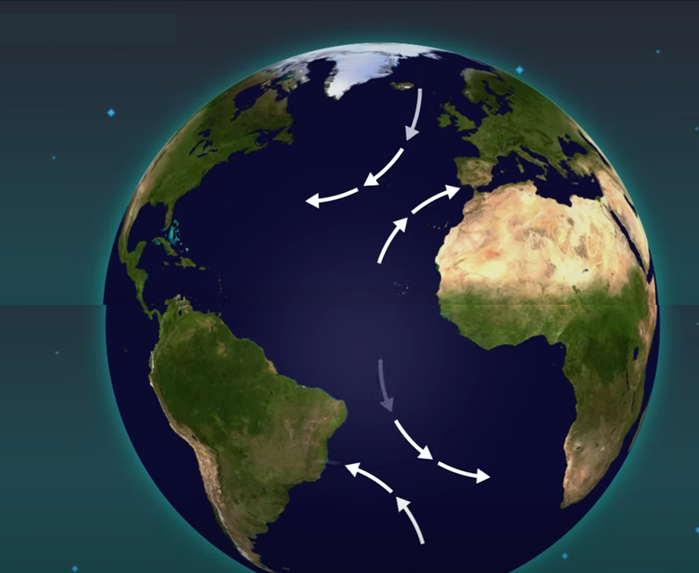
Coriolis Effect
What cause the Wind deflection?
In Northern Hemisphere:
When air moving towards the Equator , deflects Westward.
When air moving towards the North pole deflects to the Eastward.
In Southern Hemisphere:
When air moving towards the Equator , deflects to Eastward.
When air moving towards the North pole deflects to the Westward.
19

Slide 20
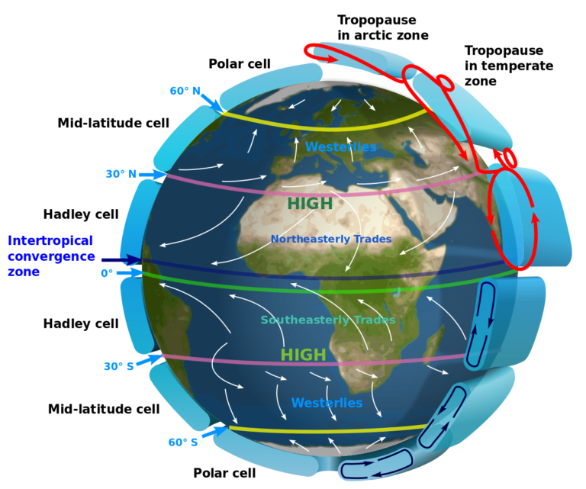
Prevailing Wind
High & Low pressure distribution
Prevailing Wind
Trade Wind
20

Slide 21
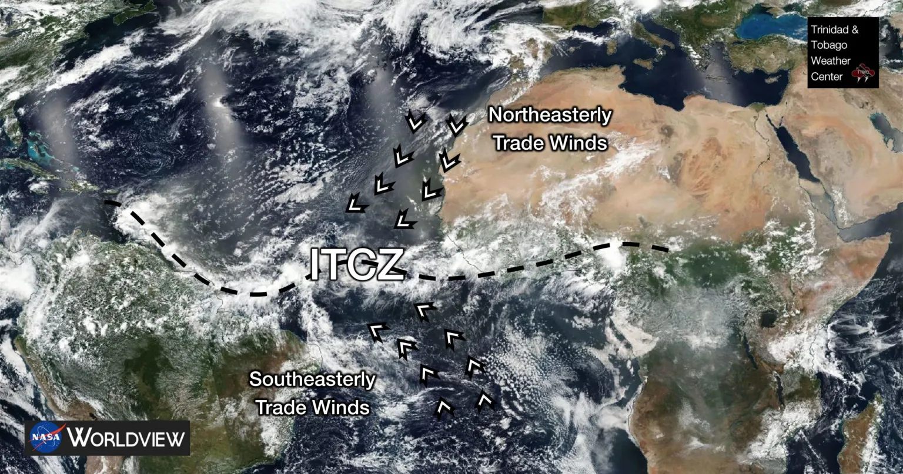
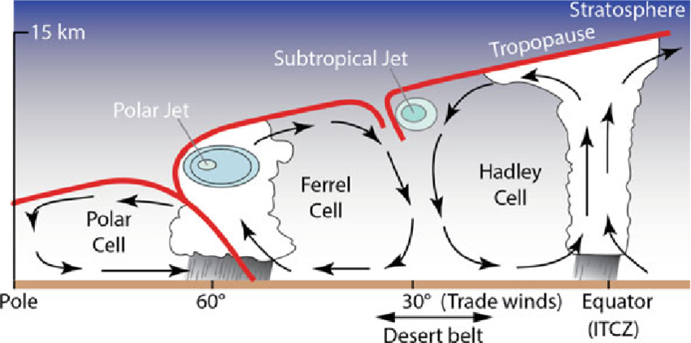
Intertropical Convergence Zone (ITCZ)
The ITCZ is part of Global Air Circulation, an area where the northeast trade winds from the Northern Hemisphere and southeast trade winds from the Southern Hemisphere meet and converge. These trade winds originate from sub-tropical highs.
21

Slide 22
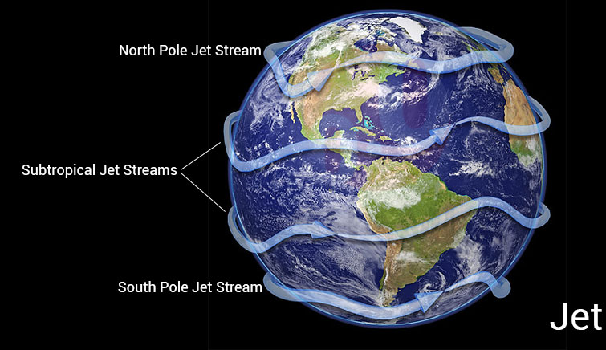
Jet Stream
Jet streams are bands of strong wind that generally blow from west to east all across the globe. They impact weather, air travel and many other things that take place in our atmosphere.
The major Jet Streams are founded just below tropopause at height ranging from 9 to 16 Km.
Reach speed of 200mph
Its flow West to East follow the Earth rotation.
The major Jet Streams :
Two Pole Jet Stream
Two Subtropical Jet Stream
22

Slide 23
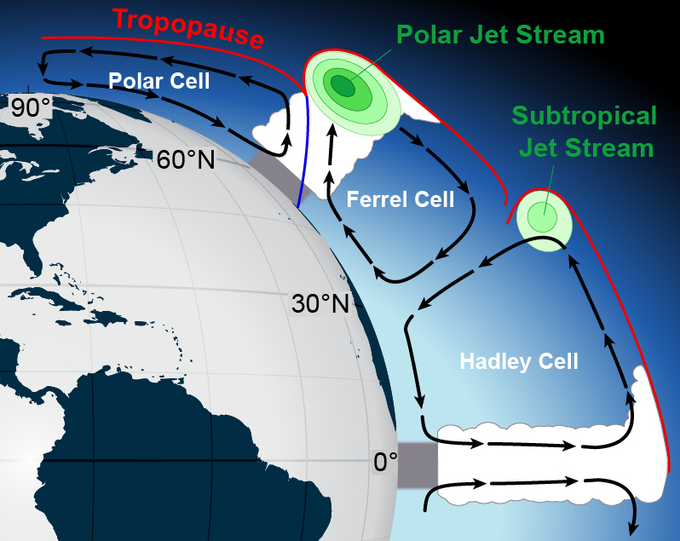
Jet Stream Effect
At 30°N the air descends, the latitude where most deserts are located (Subtropical Jet Stream)
At 60°N, rising air leads to much rainfall and many of the world’s forests. (Polar Jet Stream)
23

Slide 24
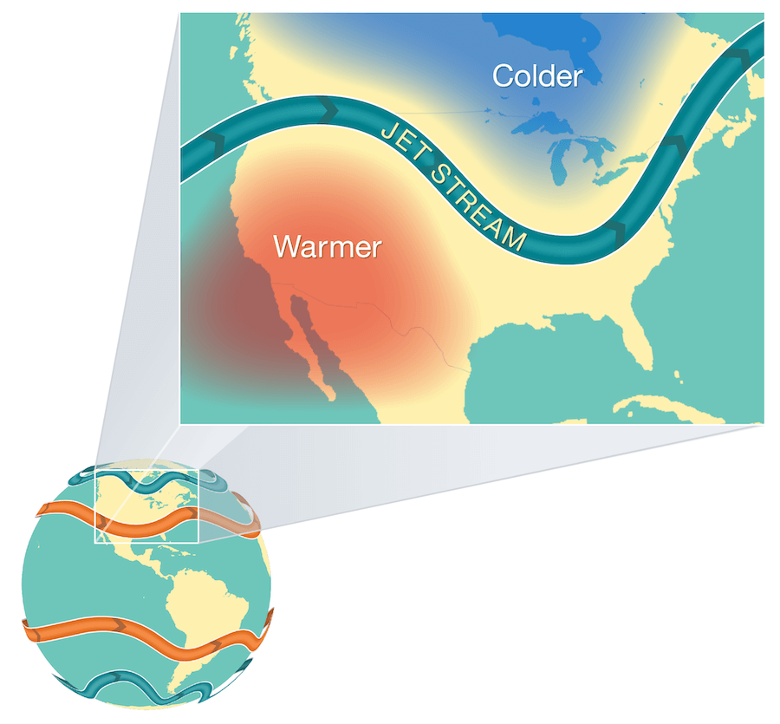
What Cause Jet Stream Effect
The atmosphere’s response to where the temperature gradient is strongest (which is also where the greatest density change occurs).
24

Slide 25
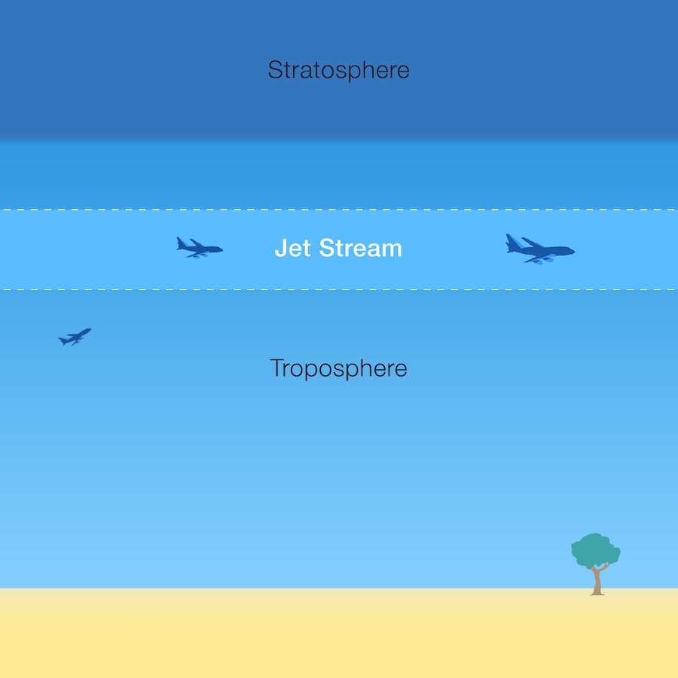
How Do Jet Streams Affect Air Travel?
Airplanes can fly in the jet stream. When they’re both headed in the same direction, airplanes can get a boost in speed from this fast moving air current.
25

Slide 26
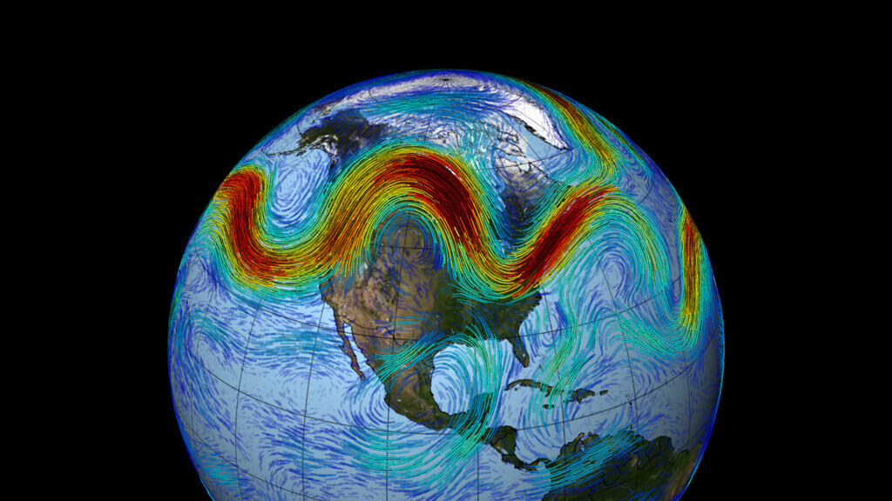
How Do Jet Streams Affect Weather?
The fast-moving air currents in a jet stream can transport weather systems across from West to East, affecting temperature , humidity and precipitation.
However, if a weather system is far away from a jet stream, it might stay in one place, causing heat waves or floods.
26

Slide 27
Thanks
Please Scan the Q-code
Directorate General of Meteorology

