Slide 1
Oman summer weather
Marine Meteorological Course for Royal Oman Navy
Lecturer: Bushra Al Saadi, Meteorologist

Slide 2
Content
Why we have seasons on earth?
Air masses affecting Sultanate of Oman
Cloud formation
Convection clouds(local)?
Monsoon

Slide 3
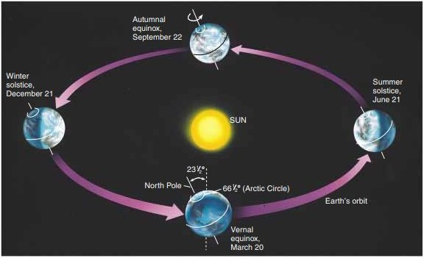
Why we have seasons on earth?
Notes:
As the earth spins on its axis, producing night and day, it also moves about the sun in an elliptical (elongated circle) orbit that requires about 365 1/4 days to complete. The earth's spin axis is tilted with respect to its orbital plane. This is what causes the seasons. When the earth's axis points towards the sun, it is summer for that hemisphere. When the earth's axis points away, winter can be expected.

Slide 4
The Seasons
2nd transitional period
From 22nd September to 20th December
Winter
21st December to 21st March
Summer
1st transitional period
21st June to 21st September
From 22nd March to 20th June

Slide 5
Subject 1:
Air masses
Air masses influence Sultanate of Oman Climate
Air masses affecting Sultanate of Oman

Slide 6
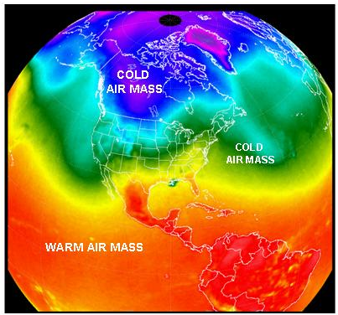
Subject 1: Air masses
Air masses are…
A large body of air sits over an area of
land or water for a long period of
time, it will take on the characteristics
of the land or water beneath it.
Named for their SOURCE REGION
Continental (c)
Maritime (m)
Arctic (A)
Polar (P)
Tropical (T)
When Air Masses move they bring their temperature and humidity to new areas.

Slide 7
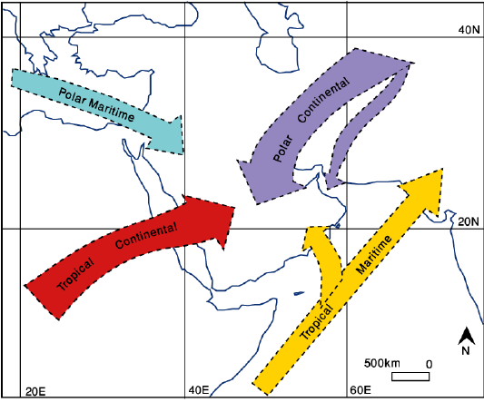
Subject 1:Air masses influence Sultanate of Oman Climate:
During winter
Originates over central Asia
low temperatures at the surface
Stable atmosphere
Occasionally out break
Frequently active During winter
North Atlantic
Cold front with TS developing
Strong winter Shamal wind
During Summer
north Indian Ocean
low temperatures + rain
Oman SE Coasts
late First Transitional and early summer
North Africa
low humidity , very high temperatures (often in excess of 45°C)
Hazy conditions invariably prevail, Dust

Slide 8
Subject 2:
Ingredients needed for cloud to form
How does water vapour get’s into the air?
Cloud formation mechanism
Cloud’s formation

Slide 9
Subject 2: Ingredients needed for cloud to form
vapor Water (water as a gas)
Conditions favoring the change of state (from gas to liquid or ice)
A flatter surface for water vapor to condense on (condensation nuclei)
1
2
3

Slide 10
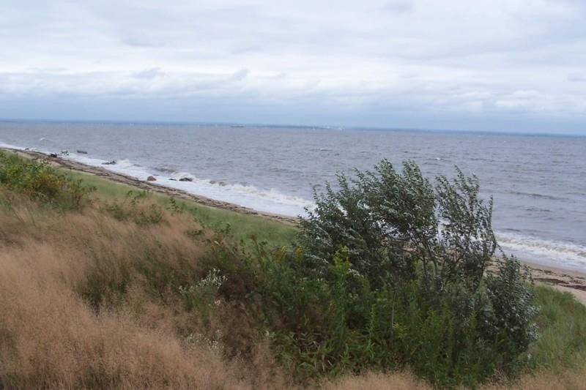
How does water vapour get’s into the air?
T
E
E
E
T
T
Notes:
By evaporation and transpiration

Slide 11
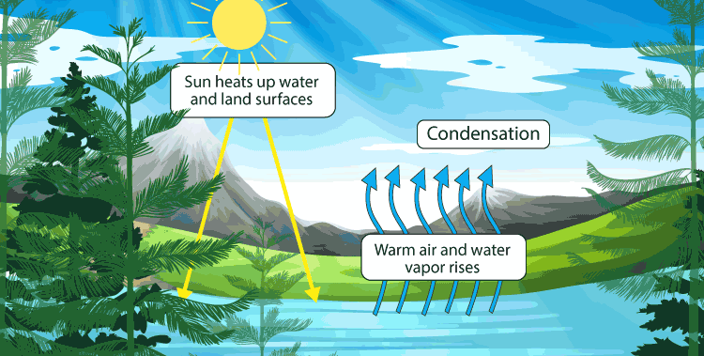
Subject 2: Cloud formation mechanism
Air rises and the water vapour within it cools.
When enough vapour condenses around the nuclei, a cloud droplet is formed.
water vapour collides with and sticks to tiny particles floating in the air - condensation nuclei forms- which include aerosols such as salt and dust.
As vapour rises and cools, these nuclei provide the surface for the vapour to condense onto.
Then combined to make a cumulus cloud.
Sometimes these water droplets combine to become larger drops or crystals.
If they become large enough and too heavy, they will gradually fall from the sky as " precipitation".

Slide 12
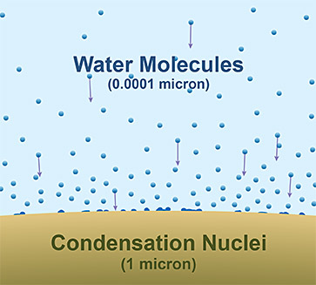
Notes:
These nuclei are minute solid and liquid particles found in abundance in the atmosphere, such as smoke from fires or volcanoes, ocean spray, or tiny specks of wind-blown soil. They are hygroscopic, meaning they attract water molecules, and are about 1/100th the size of a cloud droplet upon which water condenses.
This means that every cloud droplet has a speck of dirt, dust, or salt crystal at its core. However, even with its condensation nuclei, a cloud droplet is still essentially made up of pure water.
Condensation nuclei allow a water droplet to grow to a size large enough that can now avoid being dried out by evaporation.
Condensation nuclei hold the liquid droplets long enough so another vapor molecule can condense on it.
Due to condensation nuclei, clouds can form even at relative humidity that is below 100%! (Even as low as 75%!)

Slide 13
Subject 2: What causes the air to rise?
The sun – The sun heats the ground, which then heats the air just above it, causing it to rise upwards in the sky (warm air rises). This tends to produce cumulus clouds.
Hills and mountains - When air is travelling towards a mountain or hill, it cannot go into the hill and so it rises upwards along the terrain. Stratus clouds are often produced this way.
Weather fronts - A weather 'front' is where warm air meets cold air. The warm air rises up and over the cold air (warm air rises). This produces nimbostratus clouds, amongst others.
Convergence - Streams of air flowing towards each other from different directions are forced to rise when they meet, or converge. This can cause cumulus cloud and showery conditions.
Turbulence - A sudden change in wind speed high up can create circulations in the air which can bring the air at the surface high up into the sky.

Slide 14
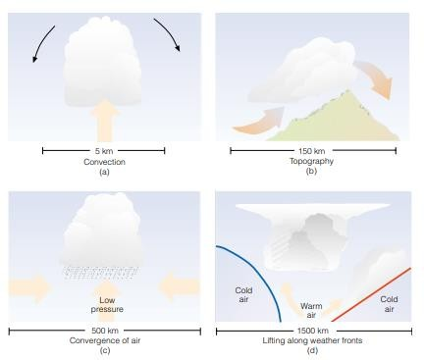

Slide 15
Subject 3:
How convection clouds form?
26th – 28th June 2022(Local event)
28th July 2023(Local event )
Convection cloud
https://www.youtube.com/watch?v=YJCW4zuoMM0

Slide 16
How convection clouds form?

Slide 17
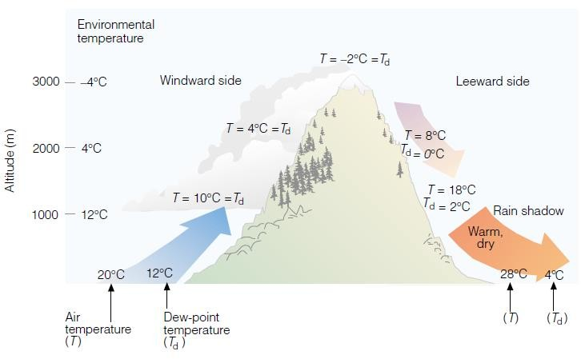
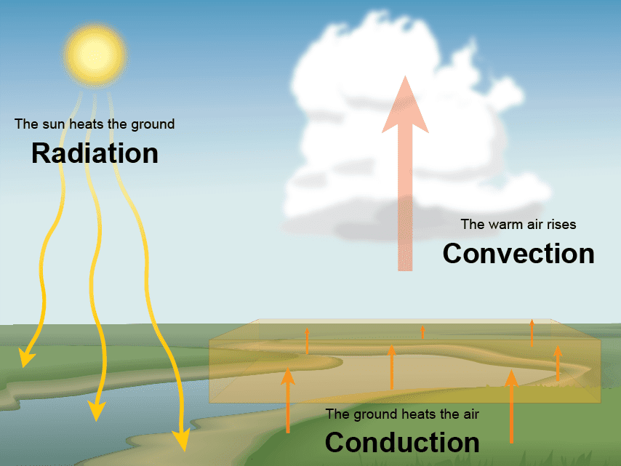
Notes:
How convection cloud form?
The Sun heating the ground (by radiation),
then heats the air above (by conduction),
then rises due to convection
(is less dense than the cooler air surrounding it.)

Slide 18
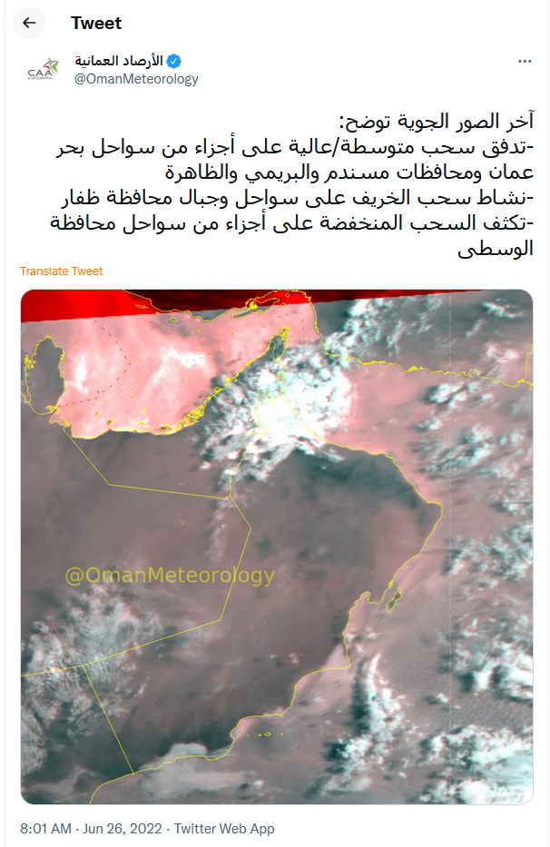
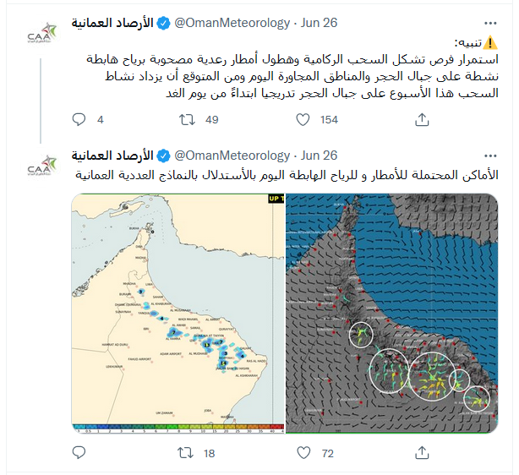
26th – 28th June 2022

Slide 19
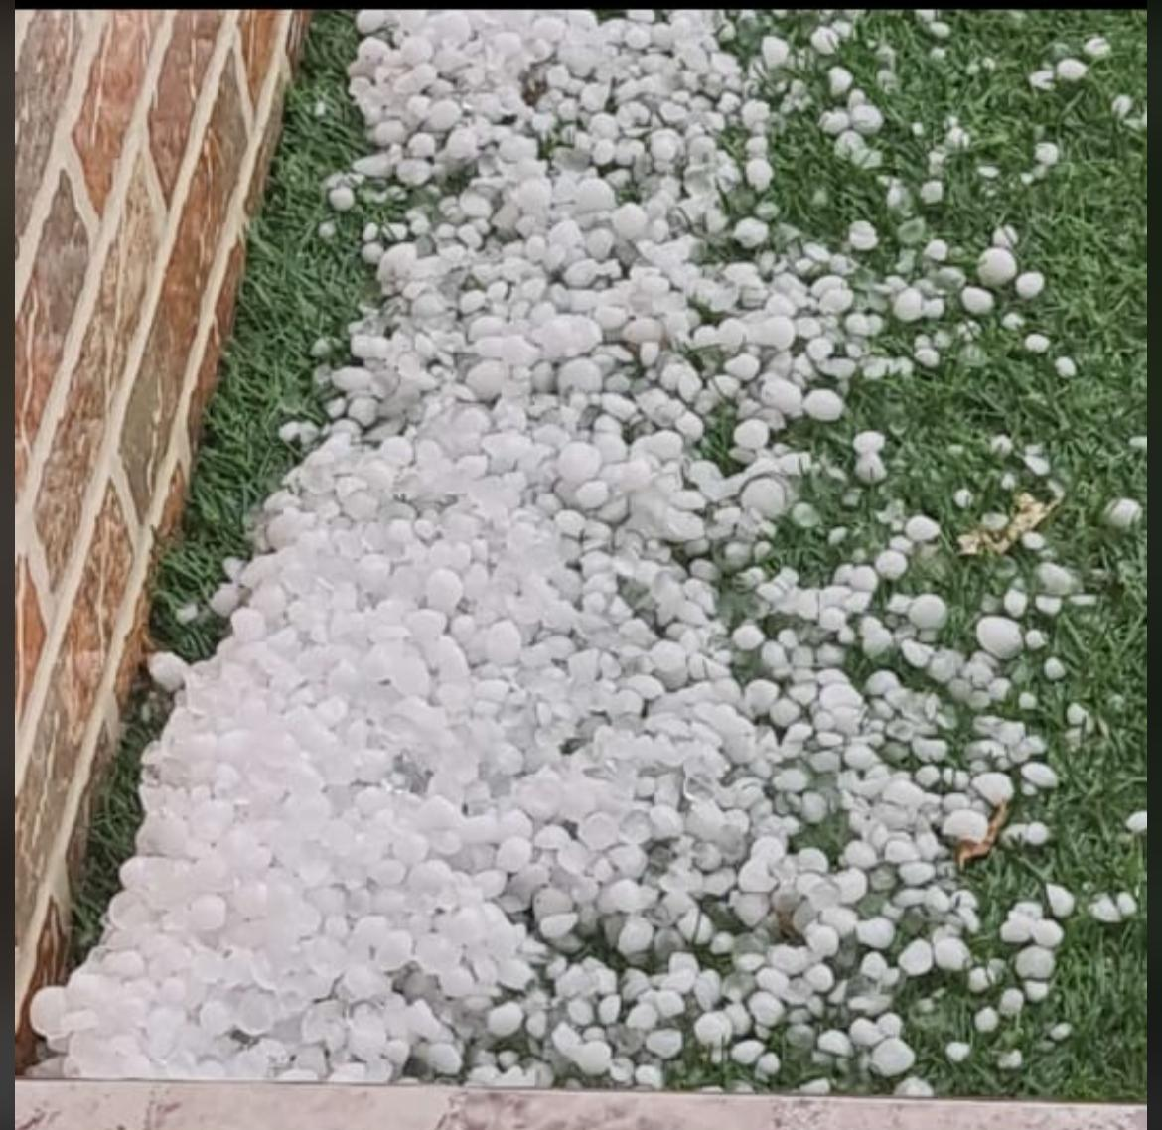

Slide 20
28th July 2023(Local event)
Main parameters:
Lifting mechanism
Humidity
High surface temperature
convergence

Slide 21
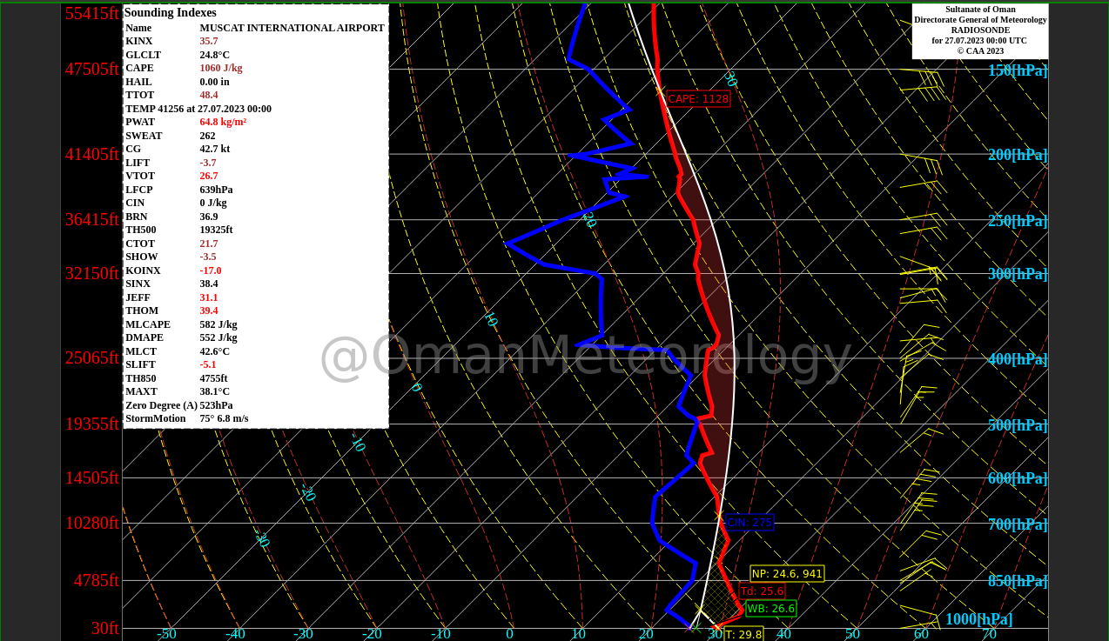
Radiosonde for Muscat 00 UTC

Slide 22
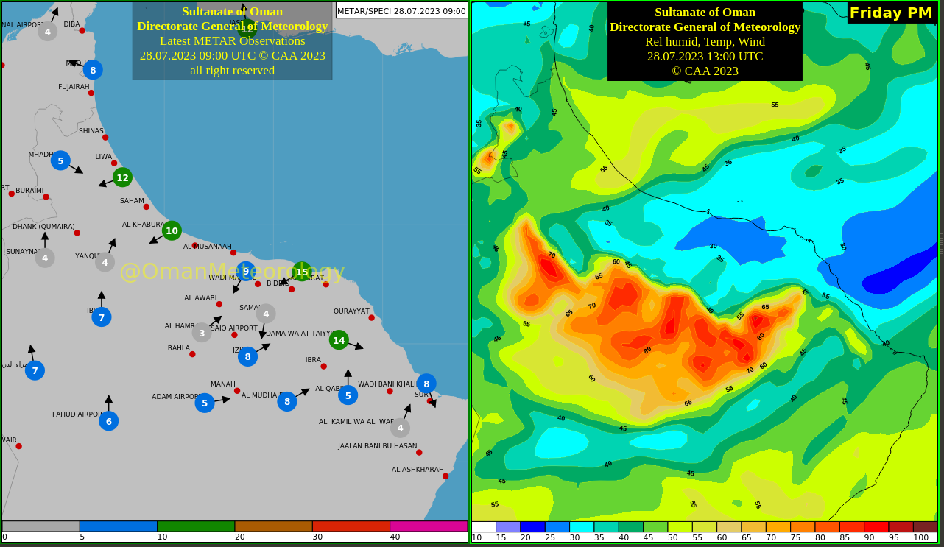
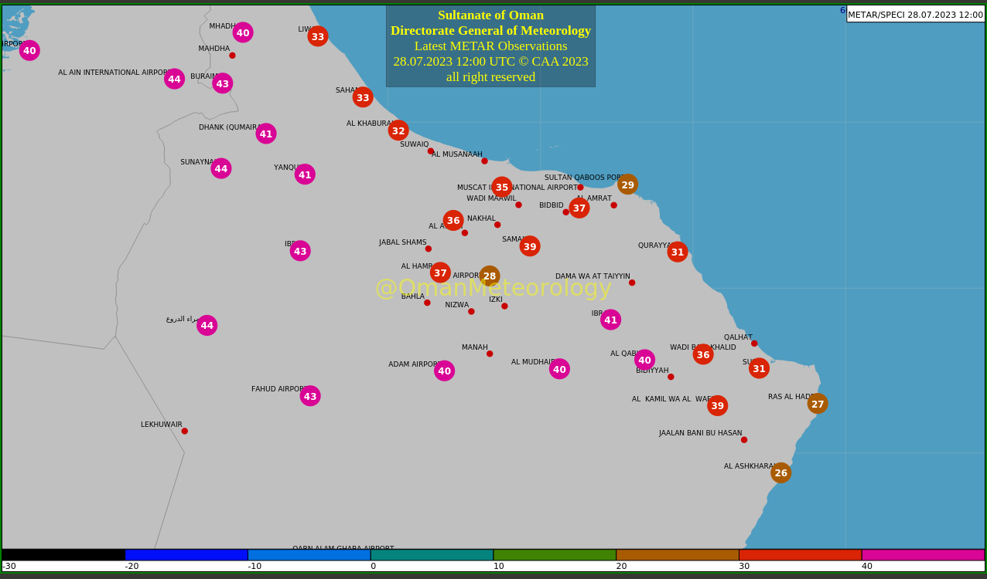
Temperature
Winds & RH

Slide 23
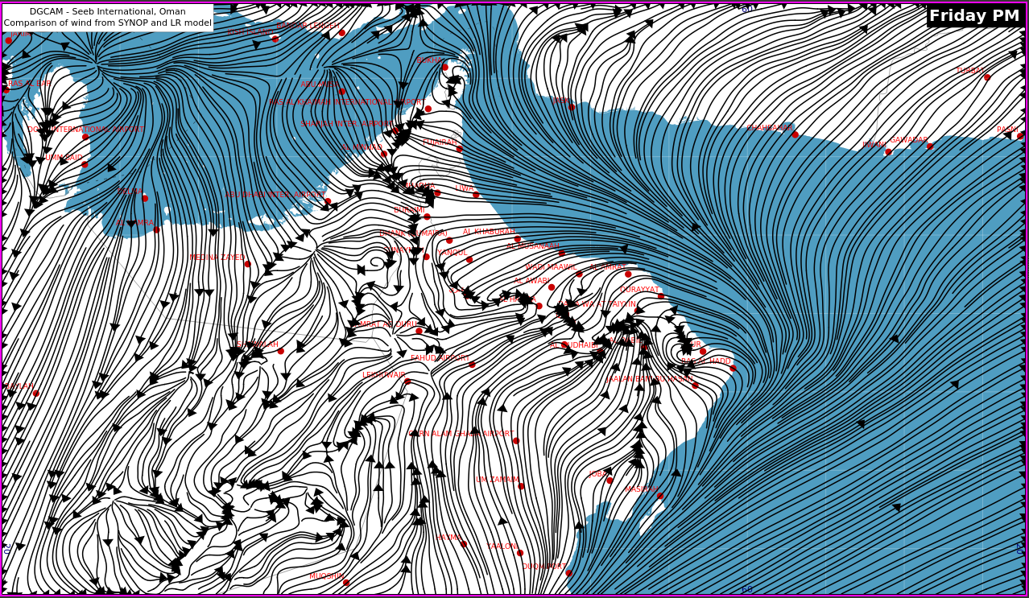
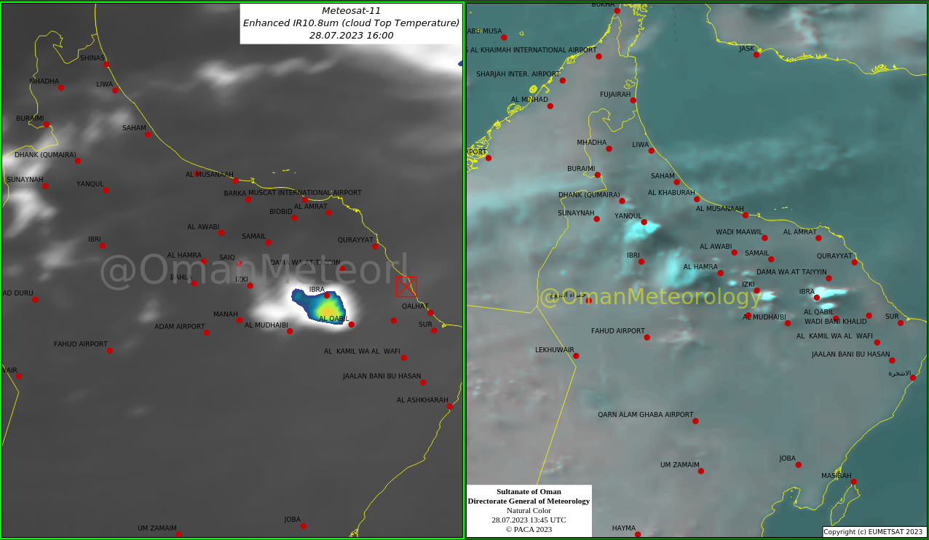
Satellite Images
Stream line

Slide 24
Subject 5:
Monsoon(Background)
Summer monsoon
Khareef
Monsoon

Slide 25
What is monsoon?
A monsoon is a shift in winds that often causes a very rainy season or a very dry season. Although monsoons are usually associated with parts of Asia, they can happen in many tropical and subtropical regions.

Slide 26
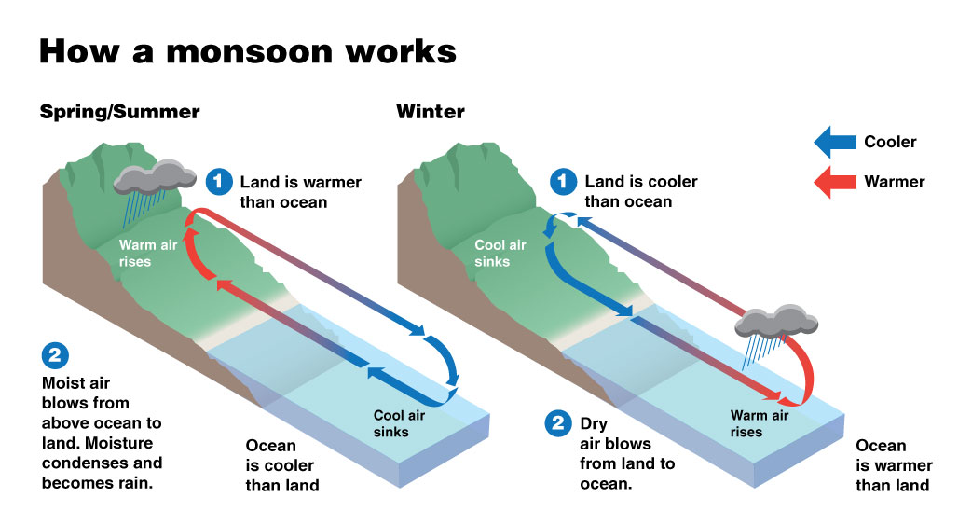
What causes a monsoon?
A monsoon is caused by a seasonal shift in the winds. The winds shift because the temperature of the land and the temperature of the water are different as seasons change. For example, at the beginning of summer, the land warms up faster than bodies of water. Monsoon winds always blow from cold to warm. In the summer, warm air rising off the land creates conditions that reverse the direction of the wind.

Slide 27
Why does a monsoon cause rain?
The monsoons that cause heaviest rainfall are summer monsoons near the Indian Ocean. Warm water in the ocean evaporates, rising into the air. This causes the wind to change direction and moisture blows toward the land in countries such as India and Sri Lanka. The warm, moist air then condenses and becomes rain. The result is a period of humidity and heavy rainfall that can last for months.
When the wind changes direction in the winter, it is called a winter monsoon. Winter monsoons in these regions near the Indian Ocean are usually dry.

Slide 28
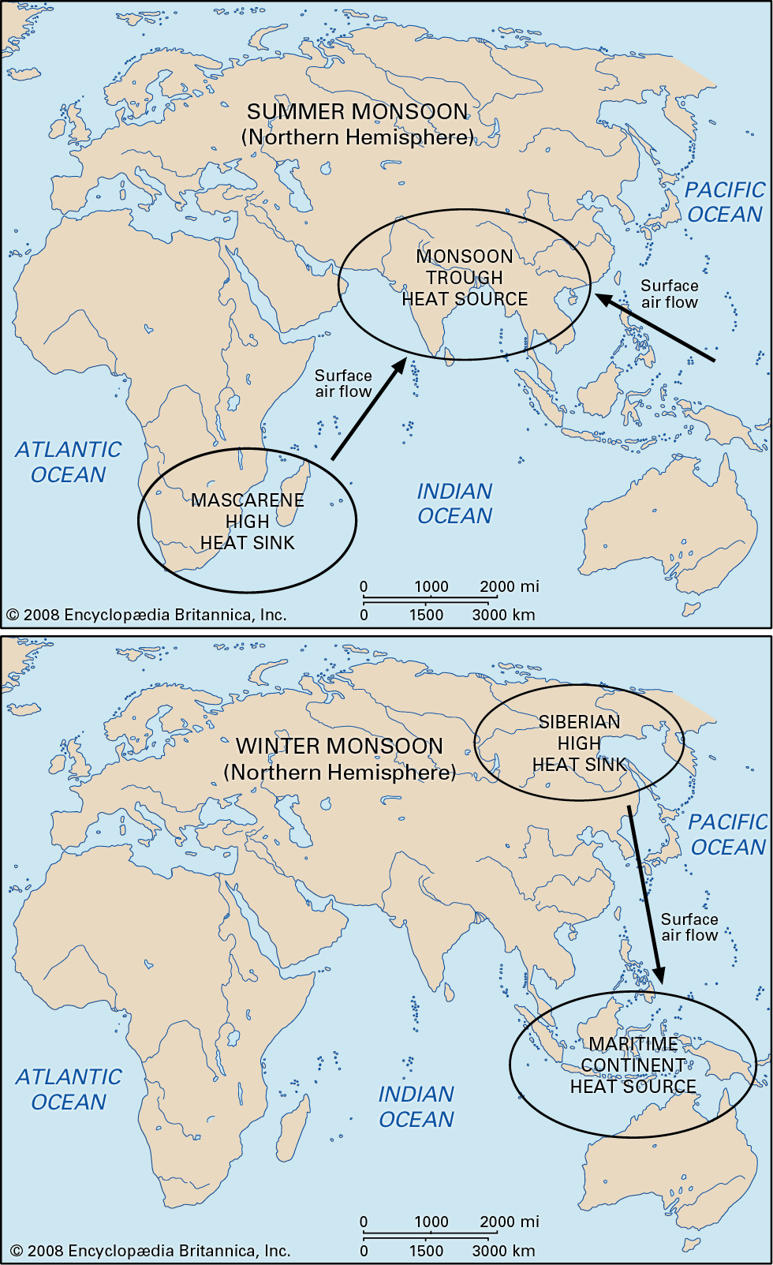
Summer monsoon components:
Monsoon Trough
Mascarene High anti-cyclonic system
The Tibetan high pressure system/Tropical easterly jet
The low level cross-equatorial jet
Notes:
the most prominent of the world’s monsoon systems, which primarily affects India and its surrounding water bodies. It blows from the northeast during cooler months and reverses direction to blow from the southwest during the warmest months of the year. This process brings large amounts of rainfall to the region during June and July.

Slide 29
Monsoon Trough
Formed over northern India.
Northern Hemisphere Summer as part of the global ITCZ.
Associated with surface low pressure.
Mascarene High anti-cyclonic system
Situated over the south-east Indian Ocean(30º S, 50º E).
The air moves north over the equator where it becomes a south- westerly flow known as the low level cross-equatorial jet.
Generates a large outflow of air.
Low level cross-equatorial jet
The jet splits in two branches at around 10º N, 60º E at this time.
Arrive over central west and southern coasts of India.
Important for rainfall amounts over western India.
Maximum intensity from June to August.
The Tibetan high pressure system/Tropical easterly jet
Upper level anticyclone.
Located over northern India above the surface monsoon trough; (low level convergence matched by upper level divergence)
Well established during summer.
Moves in a south-southeast direction following the zone of maximum surface heating and low pressure.
The outflow of air from the southern flank of the Tibetan high gives rise to the Tropical easterly jet.
Tropical easterly jet lasts from June to September.

Slide 30
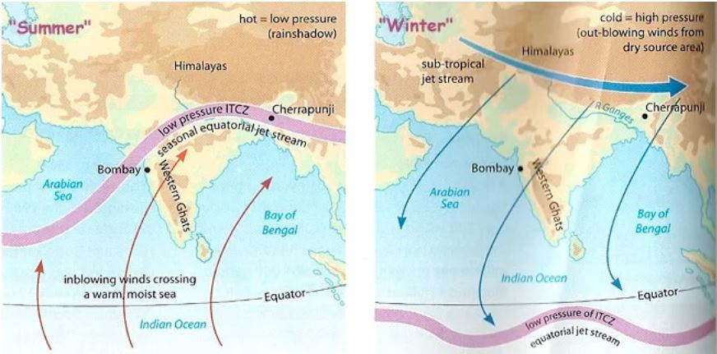

Slide 31
Main factors for Khareef
existing of thermal low over south east of Arabian peninsula.
Blowing northerly winds in 700 hpa layer.
Active SW monsoon winds.
Temperature and Dewpoint close to each other from surface till 800 hpa
Difference in pressure between OOTH station and OOSA station is around 4 mb.

Slide 32
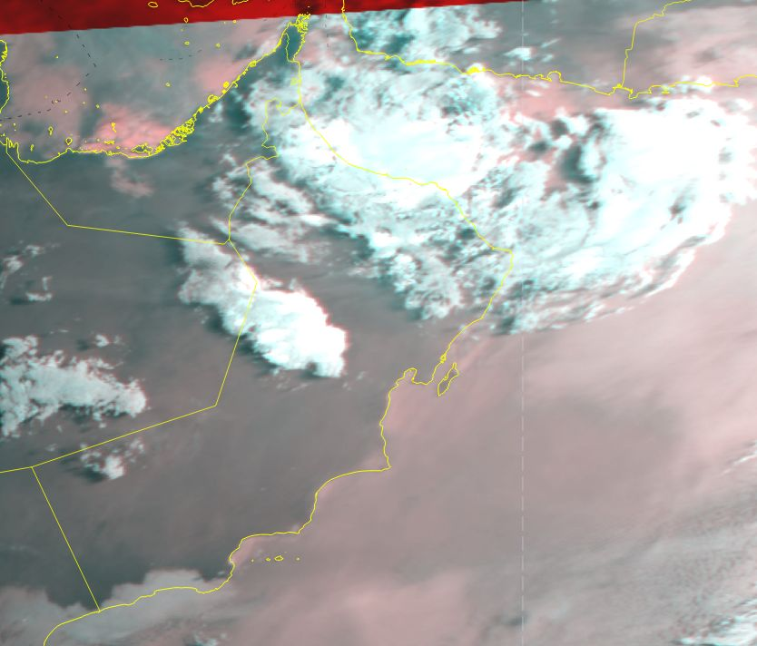

Slide 33
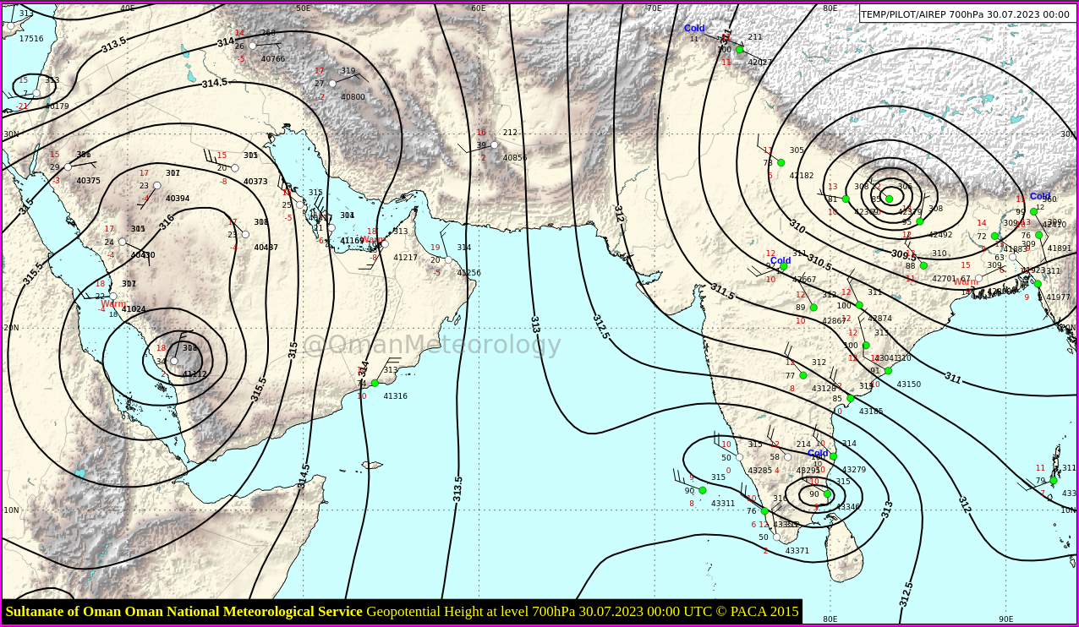
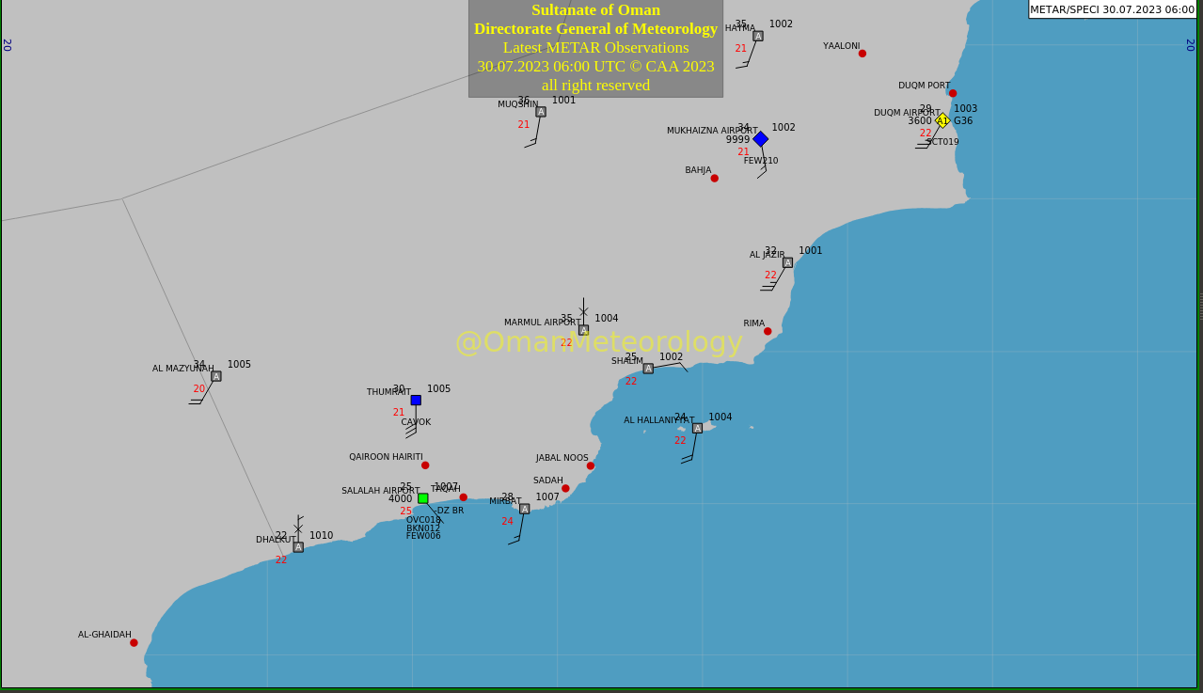
SW winds at sfc
700 hpa actual

Slide 34
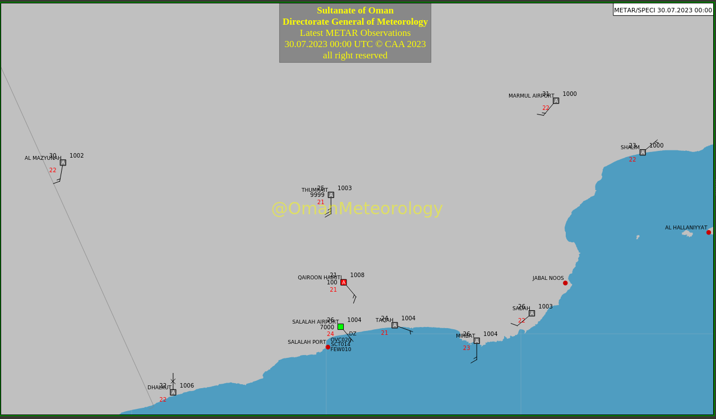
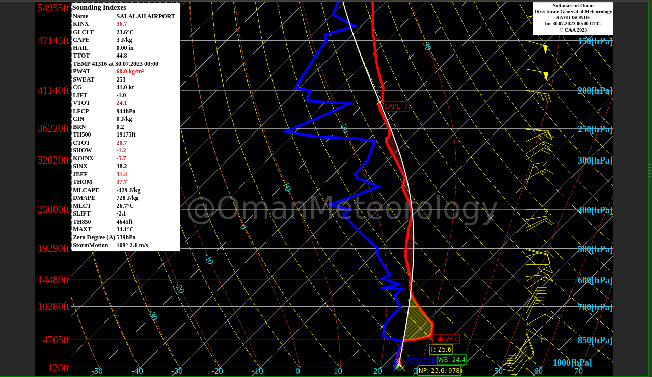
OOTH & OOSA
Radiosonde OOSA 00 UTC

Slide 35
Scan this
Kindly scan this “QR code” to evaluate this lecture.
Thank You!

