Slide 1
Basics of satellite RGBs and products
Ivan Smiljanic
EUMETSAT training team
20 March 2023, SAC Middle East course

Slide 2
Agenda
Why do we need products?
.
What kind of product do we have?

Slide 3
Agenda
Why do we need products?
.
What kind of products do we have?

Slide 4
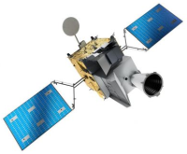
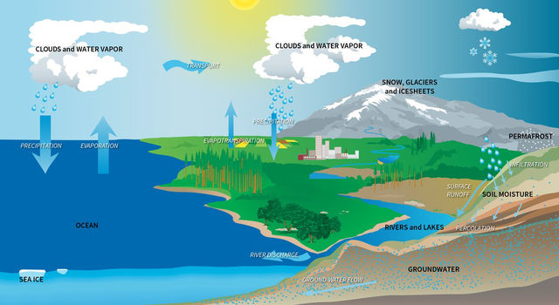
Earth, atmosphere, oceans – ‘panta rei’

Slide 5
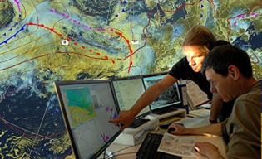
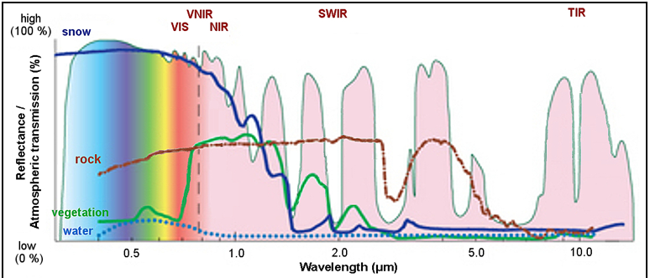
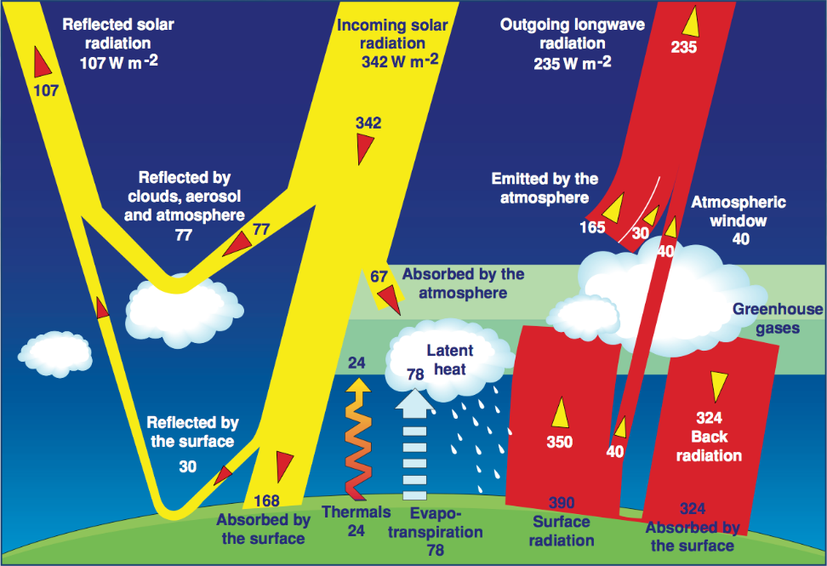
Photon to product
Solar
IR
ph

Slide 6
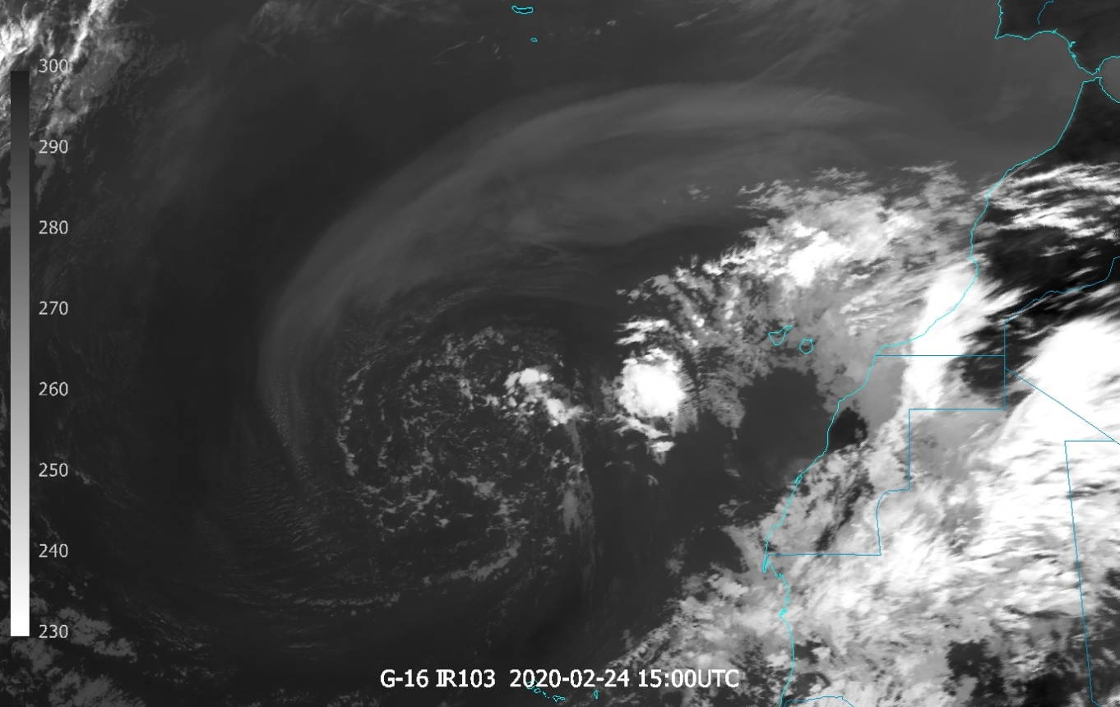
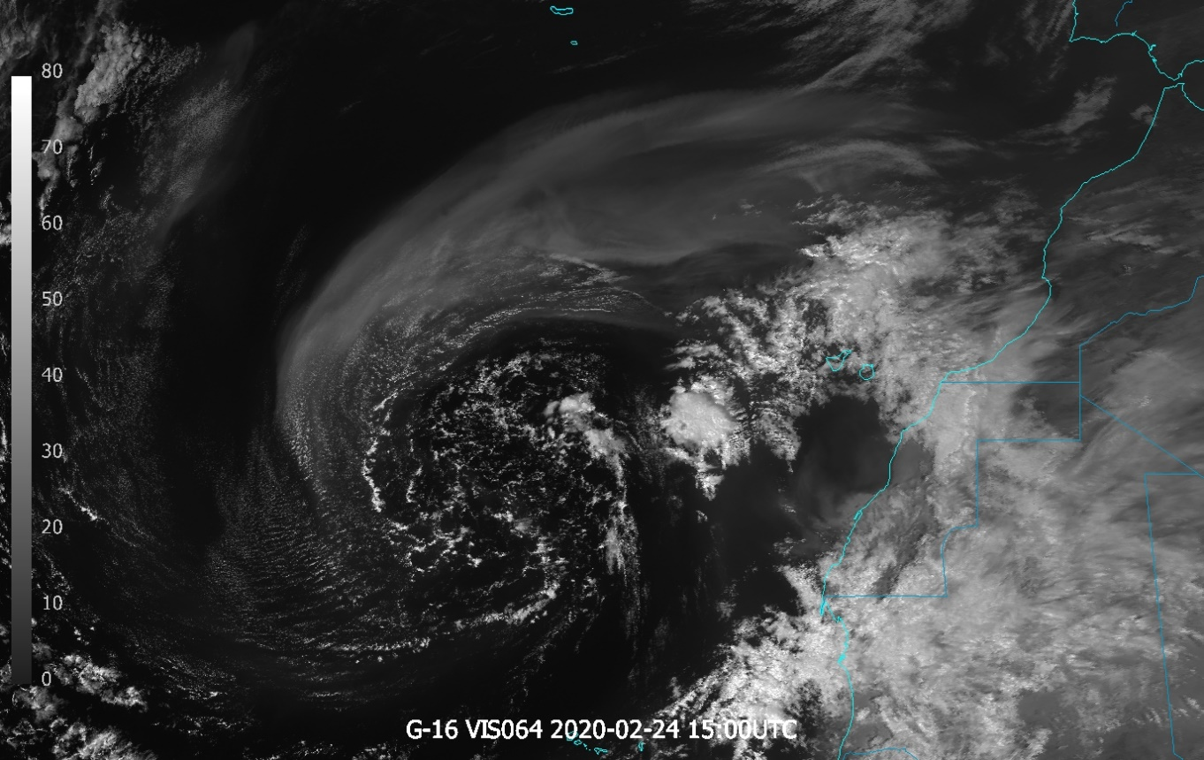
Solar and IR

Slide 7
Solar and IR

Slide 8
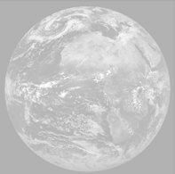
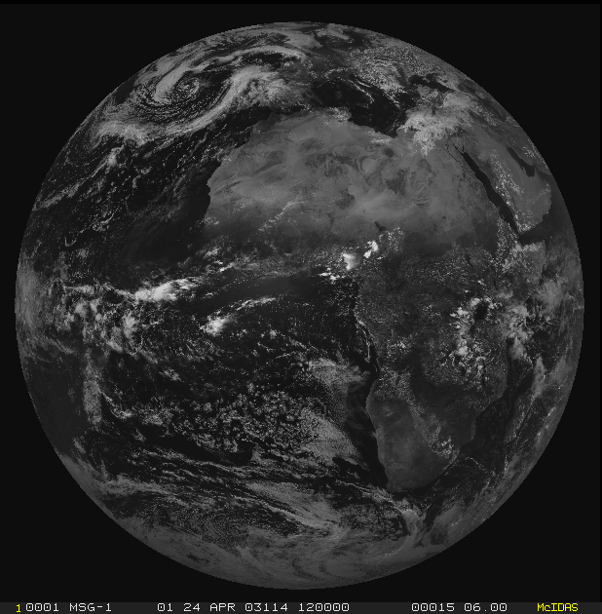
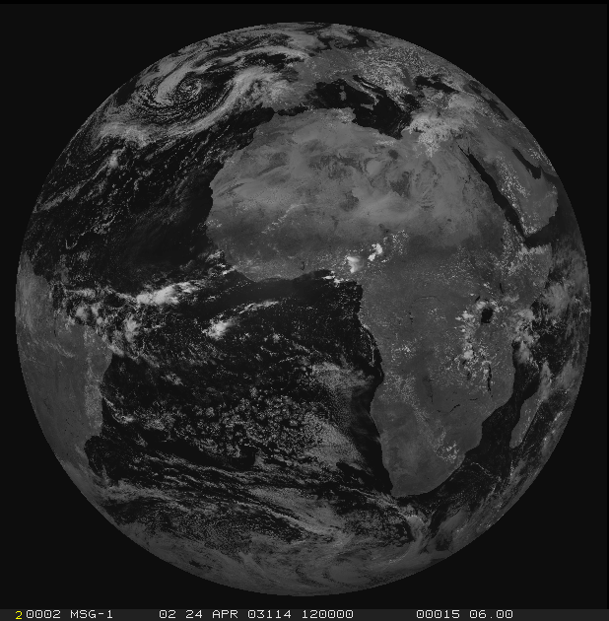
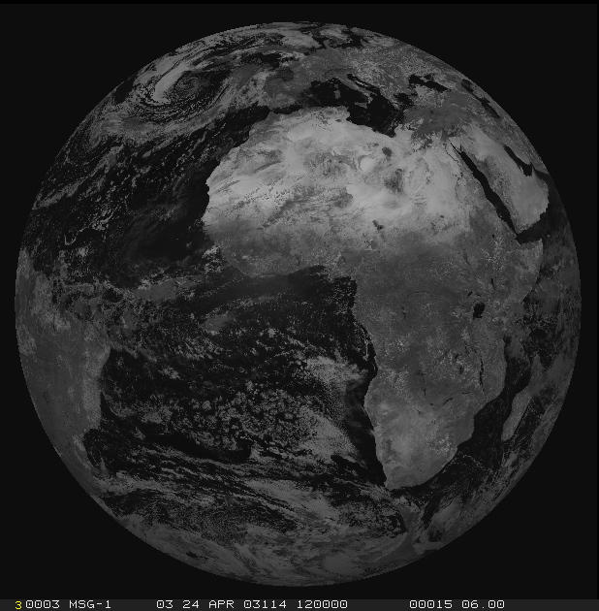
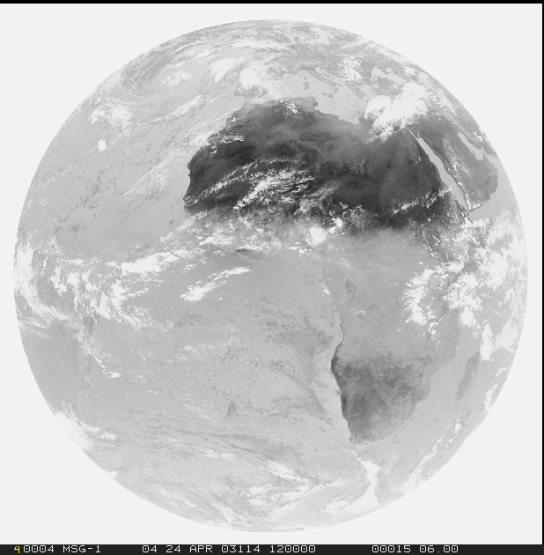
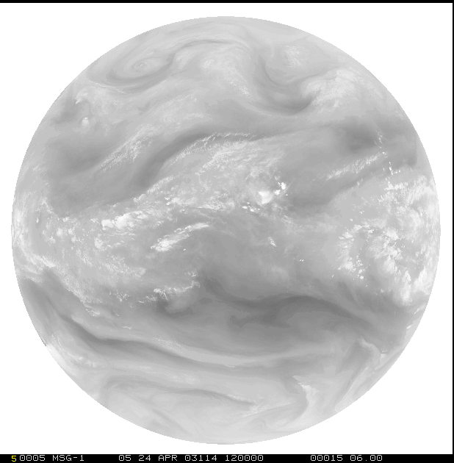
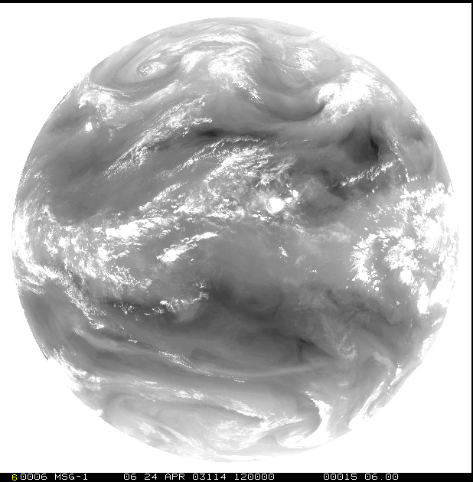
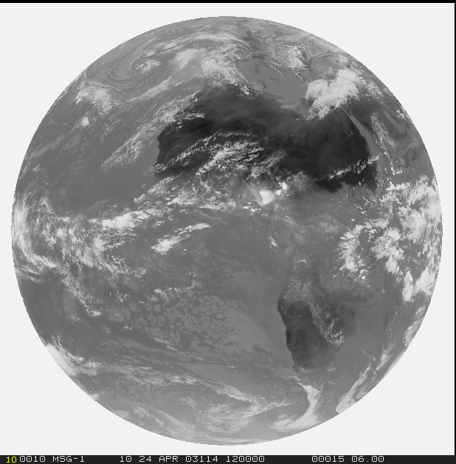
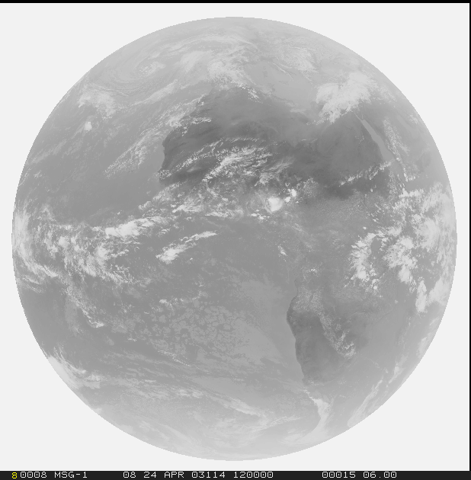
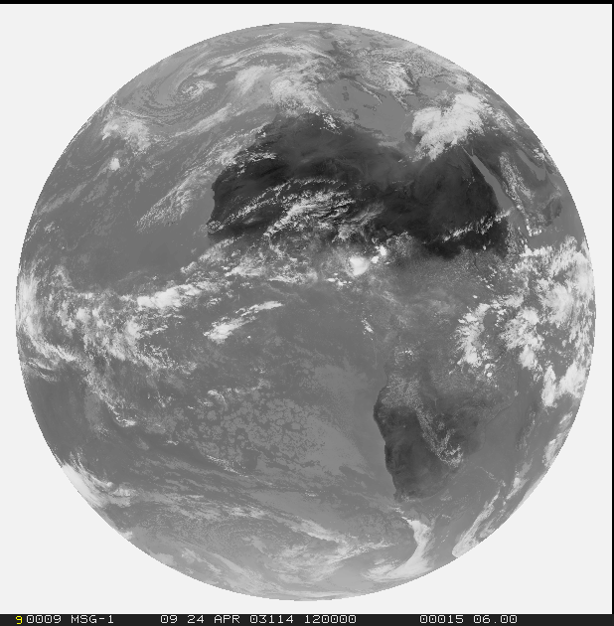
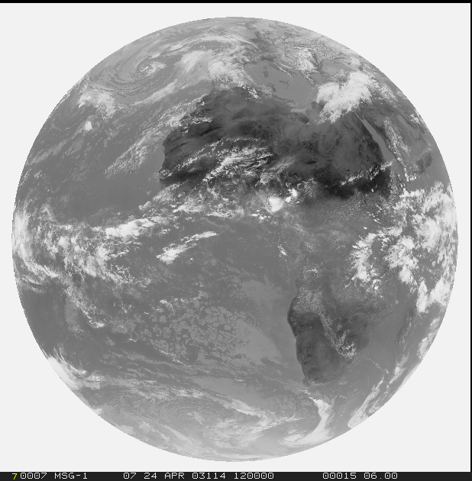
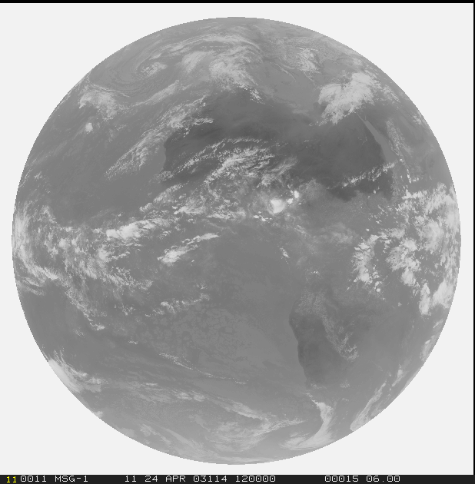
Spectral channels
1=VIS0.4
2=VIS0.5
3=VIS0.6
4=VIS0.8
5=NIR0.9
6=NIR1.3
Solar
3.0 (1.0/0.5) km
Thermal
3.0 (2.0/1.0) km
7=NIR1.6
8=NIR2.25
9=IR3.8
10=WV6.2
11=WV7.3
12=IR8.7
13=IR9.7
14=IR10.5
15=IR12.3
16=IR13.3

Slide 9
Spectral utility
Experts
1=VIS0.4
2=VIS0.5
3=VIS0.6
4=VIS0.8
5=NIR0.9
6=NIR1.3
Solar
3.0 (1.0/0.5) km
Thermal
3.0 (2.0/1.0) km
7=NIR1.6
8=NIR2.25
9=IR3.8
10=WV6.2
11=WV7.3
12=IR8.7
13=IR9.7
14=IR10.5
15=IR12.3
16=IR13.3

Slide 10
Spectral utility
1=VIS0.4
2=VIS0.5
3=VIS0.6
4=VIS0.8
5=NIR0.9
6=NIR1.3
Solar
3.0 (1.0/0.5) km
Thermal
3.0 (2.0/1.0) km
7=NIR1.6
8=NIR2.25
9=IR3.8
10=WV6.2
11=WV7.3
12=IR8.7
13=IR9.7
14=IR10.5
15=IR12.3
16=IR13.3

Slide 11
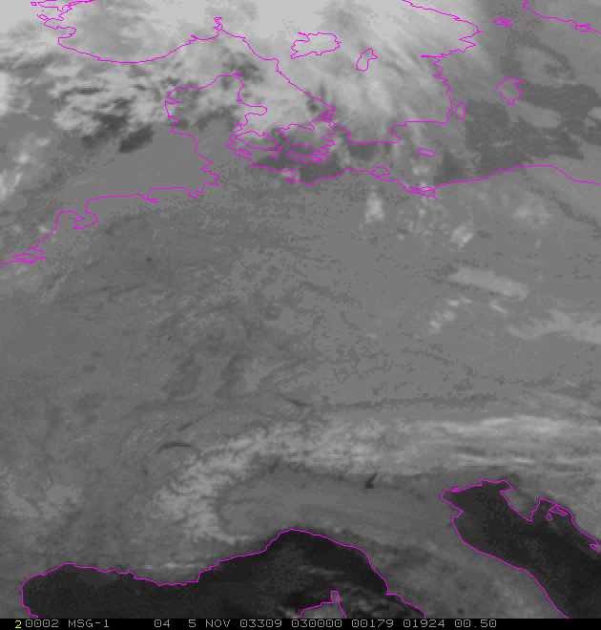
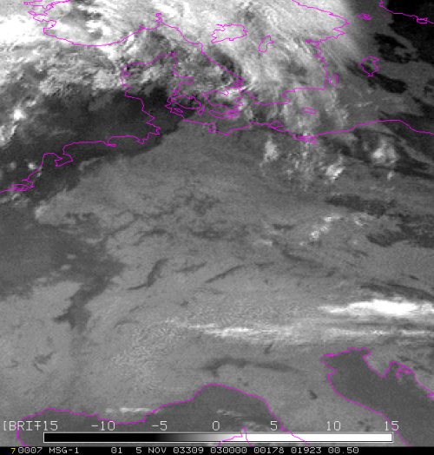
Data exploration
How to use data?
Single channel??
…
..?

Slide 12
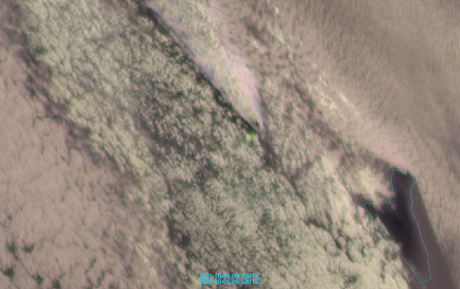
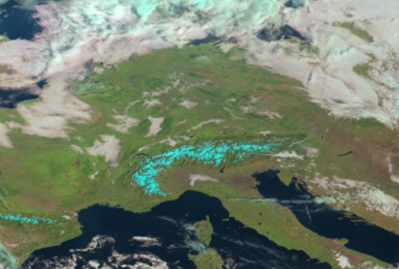
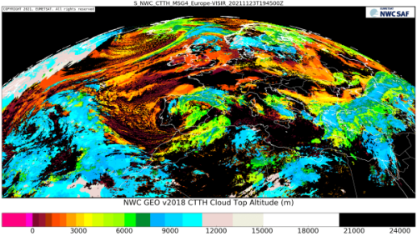
Data exploration
How to use data?
Single channel??
Channel difference/ratio
Sandwich products
RGB products
-
L2(+) / Geophysical products

Slide 13
Agenda
Why do we need products?
.
What kind of products do we have?

Slide 14
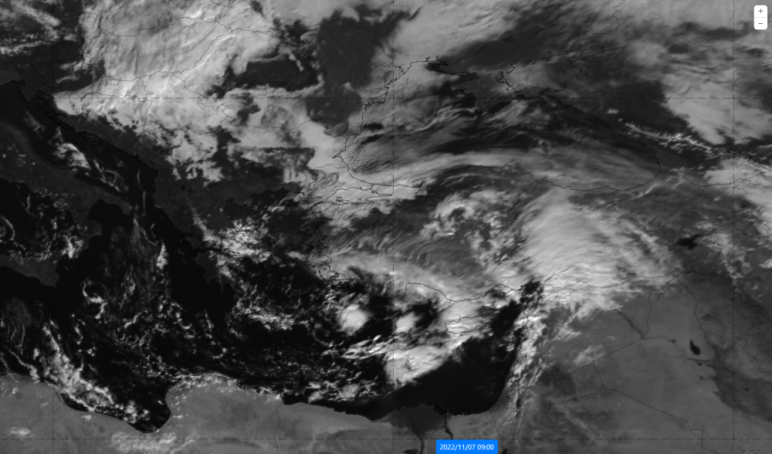
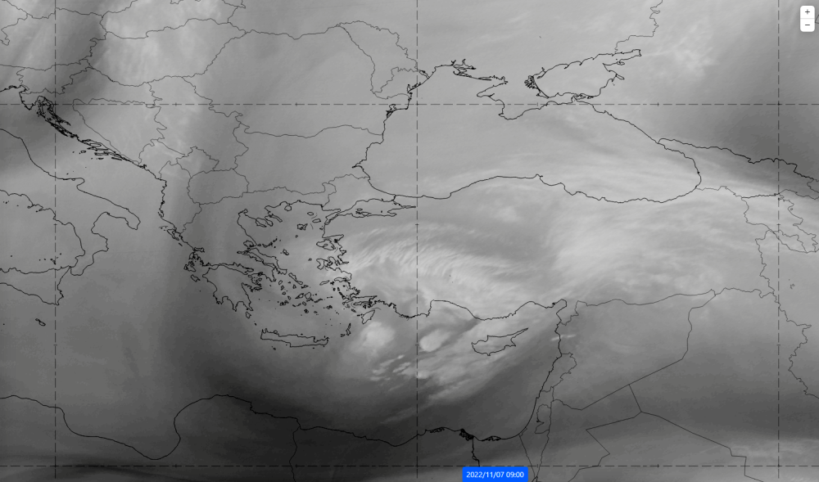
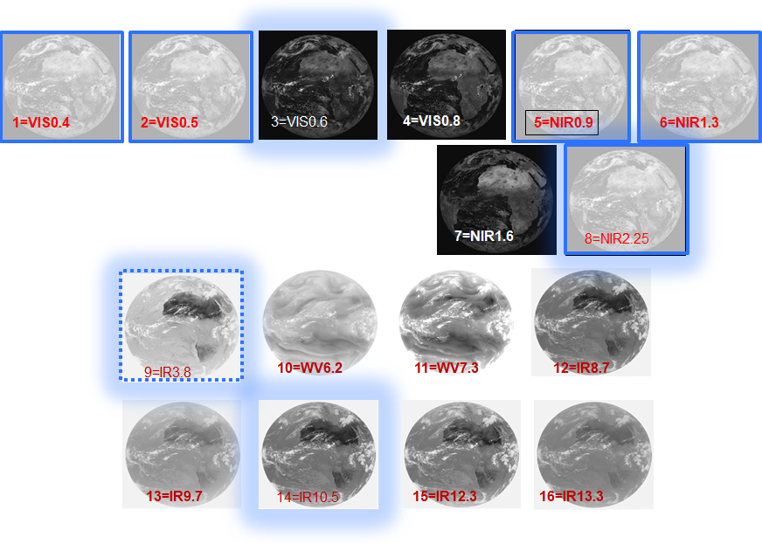
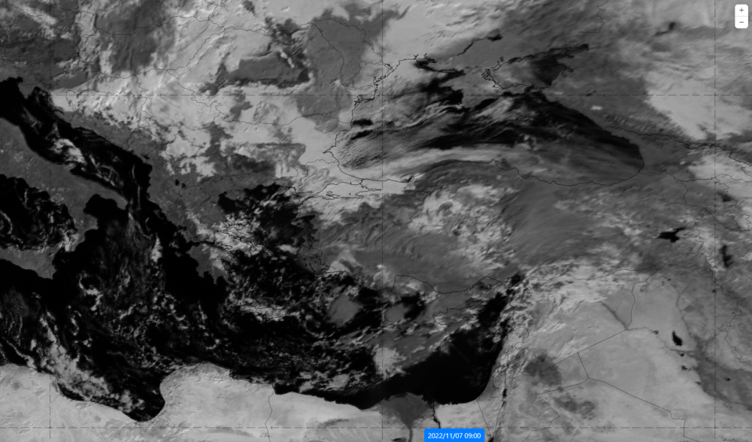
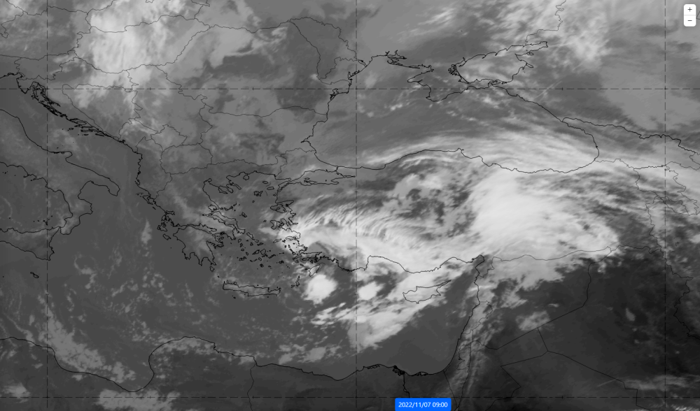
#Single channel(s) – what part of spectra?
a)
b)
c)
d)

Slide 15
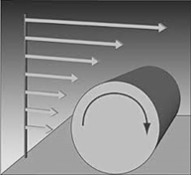
Single channel(s) – wind shear detection, storm dynamics

Slide 16
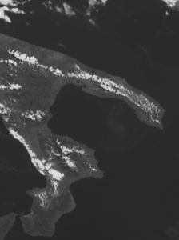
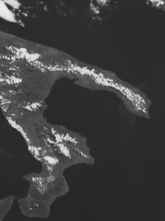
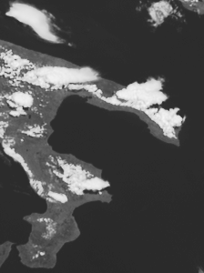
Single channel(s) – convergence line detection
Seabreeze Convergence, Southern Italy (Salento)
09:05 UTC 09:40 UTC 10:55 UTC
12 June 2007, HRV Channel (Met-8 Rapid Scans)

Slide 17
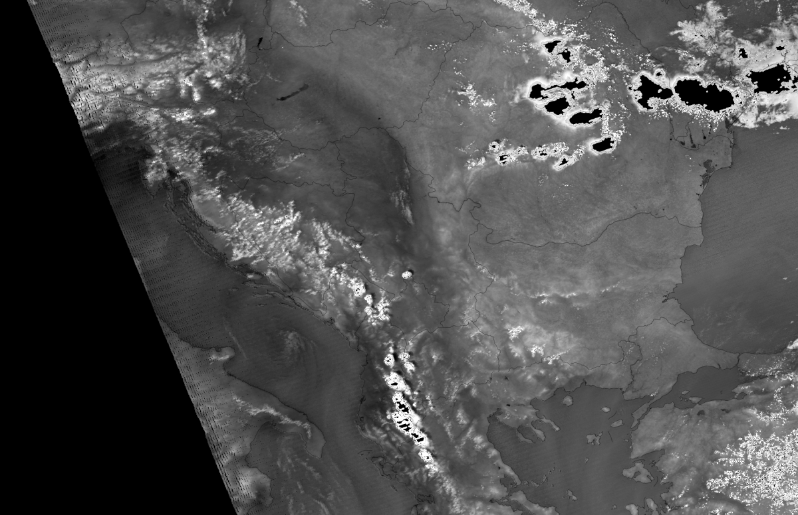
#Channel difference/ratio
Enhances the certain signal from single channels
Ratio 0.905/0.8585 – low level moisture signal
Aqua MODIS, 30 Jun, 11:10 UTC

Slide 18
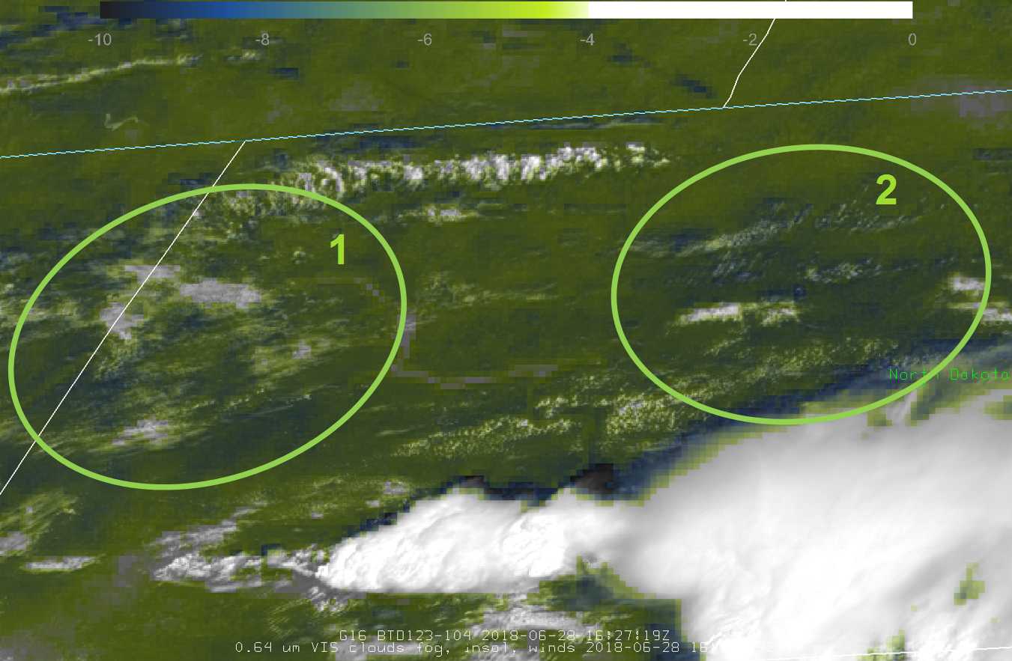
Channel differenc/ratio
Enhances the certain signal from single channels
BTD 12.0-10.8
28 June 2018
16:27 UTC
North Dakota

Slide 19
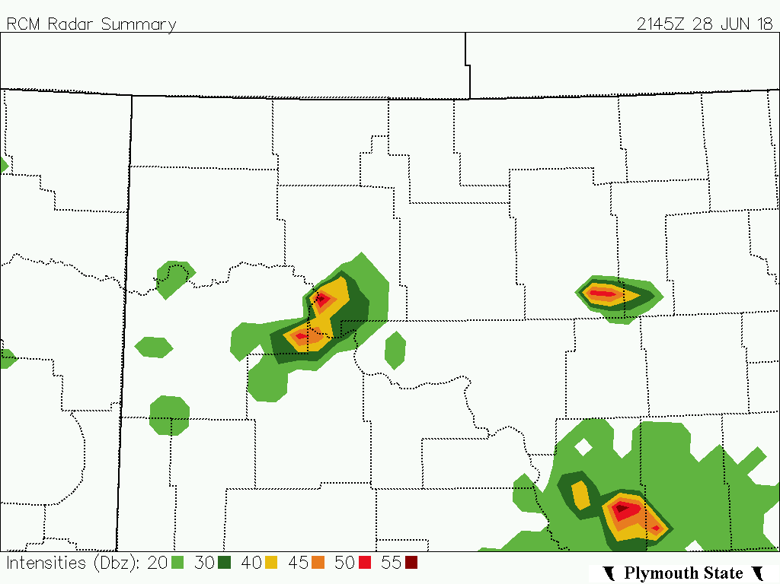
Channel differenc/ratio
Confirmation ca. 5h later from
Radar refl.
28 June 2018
21:45 UTC
North Dakota

Slide 20
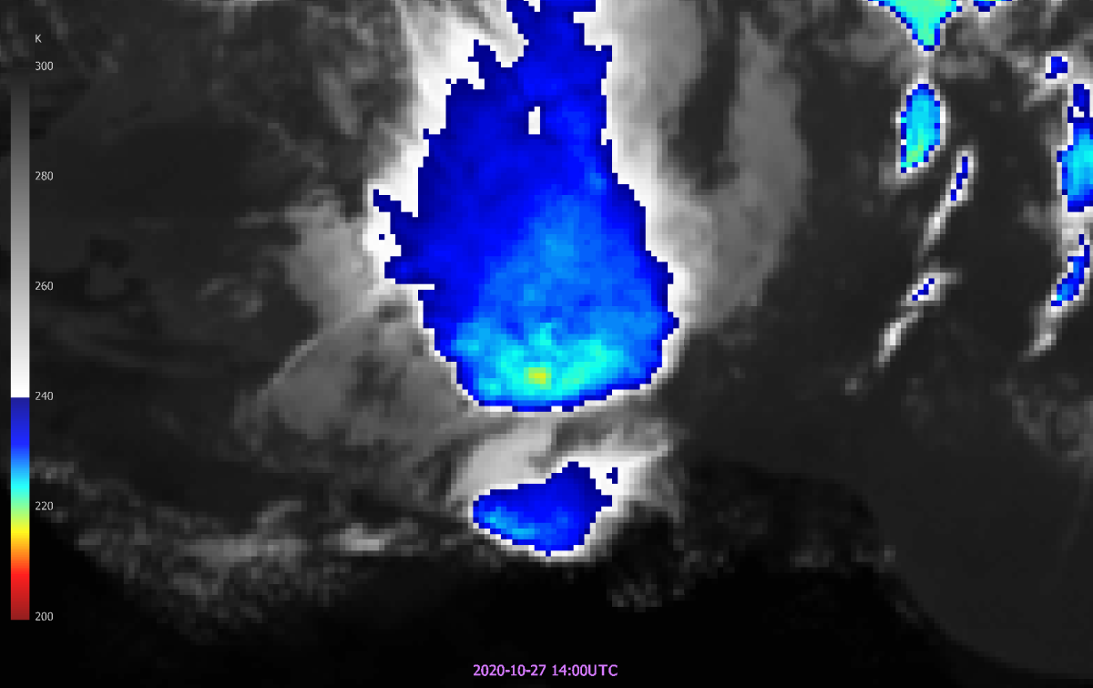
#Sandwich product
Sandwich:
IR temperature
+
enhanced spatial resolution through
HRV channel

Slide 21
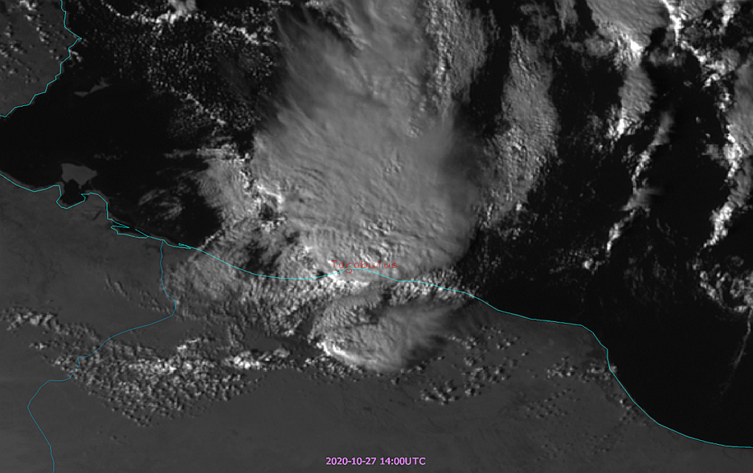
‘Sandwich’ product
Sandwich:
IR temperature
+
enhanced spatial resolution through
HRV channel

Slide 22
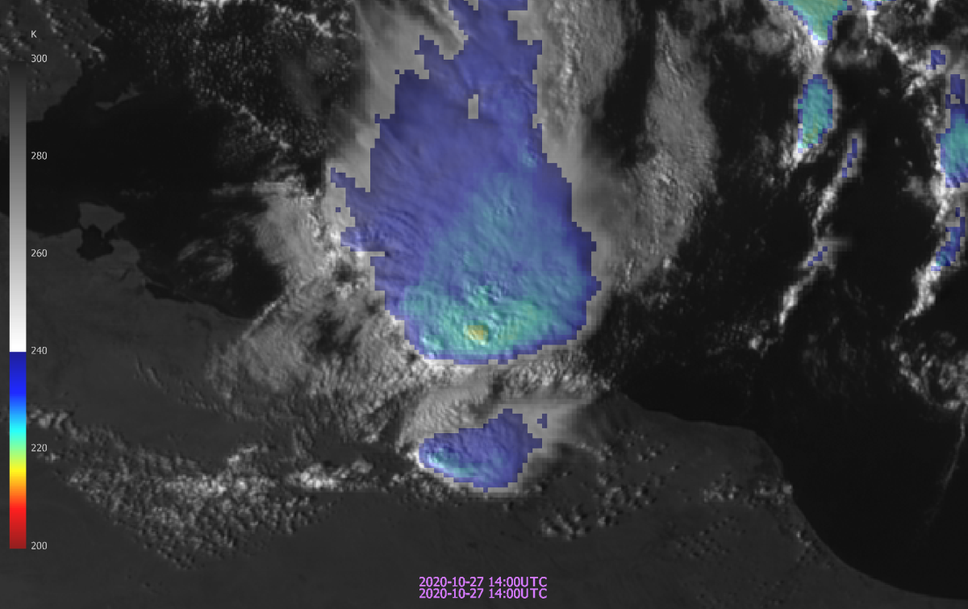
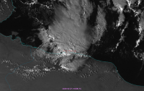
‘Sandwich’ product
Sandwich:
IR temperature
+
enhanced spatial resolution through HRV channel
+

Slide 23
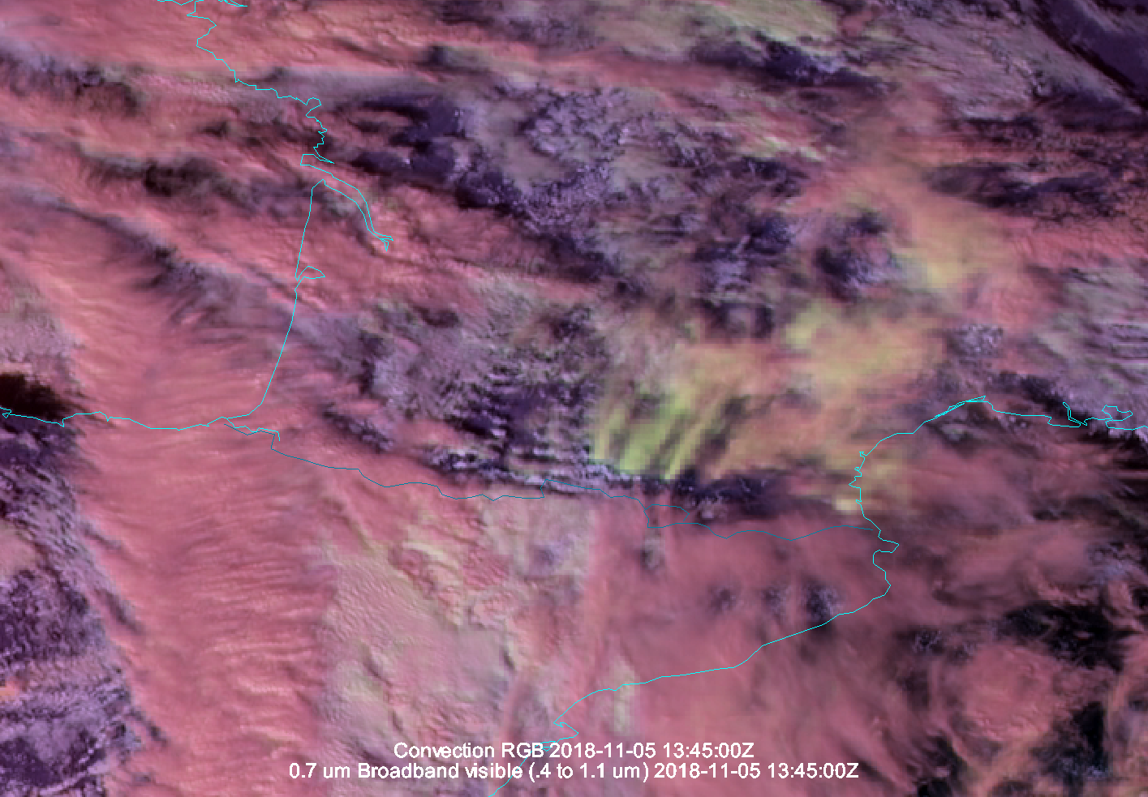
‘Sandwich’ product
Sandwich:
Convection RGB
+
enhanced spatial resolution through HRV channel
Wave clouds over Pyrenees mountains (small ice particles in yellow)

Slide 24
#RGB products
1=VIS0.4
2=VIS0.5
3=VIS0.6
4=VIS0.8
5=NIR0.9
6=NIR1.3
Solar
3.0 (1.0/0.5) km
Thermal
3.0 (2.0/1.0) km
7=NIR1.6
8=NIR2.25
9=IR3.8
10=WV6.2
11=WV7.3
12=IR8.7
13=IR9.7
14=IR10.5
15=IR12.3
16=IR13.3

Slide 25
RGB products – applications - which channels..?
1=VIS0.4
2=VIS0.5
3=VIS0.6
4=VIS0.8
5=NIR0.9
6=NIR1.3
Solar
3.0 (1.0/0.5) km
Thermal
3.0 (2.0/1.0) km
7=NIR1.6
8=NIR2.25
Convective storm?
9=IR3.8
10=WV6.2
11=WV7.3
12=IR8.7
13=IR9.7
14=IR10.5
15=IR12.3
16=IR13.3

Slide 26
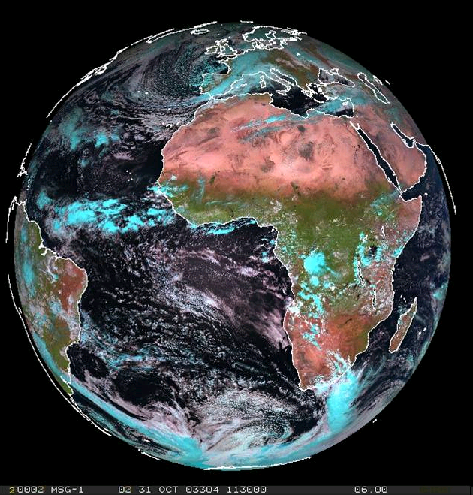
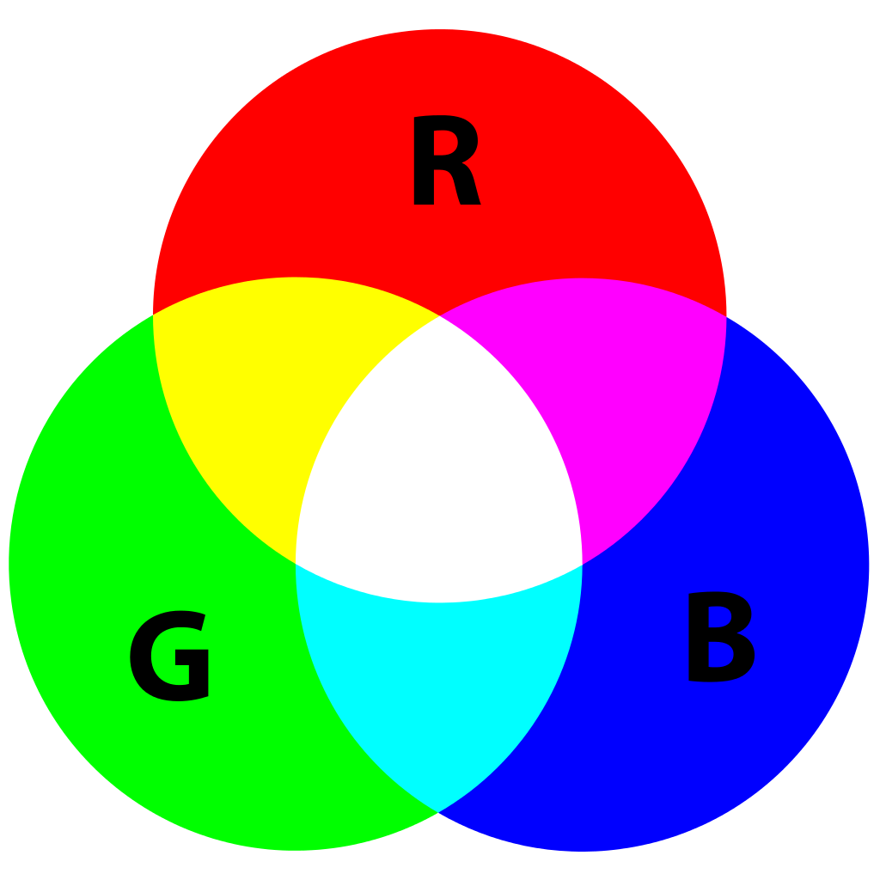
RGB products – generic example
XY RGB
Red: …
Green: …
Blue: …
-

Slide 27
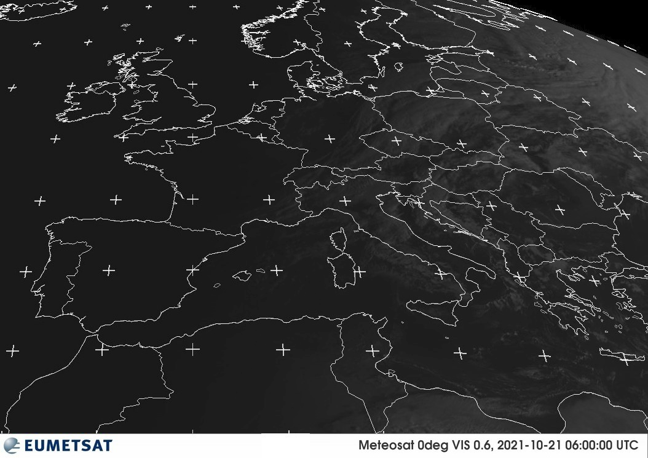
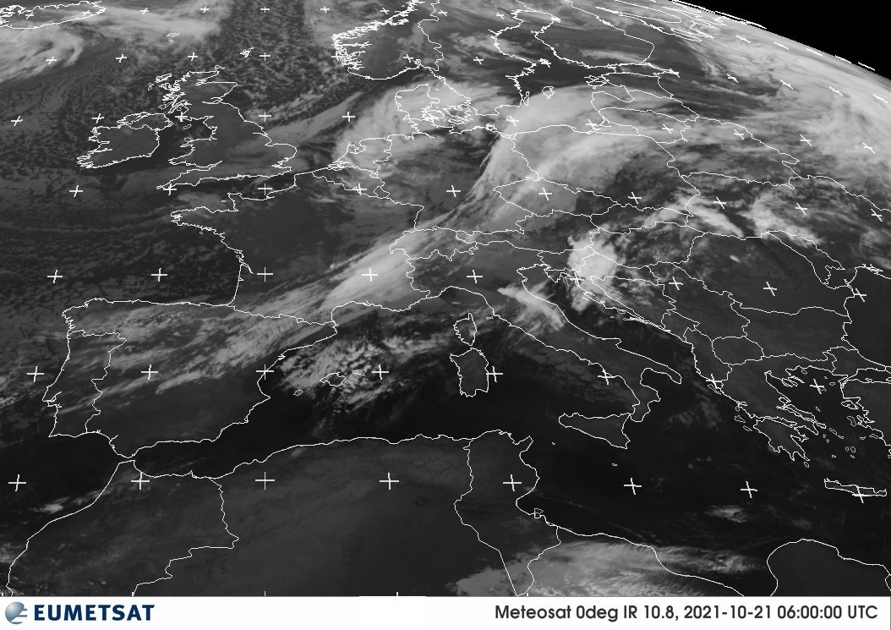
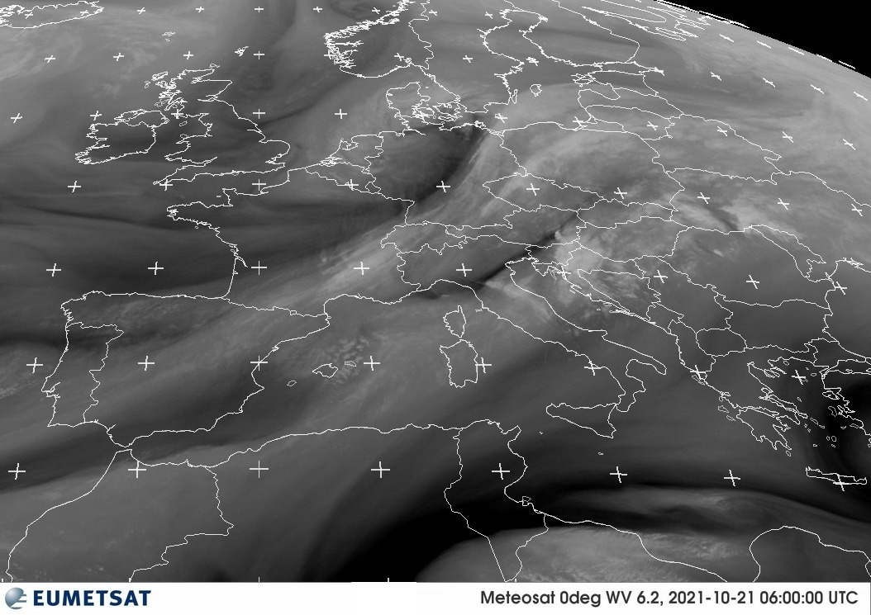
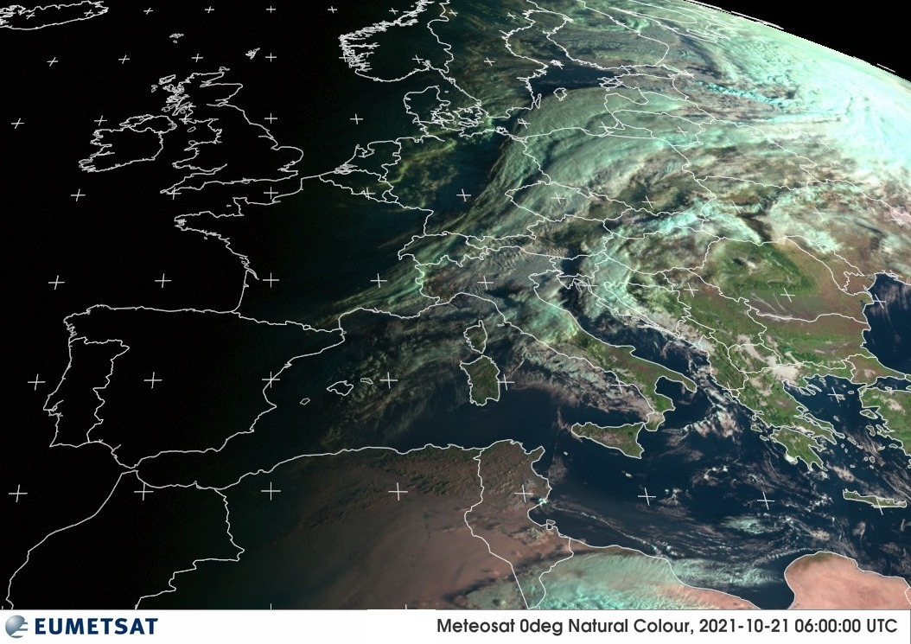
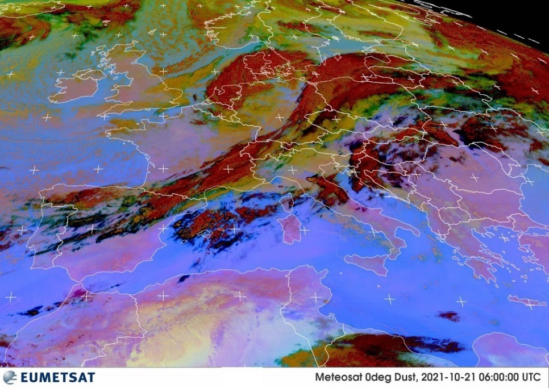
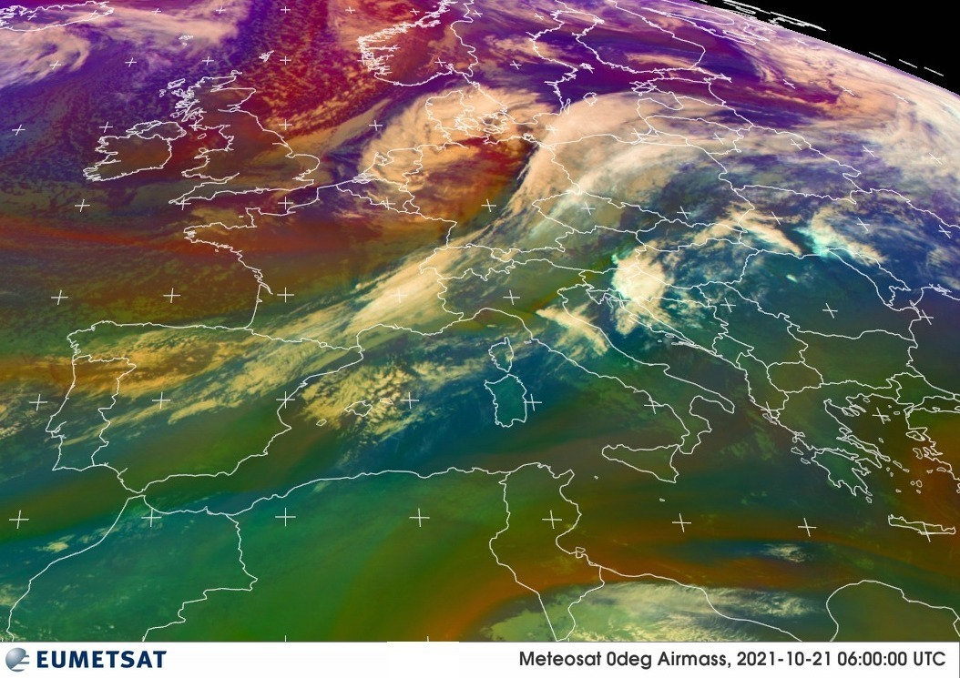
RGB products
Wind Storm Aurora 21 Oct 2021

Slide 28
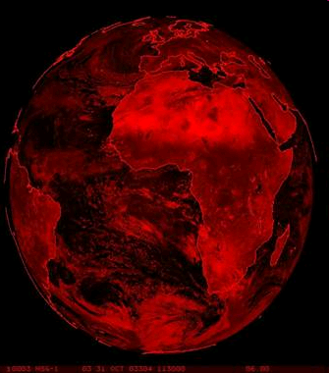
RGB products - examples
Natural Colour RGB
Red: NIR 1.6 μm
Green: VIS 0.8 μm
Blue: VIS 0.6 μm

Slide 29
RGB products – components

Slide 31
RGB 1.6, 0.8, 0.6
(" Natural Colour RGB ")
Green for vegetation – why?
Most reflection with VIS0.6
Most reflection with VIS0.8
Most reflection with NIR1.6
Cyan for ice clouds - why?
Icy clouds are cold, and cyan colour means cold object.
Ice clouds reflect a lot in NIR1.6
Ice clouds reflect very little in NIR1.6
Notes:
Ovdje je manji isječak slike u istoj kombinaciji . Ta se kombinacija najčešće upotrebljava za vegetaciju i fazu oblaka. Ovdje imam dva pitanja za vas, a ja ću vam pomoći u odgovoru tako da ću startati i color selector.

Slide 32
RGB 12-10.8,10.8-8.7,10.8
("Dust RGB")
R = IR12.0 - IR10.8
G = IR10.8 - IR8.7
B = IR10.8

Slide 33
Example: Dust
20 Feb 18:00 UTC 21 Feb 12:00 UTC 22 Feb 12:00 UTC

Slide 34
Dry Line Middle East, 16 April 2013

Slide 35
Example: Volcanic Ash
MSG-1, 25 November 2005, 09:00 UTC

Slide 36
Example: Volcanic SO2
MSG-1, 28 November 2006, 11:45 UTC

Slide 37
Example: Thin Ice Clouds
MSG-1, 12 November 2006, 23:00 UTC

Slide 38
Example: Cloud Phase
Ice
cloud
Water cloud
Met-8, 16 Aug 2006, 04:00 UTC

Slide 39
RGB 6.2-7.3, 9.7-10.8, 6.2
(“Airmass RGB")
R = WV6.2 - WV7.3
G = IR9.7 - IR10.8
B = Kanal 6.2
Red = WV6.2 - WV7.3 Green = IR9.7 - IR10.8
Blue = WV6.2i RGB

Slide 40
RGB 6.2-7.3, 9.7-10.8, 6.2
(“Airmass RGB")
Dry stratospheric air
Cold air mass
Warm air mass
MSG-1, 7 January 2005, 22:00 UTC

Slide 41
High
PV Anomaly
RGB 6.2-7.3, 9.7-10.8, 6.2
(“Airmass RGB")
Deformation Zone
Jet (polar)
Jet (subtropical)

Slide 42
Tropial Low Namibia - Botswana
24 January 2010, 12:00 UTC

Slide 43
Jets South Atlantic
MSG-1, 7 May 2005

Slide 44
Deformation Zone
Notes:
The WV imagery would be a bit easier to assist with the 3D interpretation. I certainly agree with the three main vorticity maximum tubes. The middle vot max requires another DZ which should be evident on the WV. The large backward S DZ certainly spans two large trofs. The vorticity minimums that I suggest would complete that pattern. Without animation I could be off in the positioning of these features but I am happy with that. Also, these vorticity tubes extend through large depths of the atmosphere so depending on the tilt, the position at any one level will be very different geographically from another level. The conceptual models are what are important. I have analyzed the vort max and vort min chain that straddles the axis of maximum winds. I will use colours so you will know which ones I have added :>)) Sometimes even coloured symbols don’t stand out against the false coloured image. Thank you my friends. The weather patterns always interesting. Analyzing them all could phil a book. The colder valued system is also interesting with the same or similar patterns.

Slide 45
Deformation Zone
X
COL
COL
X
N
X
There is an X here
N
X
N
X
Lateral banding – billow clouds
N
N
N
Notes:
The WV imagery would be a bit easier to assist with the 3D interpretation. I certainly agree with the three main vorticity maximum tubes. The middle vot max requires another DZ which should be evident on the WV. The large backward S DZ certainly spans two large trofs. The vorticity minimums that I suggest would complete that pattern. Without animation I could be off in the positioning of these features but I am happy with that. Also, these vorticity tubes extend through large depths of the atmosphere so depending on the tilt, the position at any one level will be very different geographically from another level. The conceptual models are what are important. I have analyzed the vort max and vort min chain that straddles the axis of maximum winds. I will use colours so you will know which ones I have added :>)) Sometimes even coloured symbols don’t stand out against the false coloured image. Thank you my friends. The weather patterns always interesting. Analyzing them all could phil a book. The colder valued system is also interesting with the same or similar patterns.

Slide 46
Summary: RGBs for Operational Forecasting
Dust Airmass Day Microphysics
08 November 2005, 12:00 UTC

Slide 47
Summary: RGBs for Operational Forecasting
Dust Day Microphysics Convective Storms
19 March 2007, 08:00 UTC

Slide 48
Geophysical (L2+) products
Quantitative values derived from satellite data (height, temperature, pressure, humidity, chlorophyll, wind vector, etc.)
Includes multiple inputs (aside from the original satellite data):
Auxiliary satellite data
NWP variables
Look-up tables
Climatology
Background maps
Parametrization parameters
Corrections
…

Slide 49
Geophysical (L2+) products

Slide 50
Geophysical (L2+) products

Slide 51
Geophysical (L2+) products
E.g.

Slide 52
Geophysical (L2+) products
CI (Convective Initiation) Product
> Probability for a cloudy pixel to become a thunderstorm?
Mecikalski at al. 2010
• yellow for [0-25%] probability of Convection initiation, • orange for [25-50%] probability of Convection initiation, • red for [50-75%] probability of Convection initiation, • magenta for [75-100%] probability of Convection initiation.
Main limitations of the product?
• In cases of cold air masses (fast-moving fractional clouds) • High FAR inherent to CI, particularly at the edges of cold cloud systems • Lack of validation

Slide 53
Thank you!
Questions are welcome.
شكرًا لك

