Slide 1
Forecasting Techniques and NWP
Khalifa Al Sudairi chief of NWP
k.alsudairi@met.gov.om

Slide 2
Current State of the Atmosphere
Get to Know the current State of the Atmosphere
By Knowing the current State accurately you can do short range forecast.

Slide 3
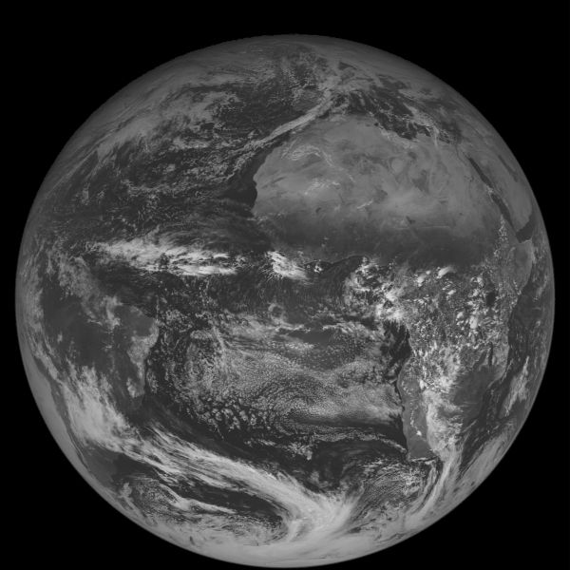
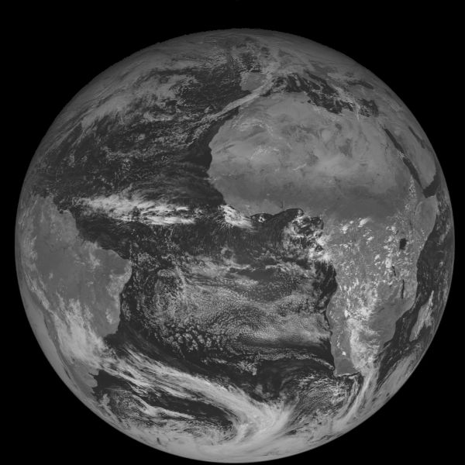
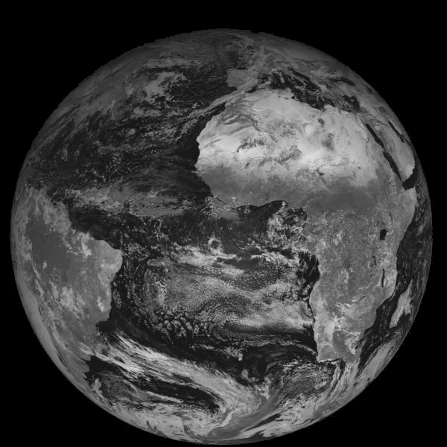
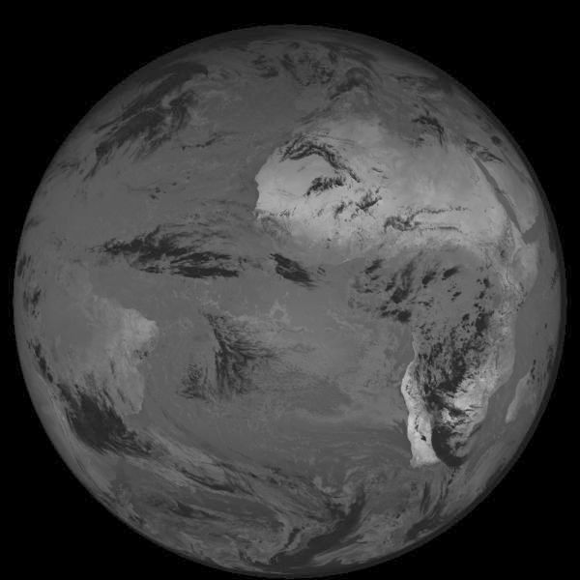
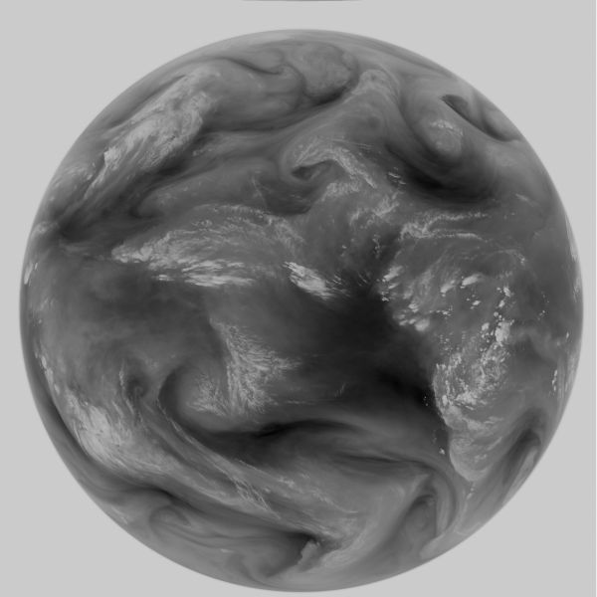
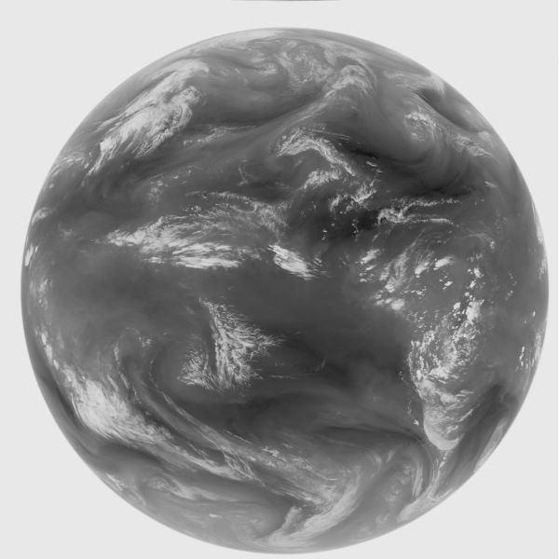
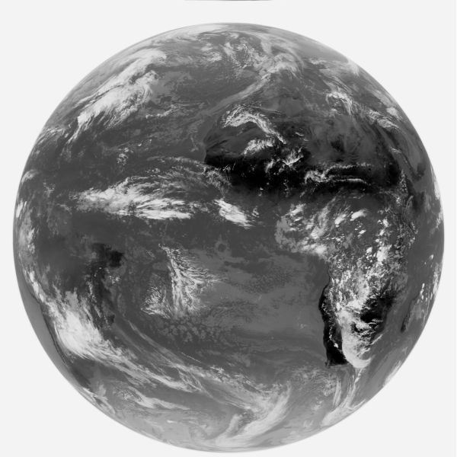
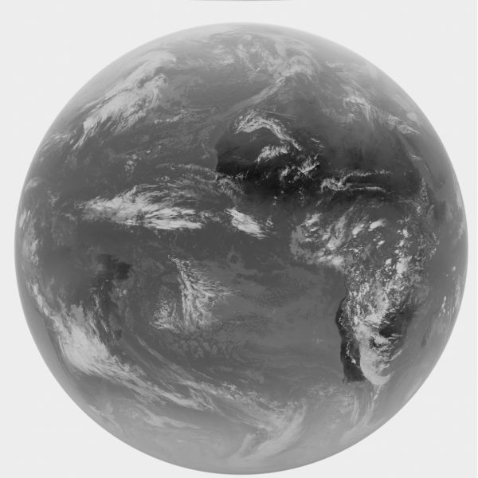
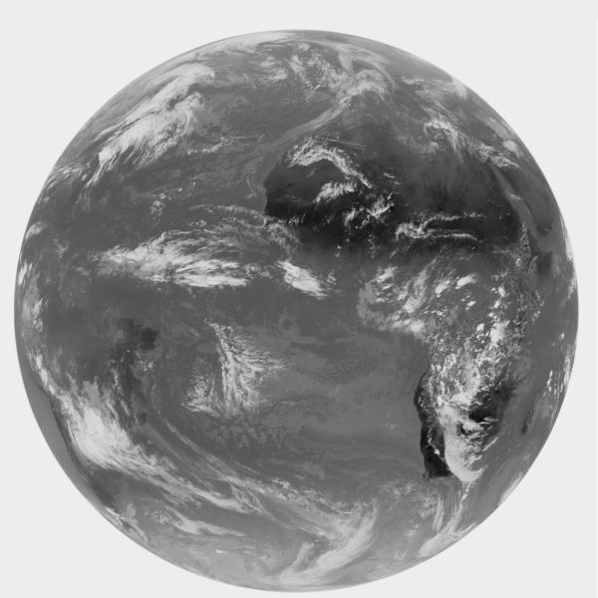
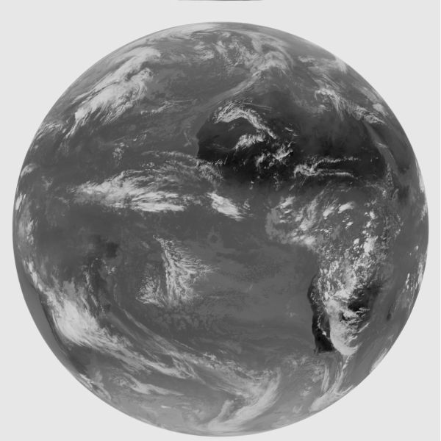
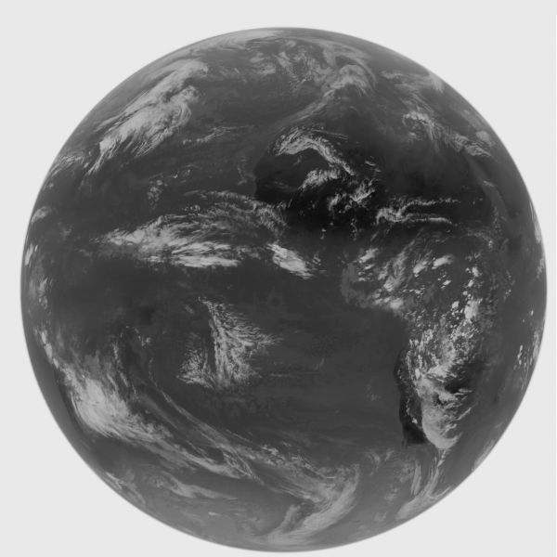
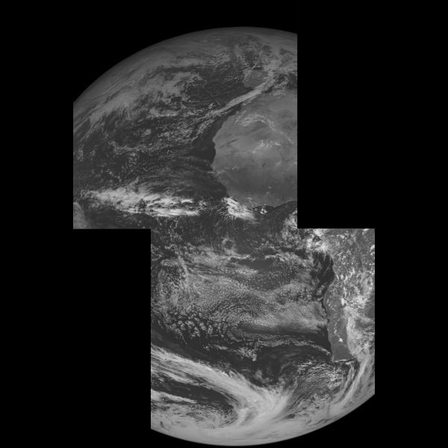
Current State of the Atmosphere
Look to different Satellites Channels
VIS 0.6 VIS 0.8 NIR 1.6 NIR 3.9
WV 6.2 WV 7.3 IR 8.7 IR 9.7
IR 10.8 IR 12.0 IR 13.4 HRVIS

Slide 4
Current State of the Atmosphere
Surface Charts
Upper Air Charts
Metars, Synops,( Ship, Aircraft, Police ) Reports

Slide 5
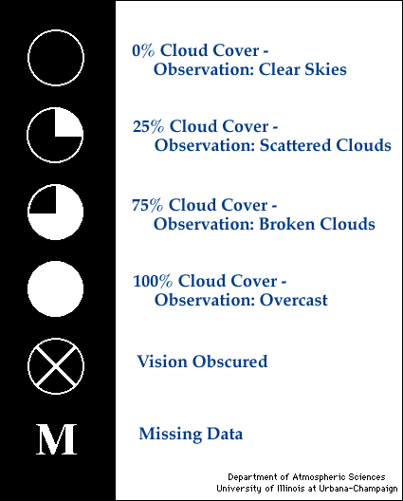
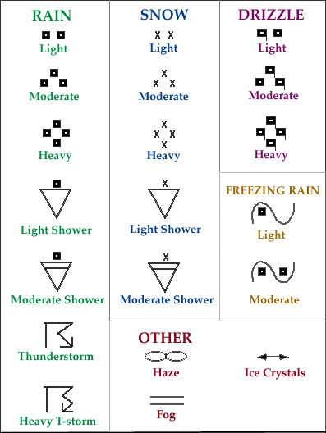
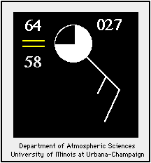
Observe Weather Elements

Slide 6
Fog over salalah

Slide 7
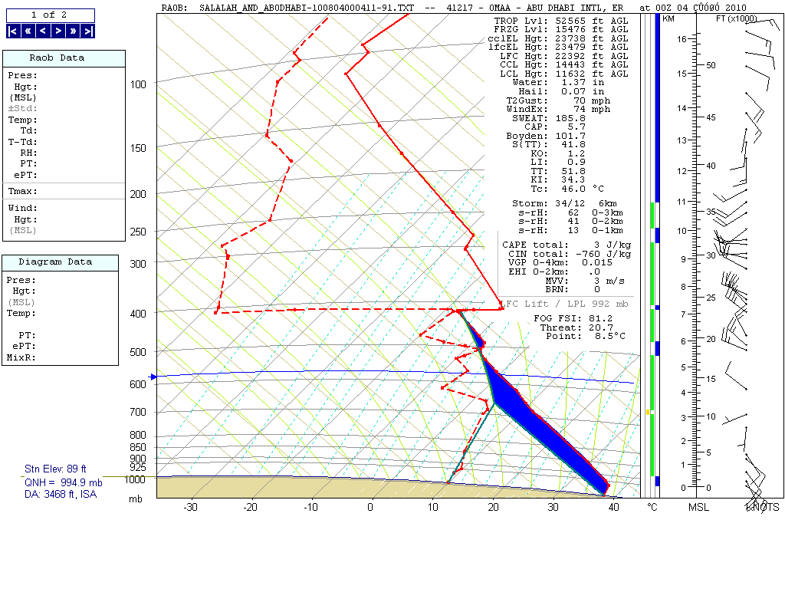

Slide 8
Tropical cyclone oman

Slide 9
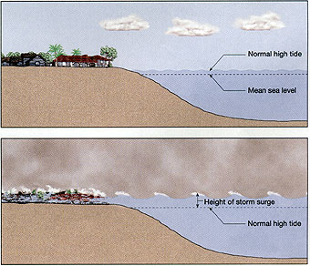
Weather associated with tropical cyclone
Floods
Strong wind
Storm surge

Slide 10
General Concepts
Numerical Weather Prediction
The modern way to forecast the weather

Slide 11
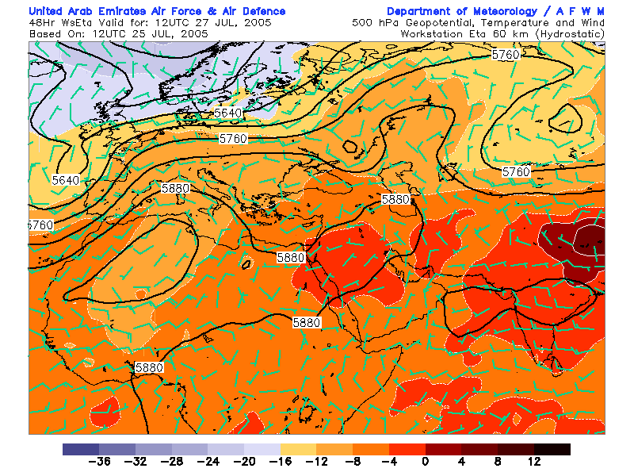
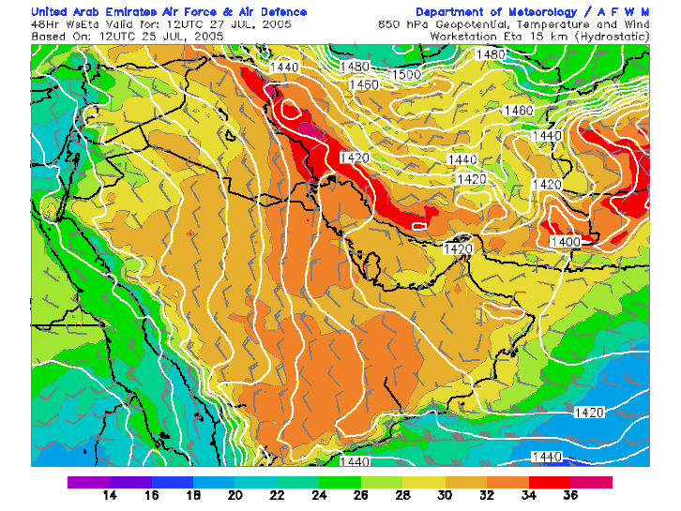
NWP model Products

Slide 12
What is NWP Model?
Take the equations that describe atmospheric processes.
Convert them to a form where they can be programmed into a large computer.
Let the computer to solve them
This is called a “model” of the atmosphere

Slide 14
What do we mean by “solve the equations”
The equations describe how the atmosphere changes with time.
For example, one equation would be

Slide 15
NWP Concept: General overview
NWP consists in :
Subdividing a chosen geographic 3D area in thousands (or millions) of little cubes.
3D cubes of the atmosphere used by NWP models

Slide 16
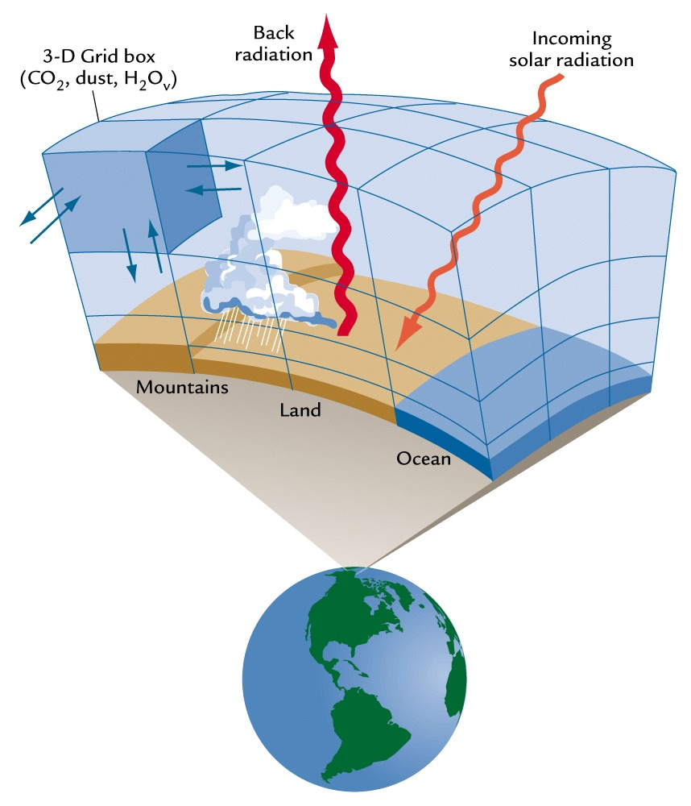

Slide 17
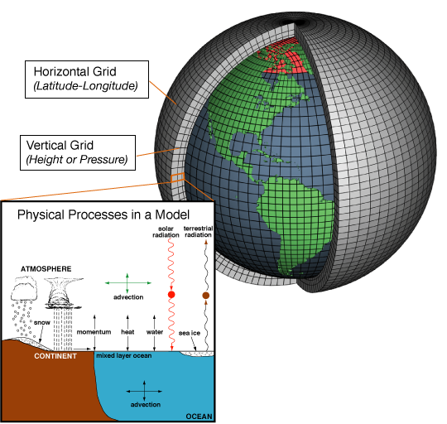

Slide 19
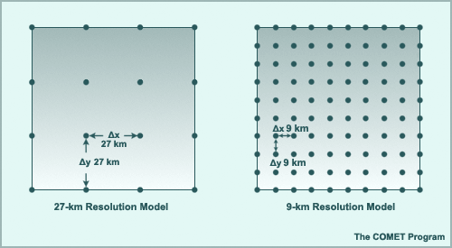
NWP

Slide 20
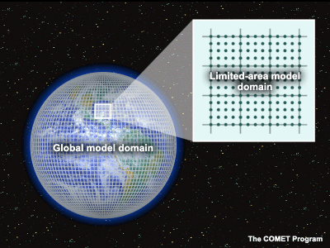
NWP concepts : Global & LAM models.

Slide 21
NWP concepts : Global models
Global models resolve atmospheric equations on the whole glob.
They can not use very fine resolution because of computers limitations.
Because of their weak resolution, they can not detect small scale phenomena.
The most popular global models are :
ECMWF/IFS (partially public and received on MDD) : http://www.ecmwf.int.
NCEP/GFS (completely public) : http://www.ncep.noaa.gov.
Météo-France/ARPEGE (not available on the net).
German DWD global model.
METOFFICE/UKMO Unified Model.
Japan Meteorological Agency JMA Global Model.
Global models are used to forecast general synoptic circulation and to provide Initial and Lateral Boundary Data for Limited Area models.

Slide 22
NWP Concepts : Limited Area Models (LAM).
They are widely used by Weather Centers over the world.
The most popular LAMs are:
HRM (used in more than 30 Centers and universities)
ETA (used in more than 50 Centers and Universities).
MM5 (AFWA and more than 20 centers over the world).
ALADIN (Private Consortium guided by Meteo-France : 15 European and north African countries)
COSMO / LM (COnsortium for Small scale MOdeling guided by DWD).
HIRLAM (Private Consortium : Scandinavian countries and Spain).
NMM / WRF (the next generation LAM model taking advantage from both ETA and MM5).
COAMPS, RAMS, RUC, …etc.

Slide 23
NWP Concepts : Initial Data.
The actual situation used by the model to start integrate equations.
It is created by techniques called data assimilation.
The information used to create initial data are:
GTS data (Conventional observations) : SYNOP, SHIP, BUOY, SYNOR, TEMP, PILOT, AIREP, AMDAR, ACAR, SATEM, SATOB).
The process of initial data creation (analysis and data assimilation) is more complicate than the forecast model itself, and more consumer in term of CPU time.

Slide 25
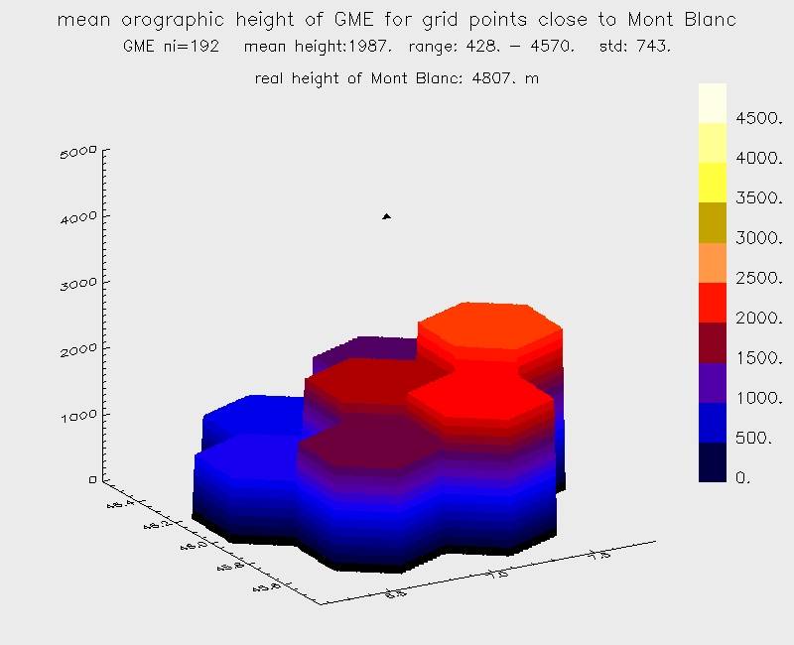
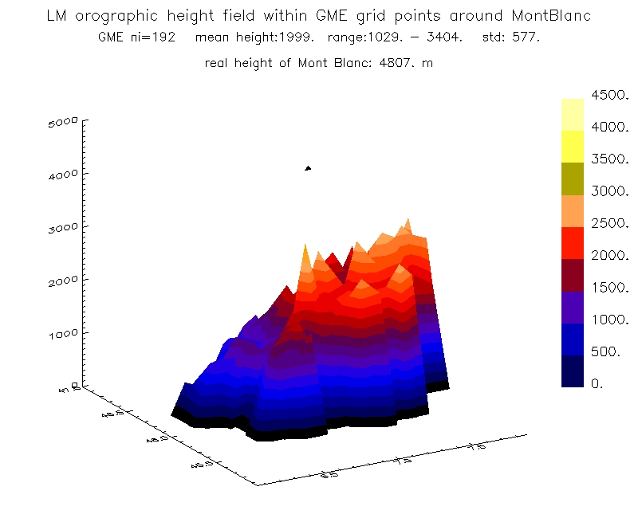
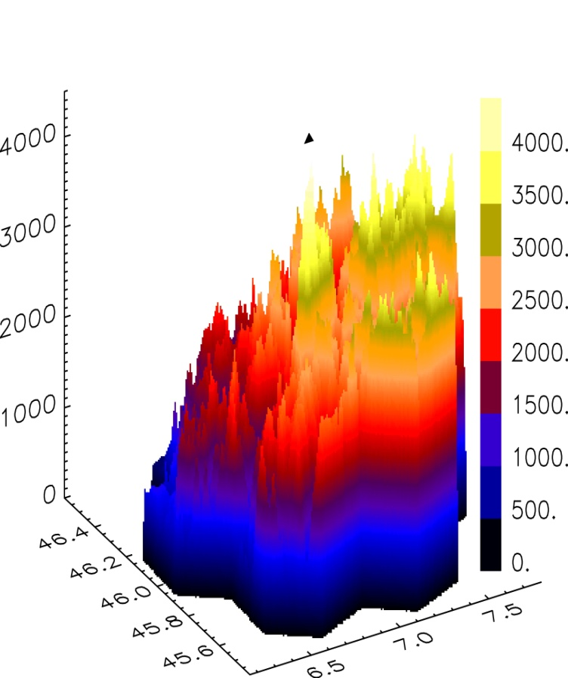
Orography (m)
Aggregated to 40-km GME;
grid element area: 1384 km²
Aggregated to 7-km HRM;
grid element area: 49 km²
1 km x 1 km raw data

Slide 26
NWP Concepts : Meteograms

Slide 27
NWP Concepts: Off-line Driven Models.

Slide 28
Guidance in Using NWP
1- Verify each of the models you are intended to use
2- Use different NWP sources, as many as you could
3- Remember the error margin when you do the forecast

Slide 29
Errors of the NWP
Due to model formulation.
Due to uncertainty in the initial state.
Due to errors in lateral boundary conditions.
Due to uncertainties in soil fields (soil temperature and soil water content, …).

Slide 30
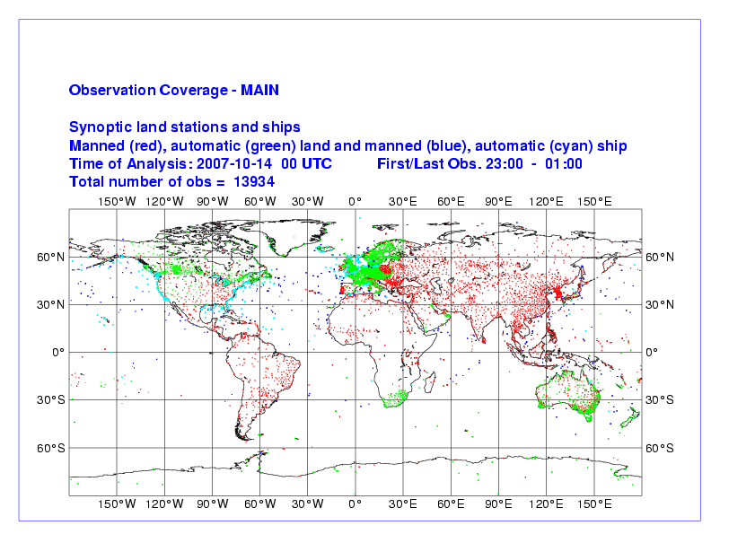
SYNOP stations and ships

Slide 31
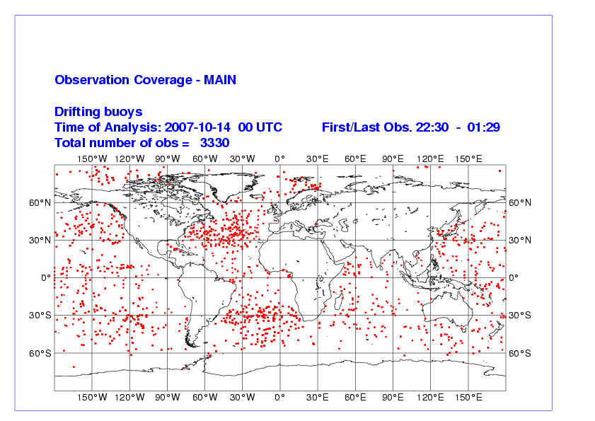
Buoys (moored and drifting)

Slide 32
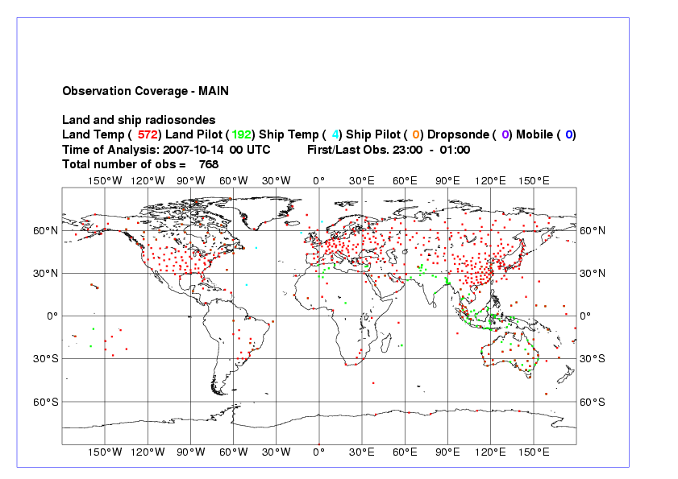
TEMP stations

Slide 33
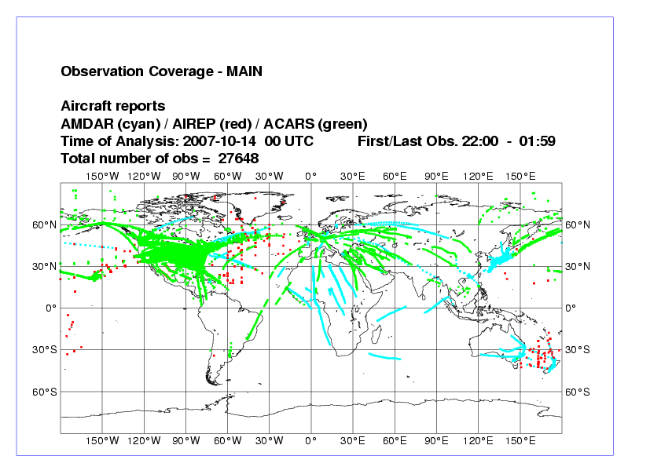
Aircraft measurements (AMDAR)

Slide 34
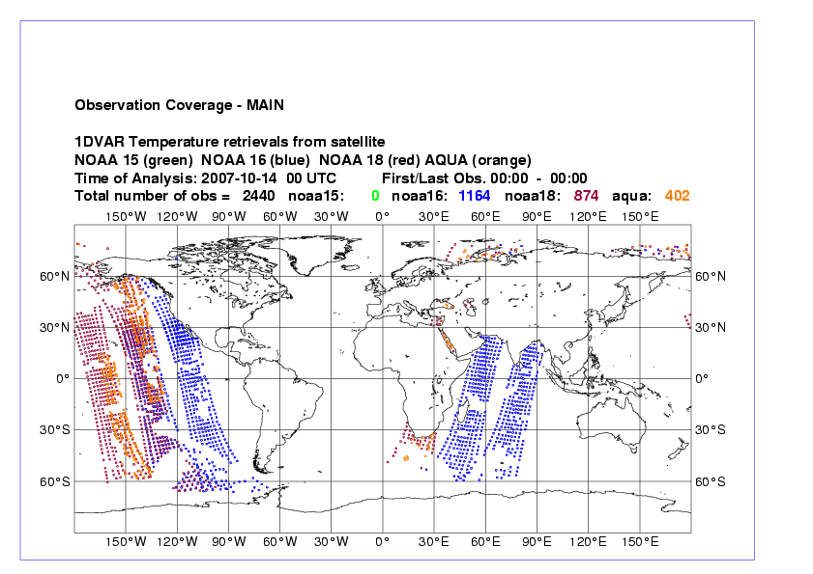
ATOVS from polar orbiting satellites

Slide 35
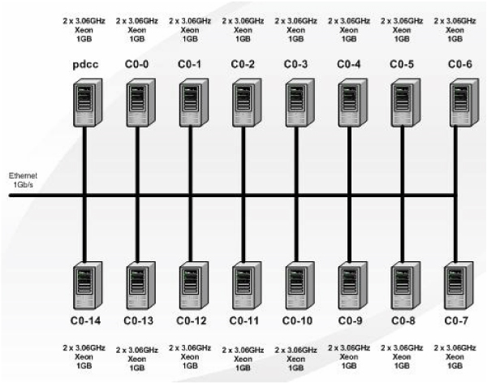
Pc cluster
A set of computers that work together so that they
can be viewed as a single system.
Unlike grid computers, computer clusters have each node set to perform the same task,
controlled and scheduled by software.

Slide 36
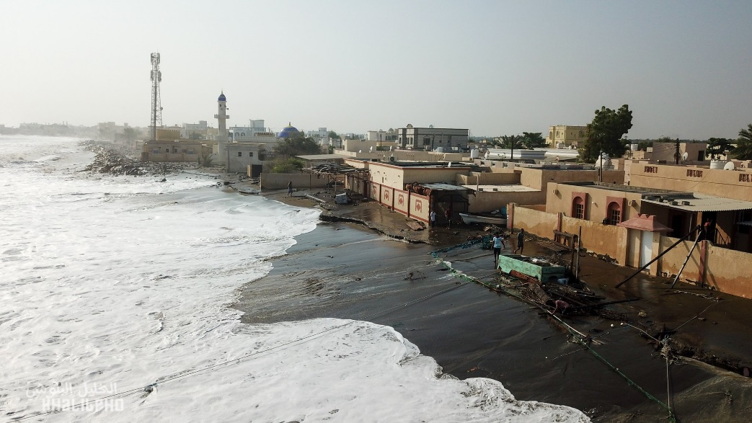
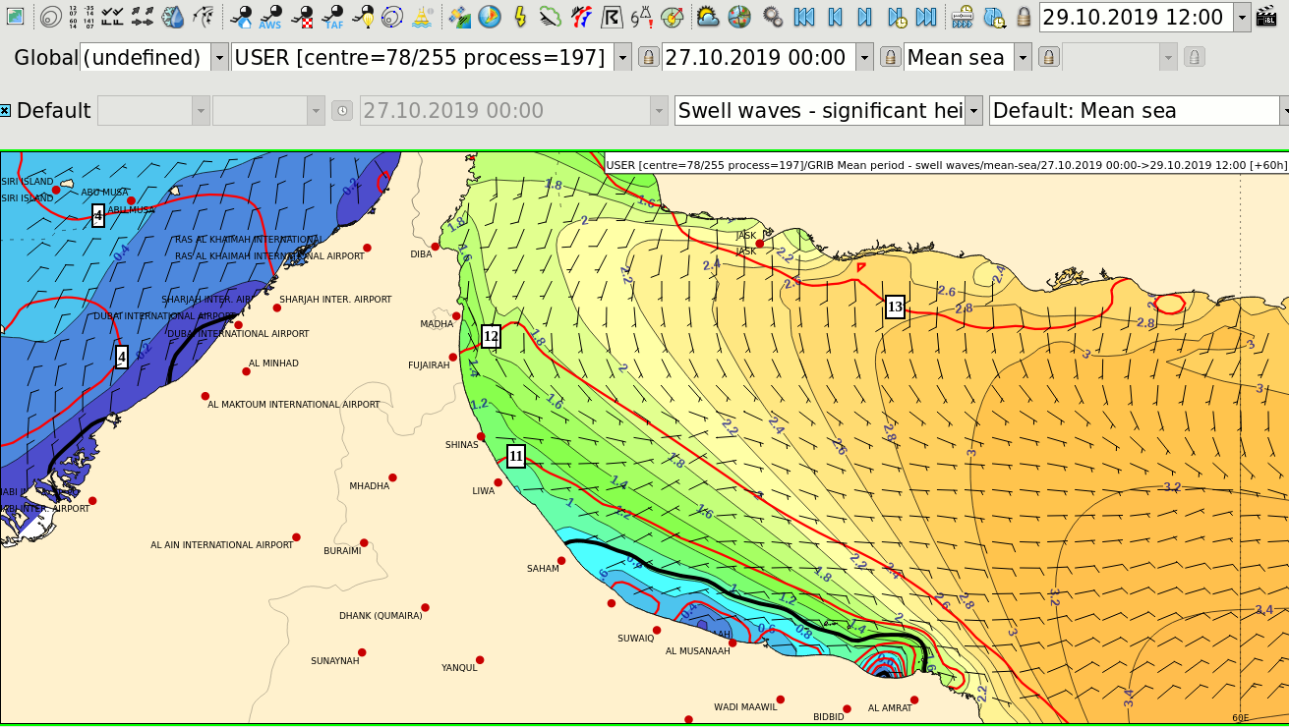
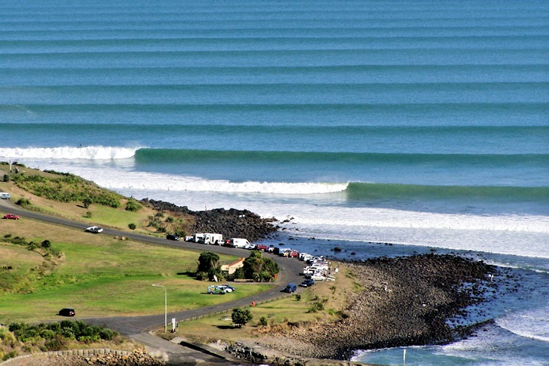
NWP Wave

Slide 37
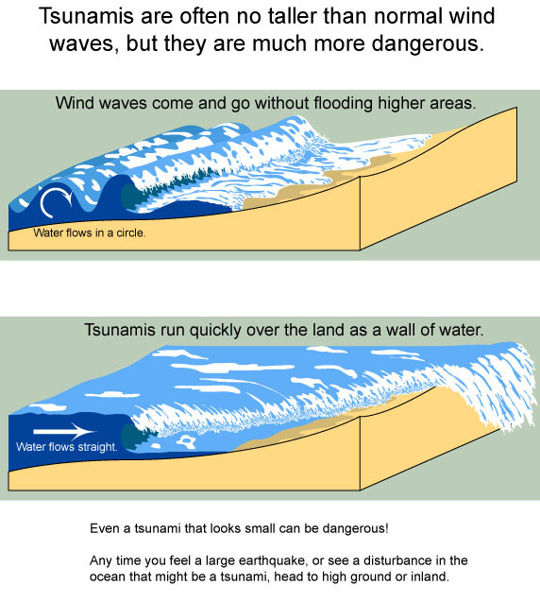
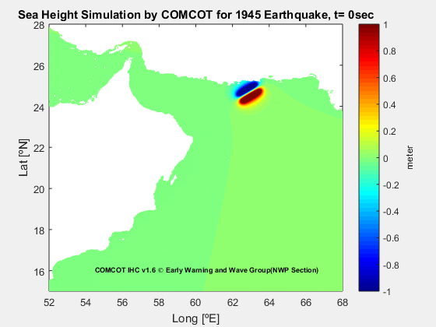
Tsunami models

Slide 38
Thank You
Kindly Scan this QR code to evaluate this lecture

