Slide 1
Oman winter weather
Marine Meteorological Course for Royal Oman Navy
Lecturer: Kauthar Sulaiman Al Jabri

Slide 2
Content
Air masses affecting Sultanate of Oman
Western disturbance
Cold front
Shamal wind/Dust
Fog
Siberian high

Slide 3
The Seasons
2nd transitional period
From 22nd September to 20th December
Winter
21st December to 21st March
Summer
1st transitional period
21st June to 21st September
From 22nd March to 20th June

Slide 4
Subject 1:
Air masses
Air masses influence Sultanate of Oman Climate
Air masses affecting Sultanate of Oman

Slide 5
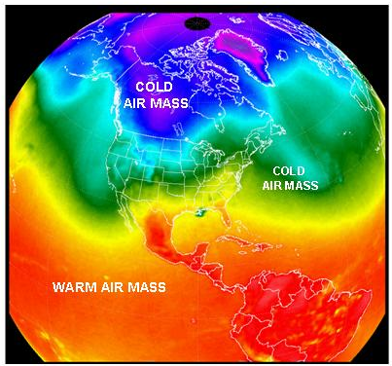
1: Air masses
Air masses are…
A large body of air sits over an area of
land or water for a long period of
time, it will take on the characteristics
of the land or water beneath it.
Named for their SOURCE REGION
Continental (c)
Maritime (m)
Arctic (A)
Polar (P)
Tropical (T)
When Air Masses move they bring their temperature and humidity to new areas.

Slide 6
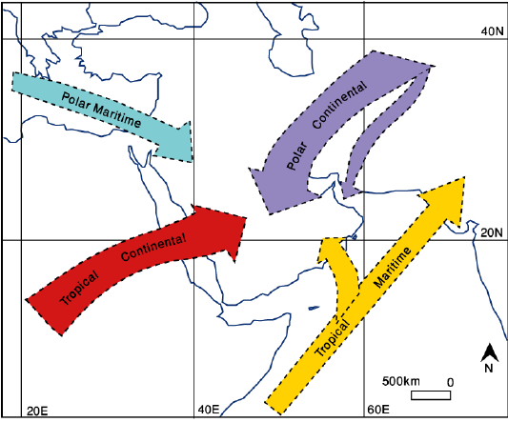
2: Air masses influence Sultanate of Oman Climate:
During winter
Originates over central Asia
low temperatures at the surface
Stable atmosphere
Occasionally out break
Frequently active During winter
North Atlantic
Cold front with TS developing
Strong winter Shamal wind
During Summer
north Indian Ocean
low temperatures + rain
Oman SE Coasts
late First Transitional and early summer
North Africa
low humidity , very high temperatures (often in excess of 45°C)
Hazy conditions invariably prevail, Dust

Slide 7
Subject 2:
What is Westerly disturbance?
How it Develop? And Its Effects
Western disturbance

Slide 8
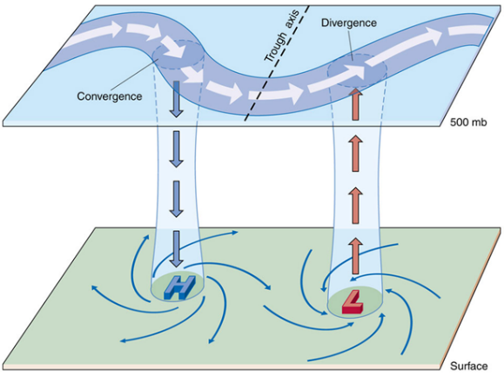
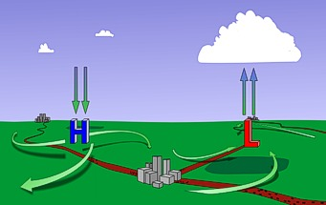
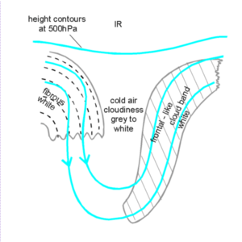
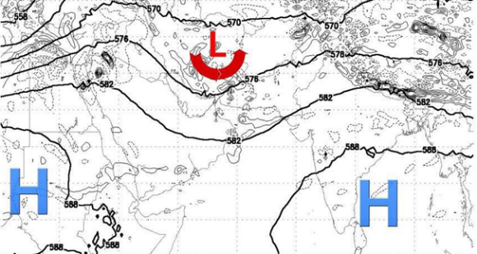
1: What is Western disturbance?
Extratropical storm that originates in the Mediterranean region which brings sudden winter rain to the north-western parts of the Indian sub-continent
A passage of upper air troughs of low pressure area.
Passing from west to east.

Slide 9
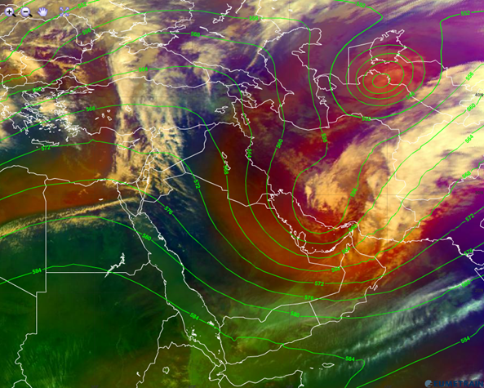
Air mass RGB image

Slide 10
2: How it Develops?
1. Deep trough
3. cold air mass
2. Amount of moisture
4. High temperatures
Develop If:
Effects:
Deep convection and thunderstorms.
Lightening.
Hail.
Strong downdraft.
Flash flood.

Slide 11
26th -27th Dec 2015
Less humidity
Light to moderate rain
Khasab recorded 8.8mm

Slide 12
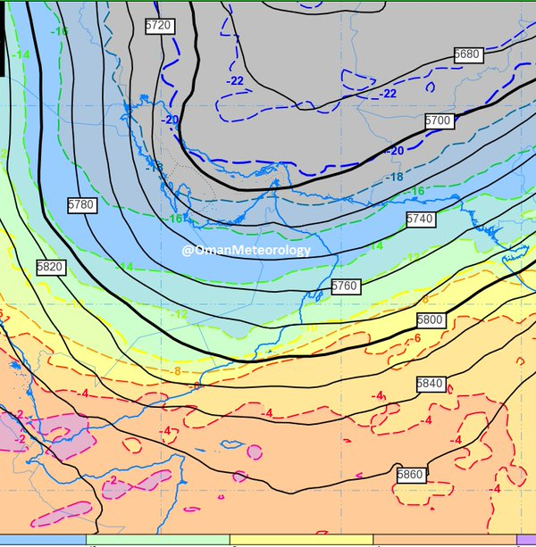
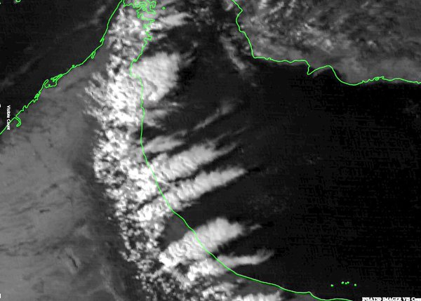
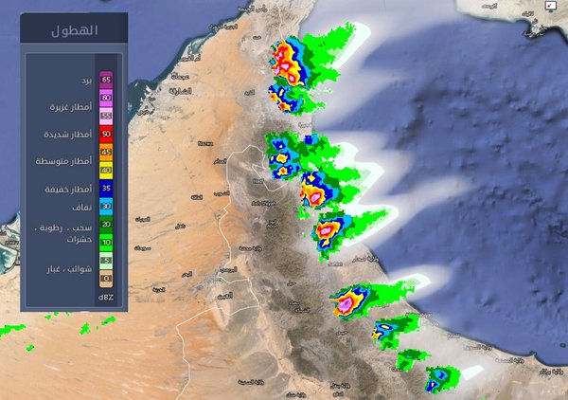
16th Feb 2015 (cold air mass)
Geopotential height 500mb
Satellite Image
Radar Image

Slide 13
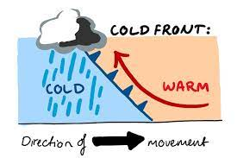
Subject 3:
Cold front
https://www.youtube.com/watch?v=YJCW4zuoMM0

Slide 15
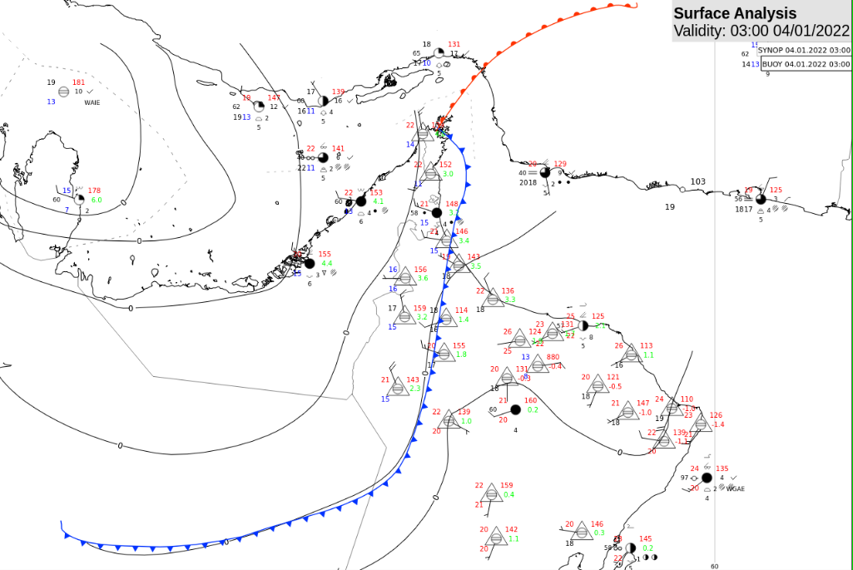
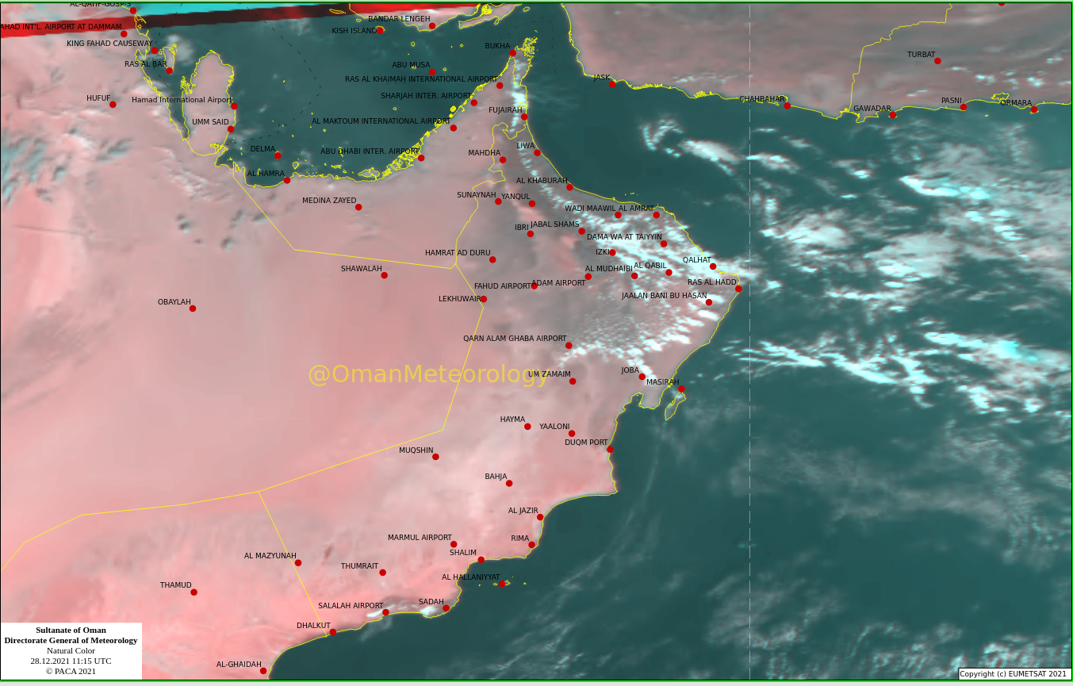
Al Azam Trough

Slide 16
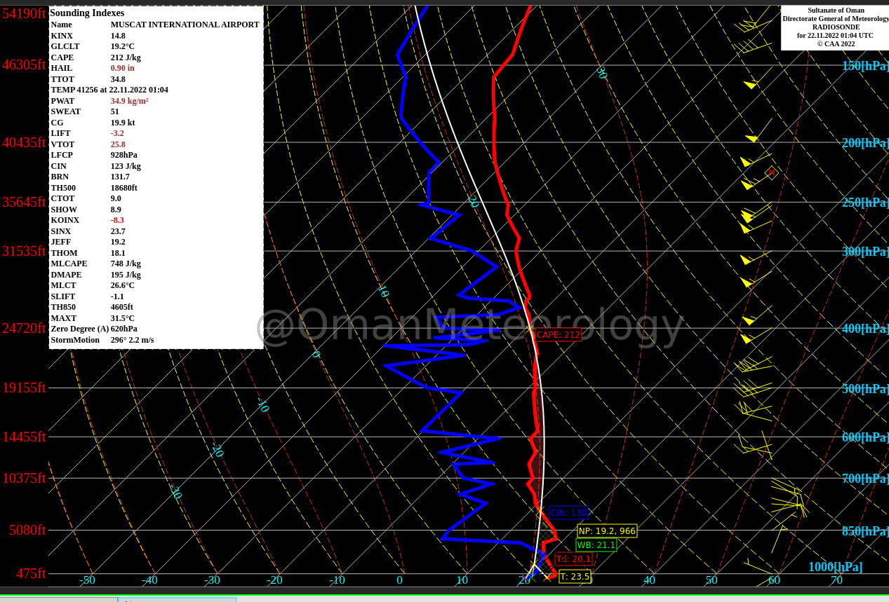
Radiosonde

Slide 17
Subject 4:
General background and its effects?
Shamal wind/Dust

Slide 18
Shamal wind/ Dust
Background
Effects
Cold air
Decrement in Temperatures.
Is a northwesterly wind blowing over Iraq and the Arabian Peninsula, often strong during the day and weaken at night.
This weather effect occurs anywhere from once to several times a year, mostly in summer but sometimes in winter.
The resulting wind typically creates large sandstorm and dust storm over the region.
Band of clouds ahead of blowing dust
Blowing dust
Disrupted human activities.
Increases wave heights

Slide 19
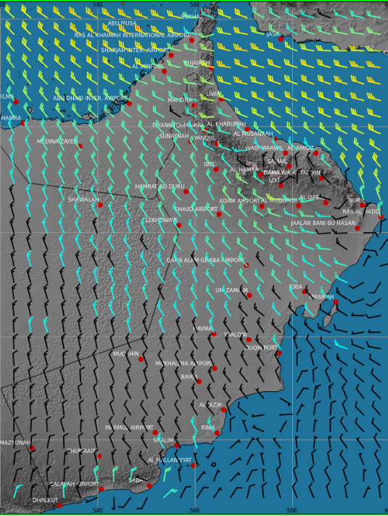
Wind (21st of Jan 2022)

Slide 20
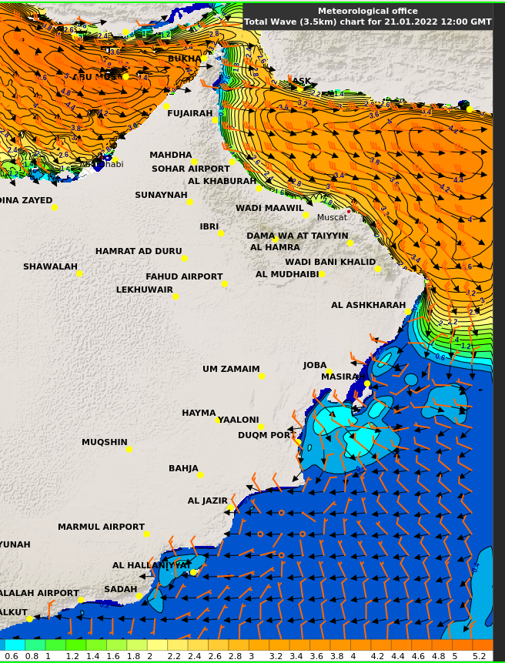
Waves (21st of Jan 2022)

Slide 21
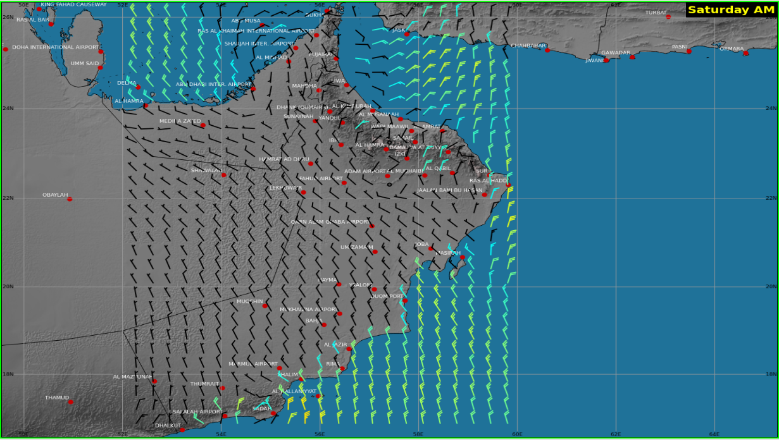
Wind (22nd of Jan 2022)

Slide 22
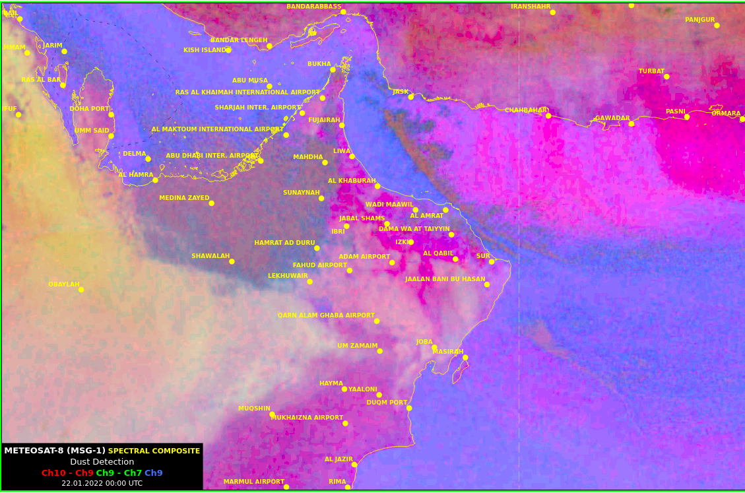
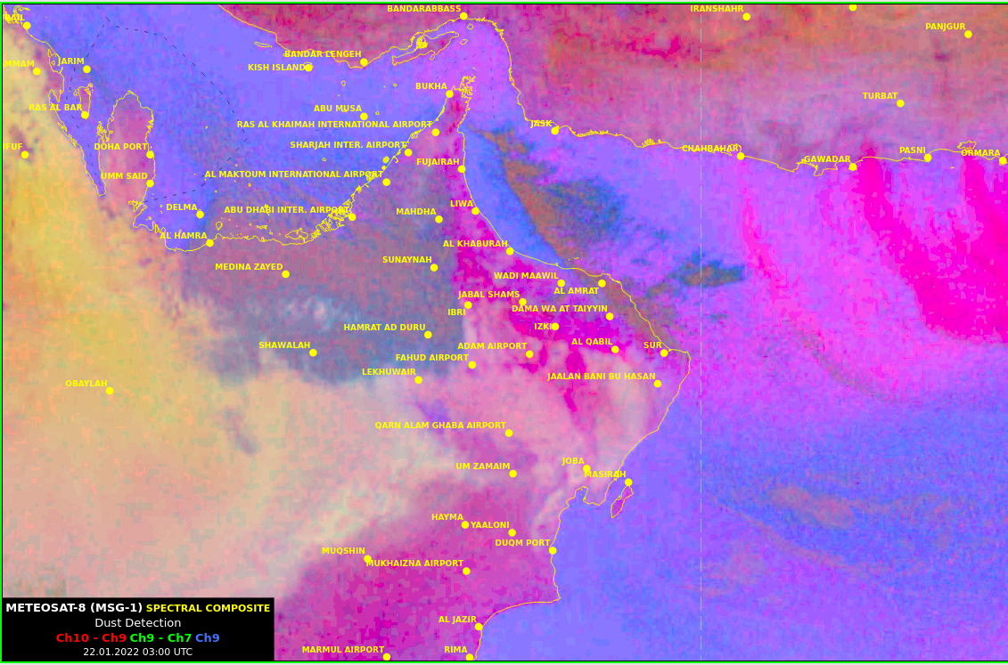
Dust RGB Product (22nd of Jan 2022)

Slide 23
Subject 5:
Fog Formation
Its effects
Fog

Slide 24
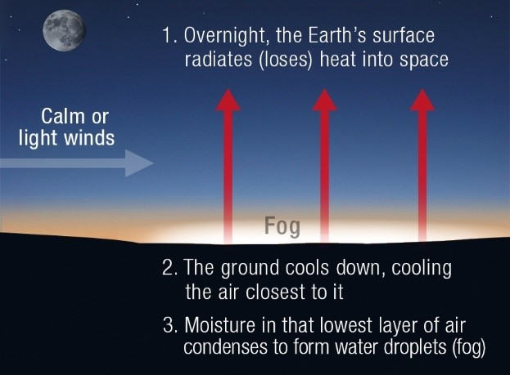
1: Fog Formation
Ideal condition for Fog Formation....
Stability (inversion )
High humidity (Saturation)
Calm to light surface wind
Low temperature
Timing: late night to early morning

Slide 25
2: Effects on human activities
Reduce in visibility
Air traffic disruption
Traffic danger

Slide 26
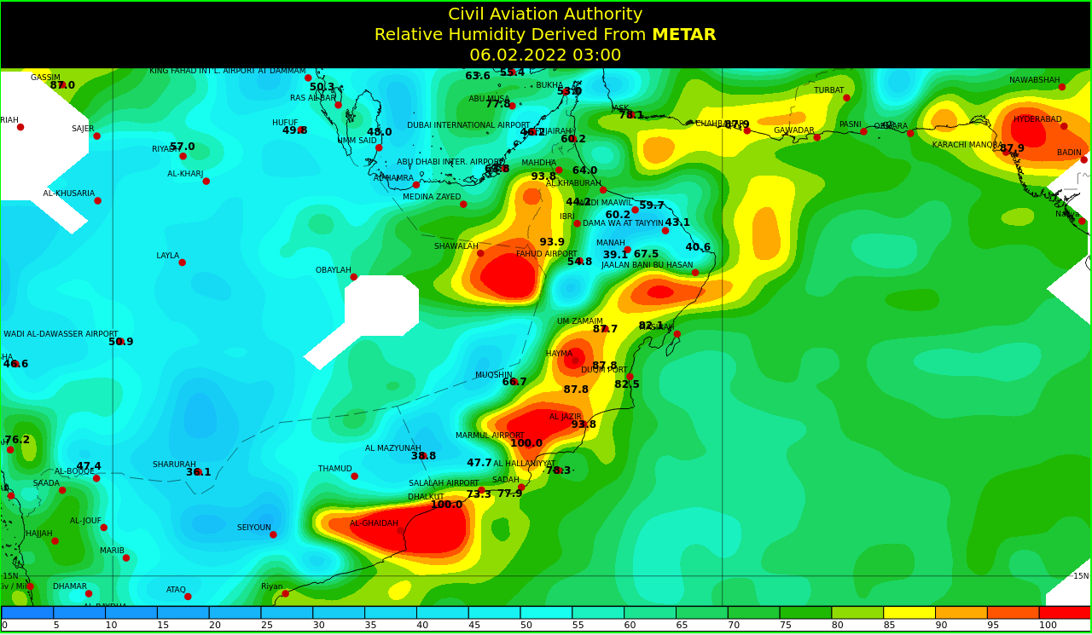
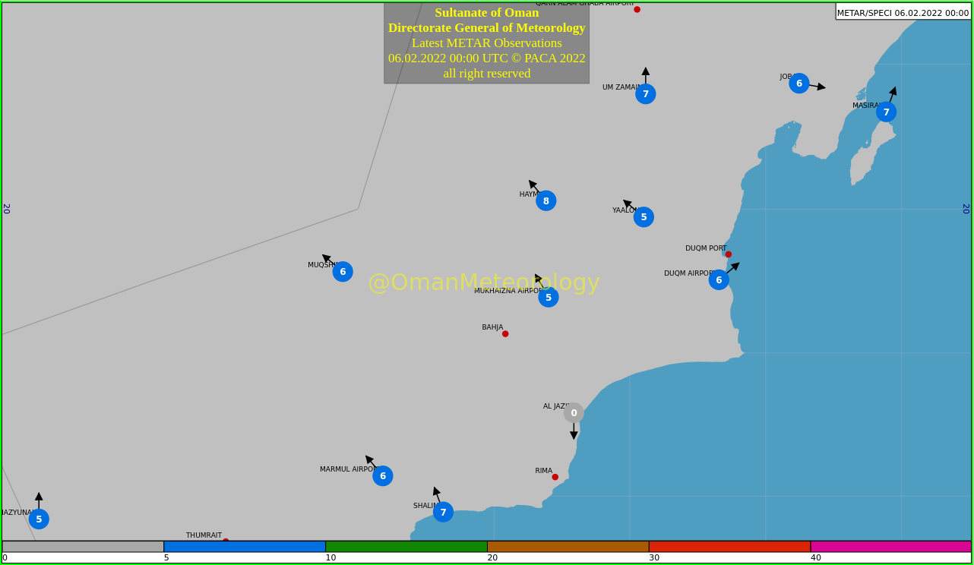
Fog over Haima on 06/02/2022

Slide 27
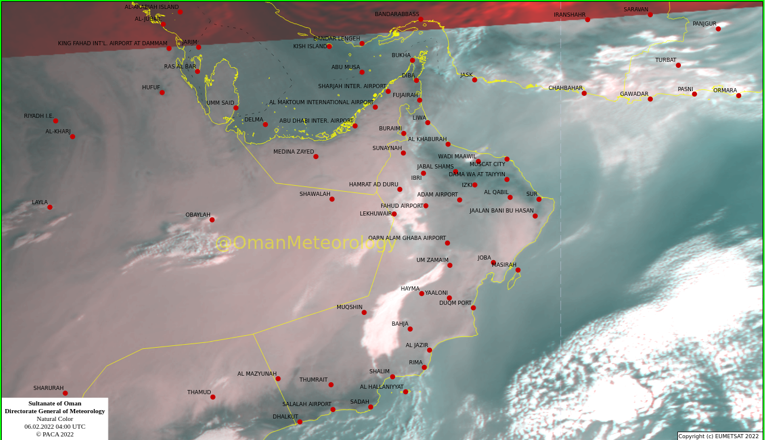
METAR
Satellite Image

Slide 28
Subject 6:
What is Siberian high?
Winter monsoon
Siberian high

Slide 29
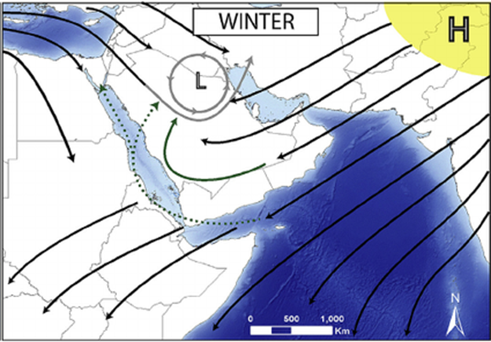
1: What is Siberian High
A strong High pressure (Siberian high) develops over Asia.
It’s a cool and dry continental air mass causes the winter monsoon.
Expected from End of Nov to Mar .

Slide 30
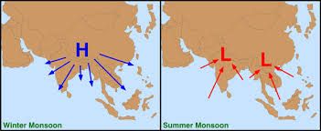
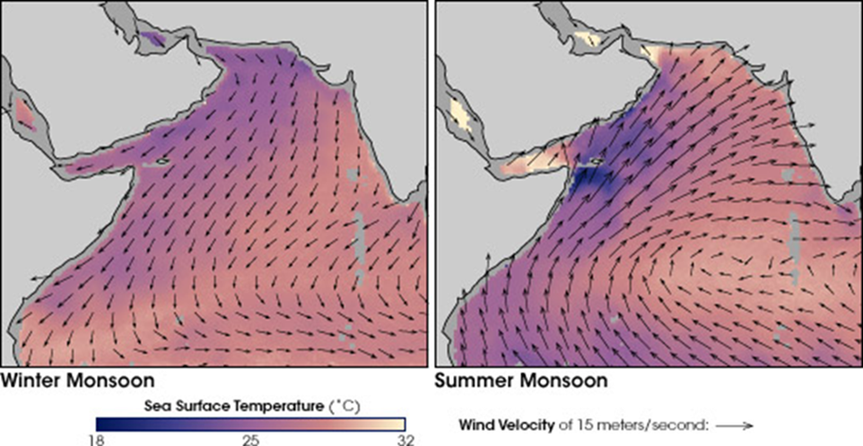
2: Winter monsoon
Wind direction (arrows) and ocean temperatures (colors).
Dark purple indicates cooler sea surface temperatures(SST), and pinkish-yellow indicates warmer SST temperatures.

Slide 31
Scan this
Kindly scan this “QR code” to evaluate this lecture.
Thank You!

