Slide 1
Basics of RGBs and products.
Ivan Smiljanic
EUMETSAT training team
SAC Trainers’ Course

Slide 2
Agenda
Why do we need products?
.
What kind of product do we have?

Slide 3
Agenda
Why do we need products?
.
What kind of products do we have?

Slide 4
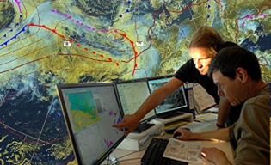
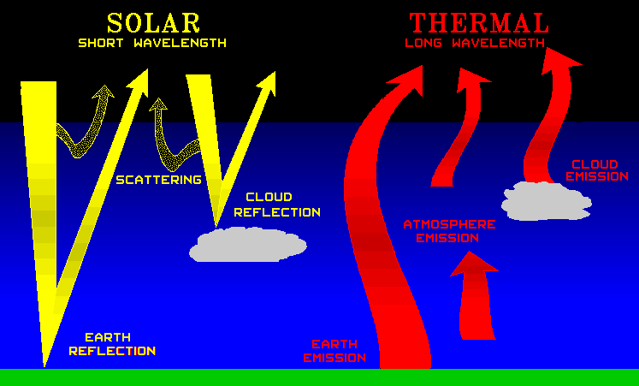
Photon’s journey
? ? ?
Where was I born?
p -

Slide 5
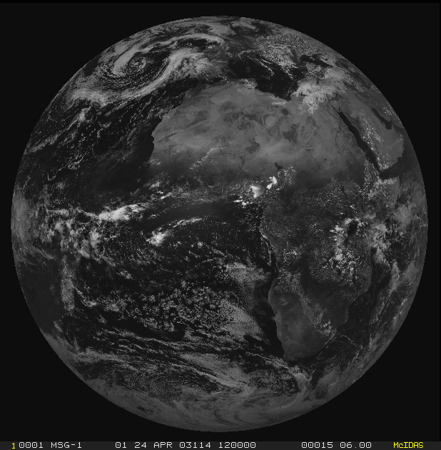
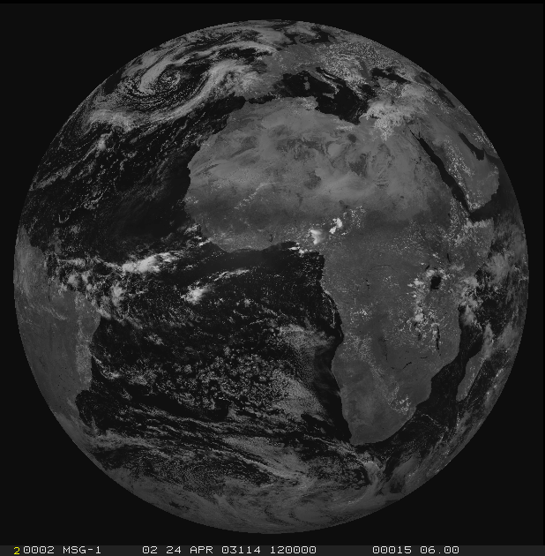
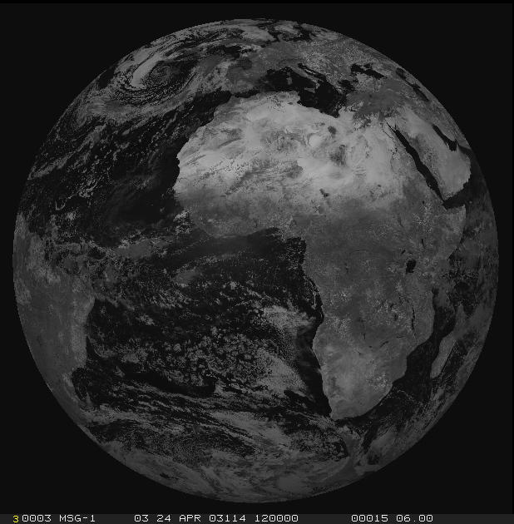
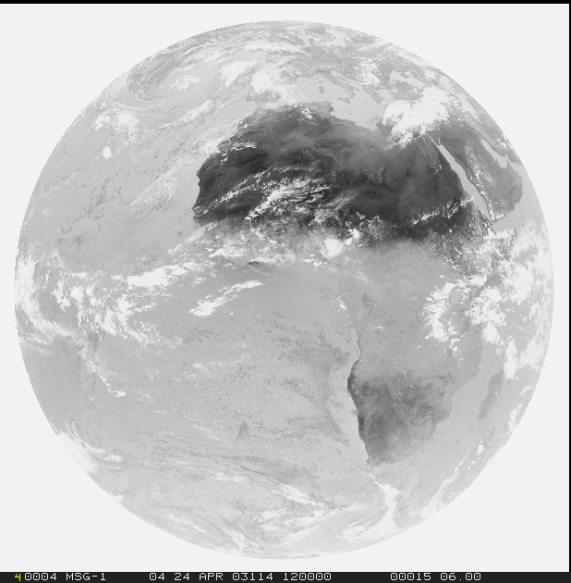
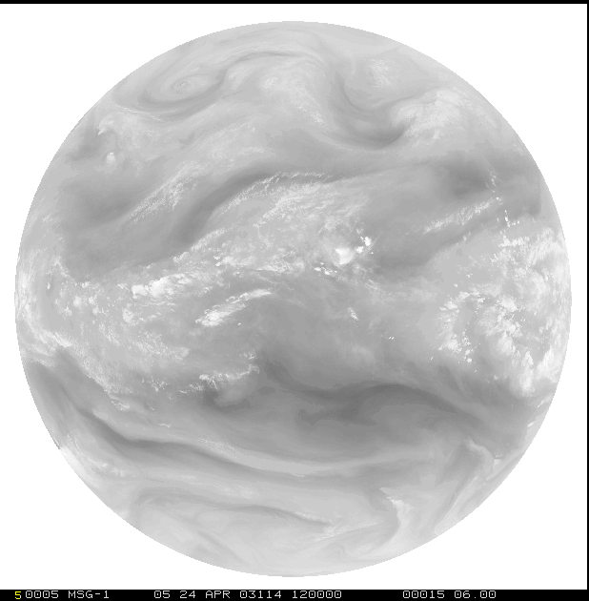
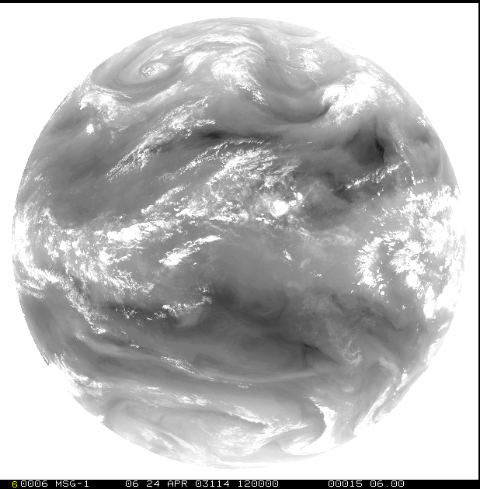
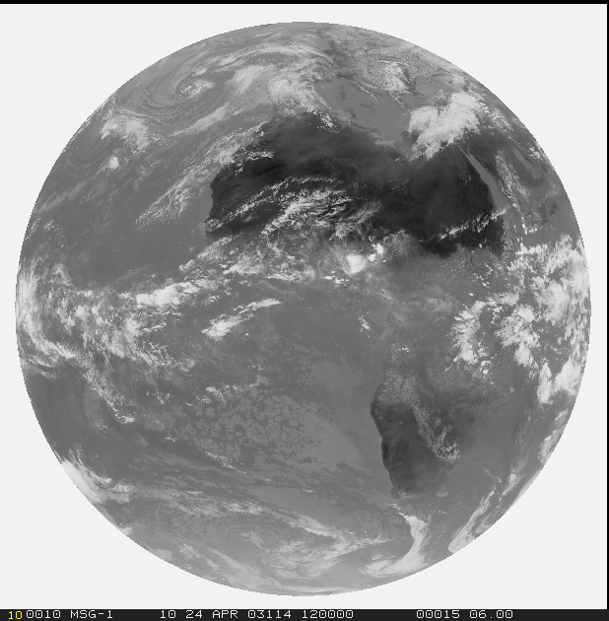
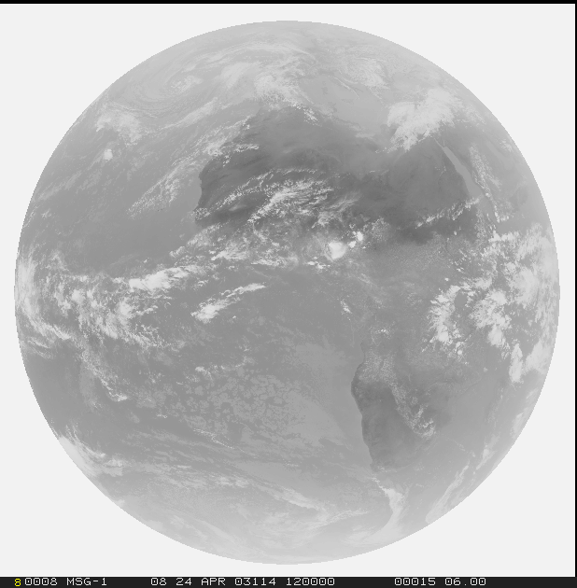
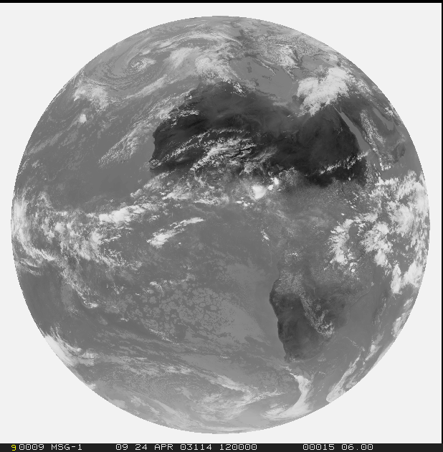
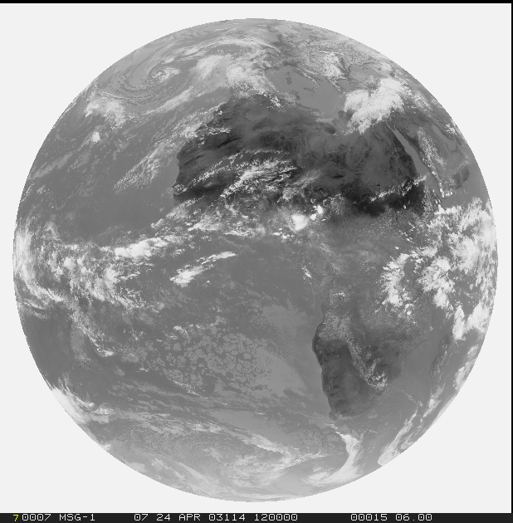
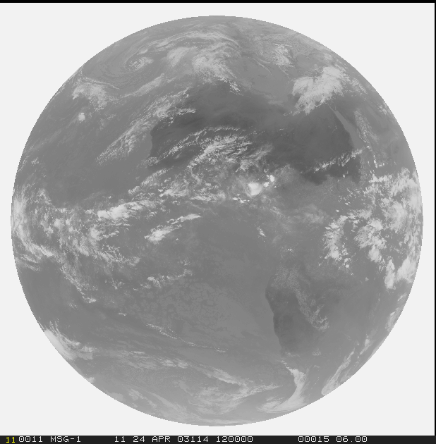
Middle of journey
3=VIS0.6
4=VIS0.8
Solar
3.0 km (1.0 km for HRVIS)
Thermal
3.0 km
7=NIR1.6
9=IR3.8
10=WV6.2
11=WV7.3
12=IR8.7
13=IR9.7
14=IR10.5
15=IR12.3
16=IR13.3

Slide 6
Middle of journey
Experts
3=VIS0.6
4=VIS0.8
Solar
3.0 km (1.0 km for HRVIS)
Thermal
3.0 km
7=NIR1.6
9=IR3.8
10=WV6.2
11=WV7.3
12=IR8.7
13=IR9.7
14=IR10.5
15=IR12.3
16=IR13.3

Slide 7
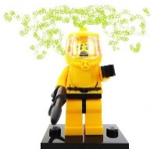
Middle of journey
Middle of journey
4=VIS0.8
3=VIS0.6
4=VIS0.8
3=VIS0.6
Solar
3.0 km (1.0 km for HRVIS)
Thermal
3.0 km
Solar
3.0 km (1.0 km for HRVIS)
Thermal
3.0 km
7=NIR1.6
7=NIR1.6
9=IR3.8
9=IR3.8
12=IR8.7
10=WV6.2
11=WV7.3
12=IR8.7
10=WV6.2
11=WV7.3
16=IR13.3
13=IR9.7
15=IR12.3
16=IR13.3
13=IR9.7
14=IR10.5
15=IR12.3
14=IR10.5

Slide 8
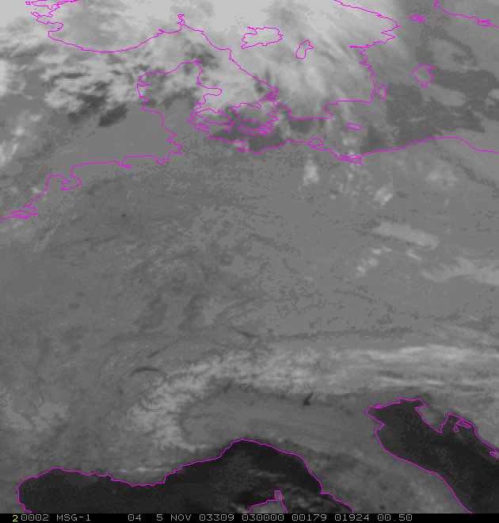
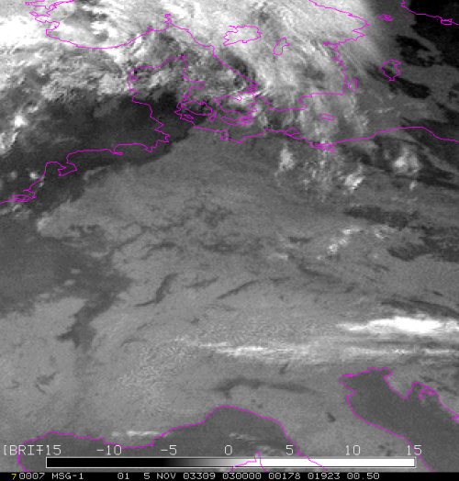
Data exploration
How to use data?
Single channel??
…
..?

Slide 9
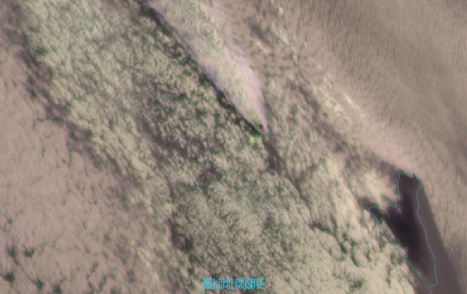
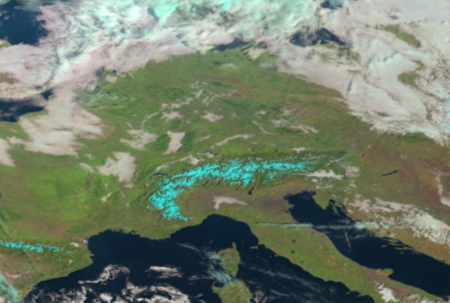
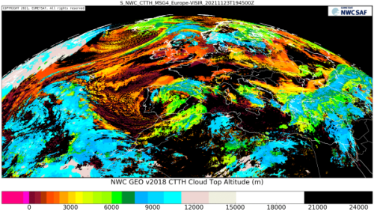
Data exploration
How to use data?
Single channel??
Channel difference/ratio
Sandwich products
RGB products
-
L2(+) / Geophysical products

Slide 10
Agenda
Why do we need products?
.
What kind of products do we have?

Slide 11
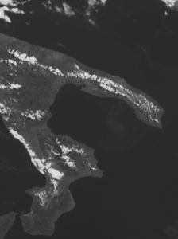
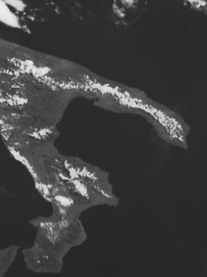
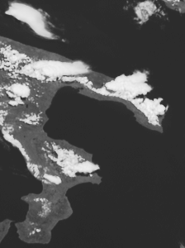
Single channel(s) – convergence line detection
Seabreeze Convergence, Southern Italy (Salento)
09:05 UTC 09:40 UTC 10:55 UTC
12 June 2007, HRV Channel (Met-8 Rapid Scans)

Slide 12
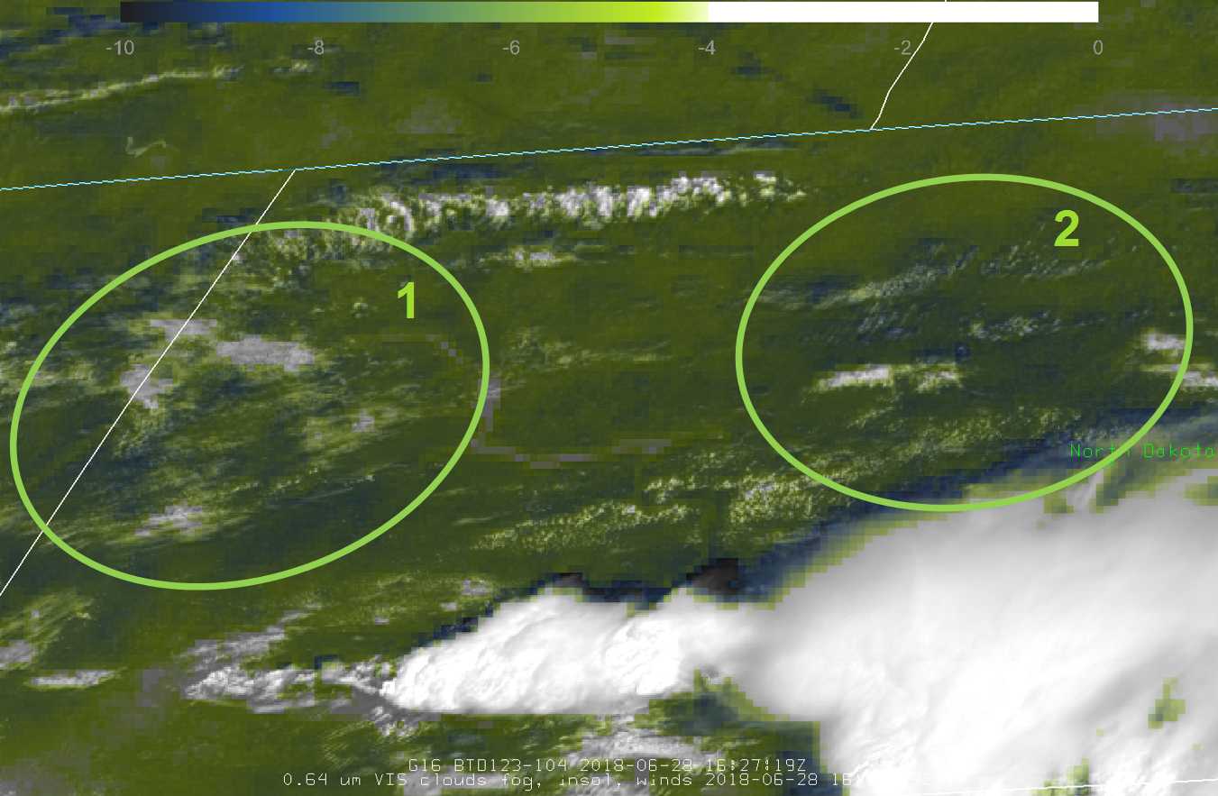
Channel differenc/ratio
Enhances the certain signal from single channels
BTD 12.0-10.8
28 June 2018
16:27 UTC
North Dakota

Slide 13
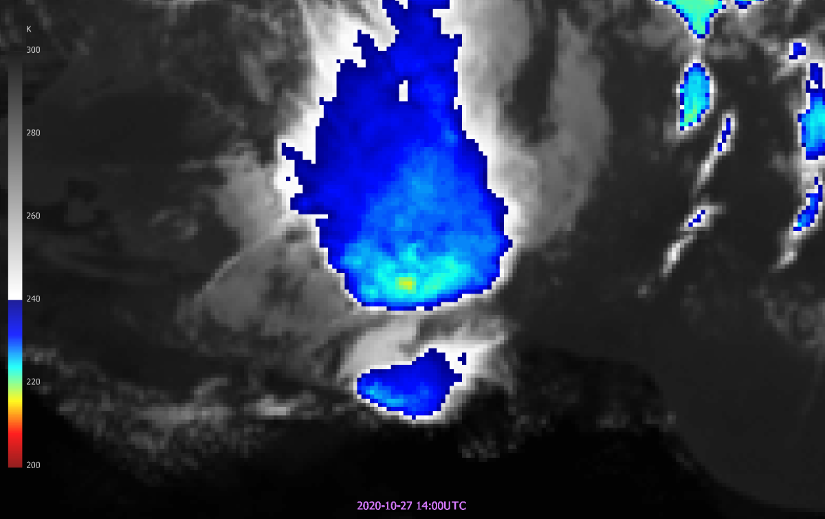
#Sandwich product
Sandwich:
IR temperature
+
enhanced spatial resolution through
HRV channel

Slide 14
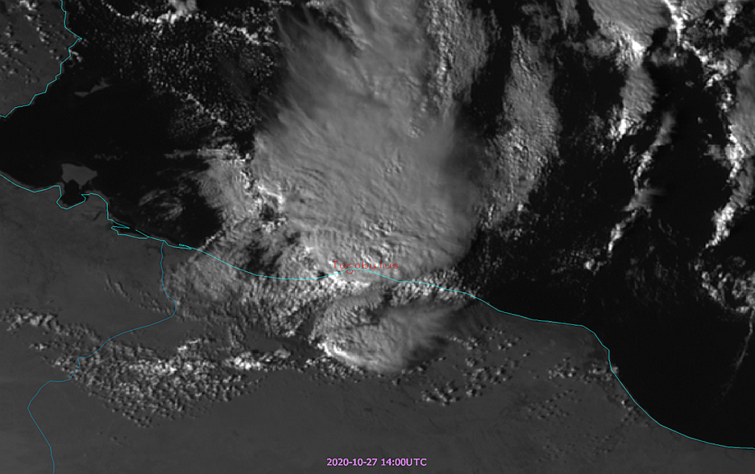
‘Sandwich’ product
Sandwich:
IR temperature
+
enhanced spatial resolution through
HRV channel

Slide 15
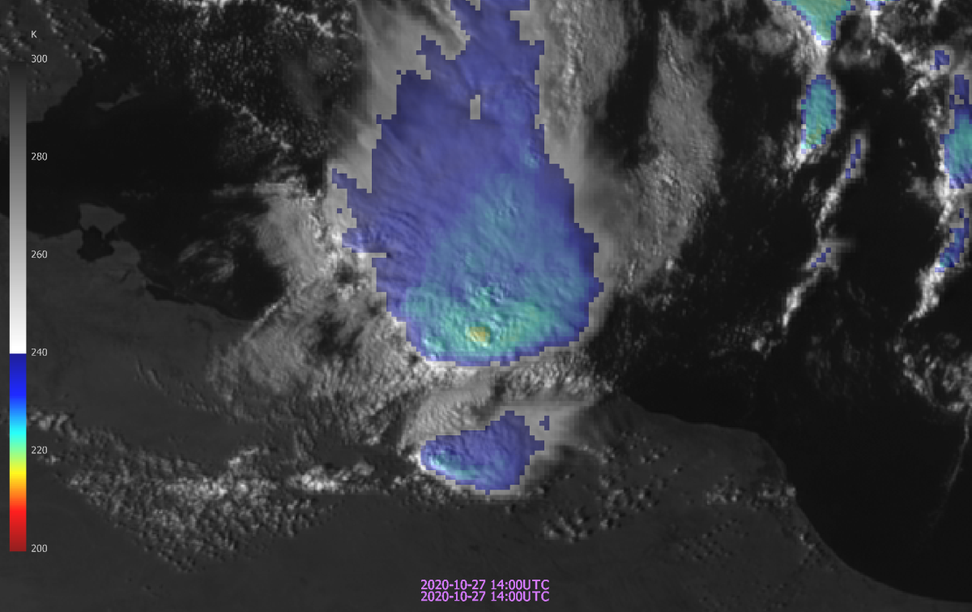
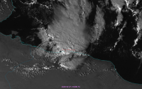
‘Sandwich’ product
Sandwich:
IR temperature
+
enhanced spatial resolution through HRV channel
+

Slide 16
Middle of journey
Middle of journey
4=VIS0.8
3=VIS0.6
4=VIS0.8
3=VIS0.6
Convective storm?
Fire
monitoring?
Solar
3.0 km (1.0 km for HRVIS)
Thermal
3.0 km
Solar
3.0 km (1.0 km for HRVIS)
Thermal
3.0 km
7=NIR1.6
7=NIR1.6
9=IR3.8
9=IR3.8
12=IR8.7
10=WV6.2
11=WV7.3
12=IR8.7
10=WV6.2
11=WV7.3
16=IR13.3
13=IR9.7
15=IR12.3
16=IR13.3
13=IR9.7
14=IR10.5
15=IR12.3
14=IR10.5

Slide 17
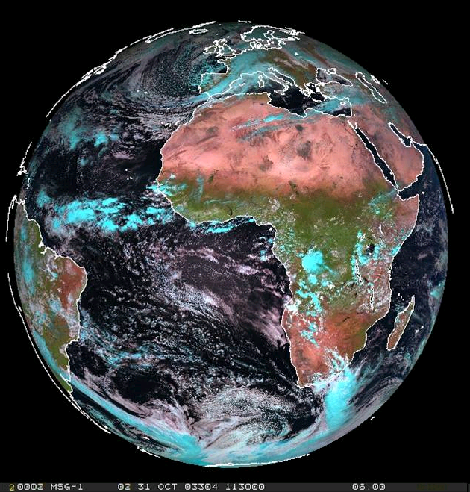
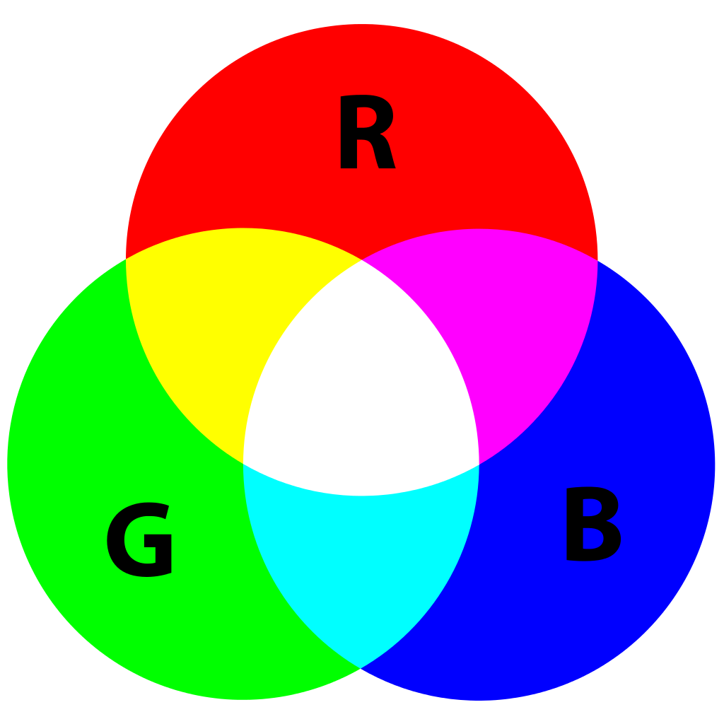
RGB products – generic example
XY RGB
Red: …
Green: …
Blue: …
-

Slide 18
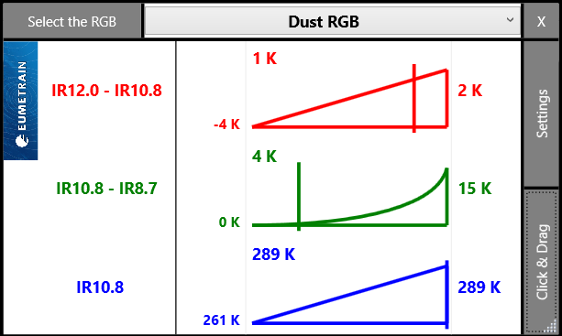
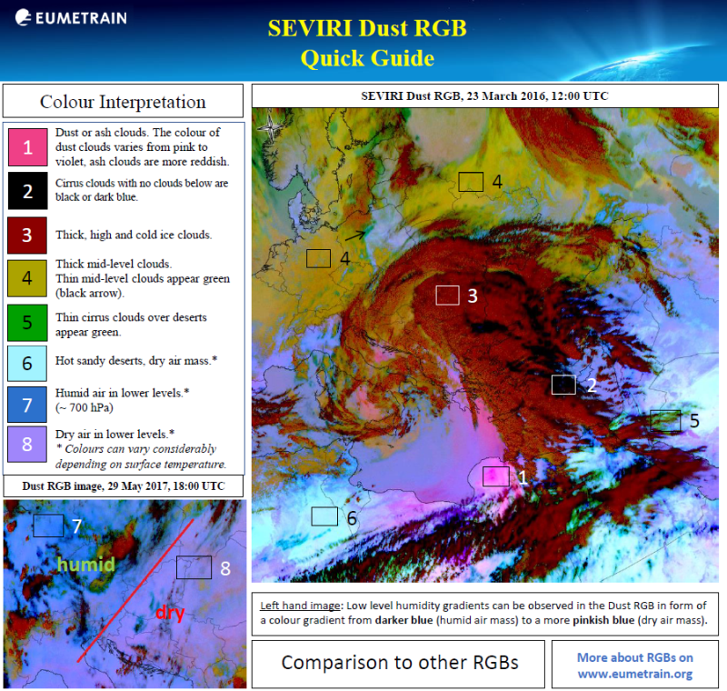
Quick help for RGBs
RGB Colour Interpretation tool:
http://www.eumetrain.org/RGBguide/instructions.html
RGB Quick Guides:
http://eumetrain.org/rgb_quick_guides/index.html
Notes:
Koji omogućuje da vidimo koliki je udio pojedine boje ( a time i zračenja u pojedinom kanalu) u nekoj boji kompozita.

Slide 19
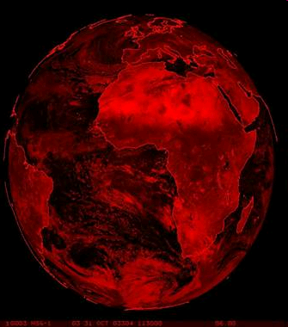
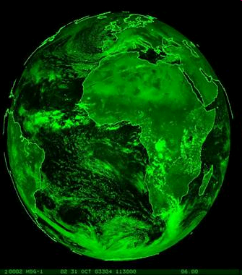
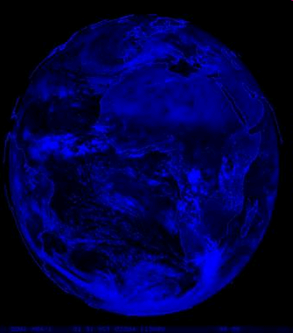
RGB 1.6, 0.8, 0.6
" Natural Colour RGB "
Red: NIR 1.6 μm
Green: VIS 0.8 μm
Blue: VIS 0.6 μm
Notes:
Evo kako to izgleda. Ovdje su prikazane slike u NIR 1.6, obojena u crveno, VIS 0.8, obojena u zeleno i VIS 0.6, obojena u plavo. Njihovim kombiniranjem dobiva se ovakva slika:
Da bismo lakše vidjeli koje značenje na slici imaju pojedine boje uzet ćemo jedan jednostavan alat

Slide 20
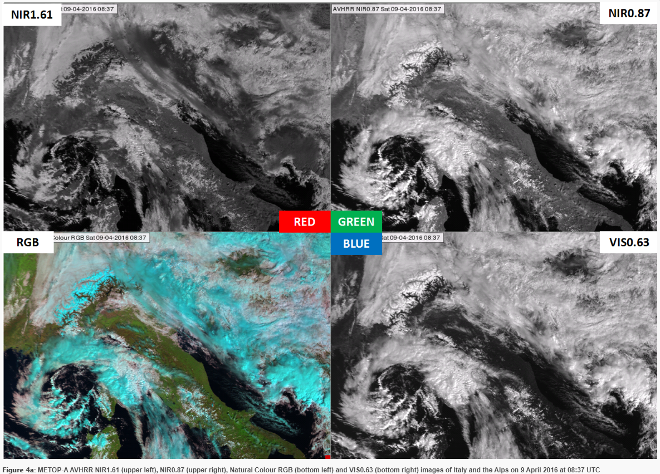

Slide 21
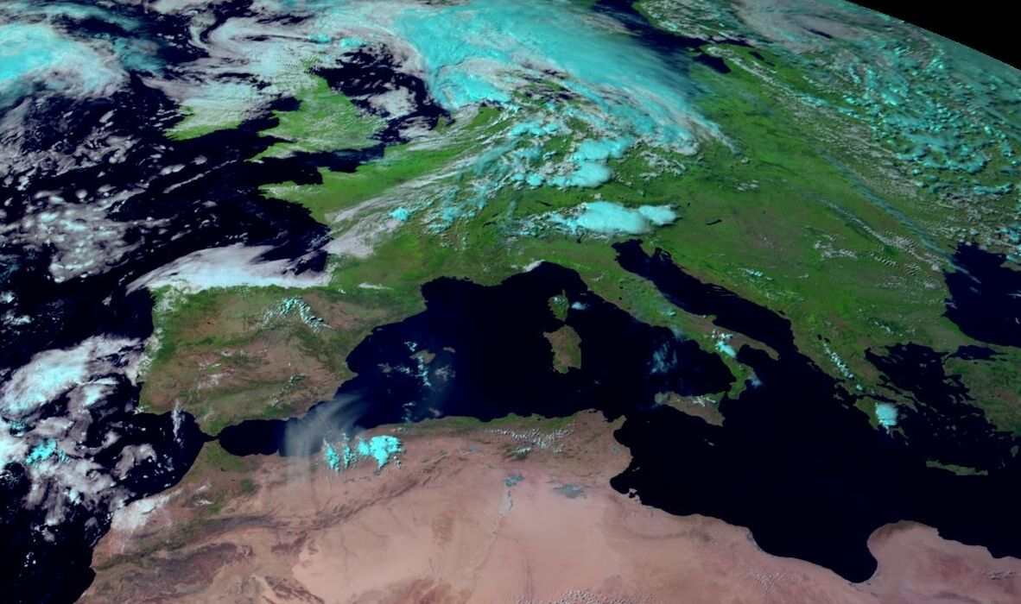
Utility: cloud phase, vegetation, dust, smoke, snow, fires
MSG-1, 23 June 2003, 15:00 UTC

Slide 22
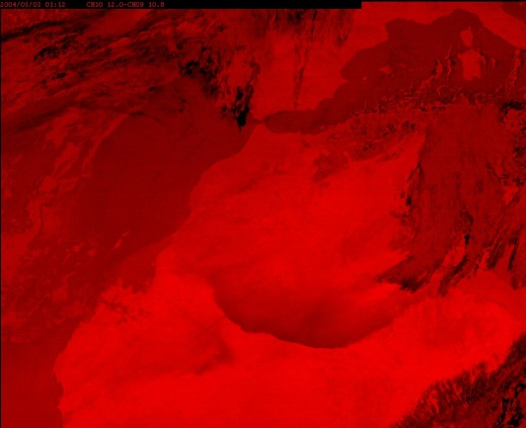
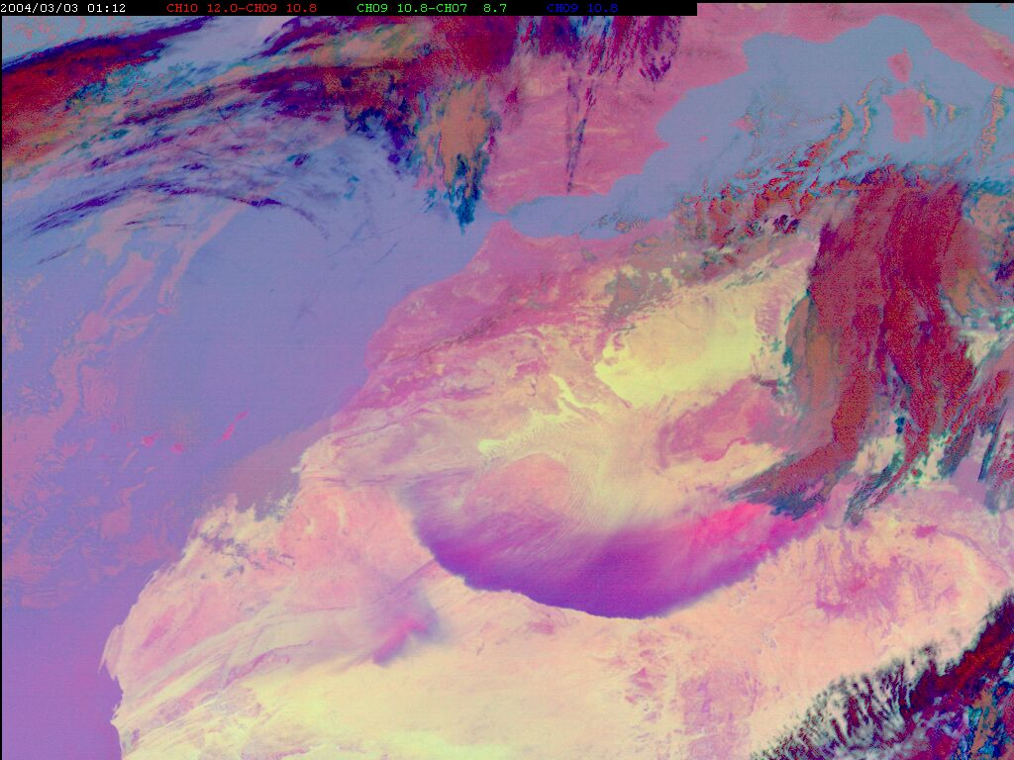
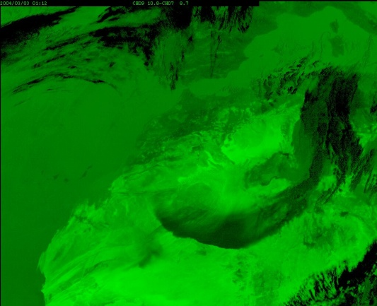
RGB 12-10.8,10.8-8.7,10.8
"Dust RGB"
R = BTD IR12.0 - IR10.8
G = BTD IR10.8 - IR8.7
B = IR10.8

Slide 23
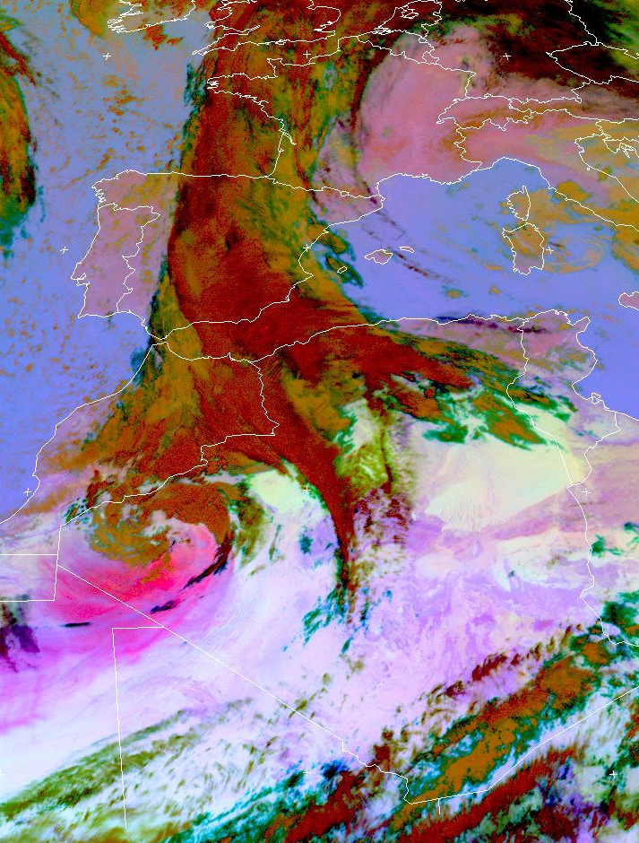
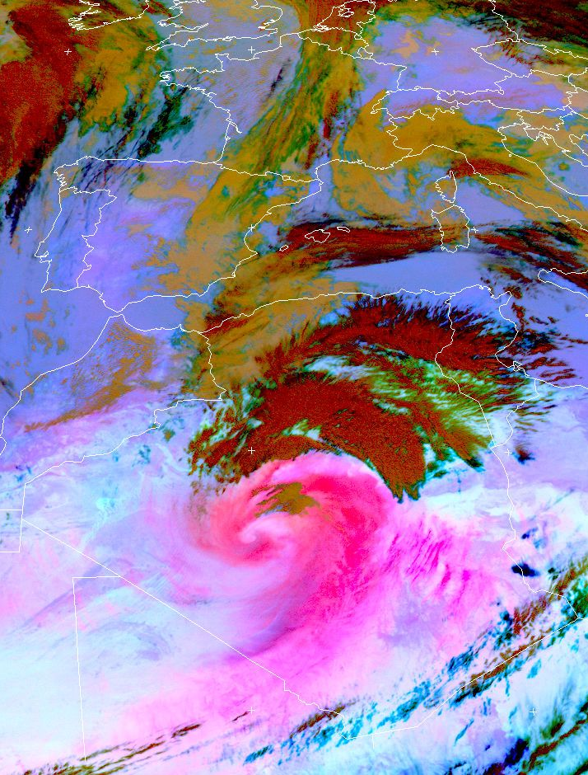
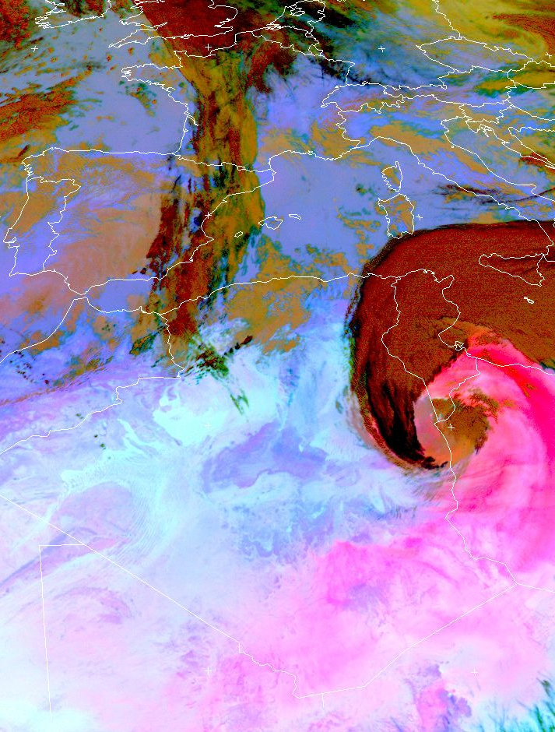
Utility: Dust (Day)
20 Feb 18:00 UTC 21 Feb 12:00 UTC 22 Feb 12:00 UTC

Slide 24
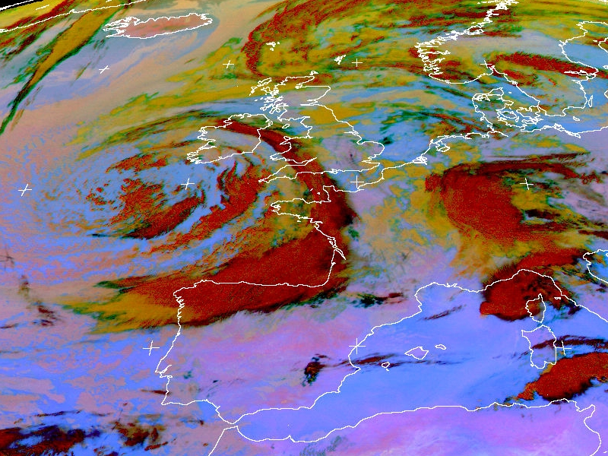
Utility: Cloud Phase
Ice
cloud
Water cloud
Met-8, 16 Aug 2006, 04:00 UTC

Slide 25
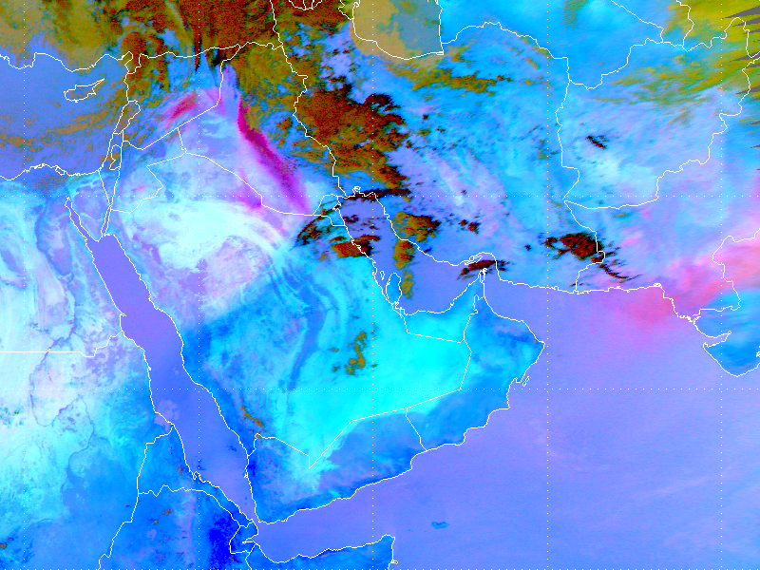
Dry Line Middle East, 16 April 2013

Slide 26
Utility: Thin Ice Clouds
MSG-1, 12 November 2006, 23:00 UTC

Slide 27
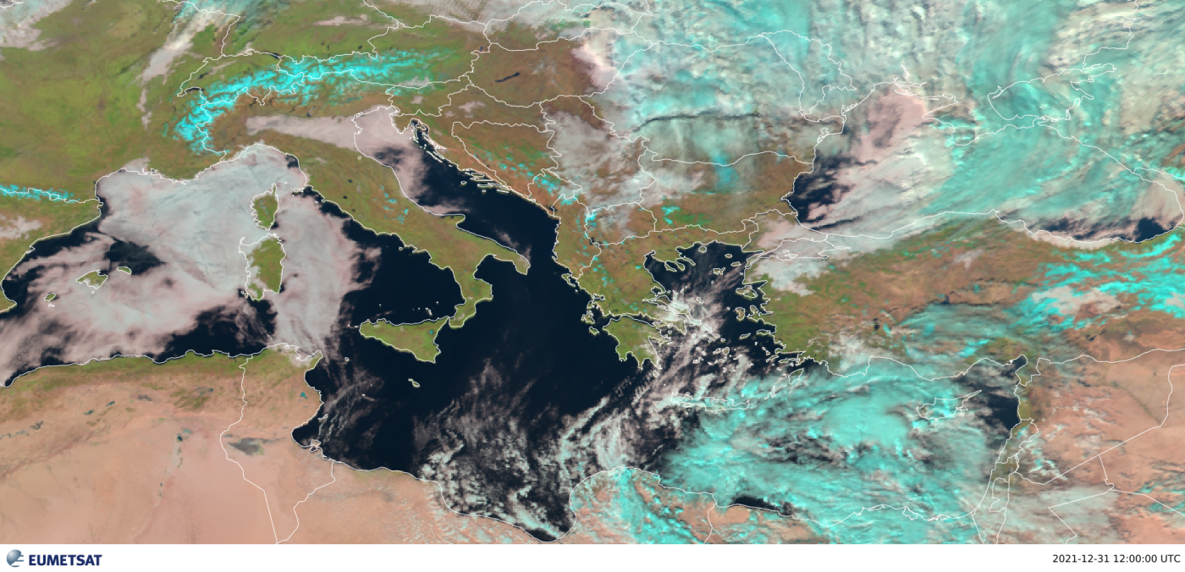
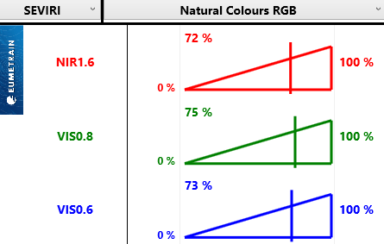
RGB walk-through
4
1
8
5
2
+
10
6
9
7
3
https://www.eumetsat.int/persistent-fog-low-cloud-over-mediterranean-sea

Slide 28
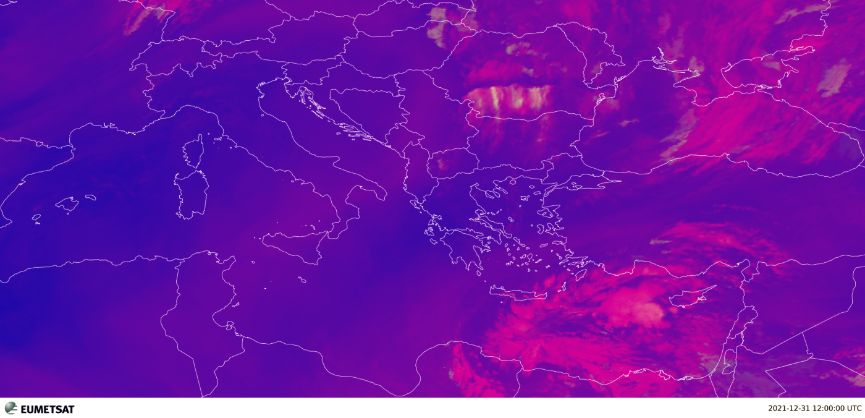
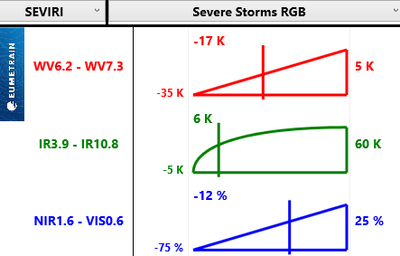
RGB walk-through
4
1
8
5
2
+
10
6
9
7
3
https://www.eumetsat.int/persistent-fog-low-cloud-over-mediterranean-sea

Slide 29
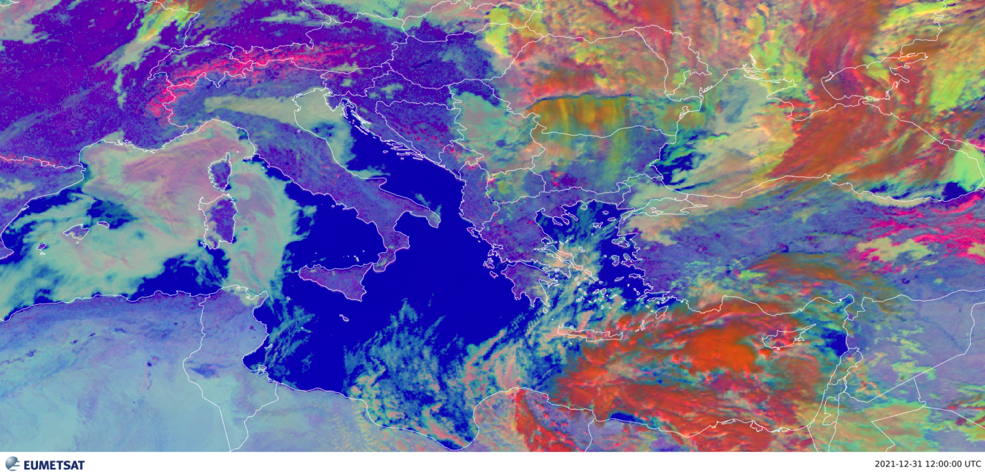
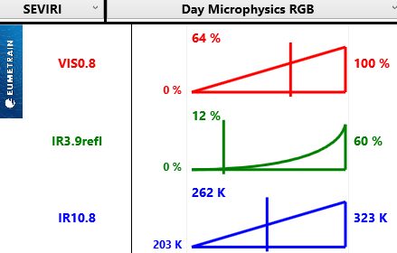
RGB walk-through
4
1
8
5
2
+
10
6
9
7
3
https://www.eumetsat.int/persistent-fog-low-cloud-over-mediterranean-sea

Slide 30
RGB walk-through
4
1
8
5
2
+
10
6
9
7
3
https://www.eumetsat.int/persistent-fog-low-cloud-over-mediterranean-sea

Slide 31
RGB walk-through
4
1
8
5
2
+
10
6
9
7
3
https://www.eumetsat.int/persistent-fog-low-cloud-over-mediterranean-sea

Slide 32
RGB walk-through
4
1
8
5
2
+
10
6
9
7
3
https://www.eumetsat.int/persistent-fog-low-cloud-over-mediterranean-sea

Slide 33
RGB walk-through
4
1
8
5
2
+
10
6
9
7
3
https://www.eumetsat.int/persistent-fog-low-cloud-over-mediterranean-sea

Slide 34
RGB walk-through
+

Slide 35
Geophysical (L2+) products
Quantitative values derived from satellite data (height, temperature, pressure, humidity, chlorophyll, wind vector, etc.)
Includes multiple inputs (aside from the original satellite data):
Auxiliary satellite data
NWP variables
Look-up tables
Climatology
Background maps
Parametrization parameters
Corrections
…

Slide 36
Geophysical (L2+) products

Slide 37
Geophysical (L2+) products

Slide 38
Geophysical (L2+) products
E.g.

Slide 39
Thank you!
Questions are welcome.

