Slide 1
Microwave Imagery
Scott S Lindstrom
University of Wisconsin-Madison
Cooperative Institute for Meteorological Satellite Studies
Oman
November 2023

Slide 2
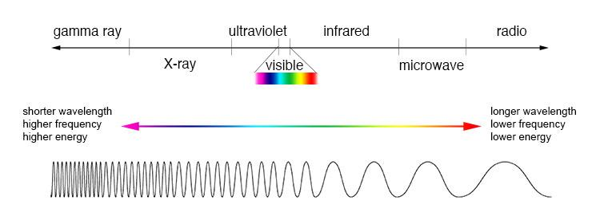
Introduction to Microwave Remote Sensing
The Electromagnetic Spectrum
0.55 μm
Long Wavelength
1 cm – 1 m wavelength
Low Energy

Slide 3
Scattering in the atmosphere
If a wavelet of energy moves through the atmosphere and encounters particles that are close to its size, it can be scattered
Long wavelength phenomena (i.e., microwave) aren’t affected much by very small particles (cloud droplets, molecules)
Microwave energy can be affected by very large droplets (think: raindrops) that are near in size to microwave wavelengths

Slide 4
Properties of Microwave
Introduction to Microwave Remote Sensing
Microwave wavelengths are not susceptible to the atmospheric scattering that affects shorter wavelengths
Microwave radiation can penetrate (mostly unaltered) through cloud cover, haze, dust, and all but the heaviest rainfall
Microwave Data can be collected at any time and in almost any weather conditions

Slide 5
Properties of Microwave
Introduction to Microwave Remote Sensing
All objects emit microwave energy of some magnitude, but the amounts are generally very small.
Fields of view must be large to detect enough energy to record a signal (or: antenna must be very large)
Most passive microwave sensors are characterized by low spatial resolution.
A passive microwave sensor detects the naturally emitted microwave energy within its field of view.
Emitted energy is related to the temperature and moisture properties of the emitting object or surface.

Slide 6
Pixel Sizes
ABI/AMI/AHI/AGRI imagery from GOES-R or GEOKOMPSAT-2 or Himawari or FY-4
0.5 – km imagery in the visible
2 – km imagery in the infrared
There’s enough energy so that pixel sizes can be small and you have sufficient signal to noise ratio
Microwave imagery pixel size is closer to 15 – 75 km [ 183 GHz, is more energetic – smaller pixel size is possible ; 23 GHz is less energetic – larger pixel size is needed ]

Slide 7
Microwave energy moves through clouds from underneath. Thus….
Microwave imagery can give you information about the cyclone structure underneath the cirrus canopy
Rain Bands
Eyewall
Moisture distribution
Large-scale only. Horizontal resolution is poor
Thermal structure
But the resolution is not great!
Microwave data can also be used to compute moisture variables: TPW, Rain Rate, etc.
MIRS: Microwave Integrated Retrieval System

Slide 8
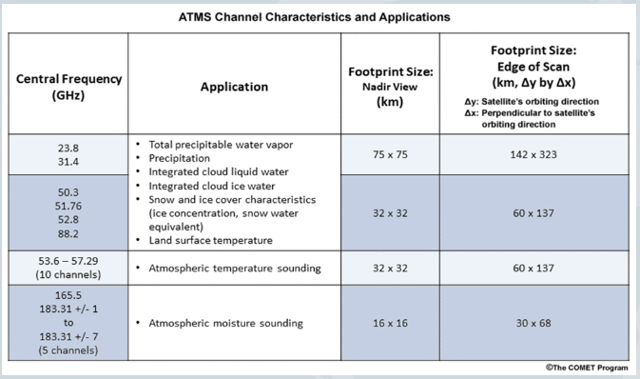
ATMS Wavelengths
Different wavelengths interact with rain, ice and moisture in different ways
Resolution increases as GHz increases

Slide 9
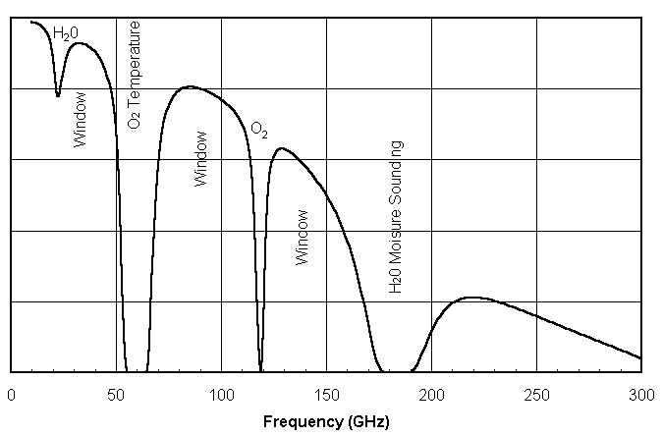
Microwave wavelengths
1.0 cm
0.5 cm
0.2 cm
Transmittance
23 GHz: (weak) absorption by water
31 GHz: little absorption by water
Difference between the two: A function of TPW

Slide 10
Microwave wavelengths
1.0 cm
0.5 cm
0.2 cm
Transmittance
50-58 GHz: absorption by oxygen
Microwave data in this band are used to
show vertical temperature profile information

Slide 11
Microwave wavelengths
1.0 cm
0.5 cm
0.2 cm
Transmittance
85-92 GHz: scattering is important
Microwave data in this region is
scattered mostly by frozen hydrometeors

Slide 12
Microwave wavelengths
1.0 cm
0.5 cm
0.2 cm
Transmittance
180-190 GHz
Microwave data in this region is
gives water vapor information

Slide 13
Challenge: Many different platforms observing at many different frequencies
Cross-Track scanning
AMSU-A
Metop-B/Metop-C ; NOAA-15 to NOAA-19
AMSU-B
NOAA-15 to NOAA-17
ATMS
Suomi-NPP; NOAA-20; NOAA-21 (and -22, -23 when they launch)
MHS
Metop-B/Metop-C ; NOAA-18/NOAA-19
MWHS-2/MWTS-2 (starting on FY -3C)
SSMI/S (on DMSP16 – DMSP-19)
AMRS-2 (on GCOM-W) ; AMSR-3 (on GOSAT-GW)
GMI ; on GPM (Core) satellite
Conical scanning

Slide 14
Conical v. Cross-Track
Scan Angle
Conical: constant scan angle, constant footprint size
Cross-track: variable scan angle, variable footprint size
Here’s a Journal Article that digs into the comparison: https://journals.ametsoc.org/view/journals/hydr/21/4/jhm-d-19-0144.1.xml
Conical generally has better resolution than Cross-Track

Slide 15
There are observations at slightly different frequencies
There’s usually an observation around 36 GHz
AMSR-2, GMI: 36.5 GHz ; AMSU-A, ATMS: 31.4 GHz ; SSMIS: 37.0 GHz
There’s usually an observation around 89 GHz
GMI, AMSU-A/-B, MHS, AMSR-2, MWHS-2: 89 GHz ; ATMS: 88.2 GHz
Does the interpretation change based on these slight variations? Probably not

Slide 16
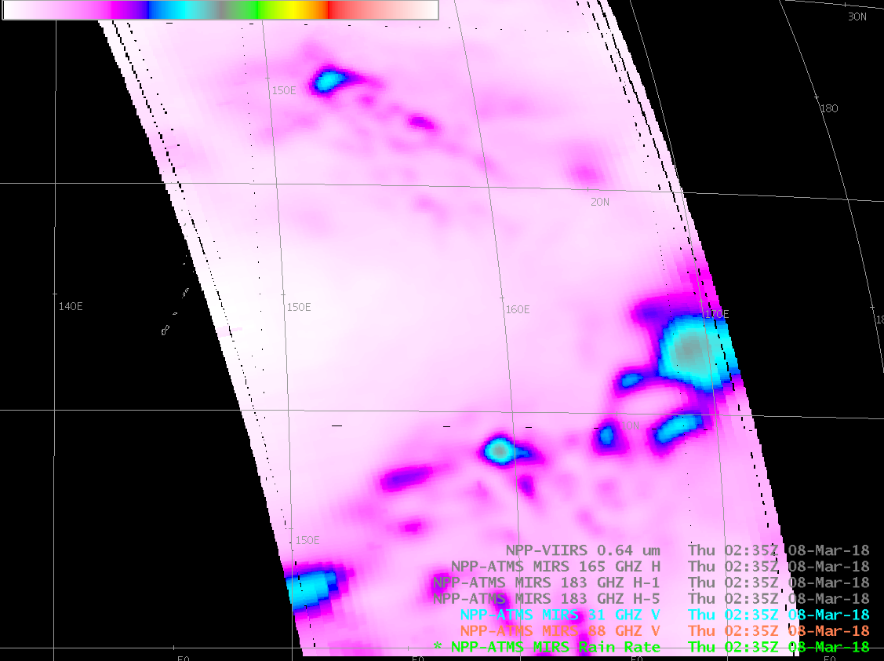
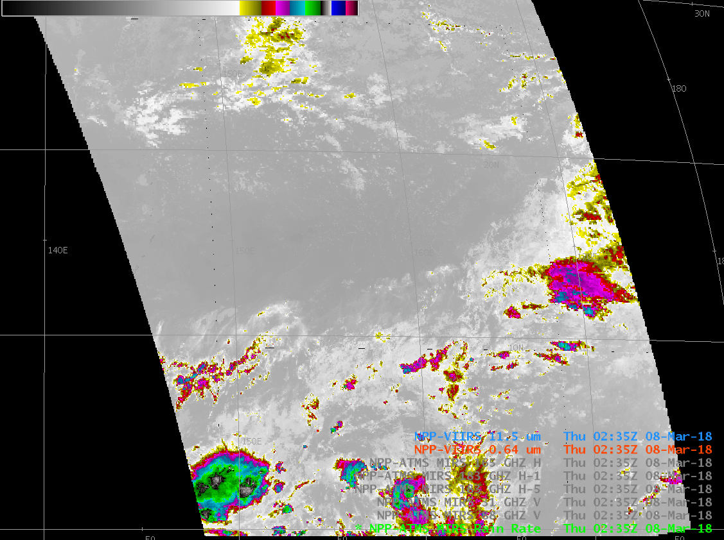
Sea water has very low emissivity
R = εσT⁴
Clear skies show the cold brightness temperature at the ocean surface

Slide 17
Microwave Information: What level?
At frequencies around 37 GHz: Microwave is mostly affected by emissions from liquid water
Warmer brightness temperatures correlate with large concentrations of cloud liquid water – so rain bands are apparent.
Imagery from observations at these frequencies shows clouds structures below the freezing level
Magnitude of land surface emissions overwhelms any moisture emissions over land areas.

Slide 18
Microwave Information: What level?
At frequencies from 85-92 GHz: Microwave is mostly affected by scattering due to frozen hydrometeors.
Strong attenuation (scattering) by ice means that ice clouds will appear very cold
Imagery from observations at these frequencies shows clouds structures above the freezing level
Smaller emissivity differences between ocean and land at these wavelengths allows for depiction of cloud features over land

Slide 19
Clouds/rain also emit (microwave) radiation
~37 GHz energy leaves the surface, there is some absorption by rain drops, but little scattering. Emission from the raindrops is from a surface with a greater emissivity than at the ocean surface, so: warmer Brightness Temperatures
Guam

Slide 20
ATMS 88 Ghz
At 88 GHz, there is little signal where low-level water is present. (It’s scattered out) You have a signal where cirrus clouds scatter information

Slide 21
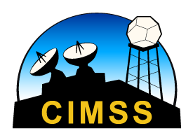
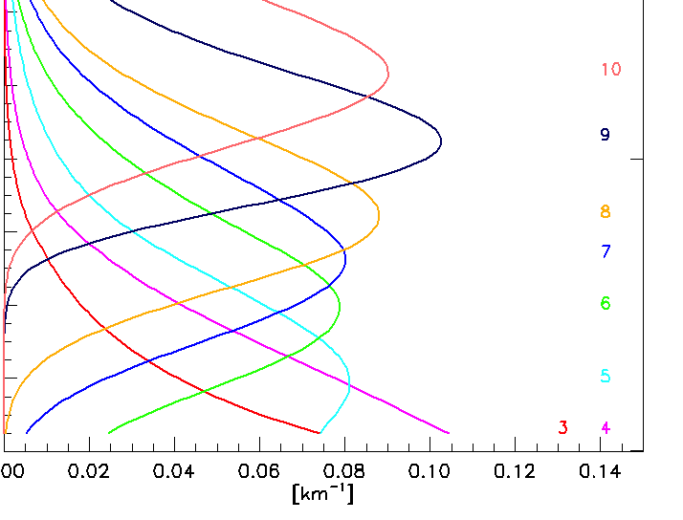
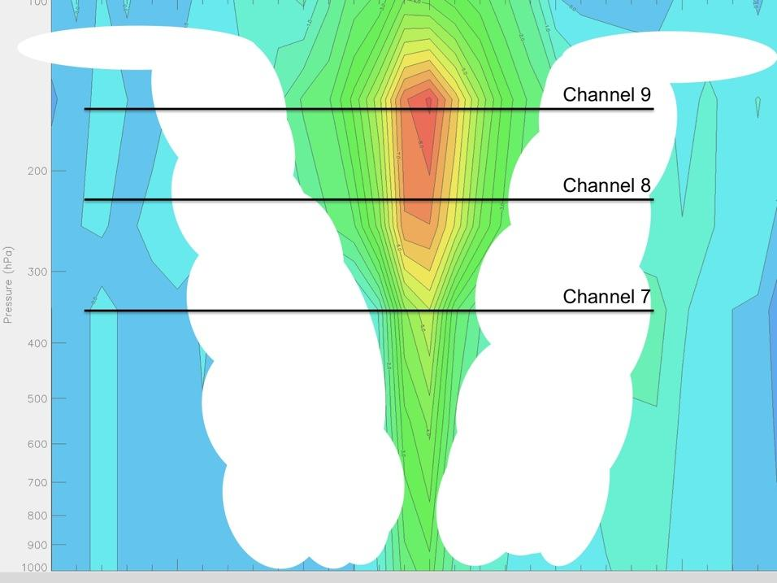
TC Intensity Analysis: Sounders
How is microwave related to tropical cyclones?
CIMSS ATMS Vertical Cross Section of Tb Anomaly for Typhoon Lekima
Weighting functions approximate where information sensed by the satellite originates
ATMS Weighting Functions
for channels 3-10
Notes:
Scattering corrected AMSU-A Tb cross-section for a typical strong hurricane. Panels to the left are for Hurricane Rita. Scatterplot shows strong relationship between AMSU-A channel 8 Tb anomaly and MSLP

Slide 22
Weighting functions for AMSU-A
250 mb
350 mb
450 mb
750 mb

Slide 23
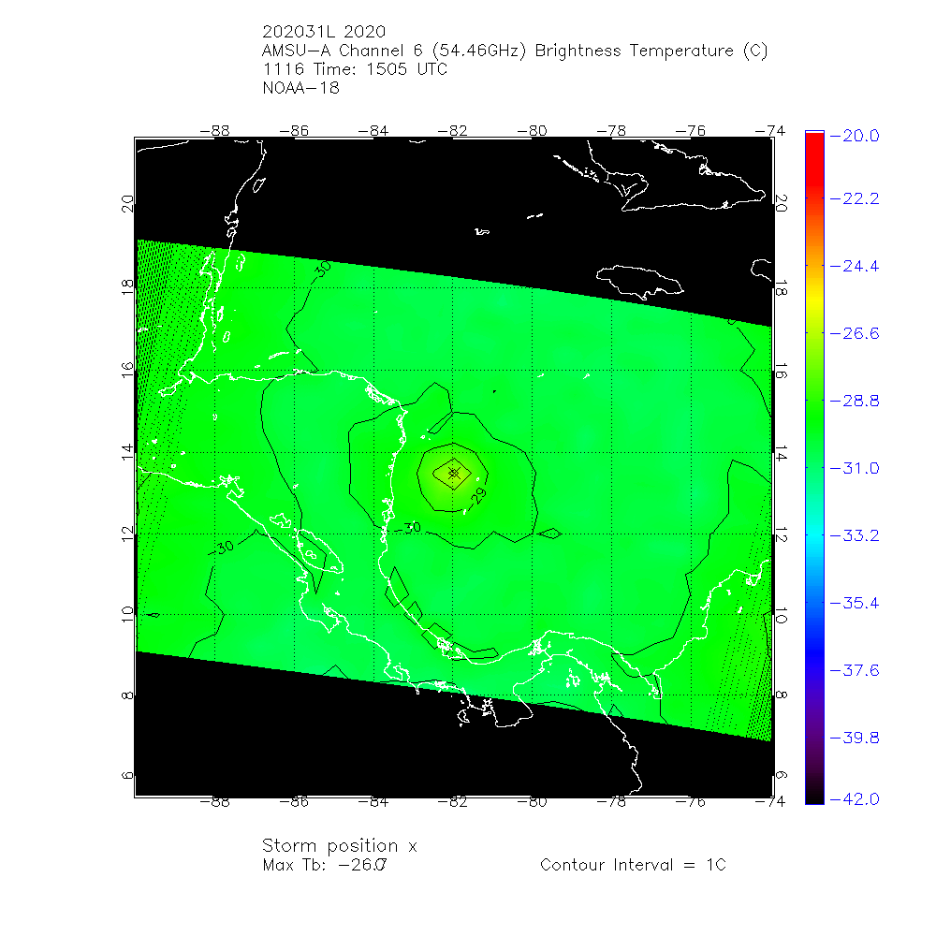
AMSU Channels 5 and 6
Channel 5 53.6 GHz [~750 mb]
Channel 6 54.46 GHz [~450 mb]

Slide 24
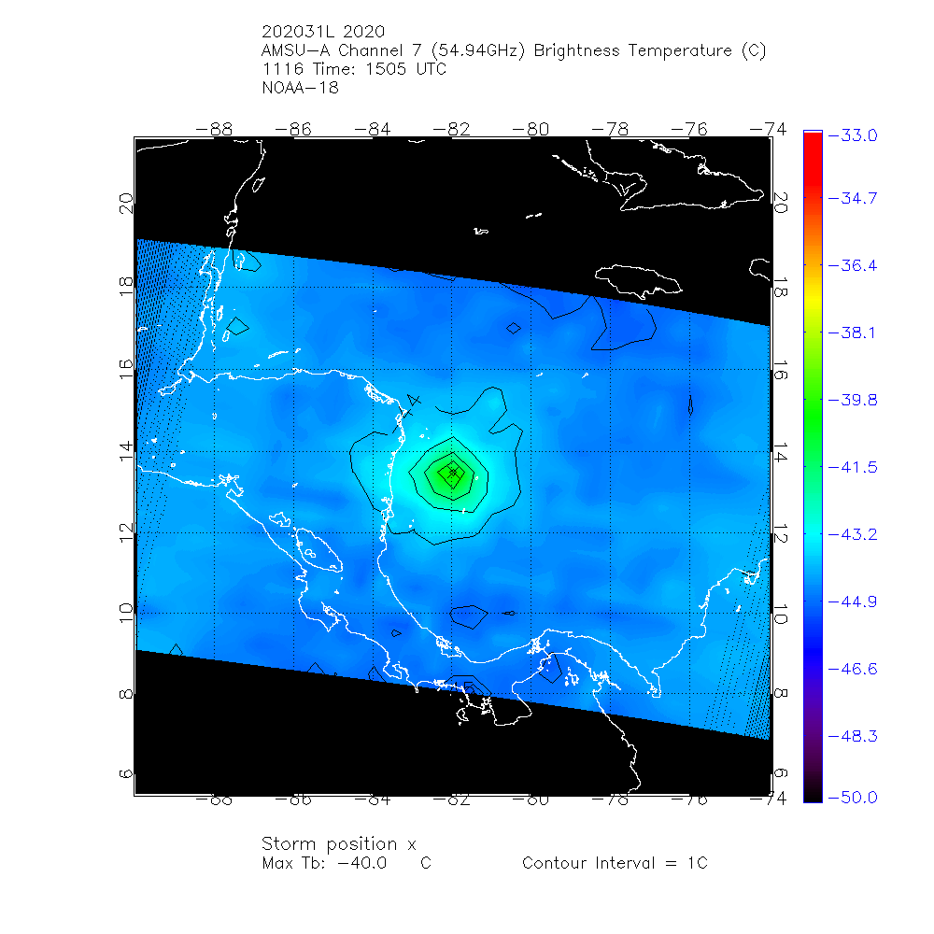
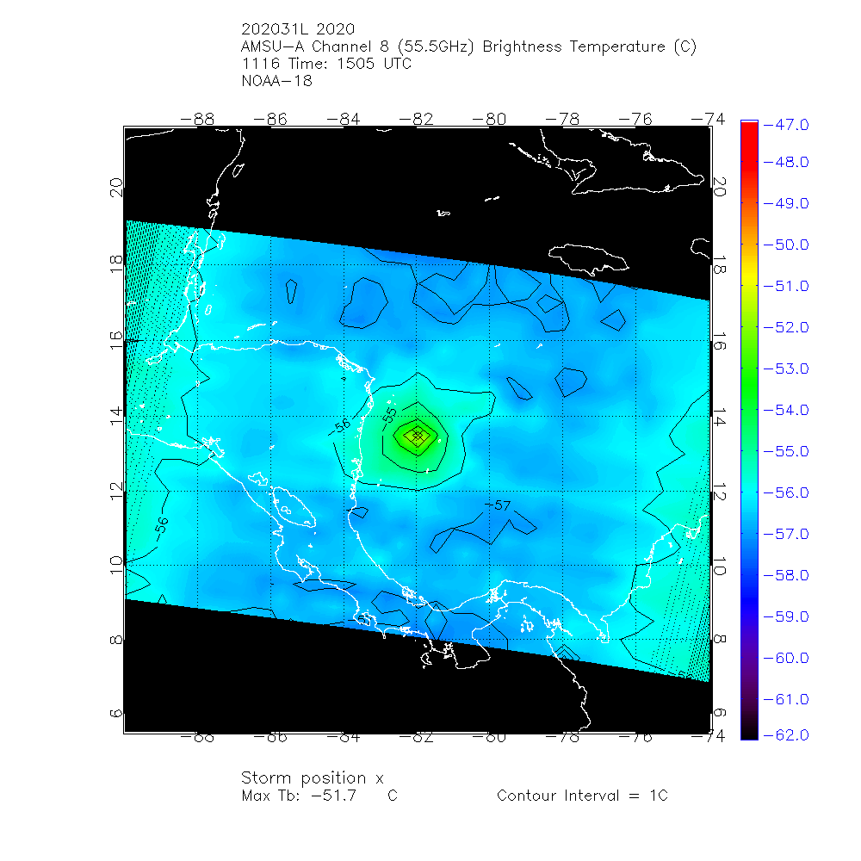
AMSU Channels 7 and 8
Channel 7 54.94 GHz [~350 mb]
Channel 8 54.46 GHz [~250 mb]

Slide 25
Resolution Matters!
That’s why the TROPICS mission is so exciting!
DMSP15 SSMI 37 GHz
Coriolis Windsat 37 GHz
Information on Coriolis

Slide 26
Sheared storm: Will not intensify
center
center
Microwave data shows the storm center far removed from the convection in this sheared storm. If the center were under the convection: this storm would be very strong and likely intensifying. Sheared, it’s weak and unlikely to strengthen

Slide 27
37 GHz Energy
You see more of the warm rains at 37 GHz
Less energy than at 89 GHz: lower resolution
Smaller parallax error than at 89 GHz because you’re detecting lower in the cloud
Use 37 GHz to find centers – because at 89 GHz you might have more parallax error
Ask the question: are you seeing parallax error or the effects of shear tilting the storm?

Slide 28
89 GHz Energy
89 GHz energy leaves the surface, and is absorbed by water droplets, and scattered by cloud droplets and large ice crystals. Not a lot of the surface emissions makes it to the satellite – because of scattering in the cloud: Cool brightness temperature
You see more of the ice precipitation in the cloud because the warm rain signal is scattered out
Better resolution than ~36 GHz
Higher Parallax error at 89 GHz because you are seeing higher in the cloud
More likely to see all the mid/upper parts of storm

Slide 29
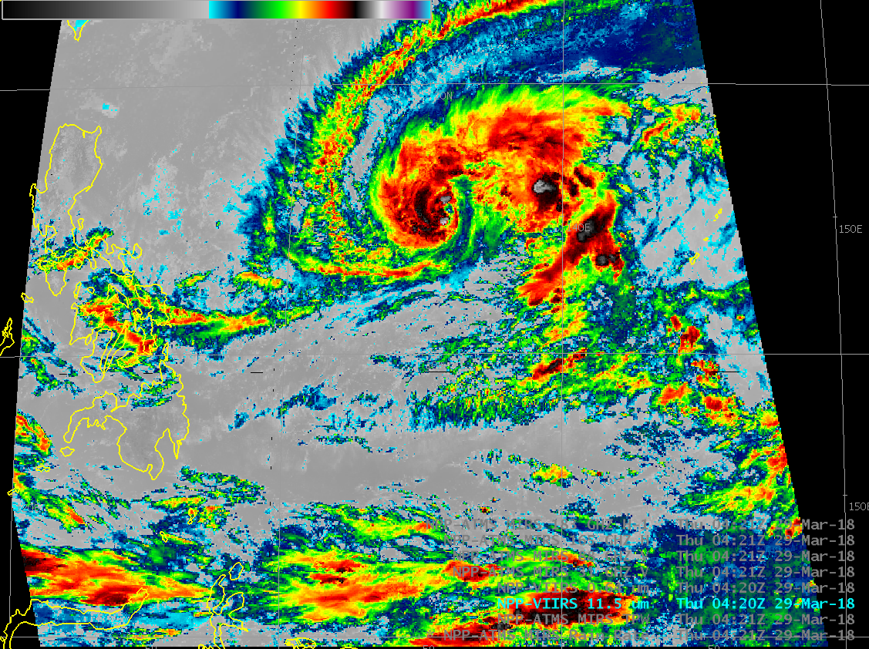
Typhoon Jelawat

Slide 30
Typhoon Jelawat
31 Ghz: sensitive to water clouds.
Note the land/sea contrast!
warm
31 GHz: Cold in clear skies! Why?

Slide 31
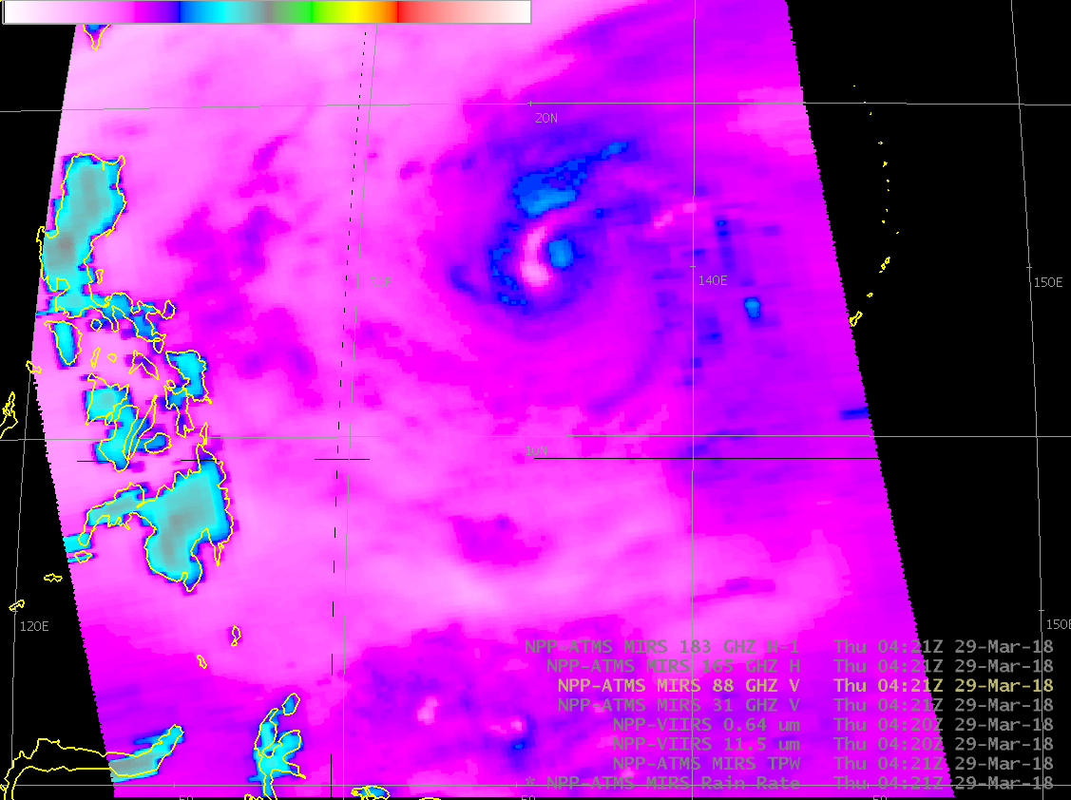
Typhoon Jelawat
88 Ghz gives a better view of ice: lots of scattering
Note also the land/sea contrast!
88 GHz: Land is a bit cooler than at 31 GHz
(more apt to see rain/clouds over land at 88 GHz)
Note how the 31 GHz signal is scattered out

Slide 32
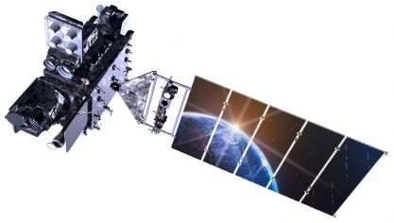
Parallax Definition
Meteorological Parallax is a mis-representation of the true location of cloud in satellite imagery
Satellite navigation – the association of a particular pixel with a latitude/longitude point – assumes clear skies.
What happens when a cloud intrudes into the ground view from the satellite?
Latitude / Longitude for where the view would intercept the Earth is assigned to the cloud; result: Cloud lat/lon is assigned to a point that is farther from the satellite sub-point than in reality
You need to know where the satellite sub-point is relative to your location! For geo imagery, thankfully, this doesn’t change, but it does for polar data.
Cloud
Parallax Shift
Terra Firma

Slide 33
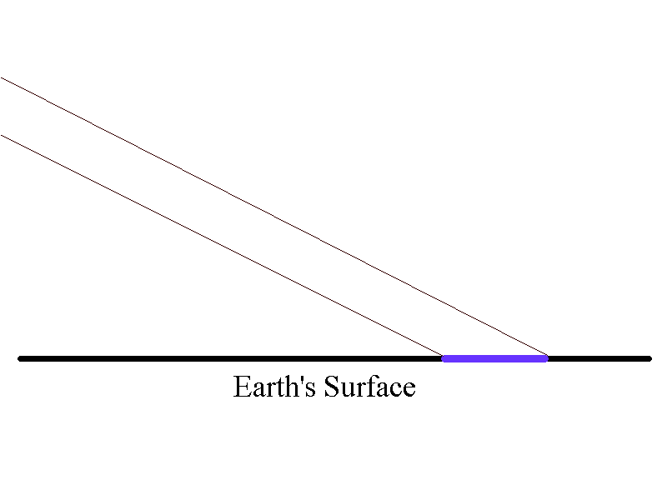
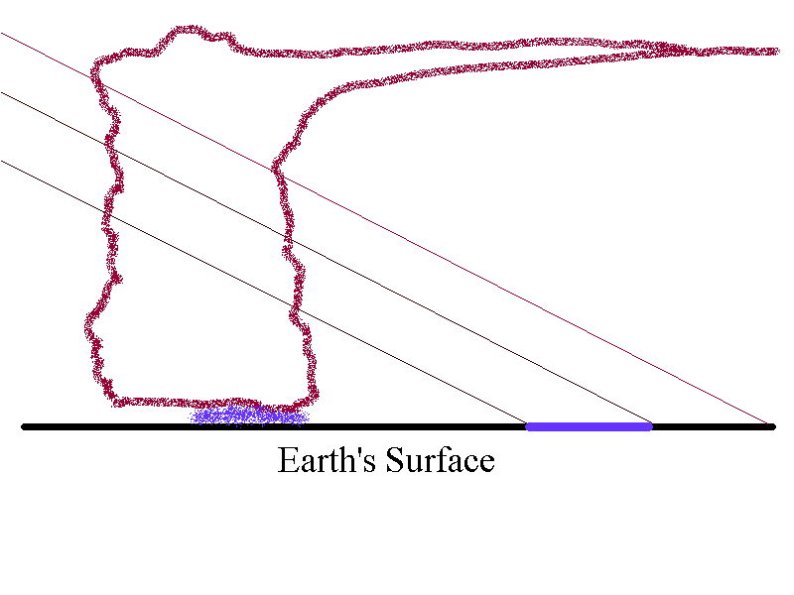
One more graphic
Parallax Shift
In clear skies (above), satellite looks in a particular direction, sees the surface. That look angle is assigned a lat/lon point
When there are clouds, that look angle still assigned a particular lat/lon, but information comes not from that lat/lon but from a cloud in between the surface and the satellite. Cloud information is assigned to the ‘wrong’ point.

Slide 34
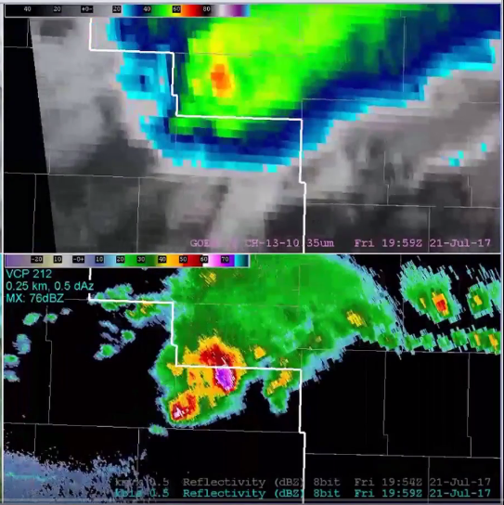
Parallax shift between GOES16 and radar over North Dakota
Note: Cold cloud top of satellite is displaced away from the sub-satellite point
Radar core and cold cloud top do not align for that reason
The line from the coldest cloud top through the radar core is towards the GOES-16 subsatellite point.
GOES-16: 0ºN, 75.2ºW
North Dakota: 47.5ºN, 101ºW

Slide 35
Parallax is a function of two main things
Distance from the sub-satellite point (this is constant for geostationary satellites)
Muscat is at 23.6ºN, 58.4ºE
Which satellites are used in Oman, and where is nadir
Meteosat-10: 45.5ºE
Himawari-9: 140.2ºE (doesn’t view Oman)
GK2A: 128.2ºE (just barely views Oman)
Cloud Height
Taller clouds (Cumulonimbus) have a larger shift
Low clouds (stratus) have a smaller parallax shift

Slide 36
Parallax
Important Underlying Assumption:
Satellite Navigation assumes clear skies
Receiving information from a specific angle, navigation places it on the land
ice
liquid

Slide 37
Parallax
Important Underlying Assumption:
Satellite Navigation assumes clear skies
Receiving information from a specific angle, navigation places it on the land
Sheared away from Nadir

Slide 38
Parallax
Important Underlying Assumption:
Satellite Navigation assumes clear skies
Receiving information from a specific angle, navigation places it on the land

Slide 39
Parallax
Important Underlying Assumption:
Satellite Navigation assumes clear skies
Receiving information from a specific angle, navigation places it on the land
Sheared towards Nadir

Slide 40
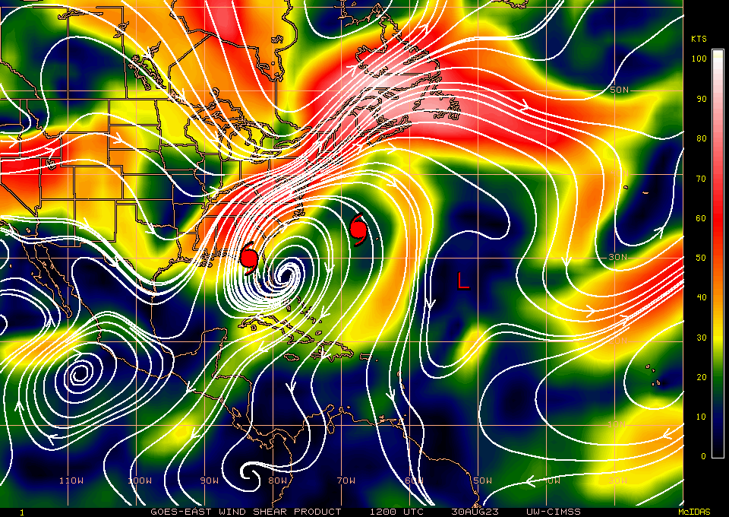
Why is there a difference between the SAR observation and the ABI?
ABI Eye
SAR Eye

Slide 41
Limb Cooling
Sensor is gimballed
As the satellite moves along its path, the sensor is swinging back and forth across the path
When there is a significant slant to the view, the path travels through more of the cooler upper atmosphere
Also: the pixel resolution is much larger at the edge
When looking straight down, the pathlength through the upper atmosphere is shorter
+/ 52.75º

Slide 42
Another view of AMSU scanning

Slide 43
There are also conical scanners
Conical scanners have a relatively constant pathlength through the atmosphere, so limb cooling is less of an issue.
AMSR-2 also has a conical scanner

Slide 44
What does limb cooling look like?

Slide 45
Why use Microwave?
Helps a forecaster evaluate TC structure
Useful for intensity forecasts
MW imagery frequently reveals eyewall formation before Visible/Infrared imagery
MW imagery is critical to identify outer eyewalls that herald the onset of an eyewall replacement cycle
MW can help locate the center if the storm is highly sheared (or when the storm is developing)

Slide 46
F14 (DMSP) 13 Oct 1998 85.5 GHz
Note the pixel size difference between the 37 & 85 GHz
Warmest Pixel at 85.5 GHz
Typhoon Zeb
Where is the storm center?

Slide 47
F14 (DMSP) 13 Oct 1998 37.0 GHz
Note the pixel size difference between the 37 & 85 GHz
Warmest Pixel at 37 GHz
Typhoon Zeb

Slide 48
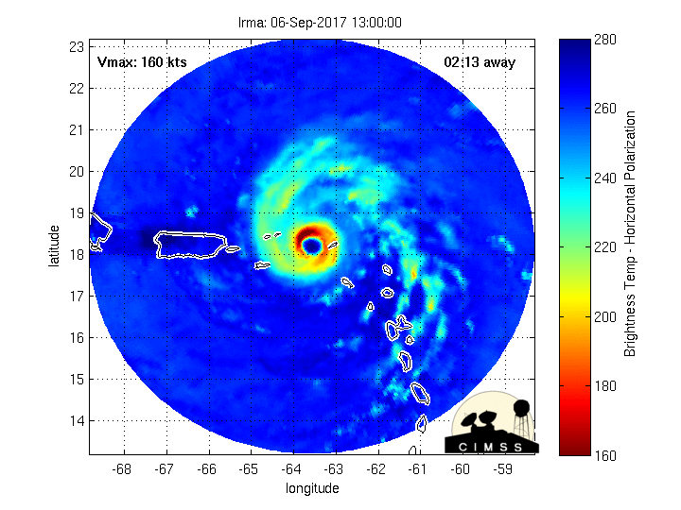
Eyewall Replacements: A strong eyewall becomes surrounded by a second eyewall; the second eyewall restricts airflow into the original eyewall and that original eyewall weakens

Slide 49
Microwave Satellite Imagery view

Slide 50
Strong Typhoon
Super Typhoon GONI

Slide 51
There are many microwave platforms
NOAA-20 and Suomi-NPP (ATMS)
MetOp-A, MetOp-B, MetOp-C (MHS and AMSU)
GCOM-W1 (AMSR-2)
DMSP (SSMI, SSMI/S)
FY-3D (MWTS, MWRI)
One algorithm to rule them all: MIRS

Slide 52
MIRS Microwave Integrated Retrieval System allows you to compute many variables
Brightness Temperature Total Precipitable Water Rain Rate Snowfall Rate Cloud Liquid Water Ice Water Path Snow Water Equivalent Snow Cover Sea Ice Land Surface Temperature Land Surface Emissivity Surface Type Temperature Profiles Moisture Profiles
MIRS allows different microwave sensors to be used to create products that are the consistent from one microwave platform to the next. Because microwave energy moves through clouds, MIRS can derive products that include information from within the cloud.
You might be able to do this with infrared sounders and machine learning (a current focus of research)
Link

Slide 53
Microwave observations of storms with the same MSLP
The wind field in this storm is nice and compact! Moisture transport and momentum transfer will be very efficient – strong convection!
MSW are stronger
954 mb
Hurricane John
MSW: 115 mph

Slide 54
Microwave observations of storms with the same MSLP
The wind field in this storm is expanding. Moisture transport and momentum transfer will not be very efficient – convection will be weaker.
MSW are weaker
950 mb (Irene)
MSW: 80 mph

Slide 55
List of Microwave Data Source
http://tropic.ssec.wisc.edu/real-time/amsu/
Will give storm-centered maps, and there’s an archive as well
https://www.ospo.noaa.gov/Products/atmosphere/mirs/sat_amsu.html
AMSU overview, plus links to global maps
https://manati.star.nesdis.noaa.gov/datasets/ASCATData.php
ASCAT winds

Slide 56
Review of Days 1 and 2
How do Tropical Storms Form
What is the climatology of Tropical Storms
How can rain bands affect Tropical Storms?
Why should you know about the MJO phase?
How and why are Eyewalls replaced
What is the Dvorak Technique?

Slide 57
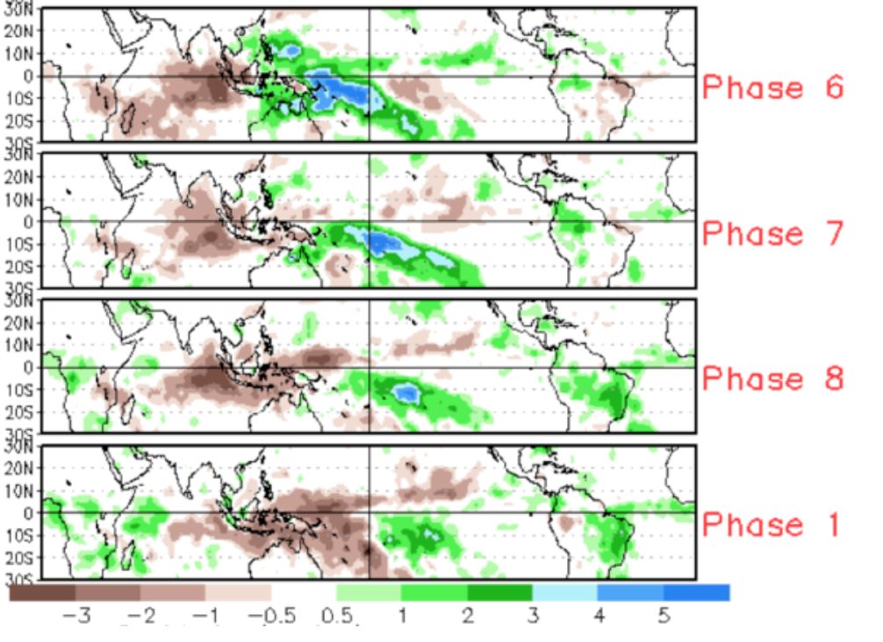
MJO has 8 phases

Slide 58
MJO phase and development
More upper divergence

Slide 59
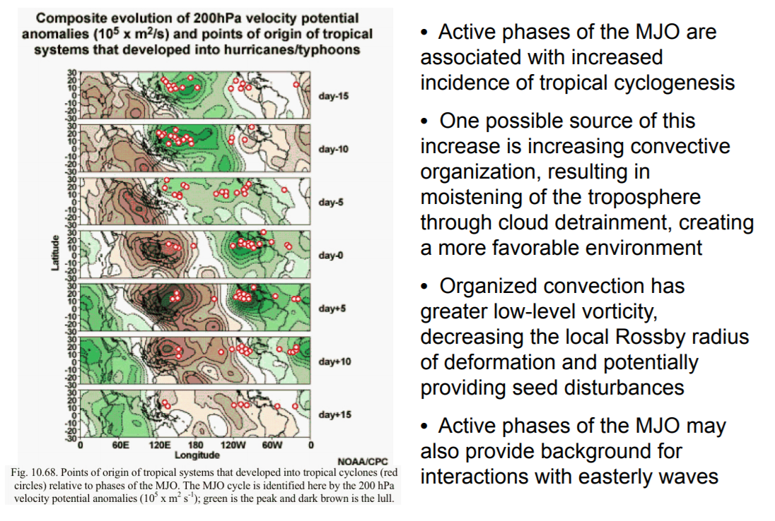
MJO phase and development
Tropical cyclogenesis is more common in regions where large-scale divergence aloft is occurring (that is: green regions); but you can also get tropical cyclogenesis in regions where large scale convergence occurs aloft (that is: brown regions)

Slide 60
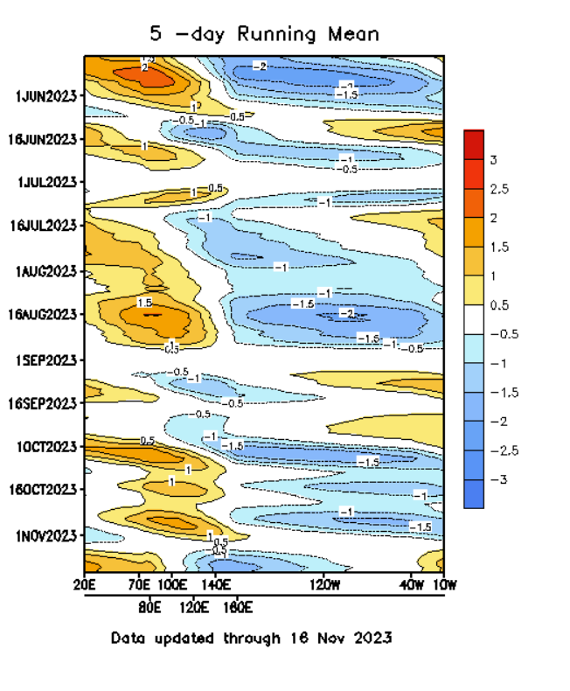
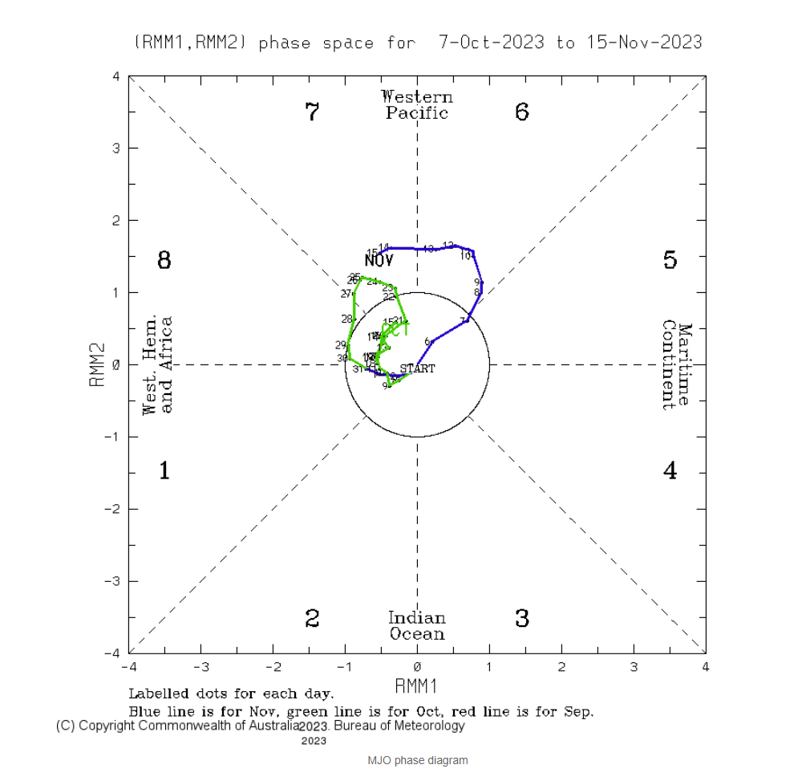
What is today’s MJO Phase?
satellite Imagery
source source

Slide 61
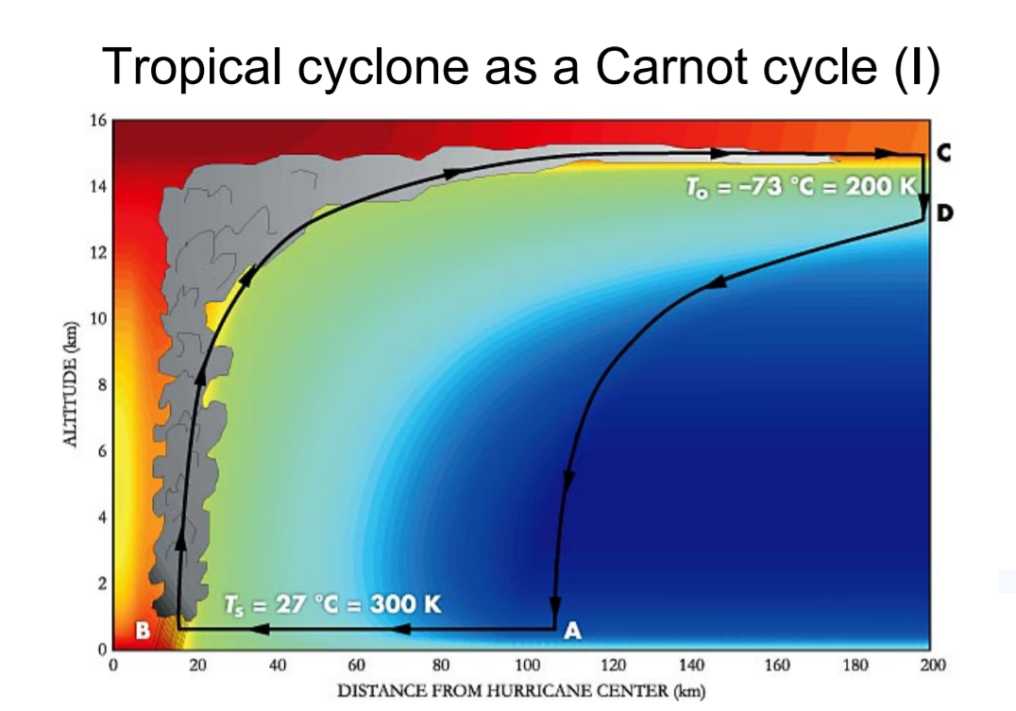
TCs as a Carnot Engine
What determines the upper limit of a tropical cyclone’s intensity? The difference between Ts and To -- the sea-surface temperature and the outflow temperature

Slide 62
Tropical Cyclone Airflow
Outflow aloft
Look for an outflow channel, and/or a region of strong upper-level divergence
The storm must be ventilated: air has to be removed (aloft) or the surface pressure will increase
Look for upper-level lows nearby – their circulation can enhance outflow, and both cyclones grow together
Upward motion
This is strongest in the eyewall. But there is upward motion in all of the spiral bands as well
Inflow at low levels
Convergence into the center of the storm
Airflow causes evaporation, adding moisture to the atmosphere
Things that impede one of the airflows will negatively affect the other airflows

Slide 63
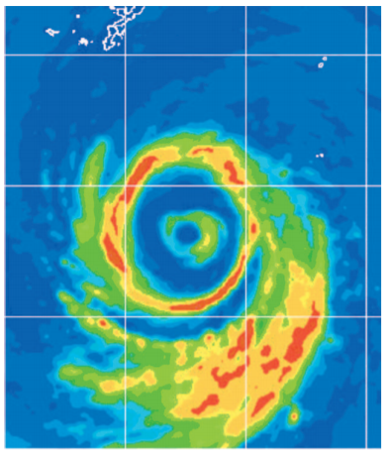
Eyewall Replacement Cycles
One is ongoing in Typhoon Dianmu (2004) to the right.
You can view these structures with microwave (including SAR data)

Slide 64
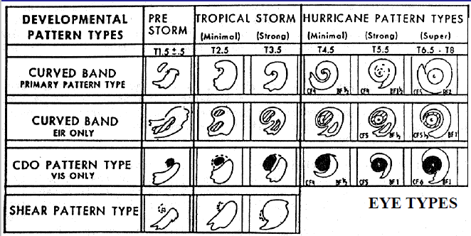
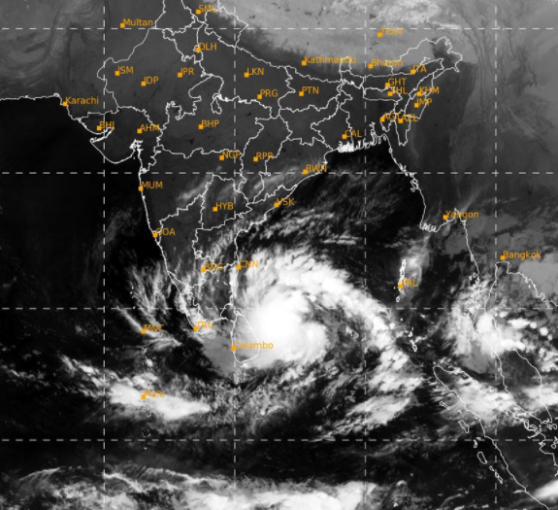
Dvorak: Coming on Tuesday

